Slide 1

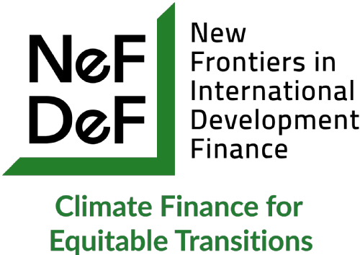
Climate Finance Analysis for the Bank Indonesia (BI) and the Otoritas Jasa Keuangan (OJK).
Dr John Hogan Morris, University of Nottingham (UK Campus).
John.morris@nottingham.ac.uk
https://www.linkedin.com/in/john-morris-43875929b/
Ashley Wahid Hasyim Jakarta, 11th February 2026.

Slide 2
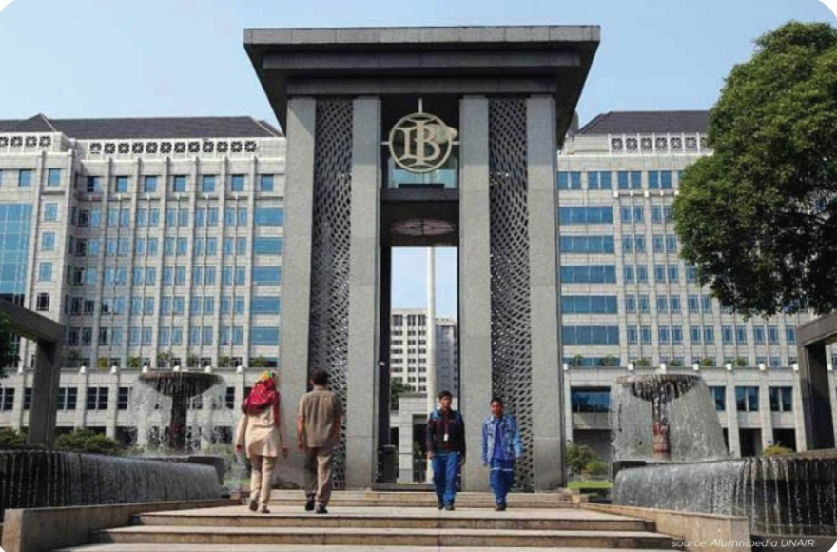
Outline
1. Climate-Related Financial Policies and Developing countries.
2. The Indonesia Green Financial
Taxonomy.
3. The Climate Risk Stress Test.
.

Slide 3
Policy | Objectives
Green Prudential Regulations | Identifying and mitigating financial risks to ensure financial stability.
Green Credit Allocation Policies | Encouraging green lending and investments through credit allocation and lending limits.
Green Financial Guidelines | Supporting the development of green or climate-aligned financial markets.
Other Disclosure Requirements | Encouraging public disclosure of climate-related financial risks, including for non-financial institutions.
Green Bonds | Promoting green lending through green bonds, including taxonomy and issuance.

Slide 4
Emerging Markets and Developing Economies and Climate-Related Financial Policies.
Key Challenges: Institutional and structural barriers, including reliance on carbon-intensive industries and limited enforcement mechanisms.
Policy recommendations: Strengthen international cooperation, capacity building, and access to green finance to address institutional and economic barriers.
Problem: generates a tension with implications for climate justice.

Slide 5
Access to Green finance…
Climate stabilization requires the mobilization of substantial investments in low- and zero-carbon technology.
But access to stable and affordable finance varies dramatically across countries.
IPCC Models used to evaluate the energy transition do not differentiate regional financing costs.
Convergence of Cost of Capital (CoC) is needed:
- would make renewable energy cheaper than fossil generation technologies and increase renewable electricity generation in developing countries.

Slide 6
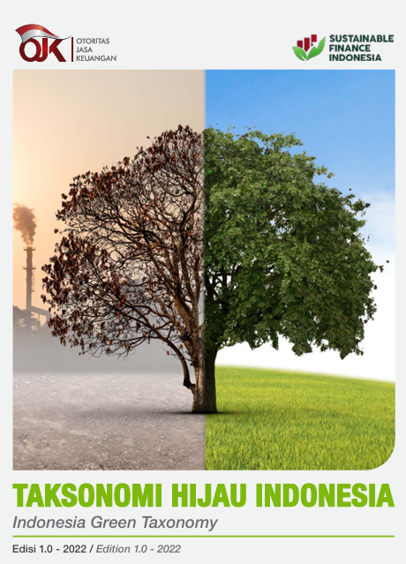
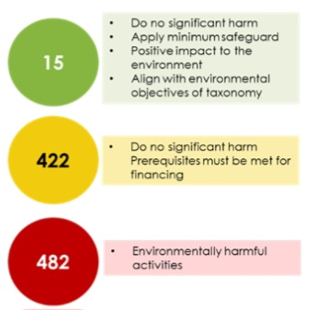
Indonesia’s Green Taxonomy (IGT 1.0)
Indonesia’s Green Taxonomy 1.0 covers 919 sectors and subsectors:

Slide 7
Introduce mandatory disclosure rules
● IGT 1.0 does not requires mandatory disclosure of relevant taxonomy-related information, which is likely to leave information gaps and limit regulators’ capacity to analyse physical and transition climate and credit risks.
● The inclusion of mandatory disclosure requirements for greenhouse gas emissions data and firms transition plans over a longer time horizon would bolster the internal credit and climate risk assessment capabilities of the OJK and BI.

Slide 8
Integrate within an overarching sustainable finance strategy
● ‘Bankability’ catalyses private investment in green infrastructure.
● Without wider governmental action, a lack of potentially profitable green projects reduces the leverage of a taxonomy, by rendering green standards relatively anachronistic.
For example, replace the planned captive coal plants that are included in IGT 1.0 ‘yellow’ classification (to support downstream industries) with captive renewable plants.

Slide 9
Gain international recognition
● Ambiguity over the interoperability of the IGT with other key taxonomies- such as the ASEAN Taxonomy- could present investors with uncertainty over potential credit and interest rate risks and threatens to hinder Indonesia’s ability to attract and retain inflows of foreign capital.
● There is therefore a need to develop mechanisms to clearly align IGT with ASEAN’s Plus standards, and at least some form of recognition from EU Taxonomy.
● This may require bilateral or multilateral negotiations, as the current version of the ASEAN Taxonomy Technical Screening Criteria allows countries to include some captive coal plants in (yellow/amber) categories that support the transition.

Slide 10
Broaden the concern for labour
● Green taxonomies provide the opportunity to go beyond enforcing labour protections so that they do more for workers impacted by economic restructuring.
● The inclusion of ‘transition support’ for workers within a later version of IGT could place a greater responsibility on employers to train workers for:
(i) Production of sustainable outputs,
(ii) Contribution to environmentally sustainable processes in companies,
(iii) Development of skills needed to work in sustainable production.

Slide 11
International Cooperation & Capacity Building…
Network for Greening the Financial System (NGFS) is focused on voluntary sharing of best practices around risk measurement and management by banks and insurers.
Its main strategy is promoting domestic climate scenario analyses, such as the OJK’s 2024 Pilot Climate Risk Stress Test.
Design of these exercises can create huge commercial opportunities for consultants, climate services and the analytics branches of credit rating agencies. This is the case with Indonesia’s pilot CRST.
Raises the spectre of reproducing unjust risk premia and climate risk premia for developing countries, making convergence over CoC harder.

Slide 12

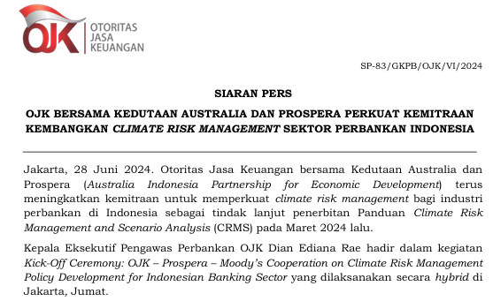
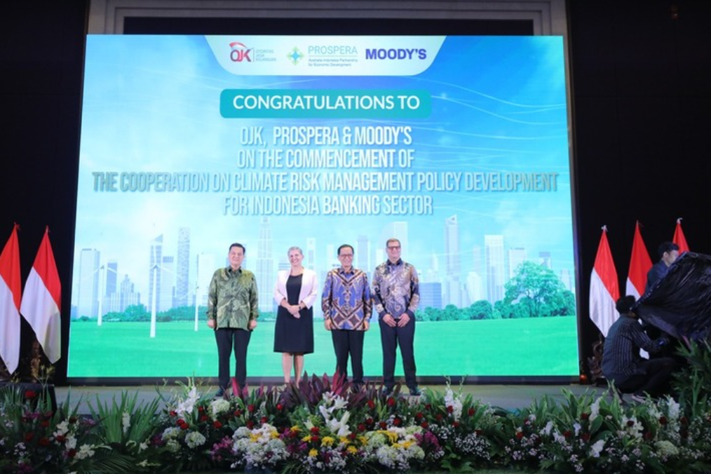

Slide 13
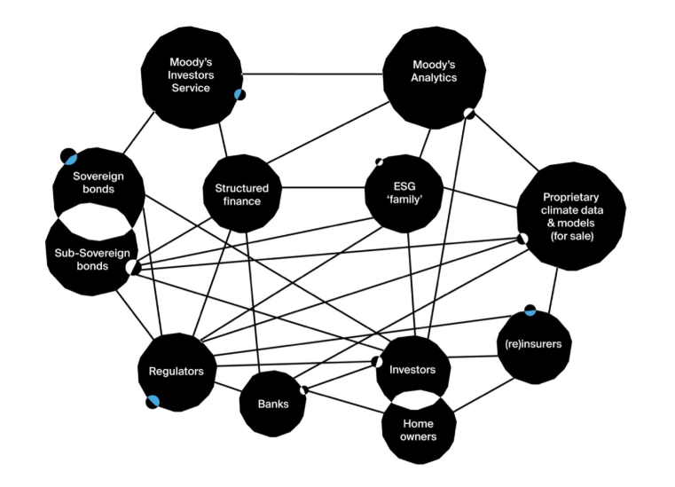
“The networks
that are emerging around the climate stress testing
regime constitute hybrid forms of coercive public
and private
authority that influence patterns
of international investment and credit.”
- (Cox et al., 2023)

Slide 14

Key Considerations
Challenges and correct the flaws and biases that NGFS scenarios may have imported from IPPC models.
A switch to a CRST that involves unstructured data being submitted to OJK and BI.
Requires OJK and BI to improve their in-house credit and climate risk assessment capacities.
This would be challenging for any supervisor.

Slide 15
Key Considerations
If third-party firms remain involved in banks’ CRST analyses and submissions, then:
Third- party vendors’ involvement in the consultancy side to banks and financial institutions needs to be fully understood and potential conflicts of interest managed.
(ii) National supervisors need to be at least equipped to scrutinize or push back against the methodologies and data provided by third-party vendors such as Moody’s/ S&P.
(iii) Supervisors must ensure that banks understand the limitations of products provided by third parties.

Slide 16
Key references
Calcaterra, M., Aleluia Reis, L., Fragkos, P., Briera, T., de Boer, H. S., Egli, F., ... & Tavoni, M. (2024). Reducing the cost of capital to finance the energy transition in developing countries. Nature Energy, 9(10), 1241-1251. https://doi.org/10.1038/s41560-024-01606-7
Climate Policy Initiative. The Next Phase of Indonesia Green Taxonomy: Transition Finance to Support Decarbonization – CPI. 2nd October 2023.
Cox, S., Morris, JH., and Taylor, ZJ. Risk-Rating and Networked Authority: A Climate Leviathan in Formation? Yale Law and Political Economy Blog. 12th June 2023.
D’Orazio, P., & Pham, A. D. (2025). Evaluating climate-related financial policies’ impact on decarbonization with machine learning methods. Scientific Reports, 15(1), 1694. https://doi.org/10.1038/s41598-025-85127-7
Kanitkar, T., Mythri, A., & Jayaraman, T. (2024). Equity assessment of global mitigation pathways in the IPCC Sixth Assessment Report. Climate Policy, 24(8), 1129-1148. https://doi.org/10.1080/14693062.2024.2319029
Morris, JH, and Collins, H. (2023). (Mis)managing macroprudential expectations: How central banks govern financial and climate tail risks. Edward Elgar.
Otoritas Jasa Keuangan (OJK). Banking Climate Risk Management and Scenario Analysis. Book 2: Technical Guidebook. 2024.
Shrivastava, S., and Prakash Jena. L. How Credit Ratings Undermine Climate Finance for the Global South Observer Research Foundation. 28th January 2026.

