Slide 1


Legal and Policy Landscape for
Just Energy Transitions
Meena Raman
Third World Network

Slide 2
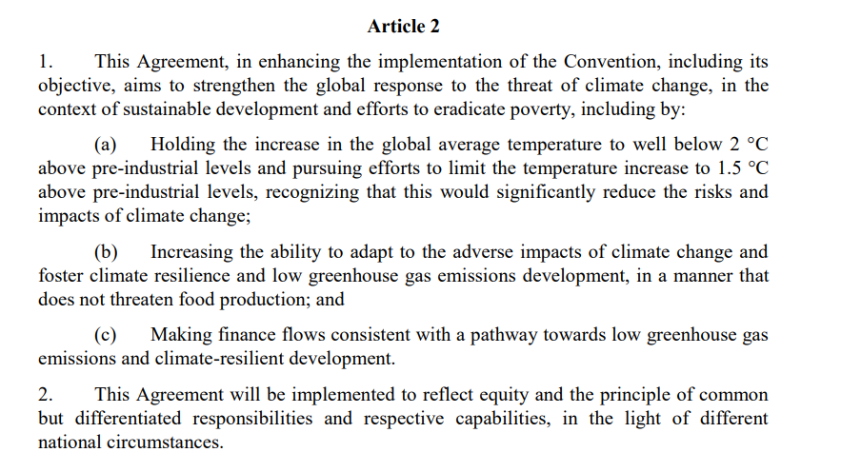
The Principle of Common But Differentiated Responsibilities (CBDR) in the Paris Agreement
Source: Paris Agreement 2015, Article 2.2
*CBDR is also included in the Principle 7 of the Rio Declaration on Environment and Development in 1992

Slide 3
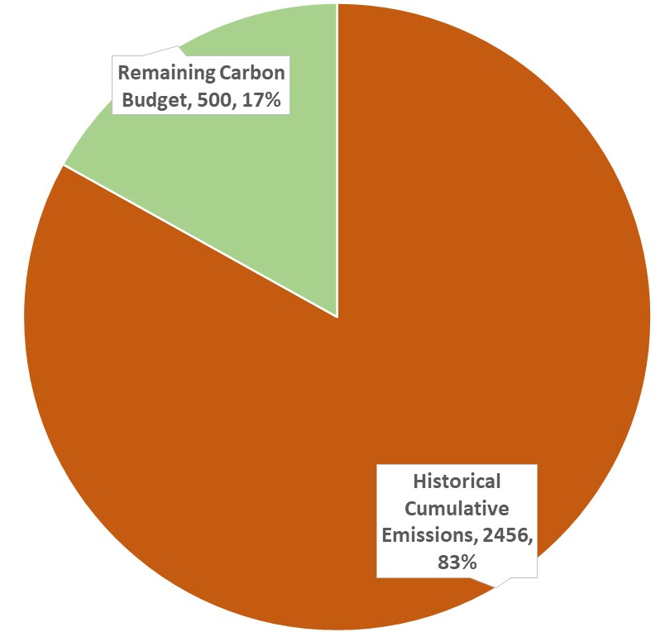
50% Probability of 1.5 deg. C
Total Carbon Budget
2956
GtCO₂

Slide 4
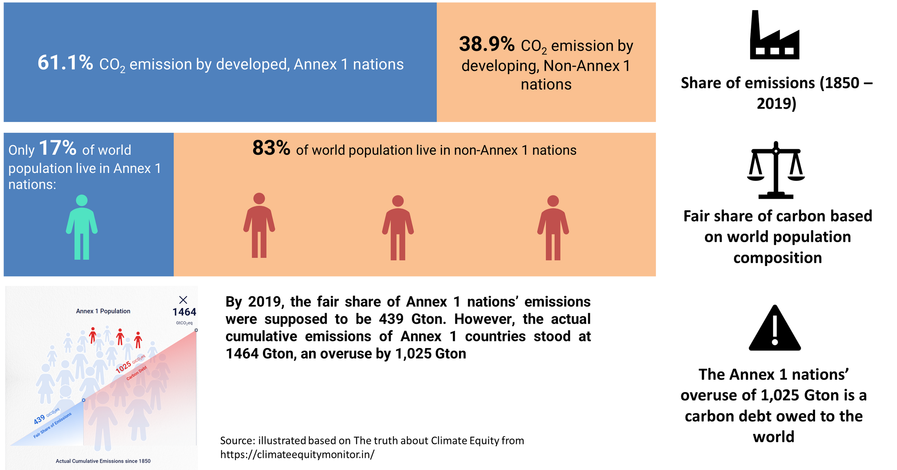
Notes:
annex 1 parties to the UNFCCC include the industrialised countries that were members of the OECD (Organisation for economic cooperation and development) in 1992, plus countries with economies in transition (The EIT parties), including the Russian Federation, The Baltic states and several central and eastern European states.

Slide 5
The UAE COP 28/CMA 5
Global Stocktake Decision – in 2023
25.
Expresses concern that the carbon budget consistent with achieving the Paris Agreement temperature goal is now small and being rapidly depleted and acknowledges that historical cumulative net carbon dioxide emissions already account for about four fifths of the total carbon budget for a 50 per cent probability of limiting global warming to 1.5 °C;
Just, orderly and equitable transitioning away from fossil fuels
28. Further recognizes the need for deep, rapid and sustained reductions in greenhouse gas emissions in line with 1.5 °C pathways and calls on Parties to contribute to the following global efforts, in a nationally determined manner, taking into account the Paris Agreement and their different national circumstances, pathways and approaches:
(d) Transitioning away from fossil fuels in energy systems, in a just, orderly and equitable manner, accelerating action in this critical decade, so as to achieve net zero by 2050 in keeping with the science.
Important question: HOW DO YOU DO THIS IN A BOTTOM-UP NATIONALLY DETERMINED MANNER, WITHOUT A FAIR SHARES AND EQUITABLE APPROACH TO EMISSIONS REDUCTIONS?
IMPORTANT TO STRESS THE CLIMATE/CARBON DEBT OWED BY DEVELOPED COUNTRIES TO DEVELOPING COUNTRIES, WHICH THEY NEED TO PAY FOR!

Slide 6
Just Transition – important elaboration in
Egypt, COP 27/ CMA.4 in 2022
Implementation – pathways to just transition
28. Affirms that sustainable and just solutions to the climate crisis must be founded on meaningful and effective social dialogue and participation of all stakeholders and notes that the global transition to low emissions provides opportunities and challenges for sustainable economic development and poverty eradication;
29. Emphasizes that just and equitable transition encompasses pathways that include energy, socioeconomic, workforce and other dimensions, all of which must be based on nationally defined development priorities and include social protection so as to mitigate potential impacts associated with the transition, and highlights the important role of the instruments related to social solidarity and protection in mitigating the impacts of applied measures;

Slide 7
COP 28/ CMA.5 – Dubai, 2023
In Dubai, another important decision was reached called the
UAE Just Transition Work Programme.
The decision, among other things, underscored “the importance of urgent delivery of means of implementation (capacity-building, climate finance, and technology development and transfer) to facilitate just transition pathways and of enhancing international cooperation on, and support for, just transition pathways, especially for developing country Parties”.

Slide 8
The UAE Just Transition Work Programme
Decides that the work programme shall include the following elements:
    Just transition pathways to achieving the goals of the PA outlined in Article 2.1 [which includes mitigation and adaptation] in the context of Article 2.2 (CBDR-RC).
    Just and equitable transition, which encompasses pathways that include energy, socioeconomic, workforce and other dimensions, all of which must be based on nationally defined development priorities and include social protection so as to mitigate potential impacts associated with the transition;
    Opportunities, challenges and barriers relating to sustainable development and poverty eradication as part of transitions globally to low emissions and climate resilience, taking into account nationally defined development priorities;
    Approaches to enhancing adaptation and climate resilience at the national and international level;
    Just transition of the workforce and the creation of decent work and quality jobs in accordance with nationally defined development priorities, including through social dialogue, social protection and the recognition of labour rights;
    Inclusive and participatory approaches to just transitions that leave no one behind;
    International cooperation as an enabler of just transition pathways towards achieving the goals of the Paris Agreement;

Slide 9

Significant outcome at COP30
Establishment of a Just Transition Mechanism
Parties agreed “to develop a just transition mechanism” and “the purpose of which will be to enhance international cooperation, technical assistance, capacity-building and knowledge-sharing, and enable equitable, inclusive just transitions”.
The decision also notes that the new “mechanism is to be implemented in a manner that builds on and complements relevant workstreams under the Convention and the Paris Agreement, including the work programme”.
On the timeline, Parties agreed that the subsidiary bodies in June 2026, recommend a draft decision on the process for its operationalization for consideration by November 2026 at COP 31 in Antalaya, Turkey.
This Photo by Unknown Author is licensed under CC BY-NC-ND

Slide 10
Other key messages from the COP 30 decision
“The importance of facilitating universal access to clean, reliable, affordable and sustainable energy for all, including through the scaled-up deployment of renewable energy and access to clean cooking, and that such efforts may promote energy security, while acknowledging that pathways to energy transitions will vary by country in accordance with national circumstances.”
Another key message is on “the importance of just transition pathways that respect, promote and fulfil all human rights and labour rights, the right to a clean, healthy and sustainable environment, the right to health, the rights of Indigenous Peoples, people of African descent, local communities, migrants, children, persons with disabilities and people in vulnerable situations, and the right to development, as well as gender equality, empowerment of women and intergenerational equity”
“That the principles of equity and CBDR-RC should guide just transition efforts”;
“The importance of ensuring broad and meaningful participation involving all relevant stakeholders, including workers affected by transitions, informal workers, people in vulnerable situations, Indigenous Peoples, local communities, migrants and internally displaced persons, people of African descent, women, children, youth, elderly people and persons with disabilities, to enable effective, inclusive and participatory just transition pathways”

Slide 11
More key messages from the outcome
“The importance of strengthening international cooperation on mobilizing finance, technology and capacity-building support for facilitating the implementation of nationally determined just transitions in a socially inclusive and equitable manner”;
“The importance of continued efforts to support just transitions through measures that avoid exacerbating debt burdens and create fiscal space for countries to advance on pathways towards low emissions and climate-resilient development”

Slide 12
Important decision on developed country provision of finance from Brazil @ COP 30
Article 9.1 of the Paris Agreement states that “Developed country Parties shall provide financial resources to assist developing country Parties with respect to both mitigation and adaptation in continuation of their existing obligations under the Convention
From decision in Belem:
54. Decides to establish a two-year work programme on climate finance, including on Article 9.1 of the Paris Agreement in the context of Article 9 of the Paris Agreement as a whole.
Important political space to assess if developed countries are fulfilling their mandatory obligations.

Slide 13
Some key take-aways
There are lots of opportunities in working together in shaping and influencing the international and national just transition discourse, including on just energy transitions, and climate finance.
Key among them is the establishment and operationalization of the Just Transition Mechanism within the UNFCCC regime.
We have to counter the JETPs advanced by the developed countries as being “just”.
Need for research, advocacy, campaigns and engagement at all levels.

Slide 14
Thank you
For further information, see
TWN Belém Updates at
www.twn.my

