Slide 1
The EU’s Carbon Border Adjustment Mechanism (CBAM):
Polluter gets Paid, Rentier Subsidies
Korupsi Kolusi Kronisme ala Europe
Yin Shao Loong
Warwick-CELIOS Workshop on JET
Date: 11 February 2026
Venue: Ashley Wahid, Jakarta

Slide 2
The EU Carbon Border Adjustment Mechanism (CBAM)
Is a story of patronage and protectionism

Slide 3
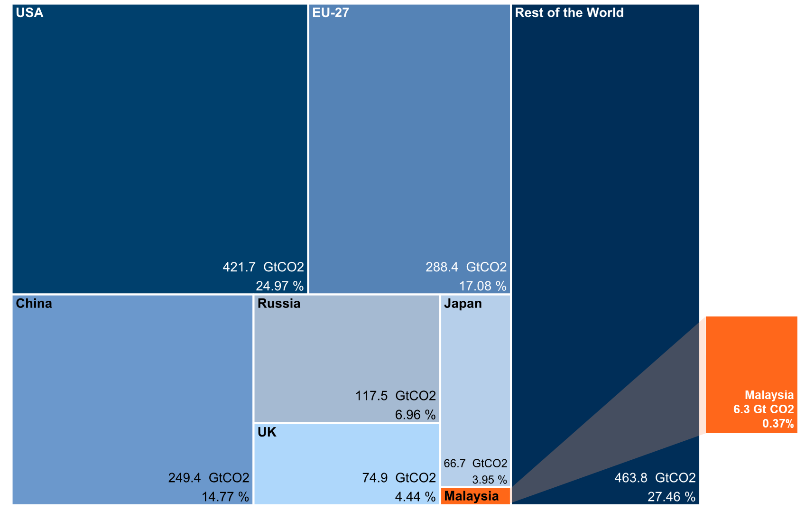
Small share of emissions, significant transition costs
Five developed countries are responsible for over 55% of historical carbon dioxide emissions.
Malaysia is responsible for less than 0.4% of historical and current annual emissions.
Its emission peers are Pakistan, Egypt, Uzbekistan and North Korea.
Energy transition costs remain significant even for a low-emission developing country.
Over US$276 billion investment required.
Source: Our World in Data (2020), KRI visualisation
Notes:
Begin at 08:30
30 seconds
Focus on Malaysia’s share of emissions

Slide 4
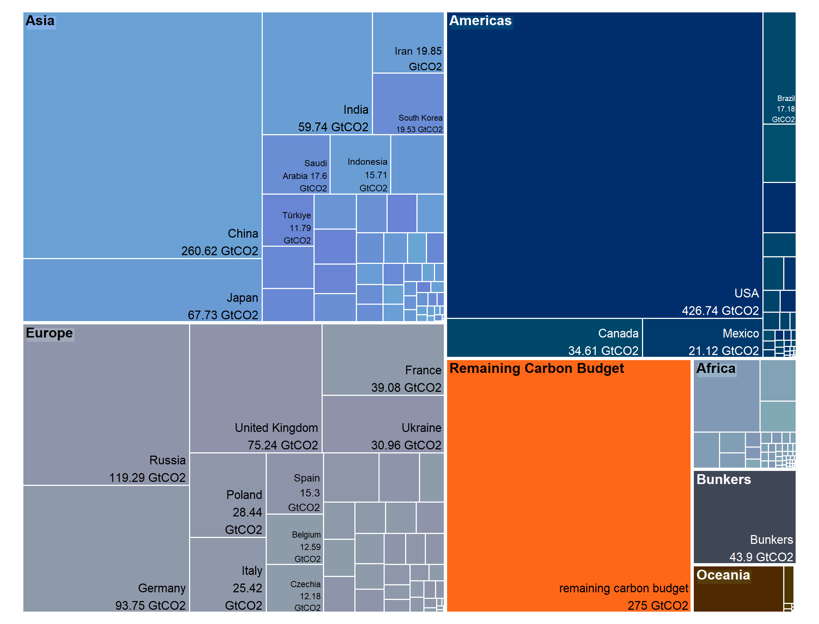
Total fossil fuel emissions and remaining carbon budget, 1850 – 2022 (GtCO₂e)
Malaysia
6.5 GtCO₂e
Indonesia
15.71 GtCO₂e
Source: Friedlingstein et el. (2023); KRI visualisation

Slide 5
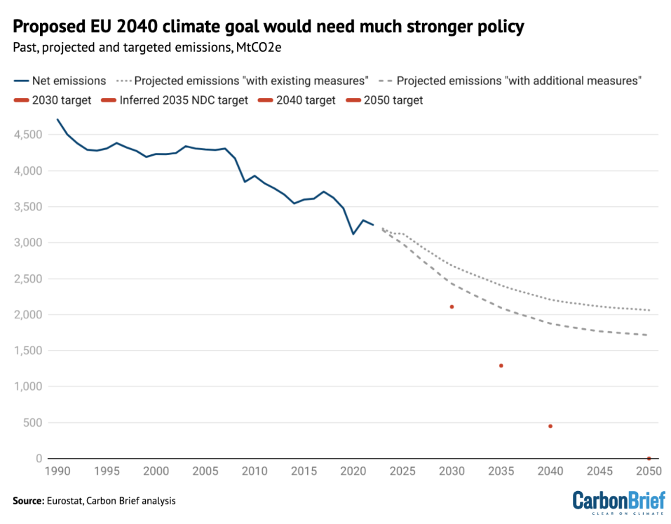
EU Climate Leadership?
The European Union (EU) is the world’s second largest historical carbon dioxide polluter. It has recently committed to “climate neutrality” by 2050 and to reduce greenhouse gas emissions by at least 55 per cent by 2030 relative to 1990 levels.
It reached 32.5% reductions by 2022. Current policies would lead to only 48% reduction by 2030; 60% by 2040; and, 64% by 2050.
Sources: Green (2021); EPRS (2023); Carbon Brief (2024)

Slide 6
Unilateral Trade Measures
The US has RECIPROCAL TARIFFS
The EU has CBAM
RECIPROCAL TARIFFS are based on questionable economic theory about trade deficits and imbalances, but they disguise the role of the exorbitant privilege of the US dollar and the offshoring strategies of US multinational corporations.
CBAM is based on questionable economic theory about carbon pricing and level playing fields, but it disguises the crisis of competitiveness faced by European industry and the ineffectiveness of European climate policy.

Slide 7
The Proposed CBAM Mechanism
According to the EU, CBAM aims to equalise the carbon price between domestic and foreign products, thereby limiting carbon leakage.
It would affect six sectors: cement, iron and steel, aluminium, fertilisers, hydrogen & electricity. There are concerns that it could later apply to other goods and services or extend to indirect emissions.
The preferred mechanism for pricing carbon at the border would involve surrendering carbon permits equivalent to those issued under the EU emission trading system (ETS).
The amount paid would be equivalent to the difference between the weekly ETS price and the importer’s domestic carbon price (if any). Exemption mechanisms remain unclear.

Slide 8
CBAM is linked to the EU ETS – ETS is a failure
The EU has the world’s largest and oldest carbon pricing system, its emissions trading system (ETS).
The ETS is the EU’s flagship climate policy and the EU intends to use CBAM to promote its version of carbon pricing around the world.
In its 20 years, the ETS delivered annual emission reductions of between 0% to 1.5%. -> HEBAT!
Sources: Green (2021); EPRS (2023).

Slide 9
ETS Limitations
The EU ETS only covers sectors representing 45% of EU emissions.
Its carbon price stagnated at very low levels for years due to the disbursement of free pollution allowances to polluting industries. These are the same industries covered by CBAM.
According to WWF, 53% of ETS emissions between 2013 and 2021 were emitted for free. Carbon pricing without a price.
Prices hovered around €6 for many years. Recently, with a tightening of the supply of free allowances, the price rose to around €100 before falling to around €66.
CBAM is INFLATIONARY, raises prices, LOWERS COMPETITIVENESS.

Slide 10
The scandal at the heart of the ETS
Faced with a carbon price, Europe’s high emission industries threatened to leave or complained that paying the price would make their products uncompetitive versus imports from countries with lower environmental standards. They call this hypothetical divestment risk, ‘carbon leakage’.
Carbon leakage measures pre-date the CBAM. Under the ETS free pollution allocations were created to entice industries who claimed hypothetical risk to instead stay.
More than 150 sectors, representing more than 97% of industrial emissions, were deemed to be at risk of ‘carbon leakage’ and thus eligible for free pollution permits.
The ETS is supposed to be a ‘polluter pays’ system. Pay to discourage pollution. However, lobbyists profited industry.
The ETS paid more to industry than it took in. From 2013-2021: EU Member states earned €88.5 billion, but industry received €98.5 billion in free pollution permits!
Free allowances suppressed the effective carbon price from €14/tonne to €6/tonne.
For every Euro spent lobbying, firms gained €1 to €4.60 in free pollution allowances.
Source: Carbon Market Watch (2015); WWF (2022); Winkler (2022).

Slide 11
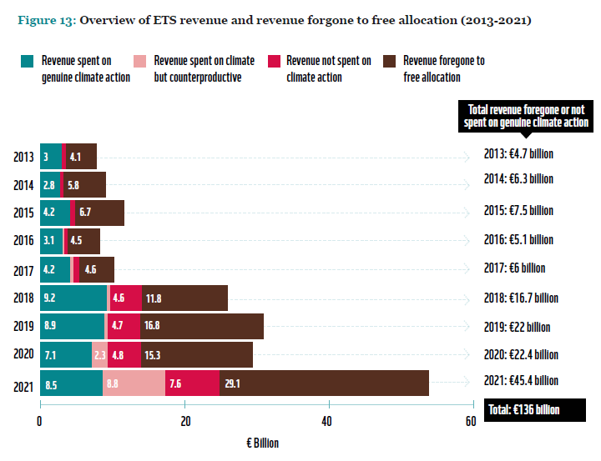
ETS subsidies
Several EU governments even established ETS compensation schemes to direct further subsidies to polluters. Germany, Spain and Italy spent over 30 billion Euros in ETS subsidies.
Under CBAM, Germany continues to provide ETS price hedging subsidies for dirty industries (2024). This undermines ‘level playing field’ claims by the EU and could be explored at the WTO.
EU Member States were estimated to have spent only 58% of their ETS earnings on climate action. Lax rules on ETS reporting mean that the money trail is hard to follow. The remainder was spent on supporting coal, gas, ETS carbon price compensation, diesel cars, high-carbon bioenergy, and fossil fuel heating systems. Over 18% of ETS revenue went towards general government spending.
Source: WWF (2022).

Slide 12
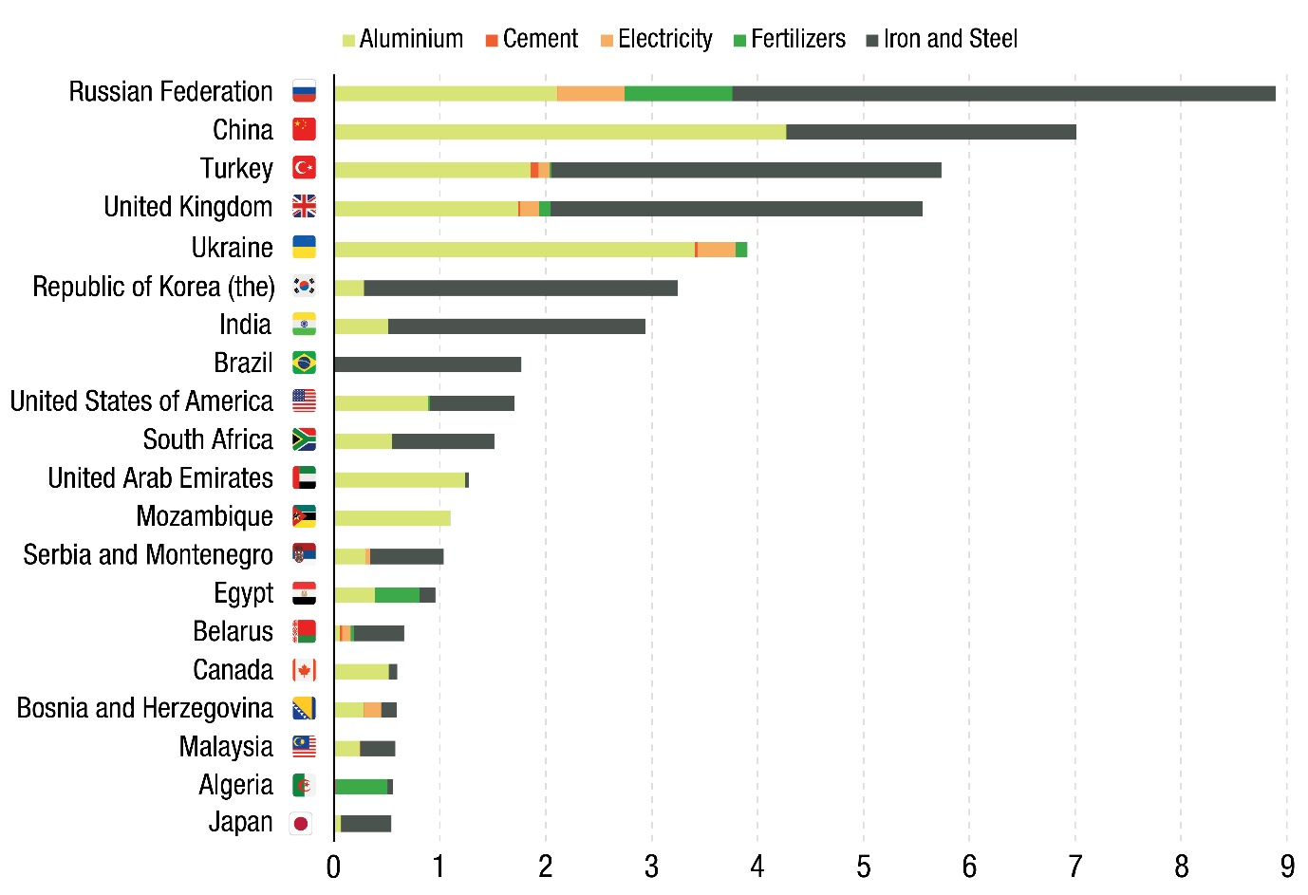
2. UNCTAD Study
Looks at developing country impacts (as opposed to Commonwealth only). Malaysia ranked 18th amongst the 20 countries most exposed to CBAM, based on 2019 exports to the EU. Exposed goods were limited to aluminium and iron and steel.
Exports by developing countries across the targeted carbon-intensive sectors would be reduced by 2.4%, if CBAM were set at $88 per tonne of CO2.
A CBAM priced at $88 per tonne of CO2 would only reduce global emissions by 0.2%. It does little to mitigate climate change.
CBAM would act like a tariff increase by a trading bloc, increasing intra-bloc trade and diverting trade of trading partners to other regions.
EU income rises by $6 billion while developing country incomes fall by $10 billion.
CBAM Primary Effect: Transfer wealth from Global South to the EU
20 most-exposed countries in terms of aggregated value of exports (USD billion)
Source: UNCTAD.

Slide 13
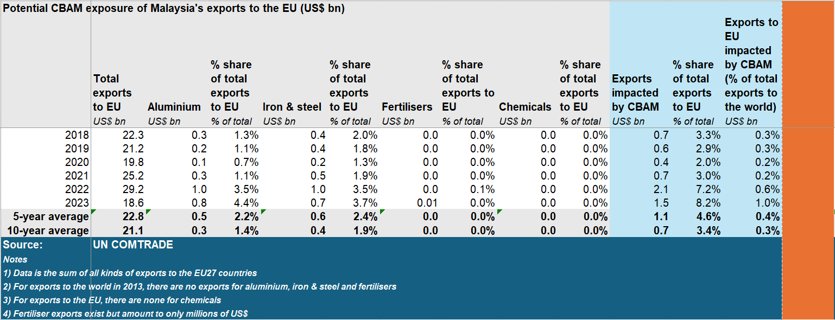
Malaysia trade exposure to CBAM
CBAM would affect 3.4% of Malaysian exports to the EU or 0.3% of total trade.
KRI tabulation

Slide 14
Potential Areas of WTO Violation
An analysis by James Bacchus, former chairman of the WTO’s Appellate Body identified three areas where the CBAM would be in likely violation of the WTO.
Most-favoured nation treatment rule of the General Agreement on Trade and Tariffs, Article 1. Requires that any advantage granted to the imported products of one WTO member must be accorded immediately and unconditionally to the like products originating from all other WTO members. CBAM violates this by discriminating on the basis of carbon content.
General Agreement on Trade and Tariffs, Article II, The Schedule of Concessions. Under this the EU established ceilings on customs duties and other charges connected with imports. CBAM would apply charges above and beyond these scheduled commitments. These would conceivably rise in time as free ETS permits are revoked.
General Agreement on Trade and Tariffs, Article III.4, National Treatment on Internal Taxation and Regulation. If the EU contends that CBAM is not a border measure but is instead an internal regulation, this would allow no quantitative limits on such requirements. This would not violate Article II. However, the trigger for CBAM is to purchase an emissions certificate upon import. Even if deemed an internal regulation, imported products are to be given no less favourable treatment than that given to like domestic products. Free ETS permits for EU companies would persist after the introduction of CBAM.
A carbon tax would be less trade restrictive than CBAM.
WTO Issues: Expects a long-drawn process with the EU likely tweaking rather than rescinding CBAM.

Slide 15
Potential Policy Responses to CBAM
Comply and pay the EU
Comply and establish a universal domestic carbon price (potentially affecting the competitiveness of scheduled goods)
Comply and establish targeted carbon prices for scheduled exports to the EU (revenues could be recycled back to affected industries for upgrading)
Defy and divert trade away from the EU
Defy and challenge the EU in the WTO
Defy and impose an historically-adjusted climate-just CBAM on the EU based on the difference in historical emissions. Target politically-sensitive goods such as agricultural products.
Countries can also copy the EU and provide their companies free pollution allowances.
Most of these policy options could sit alongside adoption of strategic subsidies ala the US IRA.

Slide 16






Follow KRI on social media to keep up-to-date with our research:
@KRInstitute
@KRInstitute or www.facebook.com/KRInstitute/
Khazanah Research Institute
@krinstitute

Slide 17
Equity
The Developing Country Climate Dilemma

Slide 18
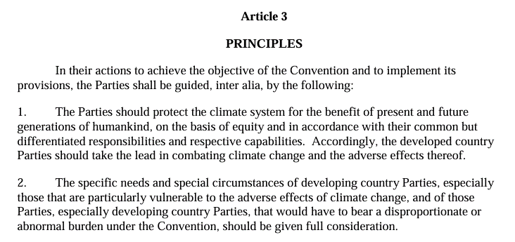
Differentiated Responsibilities for causing climate change
United Nations Framework Convention on Climate Change
…mean Differentiated Responsibilities for solving climate change

Slide 19
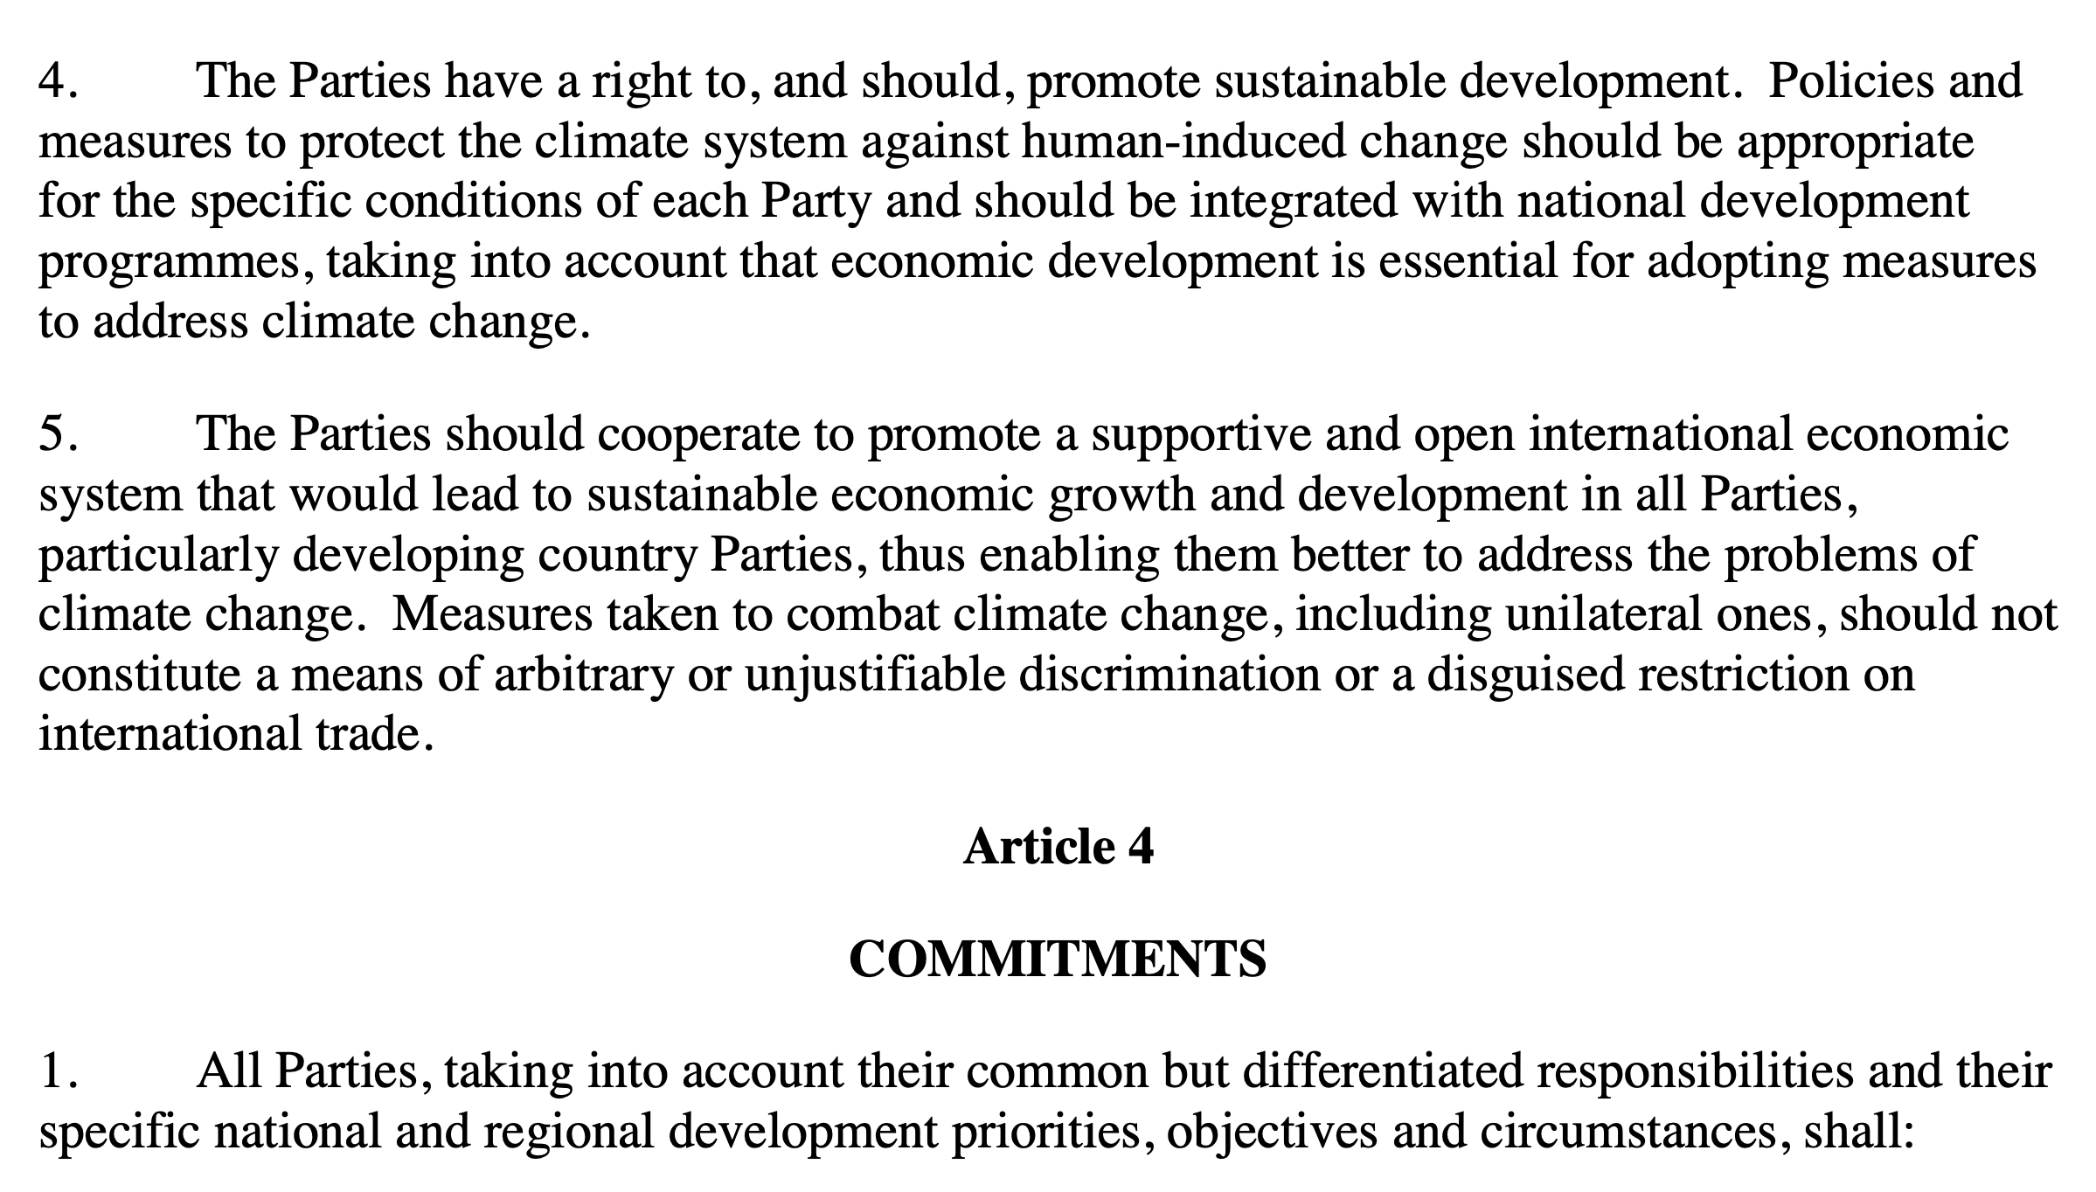
UNFCCC prohibits disguised trade restrictions
CBAM is not just a WTO problem...
… it is also a Climate Convention problem.
But the EU shows less concern about this.
There's no talk of a "UNFCCC-consistent CBAM".

Slide 20
EU Climate Leadership?
The European Union (EU) is the world’s second largest historical carbon dioxide polluter. It has recently committed to “climate neutrality” by 2050 and to reduce greenhouse gas emissions by at least 55 per cent by 2030 relative to 1990 levels.
It reached 32.5% reductions by 2022. Current policies would lead to only 48% reduction by 2030; 60% by 2040; and, 64% by 2050.
Sources: Green (2021); EPRS (2023); Carbon Brief (2024)

Slide 21
Climate transition
Requires structural transformation

Slide 22
The EU Carbon Border Adjustment Mechanism (CBAM)
Is a story of patronage and protectionism

Slide 23
CBAM is linked to the EU ETS – ETS is a failure
The EU has the world’s largest and oldest carbon pricing system, its emissions trading system (ETS).
The ETS is the EU’s flagship climate policy and the EU intends to use CBAM to promote its version of carbon pricing around the world.
Descriptions and evaluations of the ETS tend to focus on theoretical aspects (cost efficiency, market driven, cap and trade) and not on empirical ex post outcomes. This is generally true of carbon pricing discussions worldwide.
In its 20 years, the ETS delivered annual emission reductions of between 0% to 1.5%.
The IPCC calls for emissions to fall 45% below 2010 levels by 2030 in order to limit warming to 1.5°C.The EU rate of reduction is not consistent with global goals.
However, European scholars will claim that the fact that the ETS reduces emissions at all is a success. This is setting a very low bar.
Sources: Green (2021); EPRS (2023).

Slide 24
Raising ambition?
In 2024, the EC announced a new goal: a 90% cut in emissions by 2040. This was the lowest ambition choice; its scientists recommended cuts of 90-95%. The new target is dependent on carbon removal and avoids reforms to the agricultural sector following farmers’ protests.
Starting on 1 October 2023, the EU phased in a “carbon border adjustment mechanism” (CBAM) that would require importers, as of 2026, to purchase certificates equivalent to the weekly EU carbon price.
Importers would pay the difference between the EU’s carbon price and their domestic carbon price (if any) for: cement, iron and steel, aluminium, fertilisers, hydrogen & electricity.
Source: Guardian (2024); EC (2023).

Slide 25
ETS Limitations
The EU ETS only covers sectors representing 45% of EU emissions.
Its carbon price stagnated at very low levels for years due to the disbursement of free pollution allowances to polluting industries. These are the same industries covered by CBAM.
According to WWF, 53% of ETS emissions between 2013 and 2021 were emitted for free. Carbon pricing without a price.
Prices hovered around €6 for many years. Recently, with a tightening of the supply of free allowances, the price rose to around €100 before falling to around €66.
Carbon price theory calls for a ‘social cost of carbon’ (SCC). This is the marginal damage to the world of an additional tonne of carbon dioxide. Proposals range from $43 a tonne (Obama) to hundreds of dollars, and most recently $1,000 per tonne.
The ETS price has no relationship to the SCC. The earnings aren’t shared with the world.

Slide 26
The scandal at the heart of the ETS
Faced with a carbon price, Europe’s high emission industries threatened to leave or complained that paying the price would make their products uncompetitive versus imports from countries with lower environmental standards. They call this hypothetical divestment risk, ‘carbon leakage’.
Carbon leakage measures pre-date the CBAM. Under the ETS free pollution allocations were created to entice industries who claimed hypothetical risk to instead stay.
More than 150 sectors, representing more than 97% of industrial emissions, were deemed to be at risk of ‘carbon leakage’ and thus eligible for free pollution permits.
The ETS is supposed to be a ‘polluter pays’ system. Pay to discourage pollution. However, lobbyists profited industry.
The ETS paid more to industry than it took in. From 2013-2021: EU Member states earned €88.5 billion, but industry received €98.5 billion in free pollution permits!
Free allowances suppressed the effective carbon price from €14/tonne to €6/tonne.
For every Euro spent lobbying, firms gained €1 to €4.60 in free pollution allowances.
Source: Carbon Market Watch (2015); WWF (2022); Winkler (2022).

Slide 27
ETS subsidies
Several EU governments even established ETS compensation schemes to direct further subsidies to polluters. Germany, Spain and Italy spent over 30 billion Euros.
Under CBAM, Germany continues to provide ETS price hedging subsidies for dirty industries (2024). This undermines ‘level playing field’ claims by the EU and could be explored at the WTO.
EU Member States were estimated to have spent only 58% of their ETS earnings on climate action. Lax rules on ETS reporting mean that the money trail is hard to follow. The remainder was spent on supporting coal, gas, ETS carbon price compensation, diesel cars, high-carbon bioenergy, and fossil fuel heating systems. Over 18% of ETS revenue went towards general government spending.
Source: WWF (2022).

Slide 28
The Proposed CBAM Mechanism
According to the EU, CBAM aims to equalise the carbon price between domestic and foreign products, thereby limiting carbon leakage.
It would affect six sectors: cement, iron and steel, aluminium, fertilisers, hydrogen & electricity. There are concerns that it could later apply to other goods and services or extend to indirect emissions.
The preferred mechanism for pricing carbon at the border would involve surrendering carbon permits equivalent to those issued under the EU emission trading system (ETS). The amount paid would be equivalent to the difference between the weekly ETS price and the importer’s domestic carbon price (if any). Exemption mechanisms remain unclear.
An alternative approach considered would be to price carbon based on actual emissions in producing countries, rather than EU emission allowances. An importer would then have the opportunity to seek reductions based on individual carbon footprints. Currently, a lower-emission producer in a country without a carbon price would be penalised.
The CBAM will have a transitional period of 3 years from 2023 to 2025, in which the emphasis will be on reporting obligations. An 8-year phase-in period will commence from 2026 where free allowances to polluting industries in the five sectors within the EU will be gradually phased-out.
The EU claims it will engage with third countries on the trade impacts and explore dialogue and cooperation to implement specific elements of the mechanism. Agreements about carbon pricing systems and methodologies and alternatives to CBAM could be concluded with third countries.

Slide 29
Does Carbon Leakage exist?
Carbon leakage is a hypothesis. European lawmakers or EU trading partners make no attempt to test its truth. Accepting CBAM may involve accepting a false hypothesis.
A 2018 paper by Naegele and Zaklan in J of Environmental Economics & Management found that there was no empirical evidence of carbon leakage, 2004 to 2011.
Most sectors received a net subsidy from free emission allowances.
Differences in emission costs between EU and emerging economies were close to zero. Labour cost differences are between 10 to 30 times higher.
These findings are important because CBAM is based around claims of carbon leakage and free pollution allowance reform.
Even as they face criticism over the overuse of free pollution allocations, EU industry and policymakers continue to use the threat of carbon leakage to anchor successor policies such as CBAM.
Source: Naegele & Zaklan (2018)

Slide 30
Reforming free pollution allowances?
Internally within the EU, CBAM was promoted as a reform of the free pollution allowance system. However, CBAM will maintain free pollution allowances over the next 10 years, replacing them with border taxes on competing imports. Slow reform or false reform?
The EU claims that higher carbon pricing and phasing out free pollution allowances will encourage divestment by carbon-intensive firms to lower-cost regulatory regimes abroad.
This creates a justification for continued industry subsidies via border taxes on imports to prevent alleged ‘carbon leakage’.
However, the EU does not distinguish between carbon leakage and Direct Investment Abroad by EU MNCs.
The EU officially promotes DIA via its policies on investment and trade, as well as its diplomatic service. Does it also promote carbon leakage?
Are EU auto firms in China dodging the ETS or pursuing bigger markets?

Slide 31
“Carbon leakage” – Pollution havens revisited
The EU claims that CBAM will help avoid the emissions reduction efforts of the Union being offset by increasing emissions outside the Union through relocation of production or increased imports of less-carbon-intensive products. Without CBAM, it claims, “carbon leakage could result in overall increase in global emissions.”
This restates in climate change terms an old assertion in debates around transnational investment and environmental standards. The “pollution havens” hypothesis. Statistical studies have shown that this effect cannot be clearly identified at the level of aggregate investment flows. Some studies have failed to find evidence that the EU ETS has caused so-called carbon leakage.
The claim of carbon leakage suffers from Omitted variable bias. Multinational corporations have multiple reasons besides environmental regulation to locate themselves overseas: proximity to markets, cheaper labour, reduced shipping costs, tax arbitrage, subsidies, supply-chain factors, etc.
Source: European Commission (2021); Mabey and McNally (1999); EPRS (2023).

Slide 32
EU ‘level playing field’ is tilted
The EU claims CBAM will “level the playing field” between the EU and third-country producers. Levelling the playing field conflicts with obligations under the UNFCCC for the EU to “take the lead” and to consider the “specific needs and special circumstances of developing countries” (Article 3).
CBAM could potentially encourage foreign producers to decarbonise production, but they would have to pay the costs themselves in the near term. It could also unfairly penalise developing countries who do not have carbon pricing or differentiated responsibilities for climate change.
CBAM invites us to mistake current carbon dioxide emissions as a bigger problem than historical emissions.
The European economy could be seen as the product of 150-250 years of embodied carbon. Shouldn’t that be payable to developing countries rather than the other way around?

Slide 33
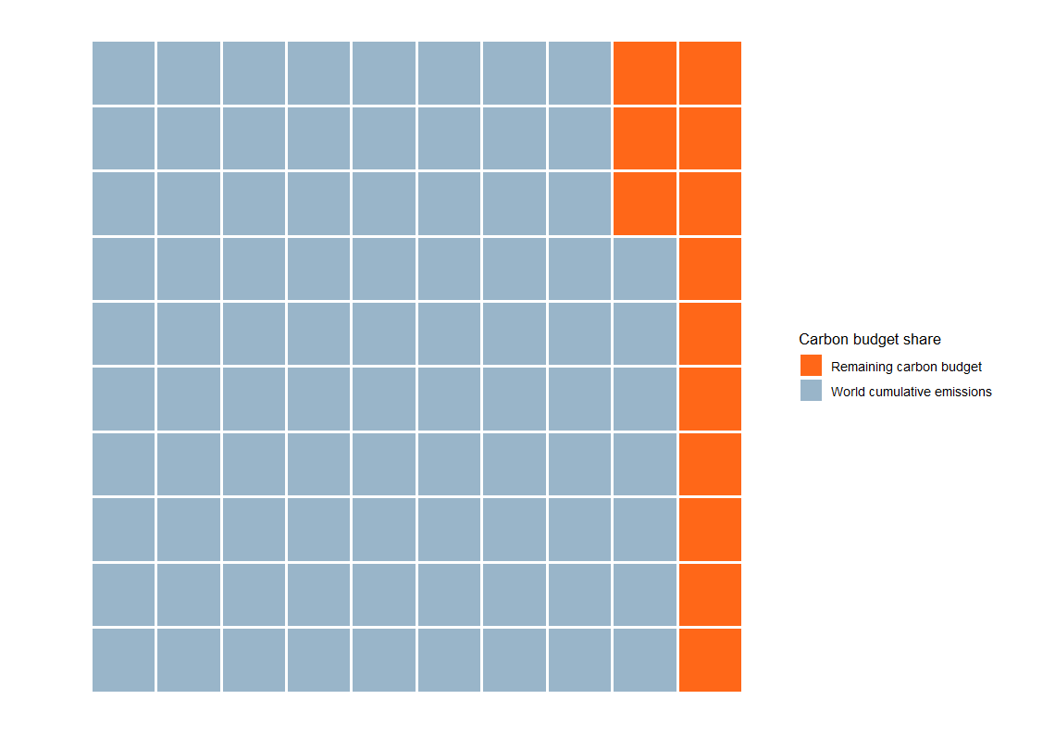
Remaining carbon budget – human cumulative emissions, 2022
Atmospheric carbon is a problem of stocks, not flows.
Current and future global warming is primarily due to past emissions.
Unequal use of remaining carbon budget.
Source: KRI data visualistion.

Slide 34
CBAM: Part of the protectionist toolbox
The CBAM is perhaps best seen as policy tool to subsidise high emission uncompetitive industries. Other policy tools are deployed to protect different sectors.
The choice of policy tool and the choice of sector benefitting from intervention, may reflect different levels of power and influence in Brussels and capitals like Berlin. For example, steel and auto appear more powerful than solar.
For electric vehicles, the EU used a subsidy review even though it is known that EVs produced in China have a higher emissions footprint.
EU solar is under fierce competition from China. Chinese solar panels have higher embodied emissions than EU panels. However, the EU wants cheap solar panels and has been slow to respond to domestic industry demands for a subsidy review.
The EU steel industry has been facing problems of competitiveness.
Border carbon adjustments may hold appeal to seize an edge in competitiveness.
However, CBAM may make for poor industrial policy as it discourages upgrading.

Slide 35
CBAM effects

Slide 36
1. Commonwealth Secretariat Study
The EU is the second largest export market for Commonwealth countries. The EU’s largest Commonwealth trading partners are: UK, India, Canada, Malaysia and South Africa (2019). Note: This is based on total trade not the five CBAM-affected goods.
CBAM-related trade exposure of: developed country Commonwealth members (5%); developing country members (4%).
Sectoral Implications: Iron and Steel (57%); Aluminium (23%), Fertilisers (14%); Cement (6%).
Steel: UK and Canada account for half of steel impacts. For developing countries: India (31%), South Africa (8%), Malaysia (5%). Caribbean and Pacific members do not produce steel, so unaffected.
Malaysian exports do not feature significantly in the other CBAM areas. CBAM could potentially expand to organic chemicals, glass and glassware, and paper and paperboard. Malaysia had an estimated glass and glassware exposure of $135 million in 2019. The other products are unlikely to have significant negative impacts on Malaysia, though they are significant to Commonwealth countries (such as UK, India and Singapore).
Administrative burden: Significant compliance costs. Firms are required to file an annual declaration on the quantity of goods, embedded carbon emissions and CBAM certificates that need to be surrendered after necessary adjustment. SME challenge.
Revenues: CBAM is estimated to generate between €2.1 billion to €14 billion per annum for the EU. There is currently no provision to exempt Least Developed Countries (LDCs) or to take account of developing countries’ differential responsibilities for climate change. Meanwhile, developed countries have fallen short of their goal to mobilise US$100 billion per year for developing countries’ climate finance.

Slide 37
2. UNCTAD Study
Looks at developing country impacts (as opposed to Commonwealth only). Malaysia ranked 18th amongst the 20 countries most exposed to CBAM, based on 2019 exports to the EU. Exposed goods were limited to aluminium and iron and steel.
Exports by developing countries across the targeted carbon-intensive sectors would be reduced by 2.4%, if CBAM were set at $88 per tonne of CO2.
A CBAM priced at $88 per tonne of CO2 would only reduce global emissions by 0.2%. It does little to mitigate climate change.
CBAM would act like a tariff increase by a trading bloc, increasing intra-bloc trade and diverting trade of trading partners to other regions.
EU income rises by $6 billion while developing country incomes fall by $10 billion.
CBAM Primary Effect: Transfer wealth from Global South to the EU
20 most-exposed countries in terms of aggregated value of exports (USD billion)
Source: UNCTAD.

Slide 38
Malaysia trade exposure to CBAM
CBAM would affect 3.4% of Malaysian exports to the EU or 0.3% of total trade.
KRI tabulation

Slide 39
WTO Concerns
Compliance or Defiance?

Slide 40
Potential Areas of WTO Violation
An analysis by James Bacchus, former chairman of the WTO’s Appellate Body identified three areas where the CBAM would be in likely violation of the WTO.
Most-favoured nation treatment rule of the General Agreement on Trade and Tariffs, Article 1. Requires that any advantage granted to the imported products of one WTO member must be accorded immediately and unconditionally to the like products originating from all other WTO members. CBAM violates this by discriminating on the basis of carbon content.
General Agreement on Trade and Tariffs, Article II, The Schedule of Concessions. Under this the EU established ceilings on customs duties and other charges connected with imports. CBAM would apply charges above and beyond these scheduled commitments. These would conceivably rise in time as free ETS permits are revoked.
General Agreement on Trade and Tariffs, Article III.4, National Treatment on Internal Taxation and Regulation. If the EU contends that CBAM is not a border measure but is instead an internal regulation, this would allow no quantitative limits on such requirements. This would not violate Article II. However, the trigger for CBAM is to purchase an emissions certificate upon import. Even if deemed an internal regulation, imported products are to be given no less favourable treatment than that given to like domestic products. Free ETS permits for EU companies would persist after the introduction of CBAM.
A carbon tax would be less trade restrictive than CBAM.
WTO Issues: Expects a long-drawn process with the EU likely tweaking rather than rescinding CBAM.

Slide 41
Is the WTO at systemic risk from BCAs?
The EU is aware that CBAM measures could run up against World Trade Organization (WTO) rules. In early drafts it took to referring to a “WTO-compliant carbon border adjustment mechanism”, although labelling it WTO-compliant does not make it so.
The final regulation drops this language, along with proposals from the European Parliament to exempt LDCs (which could violate the Most Favoured Nation principle).
Similar “Border Carbon Adjustments” (BCAs) have been debated for decades. The US, UK, South Korea, Singapore, Australia, Canada and Japan are considering them, though this hardly amounts to sweeping globalisation of BCAs.
However, the danger for countries like Malaysia and Thailand is when multiple developed trade partners adopt BCAs. This can pose a far greater threat to a rules-based trading order. ETS subsidies could be trade-distorting.
China has recently “invited” the EU to present its CBAM at the WTO. This sounds like a prelude to a challenge within the WTO’s Dispute Settlement Process.
Source: European Commission (2021); Mabey and McNally (1999); EPRS (2023).

Slide 42
Potential challenges at the WTO
The WTO Committee on Market Access has met six times in the last three years on CBAM.
Countries concerned about CBAM include:
China
Russia
Indonesia
India
Paraguay
Türkiye
South Korea
Argentina
Thailand
Taiwan
Japan
South Africa
Saudi Arabia
Bahrain
Qatar
Brazil
Kazakhstan
Venezuela
Canada
Australia
New Zealand
Egypt
BLUE Raising concern
GREEN Supporting concern

Slide 43
Potential Policy Responses to CBAM
Comply and pay the EU
Comply and establish a universal domestic carbon price (potentially affecting the competitiveness of scheduled goods)
Comply and establish targeted carbon prices for scheduled exports to the EU (revenues could be recycled back to affected industries for upgrading)
Defy and divert trade away from the EU
Defy and challenge the EU in the WTO
Defy and impose an historically-adjusted climate-just CBAM on the EU based on the difference in historical emissions. Target politically-sensitive goods such as agricultural products.
Countries can also copy the EU and provide their companies free pollution allowances.
Most of these policy options could sit alongside adoption of strategic subsidies ala the US IRA.

Slide 44
Industrial Policy

Slide 45
Carbon Prices v Subsidies
Inflation Reduction Act v CBAM-European Green Deal. Two different paradigms of climate-related industrial policy.
IRA designed to avoid conflict with fossil fuel lobby, so entirely composed of carrots. EU GD contains sticks and carrots.
Malaysia: carbon pricing in context of electricity input subsidies and tariff stagnation. Levers exist to adjust price. Would carbon pricing be redundant or contradictory?
If Malaysia embraced carbon pricing would we divert ourselves away from exploring strategic subsidies?

Slide 46


DUPLO v LEGO Policy Toolbox
Economic complexity is correlated to GDP
DUPLO
LEGO
Carbon pricing
Technology-focused industrial policy

Slide 47
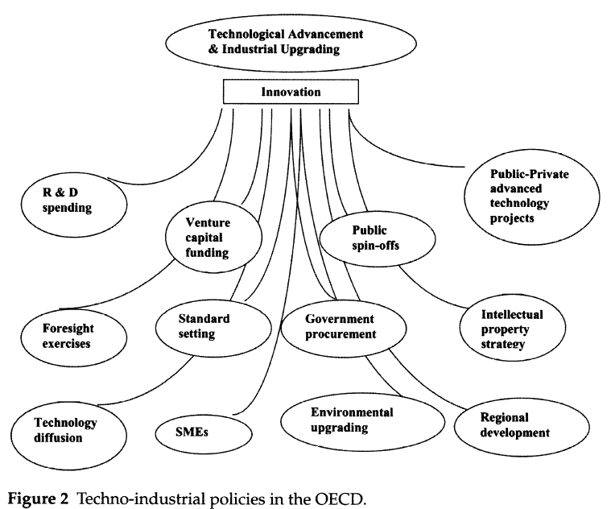
Marginal v Mainstream Policies
World Bank Climate Policy Assessment
Carbon Pricing
Fossil Fuel Subsidy Reform
Renewable Subsidies
Feebates
Emission Rate Regulations
Green Public Investments
Source: Weiss (2005). Global Governance, National Strategies: How Industrialized States Make Room to Move under the WTO

Slide 48
Thank you
www.krinstitute.org

