Slide 1

Just Energy Transition Partnership grants and country platforms
Lessons from Indonesia and South Africa
2026
Anisa Indah Pratiwi | A.I.Pratiwi@lse.ac.uk

Slide 2
Introduction
Timeline and objectives of JETP
Nov 2021
South Africa Signed (COP26 Glasgow) USD 8.5 billion pledged
Nov 2022
Indonesia signed (G20 Bali), USD 20billion pledged
Dec 2022
Vietnam signed, USD 15.5 billion pledged
Senegal signed (Paris Summit), USD2.7 billion pledged
2024
June 2023
Minimal disbursement and slow implementation
2025
US withdrawal from JETP, SA, Indonesia and Vietnam affected as ~USD 3.4 billion revoked
Objectives
Accelerate coal phase-out
Scale renewable energy
Mobilize public-private finance
Ensure "just" transition
Support country-led development
Achieve 1.5°C alignment

Slide 3
Country Platforms
Country | Platform Name | Year | Primary Objectives | Sectoral Scope
Indonesia | SDG Indonesia One (SIO) | 2018 | Mobilise resources for sustainable infrastructure aligned with SDGs | Multi-sectoral (sustainable infrastructure)
Egypt | Nexus of Water, Food, and Energy (NWFE / NWFE+) | 2022 | Address water-food-energy nexus; expanded to include transport (NWFE+) | Multi-sectoral (water, food, energy, transport)
North Macedonia | Just Energy Transition Investment Platform (JET-IP) | 2023 | Decarbonise power sector; reduce GHG emissions by 82% by 2030 (vs. 1990 levels) | Focused (energy/power sector)
Brazil | Brazil Climate and Ecological Transformation Investment Platform (BIP) | October 2024 | Align investment flows with decarbonisation, sustainable resource use, social wellbeing | Multi-sectoral (nature-based solutions/bioeconomy; industry/mobility; energy)
Colombia | Country Platform for Climate and Development | January 2025 | Energy transition, sustainable transport, ecosystem protection | Multi-sectoral
Bangladesh | Bangladesh Climate and Development Partnership (BCDP) | 2025 | Scale up climate finance; deliver climate resilience for vulnerable communities | Multi-sectoral (resilience-oriented focus)

Slide 4
Introduction
When donors pledge billions for energy transition, here's what developing countries actually receive as grants
Instruments | Indonesia | South Africa
Grants/TA | 186,969,841.00 | 785,000,000
Concessional loans | 6,946.50 | 940,000,000
Non-concessional loans | 138,000,000.00 | —
Commercial loans | 60,000,000.00 | 238,000,000
Equity | 30,000,000.00 | —
Others | 828,146,437.00 | 3,011,000,000
Total | 1,243,123,224.50 | 4,974,000,000
Financial Allocation as of June 2025
Three Critical Findings
Fragmentation without strategy: Grants scattered across short-term studies and capacity building, lacking clear framework for deployment
Just transition severely underfunded:
    South Africa: <10% of grants support workers/communities
    Indonesia: Limited social dimension support
    Political legitimacy at risk
Institutional durability uncertain: Core functions depend on donor cycles rather than domestic budgets, creating cliff effects when projects end 2026-2028
Grants are critically underfunded and poorly allocated:
Indonesia: Only ~1.5% (US$153-197M) of US$10B public funding is grants
South Africa: Only 4% (US$329-764M) of US$8.5B commitment is grants
Both rely heavily on loans, raising debt burden concerns
Notes:
Just Energy Transition Partnerships promised to be different—country-led, comprehensive, and just. Our analysis of grant spending in Indonesia and South Africa reveals why they're falling short and what must change for the next generation of country platforms

Slide 5
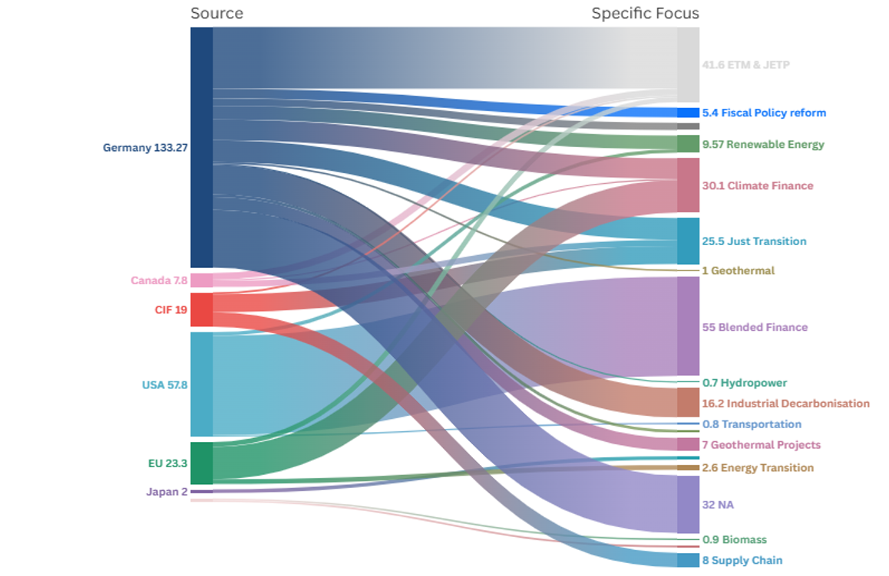
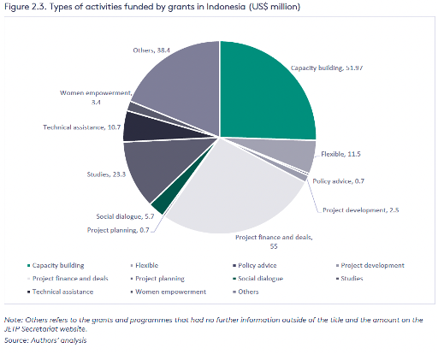
Indonesia
Tracing down the money
What's overfunded:
Studies, feasibility assessments, workshops (capacity building: US$52M Indonesia alone)
Short-term technical assistance (24-36 month cycles)
Donor-driven mandates with unclear implementation links
What's underfunded:​
Direct infrastructure investment​
Worker reskilling and community compensation​
Long-term institutional reform embedded in domestic systems​
Municipal capacity for implementation​
Notes:
Indonesia (US$285M grants)
Largest allocation: Energy Transition Mechanisms (US$41.6M) - mostly preparatory
Power sector critically underfunded: <US$20M for actual infrastructure vs US$97B needed
Major gap: Minimal engagement with PLN (state utility), whose reform is essential
US withdrawal (March 2025) leaves Germany as dominant donor, further fragmenting support
"That's a 1-to-10,000 ratio between grant infrastructure funding and actual need."
"And after the US withdrawal in March 2025, coordination fragmented further—12 donors, 10+ implementers, overlapping mandates."

Slide 6
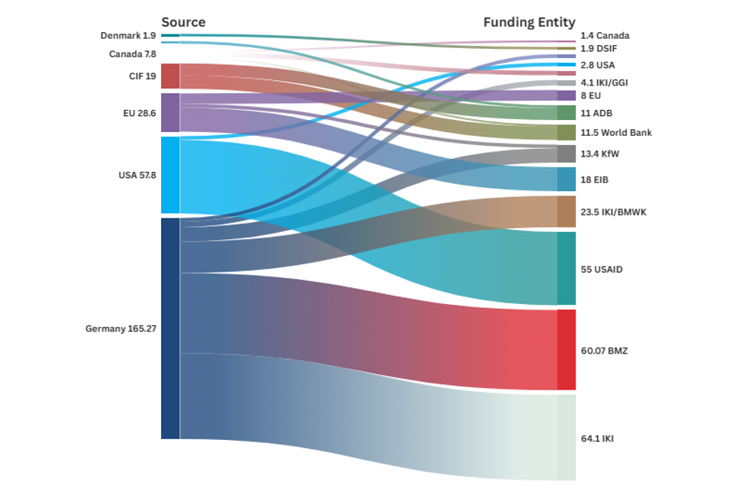
Structural Weaknesses
Instead of fostering a coordinated investment delivery mechanism, the current portfolio risks reproducing legacy challenges: donor fragmentation, implementation silos, and weak state ownership.
For blended finance mechanisms to be effective in Indonesia’s investment landscape, they must be embedded within robust domestic institutions, supported by instruments and aligned with reform mandates set by national actors such as PLN, the MEMR and Bappenas.
Unless future JETP financing structures prioritise institutional transformation of the state-owned utility company, like PLN, and strengthen local execution capacity, Indonesia’s energy transition will remain technically ambitious but operationally constrained.

Slide 7
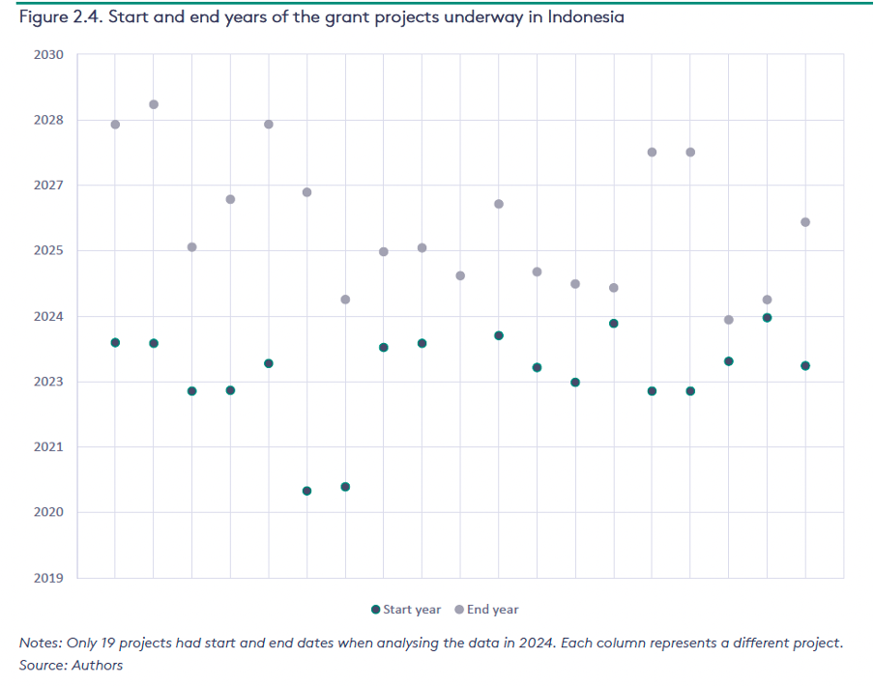
Fragmentation in Grants Mobilisation
Problem: Grants scattered across 50+ short-term projects with no organizing framework
Example: Indonesia has 15 separate "capacity building" initiatives averaging 30 months each
Impact: When projects end 2026-28, preparatory work evaporates—no institutional memory, no sustained capacity

Slide 8
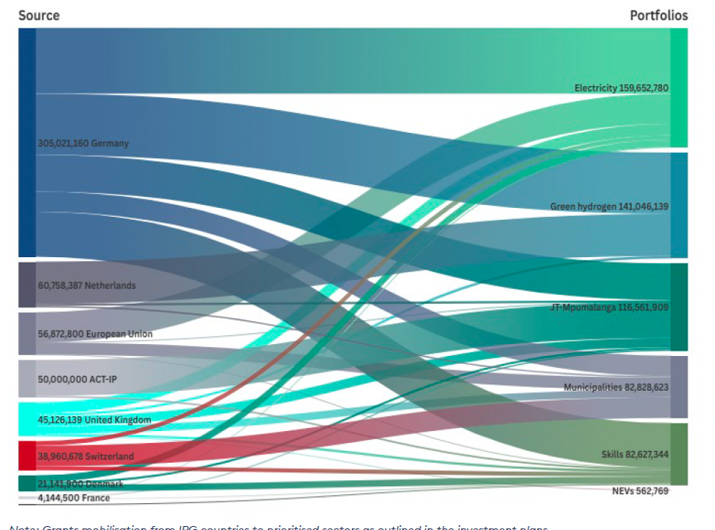
South Africa
From the outset, the portfolio’s emphasis on institutional capacity (energy transition planning) and equity (just transition) reflects the understanding that infrastructure alone will not enable a fair or feasible transition. This is essential to assist South Africa in transitioning from its ageing coal fleet, and its commitment to retire nine CFPPs by 2035. Sectors like electricity distribution, water and buildings, though visible, are nearly absent in the granular project-level dataset, pointing to a potential risk of infrastructure bottlenecks in the later stages of transition if not addressed.

Slide 9
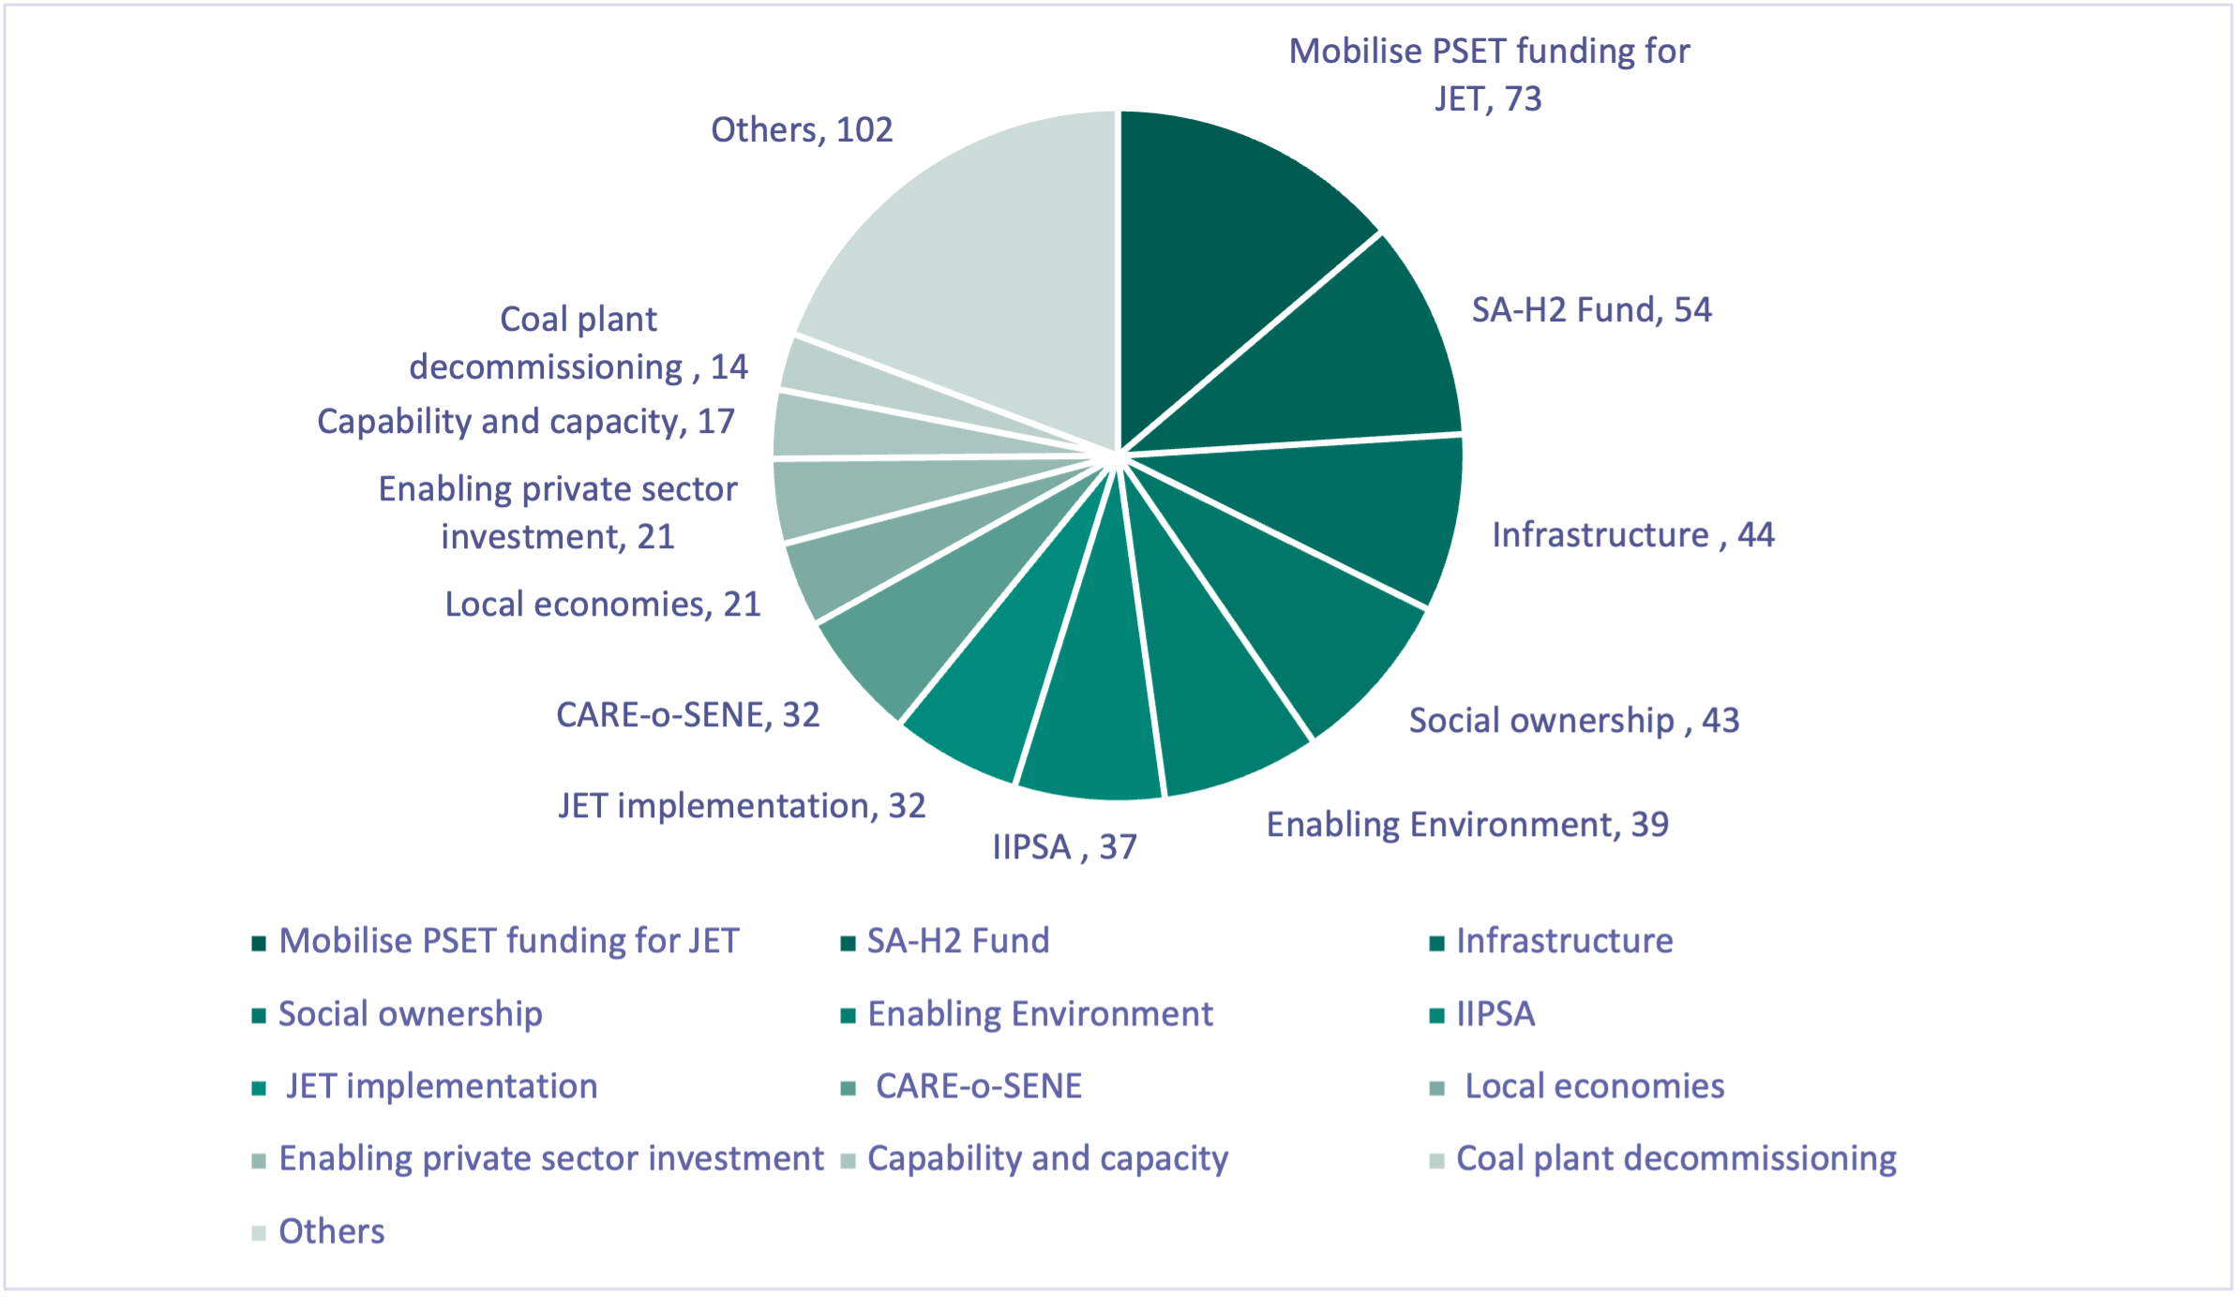
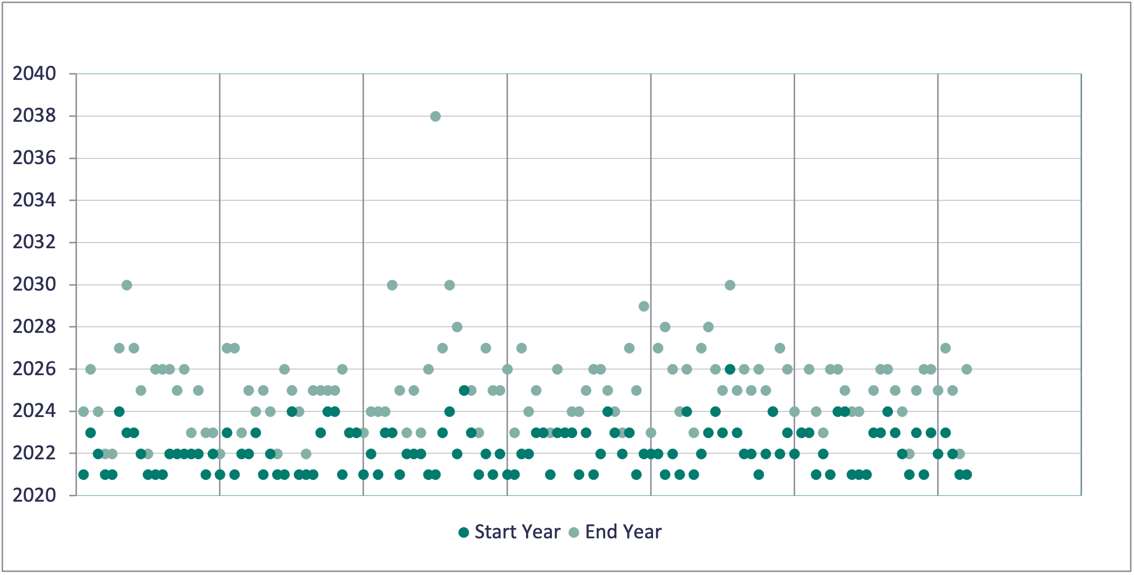
Is finance aligned with the priorities?
Green hydrogen over-emphasized: US$95.8M (only 3 projects) vs broader needs
Just transition token: US$70M (~10%) for Mpumalanga workers/communities, despite being core commitment
Timeline mismatch: Most projects end 2025-2027, but transformation requires decades
South Africa Three mega-projects dominate: 40% of grants to just 3 initiatives (skills, hydrogen, infrastructure)

Slide 10
Lesson Learned
1. Clarity of Purpose and Strategic Use of Grants
Key Lesson: Grant finance must have explicit frameworks for allocation across specific functions, not scattered across donor-driven studies.
Country Platform Design:
Establish four-function framework for grants: Regulatory/institutional reform, Project preparation, Risk reduction/de-risking, Social investment
Flexibility is essential: allow resources to pivot across functions as priorities evolve
Where possible, anchor all functions in nationally agreed priorities, not donor preferences
Indonesia spent 75% on preparation (studies, capacity building) with no clear path to implementation
Country Platform Solution: Link grants to national development/climate goals through detailed implementation plans

Slide 11
2. Stakeholder Participation, Legitimacy and Trust
Key Lesson: Without broad stakeholder buy-in, platforms lack political legitimacy and face implementation resistance.
Co-creation with multiple actors: governments, subnational authorities, labor, communities, local firms
Use participatory budgeting for grant allocation reflecting local priorities​
Address political economy barriers and entrenched fossil fuel interests​
Deploy grants strategically to build trust:​
Finance participatory processes​
Compensate affected workers​
Support local economic diversification​

Slide 12
3. From Projects to Programmes: Sequencing and Long-Term Planning
Key Lesson: Short-term, isolated projects create discontinuity; programmatic approaches enable systemic transformation.
Country Platform Design:
Programmatic approach: sequence investments, reforms, and policies toward systemic goals
Avoid dispersion across isolated projects; use grants to underpin multi-phase programmes
Fund project preparation + capacity building + enabling reforms = viable investment pipelines
Multi-year commitments replace fragmented 24-36 month donor cycles
Country Platform Solution:​​
Multi-phase programming with clear handoffs​​
High-level political agreements ensuring continuity across election cycles​​
Orient full capital stack (grants, loans, private finance) around country-led priorities​
​
Early-stage grants (studies, TA)
Mid-term investment (infrastructure)
Long-term transformation (institutional reforms)

Slide 13
4. Social and Just Transition Investments
Key Lesson: JETPs critically underfunded the "just" element, undermining political legitimacy and social acceptance.
Social protection systems for affected populations
Worker reskilling and upskilling at scale
SME development in transition regions
Community equity models in renewable projects
Move from <10% to ≥30% of grant portfolios for just transition
Country Platform Solution:​
Substantial, sustained investment in affected communities​
Integration with national social protection systems​
Rights-based accountability mechanisms​

Slide 14
5. Transparency, Accountability and Monitoring
Key Lesson: JETPs suffered from fragmented donor flows, opaque disbursement, and weak accountability.
Public grant registers:
Municipal-level reporting
show who benefits on the ground
Independent monitoring
Clear selection criteria; Real-time disbursement tracking; Beneficiary identification
Link to parliaments; National audit institutions; Trusted third parties
Observable milestones for disbursement:
Standard PPAs issued; Market rules enacted; Grid upgrades commissioned; Coal units retired; Workers enrolled/placed
Country Platform Solution:​
Transparency builds public trust​
Trust enables domestic resource mobilization​
Accountability enables timely course corrections​

Slide 15
6. The Role of NDBs, MDBs and mobilising private finance
Key Lesson: Reforms collapse when donor projects end if not embedded in domestic institutions.
Country Platform Design:
Use grants + policy-based lending for politically sensitive reforms:
  Utility restructuring
  Planning capacity development
  Regulatory framework modernization
Embed grant-funded activities into domestic budgets over time
Ensure flexible grant design adapting to shifting reform priorities
Maintain continuity of core institutional functions beyond donor cycles
Anchor in sustained high-level political commitment (head-of-state level)
Country Platform Solution:​
National ownership from design through implementation​
Progressive transfer to domestic budget responsibility​
Build state capacity, don't substitute for it

Slide 16
Terima kasih!
Anisa Indah Pratiwi
Policy Team | Just Transition Finance Lab
Grantham Research Institute on Climate Change and the Environment
A.I.Pratiwi@lse.ac.uk

