Slide 1
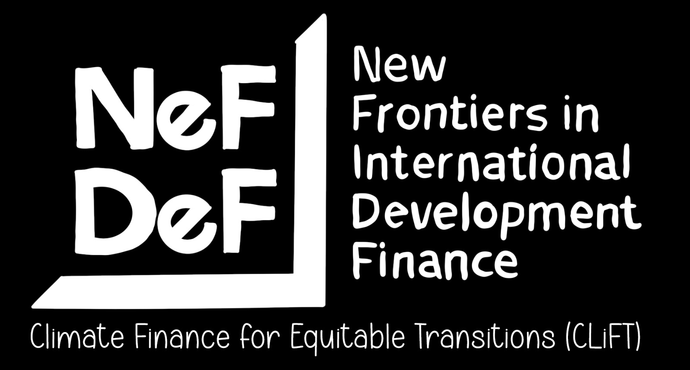
Equity and the Global Climate Finance Architecture:
An Evaluation of the Just Energy Transition Partnership (JETP) Framework
A project of the Climate Finance for Equitable Transitions (CLiFT)
Professor Celine Tan
Warwick Law School, University of Warwick, UK

Slide 2


PROJECT OVERVIEW
This project examines the Just Energy Transition Partnerships (JETPs) as a modality for mobilising and delivering climate finance to developing countries.
We are analysing the plans, processes and practices in the JETP countries with the broader objective of understanding whether these multi-donor partnerships serve as models of financing global climate transitions.
We are taking a holistic look at the JETP landscape, including the intersections of energy transition policies with domestic social and economic policies and domestic and international legal, policy and regulatory frameworks.
Photo by Anders J on Unsplash.

Slide 3




Cost of transition
Photo by Alex Kalinin on Unsplash
Cost of financing clean energy projects and programmes
eg retirement of coal-fired power plants, electric vehicles, policy and regulatory reform
Cost of mitigating impact of transition on impacted communities
eg workers, commuters, consumers, traders, environmental dislocations & externalities
Cost of enhancing adaptative capacity of communities and economies
eg economic diversification plans, infrastructure development, also climate resilience planning (linked to adaptation)

Slide 4

COUNTRY PLATFORM
The JETP is framework is a ‘country platform’ that is aimed at providing a platform for mobilising finance for each host country’s investment plan for transitioning away from coal / fossil fuels to renewable energy as well as to address social and economic transition risks.
It is meant to coordinate donors/financiers (official bilateral and multilateral and private sector), governments, domestic private sector and civil society among many stakeholders. An International Partners Group (IPG) initially comprised of the USA, UK, Canada, Germany, Denmark, France, Italy, Norway, Japan. Switzerland, Canada, Spain and Netherlands but the US withdrew this year (2025).
Private sector coordination is ostensibly coordinated by the Glasglow Financial Alliance for Net Zero (GFANZ).
Similar platforms have emerged modelled on the JETPs, eg Brazil’s Climate and Ecological Transformation Platform (BIP), Egypt’s Nexus of Water, Food and Energy (NFWE), Bangladesh’s Climate Development Partnership and North Macedonia’s Just Transition Investment Platform. The UK has recently launched the Global Clean Power Alliance which appears to follow a similar framework.
Country platforms are gained popularity to both integrate climate risks and mitigation and adaptation action in national development strategies and to coordinate mobilisation of finance, chiefly from the private sector and for blending public with private finance,
Photo by Alessandro Bianchi on Unsplash

Slide 5

Findings
Main takeaway:
JETPs promoting market-led green transition and enabling wide-ranging structural reforms in host countries that can paradoxically constrain the fiscal, policy and regulatory space for countries to undertake nationally-owned just energy transitions.
They will have wider implications for developing countries beyond access to climate finance and can impact on local and national law and policymaking and host countries’ engagement in the broader global economy and international law.
Limited financing commitments
Debt-creating finance
Derisking approach
Additionality of financing
Conditionality of financing
Social and economic transition risks
Policy leverage
Regulatory risks from finance
Legal risks from investment
(In) Compatibility with Multilateral Climate Commitments
Photo by bady abbas on Unsplash

Slide 6

Committed finance from two main sources: public finance and private finance. Public finance from the IPG however constitute a very marginal portion of total amounts projected for JETP investments.
There are also private finance sources (for Indonesia and Vietnam) coordinated by the Glasgow Financial Alliance for Net Zero (GFANZ) which includes financial institutions, such as HSBC, Bank of America, Citi, Deutsche Bank, Mizuho Financial Group, Standard and Chartered and others. The GFANZ commitments are uncosted and unclear beyond playing a convening role for private financial actors and general commitments to match funding to IPG commitments in Indonesia and Vietnam.
The amount of finance committed by the IPG and the GFANZ are limited compared to the scale of investment required. The financing committed by the IPG range from eight to 12 percent of the total costs of the transition plans for host states.
Cost of JETP Financing Needs vs IPG Pledges:
South Africa: USD12.8 billion (after US withdrawal) representing around 13 percent of the USD 98.7 billion required to finance South Africa's JETP Investment Plan (JETP-IP).
Indonesia: USD 11.8 billion, representing 12 percent of the USD$97 billion required to meet the country's on-grid power sector needs through to 2030, a major aspect of the country's energy transition. Another USD 10 billion ostensibly to be mobilised from the private sector.
Viet Nam: USD 7 billion, representing six percent of the USD 15.5 billion required to finance the energy transition plans.
1. Limited financing commitments

Slide 7
2. DEBT CREATING FINANCE
There is an over-reliance on debt instruments – including loans, guarantees and sovereign bonds – to finance the transition.
Grants and technical assistance make up a small proportion of the total commitments and most IPG finance will be delivered in the form of loans, concessional or market-based, or guarantees through bilateral, multilateral or blended finance sources.
Concessional and non-concessional loans, mainly to the private sector via development finance institutions (DFIs), amount to 53 percent and 25 percent respectively, accompanied by commercial loans, and guarantees, all of which have significant debt implications.
Guarantees and loans to private sector can sit as contingent liabilities on sovereign books.
Source: JETP Project Preliminary Data Snapshot

Slide 8

3. Debt and derisking approach
A key feature of the JETP country platform is its focus on mobilising private sector finance with a significant bulk of official financing geared towards catalysing commercial sources of financing using instruments, such as guarantees and loans to the private sector from development finance institutions (DFIs).
This means financing for grants and technical assistance, blended finance and policy-based lending aimed at:
(a) creating enabling environments for mobilising private capital, including regulatory reforms; and
(b) creating ‘bankable’ pipelines of investable projects for energy transition through financial incentives, such as guarantees via credit enhancement facilities.
Participating countries are undertaking measures to enhance their ability to raise debt financing through the capital markets through regulatory and policy reforms to create ‘enabling environments’ for private sector capital.
This includes development of carbon exchanges, financial sector reforms (to develop markets for sustainable investments), development of derivative financial instruments and credit enhancement facilities as well as liberalisation of capital markets to enable greater financialisation of the energy sector.
Photo by Towfiqu barbhuiya on Unsplash

Slide 9
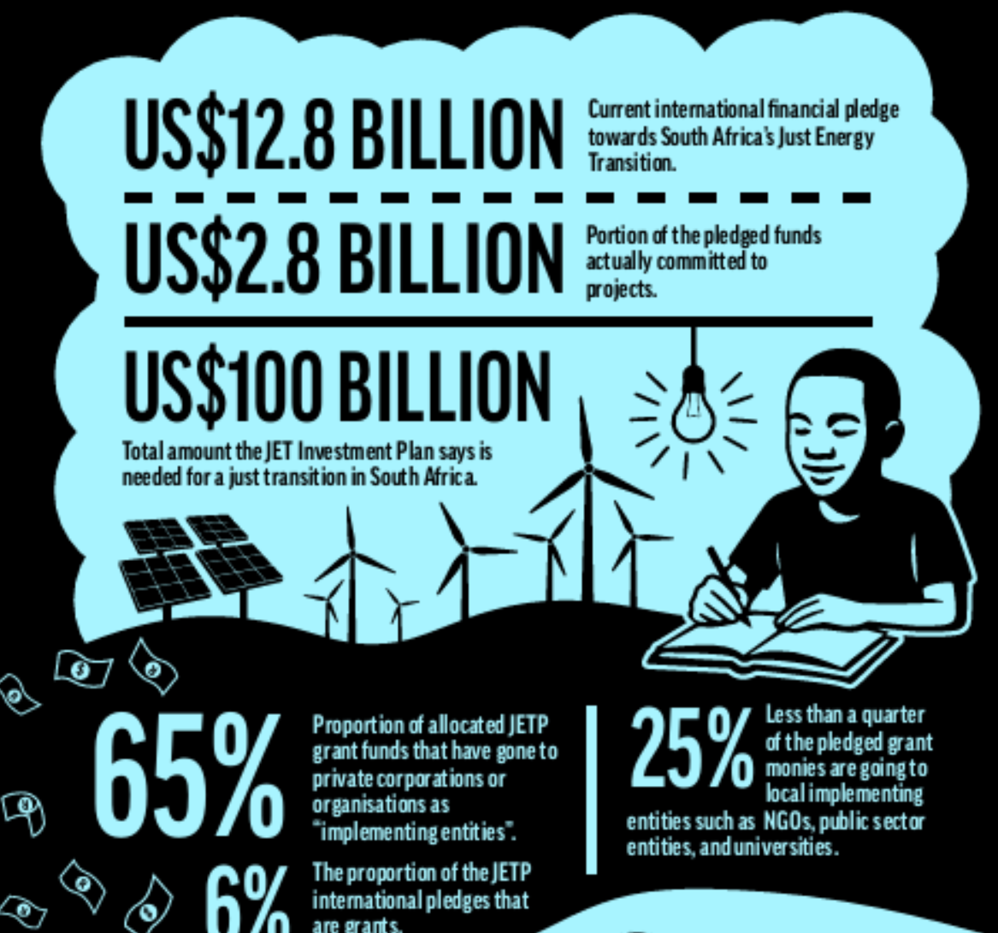
4. ADDITIONALITY OF FINANCE
There are question marks over whether the financing committed by the IPG is ‘new and additional’ for three reasons:
(a) a significant proportion of the funding committed by the IPG are for pre-existing projects
(b) a significant proportion of committed IPG funds come from the official development assistance (ODA) budget
(c) there is a significant use of guarantees which are predicated on the identification of viable projects. If projects do not materialise, the funding does not flow
Additionally, there are concerns raised over the allocation of grants where funding have been allocated to organisations, private corporations, and implementing agencies based outside the host state, including funding for technical assistance for regulatory and policy reforms.
A recent Open Secrets investigation revealed that 65 percent of the grant funding for the South Africa JETP so far as been allocated to private corporations or agencies based outside South Africa and less than a quarter of funds have gone to local agencies and organisations. A similar picture emerges in Indonesia.
Source: Open Secrets

Slide 10

5. CONDITIONALITY OF FINANCE
A great deal of the finance committed by the IPG and GFANZ are conditional on host states adopting regulatory and policy reforms to create ‘enabling environments’ for private sector finance.
GFANZ statement: ‘The commitment is subject to the involved governments and partners working closely with GFANZ and the private sector to ensure (i) continued progress in improvements to the local and international policy and enabling environment; (ii) the availability and deployment of catalytic public finance, including in structures and forms that can be used to appropriately de-risk and crowd in private finance; and (iii) a robust pipeline of competitively tendered projects that are demonstrably consistent with the JETP’s ambitious transition pathway.’ (GFANZ, 2022).
Interventions to create enabling environments for private investments and regulatory reforms through financing conditionalities may undermine rather than progress climate action.
Conditionalities attached to finance may also be ‘mitigation through the back door’ as well as create potential liabilities for host states under investment regimes by ‘locking-in’ regulatory reforms.
Photo by Gina Neri on Unsplash

Slide 11
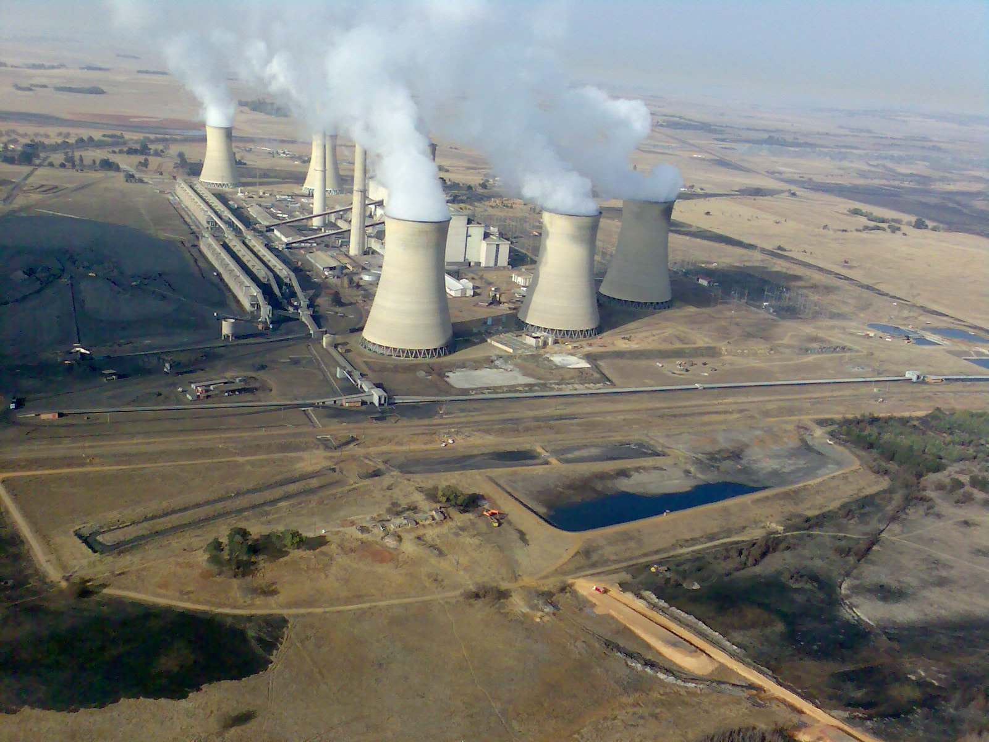
6. SOCIAL AND ECONOMIC TRANSITION RISKS
There is limited focus and funding for addressing social and economic transition risks.
(a) Transition risks are narrowly framed in terms of the risks to immediate impacts on workers and communities rather than a wider sectoral or national risks to disorderly transitions
(b) Inadequate costing and assessments of risks nor accounting for further social and environmental risks of energy transitions, such as reliance on supply and production of critical minerals
(c) Finance insufficient to cover social and economic transition risks
(d) Lack of certainty and addressing these transition risks hindering coal phase-outs in South Africa and Indonesia
Photo by Wikmedia Commons

Slide 12

Country platforms, such as the JETPs, extend beyond the transfer of financial resources and involves legal, regulatory and policy reforms in developing countries.
Regulatory and policy reforms initiated to attract financing (both official sector and private) and as conditions for such financing, alongside other terms and conditions of finance and investment contracts for energy transition can generate legal, regulatory and governance risks for host states and these contracts can attract liabilities under private and public international law.
The relatively small amounts of public finance committed by the IPG and conditional pledges by GFANZ contrast with the extensive policy reforms that are required, primarily to the energy and financial sectors.
Grants and technical assistance are focused on developing ‘expertise’ to enable these reforms, very much like the sectoral adjustment programmes. JETP loans are effectively ‘policy-based’ lending.
The focus has been on host state commitments rather than IPG and GFANZ commitments which is unpredictable now given the withdrawal of the US from climate finance, reduction in ODA and private financial institutions exiting GFANZ.
7. POLICY LEVERAGE
Photo by David Birozy on Unsplash

Slide 13

Commercial financing instruments increase the state’s debt risks in a number of ways:
(1) they form contingent liabilities on the state if backed by state guarantees or funded through blended finance instruments;
(2) the contractual terms of these arrangements may stipulate high financial exit costs for state parties
(3) they heighten the state’s exposure to volatility in international financial markets.
Without systemic reform of the current international financial architecture, including changes to the fragmented sovereign debt regime, reliance on private finance and bond finance in particular, creates significant legal and regulatory risks on top of financial risks which can risk the viability of JETP projects and programmes
An increased dependence on external private investors governed by regulatory frameworks (including corporate governance or financial conduct rules) in external jurisdictions mean that failures of regulation in these external jurisdictions (such as banking supervisory failures in the investors’ home state) may create contagion and spill-over impacts on investments located in developing countries.
Changes in the regulatory system in developed countries (such as pension fund, securities or capital requirements regulations) may also impact on investor behaviour and the value and security of investments abroad
8. REGULATORY RISKS FROM FINANCE
Photo by Joshua Hoehne on Unsplash.

Slide 14

Regulatory and policy reforms to incentivise finance and investments and even political commitments to undertake reforms or commit to financial incentives under the JETPs may attract liabilities under international investment law.
Key policy reforms under each JETP focus on the creation of enabling regulatory and financial environments for scaling up renewable energy generation and reforms geared to moving away from reliance on coal fired energy production.
We identify three main concerns emanating from the potential impact of investment law obligations of host states on JETP commitments.
(a) The creation of enabling environments through regulatory reform to incentivise clean energy investments and the potential impact of investment law obligations on future regulatory space of states in adjusting such regulations to evolving needs.
(b) Liabilities that may emerge from early retirement of coal power plants owned and operated by private investors and the use of public funds to compensate investors for early coal-retirement.
(c) Governance structures created under JETPs to drive reform and transformations and the potential frictions between different policy goals driven by different actors which may exacerbate concerns 1 and 2 above.
9. REGULATORY RISKS FROM INVESTMENTS
Photo by taopaodao on Unsplash

Slide 15

Concerns that the JETP remains a donor-dominated initiative which sits outside the auspices of the UN Framework Convention on Climate Change (UNFCCC), is not supervised by the Conference of Parties (COP) and may undermine objectives of the multilateral climate regime.
The question mark of additionality, imposition of conditionality and policy reforms can undermine commitments of developed countries under the UNFCCC and Paris Agreement.
While the aim of the JETP is to enable countries to mobilise finance in support of their Nationally Determined Contributions (NDCs), there are question marks over how much autonomy developing countries will have in aligning their domestic priorities with donor/ investor commitments and action.
Policy and regulatory fragmentation is likely to impede coordinated action on climate action and financing outside the UNFCCC may undermine commitments and negotiations in the multilateral climate regime. This includes undermining and diluting the principle of common but differentiated responsibilities and respective capabilities (CBDR-RC).
10. (IN) COMPATIBILITY WITH MULTILATERAL CLIMATE COMMITMENTS
Photo by Joshua Hoehne on Unsplash.

Slide 16




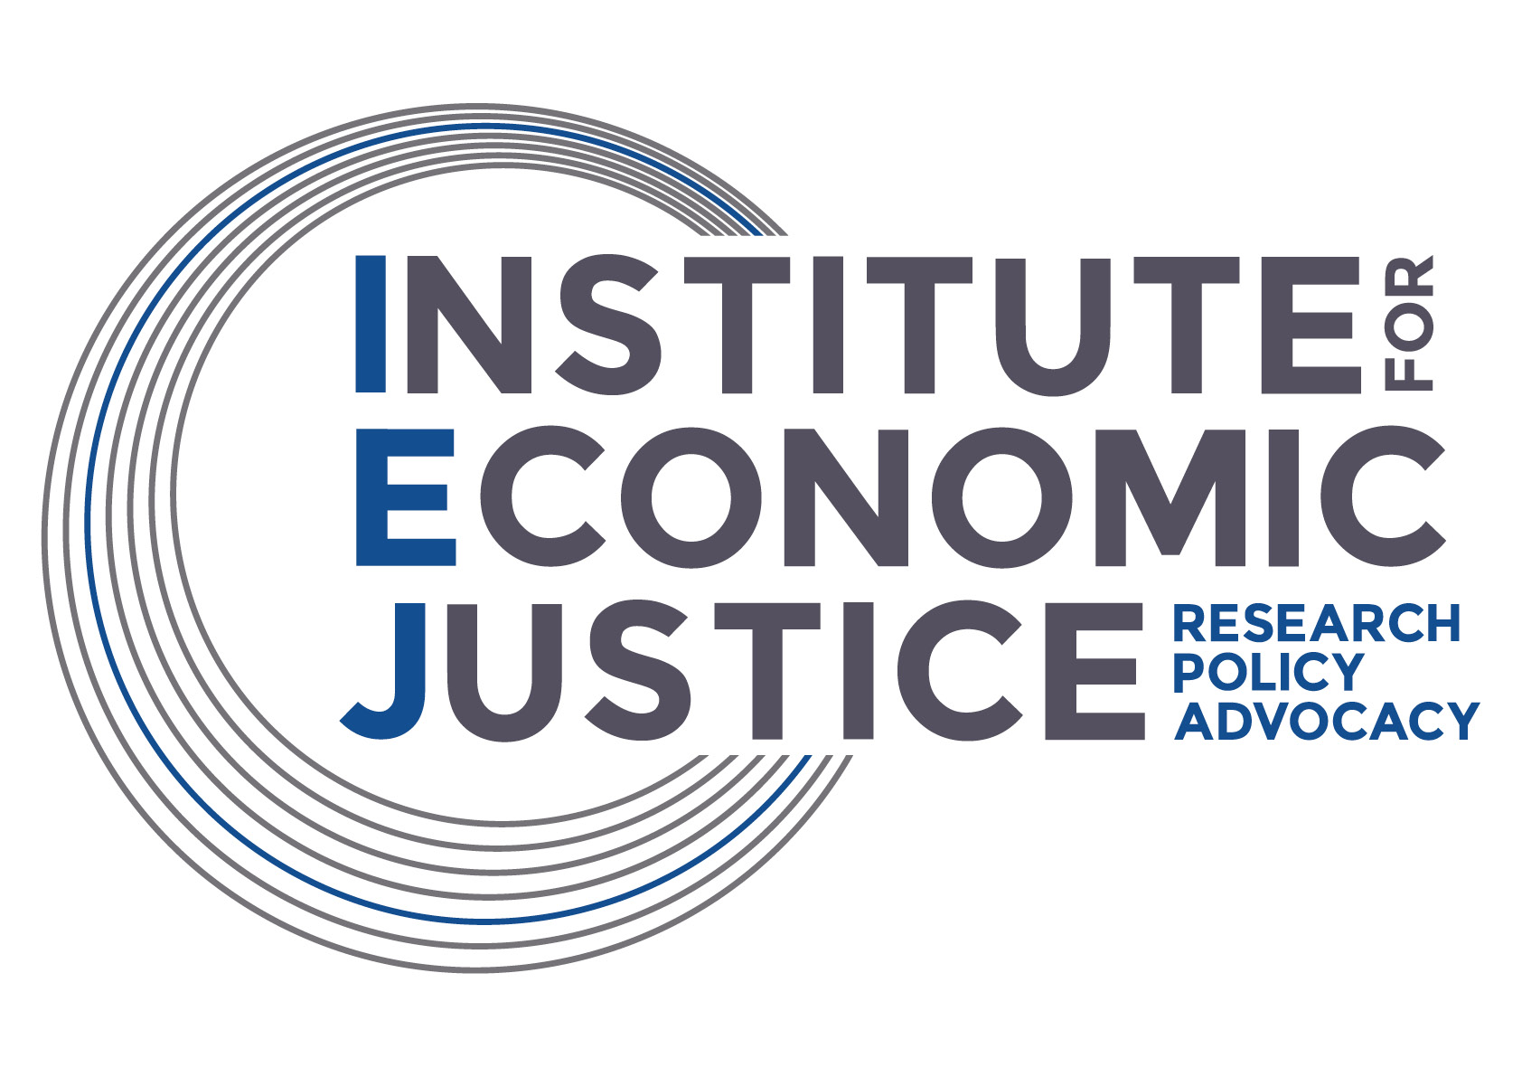





https://go.warwick.ac.uk/nefdef/climatefinance

