Slide 1
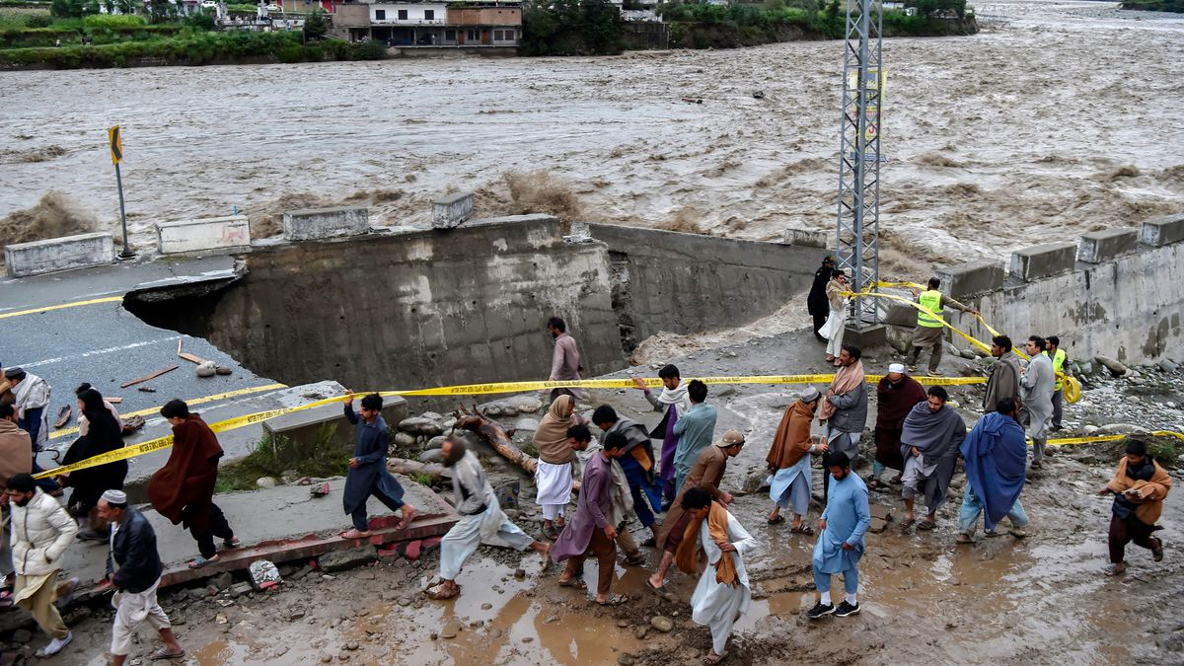
Challenges of Financing Just Transition
The Global Debt Dilemma
Workshop: Advancing Just and Equitable Energy Transitions: Legal, Policy and Financial Dimensions for Developing Countries – 2026 February Jakarta
Dr. Farwa Sial Asia
Asia Regional Director Research and policy, International Development Economics Associates –IDEAs.
Research Associate, Department of Economics, School of Oriental and African Studies-SOAS

Slide 2
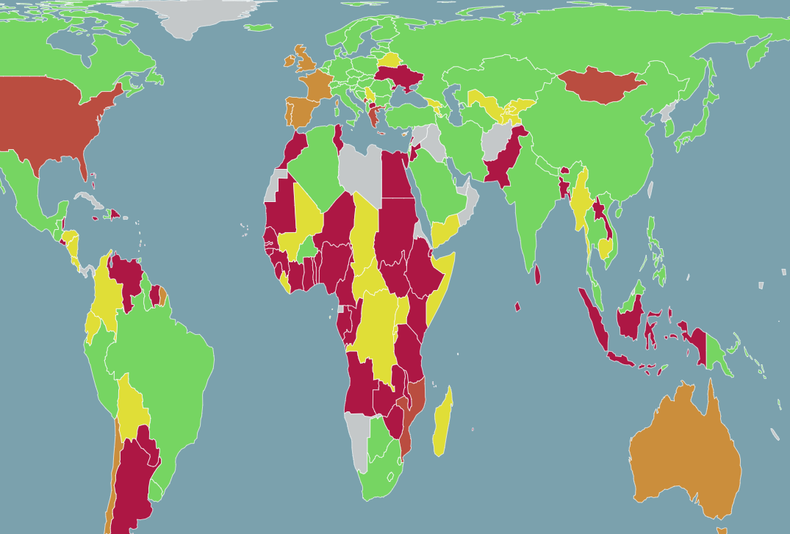
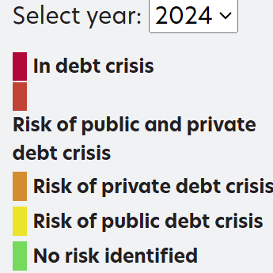
Contemporary Debt crisis
2024 Debt Crisis
Source Debt Justice UK
Recent Drivers- Covid-19-Pandemic, Russia invasion of Ukraine, War Economy following Palestinian genocide- BUT escalation in sovereign debt wouldn’t have reached this stage-but for a colonial and imperial world order:
  International Financial Architecture:
  Dollarised + other Currency hierarchy. Bretton Woods Institutions- Governance-quota +Liquidity conditions- extractive. No Global Financial Safety Net. No debt resolution mechanism. Flawed Debt Sustainability Analysis- Legacy of Heavily Indebted Poor Countries (HIPC)

Slide 3
What is different about the Current Debt Crisis?
Most debt now privately held. 2000 and 2021: Share of public and publicly guaranteed external debt of low and lower-middle income countries owed to bondholders jumped from 10 to 50 per cent.
Contemporary Debt Crisis is a Crisis of Planetary Break down.
China is now most important bilateral lender for many Global South countries; however, China’s lending needs to be analysed in relation to historical and contemporary imperial positioning of Global South countries.
Financialised Global Order with Extreme Concentration of Monopoly Capital in the Global North.
End of the Neoliberal Order. What remains of Multilateralism?

Slide 4
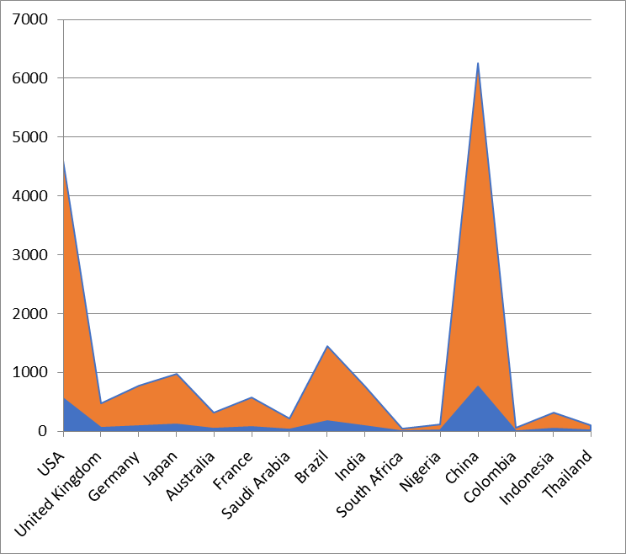
Debt and Just Transitions- Climate Finance Spending Vs. Climate Finance Needs
Exercise: Estimates of Current Public Expenditure on Climate Action by Developing and Developed Countries
Minium Vs, Desired Estimates of Climate Finance Spending by Country (Average 2021-2023- Usd bn)
Minium Vs. Desired Estimates of Climate Finance Spending by Country (Average 2021-2023- Usd bn)
 | Country | Estimate of Minimum Climate Finance Spending | Estimate of Maximum/Desired Climate Finance Spending | Estimate Climate Finance Spending (shortfall of minimum and maximum climate finance estimates)
Developed Countries | USA | 557.1 | 4041.2 | 3484.1
 | United Kingdom | 57.6 | 417.5 | 359.9
 | Germany | 94.3 | 683.9 | 589.6
 | Japan | 118.1 | 856.4 | 738.3
 | Australia | 38.6 | 280.3 | 241.7
 | France | 69.5 | 504.1 | 434.6
 | Saudi Arabia | 26.4 | 191.5 | 165.1
Developing Countries | Brazil | 175.4 | 1272.6 | 1097.2
 | India | 91.4 | 663.3 | 571.9
 | South Africa | 5.7 | 41.3 | 35.6
 | Nigeria | 14.5 | 104.9 | 90.4
 | China | 757.8 | 5496.7 | 4738.9
 | Columbia | 6.3 | 45.7 | 39.4
 | Indonesia | 38.7 | 280.9 | 242.2
 | Thailand | 11.9 | 86.4 | 74.5

Slide 5
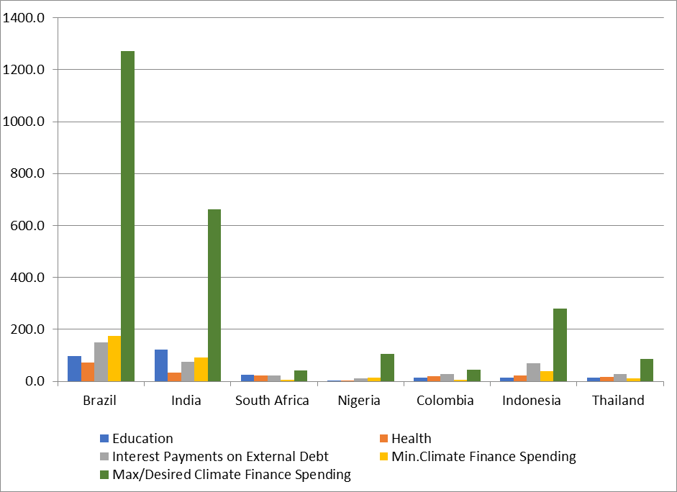
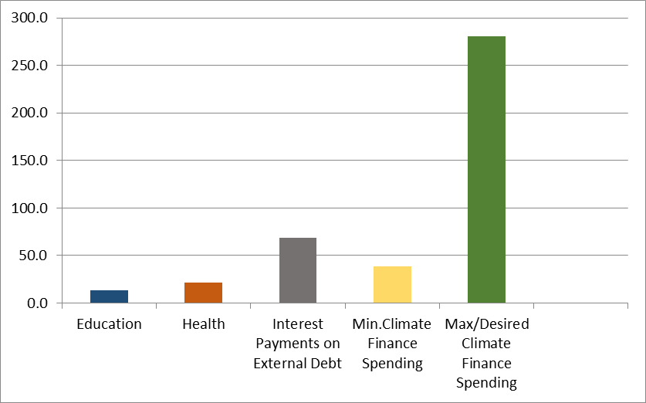
Debt and Just Transitions- Climate Finance Spending VS Health, Education and Interest Payment on Debt Spending-2
Indonesia’s Minimum and Desired Climate Finance Spending in Comparison to its Spending on Education, Health and Interest Payments on External Debt
Comparison of Climate Finance Spending Estimates (Minium and Desired) with Spending on Health, Education and Interest Payments on External Debt Servicing (Average 2021-2023 USD)

Slide 6
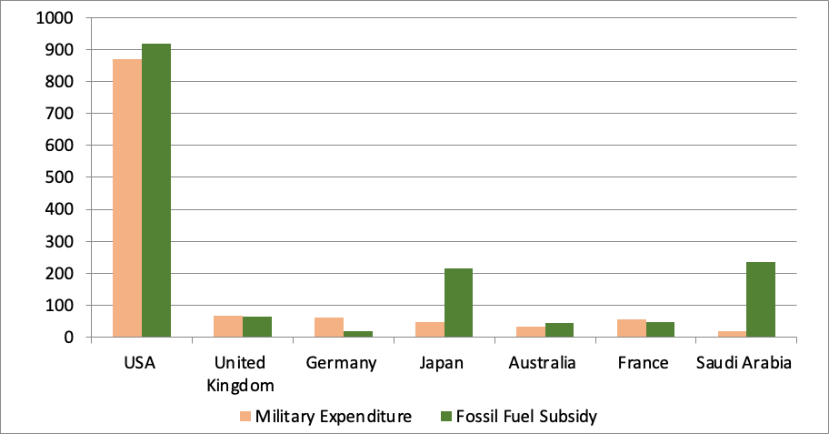
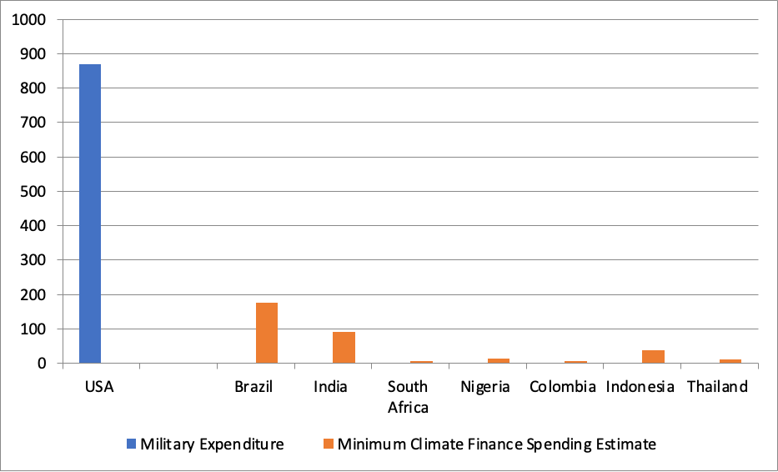
How can we get the Finance for Climate for Global South countries?
Example: Compare Rich Countries Military Expenditure + Fossil Subsidies
Comparison of USA Military Spending Expenditure with Minimum Climate Financing Spending of Select Developing Countries (3-year Average USD bn)
Military Expenditure and Fossil Fuel Subsidy of Select Countries
(3-year Average USD bn)

Slide 7
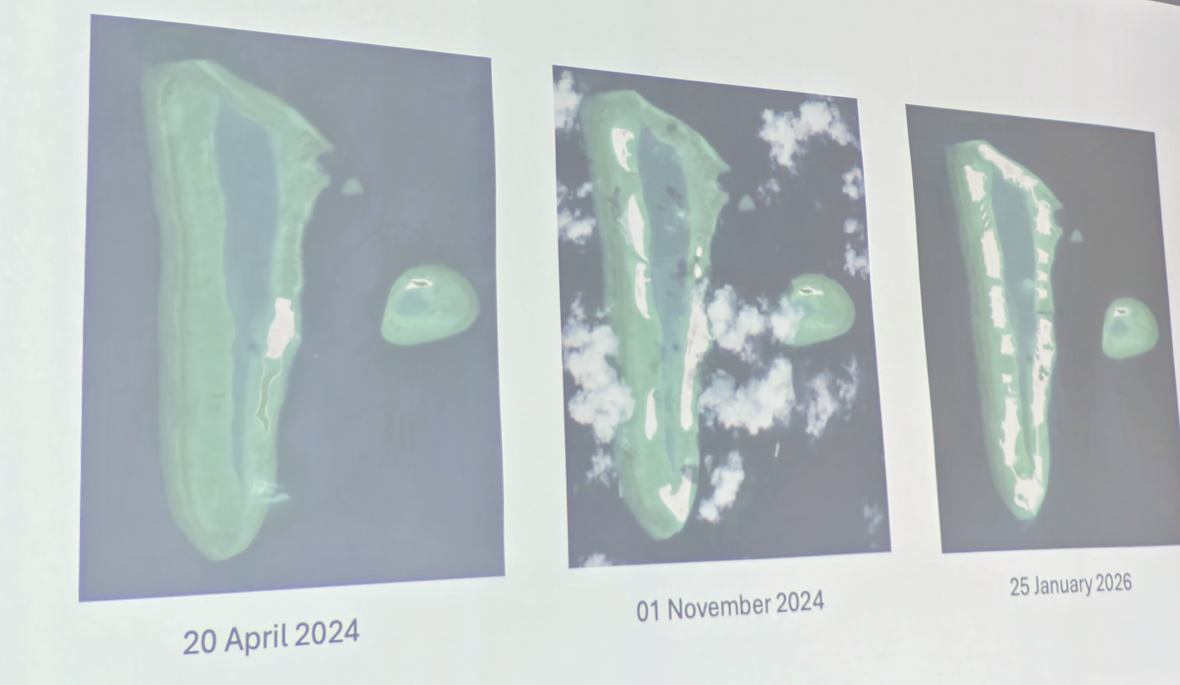
Maldives- No such thing as ‘Sustainability’ in current Capitalist Model
IDEAs Project-Debt and Compounding Vulnerabilities (Maldives, Laos PDR and Cambodia)

Slide 8
Global South Serial Creditors
Historical Imperialism vs. Bipolar World Order -Western Soft Development Vs. China’s Comprehensive Package.
Chinese aid, loans and investment should be analysed contingent to the existing Western investment as well as Global conditions of crisis post Covid-19.
IMF Serial Creditors: Pakistan: 27, Egypt 25, Argentina 23, Sri lanka 18. Where does it end?
Heightened Compliance is not equal to better outcome. Sri Lanka Post Default- South Korea 1997 Financial Crisis.
Loans cannot transform economies and the existing structural obstacles to their growth:

Slide 9
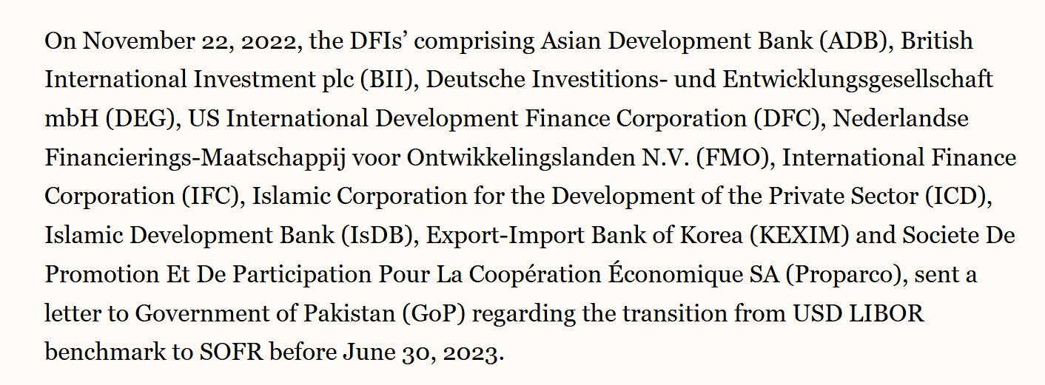
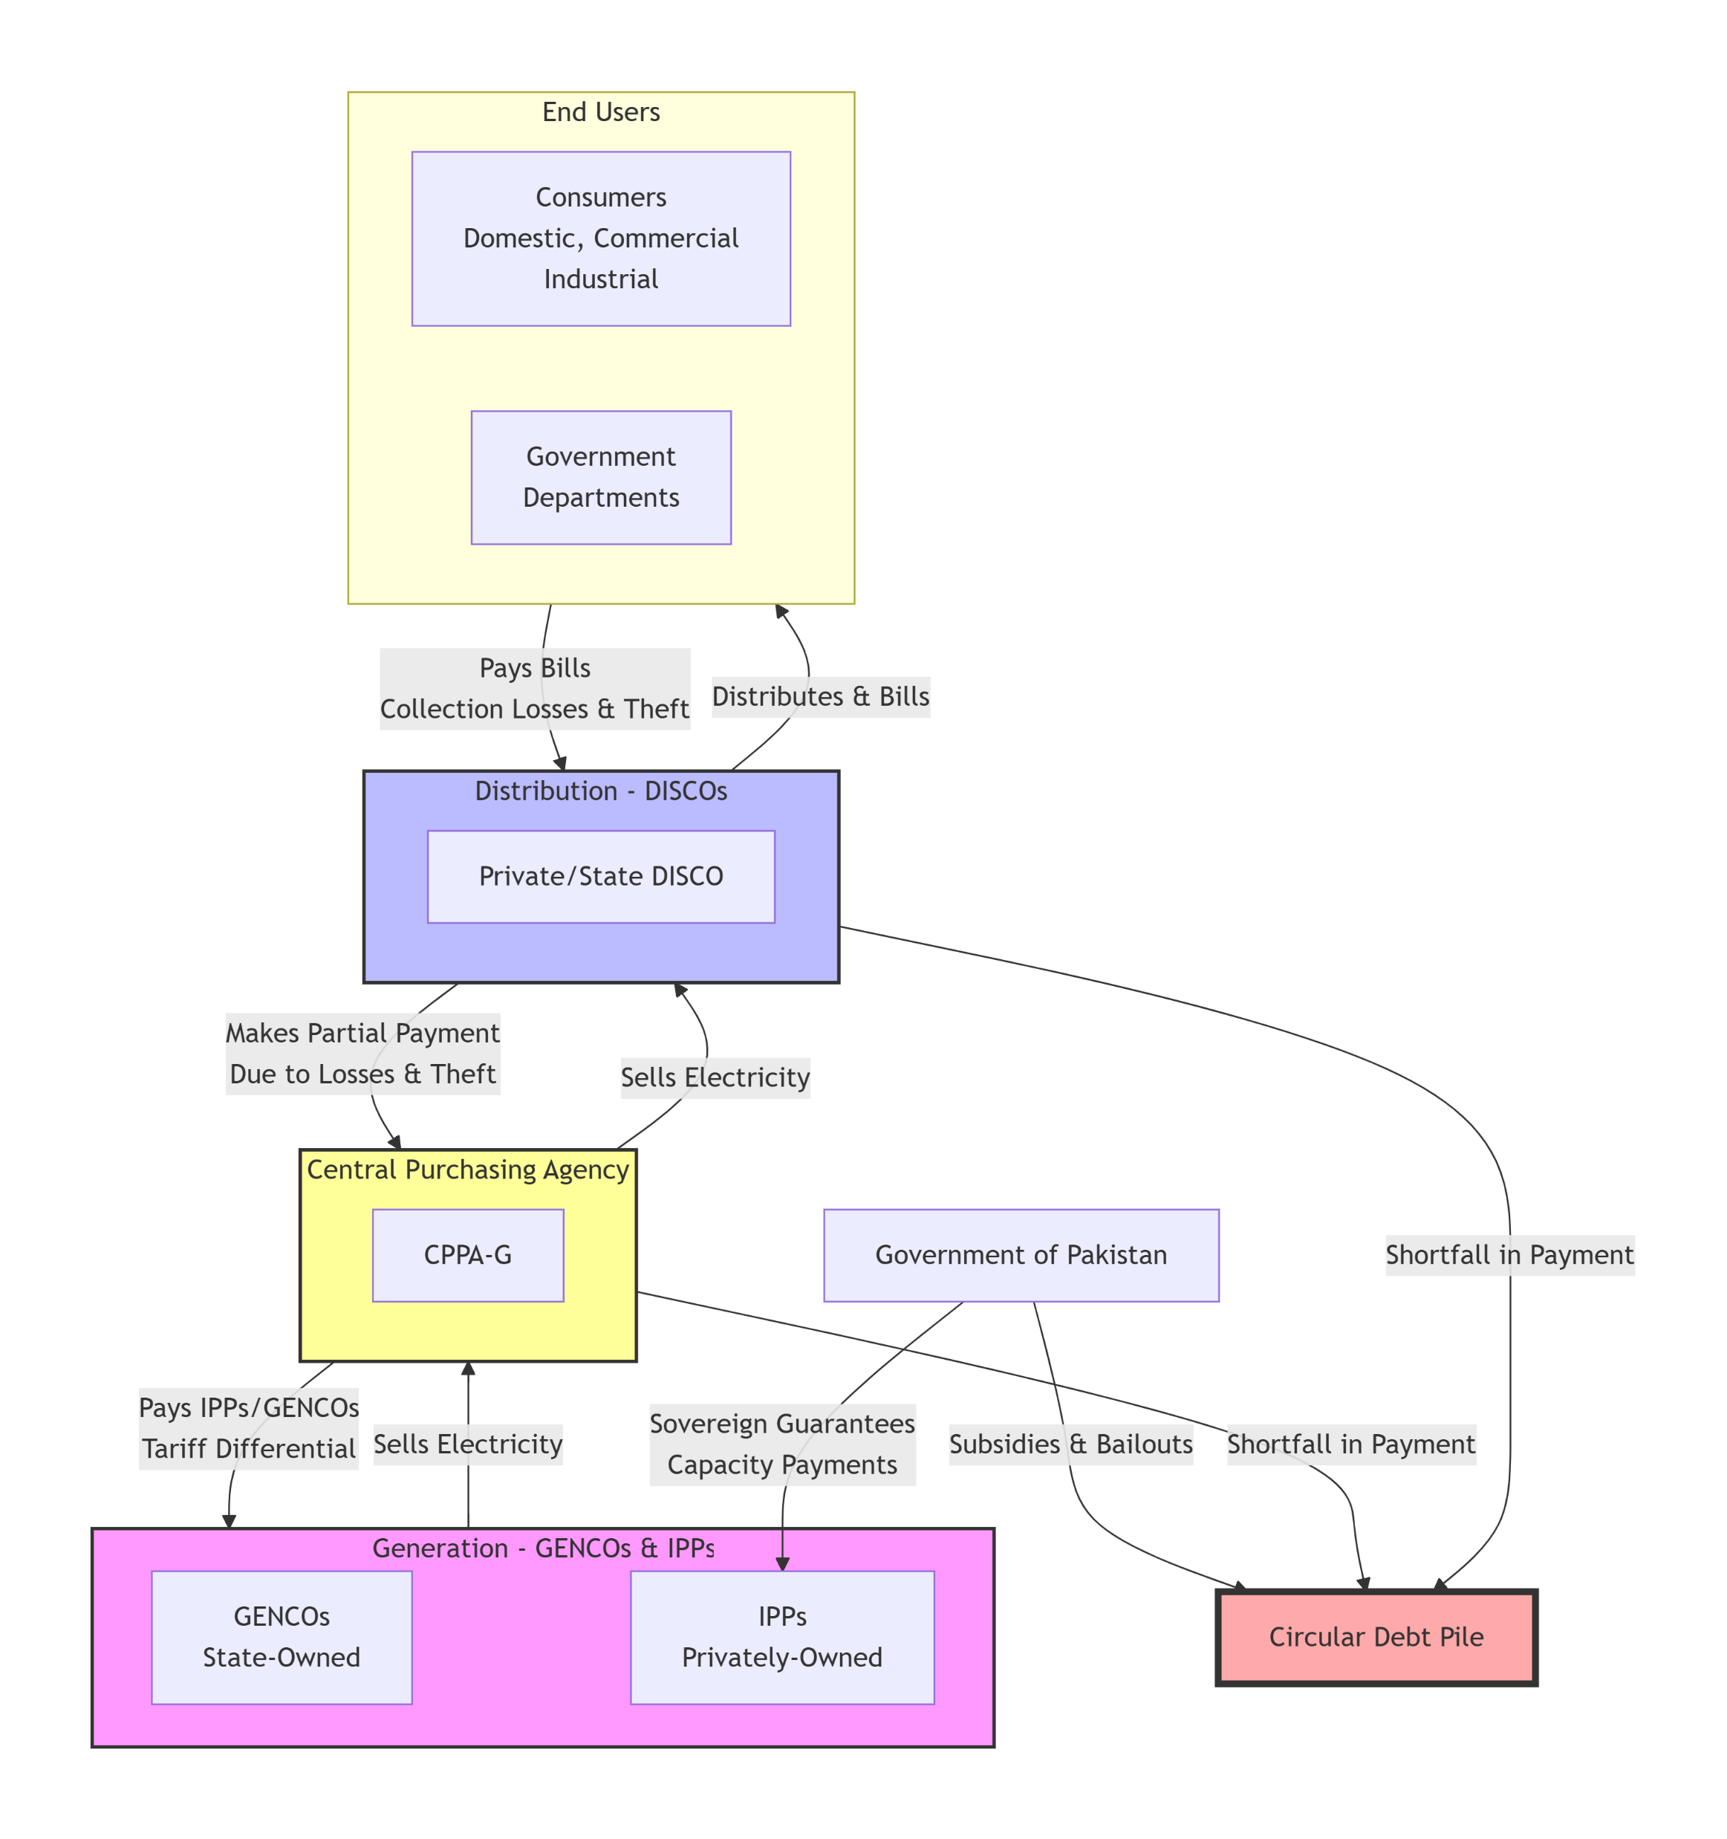
Pakistan-Privatization of Electricity-Circular Debt
Pakistan ‘Circular’ Debt Crisis – Privatised Energy Sector.
Circular debt is a cycle of interlocking payables and receivables- a complex web of financial obligations that the government, power producers, and consumers owe to each other but is ultimately passed onto consumers and state.
Case Study Pakistan:
1. Energy Debt Payments to Foreign companies using London Interbank Offered Rate (LIBOR).
2. End of LIBOR in 2023-
3. Pakistan government asks foreign companies to renegotiate contracts.
4. Insistence by Global North DFIs and Companies to move to Secured Overnight Financing Rate (SOFR)- a benchmark linked to US Monetary Policy. Friction with China but ultimate acceptance.
Result: Even higher debt!

Slide 10
Ways of getting Finance for Just Transition- Case of Debt?
Global South’s Debtor’s Club for Debt Cancellation – Political Strategy- Collective Debt repudiation.
Fundamental Overhaul of the Financial Architecture
followed by reallocating harmful expenditures, maximizing efficiency of existing resources:
Imperatives for Global Action:
  First, redirecting fossil fuel subsidies and excessive military spending toward climate action.
  Second, public finance can be strategically used to mobilise finances and boost national climate funds but without displacing grant-based obligations owed by developed economies.
  Third, enhancing the quality of public spending through robust reporting systems, and streamlined multilateral disbursements to ensures that resources deliver measurable impact.

