Slide 1

Climate Finance in
Developing Countries
Sources of Finance & The Financing Gap
CPI Global Landscape of Climate Finance 2025 & EMDE Spotlight | Data through 2023

Slide 2
Climate Finance in Developing Countries: $1.07 Trillion (2023)
PUBLIC vs PRIVATE
DOMESTIC vs INTERNATIONAL
Private
$587bn (55%)
Domestic
$857bn (80%)
Public
$478bn (45%)
International
$209bn (20%)
The China Effect
China accounts for $685 billion — 64% of all EMDE climate finance
and 99% of its flows are domestic. Stripping China out, the remaining EMDEs received just $382 billion, and the composition of that finance is fundamentally different.
Source: CPI Global Landscape of Climate Finance 2025 & EMDE Spotlight (Nov 2025)

Slide 3
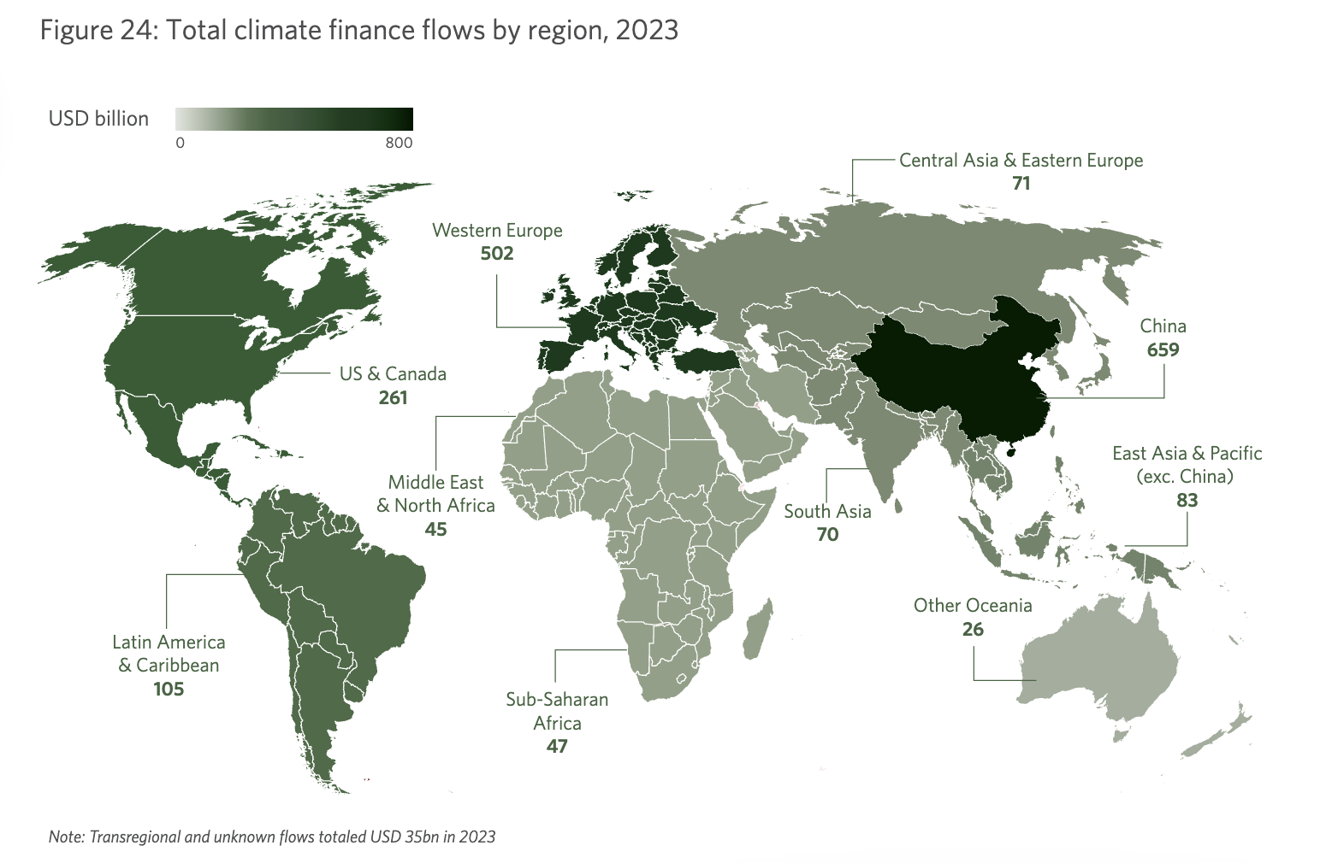
c.80% of global climate finance was
mobilized in three regions—China,
Western Europe, and the US and Canada.
Slight discrepancy in data from source

Slide 4
Three Worlds of Climate Finance
The source and character of finance varies dramatically by country group
CHINA
EMERGING MARKETS
LDCs
$685bn
$337bn
$45bn
64% of all EMDE flows
excl. China & LDCs
1.4% of global GDP, 14% of pop.
Private
57%
Private
56%
Private
22%
Public
43%
Public
44%
Public
78%
Domestic
99%
Domestic
51%
Domestic
16%
International
1%
International
49%
International
84%
Self-financing model. Clean energy = 10% of GDP.
82% of public finance is international. MDBs provide 44% of public.
Heavy structural dependency. Grants >50% of adaptation finance.
Source: CPI Global Landscape of Climate Finance 2025 & EMDE Spotlight (Nov 2025)
Notes:
Note for EMs $285bn for mitigation finance

Slide 5
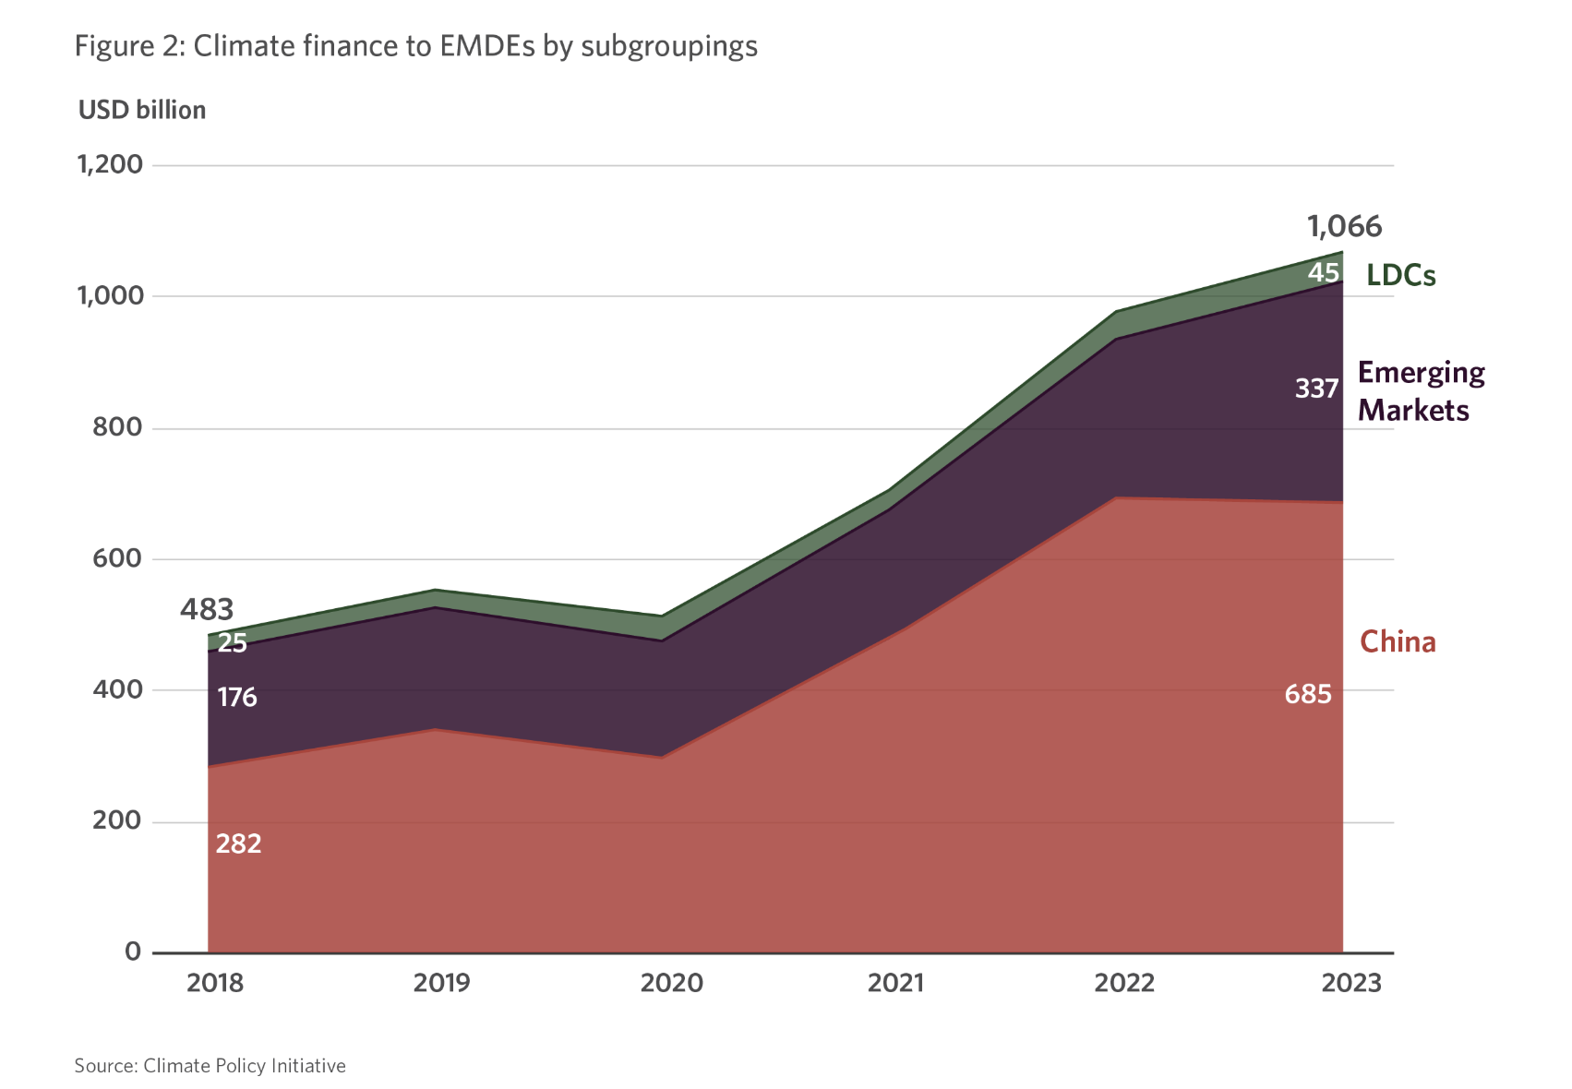

Slide 6
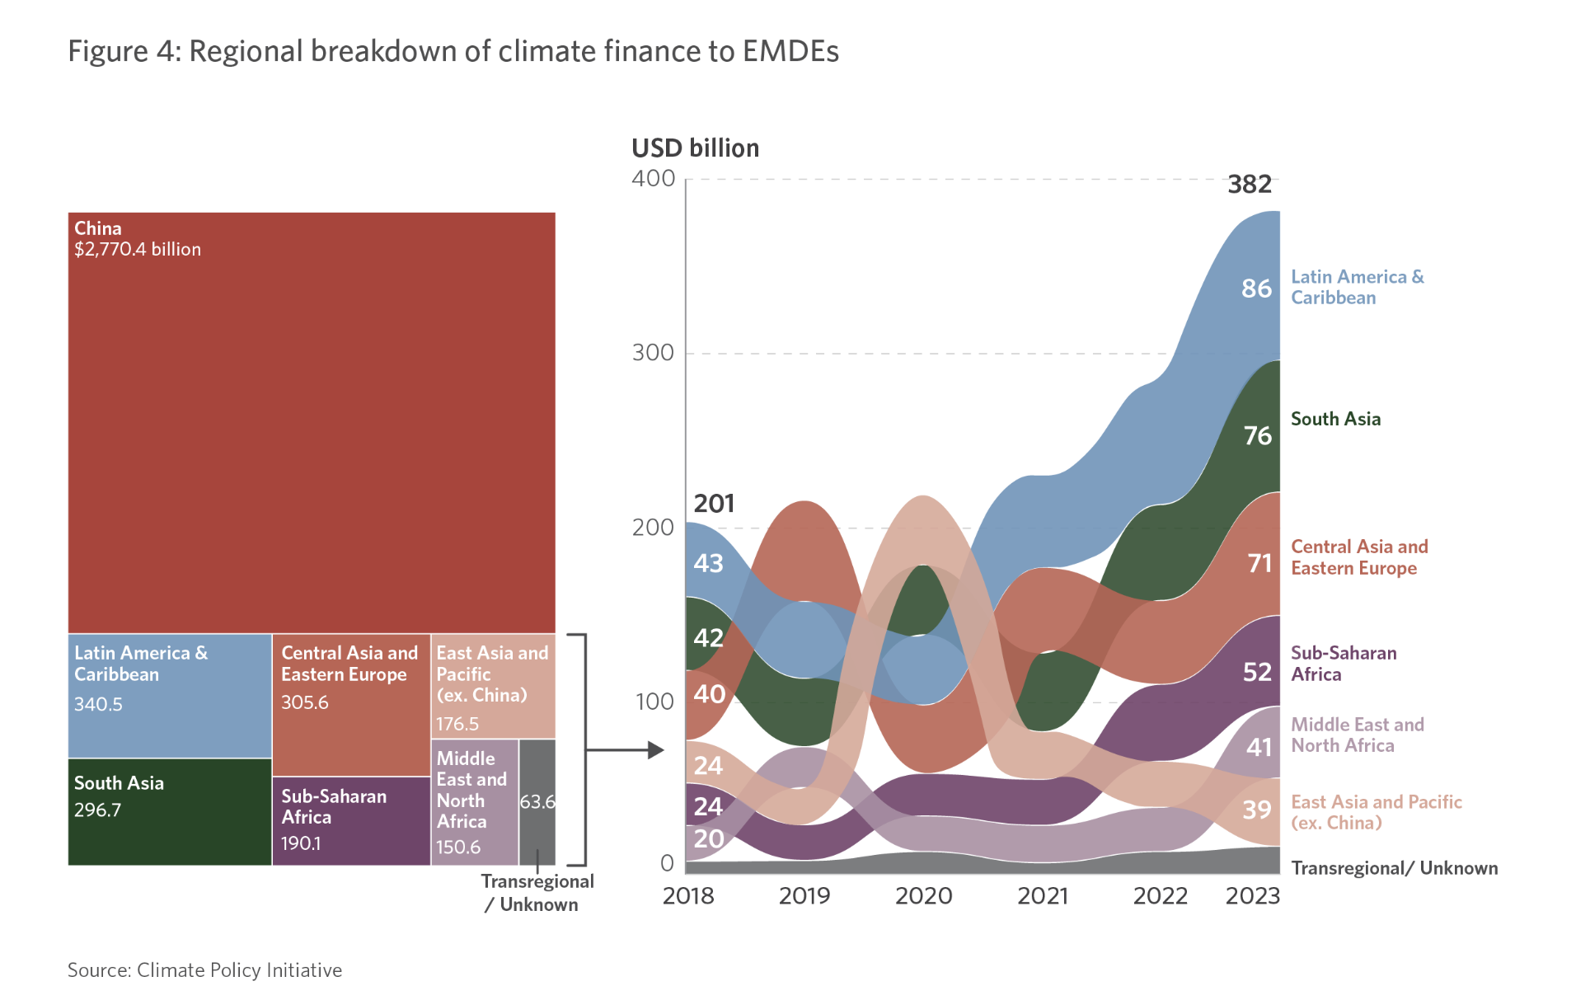
Notes:
East Asia and the Pacific accounted for almost 70% of all EMDE climate finance from 2018 to 2023.China drove the region’s flows, accounting for 94%. Excluding China, the region’s EMDEs posted a 10%CAGR, rising from USD 24 billion in 2018 to USD 39 billion in 2023. As the region with the lowest EMDE flows, excluding China, in 2023 (excluding Japan and South Korea since this is for EMDEs)

Slide 7
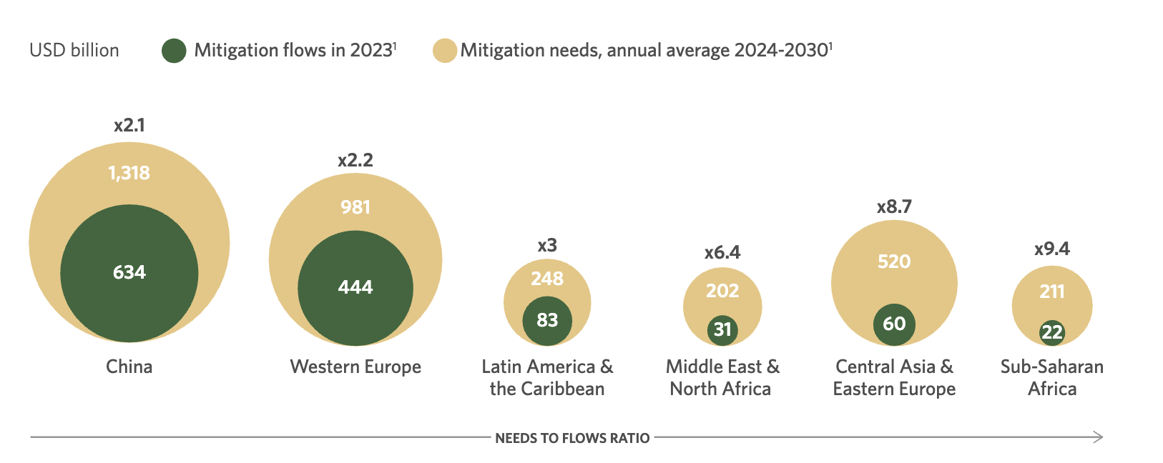
Notes:
But remains far below the estimated almost USD 4 trillion in mitigation investment needed in developing countries each year until 2030, with the greatest gaps for countries most in need. And this gap is most pronounced for the poorest countries most in need of climate finance.

Slide 8
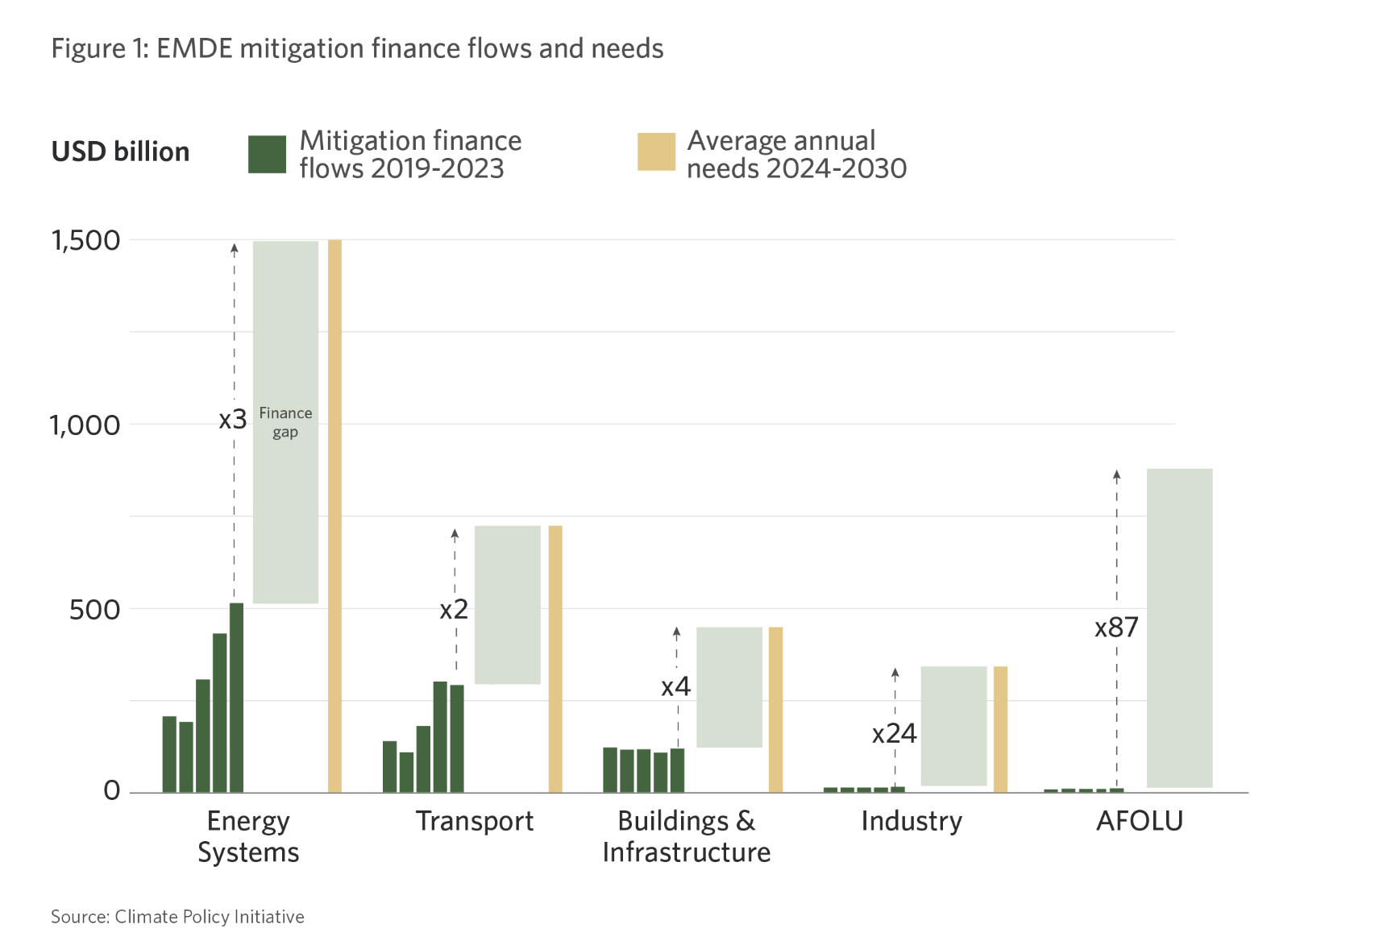
“
Notes:
Mitigation finance primarily flows where technology costs are falling rapidly, market structures are strong, and commercialization is being proven” – in short where it is most profitable. And climate finance flows for adapation is even more lacking, as shown in the next chart

Slide 9
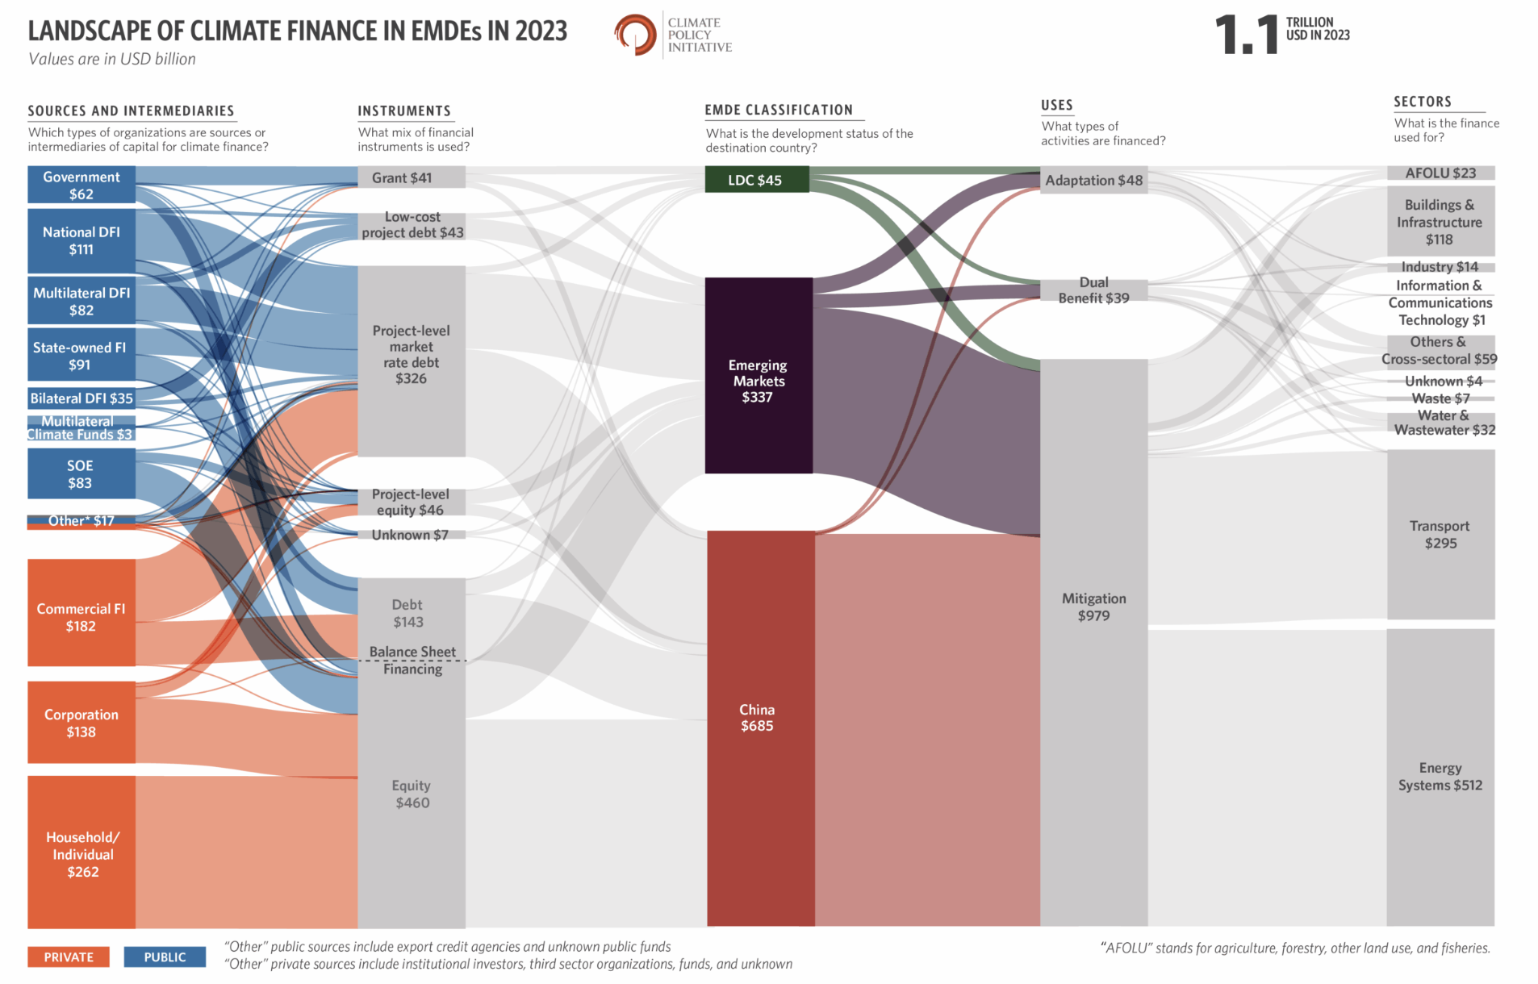

Slide 10
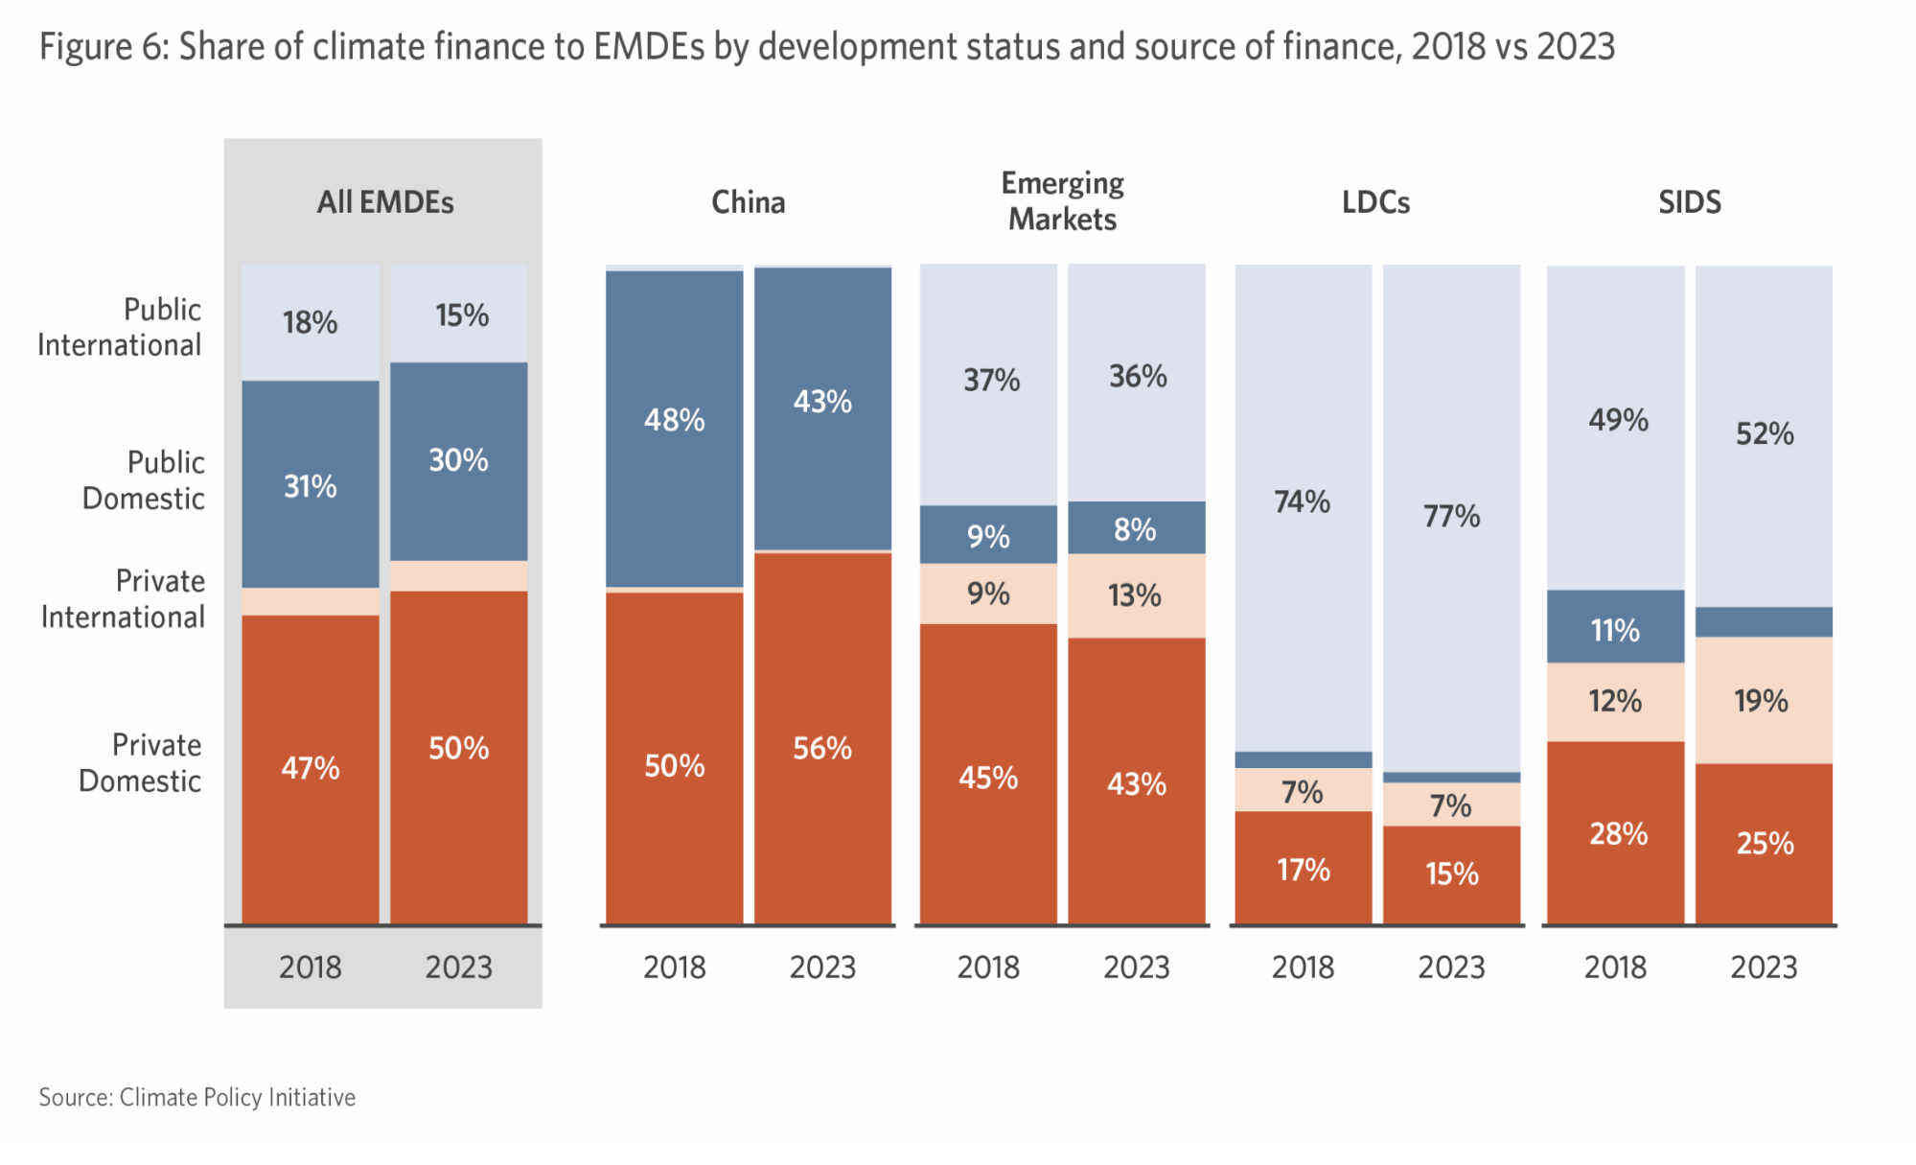
2%2%
2%
Notes:
International finance more important for EMs and in particular LDCs.
For better or for worse, limitations in raising external capital; fiscal constraints; reliant on public international sources for climate finance, which is limited and comes with conditionalities through the MDBs.

Slide 11
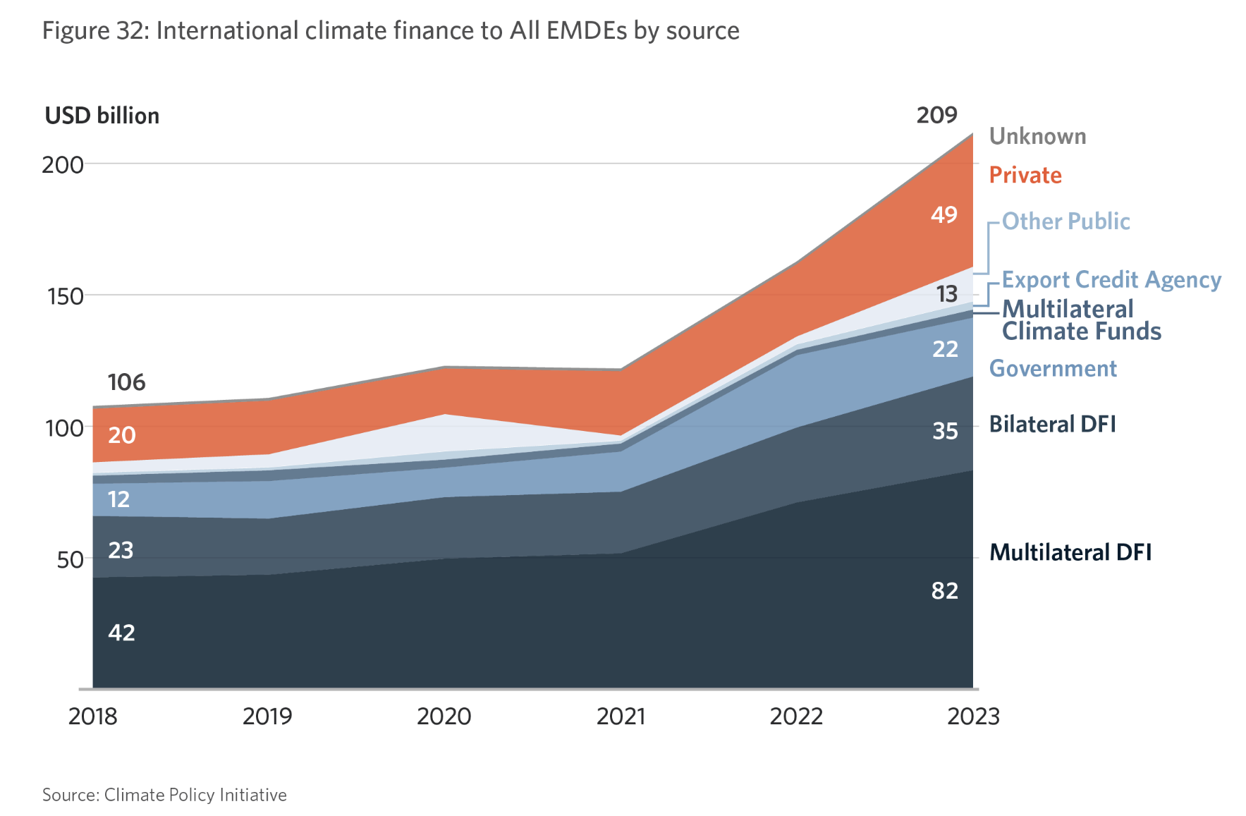
Most international private finance to EMDEs originated from advanced economies. Europe accounted for 59% of these flows to All EMDEs in 2023 (USD 29 billion). The US and Canada contributed 11% (USD 5.2 billion), and advanced economies in East Asia and the Pacific 9.8% (USD 4.8billion).
Over half of international private finance to All EMDEs went to energy systems (USD 29 billion)
Public sources provided USD 159 billion in 2023,. This critical financing may slow or even decline. ODA cuts announced by major donors amid shifting political priorities are placing increased strain on international public finance. Non-debt financing are urgently needed for many EMDEs, and LDCs in particular.
Notes:
International, external capital for developing countries faces the familiar challenges. High cost of external debt, conditionalities from the MDBs, capital flowing to the most bankable sectors, multilateral climate funds set up under the UN miniscule, the increasing politicatisation of bilateral loans, cut backs on ODA

Slide 12
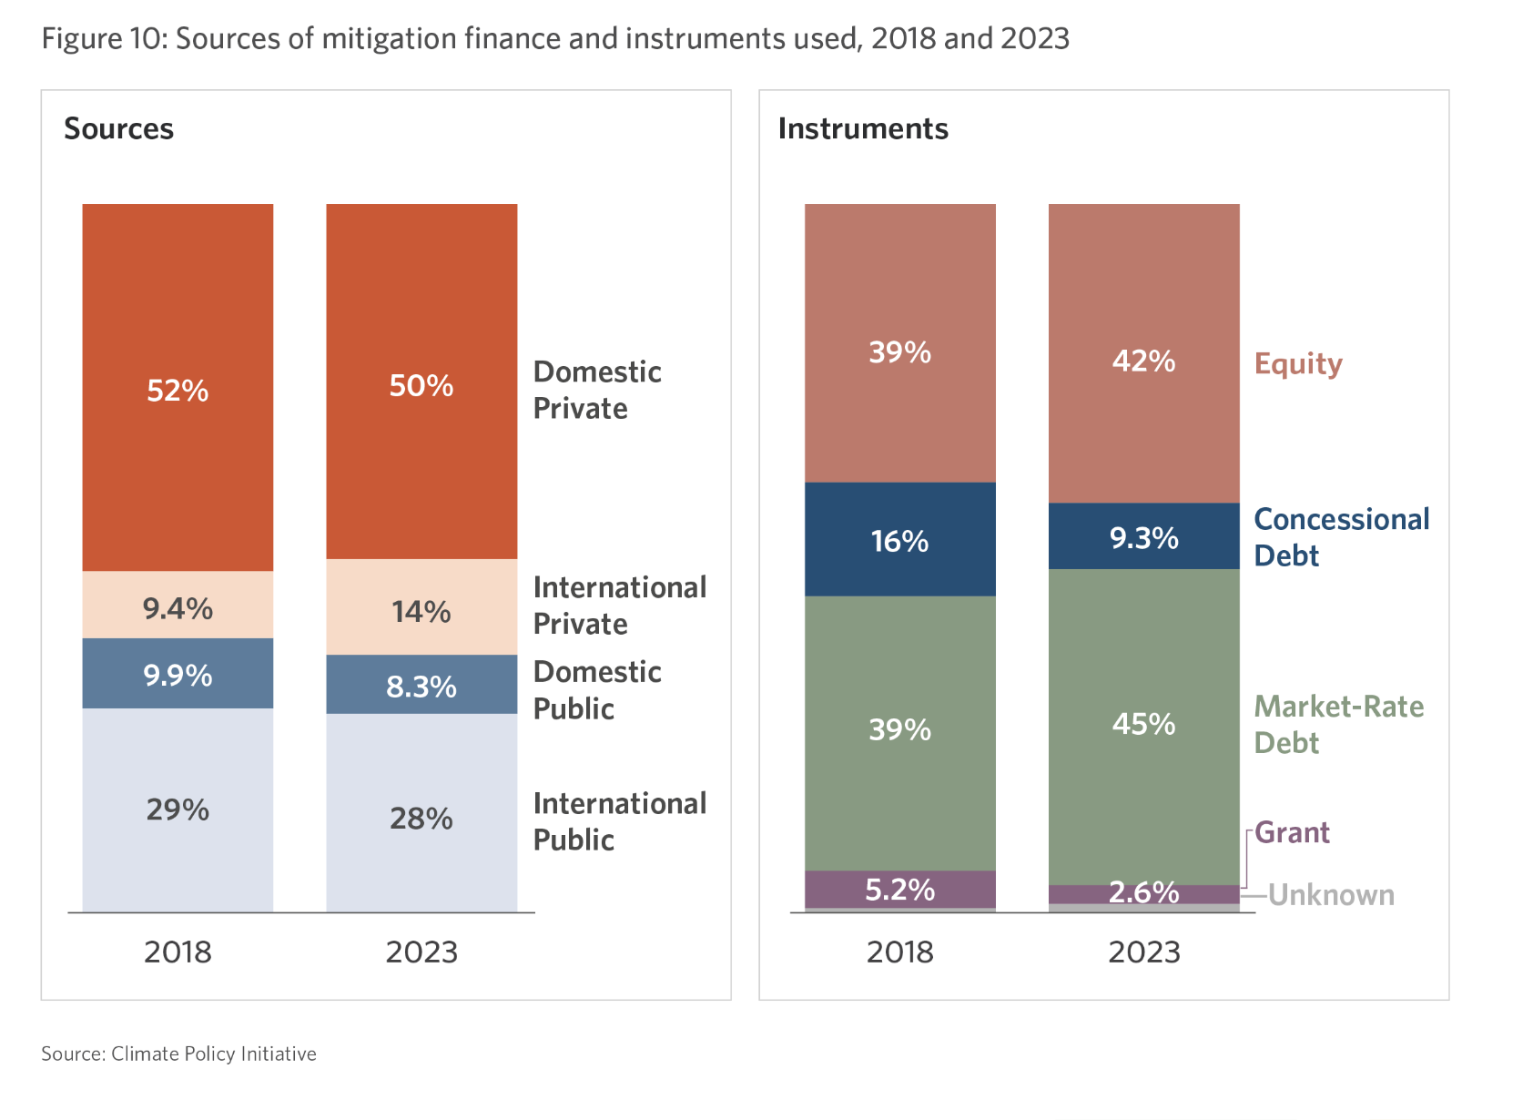
Across All EMDEs, commercial, market rate mitigation finance dominates. In
EMs only c.30% of flows in 2023 were deployed through concessional loans and grants. Even for LDCs, development finance was only half in LDCs
Notes:
Mostly market rate debt. See next slide for LDCs

Slide 13
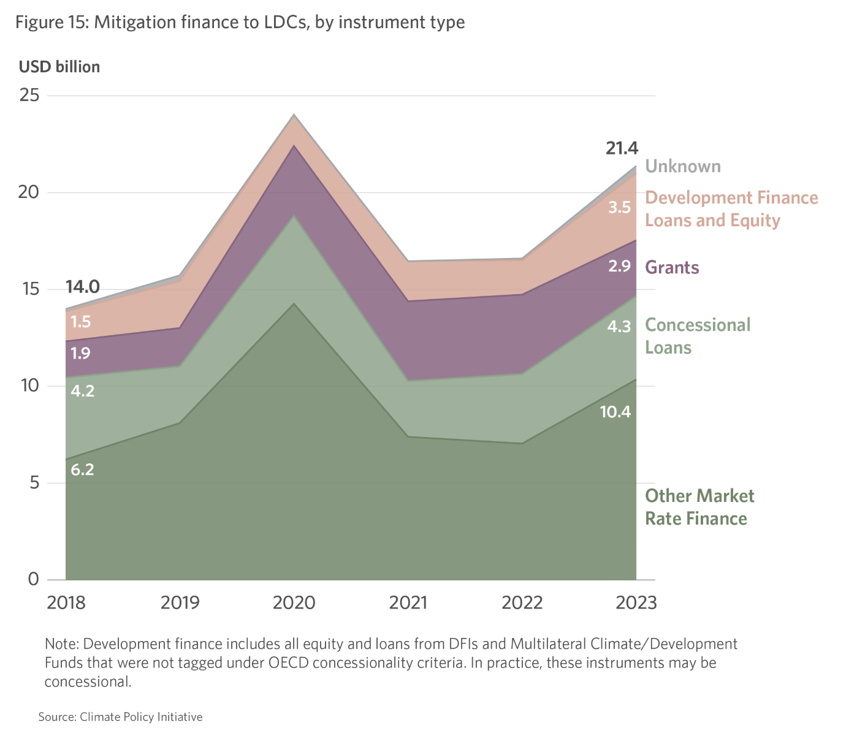
Overall mitigation finance flows also concentrated in a small number of LDCs, Angola, Tanzania, Bangladesh
Across LDCs, international public institutions remained the primary source of mitigation
finance, providing marginally more than half of total flows in 2023, primarily through large-scale projects.
Despite dire needs and lack of finances, 48% of mitigation finance to LDCs is provided at market rate. This will be even more onerous as concessional finance and grants continue to dwindle.
Notes:
The market’s advice (Amundi, IFC, etc): More needs to be done to leverage public money to de-risk investments and unlock more private finance

Slide 14
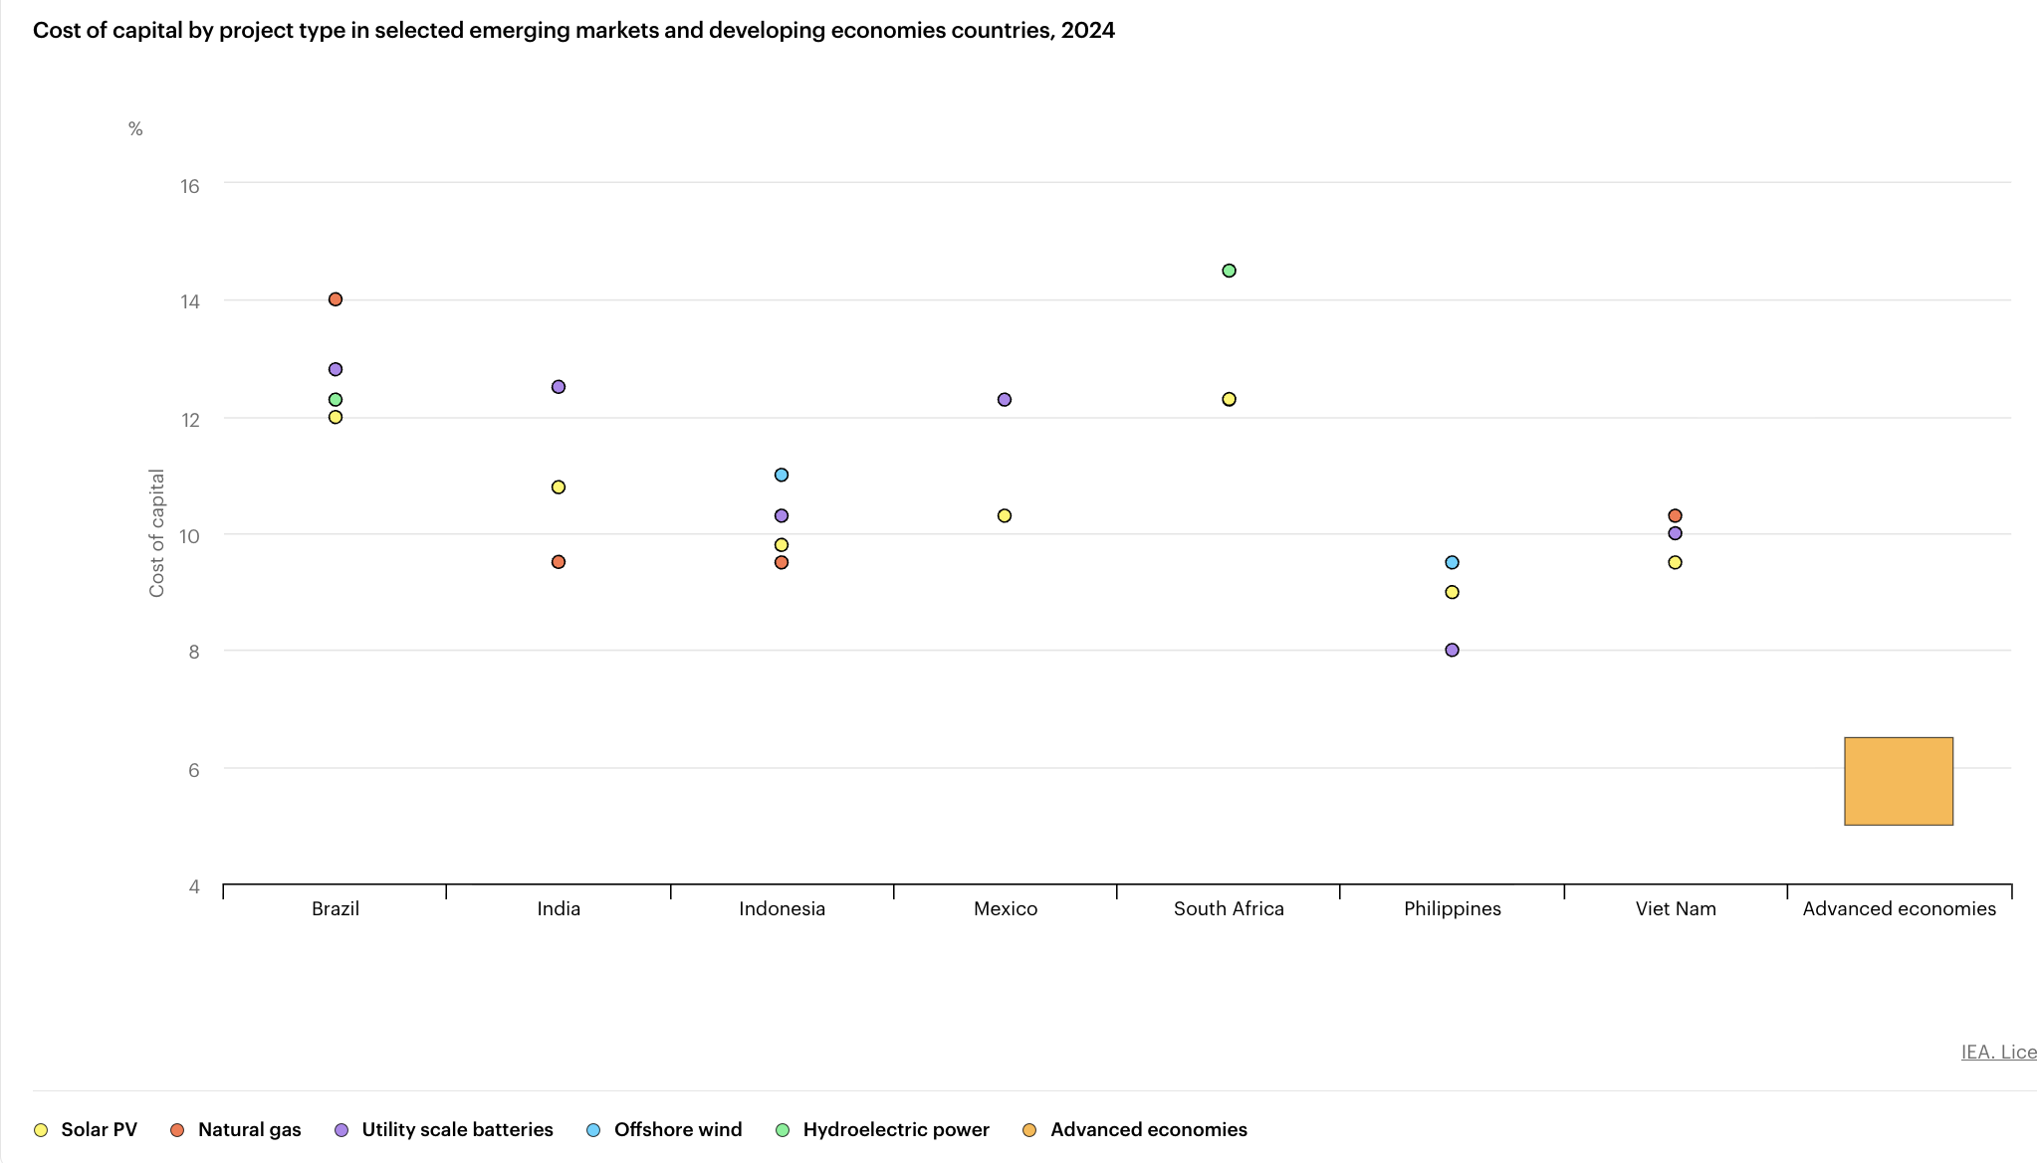
Notes:
The IEA’s Cost of Capital Observatory database, which tracks clean energy financing costs
across major developing countries, shows that the cost of capital is at least twice as high in
developing countries as it is in advanced economies. Even more expensive than external sovereign bonds. Local bond issuances in LC, smaller ticket size by private companies may be even more expensive. Since the bulk of private climate finance is domestic through domestic banks, companies and HH, especially outside China where HH is not the main source. Unsurprisingly that domestic private is major source as Over 90% of mitigation finance in EMDEs was allocated to the energy, transport, and B&I sectors, which all while have clear emission-reduction potential and more importantly quantifiable revenue streams.

Slide 15
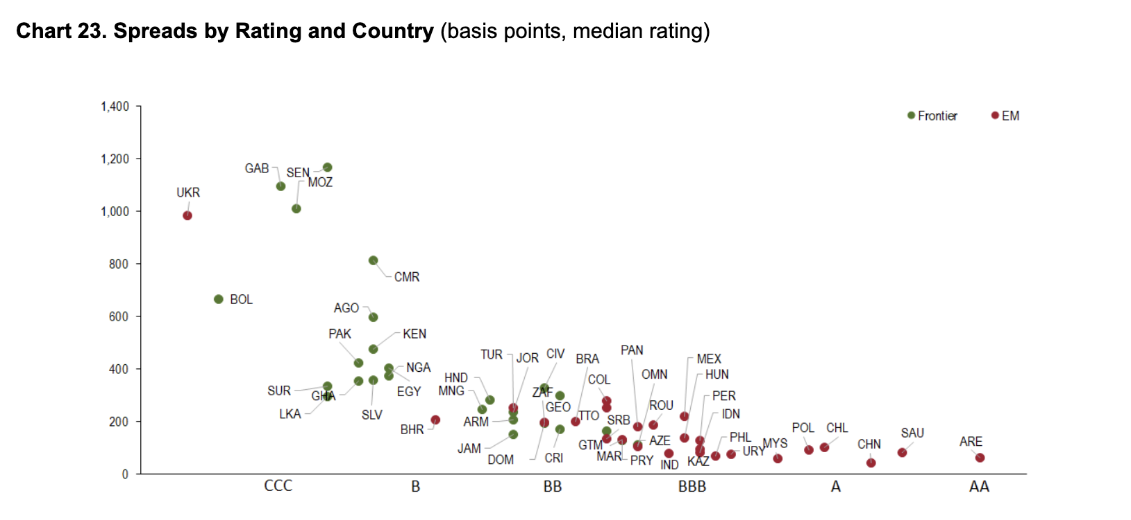
Nov- Dec 2025
Notes:
I would have thought that the spread for Ukraine would be a lot lower despite what the “objective” assessment may be by the CRAs. Politically, Ukraine will be supported more than say Bolivia, but the market doesn’t seem to think so for quite a while now.

Slide 16
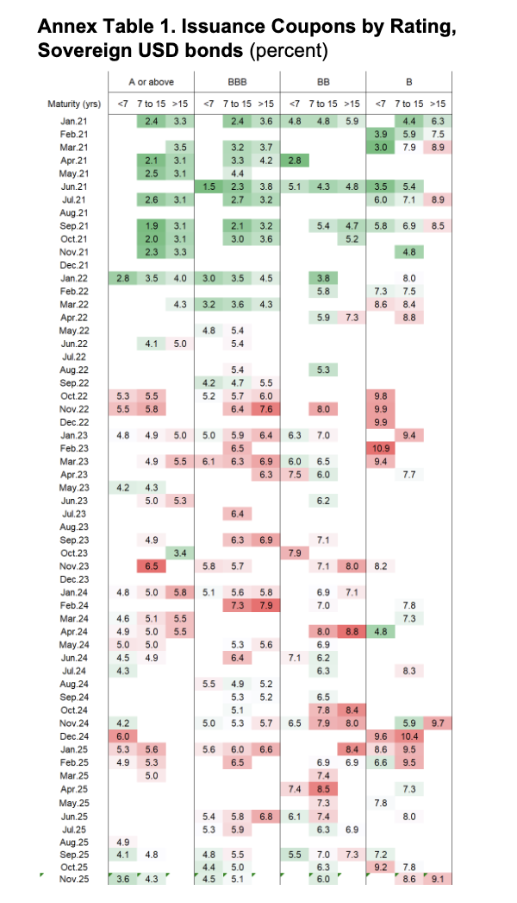
Incomplete pass-through of easing (2024-25)
The Fed began cutting in September 2024. By late 2025, A-rated coupons have partially normalised (3.6-5.1% range versus 4.5-6.0% peaks). B-rated coupons remain elevated (7.2-9.2%), suggesting credit spreads have not compressed proportionately. The easing cycle's benefits appear to be accruing unevenly.
Asymmetric transmission of monetary tightening
The 2022-2023 tightening cycle hit lower-rated sovereigns disproportionately. A-rated coupons rose roughly 200-250 basis points from 2021 to peak 2023 levels. B-rated coupons rose 300-400+ basis points over the same period. This spread widening suggests credit risk repricing compounded the base rate effect for weaker credits.
Spike in US interest rates
Market access gaps cluster in B-rated, long-tenor cells
The empty cells aren't random—B-rated sovereigns essentially lost access to >15 year money for extended periods. They simply could not issue at viable terms. When they could issue, it was predominantly short-dated. This maturity compression is arguably more consequential than the rate differential.
Term premium behaviour differs by rating
For higher-rated bonds, the >15 year premium over <7 year appears relatively stable. For B-rated, the term structure shows more volatility and occasional inversion-like patterns.
Data Source: IMF GLOBAL MARKETS ANALYSIS Emerging and Frontiers Markets Issuance- December 15, 2025.

Slide 17
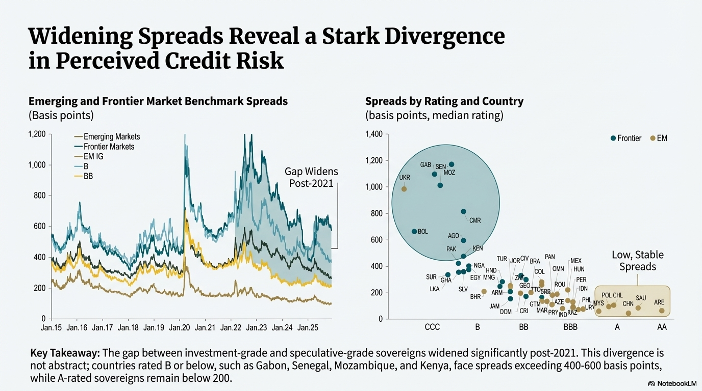
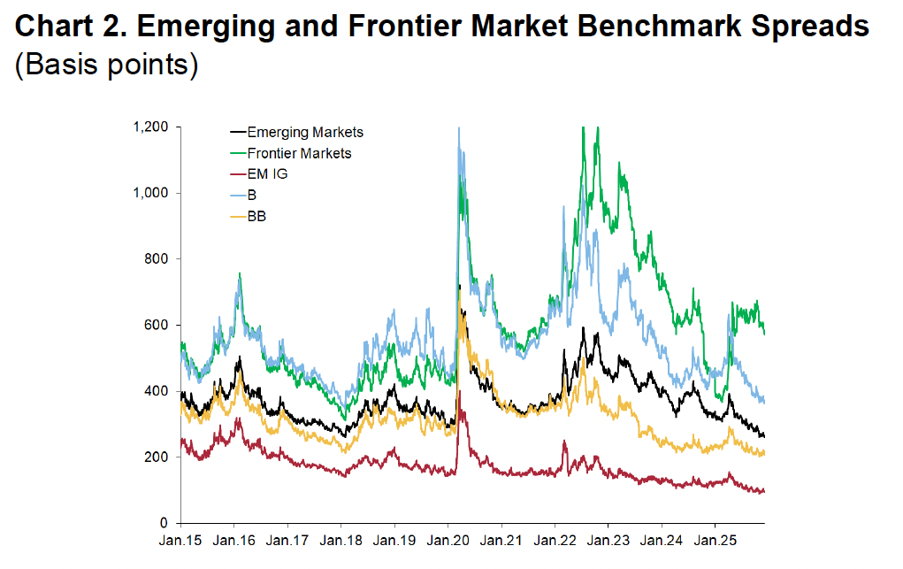
Data Source: IMF GLOBAL MARKETS ANALYSIS Emerging and Frontiers Markets Issuance- December 15, 2025.

Slide 18
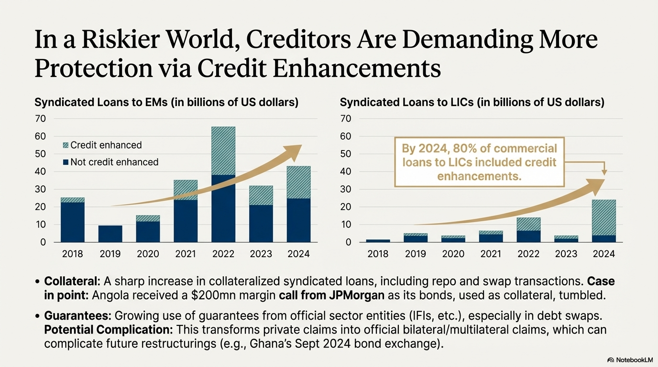

Slide 19
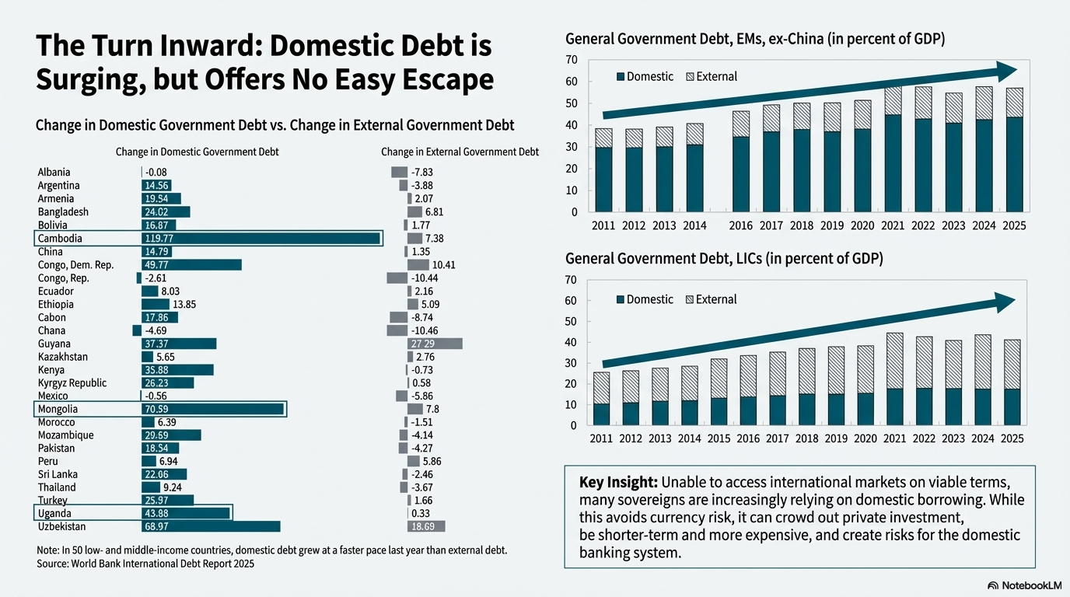

Slide 20
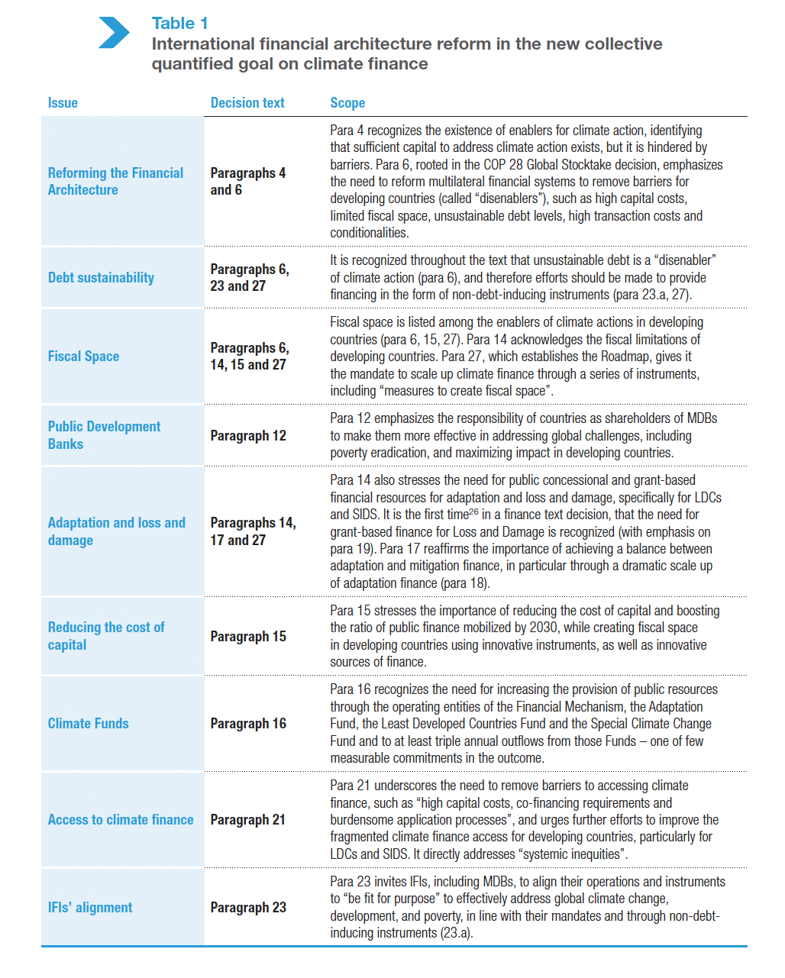
The decision text speaks of the importance of reforming the multilateral financial architecture and removing the structural barriers and “disenablers”
facing developing countries in financing climate action, “including
high costs of capital, limited fiscal space, unsustainable debt levels,
high transaction costs and conditionalities for accessing climate
finance.”
Notes:
Climate finance is shaped by the same dynamics that have long constrained development: rising debt burdens, limited policy space, and external conditionalities
For this reason, reaching the $1.3 trillion goal requires also addressing the “disenablers” in the IFA: climate finance is not separate from the broader international
financial system, but is embedded in it. [ NCQG) on climate finance for developing countries, setting a minimum floor of $300 billion per year by 2035 with developed countries taking the lead, and an aspirational goal of $1.3 trillion annually from all sources. What’s needed according to the NCQG decision based on developing countries’ NDCs is 5-7 trillion not sure how this squares with the 1.3 trillion goal.

Slide 21
The pain and challenges of sovereign debt and restructuring
Dwindling grants
Partial to private sector & bias against govt
Blended finance challenges
Miniscule

Slide 22
Debt Contracts 2.0 – Greater Creditor Protection
State Contingent Debt Instruments (SCDI) – Becoming standard. Performance based one off triggers to deal with uncertainty
  Macro
  Governance, see 7 below
  Commodity performance
Loss Reinstatement Clauses (LRC) – a type of SCDI - Making a comeback - restoring the nominal value of the bondholders’ claim to the pre-restructuring state, if there’s subsequent restructuring.
Most Favoured Creditor (MFC) – increasingly used. Sovereign borrower does not pay better recoveries to subsequent creditors, unless prior creditors are treated the same.
Debt Transparency & Information clauses – Creditors increasingly pushing for this. Needed to operationalize SCDI, LRC and MFC provisions.
Collateral. Syndicated loans with credit enhancements increased sharply for EMs as Eurobond issuances declined., 80 percent of commercial loans contracted by LICs had some form of credit enhancement. Countries entering into repurchase agreement (repo) or swap transactions, which are often collateralized with their own bonds, see Angola. Financial Times “ Angola hit with $200mn JPMorgan margin call as African bonds tumble” April 11, 2025.
Guarantees: bonds and loans from private creditors to sovereigns have benefited from guarantees provided by official sector entities, including IFls, especially in the context of "debt swap" operations. Private claim (arising from the bond or loan) transforms into a bilateral or multilateral claim by the official guarantor against the sovereign. This may complicate restructuring. See Ghana’s Sept 2024 bond exchange.
+

Slide 23
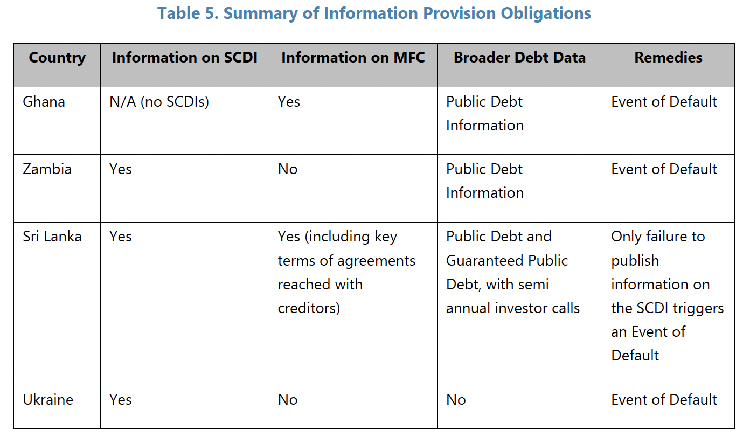
Recently restructured bond contracts contain these provisions

Slide 24
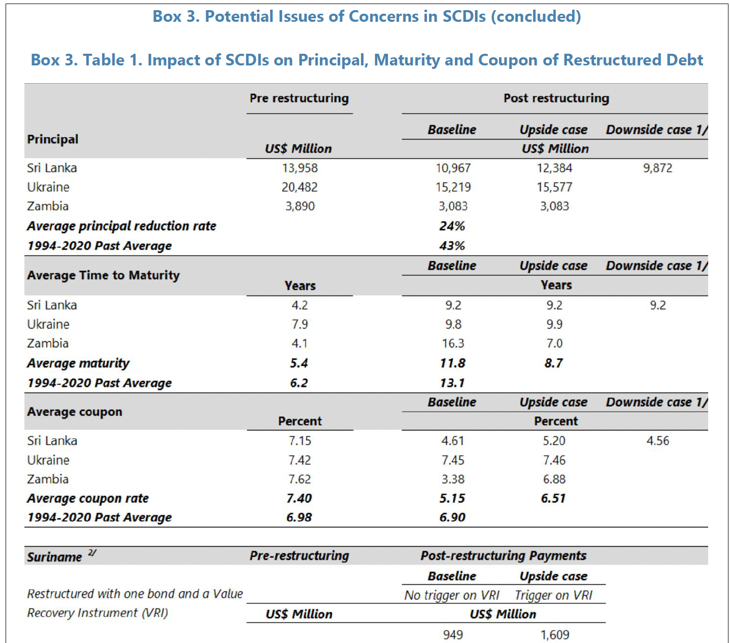
State-Contingent and Loss Reinstatement Clauses Will Reshape Debt Management & Restructurings
New contractual clauses are having a material impact. SCDIs are being used to substantially extend maturities and adjust payments based on economic performance, while LRCs provide a form of "upside protection" for creditors participating in debt relief.

Slide 25
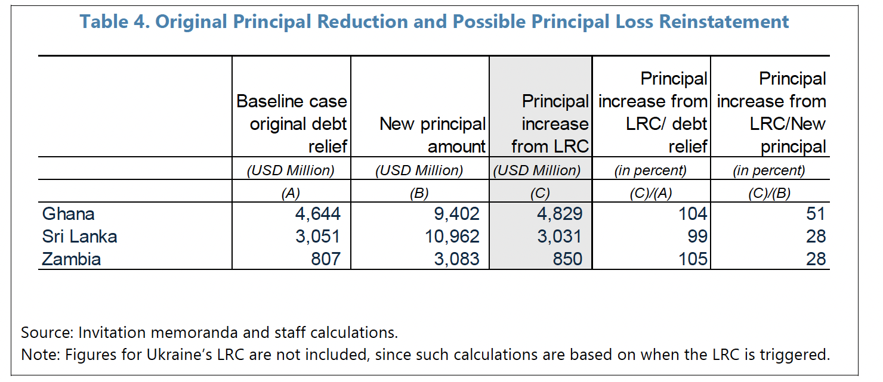
State-Contingent and Loss Reinstatement Clauses Will Reshape Debt Management & Restructurings

Slide 26
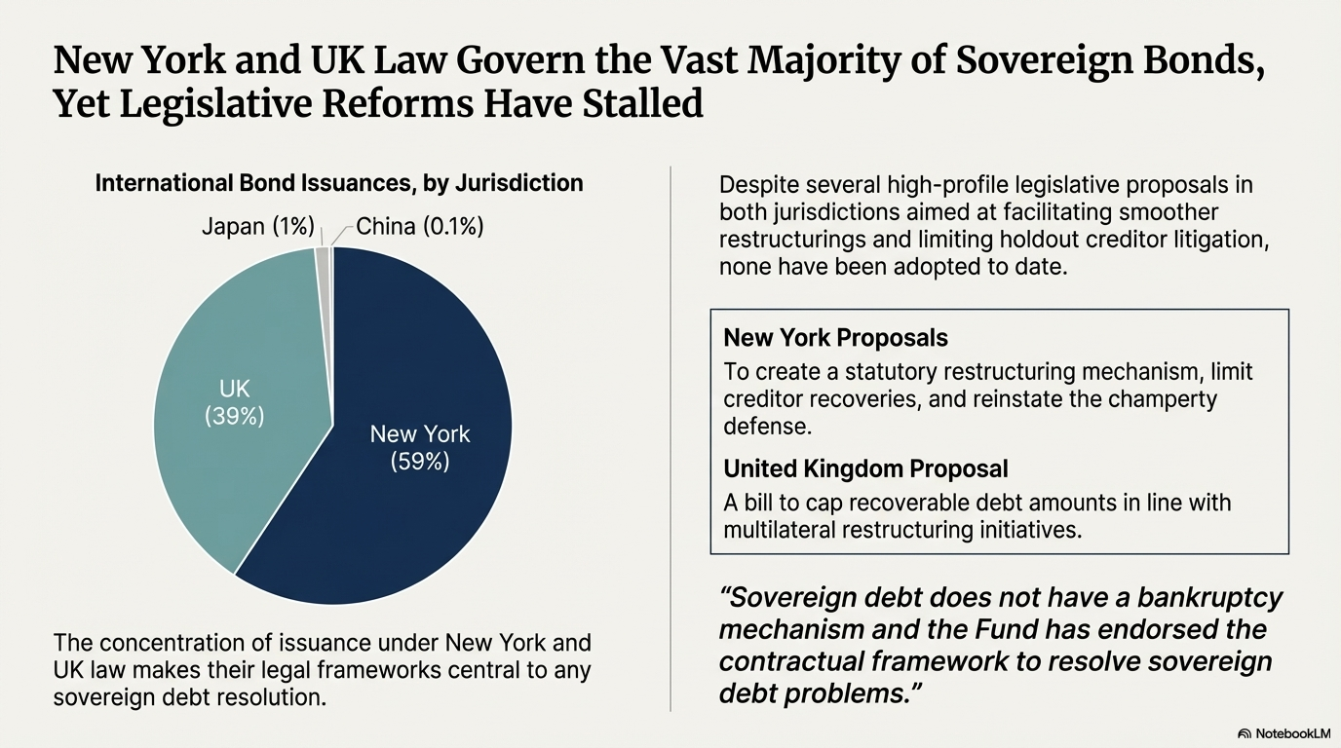

Slide 27
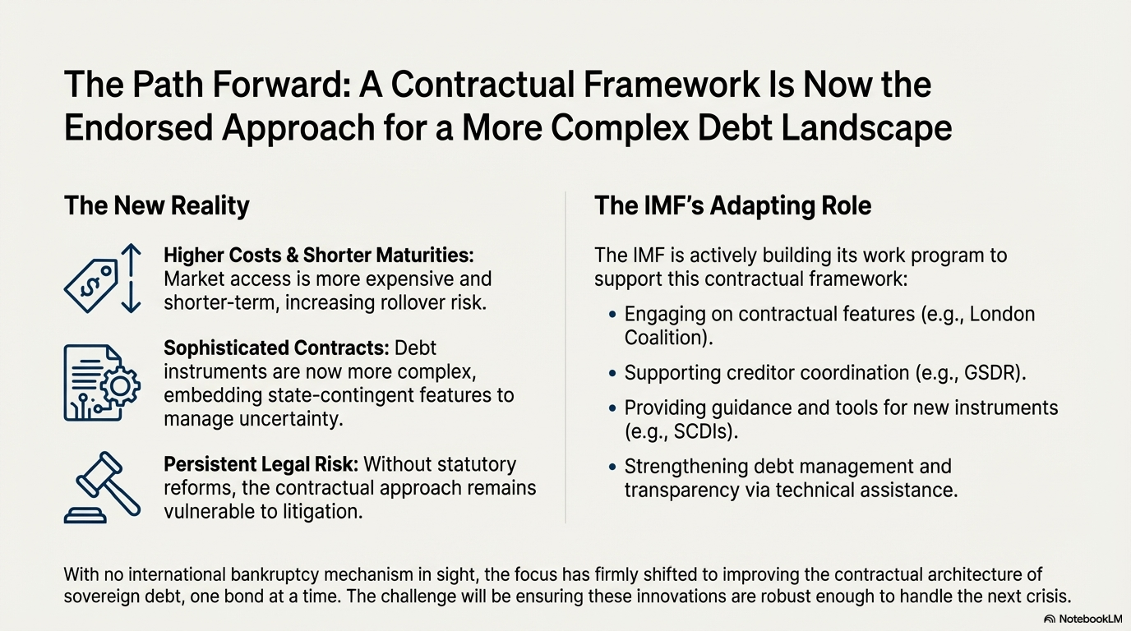
The contractual, “market-based” framework remains the endorsed and de facto approach to debt resolution

Slide 28
Geoeconomics of Debt in 2026
UN processes will be further marginalized
Security alignment for financing
Softening monetary policies - A Stronger or Weaker US Dollar? Market going into 2026 expects weakening dollar which will be good for USD denominated foreign debt, even while Trump is trying to prop up dollar dominance. US interest rates looks like it has found a political equilibrium hovering around 3.5-3.75%. Market expects one more 25 basis cut, but Fed Governor and ideologue Miran wants to see 100 basis point cut in 2026 to spur investments. Lower interest rates and cheaper dollar will be US’s biggest contribution to alleviating developing countries’ debt
Energy prices- Geopolitically induced fall in oil prices will financially benefit energy importing developing countries easing their BOP pressures, while oil exporters facing public debt stress will see their situations deteriorate challenging their debt servicing capacity.
A “new G20” dubbed Mark Rubio in Dec 2025. Trump wants G20’s bloated agenda and participation to be pared back. Topics such as climate change, debt, development, inequality, and sustainability are out; “Removing regulatory burdens, unlocking affordable and secure energy supply chains, and pioneering new technologies and innovation” are in. This ends four consecutive chairmanship of the G20 by developing countries.
“America First seeks to expand U.S. leadership in international institutions like the IMF and World Bank.” Scott Bessent, Speech at the IIF, April 2025
  IMF: To taint Chinese lending as unsustainable; limit its lending to BOP imbalances and in tenure; policy and reform conditionalities to its lending; Argentina as example.
  World Bank: Tighten eligibility for concessional lending; graduation; policy and reform conditionalities for lending; promote private sector led growth.
Global Sovereign Debt Roundtable, led by IMF, World Bank and G20 Presidency (GSDR) would be more important and influential in shaping sovereign debt resolution norms for developing countries
Notes:
Apart from the huge financing gap, according to NCGQ estimates based on costed needs based on developing countries’ NDCs is between 5-7trillion, and if you remove China out of the picture, it is about 340bn. According to Bessent, the World Bank must respond to countries’ energy priorities and needs and focus on dependable technologies that can sustain economic growth rather than seek to meet distortionary climate finance targets. On the IMF “it devotes disproportionate time and resources to work on climate change, gender, and social issues,” lending should be focused to BOP issues and temporary. Also IMF to force official creditors which their unsustainable lending practices to the table to work out debt early

Slide 29
END DRAFT

