Slide 1

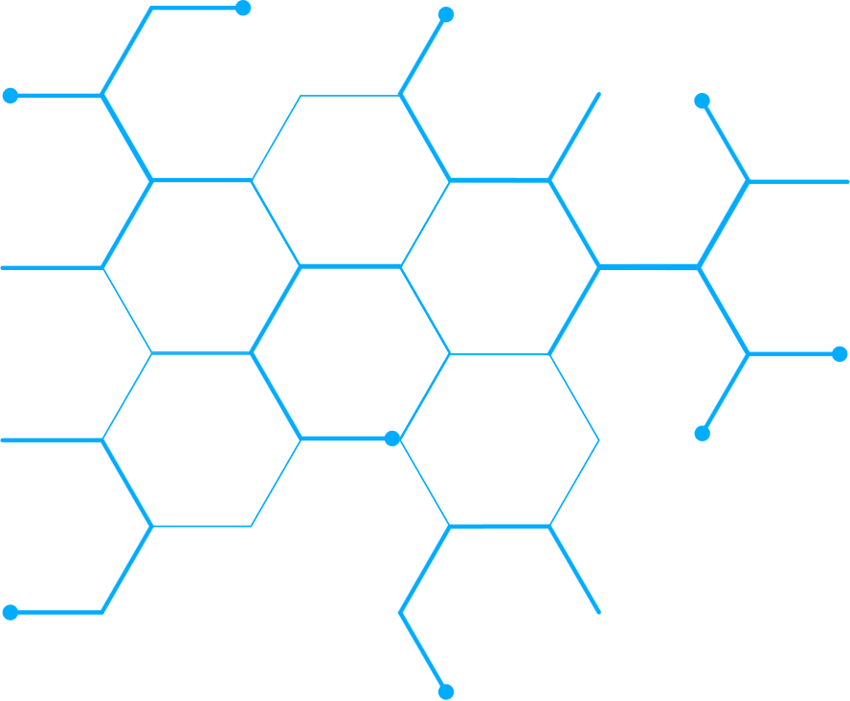
Workshop on Advancing Just and Equitable Energy Transitions: Legal, Policy, and Financial Dimensions for Developing Countries, Jakarta
10 February 2026
Challenges and constraints for a just energy transition within the
context of Malaysia and the broader global policy and legal developments
Hilary Kung
Third World Network/ FoE Malaysia
Notes:
One of the most pressing challenges facing developing countries today is pursuing climate-resilient development amid shifting geopolitical dynamics.

Slide 2
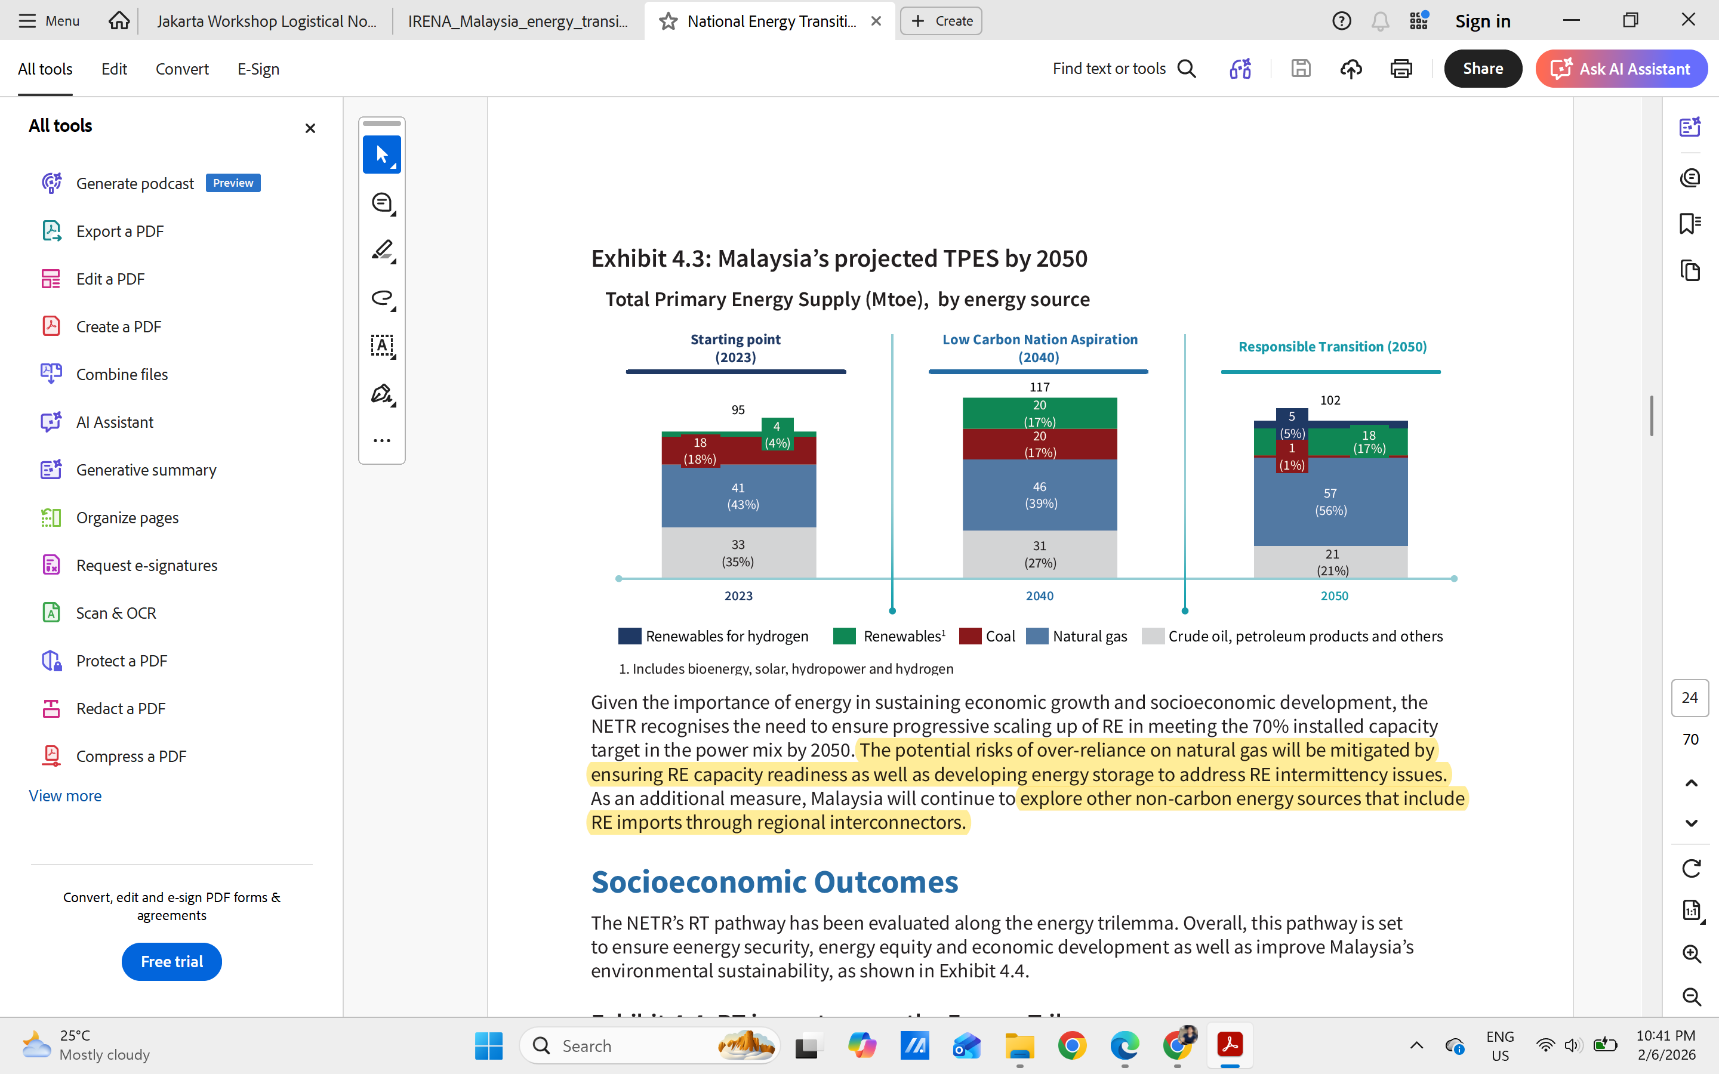

How has the government considered the energy transition in Malaysia?
  Natural gas is set to be not only a transitional fuel, but also the primary contributor to TPES (56%) in 2050.
  Only 17% of energy sources are projected to come from renewable energy by 2050.
  Near-complete coal phase‑out by about 2045, driven by natural retirement of existing plants and absence of new coal generation.
Source: National Energy Transition Roadmap, 2023, P24

Slide 3
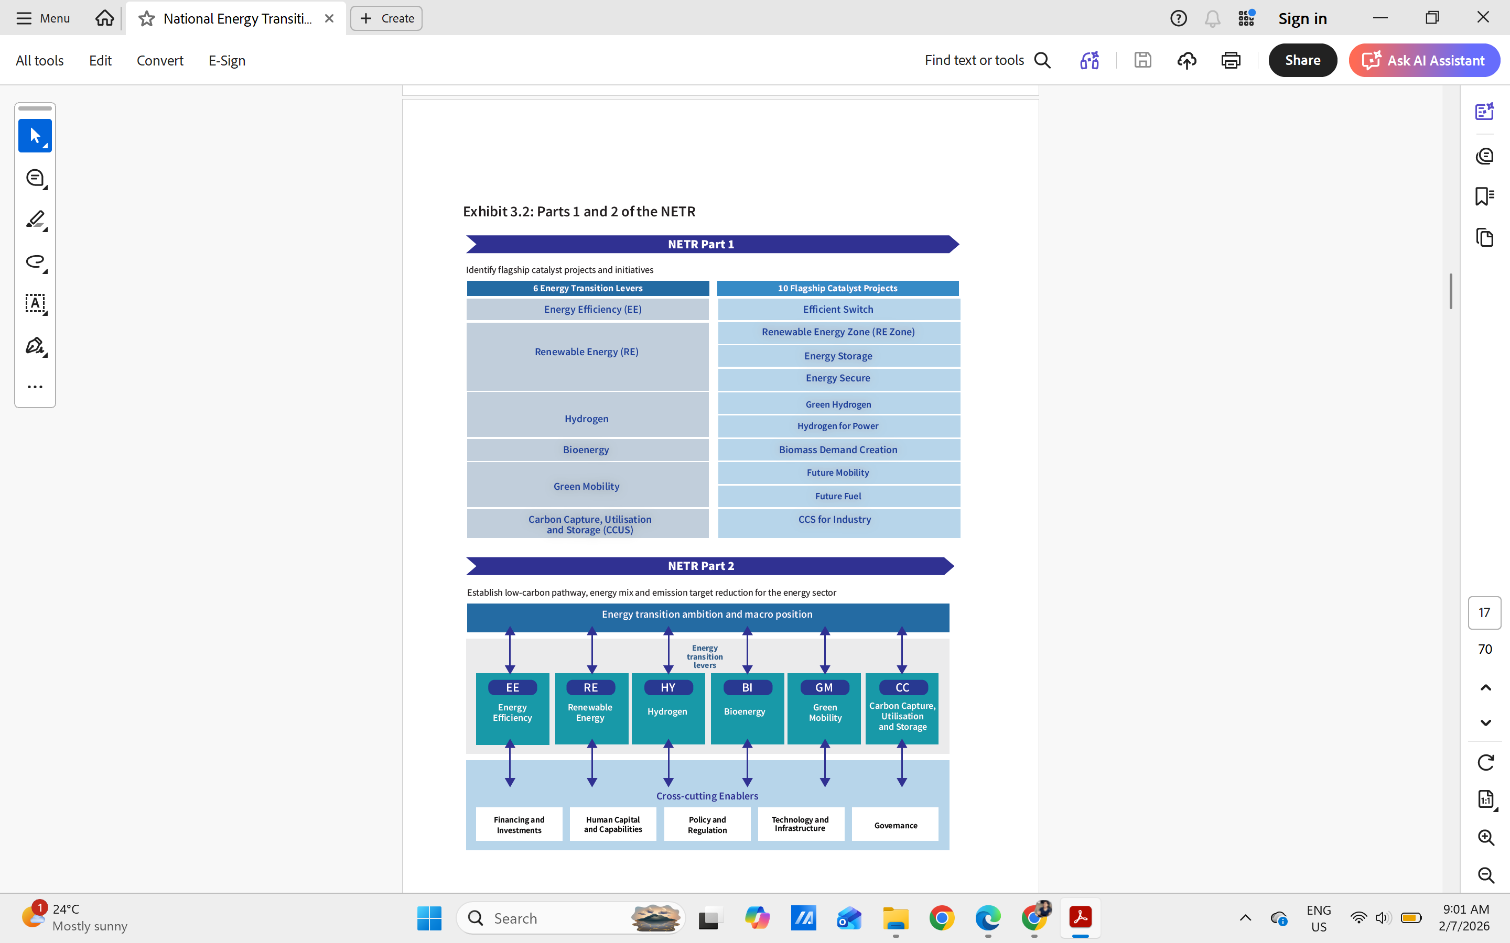
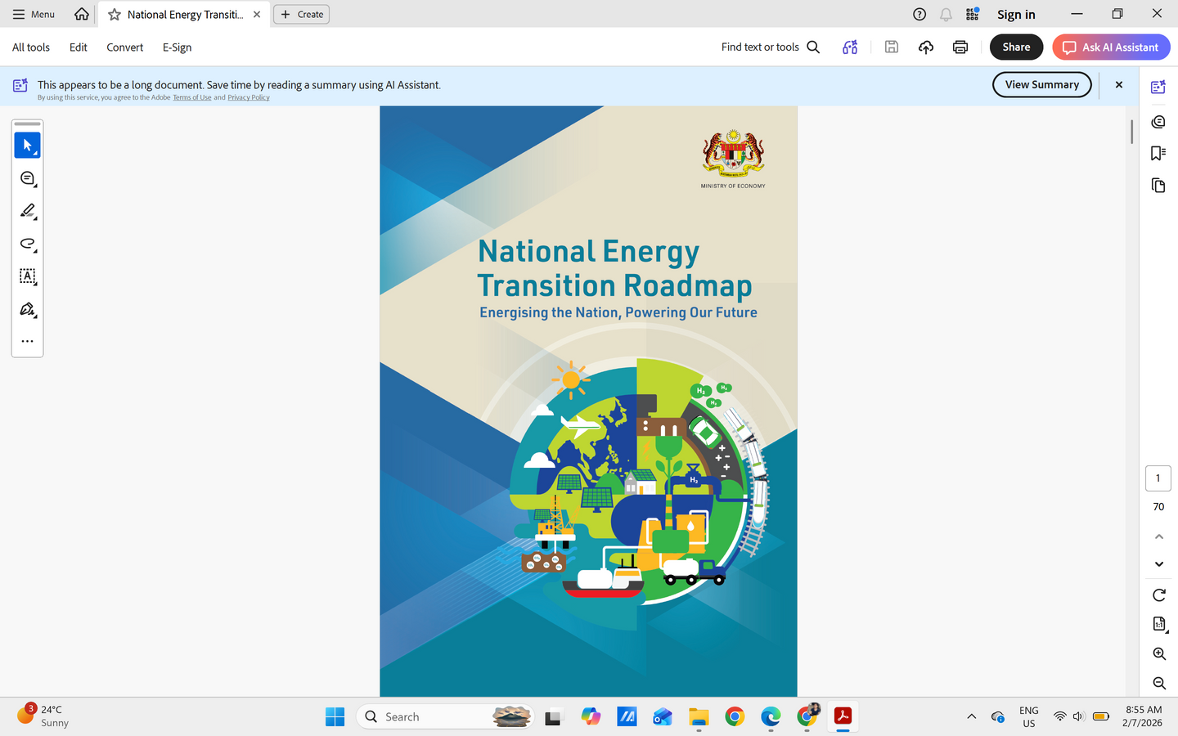
How has the government considered the energy transition in Malaysia? cont’d
  The NETR anticipates an investment of RM1.2 trillion to RM1.3 trillion by 2050 (but this figure does not account for the cost of mitigating the transition's impact on affected groups, nor for the broader social and environmental implications or expenses associated with enhancing adaptative capacity of communities and economies & addressing losses and damages.

Slide 4
How has the government considered the energy transition in Malaysia? cont’d
  National climate change policy 2.0
  The government of Malaysia has embraced carbon pricing in response to the EU’s Carbon Border Adjustment Mechanism (CBAM):
  (a) Carbon tax to be introduced in 2026 on the iron, steel, and energy sectors
  (b) Emission trading scheme in the upcoming climate bill
  (c) Voluntary carbon market
  Carbon Capture, Utilisation and Storage Act 2025
  The government is also developing 3 action plans: Gender, Just Transition and Financing, but not much information is available as only one inception workshop took place right after COP30.
  Nationally Determined Contribution 3.0
  Joint Committee on Climate Change (JC3), co-led by the Central Bank of Malaysia and the Securities Commission, has been actively involved in addressing climate risks and mobilizing finance for climate action
  * This list is non-exhaustive

Slide 5
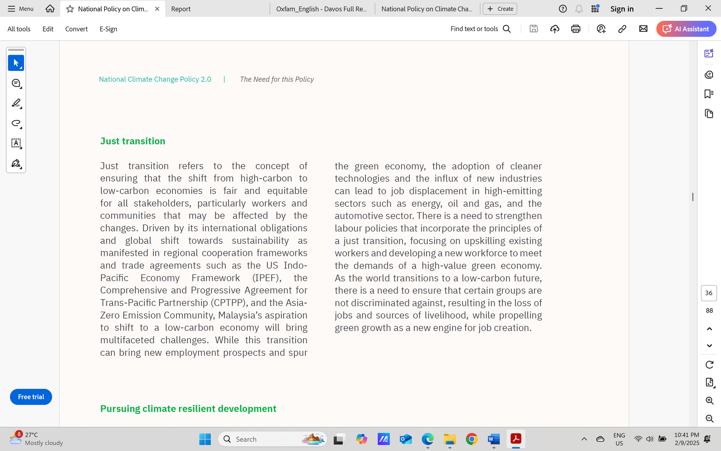

Slide 6

Challenges and constraints for just energy transition in Malaysia

Slide 7
  On early coal retirement:
  Key challenges for Malaysia include determining who should bear the costs of the transition, how compensation should be financed, and how to address concerns around energy security. Beyond compensation, there is also the question of how to finance the full cost of transition, including measures to mitigate impacts on affected workers and communities, as well as strengthening the adaptive capacity of communities and the wider economy, in line with a just transition approach. A broader and more fundamental question is how Malaysia should balance urgent adaptation needs with sustainable development priorities, while still doing its fair share in global mitigation efforts.
In 2023, the former Minister of Natural Resources and Environmental Sustainability has considered “a coal carbon reduction programme by launching a request for information to explore early retirement, mothballing, co-firing or brown to green swaps at COP28, but no further details followed.
The former minister of economy said that early retirement was considered impractical without clear solutions on costs and energy reliability.
Coal generation capacity is tied to long term Power Purchase Agreements (PPAs) and so early coal retirement cannot take place unless those PPAs are renegotiated/compensated.
Early coal power phase-out in Malaysia could cost USD 1.43 billion (approximately RM 6 billion) to renegotiate PPAs. This is just the buy-out cost, does not include other major costs on replacement capacity, grid upgrade costs or other costs from a just transition perspective.

Slide 8
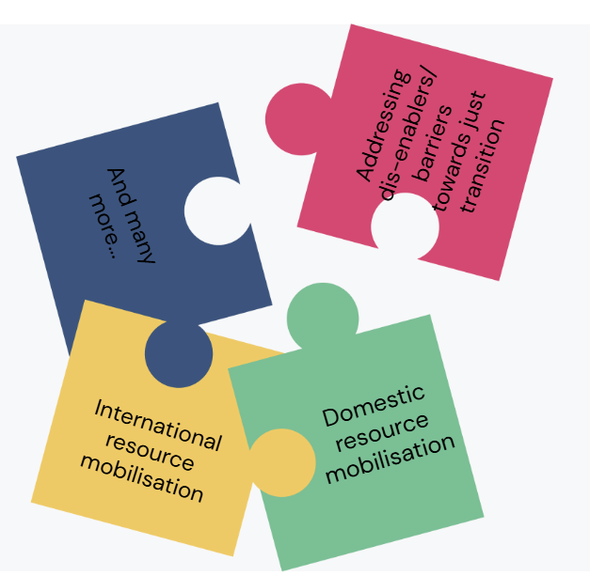
2. On natural gas as a transition fuel and barriers for renewable energy:
  Malaysia’s energy transition is complicated by the government’s plan/expectation that natural gas will remain the primary energy source in 2050, prompting questions about its fair share of emission reduction and the duration of the transition under a just energy framework.
  Only 17% of energy sources are projected to come from renewable energy by 2050. Some of the identified challenges/barriers for RE integration includes the need to upgrade the national grid to deal with the intermittent nature of RE as the current grid relies on coal as the base load, the need to invest for battery energy storage system, the need to deal with solar panels waste, among others.
  There is a need for a financing plan, which should include enhancing access to international climate funds, especially the Green Climate Fund (GCF), to finance just energy transition in Malaysia, including expediting efforts to gain direct access through enabling the accreditation of Malaysian entity(ies) as National Accredited Entities.

Slide 9
  3. No just energy transition without energy access
  Despite Malaysia's near-universal electrification claims, persistent disparities exist: 400 villages in Sabah and ~200 in Peninsular Malaysia remain under-electrified, reflecting broader Asia-Pacific realities where 69 million lack electricity access and 350 million are under-electrified, necessitating decentralized renewable energy as the primary solution for communities.
  Barriers and challenges to RE for energy access:
(a) Funding and financing
(b) Local technical capabilities (know-how)
(c) Political and institutional support
(d) RE for access often times small, not given same priority as urban-based services
(e) Funding and policy priorities of RE tied to meeting national/international targets through grid-based
options
(f) Provision of technology is not sufficient for rural development, etc.
Implementing RE in rural areas is a complex problem
    New technology in a remote/rural area
    Needs to fit in with local institutions and environment
    Technology needs to be adapted or integrated into existing ways of living (sometimes may create new ways of living)
Source: Ayu Abdullah, 9 Oct 2025, Energy Access and Just Energy Transition, JET Conference, KL

Slide 10

  4. Data centres boom
  Hyperscale DCs: 100-300 MW each, 24/7 power + cooling demand (big energy and water guzzlers), low employment density.
  There are 22 operational DCs, 43 approved projects, 6,400 MW requested capacity - mostly concentrated in Johor: spillover from Singapore, land + grid access; Selangor/Cyberjaya: legacy cluster, now water-constrained and Penang: manufacturing-linked DC demand
  Challenges: New DCs lock into fossil-heavy electricity, risk undermining the energy transition effort in Malaysia and deepening inequality; no binding requirement on Power Usage Effectiveness (PUE) limits, Water Usage Effectiveness (WUE) limits, cooling technology requirements, nuclear re-entered the debate, driven by the data centres boom, and climate impacts of the data centre boom are not factored into Malaysia’s long-term climate commitment
Source: Malaysia draws first data centre protest over pollution, water
Source: Monitoring Sustainability of Globalisation (MSN) (Dec 2025)

Slide 11
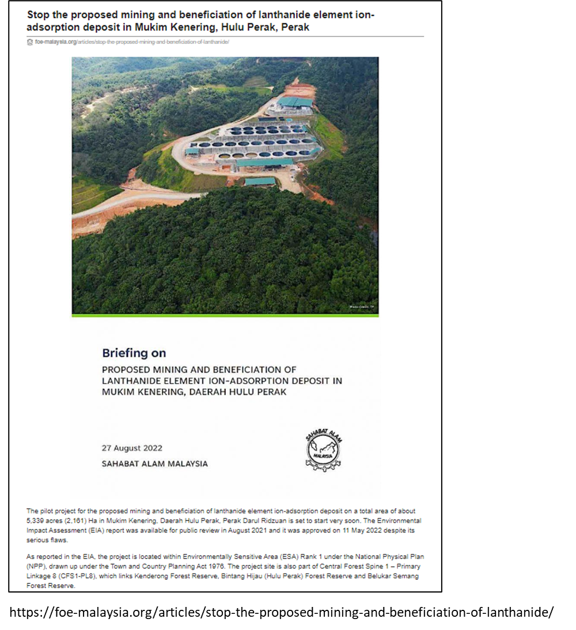
  5. Transition minerals - Rare Earth Elements
  Transition minerals are the engine of the energy transition — justice in JET determines whether that engine lifts people up or runs them over.
  A real concern is when REE resources are located in Environmentally Sensitive Areas (ESAs), and whether the government can forgo/avoid mining in these areas and recognise indigenous sovereignty and land rights. Also, there should be no biodiversity offset in a genuine just energy transition.
  Like other developing countries with transition mineral reserves, Malaysia also bans the export of REE to safeguard the resources’ value chain to build midstream and downstream industries, but the US-Malaysia Agreement on Reciprocal Trade constrains Malaysia from banning critical mineral exports to the United States and requires Malaysia to eliminate any rare earth element export quotas to the United States, among others.
First Mining And Beneficiation Of Lanthanide Element Ion-adsorption Deposit In Mukim Kenering, Daerah Hulu Perak
https://foe-malaysia.org/wp-content/uploads/2022/09/220904-Kenering-Briefing-Booklet.pdf

Slide 12
  6. Carbon capture and storage (CCS), Carbon Dioxide Removal (CDR) Technologies, and Hydrogen delay/hinder a just energy transition
  A just energy transition is about phasing out fossil fuels and phasing in RE, while protecting people and communities, but CCS, CDR, or hydrogen are used to delay that phase-out and do the opposite.
  CCS: Real-world examples call into question Malaysia’s CCS aspiration, but the most controversial is the cross-border "dumping of" carbon from developed countries like South Korea and Japan in the CCS facility in developing countries like Malaysia. The NETR estimated the cost for CCS implementation to be RM170 billion (13.1% of the total investment needs) to deliver a mere 5% emissions reduction in the energy sector by 2050.
  CDR technologies like BECCS, DACCS: The true energy transition challenge is revealed by considering the sustainability impacts of CDR technologies. The core issue is who controls it, who benefits, and what it delays.
  The NETR projects that Malaysia will rely on grey hydrogen until 2050 and hydrogen co-firing with coal or co-firing of hydrogen and ammonia. Grey hydrogen is produced from the fossil fuel industry, and hydrogen contributes to climate change by emitting high levels of methane. Methane is a potent greenhouse gas, 86 times more powerful than carbon dioxide. Hydrogen, as currently promoted, prolongs the gas industry.
Notes:
Severe restrictions on energy consumption in the Global South will allow for continued higher per capita fossil fuel use in the Global North until 2050. This is made possible by carbon offsetting through high level of Carbon Dioxide Removal (CDR) technologies deployment in developing countries. Some examples of CDR are Direct Air Carbon Capture and Storage (DACCS) and Bioenergy with Carbon Capture and Storage (BECCS).
Based on another paper by Jayaraman and Kanitkar (2023), global mitigation targets like the target of 43% reduction in greenhouse gas (GHG) emissions below 2019 levels by 2030, which was adopted at COP27 and later in the Global Stocktake at COP28, indeed assumes high level of mitigation and carbon dioxide removal (CDR) technologies in developing countries, largely from Asia and Sub-Saharan Africa.
Under the most stringent 1.5 °C scenarios, the number of people at risk of hunger is going to increase because of land use conversion from food crops to energy crops (land-based mitigation that is assumed in these scenarios including carbon dioxide removal through BECCS). All of this risks undermining the sustainable development in the country.

Slide 13
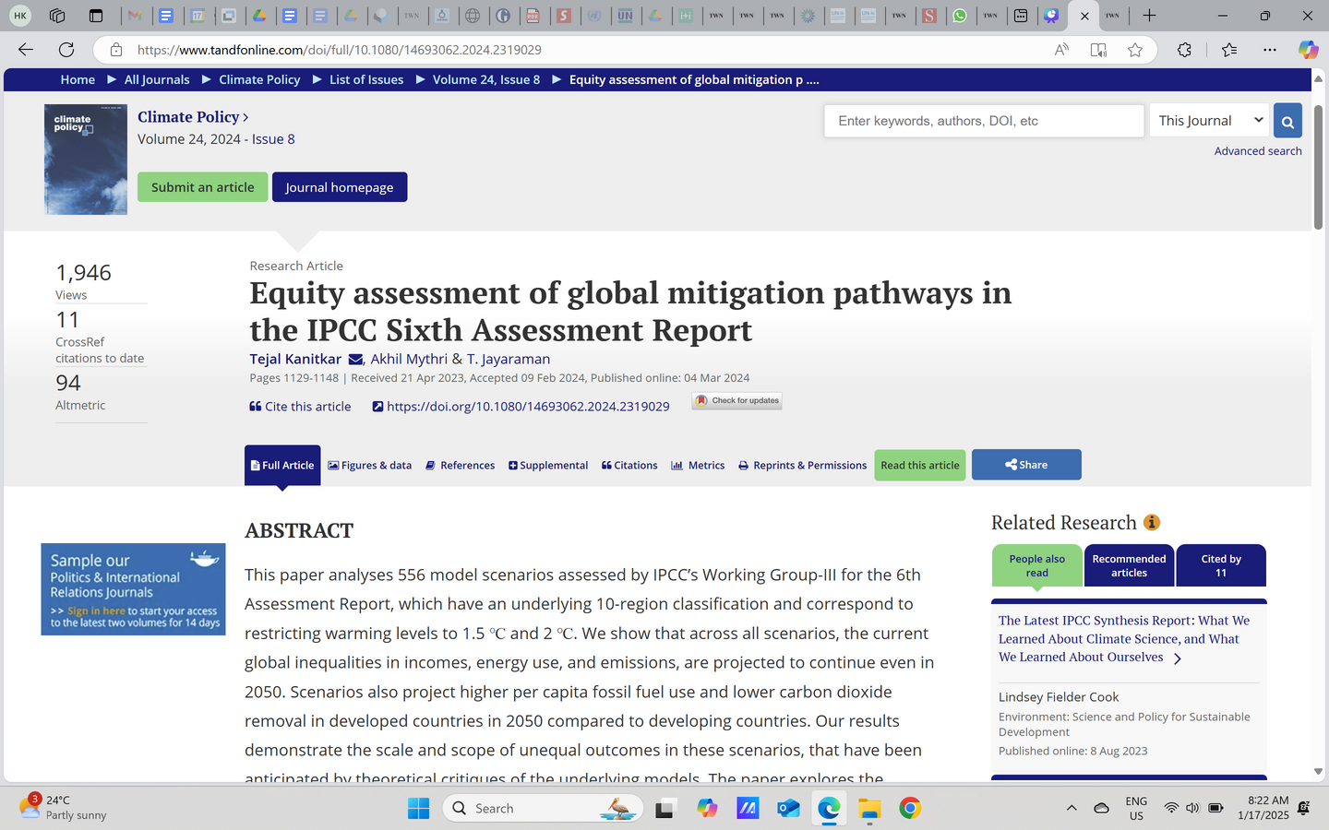
Global mitigation pathways in IPCC 6th Assessment report projected high level of CDR technologies deployment in developing countries to enable continued higher per capita fossil fuel use in developed countries
  The IPCC scenarios projects that the continued higher per capita fossil fuel use in the Global North until 2050 is enabled by carbon offsetting through high level of Carbon Dioxide Removal (CDR) technologies deployment in developing countries.
  Further, another paper finds that global mitigation targets like the target of 43% reduction in greenhouse gas (GHG) emissions below 2019 levels by 2030, which was adopted at COP27 and later in the Global Stocktake at COP28, assumes high level of mitigation and carbon dioxide removal (CDR) technologies in developing countries, largely from Asia and Sub-Saharan Africa.
  Under the most stringent 1.5 °C scenarios, the number of people at risk of hunger is going to increase because of land use conversion from food crops to energy crops (land-based mitigation that is assumed in these scenarios including carbon dioxide removal through BECCS). All of this risks undermining the sustainable development in the country.
  The IPCC scenarios project a highly unequal world with enduring levels of poverty across major parts of the developing regions and remaining carbon budget is disproportionately consumed by developed countries.
Kanitkar, T., Mythri, A., & Jayaraman, T. (2024). Equity assessment of global mitigation pathways in the IPCC Sixth Assessment Report. Climate Policy, 24(8), 1129–1148. https://doi.org/10.1080/14693062.2024.2319029

Slide 14

  7. By allowing polluters to buy offsets instead of cutting emissions, carbon markets undermine a just energy transition and fuel land grabs that harm Indigenous peoples.
Unresolvable conceptual issues with carbon markets - Carbon offsets are not based on science
Subprime/ Junk carbon, carbon bubble and financial stability risk
Cryptocurrencies like bitcoin and non-fungible tokens (NFTs) in the carbon markets
Source: (1) 0 Wim Carton, Jens Friis Lund, and Kate Dooley, “Undoing Equivalence: Rethinking Carbon Accounting for Just Carbon Removal,” Frontiers in Climate 3 (April 16, 2021): 664130, https://doi.org/10.3389/fclim.2021.664130
(2) Sahabat Alam Malaysia, “Addressing Climate Change in Malaysia: A critical perspective on carbon pricing,2023, https://www.twn.my/title2/climate/series/cc07.pdf
Notes:
Toucan, a crypto carbon company, transferred 21 million retired carbon offsets from Verra to the blockchain in the name of helping to clean up all the cheapest, lowest-quality credits, thus preventing heavy carbon polluters like oil companies from purchasing meaningless offsets – a process the crypto community called “sweeping the floor”. , This is especially controversial because carbon offsets, once retired, should be taken off the market forever and never be traded or swamped again. This is to prevent the polluter from claiming that it has offset emissions while reselling the credit for profit. – renewed demand for lowest quality credits
The current policy responses to climate change, especially the carbon market, carry significant financial stability risks that need to be looked into. These risks have not materialised so far due to the limited size and lack of real functioning of carbon markets in the past. But today, ETSs are proliferating around the world, with 25 ETSs currently in force, nine under development and 14 under consideration.
According to South Pole, a Swiss carbon finance consultancy, the demand for VCM has risen from 12 million tonnes in 2011 to 216 million tonnes in 2021. The Ecosystem Marketplace’s State of the Voluntary Carbon Markets report stated that the VCM increased fourfold towards $2 billion in 2021 compared with 2020. Trafigura, a top oil trader, even predicted that the carbon market could become 10 times bigger than the global crude oil market, as reported by Bloomberg.
The Taskforce on Scaling Voluntary Carbon Markets (TSVCM) estimates that demand for carbon credits could increase by a factor of 15 or more by 2030 and by a factor of up to 100 by 2050.[8] Overall, the TSVCM expects the market for carbon credits could be worth upward of $50 billion in 2030.
Clearly, there is an increase in scale and scope of the financial stability risks associated with carbon markets today.

Slide 15
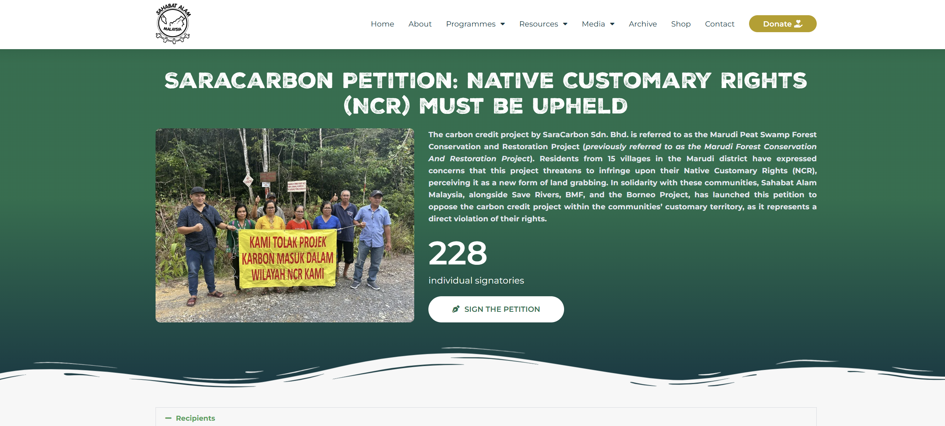
Sahabat Alam Malaysia - Towards Environmental Justice

Slide 16

8. Large hydro dams risk turning the energy transition into an unjust transition
Sarawak’s plan to build 3 more hydroelectric dams based on cascading design
The 3 proposed new dams are at Sungai Gaat at Kapit district (in central Sarawak), Sungai Tutoh at Baram district (in northern Sarawak), and Sungai Belaga at Belaga district (central Sarawak).
Shift the burden onto vulnerable communities and displace Indigenous peoples and rural communities.
Reproduce colonial and unequal power dynamics.
Deliver false climate benefits. Methane and CO₂ emissions from reservoirs—especially in tropical regions—undercut claims that large hydropower is clean energy. Locking in high-impact infrastructure diverts resources from truly low-impact renewables.
Damage ecosystems that support climate resilience. By fragmenting rivers and destroying freshwater biodiversity, dams weaken natural systems that communities rely on for food, water security, and adaptation to climate change.
Entrench inequality in energy access. Power generated by large dams often feeds national grids, export markets, or energy-intensive industries, while displaced communities may lack reliable or affordable electricity themselves.
Crowd out better alternatives. Massive hydro projects absorb public finance and political attention that could support decentralized renewables like solar, wind, micro-hydro, and community-owned energy—options that create local jobs and spread benefits more equitably.
PRESS STATEMENT: 650 Signatures Collected against Tutoh/Apoh Cascading Dam – SAVE Rivers
https://saverivers.org/2024/02/08/press-statement-650-signatures-collected-against-tutoh-apoh-cascading-dam/

Slide 17
Thank you
Hilary Kung
hilarykung@twnetwork.org

