Slide 1
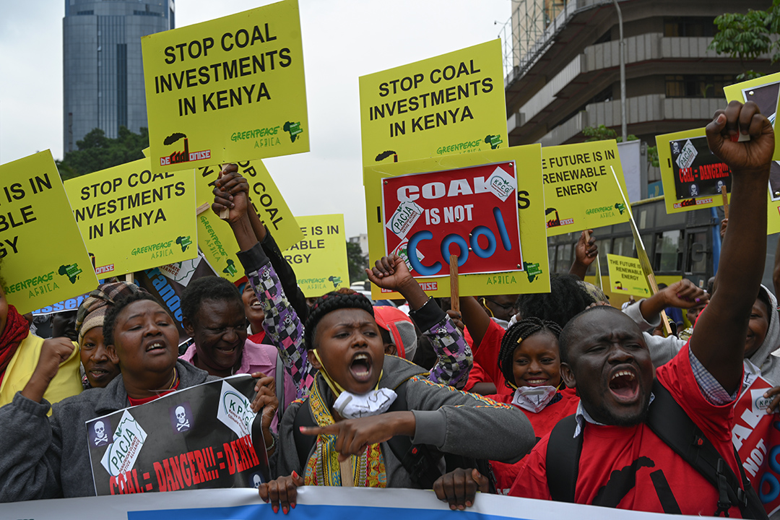
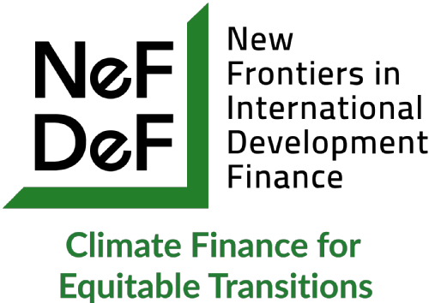
Financing the Energy transition: impacts for developing countries.
Dr John Hogan Morris, University of Nottingham
John.morris@nottingham.ac.uk
‘Pathways for Financing Just Transition.’
Centre for Economic and Law Studies (CELIOS), Jakarta, 9th February 2026

Slide 2

United Nations Paris Climate Agreement
Article 2.1. This Agreement, in enhancing the implementation of the Convention, including its objective, aims to strengthen the global response to the threat of climate change, in the context of sustainable development and efforts to eradicate poverty, including by:
(c) Making finance flows consistent with a pathway towards low greenhouse gas emissions and climate-resilient development.
i.e. aligning all types of investments and financing activities with achieving the world’s climate goals.

Slide 3
Can we really ‘green’ the investor’s gaze?
What sort of climate related data do investors want?
Consistent, commensurable and comparable
But :
Which time-frames count?
Narrow political economic interests?
Risks/rewards.
Existing risk premia when lending to developing regions/ countries.

Slide 4
Policy | Objectives
Green Prudential Regulations | Identifying and mitigating financial risks to ensure financial stability.
Green Credit Allocation Policies | Encouraging green lending and investments through credit allocation and lending limits.
Green Financial Guidelines | Supporting the development of green or climate-aligned financial markets.
Other Disclosure Requirements | Encouraging public disclosure of climate-related financial risks, including for non-financial institutions.
Green Bonds | Promoting green lending through green bonds, including taxonomy and issuance.

Slide 5
Emerging Markets and Developing Economies and Climate-Related Financial Policies.
Observed impacts of CRFPs: Mixed impacts; strong responsiveness to binding policies in specific regions, but limited effectiveness in reducing CO2 emissions in others.
Key Challenges: Institutional and structural barriers, including reliance on carbon-intensive industries and limited enforcement mechanisms.
Policy recommendations: Strengthen international cooperation, capacity building, and access to green finance to address institutional and economic barriers.

Slide 6

International cooperation and capacity building.
Network for Greening the Financial System (NGFS).
Launched by 8 central banks/supervisory authorities at the One Planet Summit in 2017.
Seeks to promote:
(a) voluntary sharing of best practices for
for environmental and climate risk monitoring and management
(b) the mobilization of capital for green and low-carbon investments

Slide 7
To date: Risk-based approach
Promotion of Climate scenario analyses undertaken by domestic supervisors.
A version of stress testing: the running of a future-oriented exercise in which the impact of a hypothetical scenario is measured on the balance sheets held across a domestic financial system.
Climate versions are exploratory and predominantly focus on transition and physical risk. Scenarios built out from IPCC scenarios.
Objectives:
Measure the current risks banks and insurers are exposed to.
Assess the risk management capacities of banks and insurers.
Encourage the building of climate risk expertise in banks and insurers.
Issues:
useability of results.
Catalyst for bonanza for consultancy industry and climate services.

Slide 8
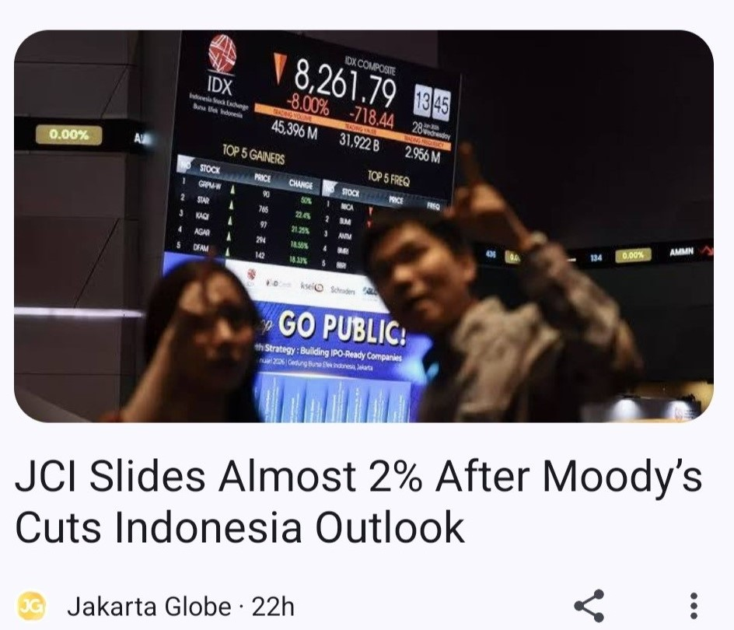
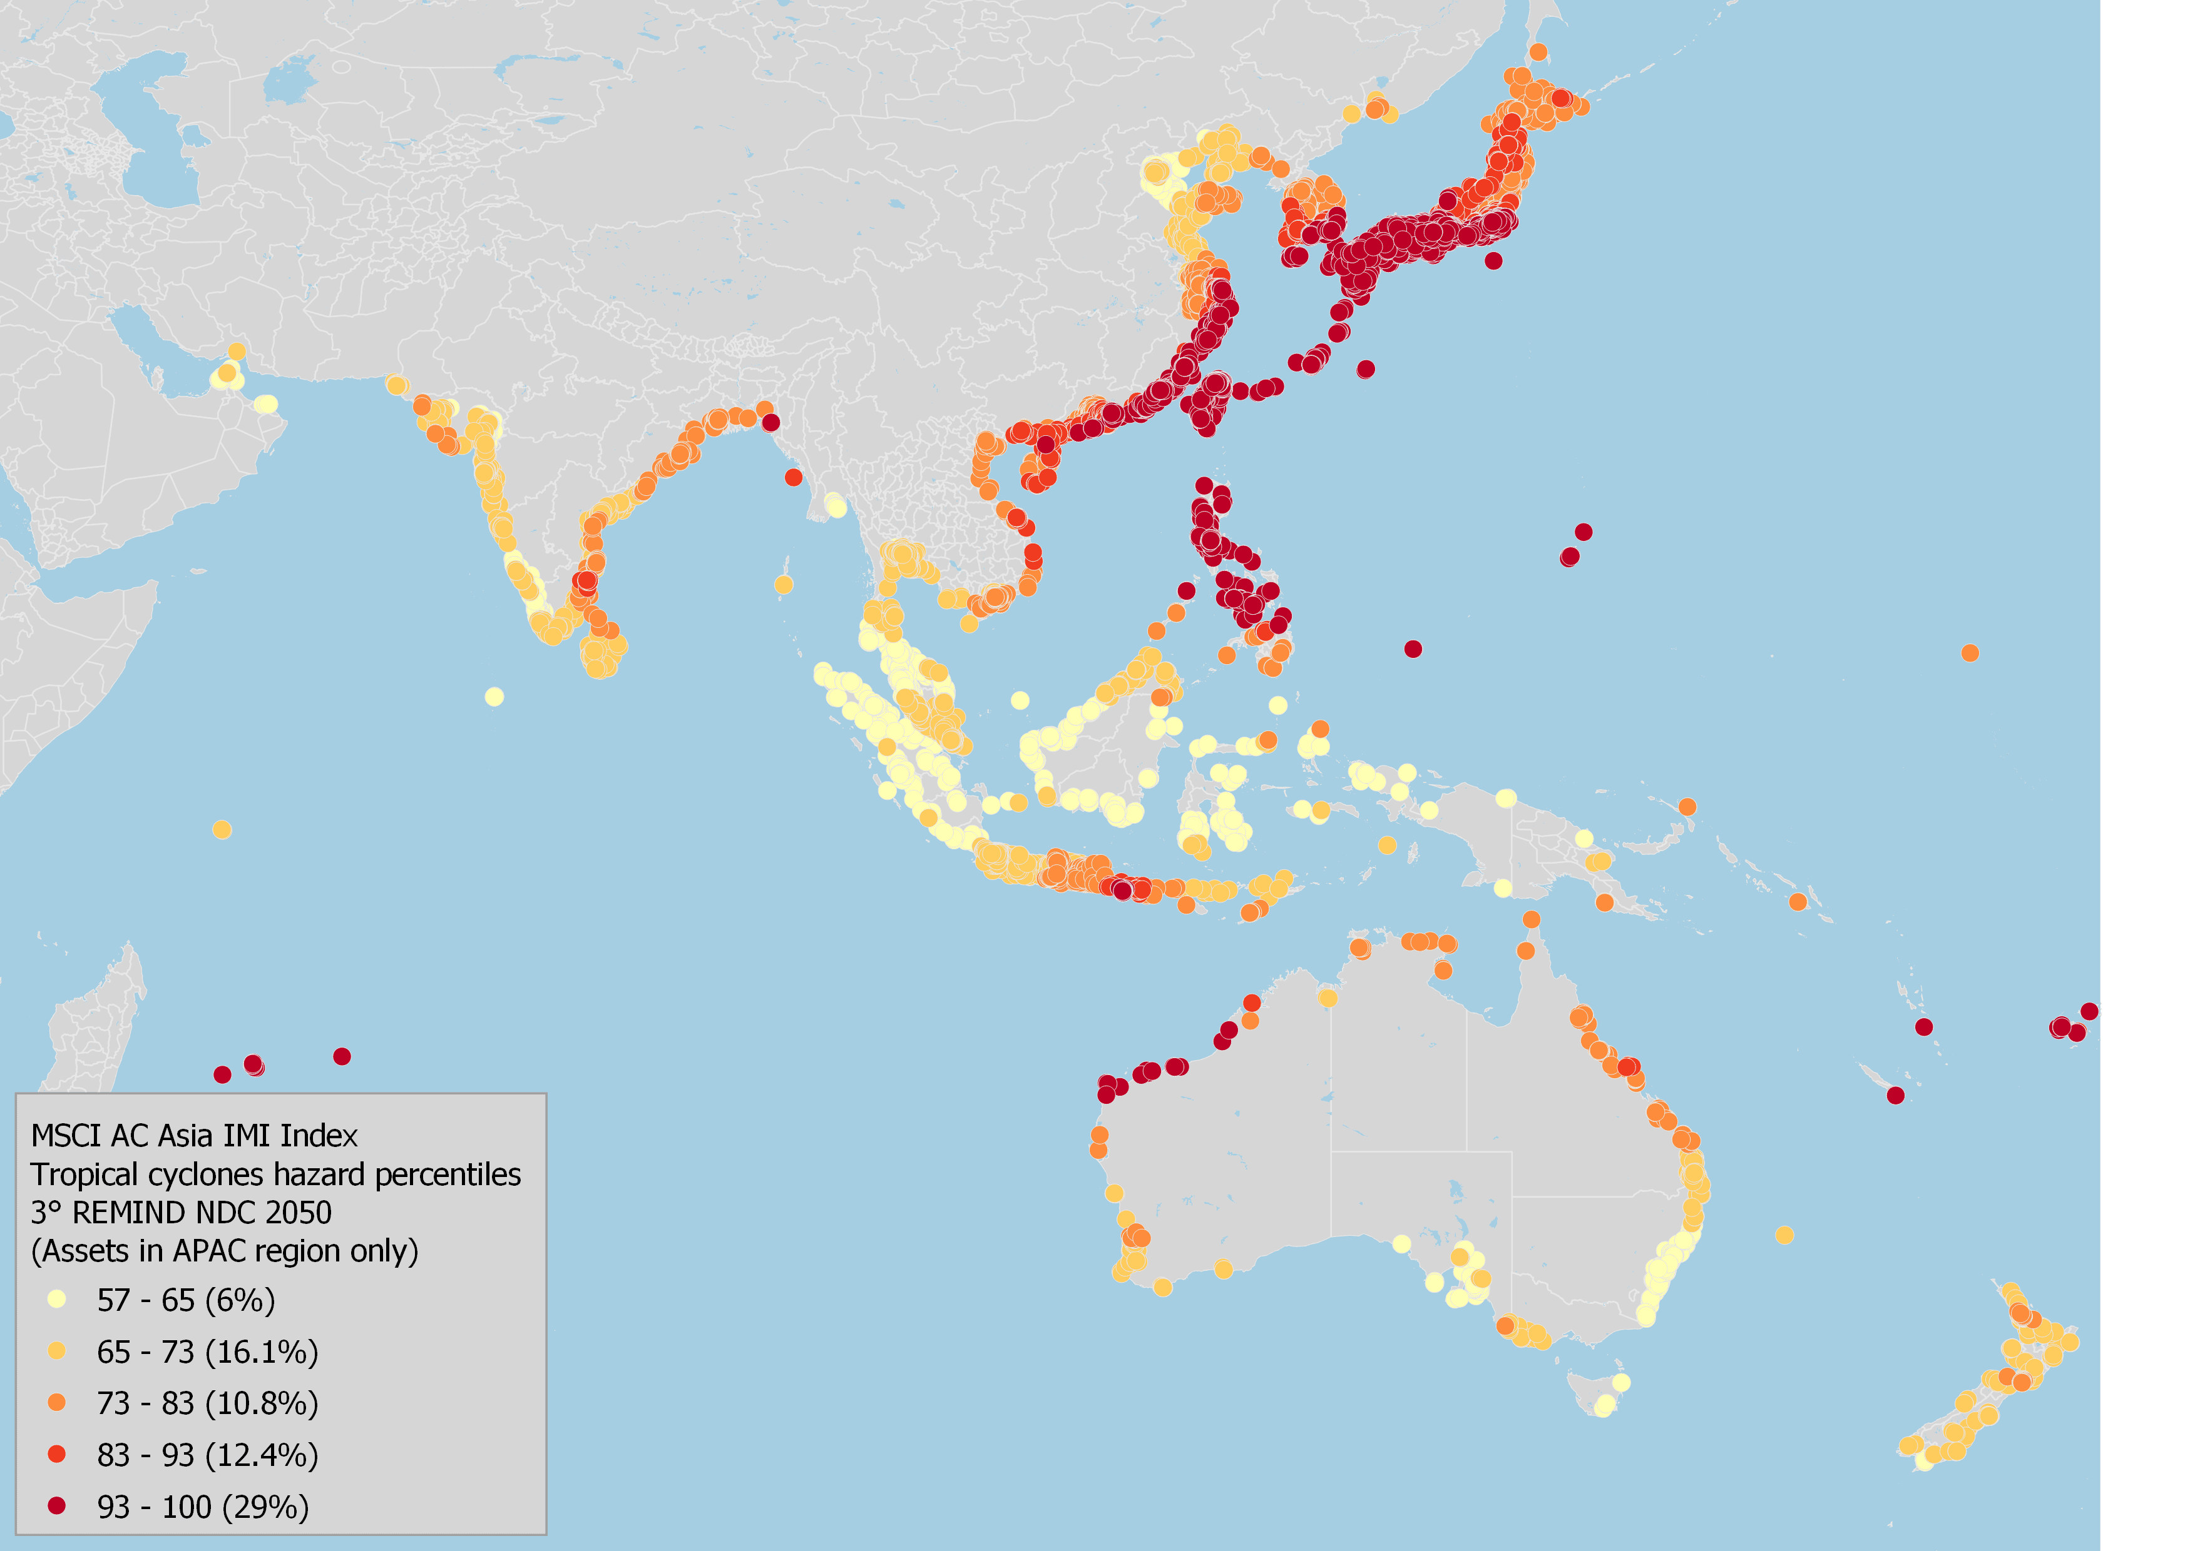
The Climatization of Sovereignty
Climate services and the infrastructural power of Moody’s and Standard & Poor’s.
Rather than treat the planet as an object of collective “saving,” it becomes a surface of uneven risks, profits and losses to be navigated accordingly, with far too familiar winners and losers.
Instrumental forms of climate action inscribe new and deepened patterns of exploitative inclusion of climate-vulnerable places within global financial systems.
Climate risk premium.

Slide 9
Cost of Capital (CoC)
Climate stabilization requires the mobilization of substantial investments in low- and zero-carbon tech.
But access to stable and affordable finance varies dramatically across countries.
IPCC Models used to evaluate the energy transition do not differentiate regional financing costs.
This means that they cannot study risk-sharing mechanisms for renewable electricity generation.

Slide 10
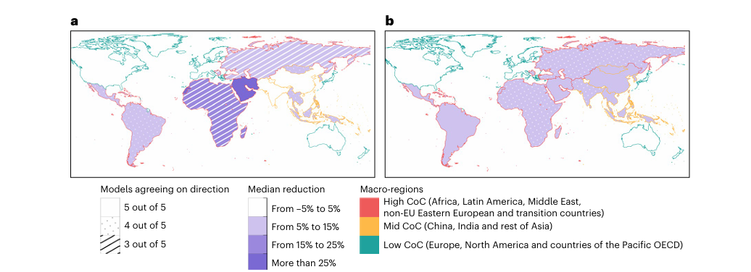
Modelling the impacts & benefits of regional CoC convergence
a. % difference in the carbon intensity of electricity between the CoC-convergence and CoC reference
scenarios under the NDC climate policy.
b. % difference in the policy cost
between the CoC-convergence and CoC-reference scenarios under the 1.5D climate policy.

Slide 11
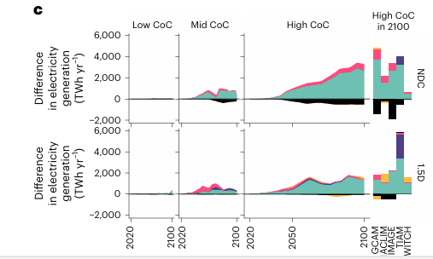
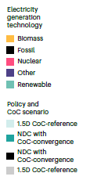
Right: breakdown by model for high-CoC countries in 2100 under the NDC and 1.5D scenarios.
Left: difference in electricity
generation between the CoC-reference and CoC-convergence scenarios across
macro-regions and time for both NDC and 1.5D scenarios, expressed as the
median values across models.

Slide 12
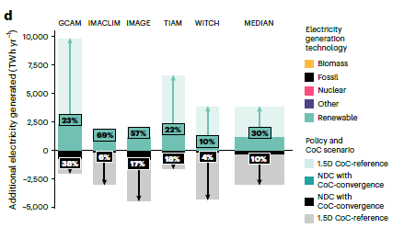
d. Additional electricity generated in an average year by energy source in
high-CoC countries.
The bars show the absolute additional electricity generated in the NDC CoC-convergence (dark shading) and 1.5D CoC-reference scenarios (light shading) with respect to the CoC-reference NDC scenario with learning.

Slide 13
The benefits of CoC Convergence
● Substantial reduction in the CoC in the Global South .
● More renewable electricity would be generated in developing countries, which increases mitigation or reduces its cost, depending on the climate policy scenario.
● Clearly improve the energy justice of the green transition.
● The main effect of a financing cost convergence scenario is to make renewable energy cheaper than fossil generation technologies.
● The large effect observed in the NDC scenario hints at the enabling potential of a policy pooling financing risks in the energy transition.

Slide 14
Key references
Calcaterra, M., Aleluia Reis, L., Fragkos, P., Briera, T., de Boer, H. S., Egli, F., ... & Tavoni, M. (2024). Reducing the cost of capital to finance the energy transition in developing countries. Nature Energy, 9(10), 1241-1251. https://doi.org/10.1038/s41560-024-01606-7
Cox, S., Morris, JH., and Taylor, ZJ. Risk-Rating and Networked Authority: A Climate Leviathan in Formation? Yale Law and Political Economy Blog. 12th June 2023.
D’Orazio, P., & Pham, A. D. (2025). Evaluating climate-related financial policies’ impact on decarbonization with machine learning methods. Scientific Reports, 15(1), 1694. https://doi.org/10.1038/s41598-025-85127-7
Kanitkar, T., Mythri, A., & Jayaraman, T. (2024). Equity assessment of global mitigation pathways in the IPCC Sixth Assessment Report. Climate Policy, 24(8), 1129-1148. https://doi.org/10.1080/14693062.2024.2319029
Lauer, A., Carpintero, Ó., & de Castro, C. (2025). In search of a missing South: an explorative study of biases in global climate and energy scenarios. Globalizations, 1-22. https://doi.org/10.1080/14747731.2025.2526295
Morris, JH. Unpacking the Greening of Finance Mechanisms: Power, Profit, and Exclusion. Paper presented at the Warwick Climate Governance and Policy Nexus Webinar at the Institute for Global Sustainable Development, University of Warwick. 25th May 2025 via Zoom.
Shrivastava, S., and Prakash Jena. L. How Credit Ratings Undermine Climate Finance for the Global South Observer Research Foundation. 28th January 2026.

