Slide 1


Legal and Policy Landscape for
Just Energy Transitions
Meena Raman
Third World Network

Slide 2
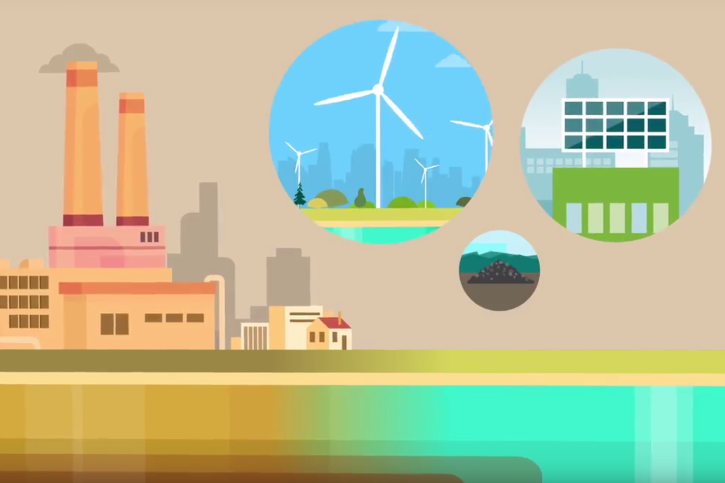
History of just transition in the global climate regime
Concept of JT was not mentioned in the UN Framework Convention on Climate Change [UNFCCC].
First time mention of it was in 2015 in the Paris Agreement in the preamble: “Taking into account the imperatives of a just transition of the workforce and the creation of decent work and quality jobs in accordance with nationally defined development priorities”
This Photo by Unknown Author is licensed under CC BY-SA

Slide 3
Just transition in the climate regime
It was in the 1970s that the concept of JT grew of the US labour movement as a response to nuclear disarmament.
The International Confederation of Free Trade Unions [ICFTU] first made a statement on JT in 1997 in the Kyoto Protocol negotiations, demanding “an equitable distribution of costs of climate change programmes for workers, through JT policies”.
While political declarations on JT that underlined the need to support fossil fuel workers displaced by the transition to green energy were adopted by some parties at COP24 in Poland [in 2018] and COP26 in Glasgow [in 2021], it was in COP27 in Egypt, in 2022, that a work programme on JT was finally established.
Source: Kiran and Kanitkar, 2023

Slide 4
The Sharm-el-Sheikh Implementation Plan –
COP 27/ CMA.4 in 2022
Energy –
8. Emphasizes the urgent need for immediate, deep, rapid and sustained reductions in global greenhouse gas emissions by Parties across all applicable sectors, including through increase in low-emission and renewable energy, just energy transition partnerships and other cooperative actions;
9. Recognizes that the unprecedented global energy crisis underlines the urgency to rapidly transform energy systems to be more secure, reliable, and resilient, including by accelerating clean and just transitions to renewable energy during this critical decade of action;
10. Stresses the importance of enhancing a clean energy mix, including low-emission and renewable energy, at all levels as part of diversifying energy mixes and systems, in line with national circumstances and recognizing the need for support towards just transitions;
Implementation – pathways to just transition
28. Affirms that sustainable and just solutions to the climate crisis must be founded on meaningful and effective social dialogue and participation of all stakeholders and notes that the global transition to low emissions provides opportunities and challenges for sustainable economic development and poverty eradication;
29. Emphasizes that just and equitable transition encompasses pathways that include energy, socioeconomic, workforce and other dimensions, all of which must be based on nationally defined development priorities and include social protection so as to mitigate potential impacts associated with the transition, and highlights the important role of the instruments related to social solidarity and protection in mitigating the impacts of applied measures;

Slide 5
COP 28/ CMA.5 – Dubai, 2023
It was in Dubai that the famous decision on ‘transitioning away from fossil fuels’ in a “just, orderly and equitable” manner was first agreed to. It is important to note that how the transition is supposed to happen in a just, orderly and equitable manner has not been made clear. Parties are supposed to do this in a nationally determined manner, according to their national circumstances. So, a key question is how in a bottom-up process of national determination, can there be an approach which is just, orderly and equitable? This is an issue which will remain controversial in the negotiations, as evidenced by the COP 30 process on the Brazilian proposal for a ‘fossil fuel roadmap’, which did not go through due to a lack of consensus.
In Dubai, another important decision was reached called the UAE Just Transition Work Programme.
The decision, among other things, underscored “the importance of urgent delivery of means of implementation (capacity-building, climate finance, and technology development and transfer) to facilitate just transition pathways and of enhancing international cooperation on, and support for, just transition pathways, especially for developing country Parties”.

Slide 6
The UAE Just Transition Work Programme
Confirms that the objective of the work programme on just transition shall be the discussion of pathways to achieving the goals of the Paris Agreement outlined in Article 2.1 of the PA , in the context of Article 2,2 (which means respecting the equity principle of common but differentiated responsibilities and respective capabilities [CBDR-RC]- which is a principle under the UNFCCC, derived from the recognition of the historical emissions and responsibility of developed countries since the industrial era, which are responsible for much of the impacts of climate change]. [Developing countries and CSOs have argued that this embodies the carbon debt owed by the developed countries to the developing countries for the overuse of the atmospheric space and carbon budget, since the pre-industrial era.]
Decides that the work programme shall include the following elements:
    Just transition pathways to achieving the goals of the PA outlined in Article 2.1 [which includes mitigation and adaptation] in the context of Article 2.2
    Just and equitable transition, which encompasses pathways that include energy, socioeconomic, workforce and other dimensions, all of which must be based on nationally defined development priorities and include social protection so as to mitigate potential impacts associated with the transition;
    Opportunities, challenges and barriers relating to sustainable development and poverty eradication as part of transitions globally to low emissions and climate resilience, taking into account nationally defined development priorities;
    Approaches to enhancing adaptation and climate resilience at the national and international level;
    Just transition of the workforce and the creation of decent work and quality jobs in accordance with nationally defined development priorities, including through social dialogue, social protection and the recognition of labour rights;
    Inclusive and participatory approaches to just transitions that leave no one behind;
    International cooperation as an enabler of just transition pathways towards achieving the goals of the Paris Agreement;

Slide 7
The UAE JTWP (cont’d)
Decided that the implementation of the work programme shall start immediately …with a view to the work programme informing the second global stocktake [in 2028] and other relevant processes, including the annual high-level ministerial round table on just transition, and agrees to review the effectiveness and efficiency of the work programme and consider its continuation at CMA 8 (Nov 2026);
Also decided that the work programme shall be implemented under the guidance of the Subsidiary Bodies and also decided that at least two dialogues shall be held each year as part of the work programme.
Dialogues that have been held since then:
“Just Transition Pathways for Achieving PA Goals through Nationally Determined Contributions (NDCs), National Adaptation Plans (NAPs), and Long-Term Low-Emission Development Strategies (LTLEDS)”.
2nd dialogue was on ‘People-centric and equitable just transition pathways with a focus on whole of society and workforce.
3rd dialogue on ‘enhancing adaptation and climate resilience within just transitions and 4th dialogue on ‘energy transition pathways’.

Slide 8

Significant outcome at
COP 30/ CMA.6
Establishment of a Just Transition Mechanism
Parties agreed “to develop a just transition mechanism” and “the purpose of which will be to enhance international cooperation, technical assistance, capacity-building and knowledge-sharing, and enable equitable, inclusive just transitions”.
The decision also notes that the new “mechanism is to be implemented in a manner that builds on and complements relevant workstreams under the Convention and the Paris Agreement, including the work programme”.
This Photo by Unknown Author is licensed under CC BY-NC-ND

Slide 9
JTWP outcome – COP 30
On the timeline, Parties agreed that the subsidiary bodies in June 2026, recommend a draft decision on the process for its operationalization for consideration by the CMA (at its session in November 2026) at COP 31 in Antalaya, Turkey.
The decision, also invites Parties and non-Party stakeholders to submit their views on the process for the development and operationalisation of the mechanism by 15 March 2026.
On means of implementation and international cooperation, the decision - “Recognises the need for enhanced support to be provided to developing country Parties for developing and implementing NDCs, NAPs and LTEDS that incorporate consideration of just transition pathways…”; -
“Emphasizes that means of implementation, including capacity-building, climate finance, and technology development and transfer, as well as enhanced international cooperation, are essential to facilitating the pursuit of just transition pathways that promote sustainable development and poverty eradication in developing country Parties, while noting that high debt burdens and limited fiscal space may hinder such efforts”;
“Recalls that scaling up new and additional grant-based, highly concessional finance and non-debt instruments remains critical to supporting developing countries, particularly as they transition in a just and equitable manner”; -
“Acknowledges that developing country Parties may lack the institutional and financial capacity to achieve just transitions on their own and that global partnerships and capacity-building initiatives can provide valuable contributions in this context and recognizes that the work programme has the potential to promote and enhance the role of international cooperation and partnerships in relation to the provision of capacity building and technical and financial assistance.”

Slide 10
Other key messages from the COP 30 decision
On a controversial paragraph linking energy access and clean cooking fuels with transitioning away from fossil fuels, the decision reads,
“The importance of facilitating universal access to clean, reliable, affordable and sustainable energy for all, including through the scaled-up deployment of renewable energy and access to clean cooking, and that such efforts may promote energy security, while acknowledging that pathways to energy transitions will vary by country in accordance with national circumstances.”
Another key message is on “the importance of just transition pathways that respect, promote and fulfil all human rights and labour rights, the right to a clean, healthy and sustainable environment, the right to health, the rights of Indigenous Peoples, people of African descent, local communities, migrants, children, persons with disabilities and people in vulnerable situations, and the right to development, as well as gender equality, empowerment of women and intergenerational equity”
“That the principles of equity and CBDR-RC should guide just transition efforts”;
“The importance of ensuring broad and meaningful participation involving all relevant stakeholders, including workers affected by transitions, informal workers, people in vulnerable situations, Indigenous Peoples, local communities, migrants and internally displaced persons, people of African descent, women, children, youth, elderly people and persons with disabilities, to enable effective, inclusive and participatory just transition pathways”

Slide 11
More key messages from the outcome
“The importance of education systems and skills development, including through upskilling and reskilling that respond to labour market needs, of labour rights and social protection systems, and of consideration of the informal sector, the care economy, unemployed people and future workers for ensuring just transitions”;
“The importance of the rights of Indigenous Peoples and of obtaining their free, prior and informed consent in accordance with the United Nations Declaration on the Rights of Indigenous Peoples, and the importance of ensuring that all just transition pathways respect and promote the internationally recognized collective and individual rights of Indigenous Peoples, including the rights to self-determination, and acknowledge the rights and protections for Indigenous Peoples in voluntary isolation and initial contact, in accordance with relevant international human rights instruments and principles”

Slide 12
More key messages from the outcome
“That universal, affordable and reliable energy access can be central to nationally defined just transition pathways, particularly in addressing energy poverty”;
“The need for scaling up access to clean cooking, highlighting the many co-benefits of clean cooking in terms of, inter alia, health, gender equality, the environment and livelihoods”;
“That energy transitions towards low-carbon economies may include socioeconomic risks and opportunities, noting the role of nationally determined just energy transition pathways in minimizing risks and maximizing opportunities associated with these transitions”
“The need to address barriers, including limited institutional capacity, implementation gaps, and financial and technical constraints faced by developing country Parties in the context of just transitions”;

Slide 13
More key messages from the outcome
“The importance of strengthening international cooperation on mobilizing finance, technology and capacity-building support for facilitating the implementation of nationally determined just transitions in a socially inclusive and equitable manner”;
“The importance of continued efforts to support just transitions through measures that avoid exacerbating debt burdens and create fiscal space for countries to advance on pathways towards low emissions and climate-resilient development”
The decision also “underscores that relevant instruments and initiatives may provide elements for consideration in designing and implementing nationally determined just transition pathways, including the International Labour Organization guidelines for a just transition towards environmentally sustainable economies and societies for all, the UN Global Accelerator on Jobs and Social Protection for Just Transitions, the UN Guiding Principles on Business and Human Rights and the UN Declaration on the Rights of Indigenous Peoples, and calls upon partners in relevant initiatives and organizations outside the UNFCCC process to take into account the key messages from the work programme in their implementation efforts.”

Slide 14
Some key take-aways
There are lots of opportunities in working together in shaping and influencing the international and national just transition discourse, including on just energy transitions.
Key among them is the establishment and operationalization of the Just Transition Mechanism within the UNFCCC regime.
We have to counter the JETPs advanced by the developed countries as being “just”.
Need for research, advocacy, campaigns and engagement at all levels.

Slide 15
Thank you
For further information, see
TWN Belém Updates at
www.twn.my

