Slide 1

UK Development Finance & Energy Investments
Workshop on Advancing Just & Equitable Energy Transitions:
Legal, Policy & Financial Dimensions for Developing Countries
Paul Gilbert (p.gilbert@sussex.ac.uk)
University of Sussex, UK

Slide 2
Overview
UK ‘Development’ Finance & the Energy Sector
British International Investment (BII)
UK Export Finance (UKEF)
Private Infrastructure Investment Group (PIDG)
Broader landscape: comparisons with other DFIs

Slide 3




UK ‘Development’ Finance & the Energy Sector
UK pledged £11.6bn on climate aid from 2021-22 to 2026-27 (DFID 2019)
At least £1.7bn of this is ‘reclassified’ aid including BII capital (Carbon Brief 2024)
In 2024-25 of £3bn spent on climate finance, £483.2m was BII injection (CB 2025)
“Between April 2011 and March 2025, it is estimated that £10,461,073,000 of private finance has been mobilised across 98 programmes. This is an increase of 28% when compared with the total up to 2024 (Figure 10). The biggest increases came from ‘Second phase of DFID’s Support to the Private Infrastructure Development Group (PIDG)’, ‘British International Investment (BII) Programme of Support in Africa, South Asia, Indo-Pacific & Carib (2015 to 2027)’ and ‘Mobilising Finance for Forests (MFF)’.” (FCDO 2025)
“Between April 2011 and March 2025, it is estimated that £10,461,073,000 of private finance has been mobilised across 98 programmes. This is an increase of 28% when compared with the total up to 2024 (Figure 10). The biggest increases came from ‘Second phase of DFID’s Support to the Private Infrastructure Development Group (PIDG)’, ‘British International Investment (BII) Programme of Support in Africa, South Asia, Indo-Pacific & Carib (2015 to 2027)’ and ‘Mobilising Finance for Forests (MFF)’.” (FCDO 2025)
“Between April 2011 and March 2025, it is estimated that £10,461,073,000 of private finance has been mobilised across 98 programmes. This is an increase of 28% when compared with the total up to 2024 (Figure 10). The biggest increases came from ‘Second phase of DFID’s Support to the Private Infrastructure Development Group (PIDG)’, ‘British International Investment (BII) Programme of Support in Africa, South Asia, Indo-Pacific & Carib (2015 to 2027)’ and ‘Mobilising Finance for Forests (MFF)’.” (FCDO 2025)
Notes:
“Of the results where the origin of private finance was reported (58%), most came from multiple origins (89%), with the next largest share from recipient countries (8%). For the results that reported how the finance was raised, the most common method was simple co-financing arrangements (54%). These include business partnerships, surveys, matching programmes, and result-based approaches to leveraging finance.”

Slide 4
British International Investment (BII)
Founded as Colonial Development Corporation (1948), BII since 2021
Self-funding (1999-2015) then periodic injections of ODA (e.g. 2024 £1.1bn)
National Audit Office (2008) noted high pay, lack of info on contribution to poverty reduction;
Independent Commission on Aid Impact (2019): lack measure of development impact, focus on commercial returns
Same questions in 2023 Int Dev Committee (Parliament) report
BII response: changing risk/return appetite (reported by Parliament as ‘lowered its profit target’), commit to 30% ‘climate finance’ 2022-2026 (£3bn)
Notes:
y 1955, however, CDC was breaking even, and by the 1970s was generating surpluses thanks to returns over and above the rate at which funds were advanced by DFID’s predecessor, the Overseas Development Ministry. Borrowing limits were increased through the 1980s, and CDC’s mandate was confirmed in 1993 as investing in “viable projects which cannot attract sufficient private funds.”^{li} Under the 1997 New Labour government, the CDC became CDC Group PLC, wholly owned by government, with existing government loan advances converted into equity, and funds being managed by two companies (Actis and Aureos) spun out of CDC staff. Between 1995 and 2016, CDC was ‘self-financing’, and from 2004 until 2012 managed entirely on a ‘fund of funds’ private equity model through Actis and Aureos. After 2012, new investment models (including direct equity and debt) were introduced, following a series of unfavourable audits and reviews.

Slide 5
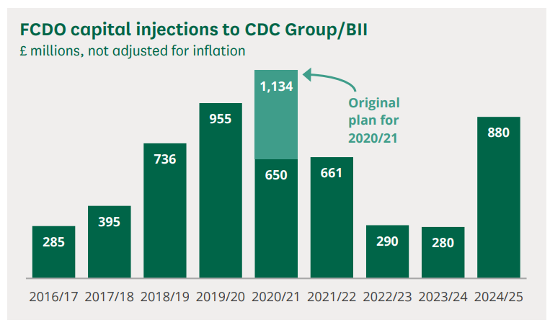
British International Investment (BII)
Loft & Brien 2025

Slide 6
BII’s pivot to climate finance
As CDC (2020), BII committed to net zero portfolio by 2050 only invest if investment supports country plans to be net zero by 2050 (see CAT)
“we will only pursue investments in gas-fired power stations and gas midstream projects if they fulfil the requirements of our emerging guidance tool to demonstrate alignment with countries pathways to net zero emissions by 2050…” (p. 7)
Despite this 2020 commitment to Paris Targets, and UK Government commitment to end fossil fuel support by 2021, in 2023 BII still had £526m (6% assets) in fossil-fuel projects (Carbon Brief 2025)
Later in the same year BII (2020) affirmed no new commitments in coal, oil, fossil fuel transport, finance (whole portfolio coal exclusion) – but accept gas if part of net zero/1.5 pathway, cement, industry with captive plants, trade finance for ‘refined energy products’

Slide 7
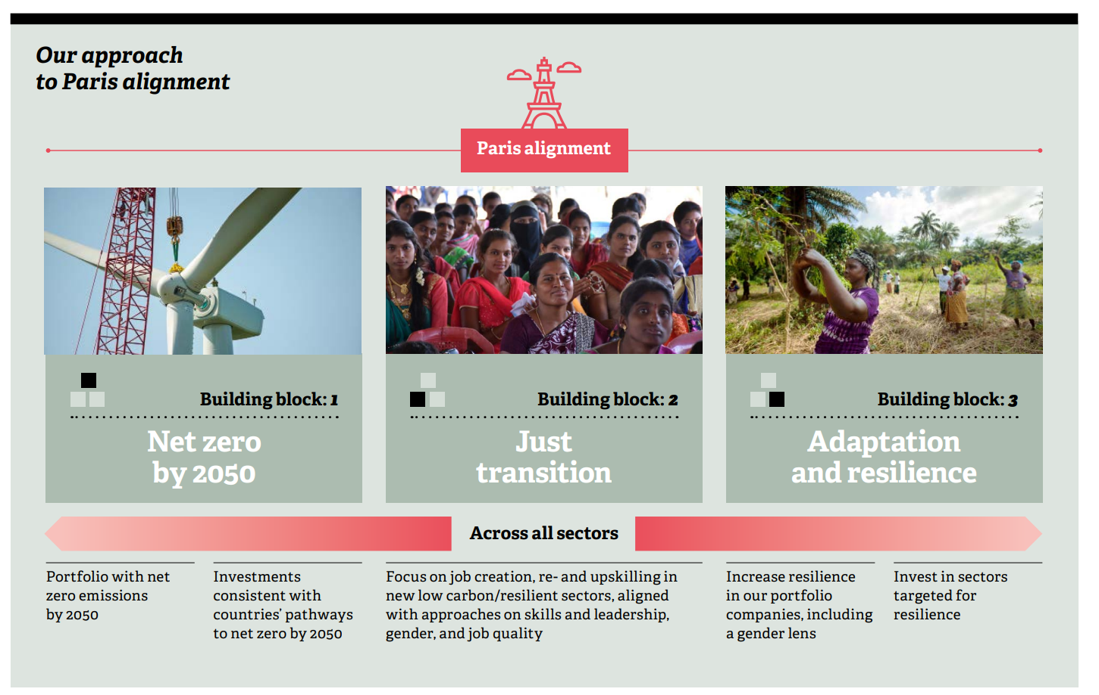
BII’s pivot to climate finance (2020)

Slide 8
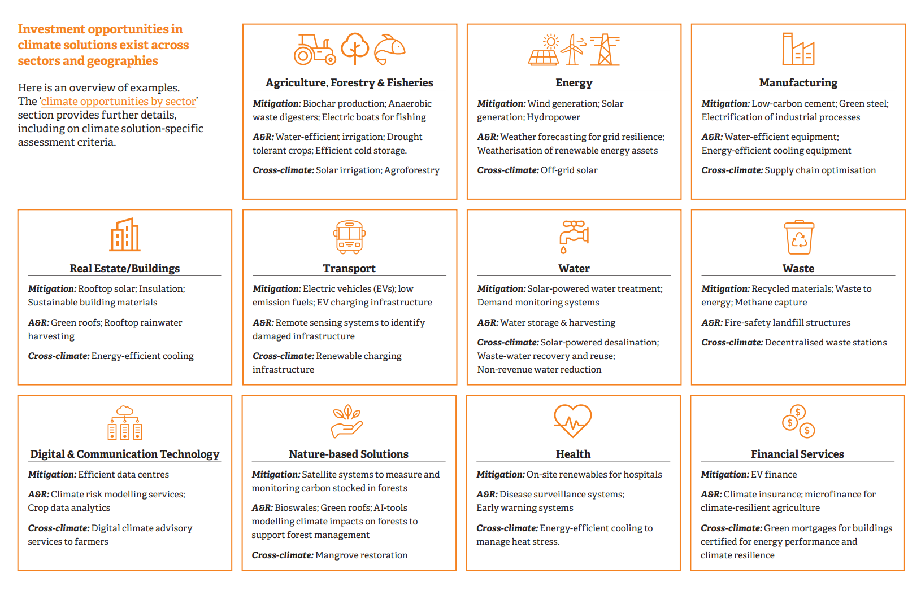
BII’s Climate Investment Playbook (2024)

Slide 9
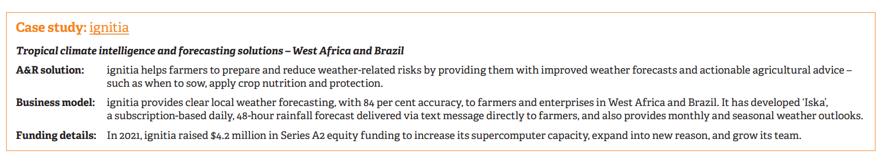
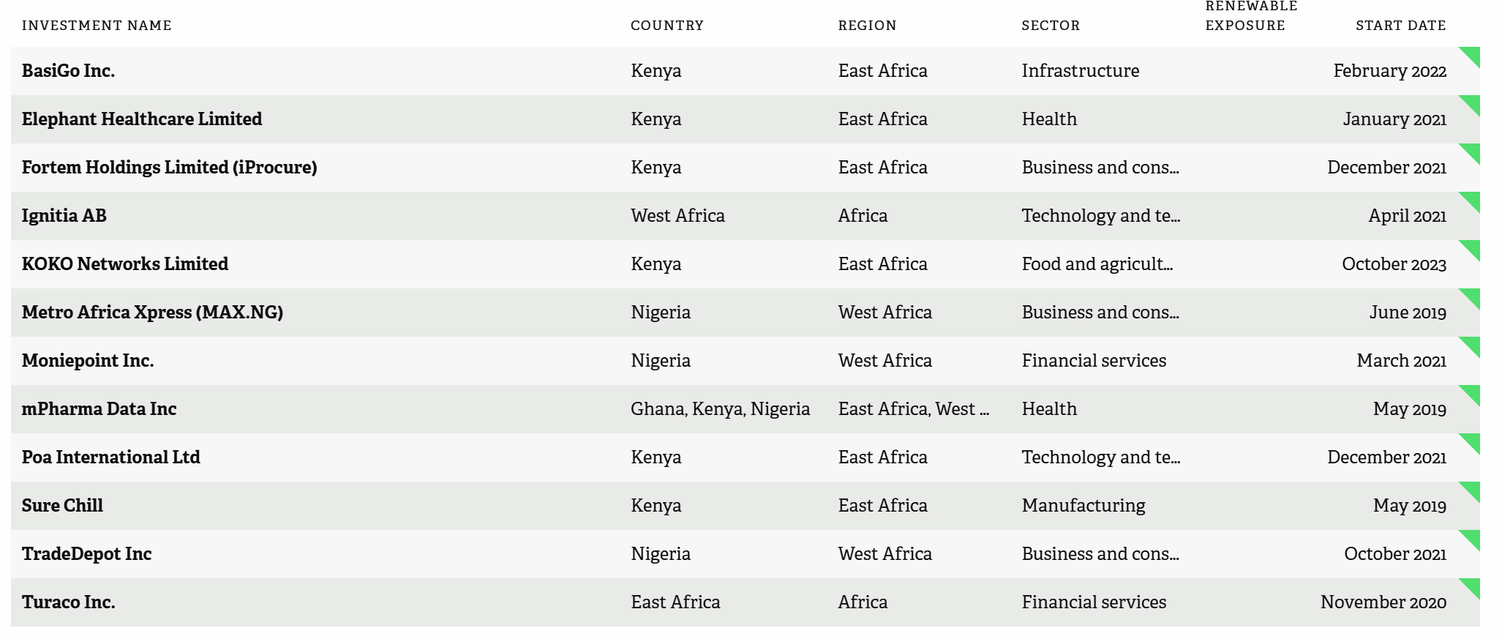
BII’s Climate Investment Playbook (2024)
Swedish co, investment via £15m invested in aMauritius domiciled Kenyan VC fund (Novostar Ventures) alongside varied other investments
Notes:
Notable emphasis on capital intensive, tech-led solutions

Slide 10
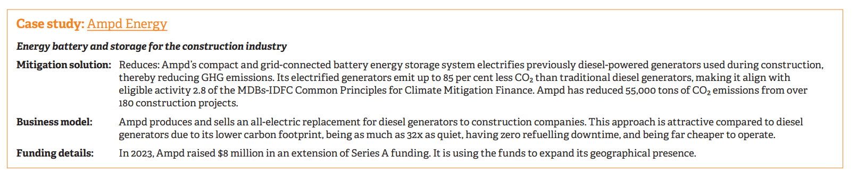
BII’s Climate Investment Playbook (2024)
Cannot actually find any evidence on BII’s portfolio of holdings in Ampd, or it’s parent company QFE
Notes:
Notable emphasis on capital intensive, tech-led solutions

Slide 11
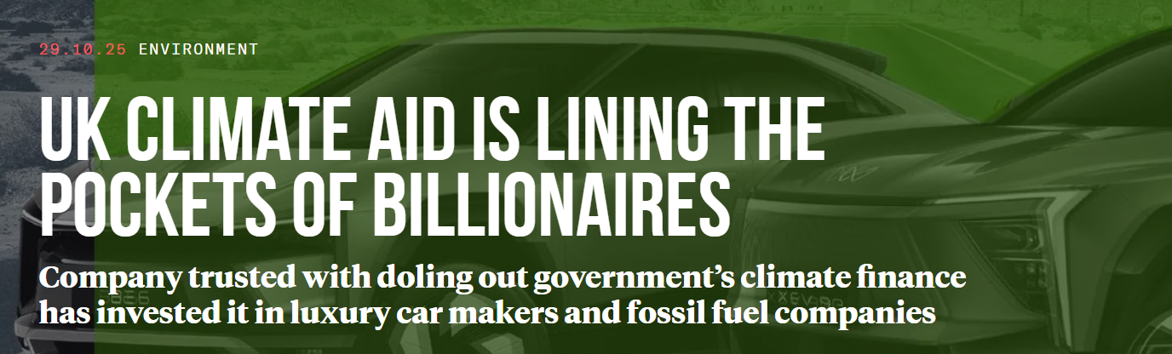
BII:
Controversies
Moulds (2025) – TBIJ report on BII climate finance
BII has a majority stake in Globeleq
Globeleq is currently constructing Temane gas-fired power in Mozambique
“BII said the investments in Globeleq that it calls climate finance have funded its renewables projects, not Temane. And it said past investments in Globeleq that supported Temane weren’t called climate finance” (Moulds 2025)
Not so straightforward: pre-2023, UK counted 30% of all capital given to BII as ‘climate finance’; after 2023 measure actual allocation (ICAI 2024)

Slide 12
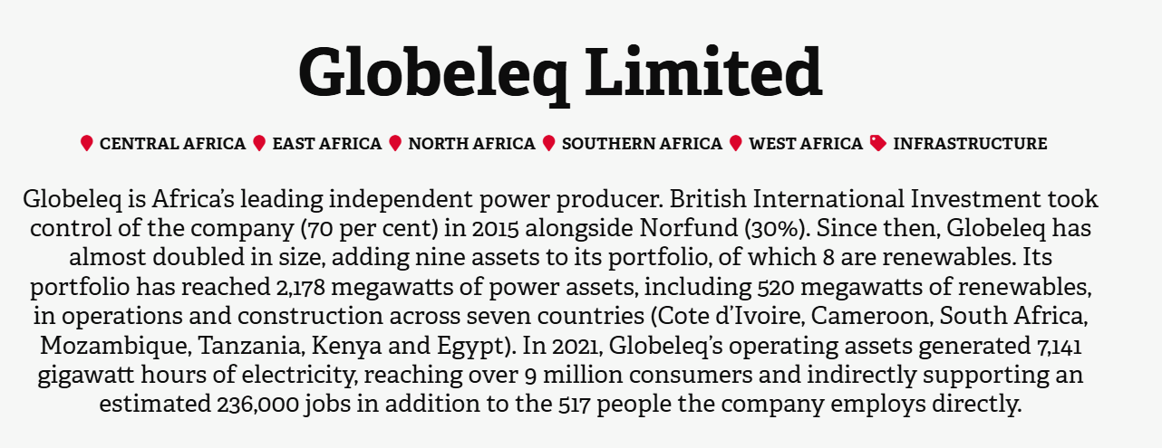
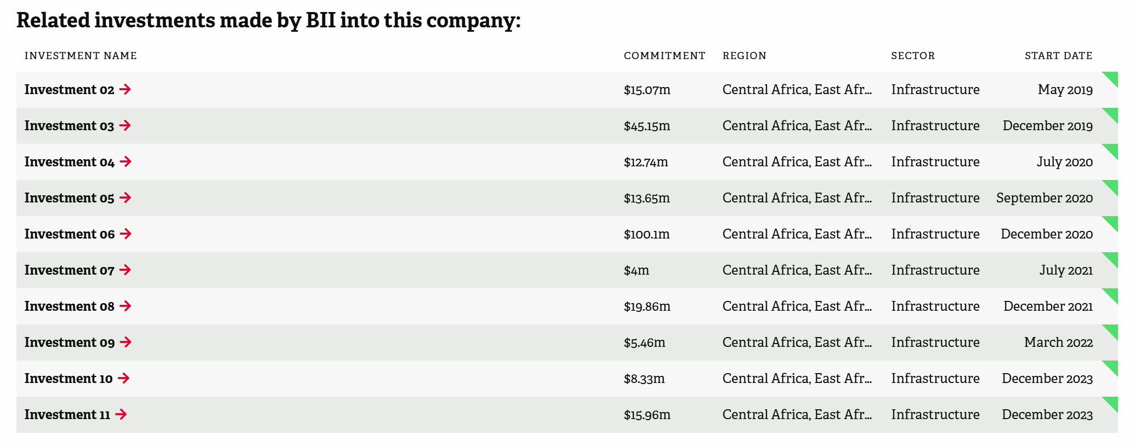
BII:
Controversies
Notes:
https://www.bii.co.uk/en/our-impact/investment/globeleq-limited-investment-01/

Slide 13
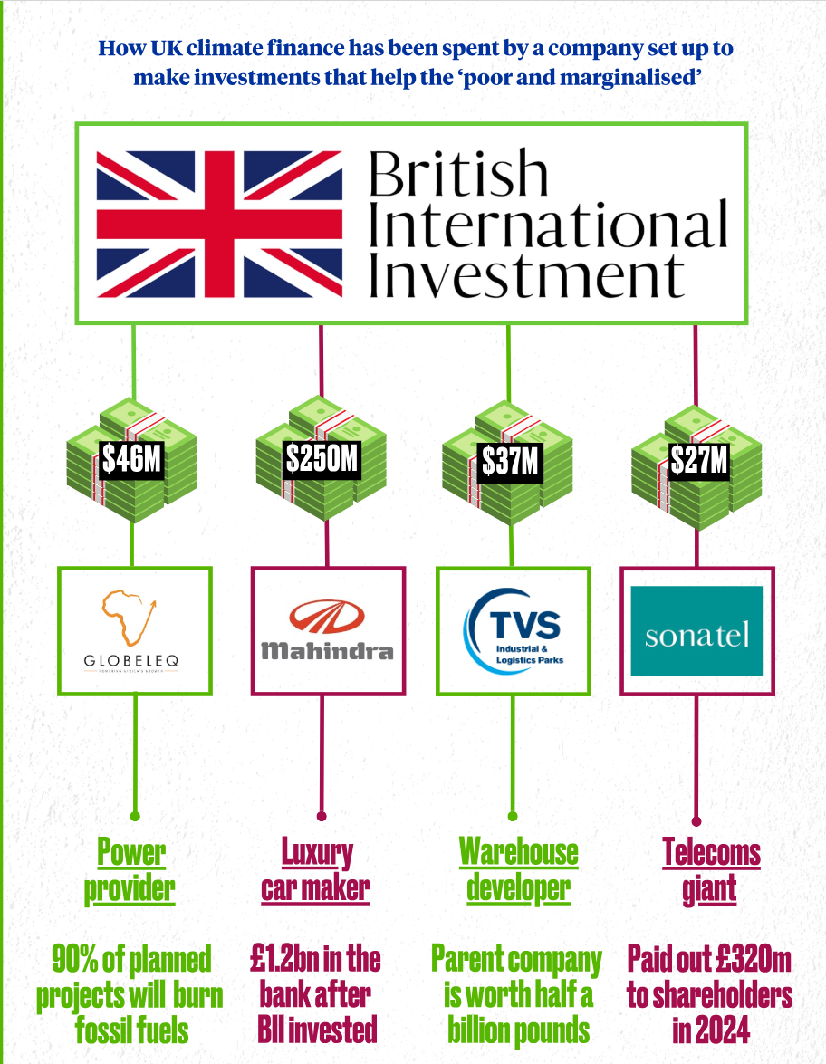
BII:
Controversies

Slide 14
UK Export Finance (UKEF)
Started life in 1919 to facilitate exports to USSR
Since 1970s, OECD agreements on minimum premiums to avoid competitive subsidy for exports
Will provide guarantees or lending to buyers of UK exports if UK has 20%+ of ‘content’
Recent deals include Cairo Monorail (£1.7bn credit extended, Canadian firm but with small UK factory)
Also include sovereign guarantees for Zambian purchase of hospitals and clinics (suspended after default)

Slide 15
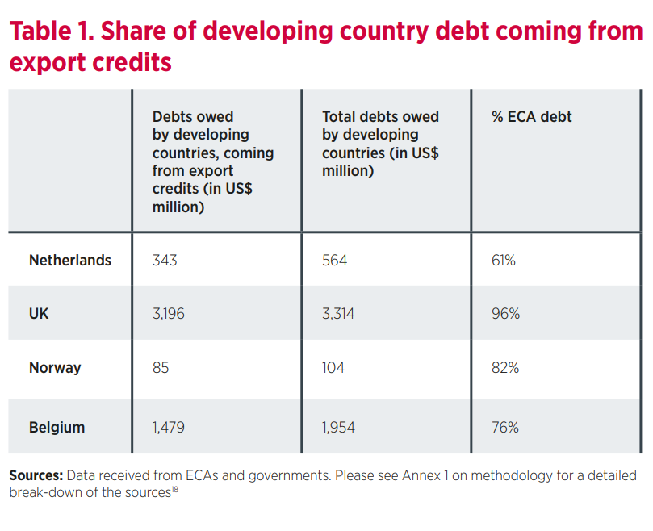
UKEF
Debt Links
Brynildsen et al. 2011
Blackmon (2017): 42% of HIPC debt in 1999 derived from ECAs like UKEF
If sovereign purchaser of UK exports defaults, claim is paid -> becomes bilateral debt
UKEF (2025: 56) note that they received ‘recoveries totalling £25.5 million from countries which continued to make payments under their UK Paris Club debt agreements.’

Slide 16
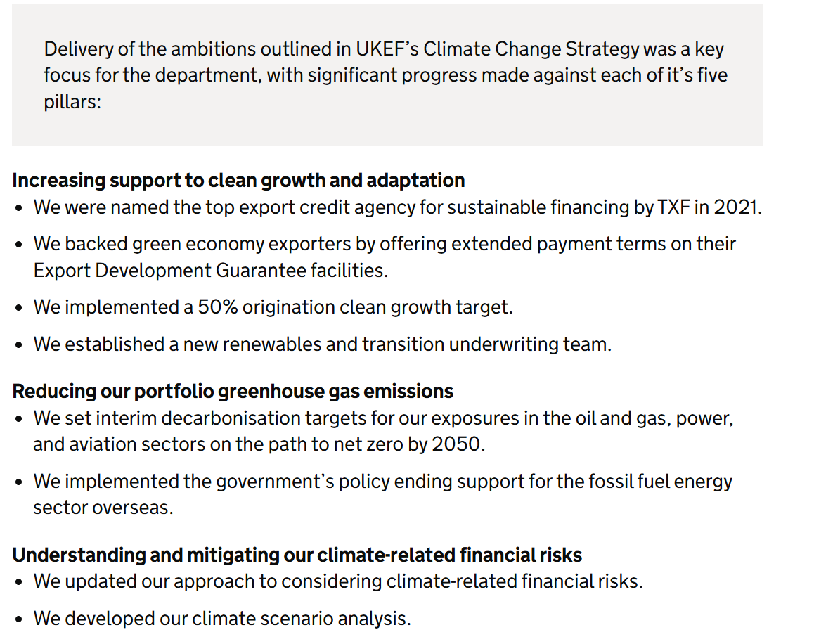
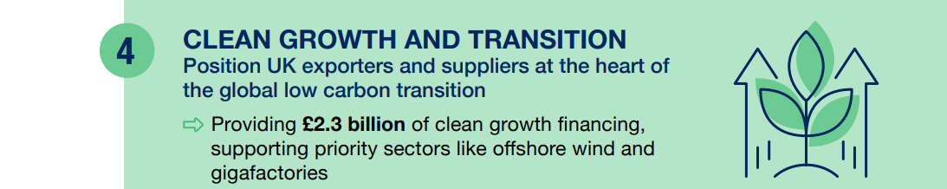
UKEF’s Climate Pivot (2024)
Notes:
https://www.gov.uk/government/publications/uk-export-finance-sustainability-strategy-2024-29/uk-export-finance-sustainability-strategy-2024-29
https://assets.publishing.service.gov.uk/media/68777b910263c35f52e4dc3e/UKEF_Annual_Report___Accounts_2024-25.pdf

Slide 17
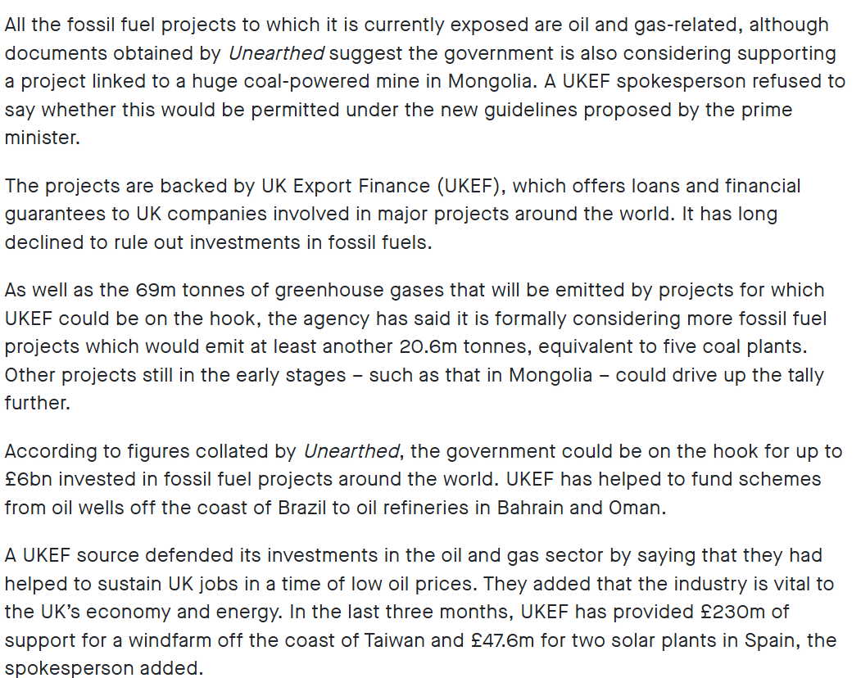
Similar story to BII around 2020:
Unearthed (2020) broke story about extensive fossil fuel investments – admittedly before UK (December 2020) committed to end fossil fuel support

Slide 18
UKEF & Friends of the Earth
Except…As recently as 2023, Friends of the Earth lost an appeal in their case against UKEF for supporting a £1.15bn natural gas project in Mozambique, with the court finding it was ‘tenable for UKEF to reach the view that funding the project was aligned with the UK’s obligations under the Paris Agreement.’
[2023] EWCA Civ 14, Appeal CA-2022-000759, Claim CO/3206/2020 in R/Friends of the Earth Ltd v. Sec State for International Trade, UKEF & Chancellor of the Exchequer.

Slide 19
UKEF, ECAs and Financing the Just Transition?
UKEF’s mandate is still primarily to support the financing (and profit repatriation) for UK exports
They have admittedly supported some large renewables focused initiatives (notably €146m credit to support Taiwan offshore wind)
But as Cenkowsky et al. (2025) and Klaasen et al. (2022) note, export credit pivots to renewables from fossil fuels = accompanied by shift to Global North
UKEF’s enthusiasm for critical minerals financing (for UK supply chains) is echoed by the Berne Union (2025)
ECAs like UKEF de-risk Northern exports / mineral supply chains; pose debt risk; invest heavily in aviation (largest sector) and increasingly defence

Slide 20
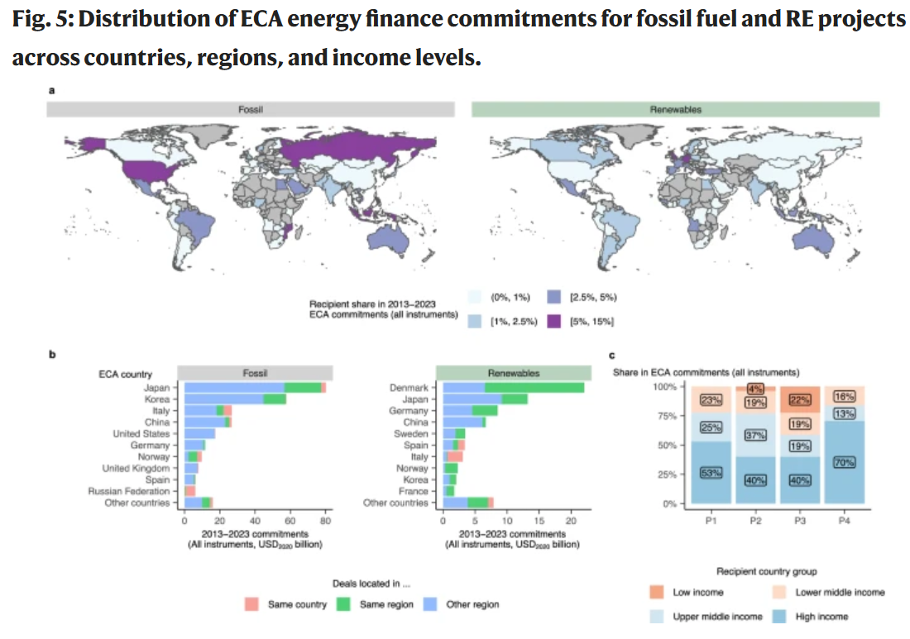
UKEF, ECAs and Financing the Just Transition?
Cenkowsky et al. 2025

Slide 21
PIDG
Founded in 2002, multi-donor initiative part-funded by UK ODA (70% of total = UK finance); exclusive focus on private sector expertise / mobilising private sector capital
Also criticised for high executive pay/expenses, unclear evidence of developmental ‘impact’
Similar story to the other two institutions: £749m - $3.6bn (2002-2018) on fossil fuels, ‘mobilising’ further private sector finance (Global Witness 2020)
Like the other two, a recent shift: Strategy 2030 “committed not only to supporting climate mitigation – through investments in renewable energy, electric vehicles, and alternative clean fuels – but also to advancing climate adaptation and resilience” (PIDG 2025)
Recent shift to invest in data platform and document ‘impact’

Slide 22
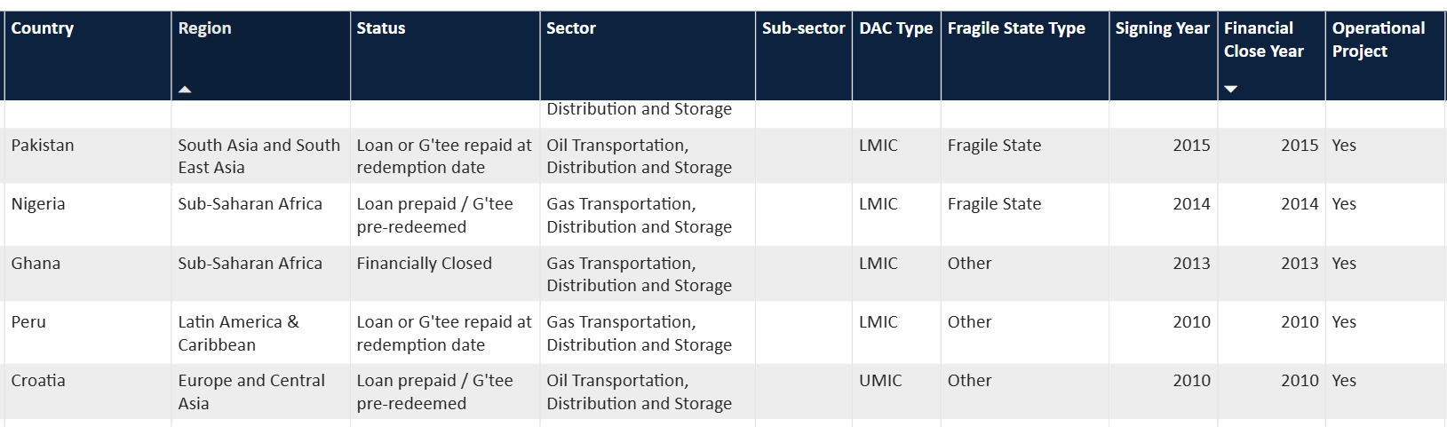
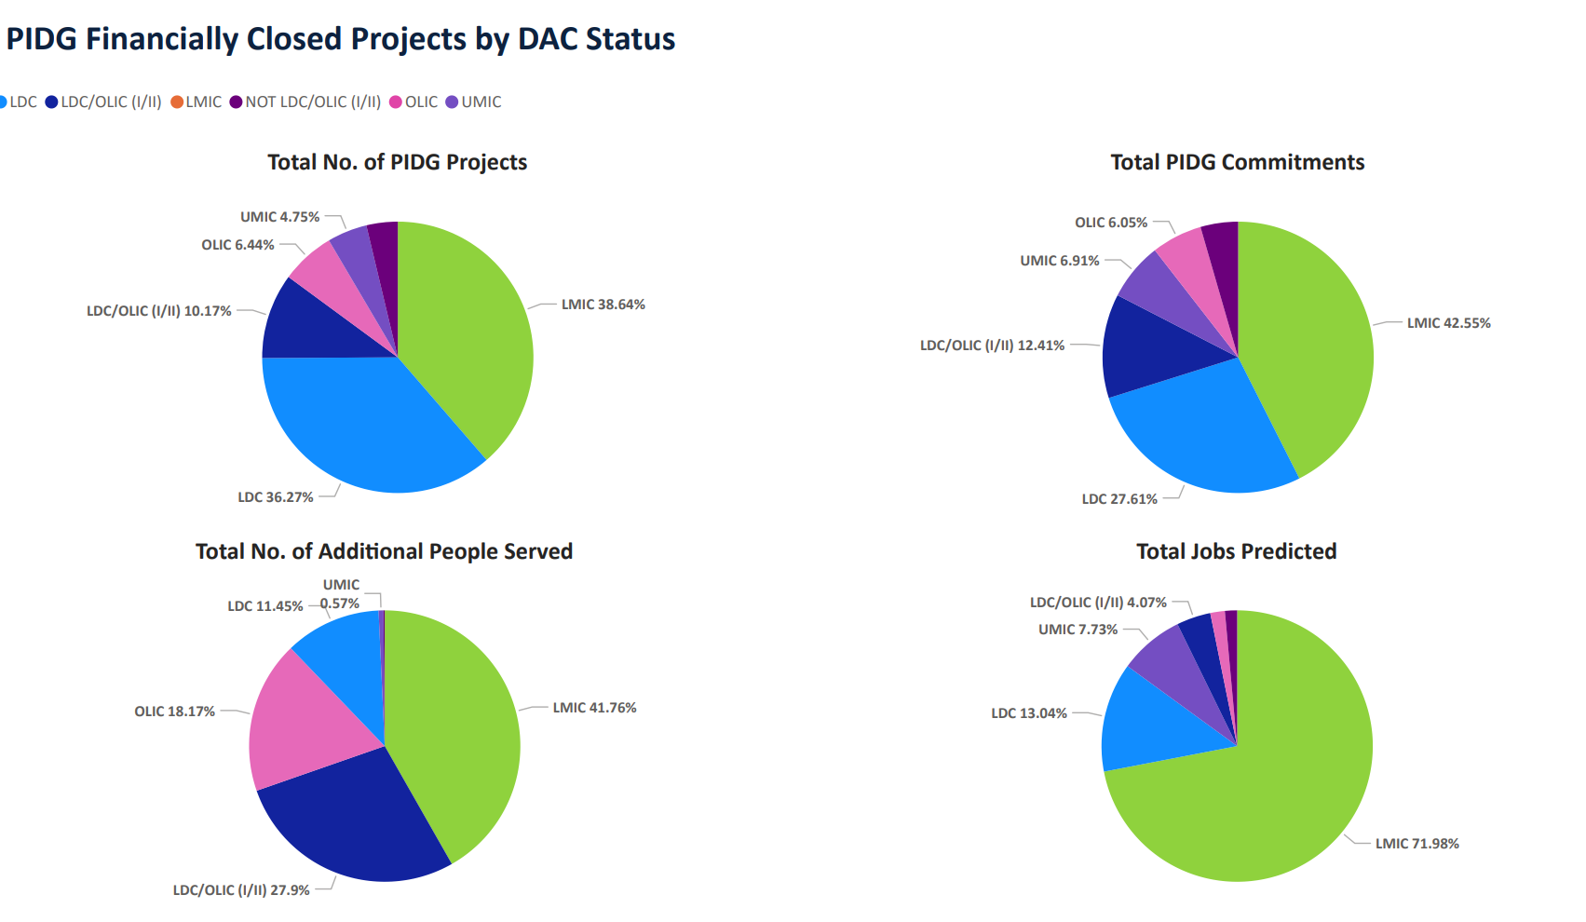
PIDG: ‘people served’ and ‘jobs predicted’

Slide 23
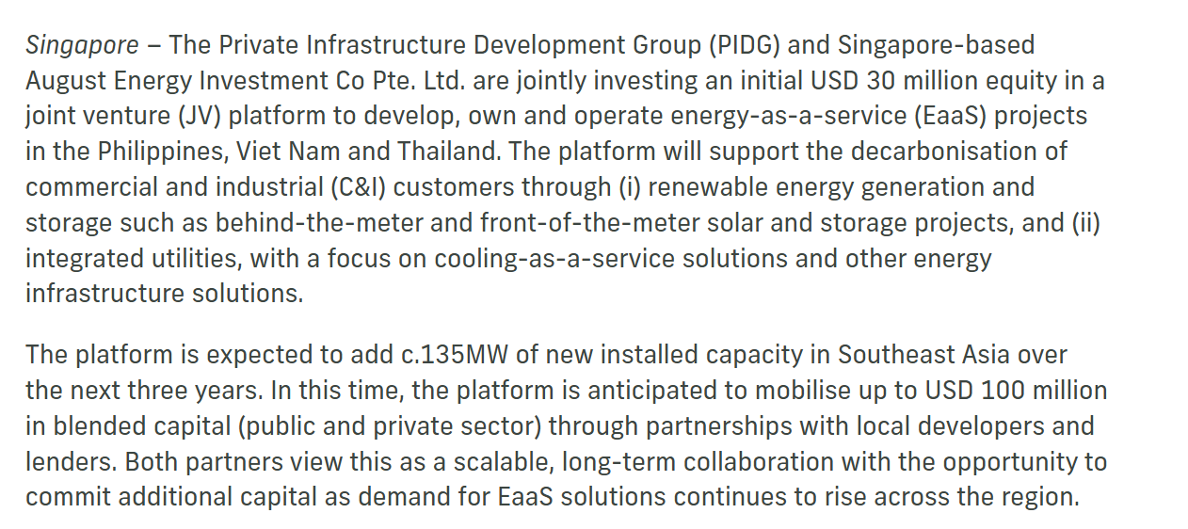
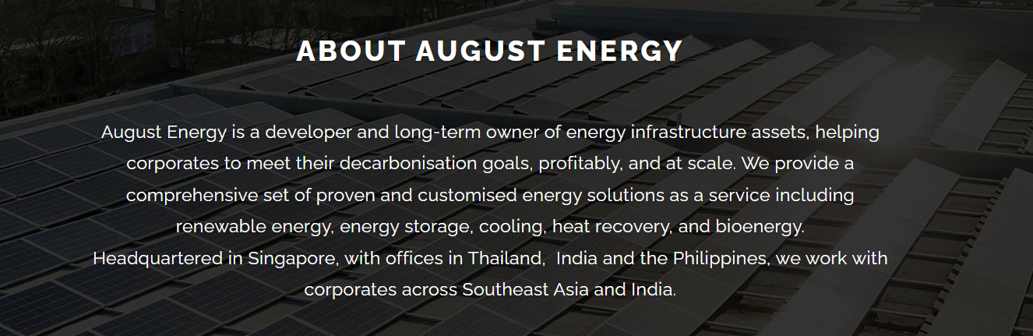
PIDG: driven by bankability?

Slide 24
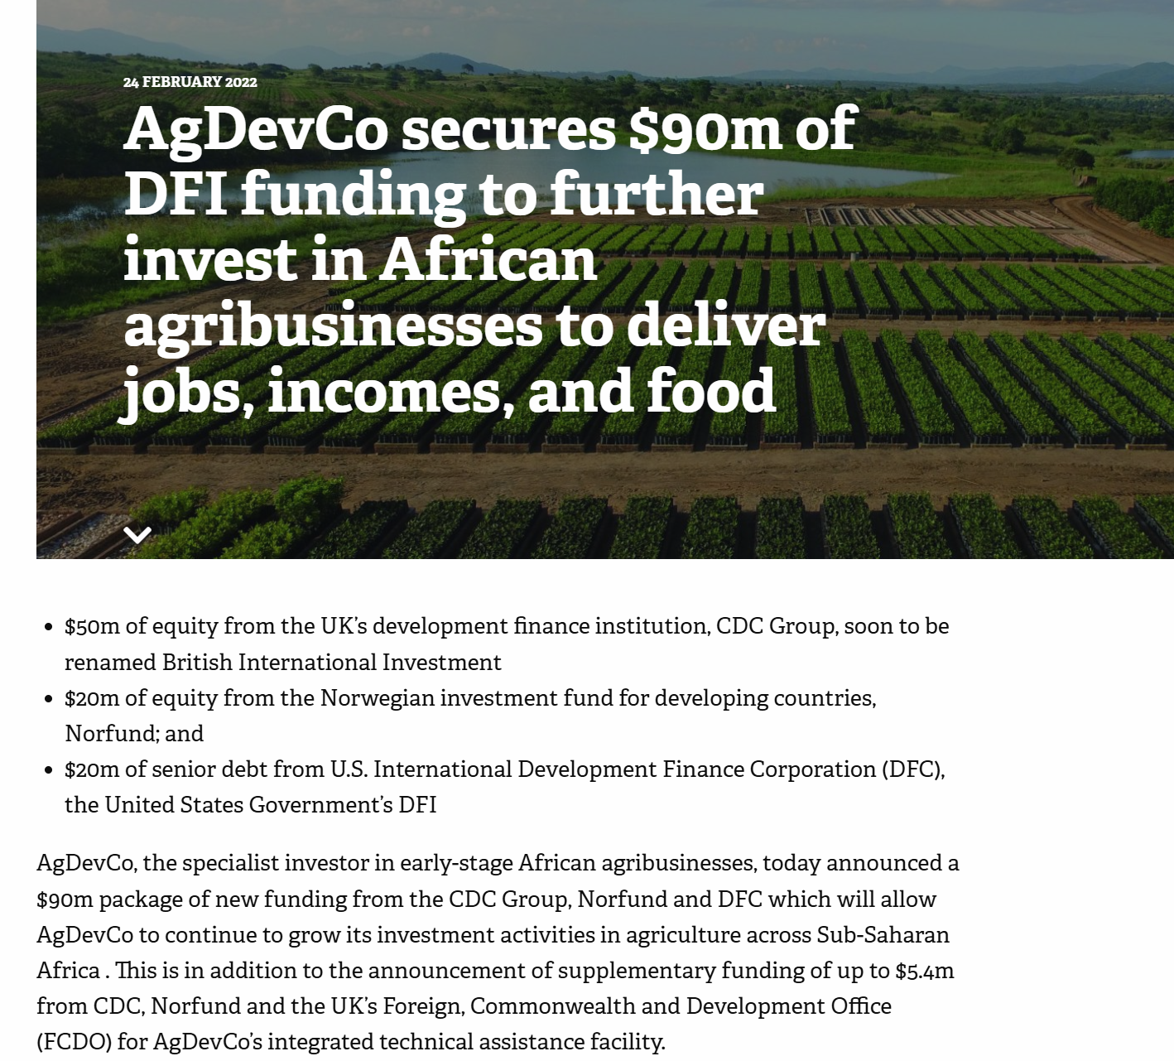
Relations with other DFIs

Slide 25
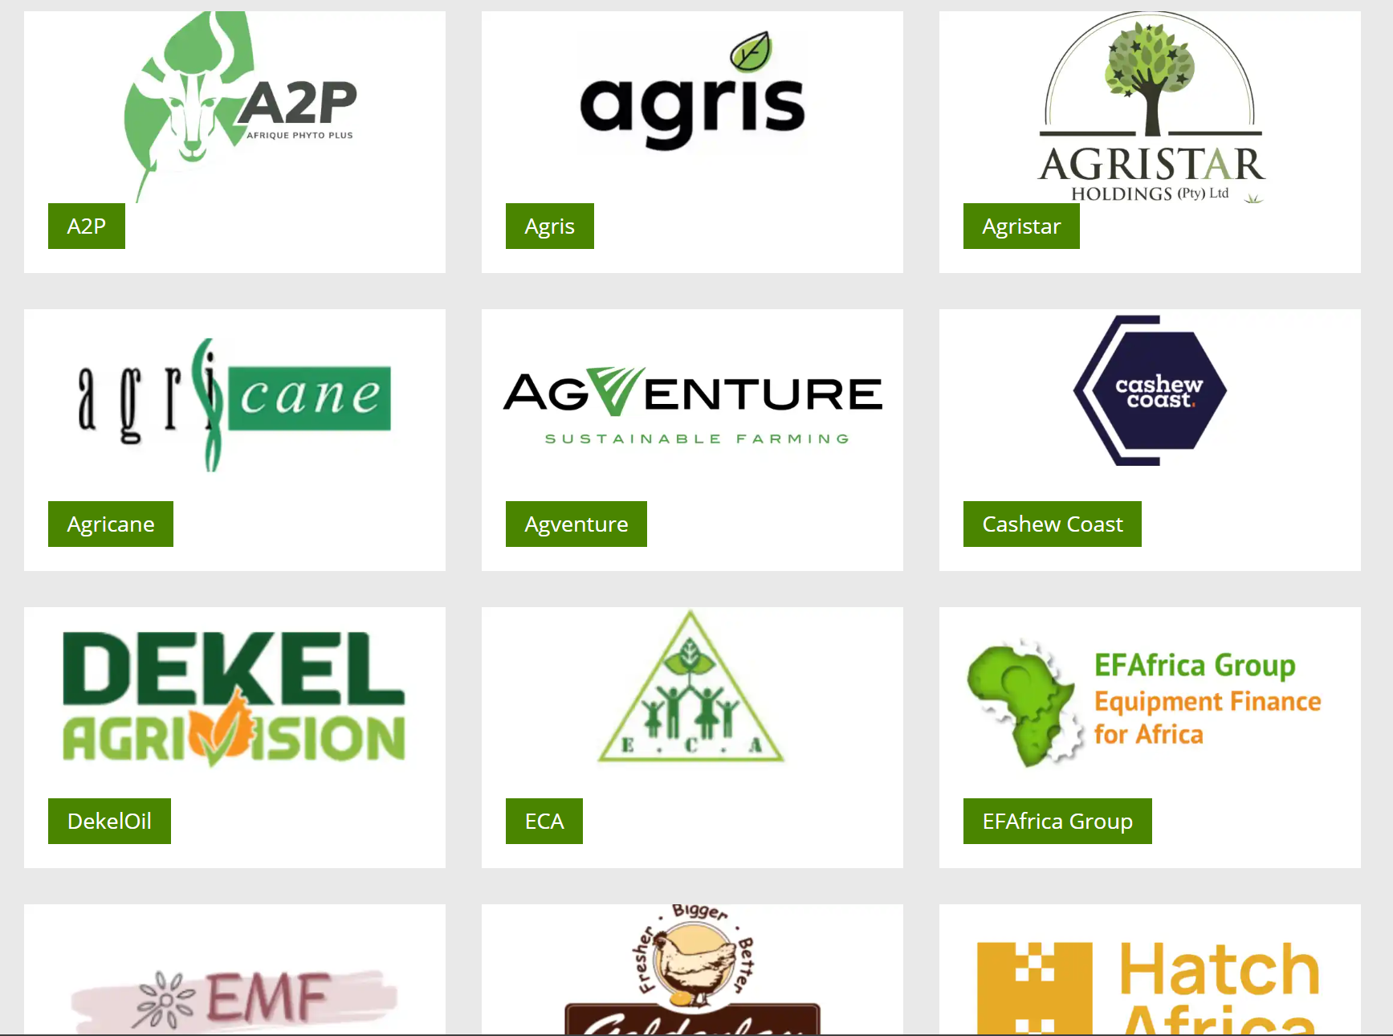
Relations with other DFIs

Slide 26
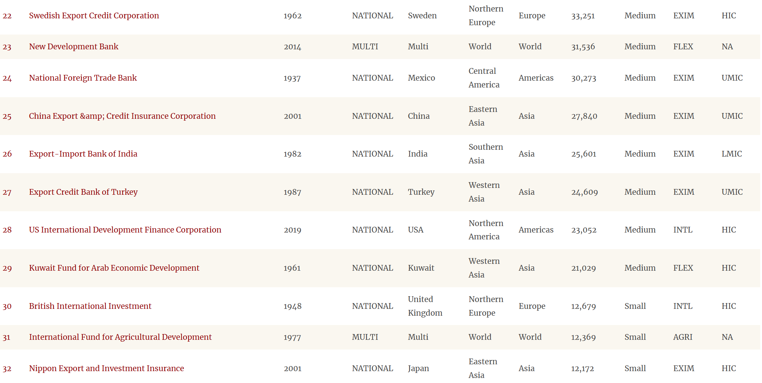
BII is Small…
Peking/AFD Database (link)

Slide 27
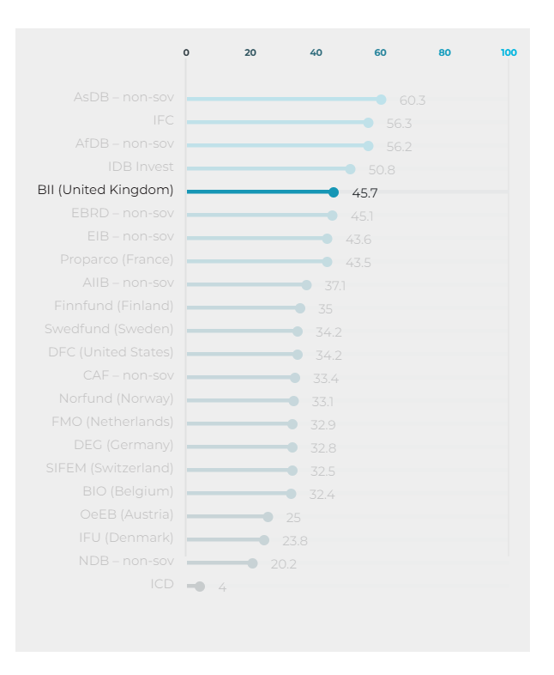
But apparently transparent (ish)…
“In the ESG and Accountability to Communities component, BII ranked joint 14th with a score of 8.5 out of 30. This marks a slight improvement from 2023 when BII ranked joint second-last for this component. Organisational-level improvements included a new explanation of E&S risk categorisation. However, BII continued to not score for any project-level indicators in this component, failing to provide adequate summaries of E&S risks and failing to disclose any E&S documentation for investments” (PWYF 2025)

Slide 28
DFIs and ECAs often overlap in function
“An expert group of DFIs and ECAs to increase coordination has already started discussions in 2024…
…Another level of hypocrisy is a simultaneous subsidising of European companies for renewables under the decarbonisation agenda and ongoing roll-out of polluting fossil fuel projects outside of the EU with export credits. This type of finance locks the countries into fossil fuel energy systems and obsolete infrastructure, fuels conflict (such as the ECA-backed Mozambique gas projects), and creates stranded assets, depriving the countries from means to advance socially and environmentally just public investments” (Counter-Balance/Both Ends 2024)

Slide 29
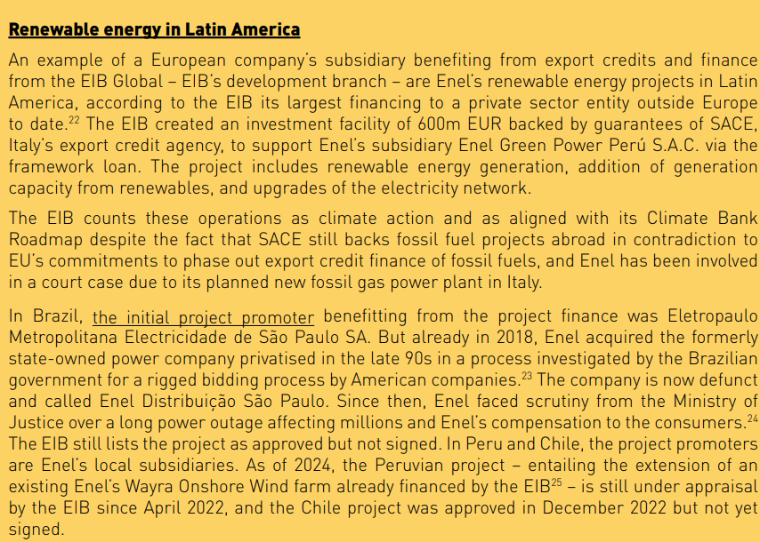
DFIs and ECAs often overlap in function

Slide 30
Misplaced Enthusiasm for DFIs / ECAs…?
“as honest brokers, DFIs can help to shape public policies to overcome the incumbent entrenchment challenge…DFIs can scale up renewable energy investments to make the price of renewable energies more competitive to ensure that renewable energy transformations will not undercut the international competitiveness of energy-intensive industries in global markets” (Xu & Gallagher 2022)
IPE scholars could ask “what role ECAs can play in securing supplies of critical minerals? …What are the prospects for renewable energy firms to receive more export finance?” (Peterson and Downie 2024: 989-90)
What kind of changes to ECAs/DFIs would it take for these to be feasible questions, and non-threatening suggestions?

