Slide 1

Linking the Global Context for Climate Justice, Trade & Energy Transitions to the Just Transition Mechanism
Vice Yu, TWN
9 February 2026, Jakarta

Slide 2
Why the Just Transition Mechanism Matters
Historic moment 1: UNFCCC recognizes need for "just, orderly, equitable" transitions (COP28 GST1 Dubai)
JTM can support developing countries contribute to fair and inclusive global climate action
Critical link between climate, development, trade, and investment
Historic moment 2: UNFCCC mandate “to develop a Just Transition Mechanism” (COP30 Belem)
Notes:
The establishment of a Just Transition Mechanism under the UNFCCC marks a historic opportunity to embed equity, development, and international cooperation at the heart of the global response to climate change.
It represents a structural recognition that transitions are not only technical or environmental processes, but deeply economic, social, and political in nature.
This comes at a moment when the global energy system, trade architecture, and investment flows are undergoing major realignments.

Slide 3
Global Context:
Are we in a Gramscian Interregnum?
Overlapping crises: climate, biodiversity, pollution, debt, energy, inequality, development gap
Geopolitical contestation over energy, critical mineral, natural resource supply chains – competition over cooperation; multipolarity out of unipolarity and hegemony
Unilateral and plurilateral trade and investment measures reshape global rules – retreat/weakening of multilateral norms and international cooperation
Notes:
Climate action today is unfolding amidst overlapping crises: rising debt burdens, energy insecurity, geopolitical fragmentation, and unequal access to green technologies and finance.
The energy transition is not neutral: it restructures global supply chains, labor markets, and technological ownership—often exacerbating existing inequalities unless governed equitably.
At the same time, new trade and investment measures—such as carbon border adjustment mechanisms (CBAMs), green industrial policies, and critical minerals strategies—are reshaping global economic relations in ways that may undermine the development space of the Global South.

Slide 4

“ll vecchio mondo sta morendo. Quello nuovo tarda a comparire. E in questo chiaroscuro nascono i mostri.” - [“The old world is dying. The new one is slow to appear. And in this chiaroscuro monsters are born.”; “the old is dying and the new cannot be born; in this interregnum a great variety of morbid symptoms appear.”; “The old world is dying, and the new world struggles to be born: now is the time of monsters”]
Antonio Gramsci’s reflection on materialism and the crisis of authority, written from within a Italian Fascist prison in Mussolini’s Italy between 1926-1937 (in his “Prison Notebooks”).
Interregnum was the term used in ancient Rome to refer to the moment of legal and political in-betweenness that followed the death of the sovereign emperor and preceded the enthronement of his successor. The declaration of interregnum was accompanied by the proclamation of justitium, for it was not only sovereignty but also legality that was suspended.
Italian philosopher, linguist, journalist, writer, politician
22 January 1891 – 27 April 1937
So are we now in a global interregnum?

Slide 5
Is Mearsheimer Correct?
The Shift to Multipolarity: "Around 2017, China and Russia emerged as great powers, and we moved into a multipolar world, with great-power competition back on the table."
The Rise of China: "The rise of China and the reemergence of Russia as major powers have restored intense strategic rivalry, increasing the risks of conflict and reducing the scope for global cooperation."
U.S.-China Competition: "Simply put, the most powerful state is the one that prevails in a dispute... China, in short has the potential to be considerably more powerful than even the United States."
The Inevitability of Conflict: "Great powers are rarely content with the current distribution of power; on the contrary, they face a constant incentive to change it in their favor."
Future Risks: "In a world of three great powers, especially when one of them has China's potential military might, there is sure to be security competition and maybe even war."
The "Godzilla" Metaphor: "In the anarchic world of international politics, it is better to be Godzilla than Bambi."
The "Tragedy" of the Shift: "Great-power politics is tragic because the structure of the international system forces states that seek only to be secure nonetheless to act aggressively toward each other
John Mearsheimer is a US political scientist best known for developing the structural realist theory of offensive realism, which describes the interaction between great powers as being primarily driven by the rational desire to achieve regional hegemony in an anarchic international system.

Slide 6
United States | China
The 2025 National Security Strategy (NSS) of the United States emphasizes a, shift toward "flexible realism," prioritized burden-sharing, and economic security, with a key quote highlighting the end of America's role as a global protector: "The days of the United States propping up the entire world order like Atlas are over". Strategic Burden-Sharing: Reflecting the need for allies to take more responsibility, the strategy notes: "In competition and conflict below the threshold of war, the decisive force will often be indigenous because they have to be". Regional Prioritization: The strategy reinforces the Monroe Doctrine, aiming to secure the Western Hemisphere while focusing on competing with China both globally and in the Indian and Pacific Ocean theaters. Economic Security: The strategy emphasizes that "superpower competition has given way to great-power jockeying, in which the United States retains the most enviable position“, utilizing US bargaining power to pursue transactional economic security goals Foreign Policy Shift: The document moves away from universal ideological goals (e.g.,, exporting “democracy”), with a focus on "flexible realism" that seeks to build relations "without imposing on them democratic or other social change that differs widely from their traditions and histories", while at the same time remaining open to more robust assertions of US power in pursuit of US economic interests within the Western Hemisphere and elsewhere Sovereignty-Focused: A core aspect of the strategy involves addressing the "civilisational erasure" that it suggests is occurring in Europe, arguing for a "sovereignty-centred" nationalist/nativist (largely against economic migrants but opening doors for HNWIs/UHNWIs) approach. | From 2026 to 2030, China’s 15th Five-Year Plan sets the comprehensive agenda for economic and social transformation. In a world of mounting external uncertainty and internal reform, the Plan aims to chart a new path towards high-quality growth, innovation, and national stability marked by: Strengthening the Real Economy - Bolstering manufacturing, infrastructure and digital economy to secure a strong industrial base. Advancing Technological Independence - Pioneering domestic innovation and key technology breakthroughs for greater self-reliance. Expanding the Domestic Market – Ramping up domestic consumption and investment, building a unified national market. Improving Socialist Market Mechanisms - Driving market-oriented reforms within State-led framework to enhance long-term growth capacity. Deepening Global Partnerships - Promoting multilateral trade and win-win Belt and Road collaborations for increased global competitiveness. Modernizing Rural Development - Fostering modern agriculture and holistic rural revitalization through urban-rural integration. Advancing Regional Balance - Optimizing balanced regional economic relationships to support urbanization and balanced coastal-inland growth. Promoting Cultural Innovation - Fostering creativity and strengthening the cultural sector for a more cohesive society. Enhancing Social Welfare and Shared Prosperity - Improving social safety nets, income distribution and public health for common prosperity. Building a Green China - Accelerating carbon neutrality, renewable energy, and ecological protection. Ensuring National Security - Modernizing security systems and governance to safeguard national stability. Modernizing National Defense - Advancing military modernization with a focus on smart and digital defense capabilities.
https://www.whitehouse.gov/wp-content/uploads/2025/12/2025-National-Security-Strategy.pdf
https://english.www.gov.cn/news/202510/25/content_WS68fc10abc6d00ca5f9a0703e.html

Slide 7
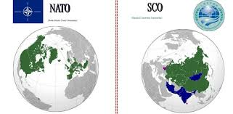

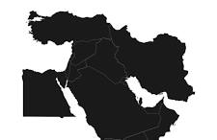
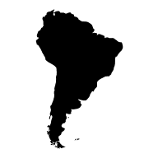

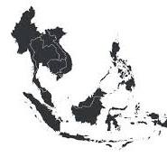
Great Power Shifts?

Slide 8
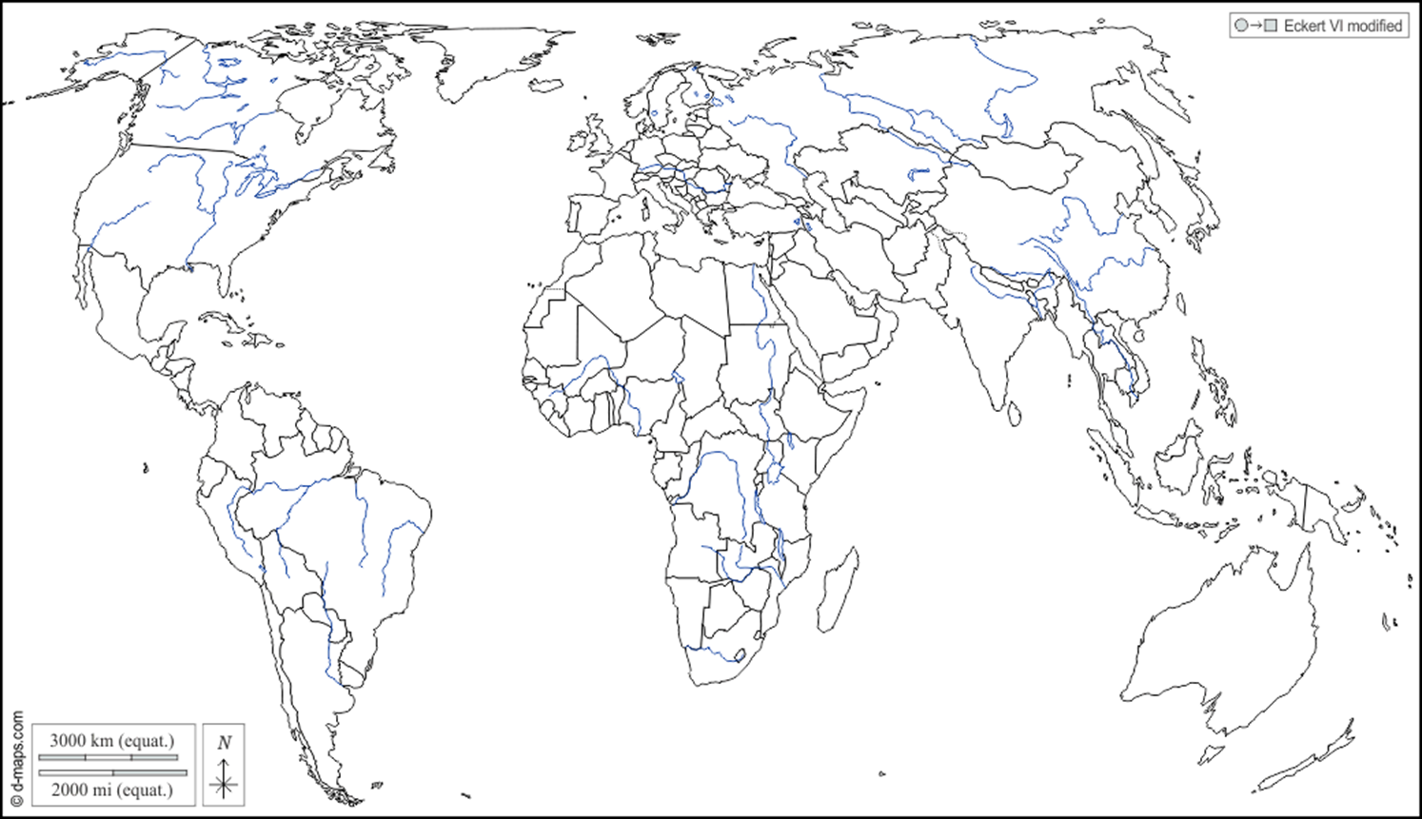
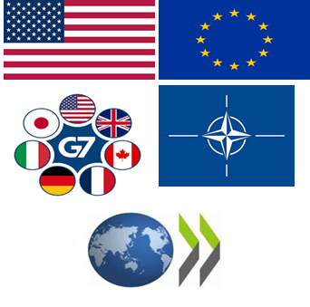






The Multipolarity Shift – Is it Happening for Real?
G7 plus rest of OECD – 1.38 billion people (17% of global population) and 46% of global GDP (PPP)
BRICS+ - 4.42 billion (54.6%) of the world's population and 42.2% of global GDP (PPP)
Rest of the global South – 2.3 billion people (28.4%) and 11.8% of global GDP (PPP) – including non-BRICS+ ASEAN (0.196 billion people (2.4%); 2.0% of global GDP); non-BRICS+ African Union (0.77 billion people (9.5%); 1.7% of global GDP); non-BRICS+ South America (0.2 billion people (2.5%); 2.9% of global GDP); non-BRICS+/ASEAN/OECD Asia (1 billion people (12.4%); 7.4% of global GDP)

Slide 9


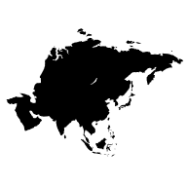


The International Law System Today:
Accelerating or supporting Multipolarity?
decoupling
contested
multipolarity
cascading protectionism
planetary crises
transactional
erosion of trust
unilateralism
selective rules application
regionalism
strategic competition
Pluri- and mini-lateralism
fragmented
heightened conflict potential
weakened
Big Questions
What is the role of “middle powers” and those with no power?
Is development convergence really taking place?
How do we deal with global commons, global public goods problems?

Slide 10


Multipolarity Tensions
North, West, East, South
Rivalries impact trade and security.
Countries balance economic and political ties with national interest – transactional in the Trumpian era here to stay?
Competing perspectives over access, ownership, control of resources, factors of production, institutions(multilateral, State, corporate, community) drive geoeconomics and geopolitics
Geoeconomics shape geo-politics shape international law and norms

Slide 11
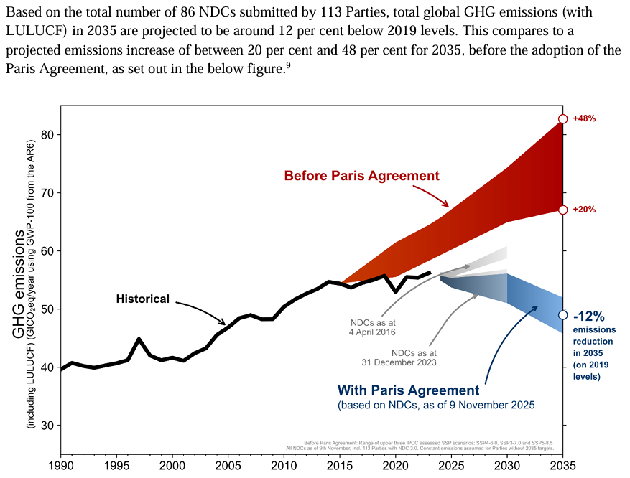
How will this affect the NDCs?
The new NDCs show a progression in terms of quality, credibility and economic coverage, with 89 per cent of Parties communicating economy-wide targets (compared with 81 per cent in their previous NDCs);
The new NDCs include responses to the outcomes of the first GST, with 88 per cent of Parties indicating that their NDCs were informed by the outcomes of the GST and 80 per cent specifying how;
The emissions trajectories set out in the new NDCs are broadly consistent with a linear trajectory from the Parties’ 2030 targets to their long-term net zero targets, showing that Parties are laying out clear stepping-stones towards net zero, although acceleration of action is still needed;
Collectively, the new NDCs show a reduction in projected emissions of 17 (11–24) per cent below the 2019 level;
All NDCs go beyond mitigation to include elements, inter alia, on adaptation, finance, technology transfer, capacity-building and addressing loss and damage, reflecting the comprehensive scope of the Paris Agreement;
Adaptation and resilience are featuring more prominently in NDCs, with 73 per cent of the new NDCs including an adaptation component;
Implementation of the new NDCs necessitates strong, ongoing international cooperation, and new and innovative approaches to unlock finance and support for developing country Parties at scale.
https://unfccc.int/process-and-meetings/the-paris-agreement/nationally-determined-contributions-ndcs/2025-ndc-synthesis-report
No US; EU, UG, EIG backtracking
Only 113 out of 196 Parties (69% of emissions) - https://unfccc.int/NDCREG

Slide 12



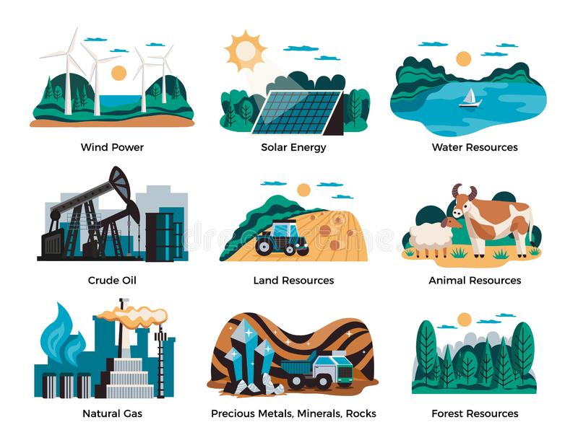

Competition, not Cooperation?

Slide 13
Emerging Risks for Developing Countries’ Just Climate Transitions in a Transactional and Geopolitical Multipolar World
Mitigation and adaptation ambition pushed delinked from and without sufficient means of implementation (MOI)
Debt-heavy and conditional transition finance models (e.g., JETPs)
Unilateral and plurilateral trade measures (CBAMs, carbon regulations) emphasize power asymmetry and disadvantage the poor
Unequal access to green technology and supply value chains and markets (regulations, cost, technology access, IPRs, critical minerals)

Slide 14
Energy Supply Chains and Green Geopolitics
Transition minerals, batteries, hydrogen, renewables = new geoeconomic battlegrounds
Risk: replicating old extractive patterns and dependency
JTM should support Global South increase participation in value-added activities needed for just transition pathways
Notes:
Energy transition supply chains—particularly for critical minerals, batteries, green hydrogen, and renewables—are fast becoming sites of geopolitical contestation.
The current concentration of value addition and technology control in a few countries threatens to reproduce North-South inequalities in the green economy.
A well-designed JTM can support inclusive participation of developing countries in green industrialization and value chain upgrading, by mobilizing:
O Support for skills development and industrial policy.
O Regional cooperation in infrastructure and logistics.
O Legal and regulatory guidance for just transition investment.

Slide 15

Technology Transfer and Just Transitions
Technology is central to decarbonization and development.
Just transitions require access to affordable, appropriate technologies.
Barriers: IPR, finance, capacity gaps, asymmetrical trade rules, access to and control of critical minerals.

Slide 16
Systemic Inequities
=
Digital economy divide
Historical imbalance in R&D investment and technology flows and productive capacity.
Unequal bargaining power in trade and IP negotiations.
Financial flows from South to North due to IP royalties (on top of debt payments, IFFs, global tax injustice, corporate profit repatriation)
Technology transfer commitments under UNFCCC remain underdelivered.

Slide 17
Key Features of an Equitable JTM: Proposal
Anchored in CBDR-RC and the right to development
Covers all pillars: mitigation, adaptation, loss and damage, response measures, MOI
Linked to other UNFCCC mechanisms (JTWP, Article 6, Finance, Tech)
Inclusive governance: workers, women, Indigenous Peoples, informal sector
Notes:
To be effective, the JTM must:
O Be anchored in CBDR-RC and the right to development.
O Avoid technocratic narrowness and include all dimensions—social protection, adaptation, resilience, and structural change.
O Be linked with other UNFCCC workstreams (e.g., JTWP, Response Measures, Article 6, Finance, GST, Technology Mechanism).
Politically, the JTM offers an opening for developing countries to set the terms of transition, resisting top-down, conditionality-heavy models like JETPs.
It is an opportunity to reclaim climate multilateralism as a space for economic justice, not just emissions governance.

Slide 18

Strategic Opportunities for the Global South
Shape global just transition norms and safeguard policy space
Build South-led alternatives to conditional partnerships (e.g., JETPs)
Technology transfer, climate finance (including adaptation and loss and damage finance) are cornerstones of equitable just transitions.
Use JTM to coordinate national and regional transitions
Align with South-led development-oriented trade, industrial, and investment policies and strategies
Without structural reforms, climate-driven transitions risk deepening inequalities.
Developing countries must lead in shaping a proactive, South-led agenda.
Notes:
Without an equitable framework, the global energy transition could deepen structural inequality and geopolitical instability.
With the right design and ambition, the Just Transition Mechanism can become a catalyst for a new era of cooperation, one that bridges climate, trade, and development—leaving no country or community behind.

Slide 19

What next on the JTM?
Develop a work plan to further define the JTM, including its objectives, scope and coverage, functions, governance and institutional arrangements, linkage to existing mechanisms (both inside and outside UNFCCC), effective and supportive MOI arrangements (GCF, GEF, AF, LDCF, SCCF, FRLD, SN, CTCN, PCCB, NDCP, etc.), linkage to non-UNFCCC entities that can provide support (MDBs and RDBs, NDB, AIIB, IRENA, UNIDO, UNCTAD, FAO, UNDP, UNEP, etc.), engagement with IPLCs and CSOs
Push for grant-based, non-debt financing, technology transfer, technical assistance and capacity building as key MOI elements for the JTM
Reject one-size-fits-all transition models – equity, flexibility for developing countries, reflection of CBDR-RC
Make the JTM a vehicle for climate justice and the right to development through international non-market based cooperation

Slide 20
Trade and Investment Linkages
Ensure compatibility of climate-related trade rules with equity
01
Prevent climate action from being weaponized via unilateral measures
02
Facilitate regional value chains and technology partnerships
03
Mobilize support for green industrialization in the South
04
Notes:
Climate-related trade and investment measures—such as CBAMs, local content requirements, and sustainable finance rules—are proliferating without adequate coordination with the UNFCCC process.
There is a growing risk that climate-related trade measures could penalize developing countries for lacking resources to decarbonize fast enough, while offering limited support in return.
The JTM can serve as a counterbalance to unilateral measures by:
O Promoting multilateral standards for fair transition financing.
O Ensuring technology access and intellectual property cooperation in green sectors.
O Supporting resilience and diversification of energy supply chains, including in fossil fuel-dependent and resource-based economies.

Slide 21
What the JTM Can Potentially Offer
Platform for cooperation and support, not conditionality
Enable nationally determined just transition pathways
Align climate goals with development, jobs, and inclusion
Bridge policy across climate action (mitigation, adaptation, LD, RM) and equitable and inclusive development transitions
Notes:
The JTM has the potential to become a coordinating platform for international cooperation on just transition that is developmentally appropriate, nationally driven, and globally supported.
It can provide policy coherence across climate action, finance, trade, and investment, by helping countries design transitions that:
O Protect and create decent jobs.
O Ensure energy access and affordability.
O Enable structural transformation, not just carbon reduction.
If properly structured, the JTM can fill a critical gap by facilitating capacity-building, technology partnerships, and concessional financing aligned with national just transition plans—not externally imposed reforms.

Slide 22
Thank You
yuvice@hotmail.com
Check out: www.twn.my (TWN)

