Slide 1
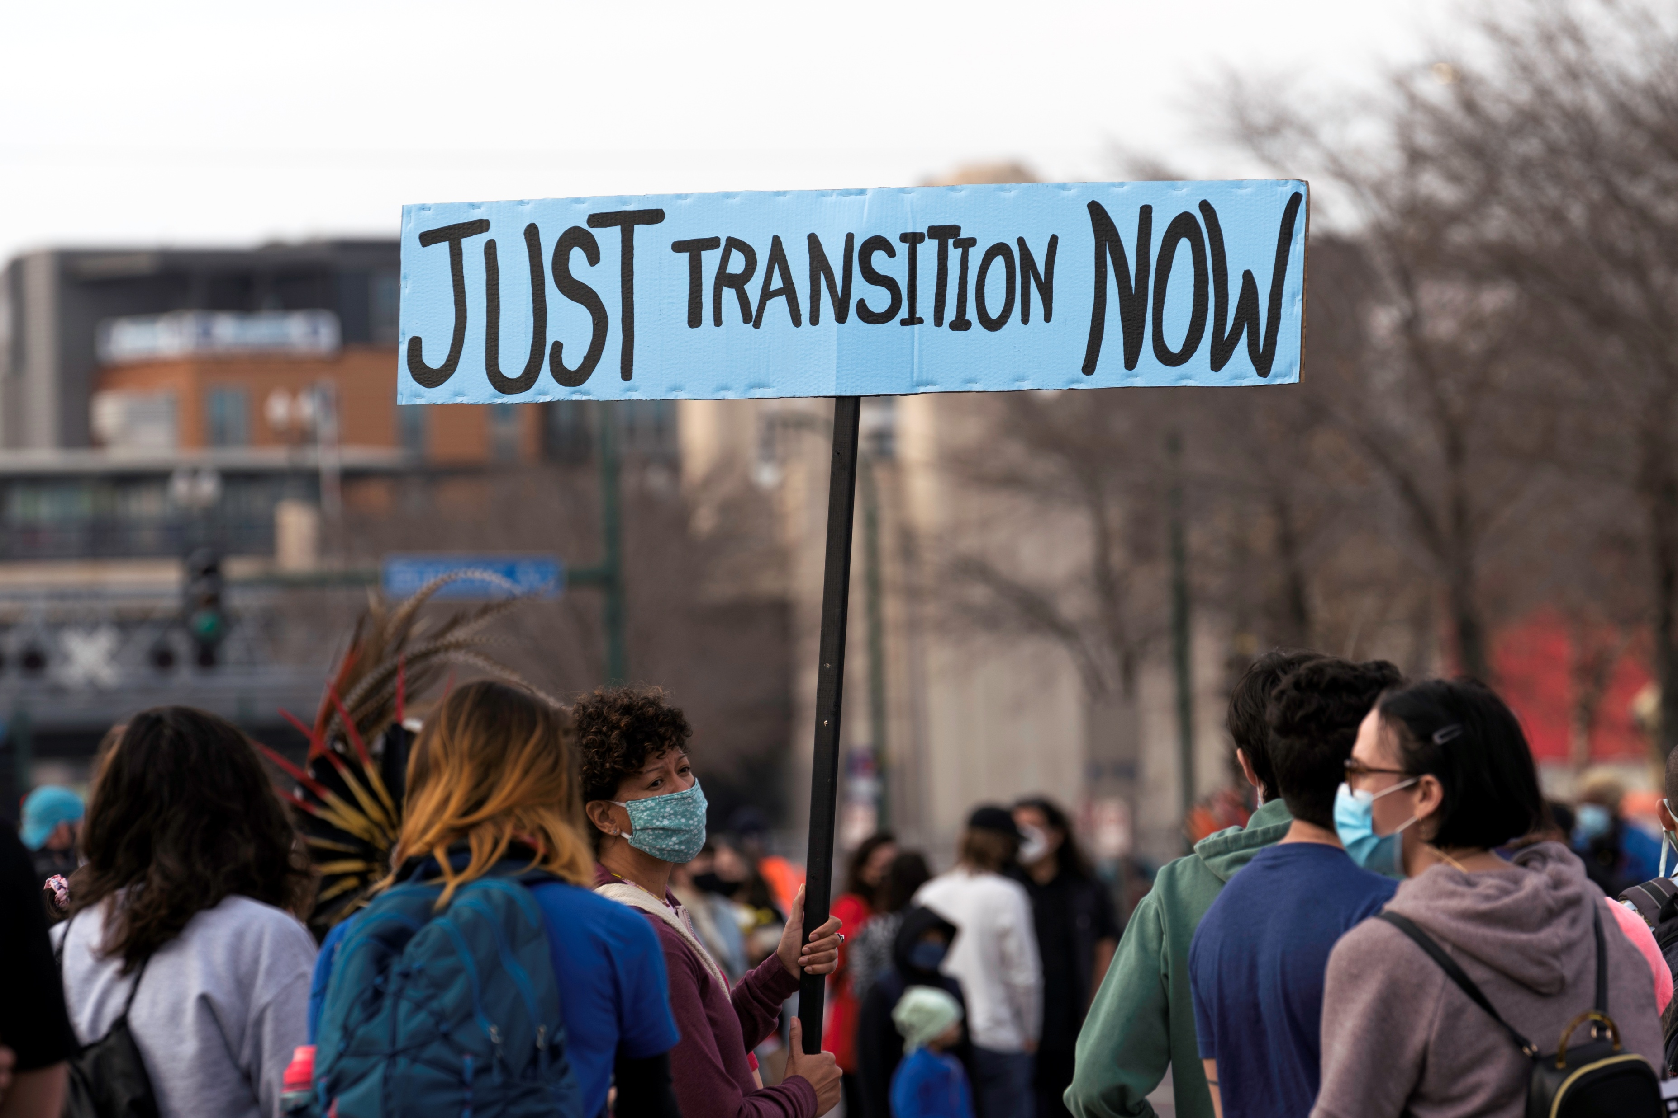

Just Transition
Challenges, Dilemmas, Ways Forward
Yin Shao Loong
8 October 2025

Slide 2


Slide 3


Slide 4
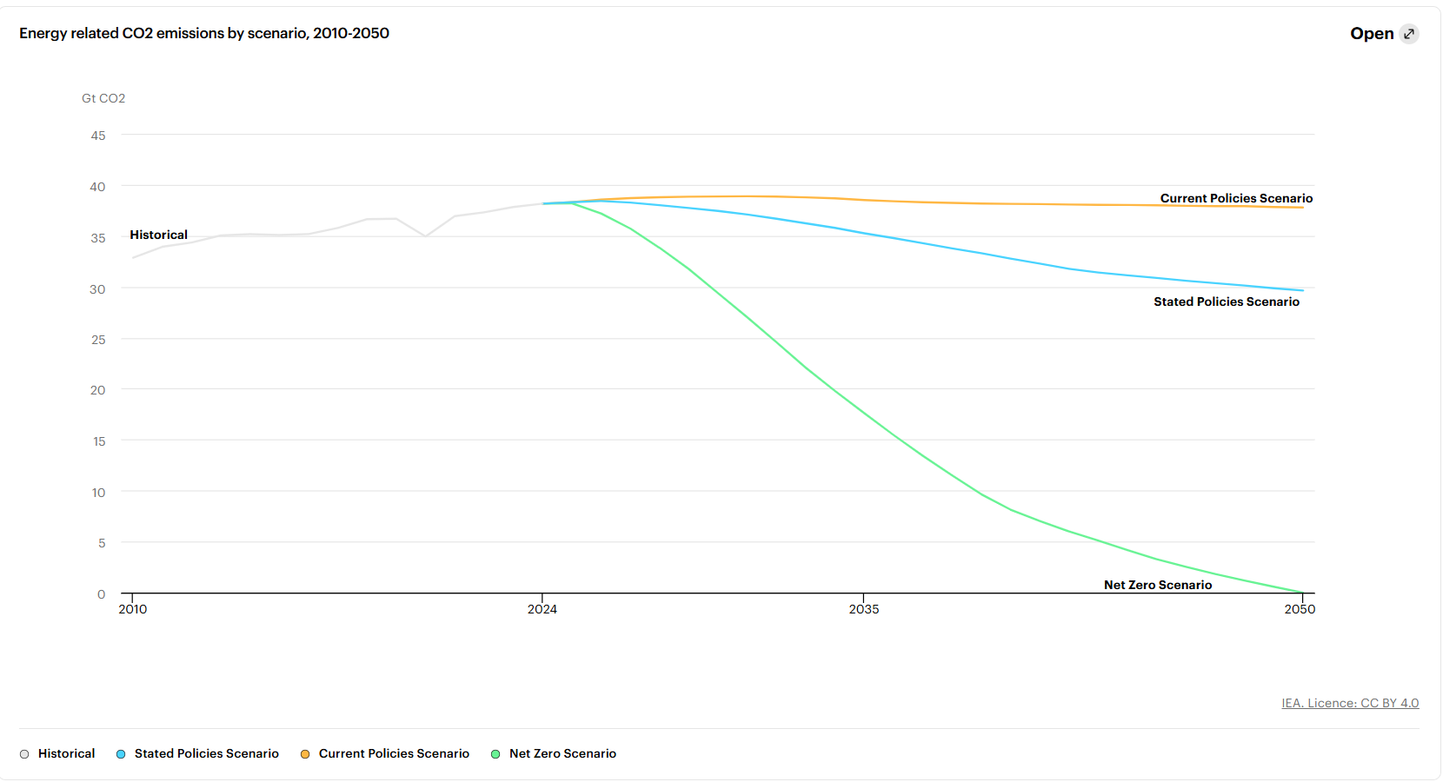

Slide 5


Slide 6
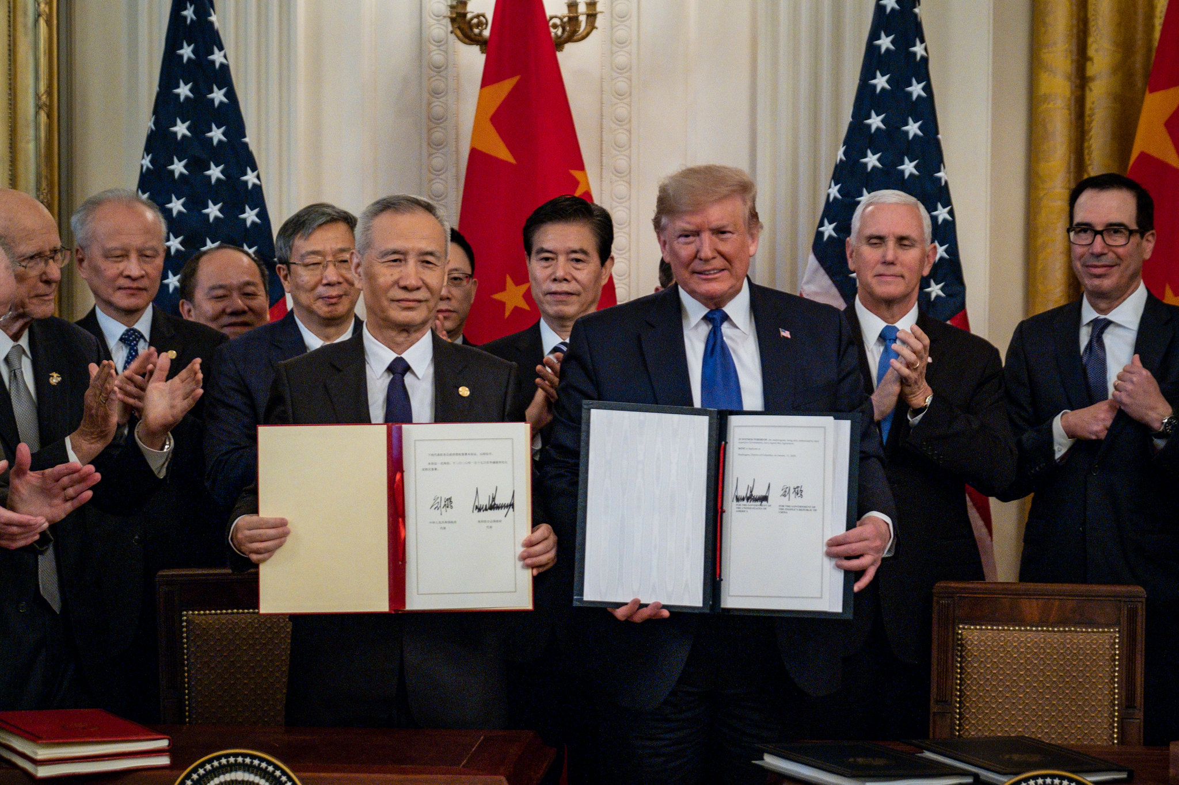

Slide 7
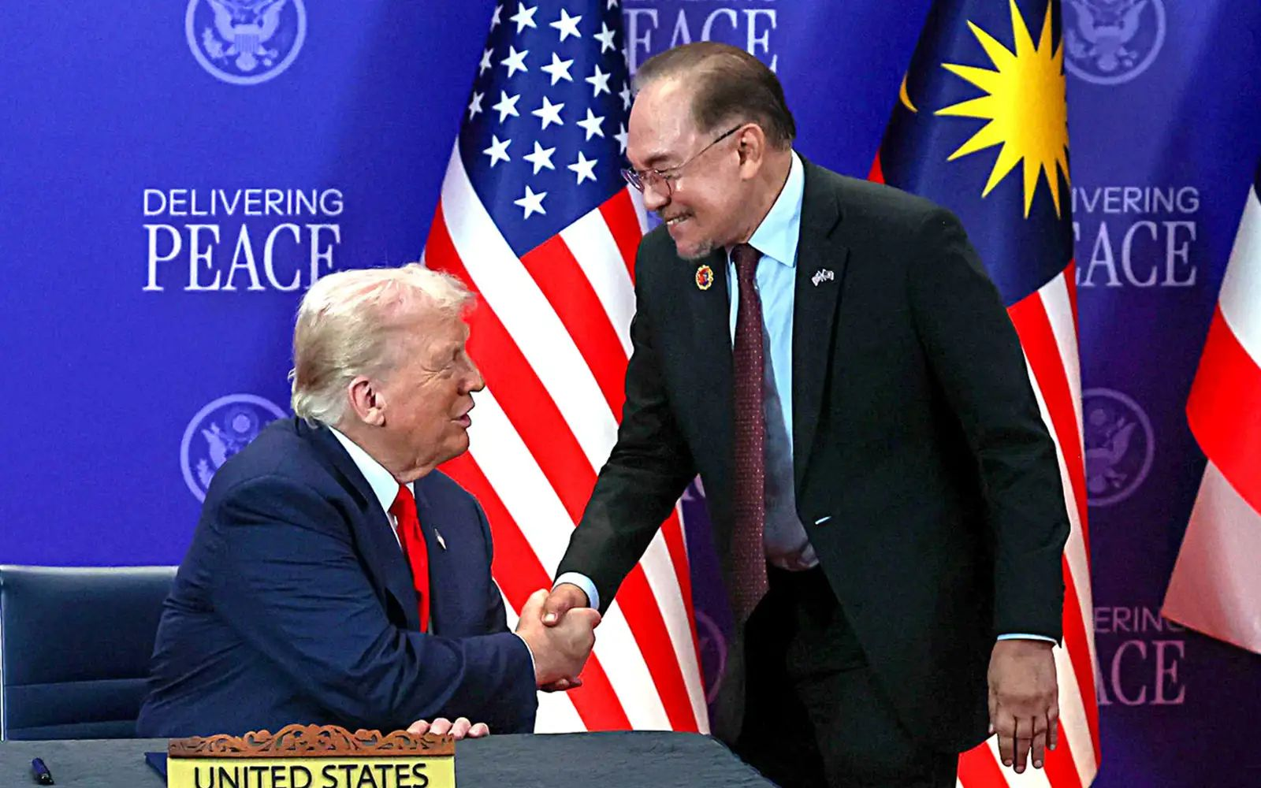

Slide 8
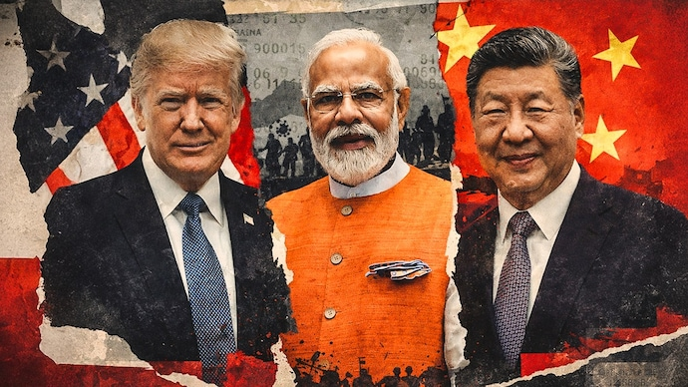

Slide 9
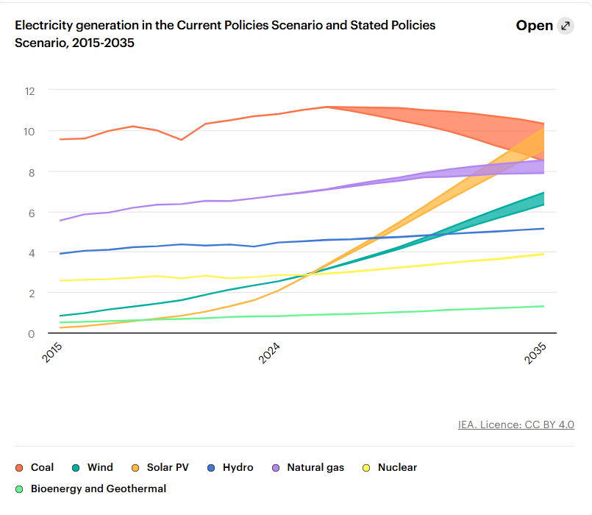

Slide 10
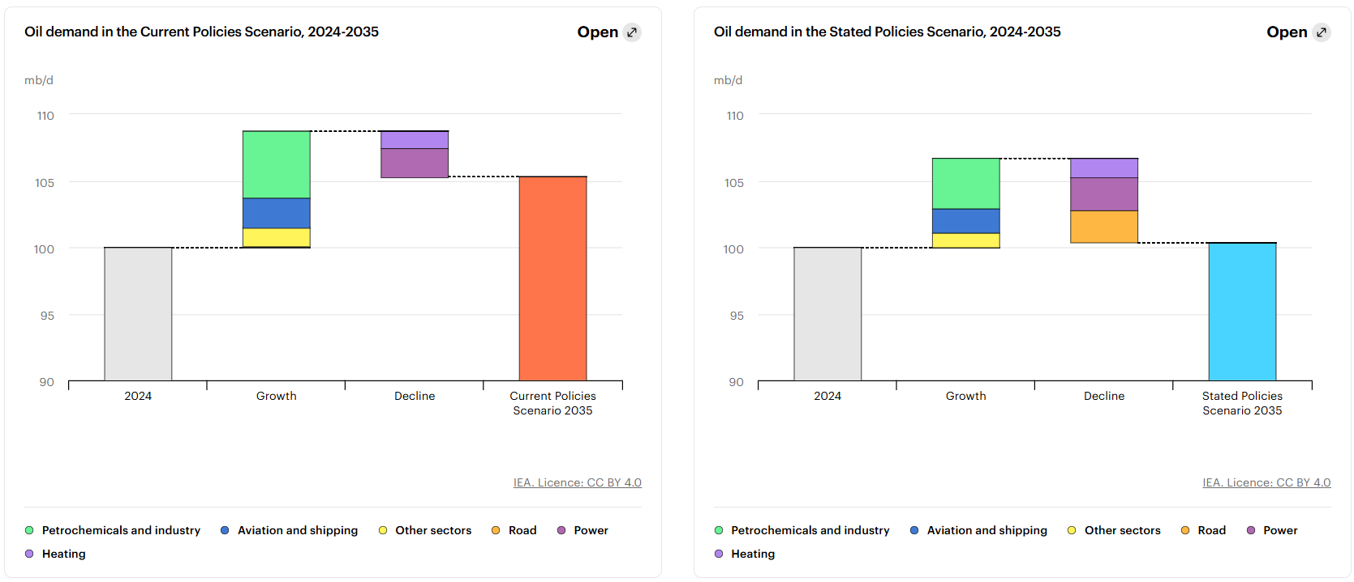

Slide 11


Slide 12
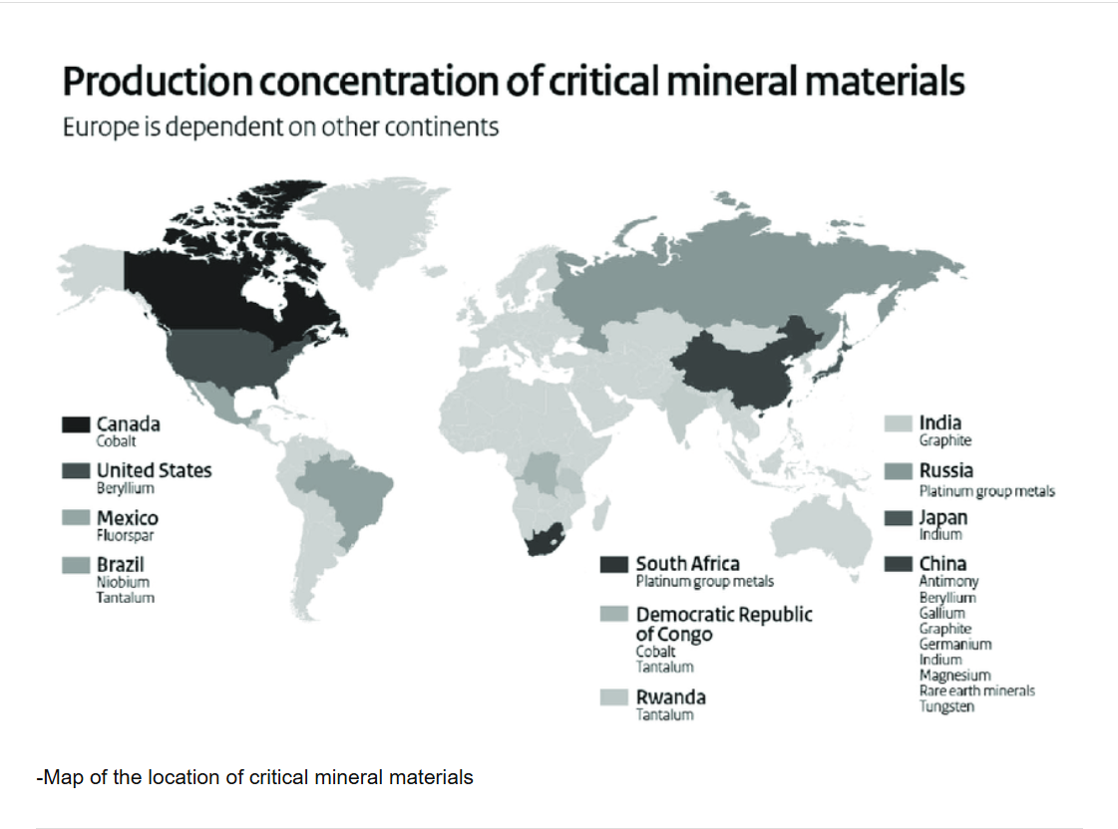

Slide 13
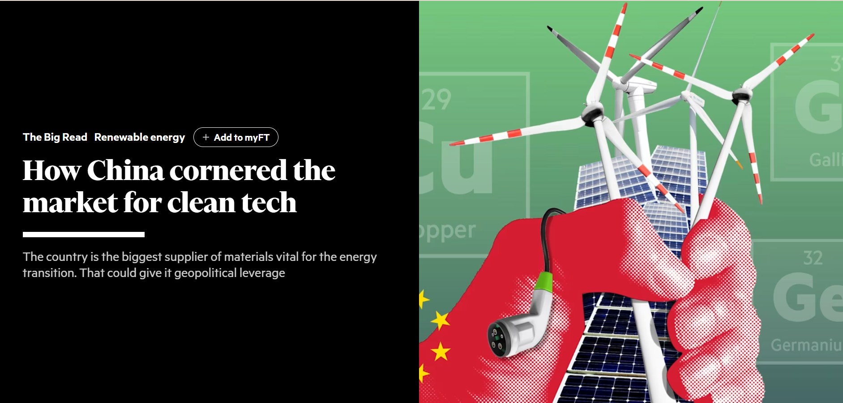

Slide 14
TRANSITION TO WHAT?
EV demand obfuscates public transport demand
Data centres rest on shoddy industrial policy, if any at all
100% RE can be very financially challenging for even UMICs

Slide 15
Building Institutions and Resources for Domestic Resource Mobilisation (UMICs/MICs)
Repurposing Multilateral Institutions may primarily benefit lower income countries
Northern donors may be increasingly irrelevant due to declining flows and poor targeting
WAYS FORWARD

Slide 16
Trade diversification for energy security. Diversified supply of fossil fuels and RE imports.
Regional RE supply network to overcome geographical mismatches of supply and demand.
WAYS FORWARD

Slide 17





Follow KRI on social media to keep up-to-date with our research:
@KRInstitute
@KRInstitute or www.facebook.com/KRInstitute/
Khazanah Research Institute
@krinstitute

