Slide 1

Just Transition and foreign investment protection
Dr Anil Yilmaz
Essex Law School & Human Rights Centre
ayilma@essex.ac.uk

Slide 2
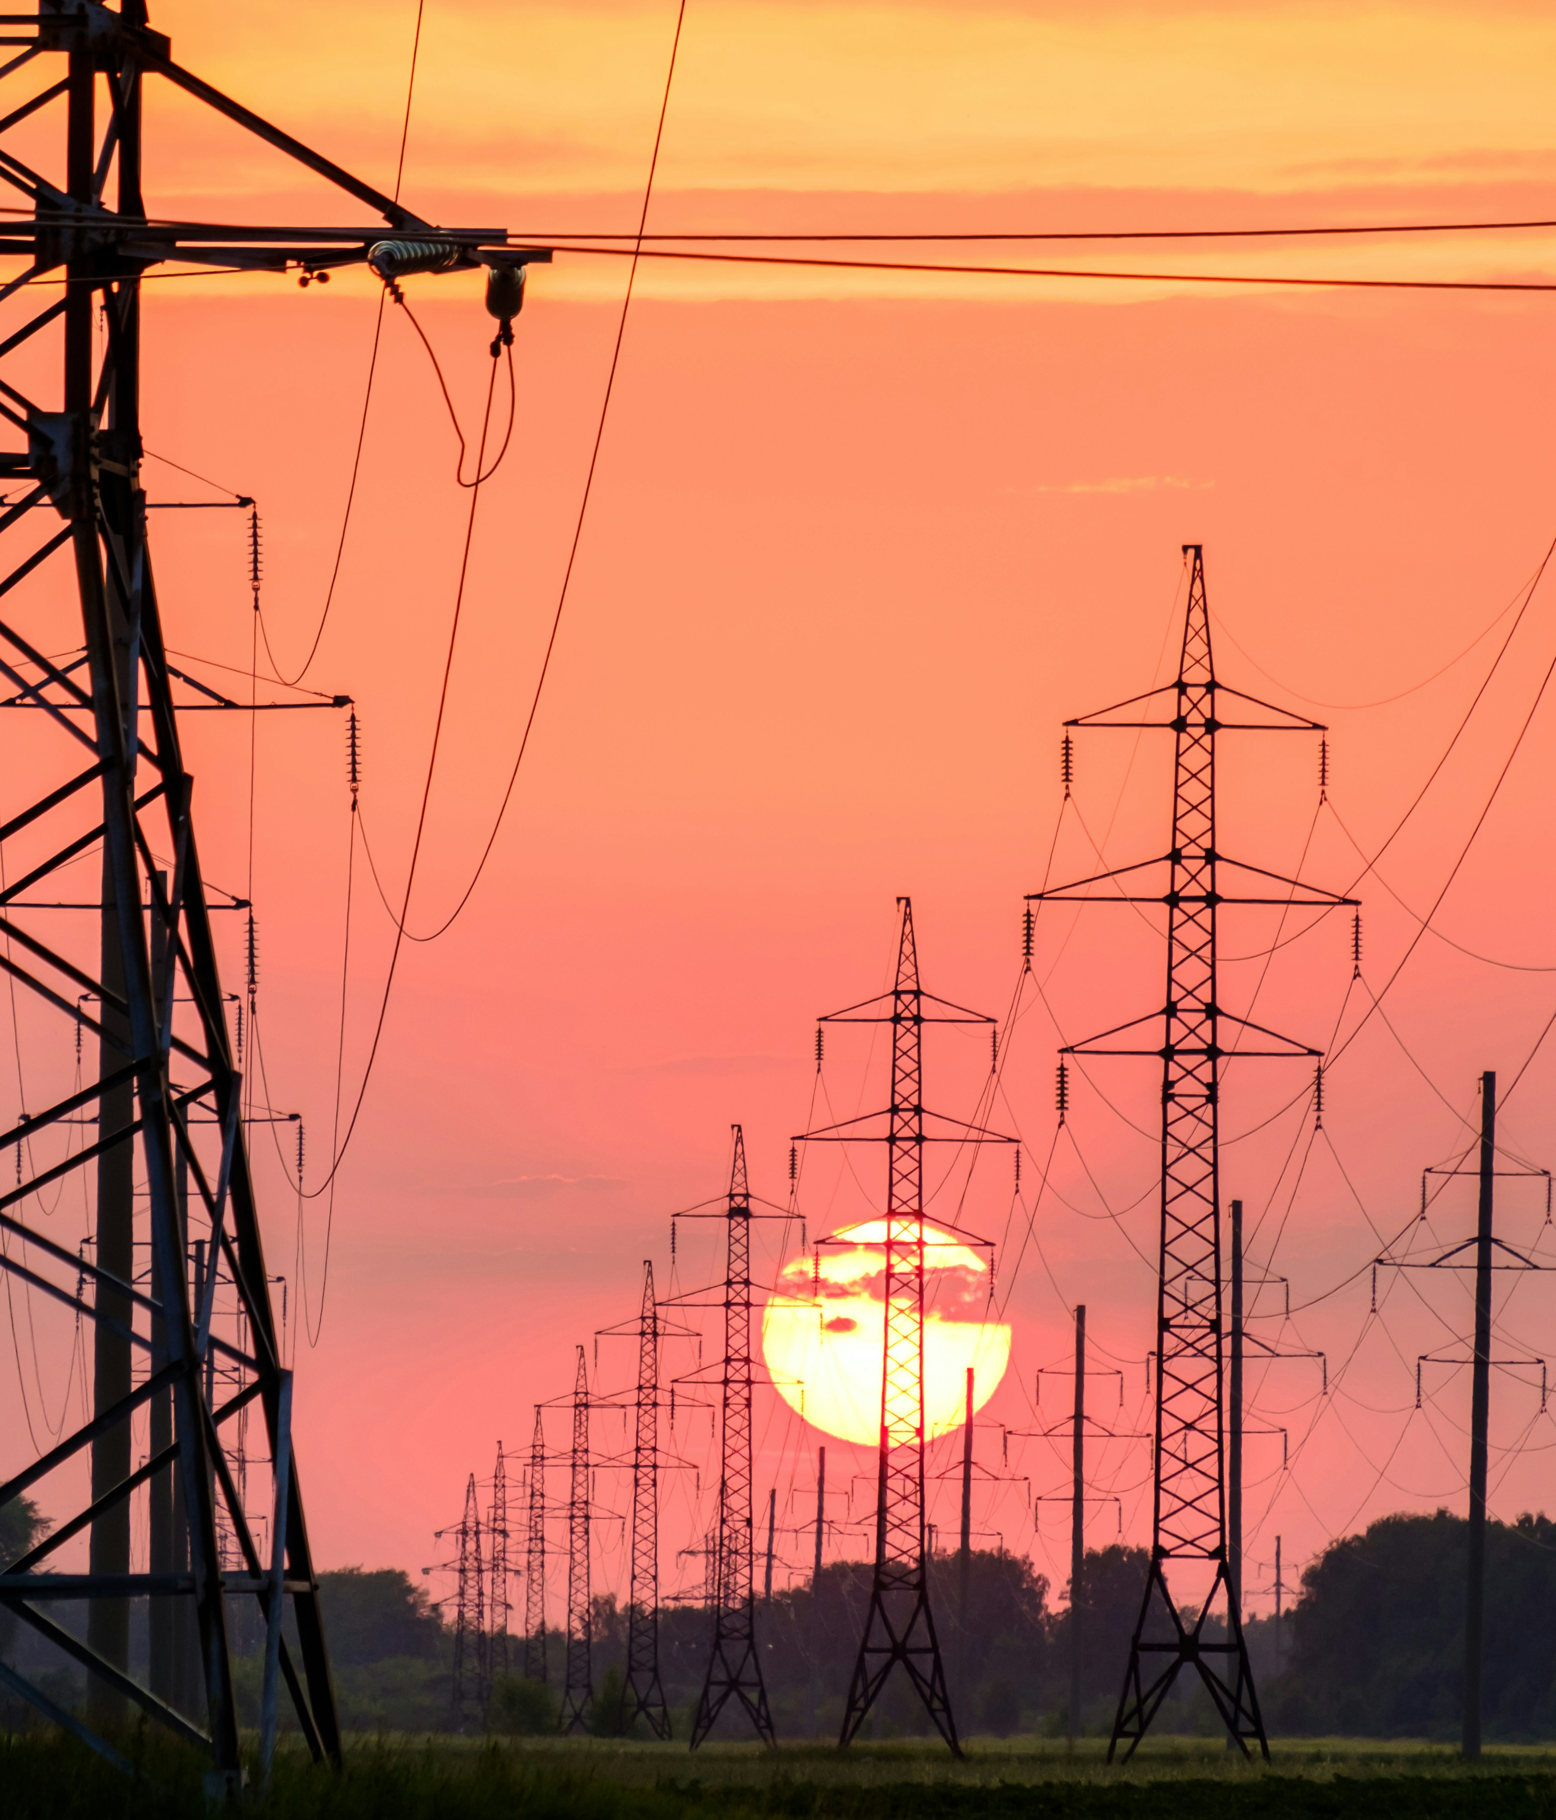
Foreign investment protection & energy transition
Foreign investors are key actors in the energy transition.
Protected by investment treaties, contracts and investor-state arbitration (so called “ISDS”).
Expropriation, fair and equitable treatment (stable business environment, legitimate expectations).
Excessive levels of compensation
Energy & extractive sectors: the largest beneficiaries.
Fossil fuels, renewables and critical minerals central to climate action & energy transition.
By Andrey Metelev - Unsplash

Slide 3
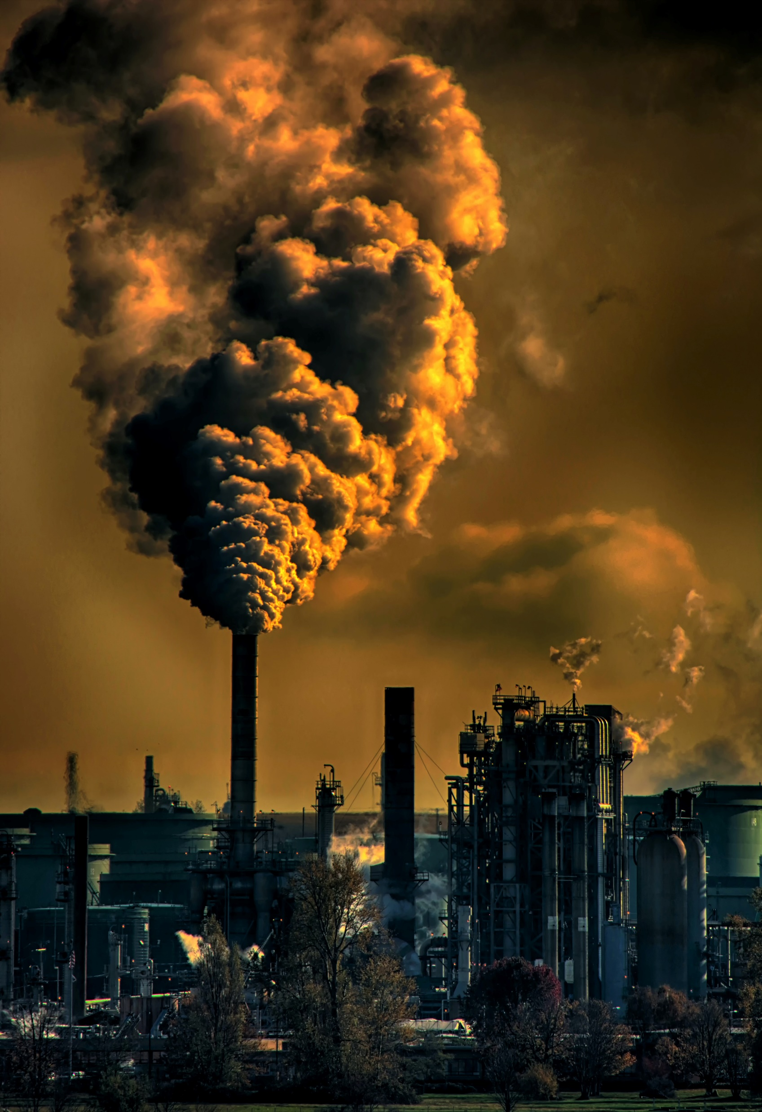
Problem: Investment treaties and fossil fuel phase-out/down
Investment treaty protections make it more costly to reduce our dependency on fossil fuels
Early retirement of coal power plants – ISDS claims against Germany, Netherlands, Canada (up to $$$ billions)
Indirect expropriation and/or breach of investor’s legitimate expectations
Image – Unsplash by Chris LeBoutillier

Slide 4
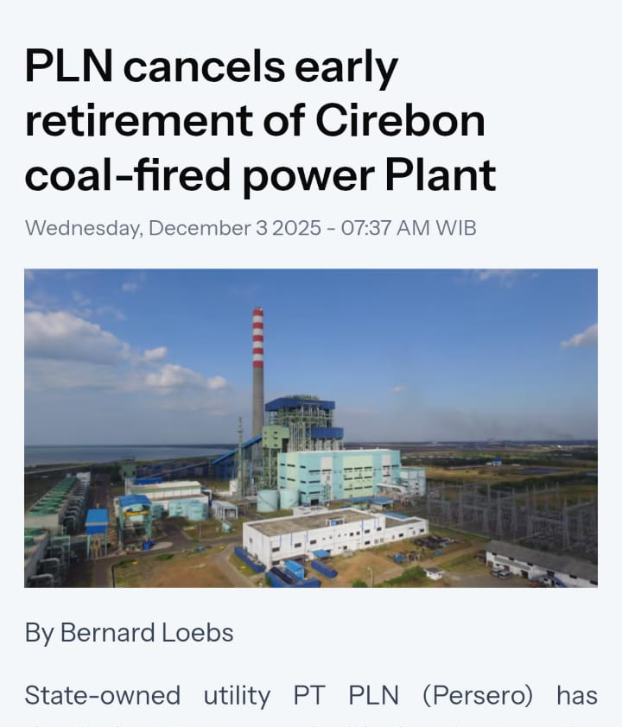
Power purchase agreements with coal fired power plants (CFPPs) - long term commitments vs early retirement
Additional investment treaty risks for early retirement of CFPPs:
Indonesia-Republic of Korea bilateral investment treaty & Comprehensive Economic Partnership Agreement (CEPA)
Indonesia-Japan Economic Partnership Agreement (EPA)

Slide 5

Curtailment / cancellation of projects at development stage
Zeph Investments v Australia (AUD 41.3 billion), Rockhopper v Italy (EUR 190 mil + interest)
Indonesia JETP 2025 Progress report:
“Net-capacity for on-grid and captive coal power capacity is set to grow further based on the current project pipeline. Over 2025 to 2034, an additional 6.3 GW of on-grid coal capacity is in the development pipeline”.

Slide 6

RENEWABLE ENERGY
Investment treaties to help scale up RE investments?
European renewables ISDS saga – over 200 arbitration claims
Reduction of profits
JETP → the creation of enabling environments
Liability risks IF response to changing needs or unforeseen outcomes causes profit reduction for investors.
Adjustments to PPA terms or pricing

Slide 7
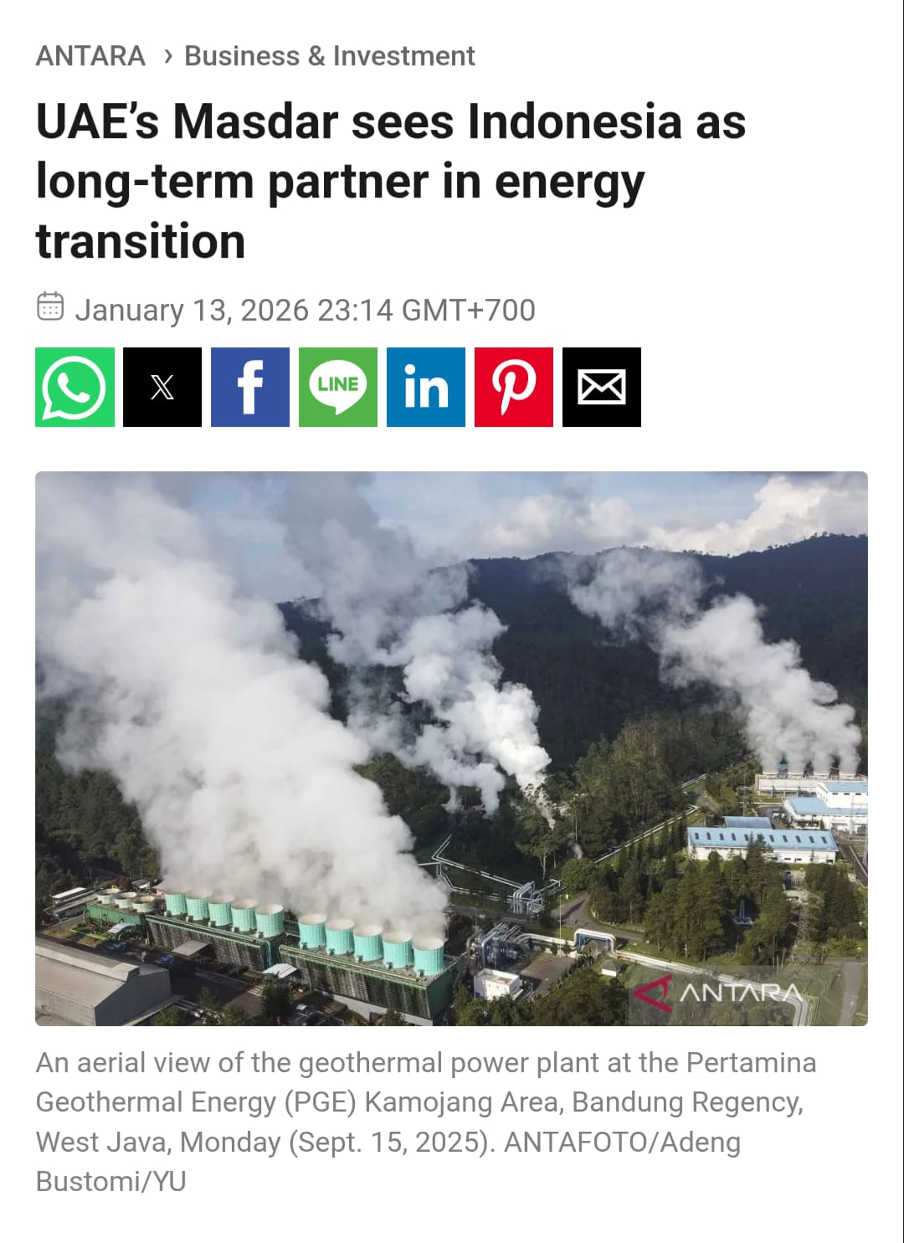
Indonesia JETP Implementation
MoF Regulation No 5/2025 – government guarantees related to the purchasing of renewable energy power by PLN
Subsidy transition from fossil fuels to RE
Relaxation of local content requirements
Investment treaties may trigger liability for changes in the RE investment climate
BITs with Qatar, UAE, Saudi Arabia
Masdar Solar v Spain - 76.70 mln USD ISDS award for reduction in profits

