Slide 1

Just Transition or Just a Transition?
Monitoring, Accountability, and Safeguards in the South Africa’s JET-IP
Workshop on advancing just and equitable energy transitions: Legal, policy and financial dimensions for developing countries
Enabling the ‘justice’ in energy transitions
10 February 2026

Slide 2
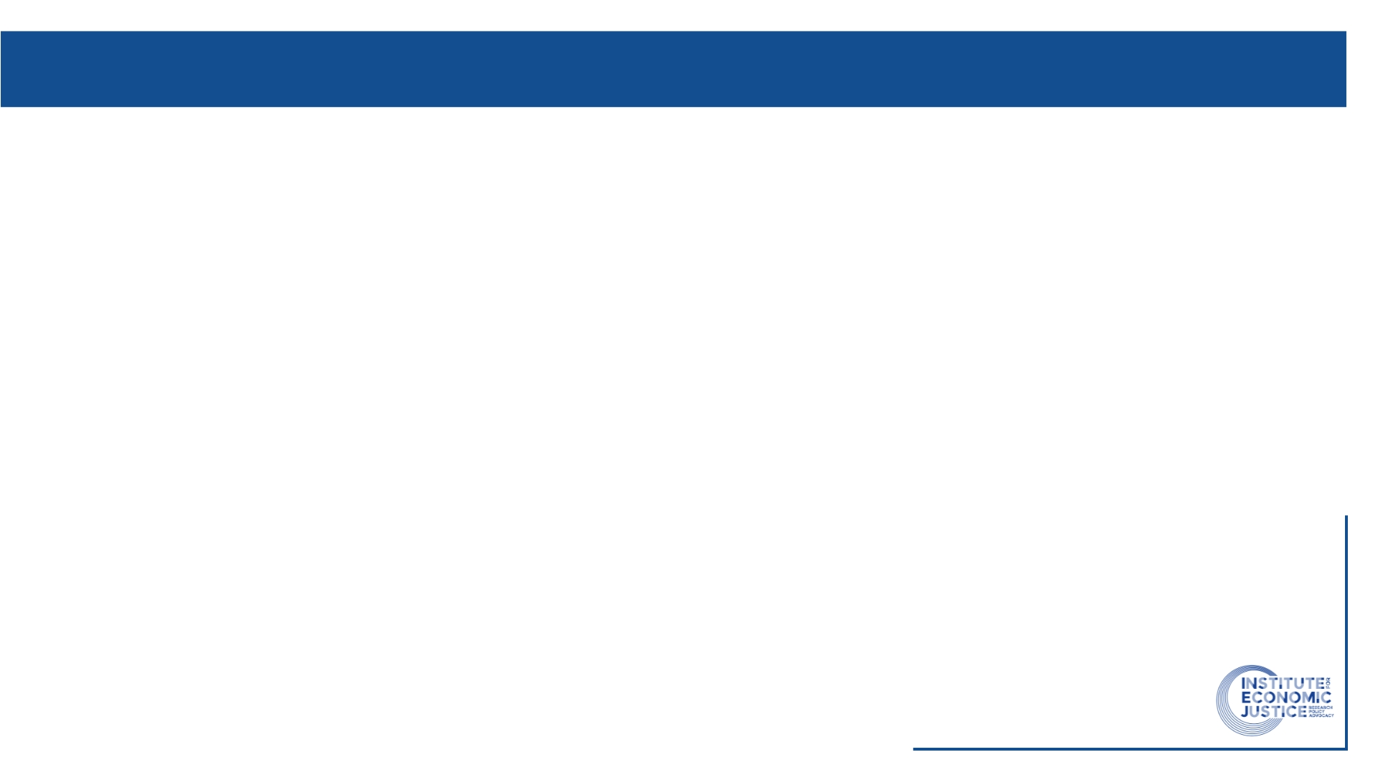
Why is accountability central to ‘justice’?
Justice can be achieved through enforceable accountability, transparent finance, and social and environmental safeguards.
JET-IP is internationally celebrated but:
  Governance and accountability mechanisms remain partial
  Heavy reliance on IFI and bilateral finance raises distributional and debt risks
Justice requires:
  Answerability: Who decides? Who explains outcomes?
  Enforceability: What happens when commitments are not met?
  Redress: How harms to workers and communities are addressed
SA’s JETP may risk:
  A shallow transition that substitutes one form of energy for another with no redress of systemic and structural economic issues
  Finance-led decarbonisation without social protection
  Debt-fuelled transitions that shift risk to the public

Slide 3
Existing accountability and M&E in the SA JET-IP
JET Project Management Unit (PMU): What exists?
  JET PMU Funding Platform
  Quarterly Reports, webinars, and future roadshows
  Improvement from IPG blog posts
Monitoring evaluation and learning
  Still largely in development and very high level - outsourcing monitoring activities to lead institutions in each sphere of government or sector.
  Potential to focus on good and under report failings as little to no mechanism for redress in the MEAL.

Slide 4
Accountability gaps
No binding social justice indicators
Jobs quality, labour transitions, community impacts weakly specified
Code of Best Practice for the Just Transition
Limited public participation
Consultation ≠ co-decision
No grievance or remedy mechanism linked to JET-IP as a whole

Slide 5
The financing framework gaps and options
Large reliance on IFI loans but opacity around terms and conditions
  Currently only MoF decision - increase transparency and accountability by broadening to include parliamentary and public oversight.
Fiscal and monetary policy transparency
  Openness of reporting and data
  IEJ work to improve coordination of macro policy through an independent economic commission
  More work needs to be done on tracking the money as per discussions on Day 1
  Climate budget tagging happening but v slow and unknown
  IFI loans primarily taken for deficit
  DFI deals in the JTFM only reported at project level and sector.
Fair Finance International Policy Assessment
  FFCSA
  Policy assessment done every 2 years since 2020. In the past it has assessed NDB, DBSA, IDC, PIC, AfDB, and Export Credit Insurance Corporation
  Fair finance Asia will also be undertaking a policy assessment of banks this year, as well as FFI.
  Only consider publicly available policies and information and measure against international standards across Cross-cutting sustainability themes; Operational themes; and Sector themes.
    8 core themes include transparency and accountability, human rights, biodiversity, corruption, gender equality, climate change, labour rights and tax.

Slide 6
What enabling justice requires…
Transparency is necessary but insufficient, accountability requires enforceability and redress
Finance design determines justice outcome
Loans, conditionalities, and safeguards matter
Policy-level assessment tools are essential
Justice must be monitored, not assumed

Slide 7
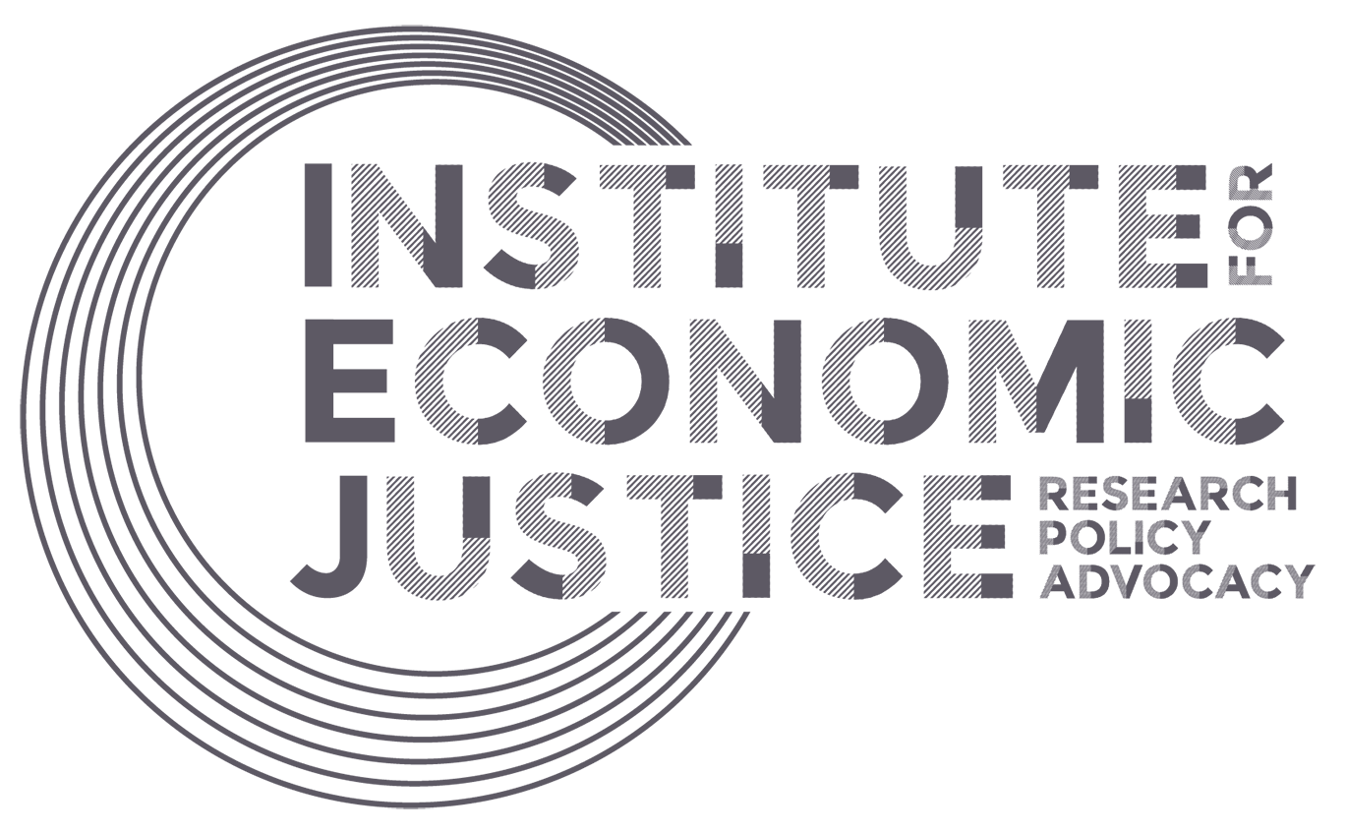
The Institute for Economic Justice (IEJ) is a progressive economic policy think tank committed to advancing economic justice, systemic change, and the equitable distribution of resources to ensure rights realisation and planetary wellbeing.
www.iej.org.za

