Slide 1
Enabling Justice in Energy Transitions:
Social and Environmental Transition Risks & Accountability / Redress
Dr. Gamze Erdem Türkelli
Workshop on Advancing Just and Equitable Energy Transitions: Legal, Policy and Financial Dimensions for Developing Countries
10 February 2026 - Jakarta

Slide 2
Social & Environmental Risks
Risks at 2 levels
1. Project-level social and environmental risks
2. Broader country-level social and environmental risks

Slide 3
Defining “Justice” in Transitions – JETP Countries
South Africa
“A just transition aims to achieve a quality life for all South Africans in the context of increasing the ability to adapt to the adverse impacts of climate, fostering climate resilience and reaching net zero greenhouse gas emissions by 2050 in line with best available science. A Just Transition contributes to the goals of decent work for all, social inclusion and the eradication of poverty. A just transition puts people at the centre of decision making, especially those most impacted, the poor, youth, women, people with disabilities, and the youth – empowering and equipping them for the opportunities of the future. A just transition builds the resilience of the economy and people through affordable, decentralised, diversely owned renewable systems, conservation of natural resources, equitable access of water resources; an environment that is not harmful to one’s health and well-being; and sustainable, equitable, inclusive land-use for all, especially for the most vulnerable.”
A Framework for Just Transition in South Africa, repeated in South Africa Just Energy Transition Investment Plan 2022.
Indonesia
“A Just Transition is an energy transition in which the resulting social, economic, and environmental risks and opportunities are equitably distributed among stakeholders according to their capacity and conditions affirmatively enable vulnerable underserved stakeholders to participate in decision-making that mitigates the risks and captures benefits from opportunities.”
Comprehensive Investment and Policy Plan (CIPP) 2023 of Indonesia
Vietnam
“The overall goal is to maximise people’s wellbeing. More specifically, to ensure that workers, households and businesses affected by the energy transition have access to energy and energy security, (b) can benefit from sustainable and inclusive economic development and seize business and employment opportunities generated by the transition, (c) are protected from negative effects of the transition, and (d) participate in the energy transition process.
Vietnam JETP Resource Mobilisation Plan (RMP)

Slide 4
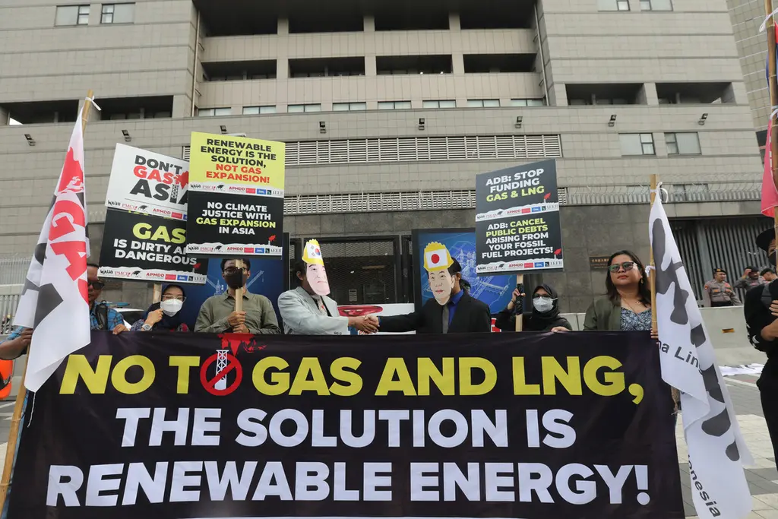
Implementing “Justice” in Transitions
International Partners Group (IPG)- UK, Germany, France, EU, Denmark & Netherlands (after US departure)
Focus on:
  “Net zero” focused – but not complete decarbonization
  Transition in coal-producing regions
  Limited energy-linked issues (such as green transport) beyond limited scope of transitioning away from coal
  No structural connections between social and environmental issues, ex: land for renewables - displacement
  No structural consent and consultation processes
  No specific grievance / redress mechanisms
Protest by Indonesian Environmental Forum (Walhi) in front of the Japanese Embassy in Jakarta (5 April 2023)
Source: Kompas

Slide 5
Turn to private financing – accountability questions
Idea: To bridge the climate finance/transition needs by de-risking b/c these are not seen by private investors as ‘profitable’ – bringing in the DFIs
Public finance needed for the climate, including in grants, is being channeled into ‘leveraging’ private finance (not just climate finance but all devfin) – inc. blending
Resurgence of the Public Private Partnership model in (infrastructure) investments
Accountability mostly outside of public systems of justice and mostly reliant on self-regulation and internal grievance mechanisms of development finance institutions (DFIs)

Slide 6
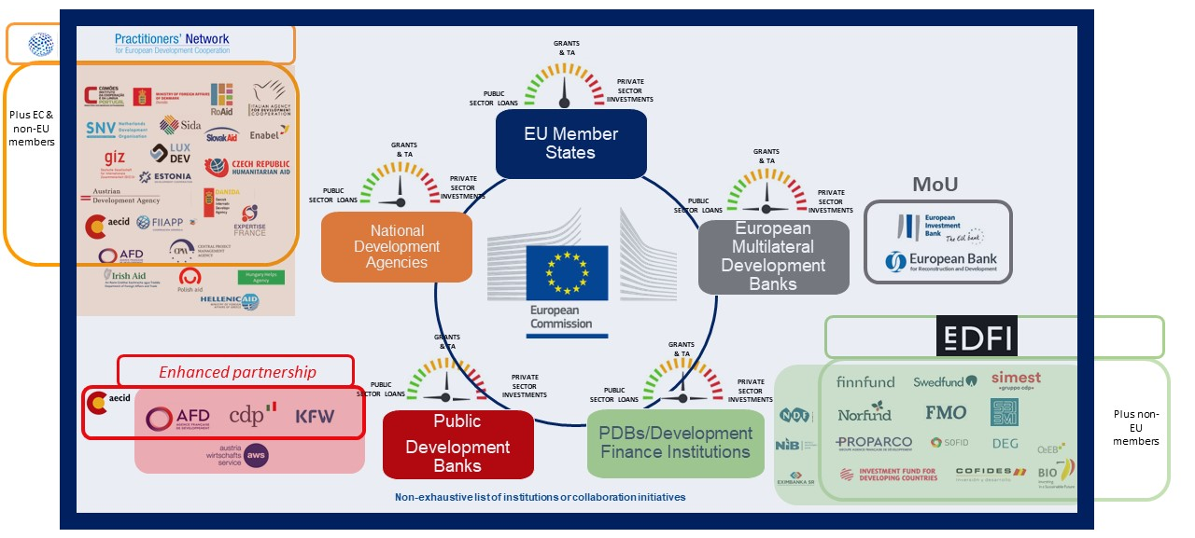
Devil is in the Detail: The ‘private’ turn in development financing

Slide 7
Multiple financiers – multiple financing modalities
Multiple institutional financiers from the International Partners Group
  Inc. European Investment Bank
  European Development Agencies – AfD, DEG, Dutch Dev Agency
  Bilateral DFIs – Proparco, FMO, KfW, BII, Impact Fund Denmark, Cofides, etc.
Multiple financing modalities
  Concessional loans
  Non-concessional loans
  Guarantees
  Equity Investments
  Grants (very small percentage)
Multiple self-regulatory frameworks that may or may not apply
  Unclear which rules of what institution will apply
  No dedicated accountability mechanism

Slide 8
Project-level social and environmental risks
Significant social & economic dislocation accompanying decarbonisation plans - shift away from coal & shift to green technologies
Financing and implementation of the JET-IP can compromise existing public accountability and environmental, social & governance safeguards mechanisms for local communities
Risk, particularly social risks, safeguards risks and public health risks, defined in a very narrow manner, excluding many rights-holders, particularly those most prone to being marginalize
ex: Social risks defined mainly as social risks to communities in the coal regions arising from the transition while much larger parts the population may be adversely impacted by policies, programmes and projects under JET-IP if adequate social, labour and environmental standards are not effectively respected

Slide 9
Project-based Risks: Safeguards
Reliance on a risk-based accountability & governance framework
vs.
a rights-based accountability & governance framework
Reliance on governance frameworks of implementing & financing institutions (DFIs – EU and bilateral) do not match the substantive & procedural content of obligations owed to rights-holders under national and international law
Safeguards and mitigation strategies limited – centering on Monitoring & Evaluation + potential stakeholder consultations
Greater opacity surrounding private sector projects in development projects compared to those undertaken by the public sector
MDB – official grant or loan versus DFI- private sector or PPPs with weaker transparency & info disclosure policies (on grounds of ‘commercial sensitivity or client confidentiality’
Obstacles to community participation and access to info at pre-project / consent stage as well as redress / grievance stage
Insufficient (by Design) Self-Regulatory Framework
Multiple financiers - obscured accountability -unclear grievance / redress mechanisms (may be at the project or financier level)

Slide 10
Broader country-level social and environmental risks
Risks of undermining human rights obligations of the JETP-implementing country more broadly
Decreasing public revenues from traditional energy production sources may curtail public expenditure on public services such as education / health + curtail the progressive realisation of human rights unless accompanied and offset by alternative funding sources, ex. international assistance /cooperation (Article 2.1 of the International Covenant on Economic, Social and Cultural Rights)
Conditionalities around extending concessions (tax or tariff exemptions) to investors - may limit economic benefits / contributions to public finances, creating value exclusively or primarily for investors
Investment projects focusing on renewables and green energy may also cause displacements of communities & loss of livelihoods through large-scale land acquisitions that disproportionately impact human rights along gender lines

Slide 11
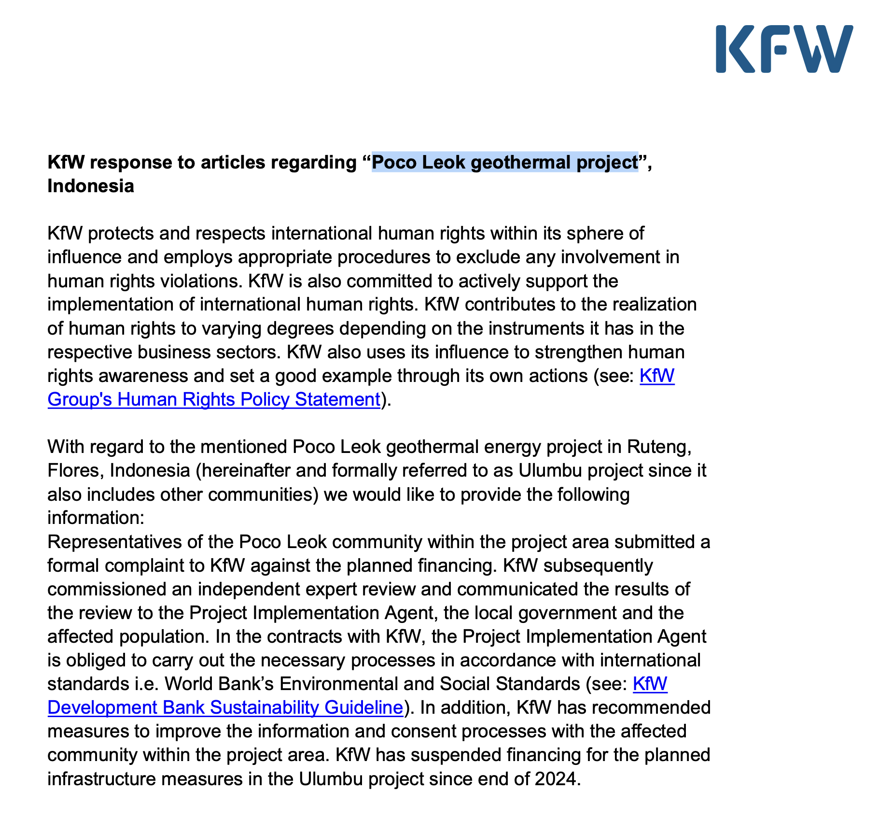
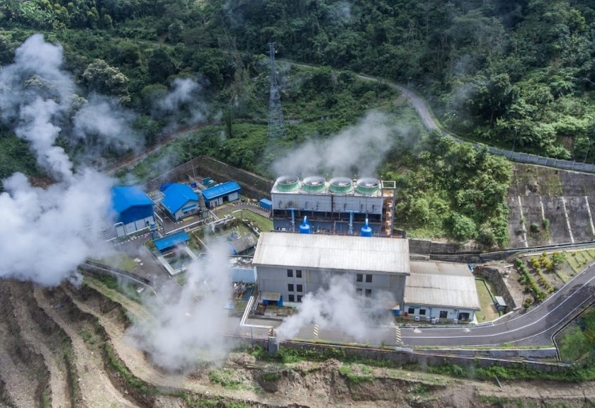
Example: Poco Leok geothermal project & KfW
German DFI KfW Development Bank
  Expansion of existing geothermal project
  Indigenous community’s explicit rejection of the project’s expansion – no FPIC
  (free, prior and informed consent)
  + ongoing investigations by the National Human Rights Commission of Indonesia and
  Independent team commissioned by the KfW Development Bank

Slide 12
Accountability and Redress
Need to center individual and community human rights holders
(and not investors)
– not only at Environmental & Social Impact Assessment Stage to tick boxes for consultation but substantively through human rights impact assessments (before, throughout and after) as well as appropriate consent (FPIC in the case of indigenous peoples)

Slide 13
Thank you!
gamze.erdemturkelli@uantwerpen.be

