Slide 1
Trade Terms- INCOTERMS LA931 International sale of goods LECTURE 1
Dr Hassan Nizami
Office hours: 12:00-2:00
S 1.15

Slide 2
introduction
One of the main clauses in contract for the international sale of goods (international sales contract)
Standardized abbreviations developed by merchants.
Encompass a catalogue delivery obligations
Why do we need them?
1) Enhance legal certainty.
2) Negotiation Costs

Slide 3
iNcoterms
Divergence in the interpretation of these terms began to surface.
ICC set out to fix and unify the content of these terms and published the first version of INCOTERMS in 1936.
Today the INCOTERMS are the most widely recognized trade terms in international sales.
General rule: INCOTERMS must be agreed upon by the parties- Do not act as default rules of the law. They DO NOT have the force of statutory law.
Since 1936, 7 revised versions of the INCOTERMS have been published by the ICC

Slide 4
Incorporation of incoterms
The INCOTERMS provide 11 alternatives for the parties to choose from.
Express reference: FOB Hamburg INCOTERMS 2010.
Q) What if parties simply state FOB Hamburg INCOTERMS?
Indirect reference: parties simply state ‘FOB Hamburg’.
Q) Are the parties referring to FOB as defined by the INCOTERMS or by the national understanding of the term?

Slide 5

Coverage
INCOTERMS deal with certain important aspects of international trade but not all.
Regulated:
a) When risk passes from the seller to buyer.
b) Which party has to arrange, and to what extent, for transport, insurance and custom clearance.
Not regulated (non-exhaustive):
a) Conclusion of a contract
b) Issues of title
c) Consequences of failure of performance

Slide 6
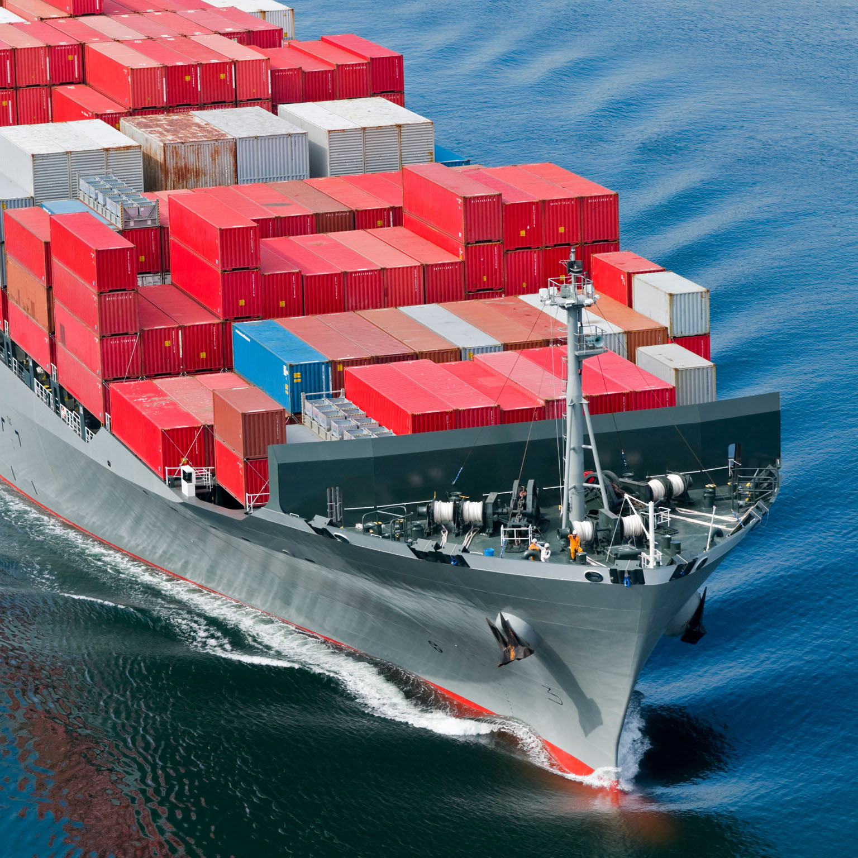
General description
The INCOTERMS can be viewed as a sliding scale- EXW to DDP.
Each term contains 10 A and B rules. The rules for each term follow the same pattern and address the same issue. They simply allocate the costs and risks differently.
If parties choose/agree on a specific INCOTERM, they must also nominate a specific place that fits to the term

Slide 7
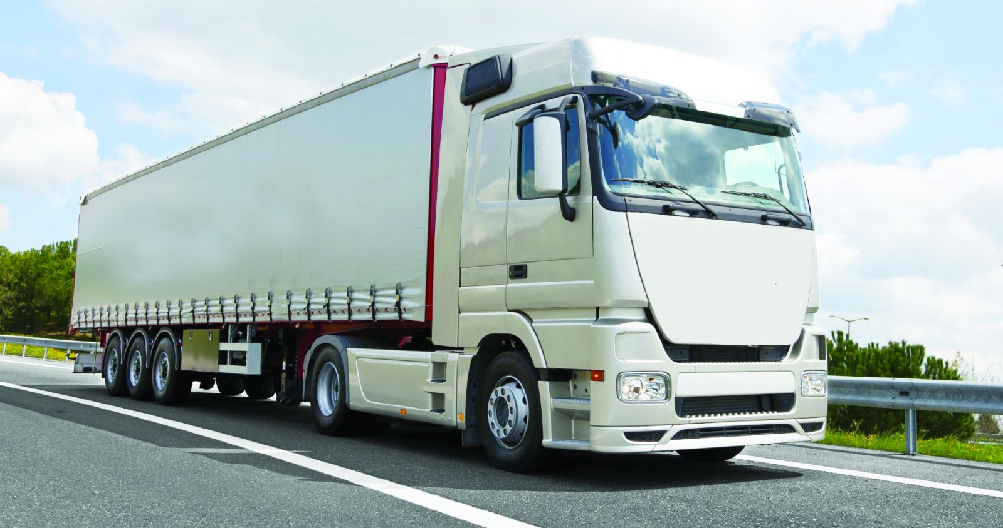
Place of delivery and passing of risk
One of the central aims of the INCOTERMS is to fix the place where the goods have to be delivered (A4 and B4).
For all INCOTERMS, the risk of loss or damage to the goods passes from the seller to the buyer with delivery (A5 and B5).
For most terms, once delivery has been made the buyer bears all further costs. Exception to this are CPT, CIP, CFR and CIF.

Slide 8
Performance aspects
Basic obligation to deliver and pay (A1 and B1)
Precise definition of delivery (A4 and B4)
Duty to clear goods for ex-port and import (A2 and B2)
Which party has the duty to procure insurance and transport (A3 and B3) and which party has to bear the costs (A6 and B6)
Provision of Information necessary for the performance and completion of the transaction (A 7/10 and B7/10)
Duties to provide the transport documents (A8 and B8)
Duties concerning pre-shipment inspection, packaging, quality control and the distribution of associated costs (A9 and B9)

Slide 9
Question
What if parties choose an incoterm in their contract but then go on to include contract terms that are inconsistent with the term? Do we follow the INCOTERM or what the parties have stipulated?

Slide 10
Ways of classifying the 11 terms
Method 1
Method2
All Types of transport | Water Transport only
EXW | FAS
FCA | FOB
CPT | CFR
CIP | CIF
DAT
DAP
DDP
E-Clause | B must pick up the goods | EXW
F-Clause | S must deliver to carrier | FCA, FAS, FOB
C-clause | S must pay for carriage and deliver to carrier. | CPT, CIP, CFR,CIF
D-clause | S must deliver to destination | DAT, DAP, DDP

Slide 11

Rules for any Mode of Transport

Slide 12
EXW-Ex Works:
Buyer has maximum and seller has minimal burden.
Seller is obliged to place the goods at an agreed place and time at the buyer’s disposal.
Everything else is the buyer’s duty.
Risk passes from the seller to the buyer when the seller has fulfilled its obligation of placing the goods at the agreed place and time.
As a result of rule A9 (EXW) the seller is obligated to package the goods in a manner that is appropriate for their transport at his own expense. (Compare with English Law)

Slide 13
The buyer is responsible for:
loading the goods onto a vehicle,
all export procedures and
for all costs arising after collection of the goods.
Problems?
The INCOTERMS place an obligation on the seller to render any required assistance in obtaining an export license at the buyer’s request, risk and expense.

Slide 14
Question.
1) What if buyer has specific packaging requirements and informs the seller before the conclusion of the contract?
2)What if the buyer notifies the seller after the conclusion of the contract?

Slide 15
FCA- Free Carrier
Seller must deliver the goods to the carrier (paid for by the buyer) and to clear them for export.
Question: What if the named place is seller’s place of business? Delivery is only finalized if the seller has loaded the goods on the carrier’s vehicle at the named place. No such duty exists if another place of delivery is agreed upon (simply placing the goods at the carrier’s disposal is sufficient).
All other costs must be borne by the buyer. (Convenient for transport by container).

Slide 16
CPT- Carriage Paid To:
Seller has to clear the goods for export, hand them over to the first carrier, and to pay for transportation to the agreed destination.
The buyer must clear the goods for import.
Risk passes to the buyer when goods have been handed over to the first carrier.

Slide 17
CIP- Carriage and Insurance Paid to:
Seller has to clear the goods for export, hand them over to the first carrier, and to pay for transportation to the agreed destination. Moreover he has to bear the cost of insurance (minimum cover).
The buyer must clear the goods for import.
Risk passes to the buyer when goods have been handed over to the first carrier.

Slide 18
DAT- Delivered at terminal
Seller bears all risk and costs till the goods reach the agreed delivery terminal. These costs include those associated with export-clearance, carriage to terminal and unloading.
Risk passes from the seller to the buyer when the goods are delivered to the agreed terminal.
Buyer must obtain and pay for import clearance.

Slide 19
DAP- Delivered at Place
Same obligations on the seller as under DAT clause, with the exception that instead of a terminal, any place can be agreed upon for delivery.

Slide 20
DDP- Delivered Duty Paid:
Seller has maximum and buyer has minimal burden.
Seller must place the goods at the Buyers disposal at an agreed place, ready for unloading. At this point the risk passes to the buyer.
Seller has to clear the goods for both export and import and arrange for carriage (and pay all respective costs).
Buyers only obligation is to take the goods, pay the price, arrange for unloading and pay for further transport if required.

Slide 21
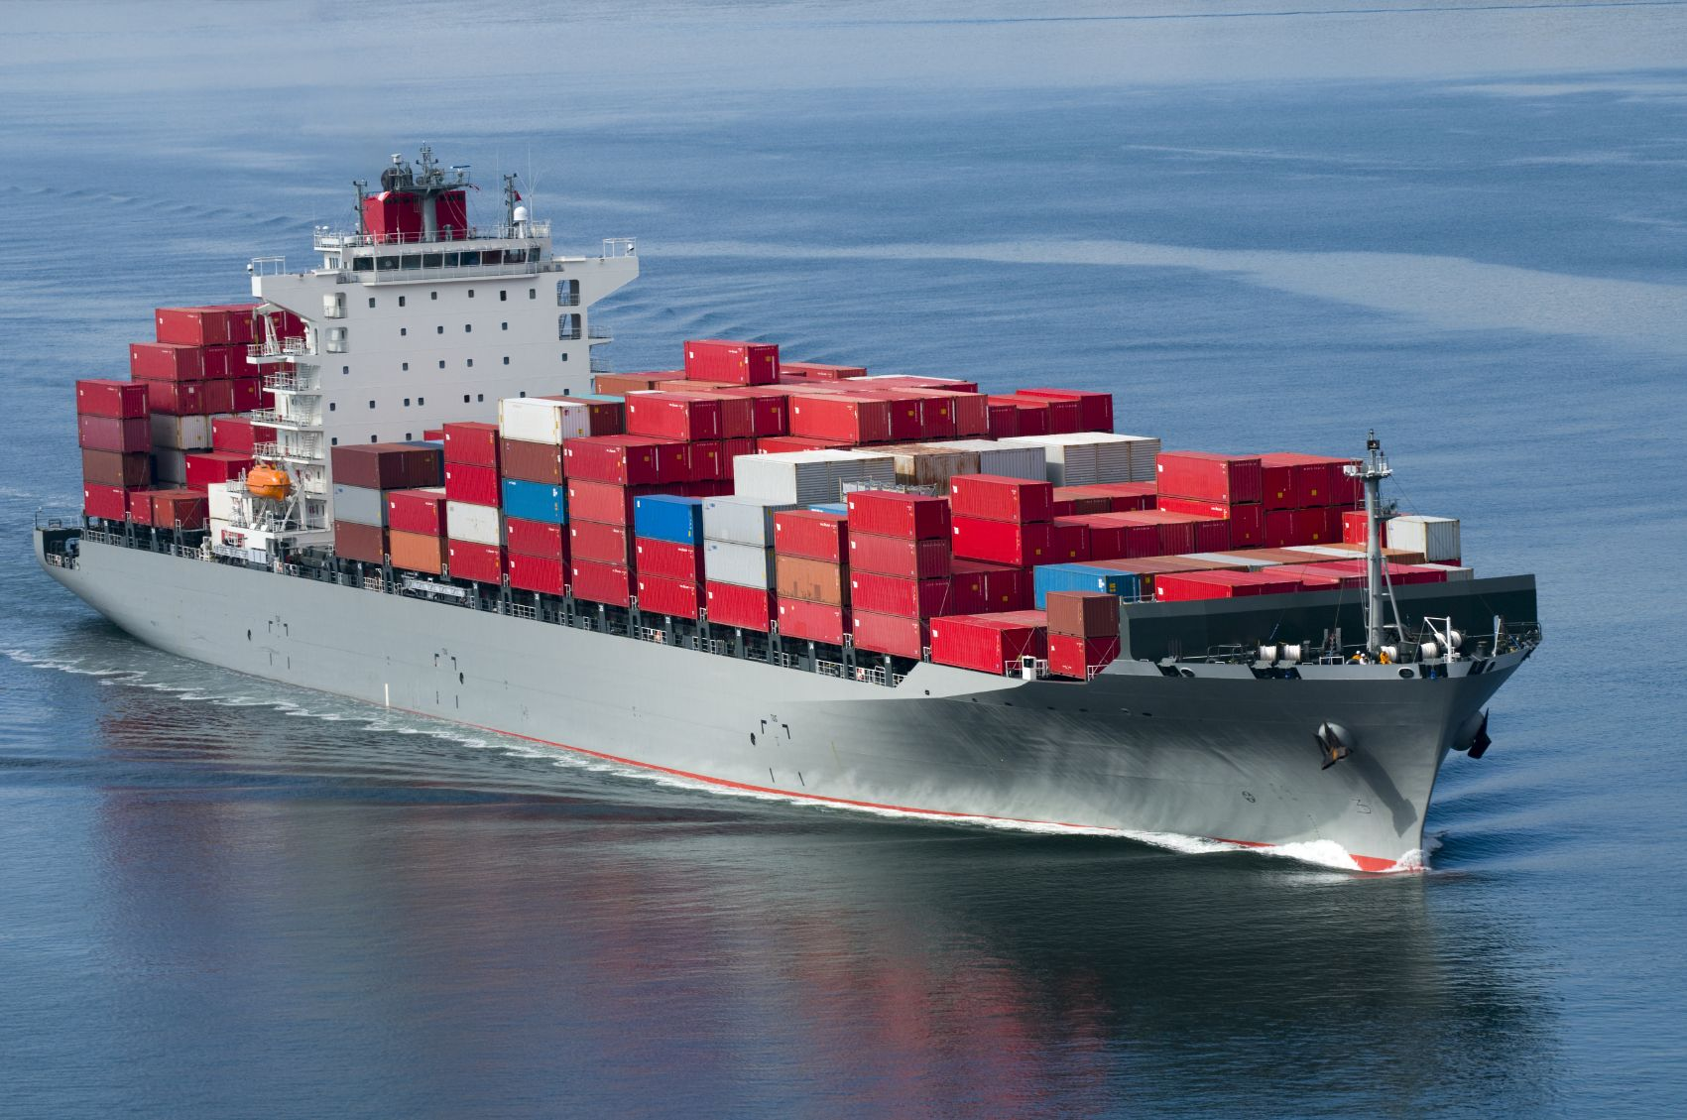
Rules for Waterway Transport

Slide 22
FAS- Free Alongside Ship
The seller is obligated to place the goods alongside the ship and clear the goods for export (the buyer is responsible for loading the goods and all related costs).
Moreover, it is the duty of the seller to obtain and pay for the export license and custom clearance.
Once the goods are placed alongside the ship, risk passes to the buyer.
The ship is arranged and paid for by the buyer. Import clearance is also the duty of the buyer.
Rarely used for containerized goods.

Slide 23
FOB- Free on Board
Apart from CIF, probably the most commonly used INCOTERM
The seller must deliver the goods on board the ship arranged and paid for by the buyer.
Seller must arrange for export clearance whereas the buyer must arrange for import clearance.
Risk passes when goods have been placed/delivered on the ship.
Seller is only obligated to pay for costs till that point i.e. all costs arising afterwards such as transport costs to destination, eventual insurance, import clearance etc. are the buyer’s burden.

Slide 24
CFR- Cost and Freight
Seller to arrange and pay for the ship, export clearance, export licence and place the goods on the ship.
Apart from transport costs, all costs and risks pass to the buyer when delivery is made at the port of departure .
Seller does not have the duty to insure the goods.
C&F is usually used where the importing country prohibits insurance of the cargo by the buyer .
Note: the buyer’s obligations are the same as under the CIF clause (see below)

Slide 25
CIF- Cost Insurance Freight
Very widely used Incoterm (most popular in sea-borne commerce).
Same rights and obligations as in CFR, only seller has to pay for insurance- minimal cover i.e. it must cover the contract price plus 10%.
The seller must pack the goods at his expense.
Risk passes to the buyer with delivery which here means the loading of goods on the ship.
Certain developing countries prohibit the use of CIF. Why?

Slide 26
Choosing the ‘right’ Incoterm
Choosing the ‘right’ INCOTERM requires the parties to a international sales to consider, amongst others, the following elements:
1) The capabilities of and the efficiency with which the seller or the buyer can perform the obligation to deliver.
2) The means of transport: maritime, non-maritime.
3) The nature of the goods: containerized, manufactured goods, bulk goods or commodities, etc.

Slide 27
1) Efficiency
Example: Who should organize international transport?
The question has to be evaluated according to relative positions of the buyer and seller in the market.
Which terms is a seller with large and regular sales volumes likely to prefer?
Would you change your answer if the seller was a manufacturer of custom made luxury goods or sells goods in a competitive foreign market ?

Slide 28
2) mode of transport
This is an issue of suitability.
Maritime terms.
FOB where transport of goods in by air?

Slide 29
3) The nature of the goods
The container revolution of the 1960-70s
a) Different documentary requirements.
b) Different points of delivery.
c) Lability without control: Insurance gap.
d) General incompatibility.

