Slide 1
Module APPLICATION, ALLOCATION AND REGISTRATION 2026-27
a
Dr Maggie O'Brien, Director of Undergraduate Studies
Kelly Taylor, Head of Administration (Student Services)
May 2026

Slide 2
Module Selection Preparation
01
Choosing the right modules for you
02
Course and Professional Requirements
03
Optional modules 2026/27
04
Module Application form
05
Module allocation process
06
Questions

Slide 3
Choosing the right Modules for you
Points to Consider
Module Choices are important!
You have to consider a number of issues when choosing
Practical Considerations
How many modules are you required to choose? (Course Information and the CAT system)
Do you wish to go into practice ( Professional Requirements)
Pedagogical Considerations?
What teaching methods do you respond best to?
Do you want to vary your assessments? Or find Modules that offer a particular assessment type?
What opportunities exist outside the Law School?
Personal Considerations?
What subjects am I likely to enjoy?
What aspects of law have I found most rewarding in my previous years' study?
Should I specialise early, or use optionality to find my specialism?

Slide 4

Course and professional requirements
01

Slide 5
Understanding the requirements of your degree
Automatically enrolled for the core modules
60 CATS modules each term (4 modules) – can be a combination of 15 and 30 CATS options
How many optional module spaces do you have each term?
Do you need to take external modules (e.g. Law with Humanities and Law and Sociology)
Are you able to take external optional modules?
Are you taking a 15 or a 30 CATS Supervised Project (finalists only)
Need to pass a minimum 90 CATS of level 6 (e.g. LA3xx) modules during degree
Course and year you will be in 2026/27
Course Information
UG Module List

Slide 6

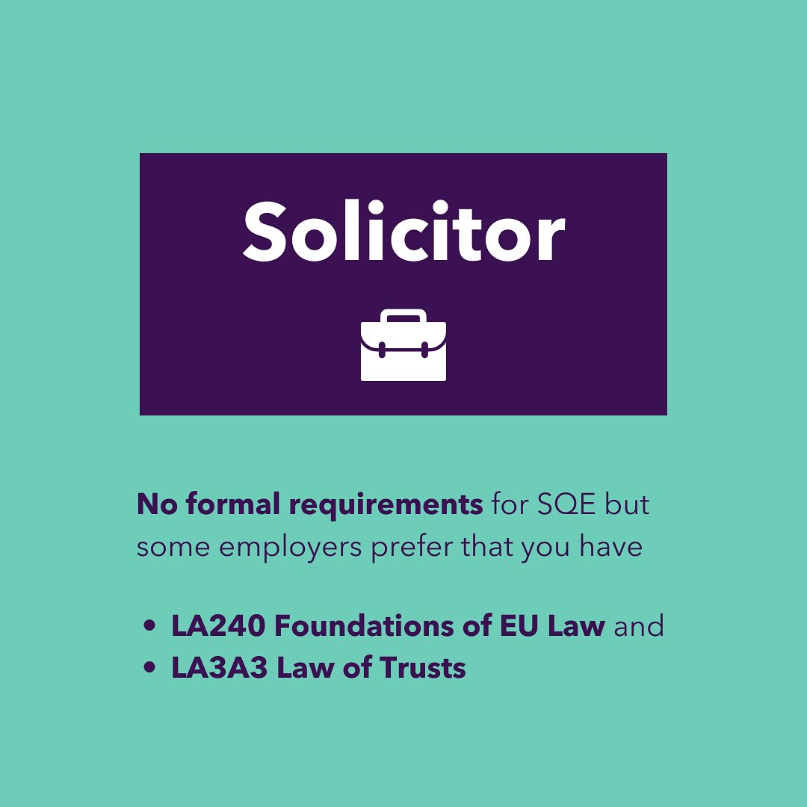


Modules needed for legal qualification:
England and Wales
Foundational Legal Knowledge Modules:
Criminal Law (LA104)
EU Law (LA240)
Contract Law (LA247)
Tort Law (LA124)
Constitutional and Administrative Law (LA129 LSI)
Land Law (LA248 Property)
Trusts (LA3A3)
Select LA240 EU Law / LA3A3 Law of Trusts when prompted on the module form
Qualifying as a solicitor
Qualifying as a barrister

Slide 7
Modules for legal qualification: other jurisdictions
Students wishing to qualify in another jurisdiction should check the minimum credit requirements for the foundational subjects with the relevant authority and, if necessary, consult their personal tutor for guidance.
In addition to the core modules, if you are intending to qualify as a lawyer in another jurisdiction (for which an English Law degree is a requirement), you should take the following modules as well:
LA240 Foundations of EU Law in Year 2, 3 or 4 (Term 2)
LA3A3 Law of Trusts in your third or final year (Term 1)
Some jurisdictions require a full year (30 CATS) of Contract, Property and/or Trusts Law. In term 2, we offer optional modules that expand on the core/recommended modules you will study in term 1:
LA249 Contemporary Challenges in Contract Law
LA251 Contemporary Perspectives on Property,
LA3C9 Contemporary Issues in Trusts Law

Slide 8
Law with Humanities (M136) student going into year 3
90 CATS of modules from must be taken from departments in the Faculty of Arts over years 2-3
Students can also take 15 CATS of non-Law options in years 2 and 3, this can be in either term.
This student would like to take a 30 CATS supervised project, and LA3A3 Law of Trusts in term 1 (15 CATS).
How many Humanities options must they take in year 3?
Could they take a WBS optional module?
How many Law options would this leave them with?
How many level 6 modules do they need to take in year 3?
Year 1 | Term 1 | LA104 Criminal Law | LA124 Tort Law | LA128 Understanding Law in Context | LA129 Law, State and the Individual
 | Term 2
Year 2 | Term 1 | LA247 Contract Law | LA248 Property Law | PH211-15 (Faculty of Arts Option) | HI276-30 Radical Politics and Struggle for Democracy in Europe (Faculty of Arts Option)
 | Term 2 | LA240 EU Law | LA251 Contemporary Issues in Property | LA333 Medicine and the Law
Year 3 | Term 1 | Supervised Project LA399 30 CATS Classic Dissertation | LA3A3 Law of Trusts
 | Term 2

Slide 9
Law with Humanities (M136) student going into year 3
90 CATS of modules from must be taken from departments in the Faculty of Arts over years 2-3
Students can also take 15 CATS of non-Law options in years 2 and 3, this can be in either term.
This student would like to take a 30 CATS supervised project, and LA3A3 Law of Trusts in term 1 (15 CATS).
How many Humanities options must they take in year 3?
Year 1 | Term 1 | LA104 Criminal Law | LA124 Tort Law | LA128 Understanding Law in Context | LA129 Law, State and the Individual
 | Term 2
Year 2 | Term 1 | LA247 Contract Law | LA248 Property Law | PH211-15 (Faculty of Arts Option) | HI276-30 Radical Politics and Struggle for Democracy in Europe (Faculty of Arts Option)
 | Term 2 | LA240 EU Law | LA251 Contemporary Issues in Property | LA333 Medicine and the Law
Year 3 | Term 1 | Supervised Project LA399 30 CATS Classic Dissertation | LA3A3 Law of Trusts | Faculty of Arts option
 | Term 2 |  | Faculty of Arts option | Faculty of Arts option
Year 1 | Term 1 | LA104 Criminal Law | LA124 Tort Law | LA128 Understanding Law in Context | LA129 Law, State and the Individual
 | Term 2
Year 2 | Term 1 | LA247 Contract Law | LA248 Property Law | PH211-15 (Faculty of Arts Option) | HI276-30 Radical Politics and Struggle for Democracy in Europe (Faculty of Arts Option)
 | Term 2 | LA240 EU Law | LA251 Contemporary Issues in Property | LA333 Medicine and the Law
Year 3 | Term 1 | Supervised Project LA399 30 CATS Classic Dissertation | LA3A3 Law of Trusts
 | Term 2
45 CATS

Slide 10
Law with Humanities (M136) student going into year 3
90 CATS of modules from must be taken from departments in the Faculty of Arts over years 2-3
Students can also take 15 CATS of non-Law options in years 2 and 3, this can be in either term.
This student would like to take a 30 CATS supervised project, and LA3A3 Law of Trusts in term 1 (15 CATS).
How many Humanities options must they take in year 3?
Could they take a WBS optional module?
Year 1 | Term 1 | LA104 Criminal Law | LA124 Tort Law | LA128 Understanding Law in Context | LA129 Law, State and the Individual
 | Term 2
Year 2 | Term 1 | LA247 Contract Law | LA248 Property Law | PH211-15 (Faculty of Arts Option) | HI276-30 Radical Politics and Struggle for Democracy in Europe (Faculty of Arts Option)
 | Term 2 | LA240 EU Law | LA251 Contemporary Issues in Property | LA333 Medicine and the Law
Year 3 | Term 1 | Supervised Project LA399 30 CATS Classic Dissertation | LA3A3 Law of Trusts | Faculty of Arts option
 | Term 2 |  | Faculty of Arts option | Faculty of Arts option
Year 1 | Term 1 | LA104 Criminal Law | LA124 Tort Law | LA128 Understanding Law in Context | LA129 Law, State and the Individual
 | Term 2
Year 2 | Term 1 | LA247 Contract Law | LA248 Property Law | PH211-15 (Faculty of Arts Option) | HI276-30 Radical Politics and Struggle for Democracy in Europe (Faculty of Arts Option)
 | Term 2 | LA240 EU Law | LA251 Contemporary Issues in Property | LA333 Medicine and the Law
Year 3 | Term 1 | Supervised Project LA399 30 CATS Classic Dissertation | LA3A3 Law of Trusts | Faculty of Arts option | WBS option
 | Term 2 |  | Faculty of Arts option | Faculty of Arts option
45 CATS
Yes (15 CATS)

Slide 11
Law with Humanities (M136) student going into year 3
90 CATS of modules from must be taken from departments in the Faculty of Arts over years 2-3
Students can also take 15 CATS of non-Law options in years 2 and 3, this can be in either term.
This student would like to take a 30 CATS supervised project, and LA3A3 Law of Trusts in term 1 (15 CATS).
How many Humanities options must they take in year 3?
Could they take a WBS optional module?
How many Law options would this leave them with?
Year 1 | Term 1 | LA104 Criminal Law | LA124 Tort Law | LA128 Understanding Law in Context | LA129 Law, State and the Individual
 | Term 2
Year 2 | Term 1 | LA247 Contract Law | LA248 Property Law | PH211-15 (Faculty of Arts Option) | HI276-30 Radical Politics and Struggle for Democracy in Europe (Faculty of Arts Option)
 | Term 2 | LA240 EU Law | LA251 Contemporary Issues in Property | LA333 Medicine and the Law
Year 3 | Term 1 | Supervised Project LA399 30 CATS Classic Dissertation | LA3A3 Law of Trusts | Faculty of Arts option | WBS option
 | Term 2 |  | Faculty of Arts option | Faculty of Arts option | Law option
Year 1 | Term 1 | LA104 Criminal Law | LA124 Tort Law | LA128 Understanding Law in Context | LA129 Law, State and the Individual
 | Term 2
Year 2 | Term 1 | LA247 Contract Law | LA248 Property Law | PH211-15 (Faculty of Arts Option) | HI276-30 Radical Politics and Struggle for Democracy in Europe (Faculty of Arts Option)
 | Term 2 | LA240 EU Law | LA251 Contemporary Issues in Property | LA333 Medicine and the Law
Year 3 | Term 1 | Supervised Project LA399 30 CATS Classic Dissertation | LA3A3 Law of Trusts | Faculty of Arts option | WBS option
 | Term 2 |  | Faculty of Arts option | Faculty of Arts option
45 CATS
Yes (15 CATS)
1 (15 CATS)

Slide 12
Law with Humanities (M136) student going into year 3
90 CATS of modules from must be taken from departments in the Faculty of Arts over years 2-3
Students can also take 15 CATS of non-Law options in years 2 and 3, this can be in either term.
This student would like to take a 30 CATS supervised project, and LA3A3 Law of Trusts in term 1 (15 CATS).
How many Humanities options must they take in year 3?
Could they take a WBS optional module?
How many Law options would this leave them with?
4. How many level 6 modules do they need to take in year 3?
Year 1 | Term 1 | LA104 Criminal Law | LA124 Tort Law | LA128 Understanding Law in Context | LA129 Law, State and the Individual
 | Term 2
Year 2 | Term 1 | LA247 Contract Law | LA248 Property Law | PH211-15 (Faculty of Arts Option) | HI276-30 Radical Politics and Struggle for Democracy in Europe (Faculty of Arts Option)
 | Term 2 | LA240 EU Law | LA251 Contemporary Issues in Property | LA333 Medicine and the Law
Year 3 | Term 1 | Supervised Project LA399 30 CATS Classic Dissertation | LA3A3 Law of Trusts | Faculty of Arts option | WBS option
 | Term 2 |  | Faculty of Arts option | Faculty of Arts option | Law option
Year 1 | Term 1 | LA104 Criminal Law | LA124 Tort Law | LA128 Understanding Law in Context | LA129 Law, State and the Individual
 | Term 2
Year 2 | Term 1 | LA247 Contract Law | LA248 Property Law | PH211-15 (Faculty of Arts Option) | HI276-30 Radical Politics and Struggle for Democracy in Europe (Faculty of Arts Option)
 | Term 2 | LA240 EU Law | LA251 Contemporary Issues in Property | LA333 Medicine and the Law
Year 3 | Term 1 | Supervised Project LA399 30 CATS Classic Dissertation | LA3A3 Law of Trusts | Faculty of Arts option | WBS option
 | Term 2 |  | Faculty of Arts option | Faculty of Arts option
45 CATS
Yes (15 CATS)
1 (15 CATS)
Took 15 CATS in year 2, need 75 CATS in year 3 (already taking 45 CATS so need another 30 CATS from optional modules)

Slide 13
Optional modules
02

Slide 14
Term 1 optional modules
LA3B6 Cinematic Explorations of Public Law*
LA3C3: Gender, Sexuality and the Law*
LA3C8 Resistance and Revolution
LA3D1: Corruption and Law
LA3G4 Law in the Culture Wars
LA3G5 Artistic Practice in Contemporary Legal Contexts
LA3G6 Public Enquiries: Democracy, Truth and Justice Beyond the Courtroom
LA3H2 Principles of Corporate Law and Governance
L29275 Trade Marks in Context: Branding, Law and Regulation
15 CATS options
LA308: Social Welfare Law in the Community
LA320 Comparative Human Rights
LA321: Crime and Justice
LA334: Jurisprudence
LA358: Child Law
LA363: Climate Change and Law
LA374: Crime and Punishment
LA381: Writing Human Rights
LA383 Issues in the Legal Theory of Race
LA384: The Art of Advocacy
LA392: Shakespeare and the Law
LA394 Global Health Law
LA396: Modern Challenges for English Family Law
LA3A3: Law of Trusts
LA3A6: Labour Law in Context
LA3B5: Judicial Review and Administrative Justice*
30 CATS options
LA205: International Law
LA217: Social Theory of Law
LA239 Human Rights in Practice
LA390: Public Legal Education
*Pre-requisite/anti-requisite
Module available in year 2 only
Module available to year 3 & 4 only

Slide 15
Term 2 optional modules
LA373: Criminal Evidence
LA380: Art and Cultural Heritage Law
LA389: Private Rights & Wrongs
LA391: Data: Law and Governance
LA393 Transitional Justice
LA398: History of Philosophy of Law
LA3A7: Restorative Justice
LA3C5: Charities, Civil Society and the Law
LA3C7: Intellectual Property Law: Copyright and Trade Marks
LA3C9: Contemporary Issues in Trust Law*
LA3G7 Art, Technology and Law
LA3127 International Law in Crisis
15 CATS options
LA227: Introduction to Competition Law
LA240: Foundations of European Law
LA249: Contemporary Challenges in Contract Law*
LA251: Contemporary Perspectives on Property*
LA2H1 Gender, Violence and Criminal Justice
LA319: Regulation and Technology Governance
LA333: Medicine and Law
LA335 Sentencing and Justice
LA337: Corporations, Law and Colonialism
LA359: Family Law
LA365: Financial Services Regulation
LA367: International Economic Law
LA370 Comparative Constitutional Law
LA371: Corporate Tax Law
LA372: Commercial Law*
30 CATS options
LA205: International Law
LA217: Social Theory of Law
LA390: Public Legal Education
*Pre-requisite/anti-requisite
Module available to intermediate only
Module available to year 3 & 4 only

Slide 16
Module pre-requisites/exclusions
Check which modules are open to finalists only
Pre-requisites
Exclusions
LA249 Contemporary Challenges in Contract Law – must have taken LA247 Contract Law
LA251 Contemporary Issues in Property Law – must have taken LA248 Property Law
LA3C9 Contemporary Issues of Trust Law – must have taken LA3A3 Law of Trusts
PPL students should check the guidance as there are some pre-requisites which are core modules for Law students which you may not have taken
LA251 Contemporary Issues in Property Law is not available to finalists
Students who have taken LA346 Gender and the Law (30 CATS) can’t take the new 15 CATS variants LA3C3 Gender, Sexuality and the Law (term 1) and LA3C4 Gender and the Law in the Global Context (term 2)
Notes:
QLD students can not take the new versions of modules e.g. LA249, LA251, LA3C9, LA3B5 (Judicial Review – was covered in LA201). Year 2 students can’t take finalist modules, and LA251 is only open to year 2 students. Pre-requisites
LA346 is an anti-requisite for LA3C3 Gender, Sexuality and the Law (term 1) and LA3C4 Gender and the Law in the Global context

Slide 17
How many modules to apply for
Check the number of optional modules you need to take per term on the module pages:
0 CATS = 0 optional modules
15 CATS = 1 optional module
30 CATS = 2 optional modules
45 CATS = 3 optional modules
60 CATS = 4 optional modules
In the module application forms you will be asked to select 6 modules per term.
30 CATS modules run across the full year, so should be included in your totals for terms 1 and 2.
You can’t take a module you have already done, or a module you are not eligible to take.

Slide 18
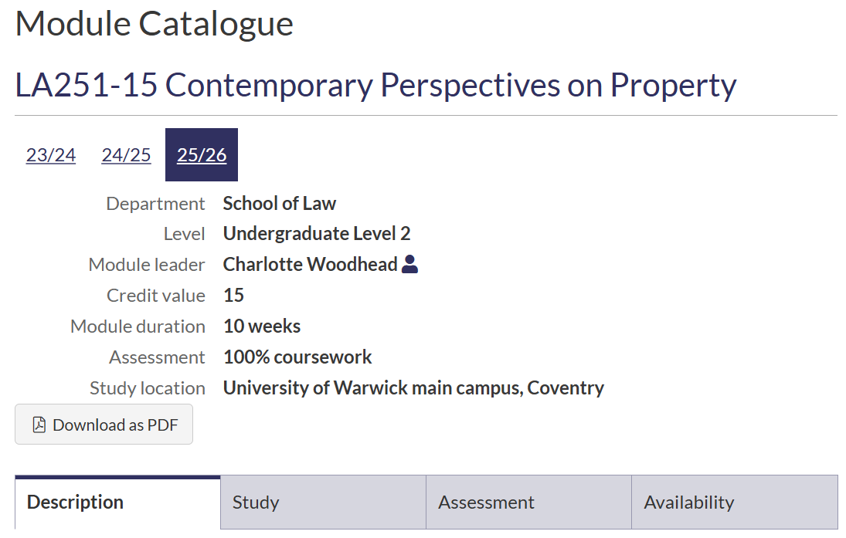
Module information
Look beyond the title …
Module list/catalogue
Module fair
Module taster videos
Speak to module convenor
Notes:
The module catalogue hasn’t been updated with all the modules the Law School are offering next year, please use the Law webpages as the correct source of information. The full module list for 2026/27 contains links to the most recent entry on the module catalogue for each module running in 2025/26, but please note in some cases this will be a previous year whilst the module catalogue is being updated.

Slide 19
Consider assessment methods Term 1
LA3B6 Cinematic Explorations of Public Law
LA3C3: Gender, Sexuality and the Law
LA3C8 Resistance and Revolution
LA3D1: Corruption and Law
LA3G4 Law in the Culture Wars
LA3G5 Artistic Practice in Contemporary Legal Contexts
LA3G6 Public Enquiries: Democracy, Truth and Justice Beyond the Courtroom
LA3H2 Principles of Corporate Law and Governance
L29275 Trade Marks in Context: Branding, Law and Regulation
15 CATS options
LA308: Social Welfare Law in the Community
LA320 Comparative Human Rights
LA321: Crime and Justice
LA334: Jurisprudence
LA358: Child Law
LA363: Climate Change and Law
LA374: Crime and Punishment
LA381: Writing Human Rights
LA383 Issues in the Legal Theory of Race
LA384: The Art of Advocacy
LA392: Shakespeare and the Law
LA394 Global Health Law
LA396: Modern Challenges for English Family Law
LA3A3: Law of Trusts
LA3A6: Labour Law in Context
LA3B5: Judicial Review and Administrative Justice
Online exam
In person exam
Coursework
Coursework and in person exam
Coursework and test
Presentation/Video and coursework
30 CATS options
LA205: International Law
LA217: Social Theory of Law
LA239 Human Rights in Practice
LA390: Public Legal Education

Slide 20
Consider assessment methods Term 2
LA391: Data: Law and Governance
LA393 Transitional Justice
LA398: History of Philosophy of Law
LA3A7: Restorative Justice
LA3C5: Charities, Civil Society and the Law
LA3C7: Intellectual Property Law: Copyright and Trade Marks
LA3C9: Contemporary Issues in Trust Law
LA3G7 Art, Technology and Law
LA3H5 International Law in Crisis
LA3H1 Gender, Violence and Criminal Justice
LA3H2 Principles of Corporate Law and Governance
15 CATS options
LA227: Introduction to Competition Law
LA240: Foundations of European Law
LA249: Contemporary Challenges in Contract Law
LA251: Contemporary Perspectives on Property
LA319: Regulation and Technology Governance
LA333: Medicine and Law
LA335 Sentencing and Justice
LA337: Corporations, Law and Colonialism
LA359: Family Law
LA365: Financial Services Regulation
LA367: International Economic Law
LA370 Comparative Constitutional Law
LA371: Corporate Tax Law
LA372: Commercial Law
LA373: Criminal Evidence
LA380: Art and Cultural Heritage Law
LA389: Private Rights & Wrongs
Online exam
In person exam
Coursework
Coursework and Test
Coursework and in-person exam
Presentation/video and coursework
30 CATS options
LA205: International Law
LA217: Social Theory of Law
LA239 Human Rights in Practice
LA390: Public Legal Education

Slide 21
External (non-Law) modules
Check your course structure to see if you are permitted to take external modules
You can see the available external modules via the module catalogue and on departmental webpages
Apply directly to the host department – there are different module application processes and deadlines
You must select a full range of Law Modules but indicate on the Law Module Application Form if you have applied for external modules
External module confirmation form
Once your space is confirmed on the external module your Law module(s) will be replaced with the external module.
The Law School will register you onto any external modules on the University’s Module Registration system.
Administration of the module is managed by the host department

Slide 22
WBS modules
Register through the my.wbs system - set up your my.wbs account which will enable you to access the module application system with ease when it is open - my.wbs.ac.uk/registration
There are usually 2-3 rounds of module registration a year
Law students are not permitted to take the following Warwick Business School Law modules:
    IB3F20 - Company Law
    IB1130 - Business Law
    IB2370 - Business Law 2
    B3G40 - Law for Entrepreneurs
    IB2C1 - Fundamentals of Business Law
    IB3N4 - International Trade Law

Slide 23
Language Centre modules
The Language Centre modules in Arabic, Chinese, French, German, Italian, Japanese, Korean, Russian, Portuguese and Spanish.
Different levels - acquire a new language or improve your language skills. Language proficiency test before the start of the academic year
Modules for credit must be agreed with Law before enrolling
Final year students may not apply for a beginner’s level (Level 1) module, unless it is the beginner’s (accelerated) level.
Ongoing assessments throughout the academic year, and end of year examinations
30 CATS modules
The same modules as those available for credit are also available to take in addition to degree studies. A fee applies to these modules.
Email law.DUGS@warwick.ac.uk for permission
The Language Centre - Academic Modules (warwick.ac.uk)

Slide 24
Module
APPLICATION form
03

Slide 25
Module Application Forms
Open Thursday 14 May, 11am BST – Friday 29 May 2026 3pm BST
One form for single honours students, and one for joint honours students. Also forms for visiting Students and external Students.
Can submit the form as many times as you like within the time period above. Your last dated submission will be the only submission we look at.
Once the form has closed it is not possible to amend your Law module applications; changes will only be made for students who have a clash or get accepted onto an external module
Late forms will be reviewed after modules have been allocated to students who met the deadline. There may not be space on your preferred modules, so you will need to give us details of six preferred modules for each term.
Access the forms via the Module Application, Allocation and Registration page, or links in the emails

Slide 26
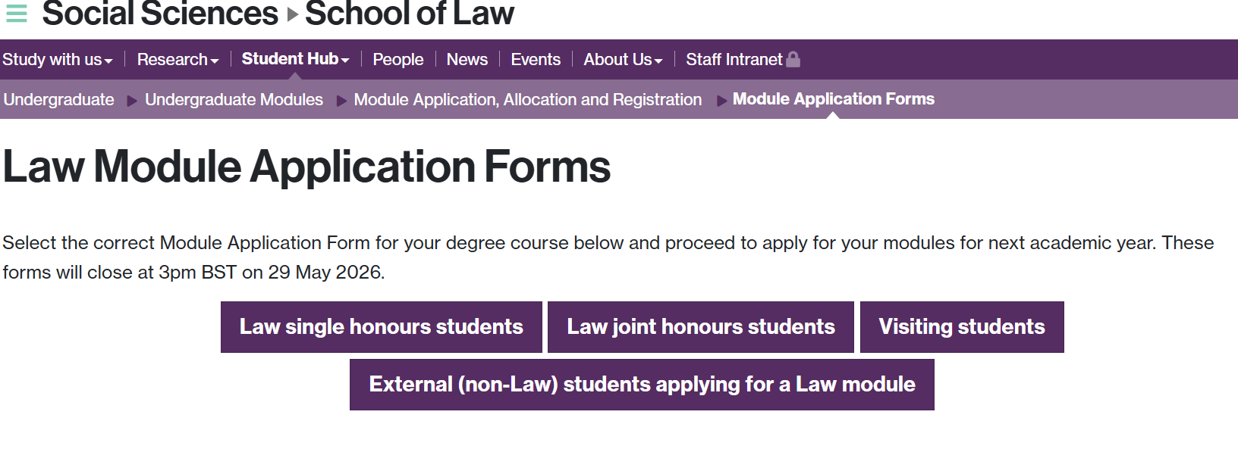


Completing the Module Application form 1
There are 4 different forms: for single honours, for joint honours, visiting students, and external students.

Slide 27
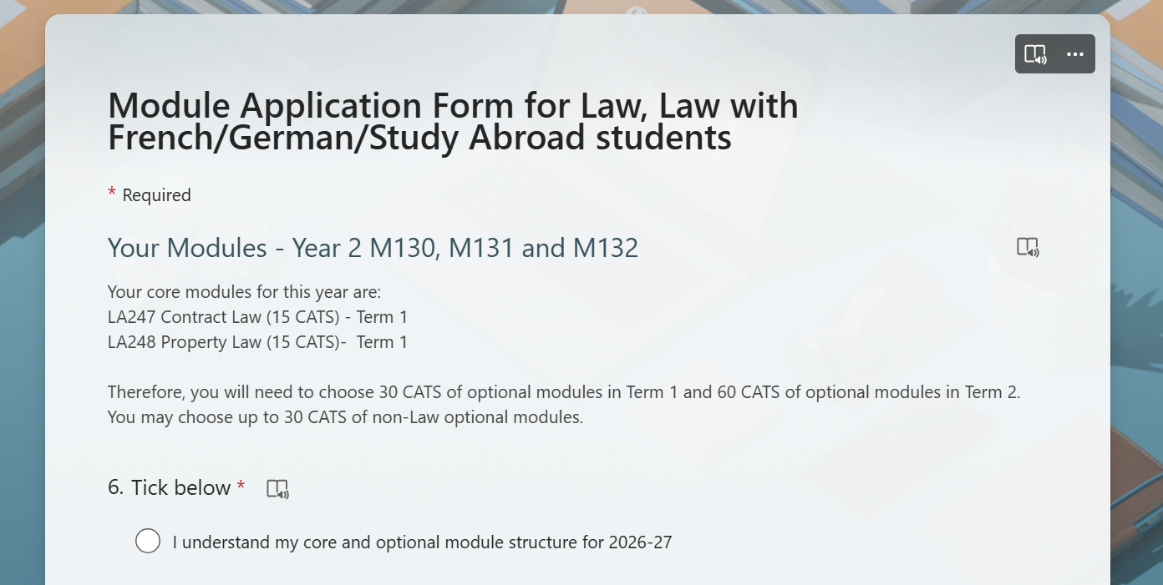
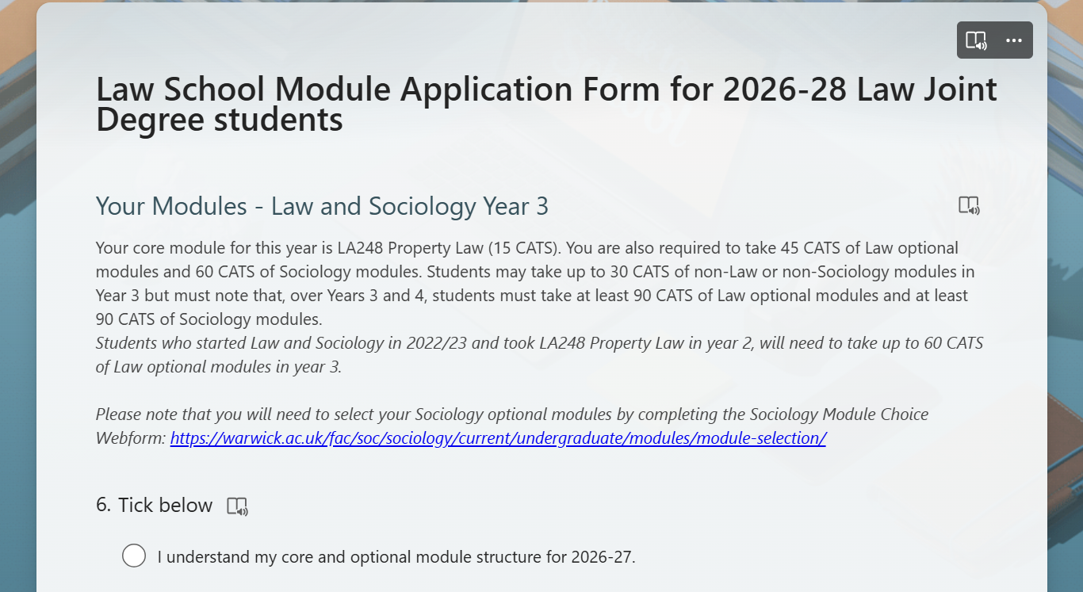
Completing the Module Application form 2
The form will ask you to enter your personal details and your degree course and year in 2026/27.
It will then show you the core and optional module requirements tailored to you.
You will be asked to tick your understanding of your core and optional module structure

Slide 28
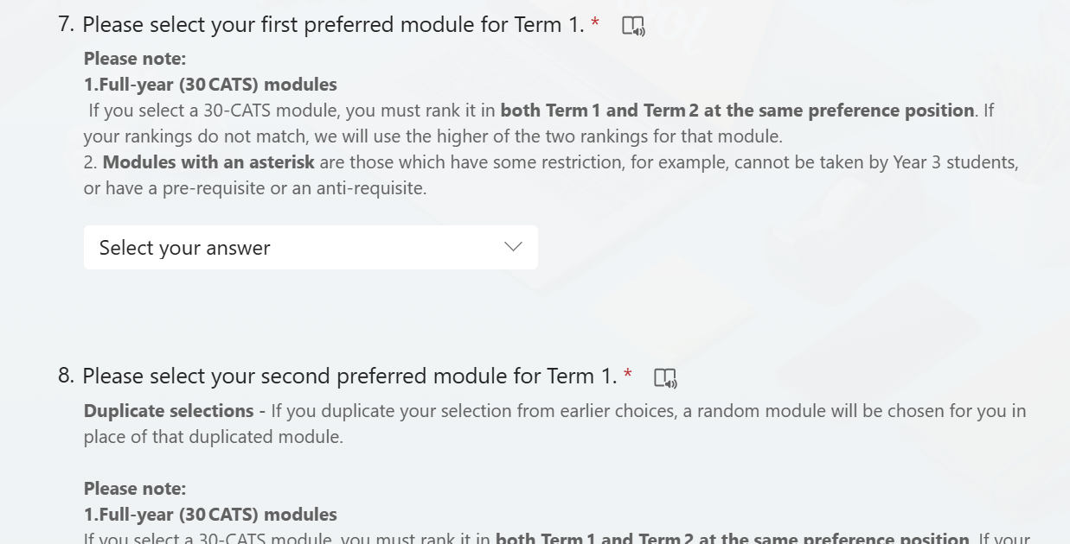
Completing the Module Application form 3
You will then be asked to choose six modules from a dropdown menu for Term 1 and six modules for Term 2, in order of preference.
If you select duplicate modules in your six choices, a random module will be later chosen for you.
30 CATS modules run across the full year, so if you choose one of those, you should rank it as the same preference number in both terms 1 and 2.
Modules with restrictions are marked with an asterisk.

Slide 29
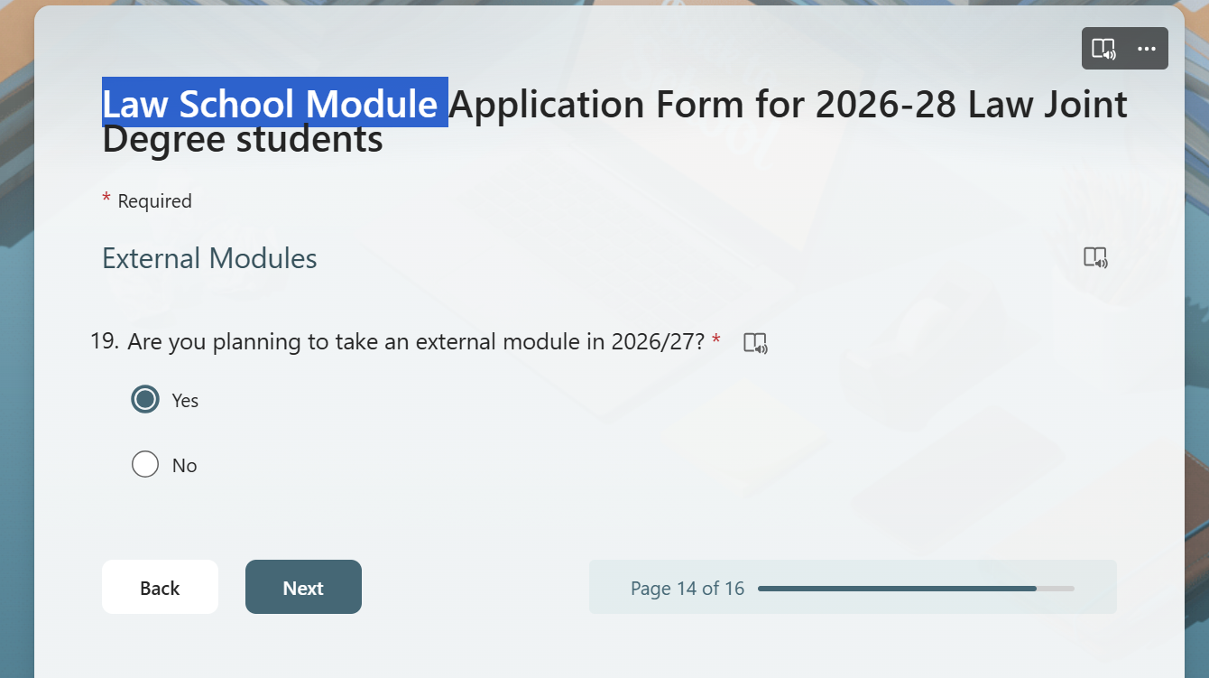
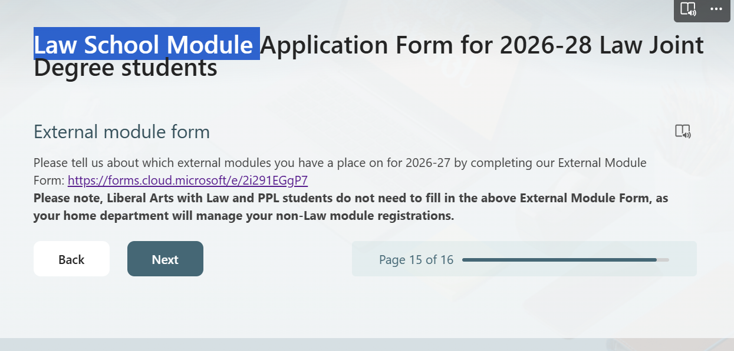
External modules
Let us know if you are thinking of taking any external modules in 2026/27
You must still apply for a full range of Law modules. Once your space is confirmed on the external module your Law choice(s) will be replaced with the external module
External module confirmation form

Slide 30
Module allocation process
04

Slide 31
How your modules are allocated
5-month process …
Module Application Form open
Forms collated
Data cleanse
LA240 and LA3A3 allocated
Optional modules allocated
Checks
Share module allocation with students
Adjustments (ext. modules & clashes)
Register Law students onto modules
May-June
July-August
Timetable and seminar selection
September-early October
Notes:
Forms collated for Law, PPL, Liberal Arts and Visiting students, as well as any external students taking a limited range of Law modules. Then late students added
Modules allocated from choice 1 → choice 6 until the module is full, and each student has enough modules for that term

Slide 32
Oversubscribed modules
How the Student Services Team fairly allocate modules
Allocate all first-choice students
Then rounds of second, third, fourth, fifth and sixth choice until the module is full
After the first round, students are only considered if they need modules for that term (i.e. you won’t be allocated choice 5 if you already have 60 CATS for the term); they are eligible to take the module; and there are no clashes with a higher choice module
Within each round, if there are more students than spaces, finalists will get preference and students who submitted the form late will be considered last
Allocation is on the basis of preference, not first come, first served.
Module Application Forms for the previous year are not taken into account
Law single and joint honours students are treated equally to PPL, Liberal Arts and visiting students. Some modules have spaces set aside for non-Law students

Slide 33
Final comments
No waiting lists – external choices and clashes are already factored in when allocating
It does not matter when you submit your form during the module application window as long as you’re not late, so take time to fully consider your choices
Don’t waste choices – check your eligibility for modules first and consider how many options you need to take
Your modules will be confirmed in mid-September and the Law School will register you for all modules in Welcome Week - your lecture timetable will be available at the end of Welcome Week and seminar selection will take place in week 1 (for Law modules) at which point you will have a full timetable
The Student Services team try to make the process as fair as possible ☺
Module fair today 11am-1pm S.0.08, S0.09, S0.10
Student Services Team will have a helpdesk in the Student Hub 11am-1pm today

Slide 34

Any questions?
undergraduate.law@warwick.ac.uk
Please include your Student ID, module code and module title into any queries.
At peak times it may take 3 working days to reply

