Slide 1

LA3H2 Principles of Corporate Law & Governance
15 CATS / Term 1

Slide 2
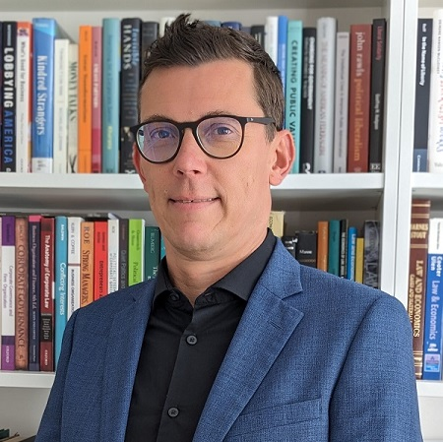


Dr David Gindis
(module convenor)
david.gindis@warwick.ac.uk
Office: S1.30
Prof Irit Mevorach
irit.mevorach@warwick.ac.uk
Office: B1.13

Slide 3
Aims
Learning outcomes
  ✓ Understand the economic and commercial benefits of the corporate form
  ✓ Be familiar with the general body of company law and related legislation
  ✓ Rely on case law to identify continuing areas of legal uncertainty
  ✓ Understand corporate governance through common law and statutory developments
  ✓ Formulate and evaluate relevant policy proposals
LA3H2 provides a systematic, critical, and contextual understanding of key principles, concepts, and issues in UK company law and corporate governance
Integrates theoretical, policy, and practical perspectives

Slide 4
Topic
Key legal issues
Setting up a company
Advantages of the company
Consequences of the company
Dealing with outsiders
Managing the company
Protecting the company
Protecting the shareholders
Protecting the creditors
✓ Types of companies, corporate constitution
✓ Corporate personality, limited liability
✓ Veil piercing, parent company liability
✓ Corporate contracting, authority, agency
✓ Directors, directors’ duties
✓ Defaulting directors, company remedies
✓ Derivative actions, personal actions
✓ Creditor-regarding duties, wrongful trading

Slide 5
Structure
Assessment by exam
Part A: Essay question
Part B: Problem question
Formative
Readings
9 lectures
7 seminars from week 3
Seminars follow lecture with 1-week lag
Seminars
Companies Act 2006
Key case law
Textbook
Academic commentary
Essay questions
Problem questions
Critical article analysis

Slide 6
“The seminars are very useful in clarifying challenging material.”
“I always felt like I had left the seminar gaining something from it. The knowledge I have gained will come in handy when I start SQE and my training after that!”
“Problem questions and essays questions in seminars helped me to understand how to answer well in exams.”

