Slide 1

Living through climate change
Global Groupwork project: 2024
Helen Nesadurai (Monash Malaysia)

Slide 2
Writing Guidelines (from guidance document)
Requirement 1: Select one object or practice
Cause/source of climate change
Impact on, or impacted by, climate change
Mitigate climate change
Requirement 2: Connect object/practice to theory, concept or key issue in IPE
Free trade (worsens climate change?)
Global governance: Role of states (governments), civil society (NGOs), businesses (corporations), banks?
Advocacy and community action: slow fashion movement, recycling, protests?

Slide 3
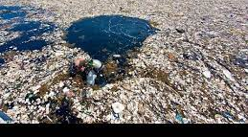
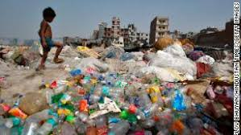
Think more deeply
Sources and impacts of climate change are both local and global
Plastics, Food, Fashion
Governance solutions to mitigate/address problems can be local/global
These solutions can themselves have adverse consequences
Electric vehicles, urban public transport
Are “good” objects and practices always “good” for the climate and our everyday lives?
How does what we use everyday become a global crisis?
Who has power to decide how/when we address climate change? Affordability & access to climate-friendly products?
Recycling, go vegetarian, electric vehicles
Who says so, and on what basis?

Slide 4


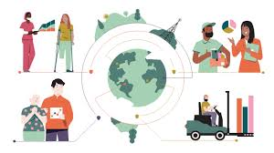
Global Groupwork: Living with climate change
Everyday living through climate change – sometimes very obvious, often less so
Go below the surface to ask broader questions, research & read widely but with focus
The global groupwork partnership brings insights, expertise of different students
Work collaboratively; engage in discussion, share/exchange ideas [communicateX3]
Enjoy the task (no marks to worry about) but work to ensure a shared quality output

