Slide 1
Decentring and recentring everyday crises of social reproduction
Juanita Elias, Jayanthi Thiyaga Lingham and Shirin Rai

Slide 2
Feminist (political economy)theorizations of crisis
Capitalist crisis and Social reproduction
‘the rupture between life making and profit under capitalism’
Crisis of the labour of social reproduction
Crisis experienced as a crisis of the labour social reproduction; plays out in deeply gendered ways
Challenging ideas of crisis as one-off event
Crises as experienced slowly and relentlessly over time
Crises as opportunities for social change

Slide 3
Conceptual contribution
Social reproduction lens
Crisis and everyday life
Challenging temporally bound notions of crisis
Decentre much social reproduction theorizing from its global north centric intellectual tethering
i.e. centring social reproduction scholarship and decentring its conceptual gaze
Empirical contribution
Using empirical examples to illustrate theoretical arguments
Enables us to point to the racialized, gendered and violent nature of struggles over social reproduction
It also enables us to bring is a discussion of the spatial and temporal dimensions of crises (where is crisis experienced, when is it experienced and for how long?)

Slide 4
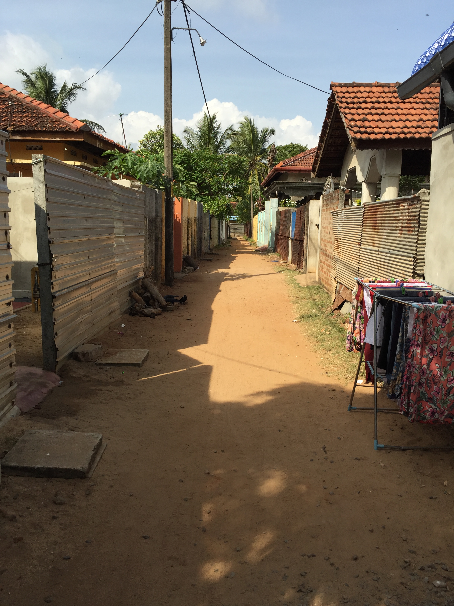
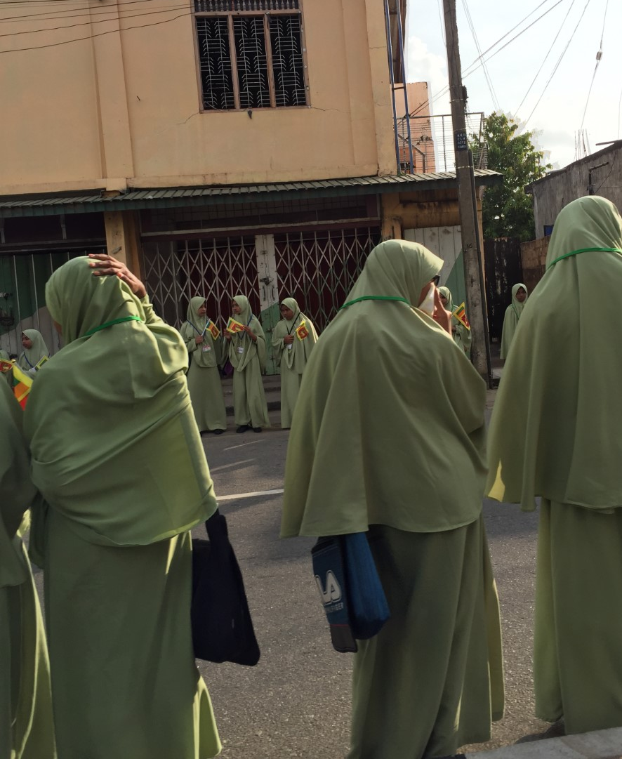
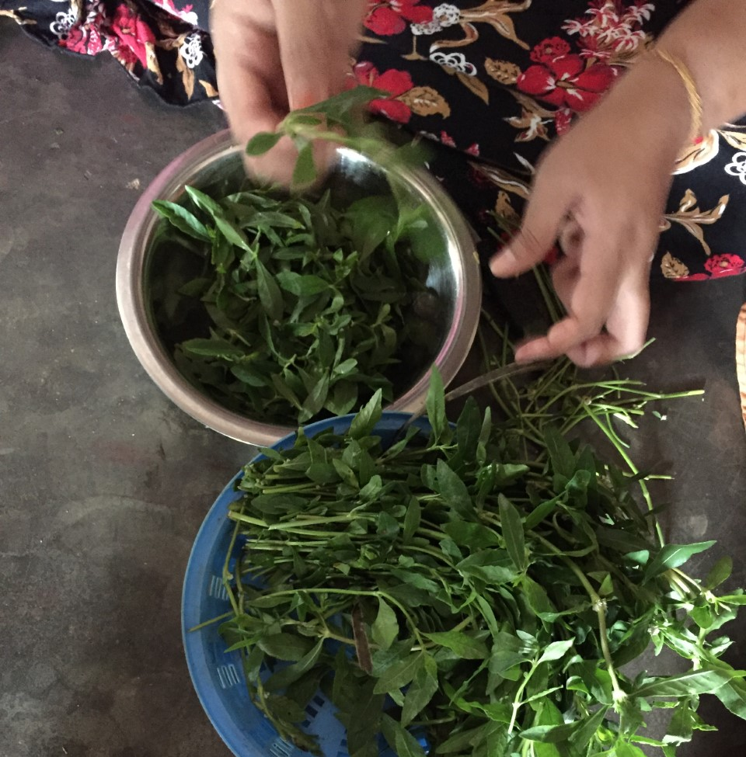
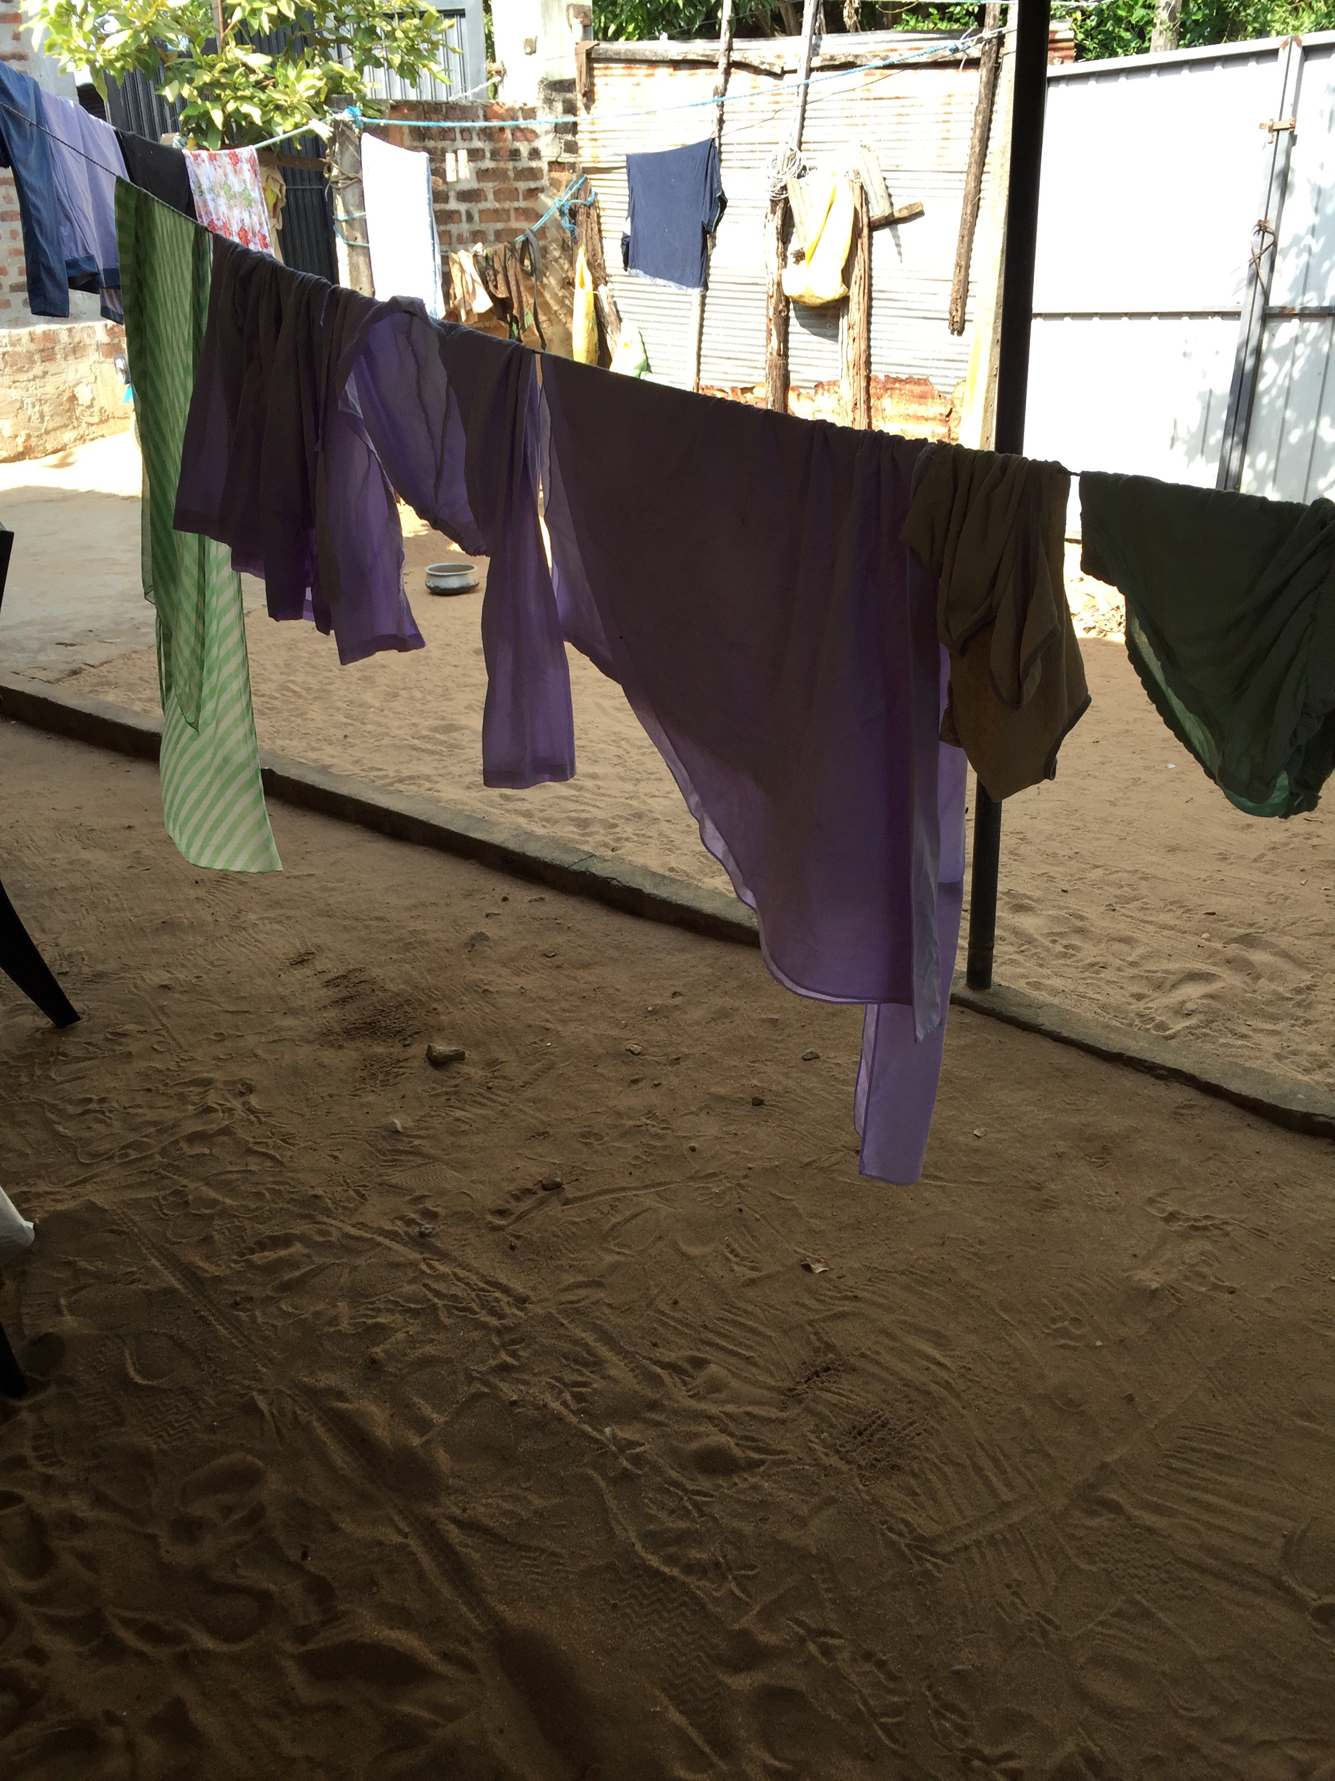
‘Post-conflict’ Sri Lanka, February 2020: minoritised households absorb ongoing and everyday crisis

Slide 5
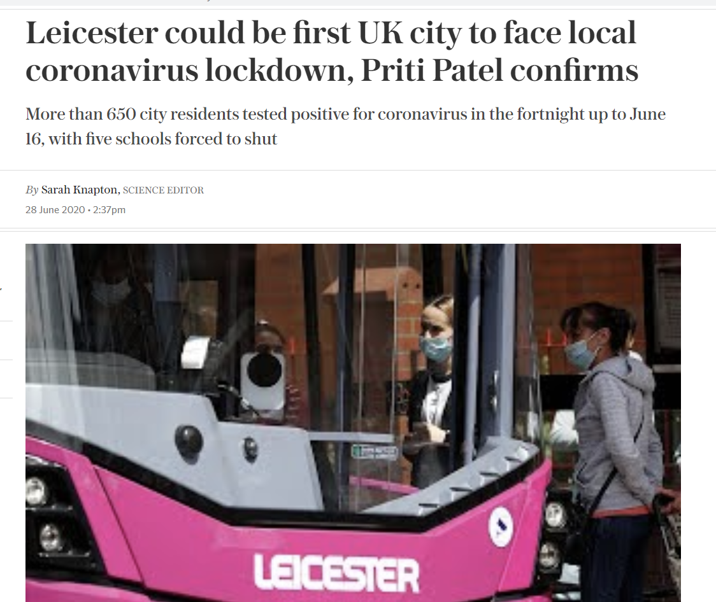
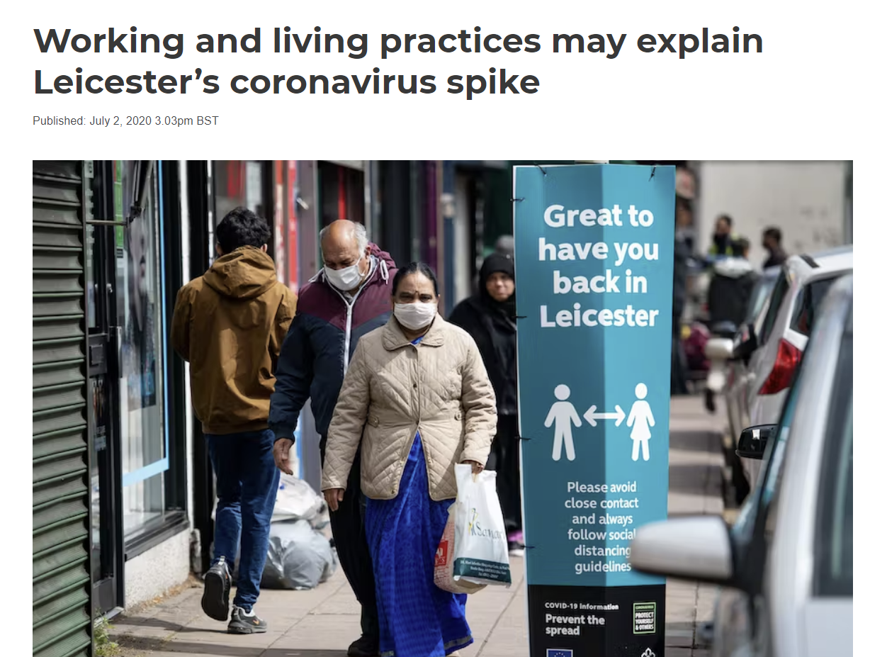

UK summer 2020: Racialised households and communities blamed for COVID-19 crisis

Slide 6
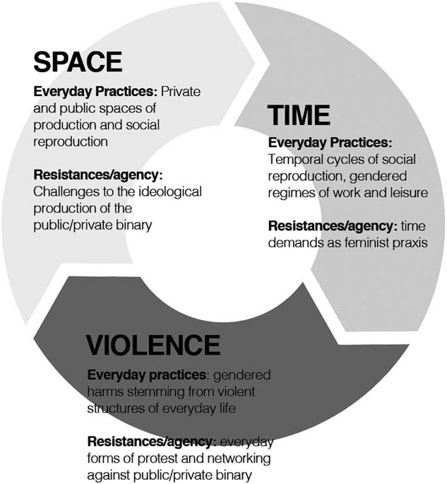
Image from Elias and Rai (2019) ‘Feminist Everyday Political Economy: time, space and violence’ Review of International Studies.

Slide 7
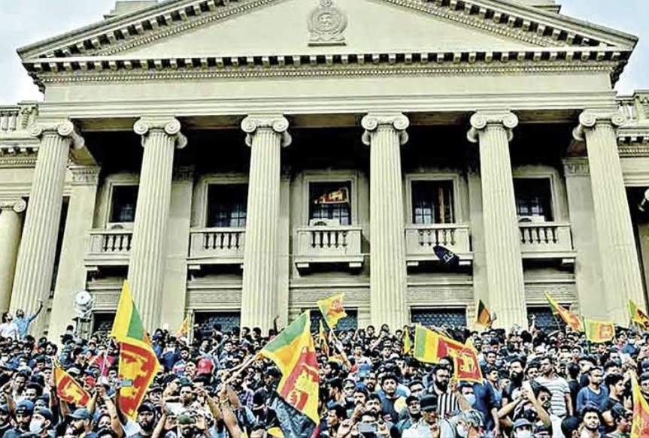
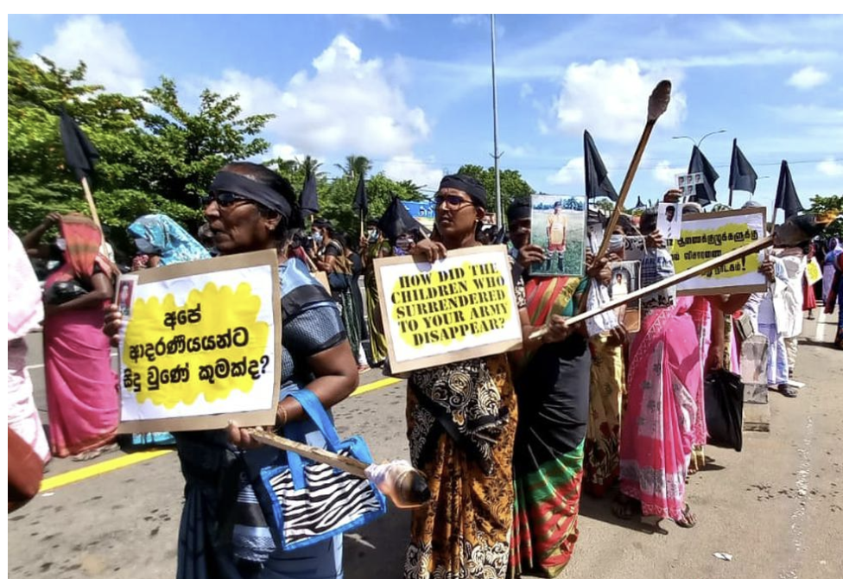
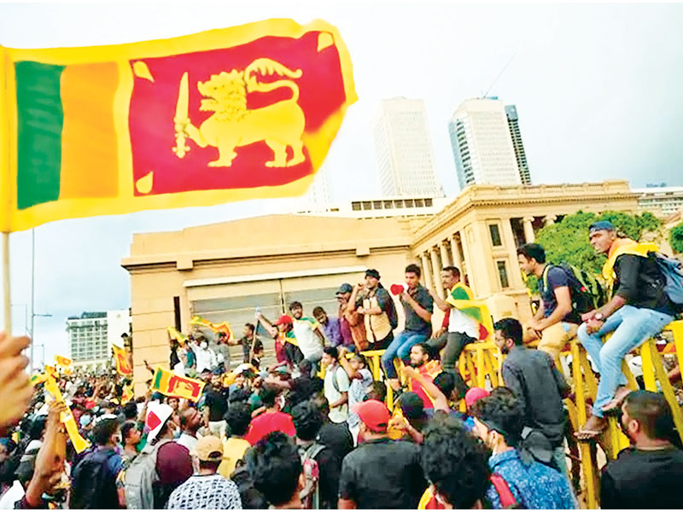
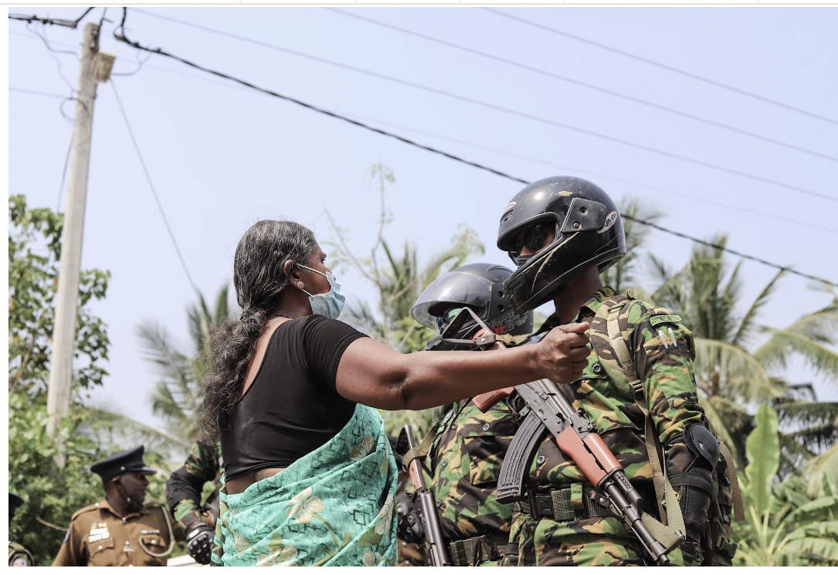
Agency and resisting crisis: whose voices do we foreground?
Colombo, Sri Lanka: ‘Aragalaya’ 2022
Northern Province, Sri Lanka: Families of Disappeared 2022

