Slide 1
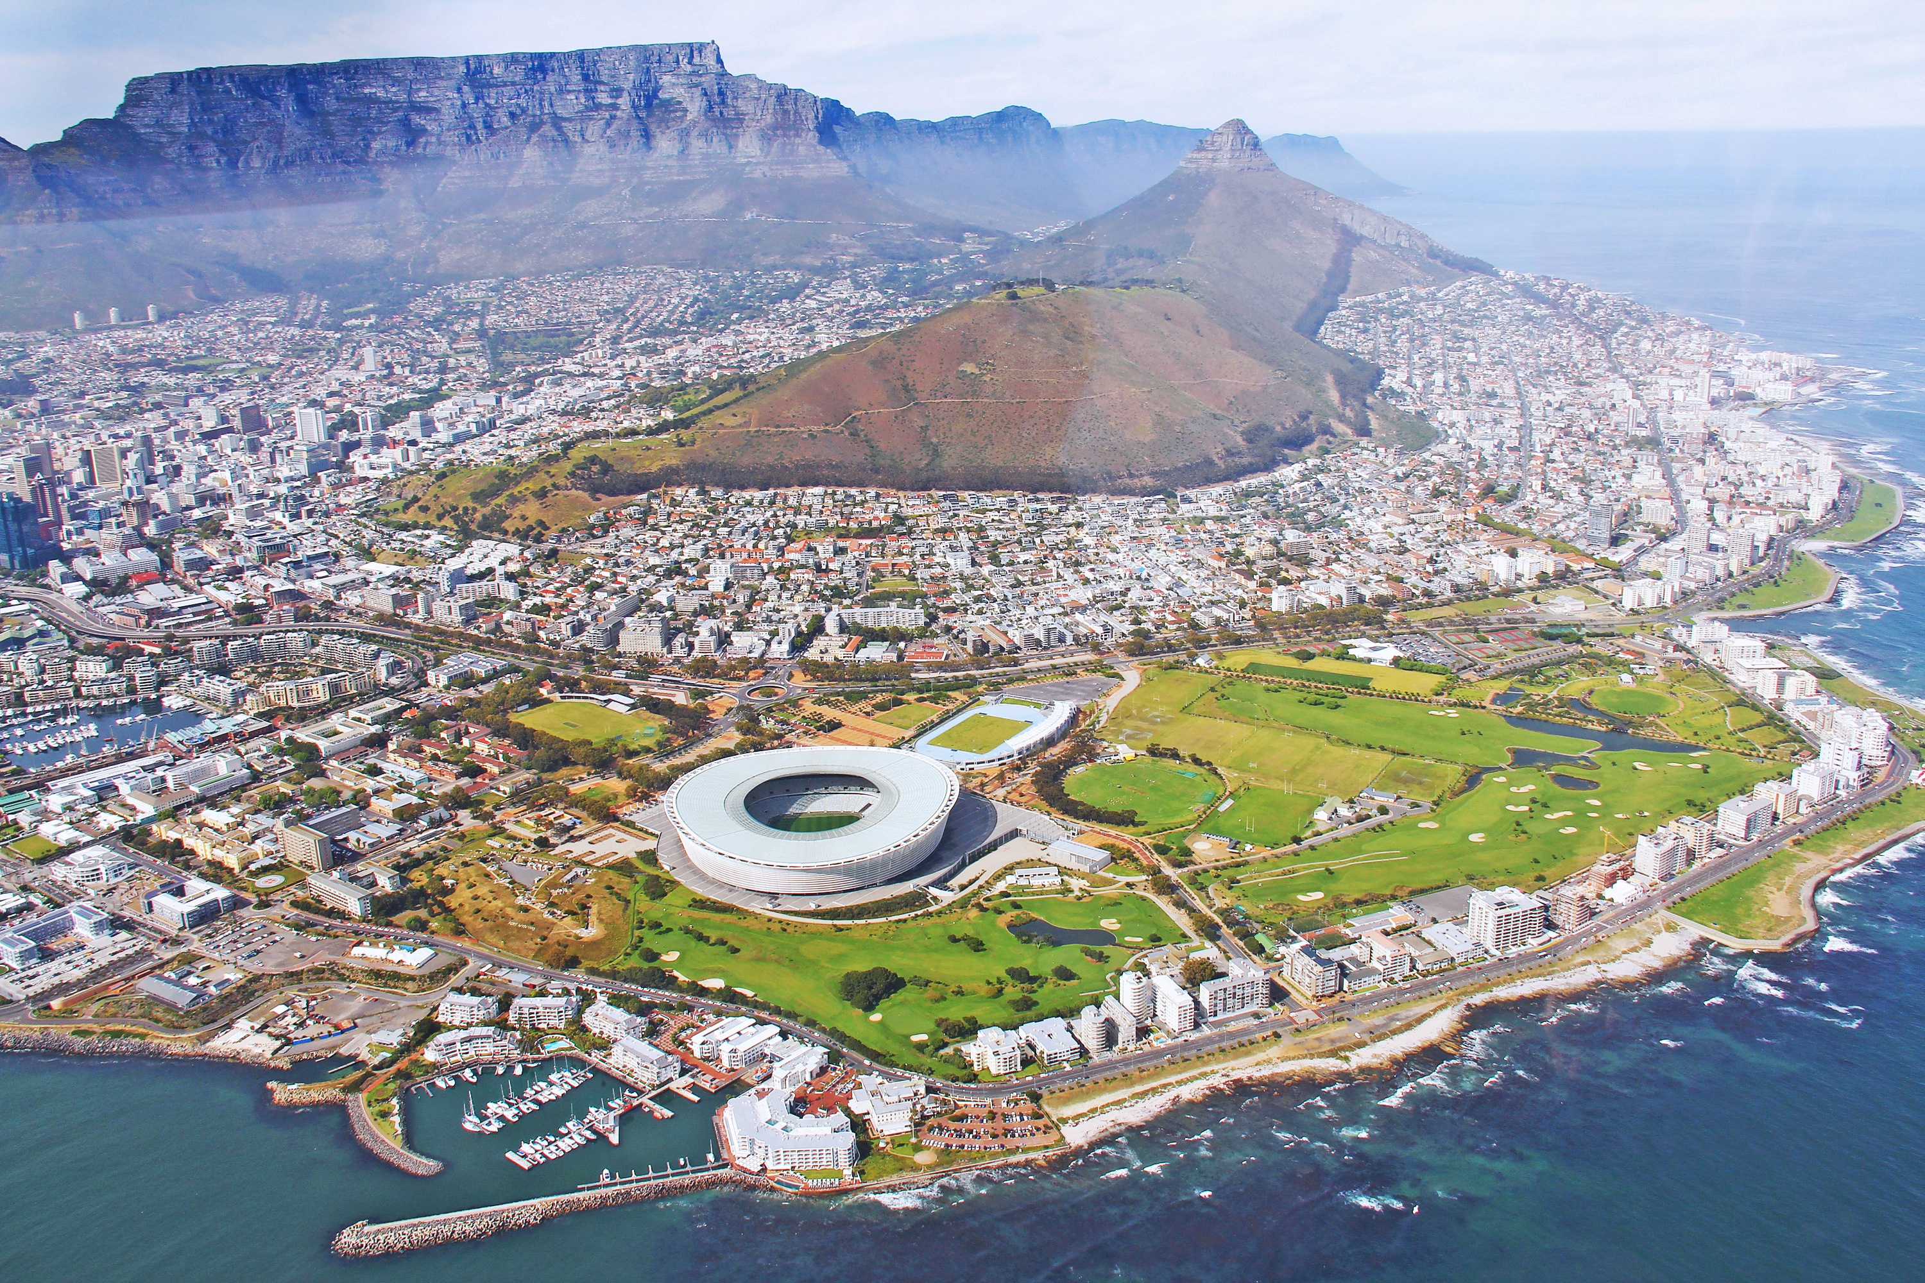

Ethical Toolkit
FOR POLICY DELIBERATION
A microlearning course on ethical decision-making and deliberation

Slide 2
ETHICAL TOOLKIT
3
OBJECTIVES AND TOPICS
Contents
5
TOPIC ONE: ETHICAL DELIBERATION
10
TOPIC TWO: THE ETHICAL TOOLKIT
TOPIC THREE: ETHICAL DELIBERATION IN POLICYMAKING
21
The course aims to provide you with the necessary tools for ethical deliberation within your specific policy area. Originally centered on climate adaptation, the valuable insights gained can be applied to any policy-related decision-making process.
The course will take you through each of the steps of the ethical toolkit, using examples, videos, and questions to check your understanding throughout.

Slide 3


ETHICAL TOOLKIT
Course
Objectives
1
To understand the role of ethical deliberation in policymaking
2
To be able to use the ethical toolkit step by step in ethical deliberation
3
To be able to make judgments about key ethical issues that may arise

Slide 4


ETHICAL TOOLKIT
INTRODUCTION TO ETHICAL DELIBERATION
What is ethics?
What is ethical deliberation?
How can ethical deliberation assist municipal planning?
THE FRAMEWORK
Six stages of the framework for ethical deliberation (policy alternatives, context, fairness, ethical issues, solutions, courses of action)
Topics
ETHICAL DELIBERATION IN POLICY-MAKING
Covered
Framework in action
FAQs
Further resources

Slide 5

ETHICAL TOOLKIT
WHAT IS ETHICS?
01
This section takes learners through some of the questions that the study of ethics asks and some of the key features
Topic
WHAT IS ETHICAL DELIBERATION?
Area One
02
Using examples, this section outlines the role of ethical deliberation and some of its important values
Introduction to ethical deliberation
HOW CAN ETHICAL DELIBERATION ASSIST MUNICIPAL PLANNING?
03
This section demonstrates how ethical deliberation is useful in identifying important considerations for municipal planning decisions

Slide 6
ETHICAL TOOLKIT
Introduction to ethical deliberation
Ethics is the branch of philosophy that involves the systematic reflection on what is right and wrong, good and bad.
Consequently, ethics aims to be prescriptive (or normative) rather than descriptive: whereas descriptive statements make empirical claims that can describe a situation or state of affairs, prescriptive and normative statements make claims about what people ought or should do or be based on what has been determined to be right or wrong, good or bad. For example, the statement ‘I like oysters!’ is descriptive because it describes a personal preference (namely, that the person making the claim likes oysters) rather than making a claim about whether that such preferences are good or bad. In contrast, the statement ‘I like oysters and everyone should like oysters too!’ is prescriptive because it makes a claim about what is good (namely, that oysters are good) and thus prescribes what people ought or should do (namely, that they should like oysters). In this way, ethics is often action-guiding as it prescribes actions that are good or right and disavows actions that are wrong or bad.
01
WHAT IS ETHICS?

Slide 7
ETHICAL TOOLKIT
Introduction to ethical deliberation
Whereas personal preferences are just that – namely personal – prescriptive claims can be evaluated and deliberated upon. The aim of ethics is to ask questions about how and why prescriptive claims are justified, for example:
Is the claim supported by evidence (i.e., are there any benefits or disadvantages to eating oysters)?
Who has been involved in setting forward this claim and has this process been inclusive (i.e., does all relevant stakeholders support eating oysters)?
Does the claim adhere to accepted normative principles of fairness (i.e., does the prescription to eat oyster unfairly impact some people rather than others, such as people with shellfish allergies or people who cannot afford to buy oysters, or benefit some, such as oyster farmers)?
Who should be responsible for upholding this claim (i.e., who should enforce people eating oysters and would this be appropriate)?
Does the claim violate the distinction between the public and private sphere (i.e., is eating oysters a personal choice rather than one that should be enforced as part of public policy)?
How is the claim normatively justified (i.e., why should everyone eat oysters and is this justified)?
01
WHAT IS ETHICS?

Slide 8

ETHICAL TOOLKIT
Introduction to ethical deliberation
02
WHAT IS ETHICAL DELIBERATION?
Questions to consider:
How does ethical deliberation fit into your work?
Are there any examples you can think of where you have had to consider ethical issues in your day-to-day planning?

Slide 9
ETHICAL TOOLKIT
Introduction to ethical deliberation
Municipal planning commonly involves issues that are of ethical interest, including poverty alleviation, distribution of resources, safeguarding against environmental risks, promotion of childhood development and education, and urban renewal. These issues often concern what public programmes to promote and prioritize; what communities to assist; and whose interests and needs to address. Ethical deliberation can assist municipal planning on ethically relevant topics and dilemmas in several ways. Most importantly, it can help identify issues that are not always revealed. In this way, ethical deliberation can lead to more robust solutions that can anticipate and avoid potential negative consequences. Moreover, by engaging in ethical deliberation decision makers are better equipped to articulate ethical justifications for a particular course of action and can show how plans have undergone rigorous scrutiny by considering a variety of arguments and reasons for and against.
03
HOW CAN ETHICAL DELIBERATION ASSIST MUNICIPAL PLANNING?

Slide 10

This section of the course outlines each of the six stages of the ethical framework.
ETHICAL TOOLKIT
Topic
Stage 0 : Identification of policy alternatives (optional)
Stage 1. Description of context
Area Two
Stage 2. Identification of principle(s) of fairness
The framework
Stage 3. Identification of ethical issues
Stage 4. Identification of solution(s)
Stage 5. Identification of course(s) of action

Slide 11
ETHICAL TOOLKIT
The framework
INTRODUCTION TO THE FRAMEWORK
Use this module to work through the framework step-by-step for a policy area familiar to you. In what follows, each step of the framework will be explained in more detail, and important questions will be asked along the way.

Slide 12
ETHICAL TOOLKIT
The framework
Before deliberators begin to discuss ethical issues in climate action and how to address them, they might optionally choose to identify possible available policy-options and interventions that they can implement given municipal priorities and resources. This will narrow down the scope of the deliberation to only focus on ethical issues within the available options. There are several reasons why a narrowed-down deliberation would be preferred: deliberators will not always have the authority to make final policy-decisions; only some alternative solutions would fit within the general policy-aims of the municipality; only some alternative solutions can realistically be achieved given municipal resources; and/or the issue at hand requires urgent action that precludes a longer, more open-ended deliberation process.
Alternatively, if deliberators aim to use the framework to identify ethically sound alternatives, they will benefit from a more open-ended deliberation and should thus skip straight to Stage 1.
01
IDENTIFICATION OF POLICY ALTERNATIVES
Questions to consider:
Are there only a specific number of policy options available to you? Or are there several possible policy options?

Slide 13
ETHICAL TOOLKIT
The framework
The first stage of the deliberative framework asks deliberators to provide a narrative description of the current situation: what has happened, what are the aims, who is involved? This description will provide the necessary details that allow deliberators to make informed and evidence-based decisions throughout the subsequent stages. Deliberators should strive to describe the situation from different perspectives that consider the various interests of disparate groups in society.
02
DESCRIPTION OF CONTEXT
Questions to consider:
Context Descriptor | Examples
What has happened?
What are the aims?
Who is involved?

Slide 14
ETHICAL TOOLKIT
The framework
During the second stage, deliberators are asked to consider and reflect on six definitions (principles) of what fair public policy should look like. Deciding on a principle of fairness is essential because it provides the standard metric for and helps identify unfair states of affairs, and thus what counts as an ethical issue (stage 3), and fair solutions to address them (stages 4 and 5). Each principle has its benefits and disadvantages. Thus, it is important to note that merely deciding on one or more principle(s) of fairness does not necessarily provide clear-cut answers to the issue at hand and still leaves some discretion for deliberators to make decisions about how to apply them in practice.
03
IDENTIFICATION OF PRINCIPLE(S) OF FAIRNESS
This section will take you through the six principles of fairness. Read through each of the principles and weigh up the advantages and disadvantages for your work.
Utilitarianism: Interventions should benefit the most people
Egalitarianism: Interventions should benefit everyone equally
Luck egalitarianism: Interventions should benefit those who are worse off through no fault of their own
Prioritarianism: Interventions should benefit the worst-off
Sufficientarianism: Interventions secure a minimum standard of living for everyone
Limitarianism: Interventions should limit the amount of excess advantage for some

Slide 15
ETHICAL TOOLKIT
The framework
1. The first principle holds that public policy should aim for interventions that benefit the most people (utilitarianism). While planning municipal interventions around a utilitarian principle can be expedient and clear-cut due to its cost-benefit analysis, a major issue is that it tends to ignore how severely interventions impact the minority who do not benefit from it. For example, although a minority of households in the Western Cape can be classified as informal settlements (20% of overall households, according to the 2011 census), these are arguably the ones most in need of municipal assistance. Yet, informal settlement communities might be down prioritized if a utilitarian view is taken that focuses on maximizing benefits for the most people.
2. The second principle holds that public policy should ensure that everyone benefits equally (egalitarianism). While egalitarianism can help justify actions to eradicate socioeconomic inequalities, it can also be prohibitively ambitious, and is vulnerable to leveling down: the avoidance of many arguably good actions on the basis that many such actions will not have equal benefit for all.
03
IDENTIFICATION OF PRINCIPLE(S) OF FAIRNESS

Slide 16
ETHICAL TOOLKIT
The framework
3. The third principle favors interventions that prioritize those who are worse off through no fault of their own (luck egalitarianism). The benefit of this principle is that can help distinguish cases where people are unfairly disadvantaged because they have made poor choices when they could have done otherwise. For example, building a shopping mall in a flood zone when they could have done otherwise That said, luck egalitarianism can have difficulties making judgements in grey zone cases where it is unclear whether someone really had a choice at all. For example, informal settlements are often built in climate-vulnerable zones because their inhabitants had few other choices to live elsewhere.
4. The fourth principle is concerned with prioritizing the worst-off (prioritarianism). Prioritarianism avoids the leveling down-objection because it recognizes that interventions must be unequal, with priority given to the worst-off. The problem with prioritarianism however, is that it can lead to municipal interventions being resource sinks (especially in cases where the worst-off are so destitute that interventions make no significant difference to their standard of living) or of little benefit to those are not the worst-off, yet still destitute, because they will not be prioritized.
03
IDENTIFICATION OF PRINCIPLE(S) OF FAIRNESS

Slide 17
ETHICAL TOOLKIT
The framework
5. The fifth principle holds that municipal interventions should ensure that everyone is raised to a minimum standard of living (sufficientarianism). The benefit of this principle is that it recognizes that there is some minimum threshold that everyone is owed in order to live a safe and healthy life. However, because the principle is only concerned with inequalities below this threshold, it does little to address inequalities and injustices above the threshold and thus allows for large socioeconomic inequalities as long as everyone has a minimum standard of living.
6. The sixth principle (limitarianism) holds that municipal interventions should aim to limit the excess of advantaged groups and individuals as long as these inequalities have adverse socioeconomic consequences for society at large. For example, excess wealth can buy excess democratic power while excess carbon emissions by a few are bad for the shared environment and should therefore be limited. That said, limitarianism does not by itself do anything to address poverty and destitution and should therefore be combined with one or more of the other principles.
03
IDENTIFICATION OF PRINCIPLE(S) OF FAIRNESS

Slide 18
ETHICAL TOOLKIT
The framework
In the third stage of the framework, deliberators are asked to identify and make explicit a list of ethical issues that arise in the case described during the first stage by using the principle(s) of fairness identified in the second stage. Ethical issues will take the form of inequalities that are unfair according to the principle(s) of fairness.
04
IDENTIFICATION OF ETHICAL ISSUES
Some ethical issues that may arise include but are not limited to:
Excludes certain communities
Promotes socioeconomic inequalities
Does not reduce socioeconomic inequalities
Unfair consequences for specific communities
Levelling down

Slide 19
ETHICAL TOOLKIT
The framework
In the fourth stage of the framework, deliberators will discuss different solutions to address the ethical issues identified in the third stage. In the process, deliberators will discuss what obstacles there are to achieving different solutions; what solutions make the fewest trade-offs; and what trade-offs must inevitably be made. Deliberators will also try to take into account what unintended and derivative consequences, both positive and negative, the preferred solution(s) might have in the future and beyond the particular case(s) being discussed.
05
IDENTIFICATION OF SOLUTION(S)
Some trade-offs may include:
Monetary costs
Trade-offs with other projects
How to work with and in affected communities
Consequences may include:
Changes to communities and their everyday lives
Socioeconomic changes within society
Relationships between groups within society

Slide 20
ETHICAL TOOLKIT
The framework
Once a preferred solution has emerged, it is necessary to consider what needs to be done to achieve that solution. This involves distributing responsibilities to relevant actors and identifying possible civil society partners as well as setting out concrete steps for moving forward. It may also be important to take note of negative consequences and trade-offs that might be associated with the solution so that attention can be paid to these issues during the implementation and in the future.
06
IDENTIFICATION OF COURSE(S) OF ACTION
Use this time to think through what a project plan may look like in your area of planning, drawing on your preferred project management frameworks.
Some aspects to consider include how to embed the ethical deliberation you have done into existing processes.

Slide 21




ETHICAL TOOLKIT
This section provides a worked through example of how the framework can be used. Use this to check your understanding of each of the stages of the framework.
Topic
THE FRAMEWORK IN ACTION
Area Three
A short section on frequently asked questions
Ethical Deliberation in Policy-making
TROUBLESHOOTING
This section provides further information on ethical deliberation in policymaking including extra resources
FURTHER RESOURCES

Slide 22
ETHICAL TOOLKIT
THE FRAMEWORK IN ACTION

Slide 23
How does this framework help me in my everyday work?
The aim of this framework is to centre ethical deliberation in the work you already do in municipal planning. The framework is intended to complement existing project management frameworks and tools to assist you in working through consequences of planning decisions that may not be identified in traditional cost benefit analyses.
When should I use the framework?
The framework is designed to assist municipal planning both in the initial mapping stages of a project, and whenever a planning decision throughout the lifetime of the project may have undesirable results for stakeholders.
ETHICAL TOOLKIT
FREQUENTLY ASKED QUESTIONS

Slide 24
ETHICAL TOOLKIT
FURTHER RESOURCES

