Slide 1

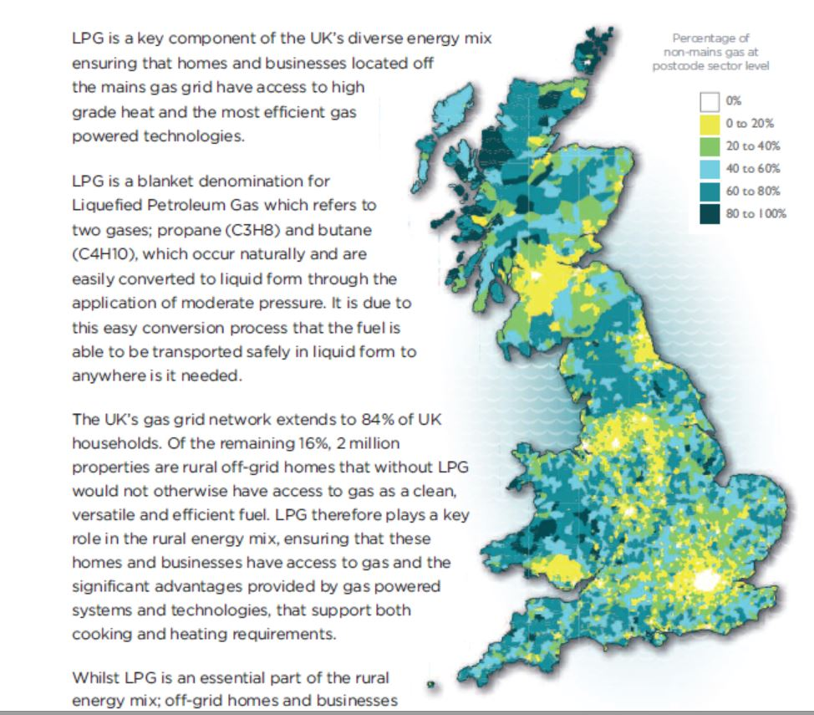
How do we make ‘A Future Framework for Heat in (off gas grid) Buildings’ work for all LAs?
Dr Steffi Harangozo, Energy Team, North Yorkshire County Council
Compelling social, environmental & economic case for retrofits of 1.1 million homes off the gas grid (CCC): North Yorkshire 62,000 homes & 195 schools. School oil consumption =17.6 MWh / £680,000 p.a.
RHI: Only ~5% of heat from renewable sources by 2020 (target was 12%)
Major ‘regional’ scale retrofit opportunities but how do we do 10s of thousands of retrofits every year?
BEIS consultation

Slide 2
Need for ‘collective’ solutions involving multiple authorities – cities, towns & shires
Prerequisite for sub/regional delivery prospectus that can work everywhere?
Authority | Homes off gas grid | %
South Cambridgeshire DC | 18,000 | 29%
Hambleton DC (North Yorkshire) | 14,000 | 37%
York | 9,000 | 10%
Liverpool | 20,000 | 9%
Salford | 16,000 | 15%
Chichester | 14,000 | 26%
Warwick | 8,000 | 13%
Leicester | 12,000 | 10%
Great Yarmouth | 11,000 | 25%
Brighton & Hove | 18,000 | 14%
Taunton Deane | 9,000 | 17%
Lots of low carbon heating & fabric retrofits needed for all types of LAs, e.g. Liverpool.
We are all part of the solution!
Advantages of working together:
Build up capacity & share knowledge
Scaling & phasing of imp-lementation
BEIS will be more supportive of ‘cross border/sector’ prospectus bids, rather than small scale efforts. Combined Authority bids, e.g. West Midlands, SW England, attest to this.
Data from BEIS

Slide 3
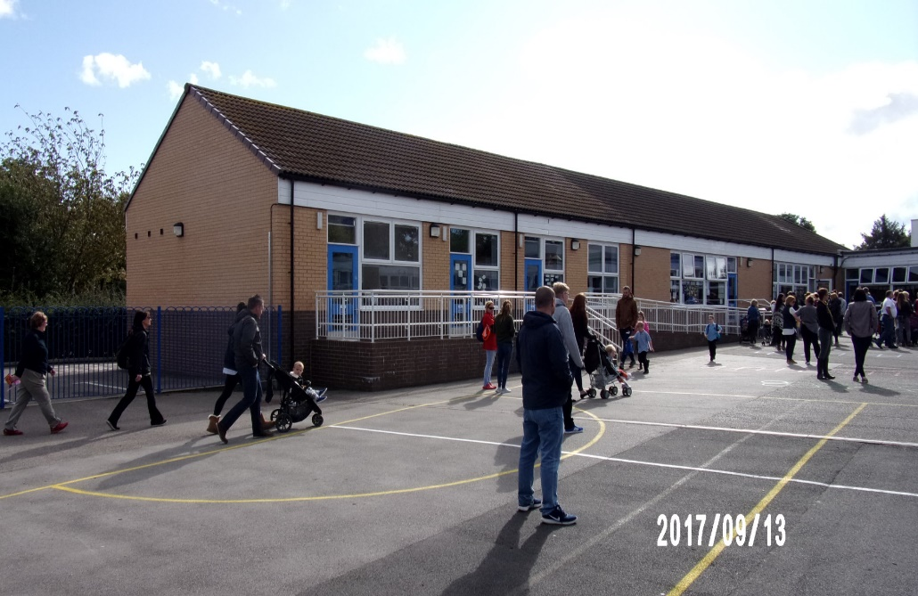
Prioritize sectors: start with schools & social housing to ‘pump prime’ retrofit market?
Schools are a big part of public sector halving its carbon emissions by 2030
LAs have good knowledge of their schools so many are retrofit-ready with good fabric or can be straightforwardly made so but ..
HMG must mandate the rest to take up Salix Finance to catch up, install modern heating controls etc
Create school ‘low carbon’ hubs to make low carbon solutions more cost-effective, e.g. supply heat to local homes with heat when school’s are not open
Community share offers set up by LAs?

Slide 4
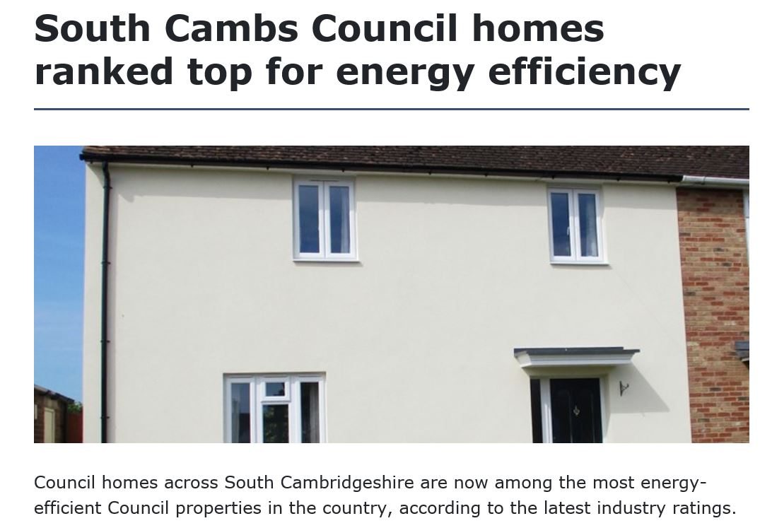
Successful retrofitting of LA homes: but how do we scale to large ‘pipelines’ of projects?
We know how to do retrofitting to get all homes to EPC ‘C’ rating by mid 2030s. But we need to scale up
SCDC business model: 5,500 homes most efficient in UK: extensive fabric upgrades, oil to heat pump conversions etc, over 4 years, £15 m (from rent receipts) = average SAP rating of 75.5 = EPC ‘C’
Integrated ‘Heat & Power’ approach with PVs on 2,400 homes
Dutch ‘Energiesprong’ approach’?

Slide 5
Workshop Questions
Would we like to send some (maybe three) ‘asks’ to the Energy Minister?
What are the opportunities & constraints on joint working across different LAs to scale up low carbon solutions & fabric improvements?
What constraints stop LAs working with other sectors, e.g. housing associations, academies, SMEs?
Are ‘regional’ consortia of LAs & partners the way to deliver major implementation programmes enabling phased roll outs starting with buildings with good fabric?
Is it more cost-effective to install PVs than expensive external cladding systems on ‘hard to treat’ buildings?
How do we get more BEIS support, e.g. capacity building such as programme coordinators?

