Slide 1

Reconfiguring Greater Manchester? The Struggle between Autonomy and Amenability in Shaping Urban Sustainability Transitions DISCUSSION Piece
Mike Hodson and Andy McMeekin, Sustainable Consumption Institute, University of Manchester

Slide 2
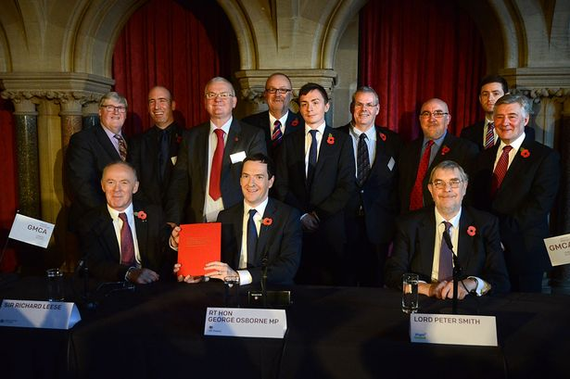

Slide 3
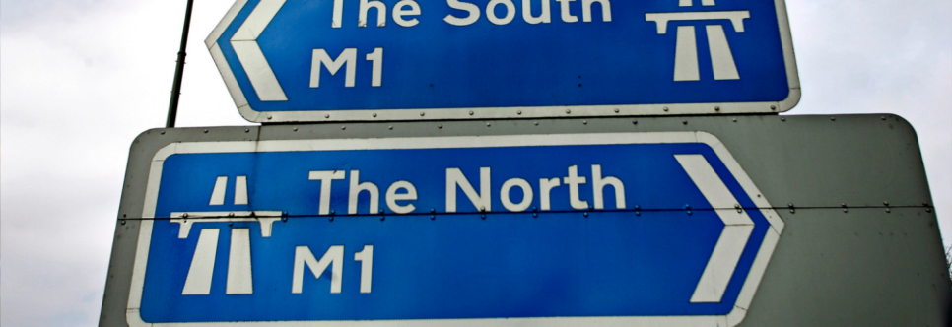
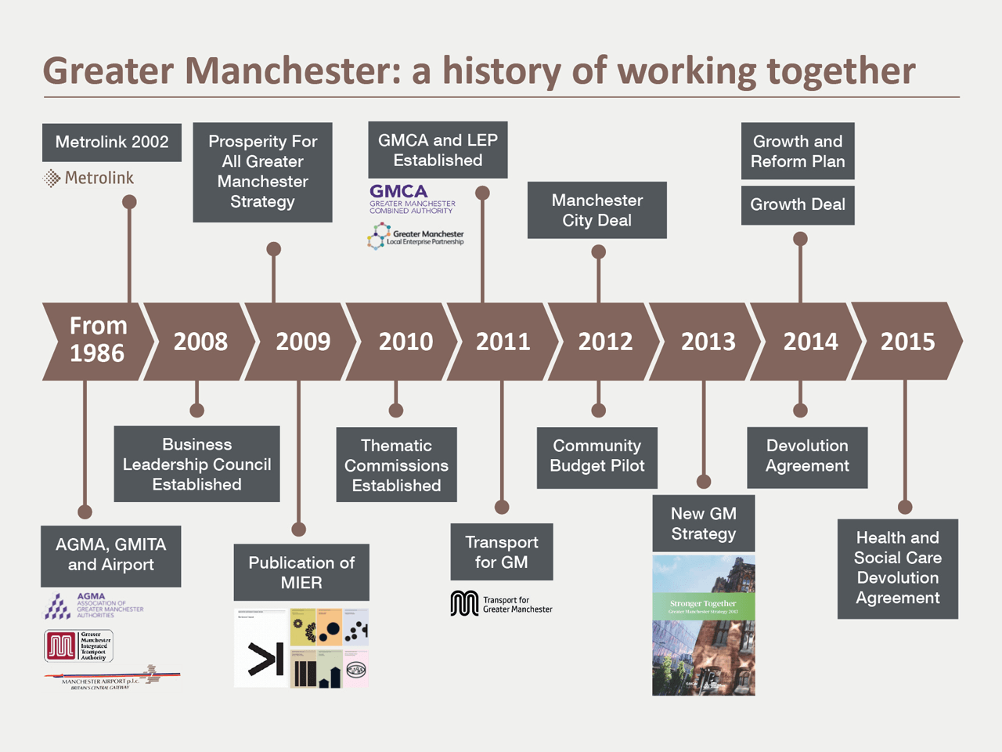
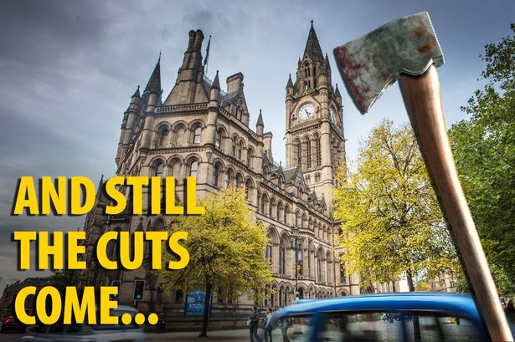
1. Context
What are the implications of political devolution/decentralisation for making future sustainable cities?

Slide 4
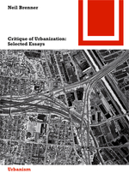
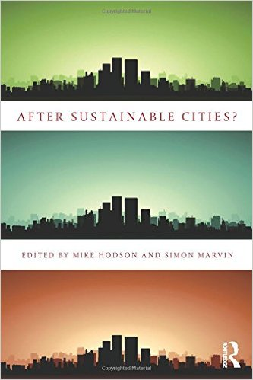
Devo and Making ‘Sustainable Cities’ of the Future?
Wider argument focuses on three debates and their intersection:
Global urban restructuring… and the state re-making of urban space
Term ‘urban’ & privileging of category of ‘city’ focus of theoretical and conceptual struggle in recent years (Robinson & Roy, 2016; Scott & Storper, 2015; Brenner & Schmid, 2014)
One view: move beyond methodological cityism (Angelo and Wachsmuth, 2015) & not ‘treat the urban as a pregiven, self-evident formation to be investigated or manipulated’ (Brenner and Schmid, 2014, p.749). New conceptual thinking needed
Devo
Disorderly devo of powers to English cities and regions - context of political devolution/decentralisation - (Pike et al, 2016)
Devo as:
Transferring power & enhancing place-based autonomy, discretion & capability to act in shaping transitions?
Or, as scalar dumping where responsibility on urban contexts to realise transition while also reducing the resources to do so (Peck, 2012)?
Visions of the future shape of the sustainable city/urbanisms
Visions of ‘sustainability city’ in 1990s - contested but influential views of urban management of economy, ecology & social
In context of economic crash & austerity - fragmentation of sustainable city discourse & emergence of multiple visions of future ‘sustainable’ city (Hodson and Marvin, 2014)

Slide 5

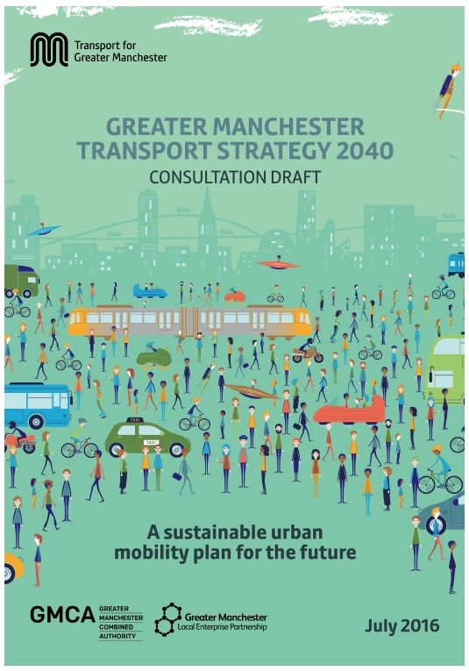
Urban transitions in a context of political devolution
Within this context, how can we understand urban sustainable infrastructure transitions?
Theoretically and conceptually understand urban transitions not as sharp ruptures but as multiple reconfiguration dynamics
We want to better understand the future shape of the ‘city’, what is being reconfigured and how and who is shaping this?
Empirically we focus on Greater Manchester as an ‘exemplar’ of devolution in English state-space
Drawing on long-term spatial and transport strategies as proxies for dominant accounts of what about GM built environment and transport is being reconfigured and how
Who claims to speak for the city/urban is a political struggle
Focus on these plans to articulate:
the priorities they embody
the interventions that flow from this and
the implications of this in respect of what the long-term remaking of GM looks like and who is doing this

Slide 6
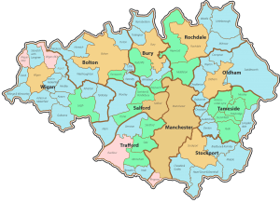

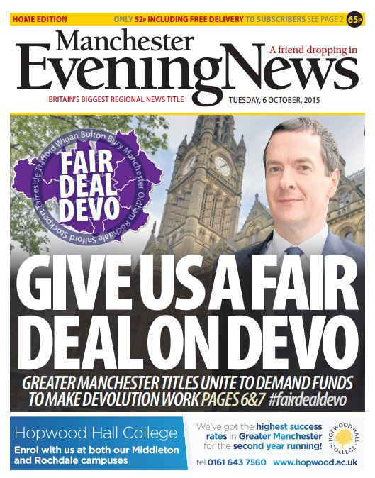
4. Representing State-spatial Reconfiguration of Greater Manchester
Metropolitan area, 10 LA areas around Manchester
Accounting for around 2.7 million people
Forefront of state-spatial restructuring in England since late 1980s, particularly since 2007/8 (Deas, 2014)
Wider context of disorganised agenda of restructuring English urban areas (Shaw and Tewdr-Jones, 2016)
‘Devo Manc’, has produced a slew of positive symbolism but much uncertainty about long-term implications
Dominant representation sees future GM at the centre of a Northern Powerhouse of connected northern English metro areas
Stated aim: to address UK’s economic imbalance towards London & SE & create a second growth pole able to compete with global economic powerhouses
Promotes agglomeration - implies prioritising particular areas and sectors of ‘strength’ rather than whole of GM

Slide 7
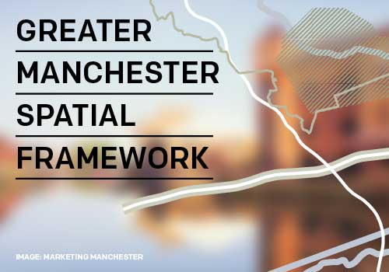
5 Reconfiguring Greater Manchester: priorities and interventions
2016 - GMSF sets out strategic orientation in relation to housing, land-use, employment and associated infrastructure for next 20 years
Focus of GMSF is on the acceleration of growth in GM
Assumption is accelerated growth underpinned by population growth of 294,800, informing an additional 199,700 jobs and requiring 227,200 net new homes.
Not a spatially even process. All places are important just some are more important than others!
Office, residential and retail development prioritises Manchester city centre, and, additionally, the now regenerated old docklands area of Salford Quays, and the Airport.
Also prioritisation of numerous Gateways and Corridors through intensifying warehousing and logistics capacity
What happens in the remainder of the city-region remains at best under-developed and worst unspecified.

Slide 8
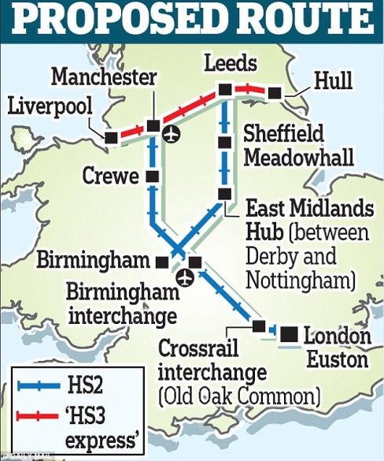
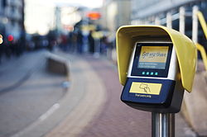
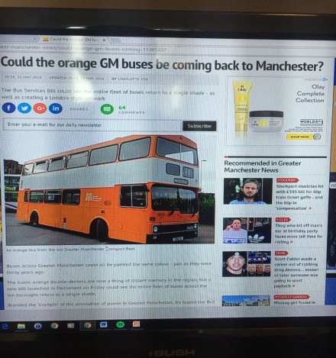
6. How Priorities and Interventions are Reconfiguring Greater Manchester
IMPROVING GLOBAL CONNECTIVITY:
Emphasis on growth through enhanced global connectivity of people and goods, primarily via Mcr Airport and connections to global trade circuits via Manchester Ship Canal & port of Liverpool
INTER-URBAN CONNECTIONS:
Efforts to position GM at the centre of a new North. Transport connectivity at its core
Specifics of this are often less than clear
COMPACTING THE REGIONAL CENTRE:
Plans to significantly densify and extend Manchester city centre over next two decades - up to 50,000 more homes by 2040 and potentially 110,000 more jobs. For levels of peak hour car trips to remain at current levels, by 2040 around 68,000 additional trips need to be made by public transport, walking or bike
CONNECTIONS ACROSS THE CITY-REGION:
Connections across GM, outside of Mcr centre, are less well developed

Slide 9
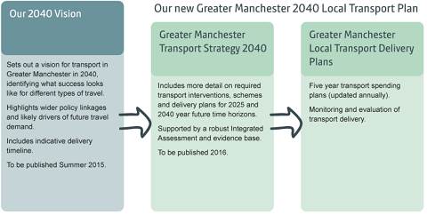
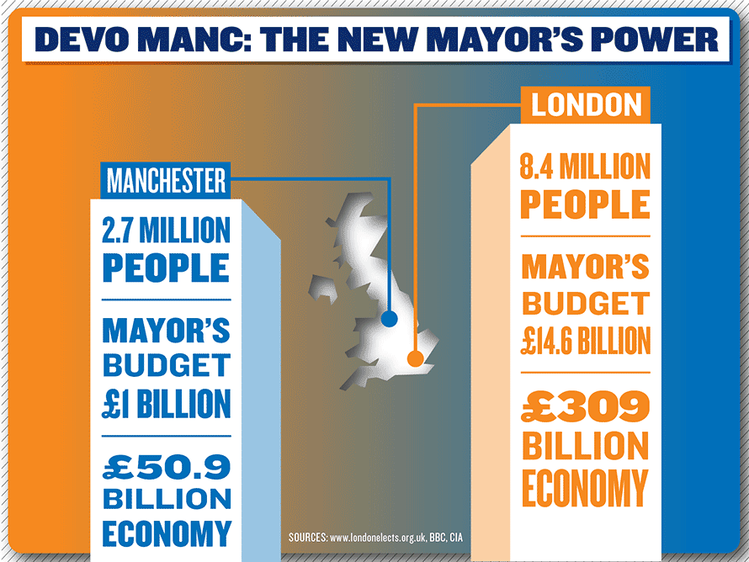
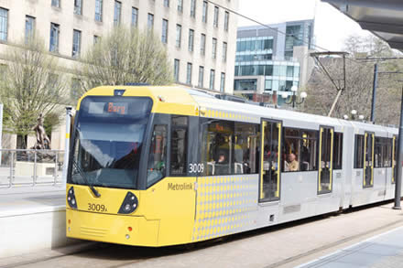
7. FIVE implications/themes of our argument
There are five implications of this argument.
Material realisation of transitions in GM’s infrastructure spatially uneven
(At present) limited realisation
‘Autonomous’ GM capability to re-shape infrastructure is fragmented and weak. Preliminary conclusion: weak place-based autonomy has resulted in strategies of making place amenable to ‘others’ to shape urban transition
Mediated by narrow economic concerns - strong ‘economic development’ focus - where wider sustainability concerns are being squeezed
Need for future inter-disciplinary research to better understand the role and importance of place-based autonomy and its tensions with strategies of amenability in shaping urban sustainability transitions

