Slide 1

Local Authority Sustainable Energy: Opportunities, Constraints, Ways Forward
Steve Cains
PPS

Slide 2





Technologies
“Bridge” Model
Public sector
Private sector
1
2
3
4
5
Construction support
Asset management
Power Services
Feasibility
Development
Procurement
Private sector

Slide 3
BIG Challenges variability, uncertainty, capacity, fragmentation
1
Limited, diminishing capacity to enable/deliver
2
Power purchase price uncertainty
3
Navigating the planning system
4
Complex integration – Defining bankable business cases

Slide 4
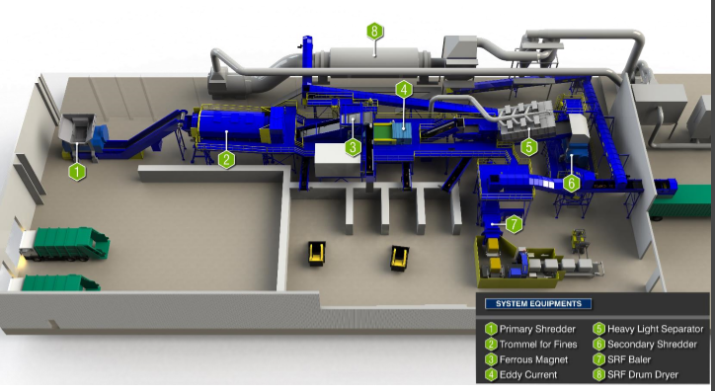
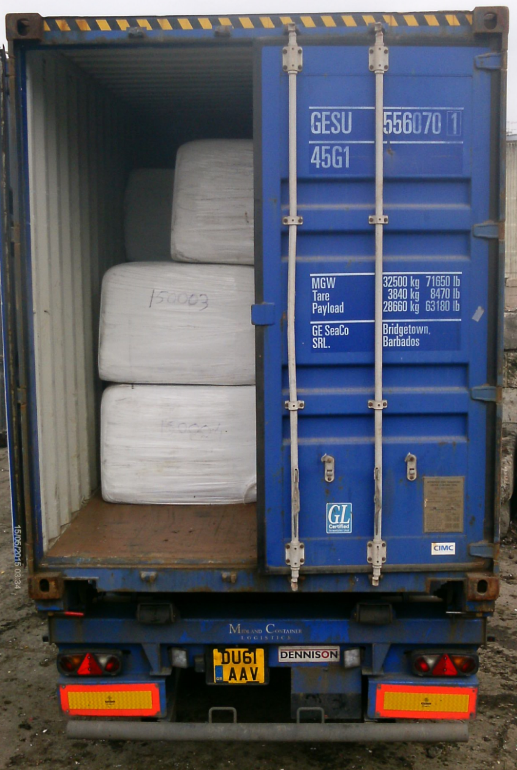
Waterside, Swindon.
2014 – the UK’s first Solid Recovered Fuel (SRF) plant for municipal waste (25 year life).
2018: 2.5MW solar PV with
1.5MW battery
2018: Deployment of EVs (Council fleet)
Outputs:
SRF – widely used in cement production, cost saving
Notes:
Limited capacity
Power purchase uncertainty
Planning system – LDO
Complex bankable schemes

Slide 5
BIG Opportunities
standardisation, joint working, blended finance, demonstrators, leveraging benefits
1
Assets and loads – massive potential for generation and balancing
2
Access to capital (LA/Community platforms) and a robust PPA partner
3
Power price variability – private wire, long term PPAs, sleeving, public-private
4
Embrace uncertainty - do it anyway – where are the trailblazers?

Slide 6
A few questions...
What needs to change to enable LA finance and assets to flow into energy generation projects?
With high level support at NPPF level, how can a project navigate the planning system with little local policy support?
How can we create longer term certainty around PPA values?
What needs to happen to enable LA driven complex energy projects to progress?
Notes:
Through a regulatory/policy/legal lens
LA policy/CO2 reductions
Planning at a local level/planning keep up/no teeth
PPA/Licensed electricity supplier

Slide 7

scains@publicpowersolutions.co.uk
07769 281794

