Slide 1

Local Authorities and Sustainable Energy
Constraints and Ways Forward
Andrew Briggs
Stoke-on-Trent City Council

Slide 2
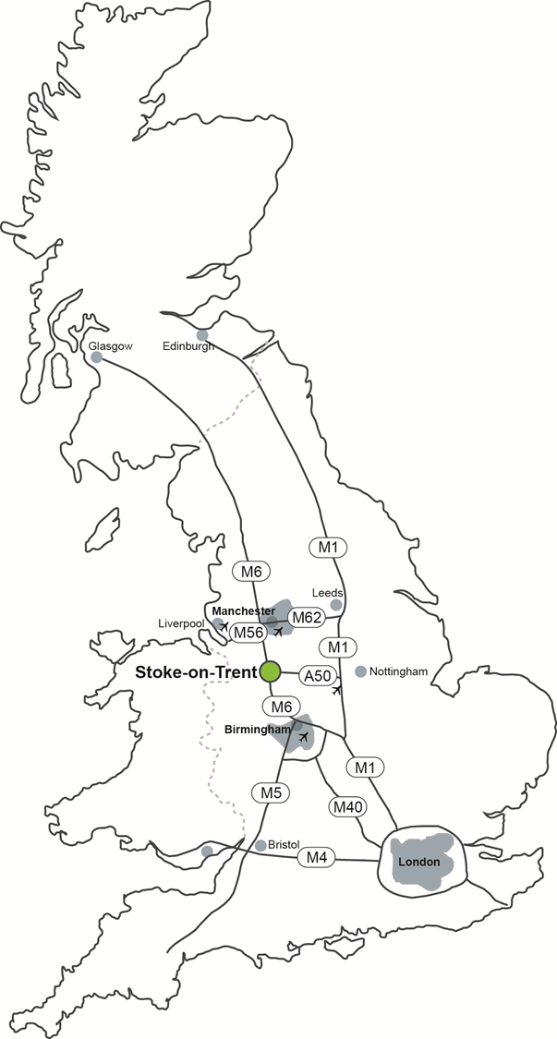
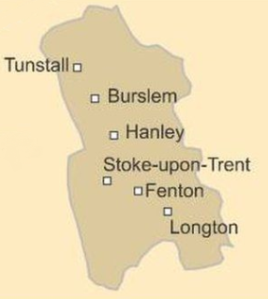

Stoke-on-Trent
Unitary Authority (6 towns)
250,000 inhabitants
Commonly known as
“The Potteries”

Slide 3
Distributed Energy – A place based approach
Constraints and Ways Forward
‘The local energy system might be characterised as aged, suffering significant constraints and with disruptive capacity limits blocking new development’
Addressing this issue is the key to success for our city;
Secure and affordable indigenous energy supplies with grid independence
Improved environmental footprint and air quality
Opening key employment sites
Supporting job creation in key sectors
Encouraging and assisting business start-ups
Attracting inward investment

Slide 4

Constraints and Ways Forward

Slide 5
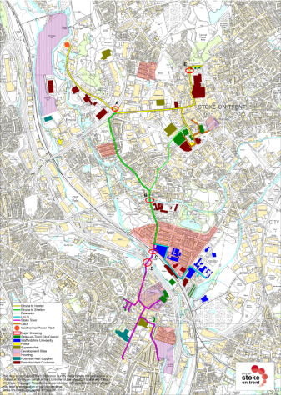
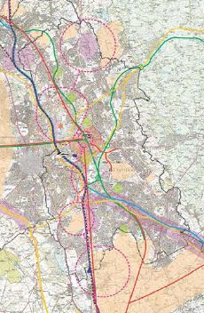

Sustainable energy driving a smart city
AMBITION FOR A CENTRAL NERVOUS SYSTEM OF LOCALLY OWNED
AND MANAGED INFRASTRUCTURE
Carbon free heat, low carbon energy at scale, improving air quality and health
Smart grid for enabling integration of multiple energy sources at a scale attractive to national energy providers and capable of providing a useful local return
Smart load balancing and aggregated energy savings through integrated energy management and device control
Improved local energy resilience and independent of current national issues and market volatility
Transport integration and management of systems improving flow and reducing pollution
Phase 1, DHN
18Km pipework and fibre network connecting key public assets + up to 1000 domestic residencies. Saving 12,000 tons CO2 p.a.
Year 25,
500Km+ pipework , infrastructure and fibre network with multiple energy sources connected managed and controlled via local systems

Slide 6
Constraints and Ways Forward
The need through a managed process to address the problem identified and:
Current procurement and delivery requirements
Current contract management and commercial approaches
Policy
Planning
Capacity
Avoiding the piecemeal approach of individual supplier led solutions and potential legacy issues of not vanilla, non integrated products…

Slide 7
Constraints and Ways Forward
Opportunities underpinned by ‘scale and an appetite for change’
A commercial council
Investment in place, DH Network investment of £23m – priority works in delivery , full role out 18km planned
Significant public sector partners
Digital infrastructure - fibre network, existing and new planned
EfW, electricity and waste heat responsibility
Development cluster identification, sites and significant public assets
Social housing, 18,500 social houses

Slide 8
Constraints and Ways Forward
Working through a structured approach to enable commercial realisation of;
DHN development opportunities
Distributed Energy Infrastructure
Social Energy opportunities
Investment leverage
Income generation

Slide 9
Constraints and Ways Forward
Masterplan - Detailed GIS based master plan for distributed Energy infrastructure driving:
District Heating
Energy campus models
Peaking plant
Load balancing and FFR
Battery storage
Energy efficiency
Community / Social Energy solutions, Energy Co
Digital infrastructure

Slide 10
Constraints and Ways Forward
Making it happen:
Collaboration and co-creation
Pioneering a new way of working
Working together to define and being honest about the outcome
Creating a template for a city…..(a real one with 300 years of industrial legacy issues)

Slide 11
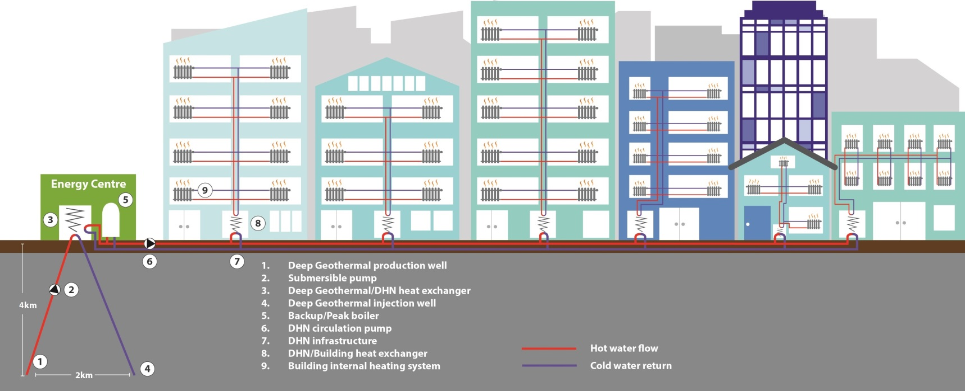
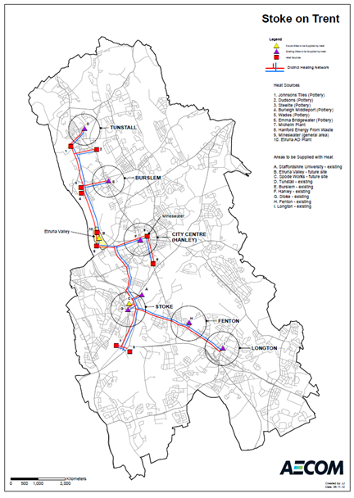
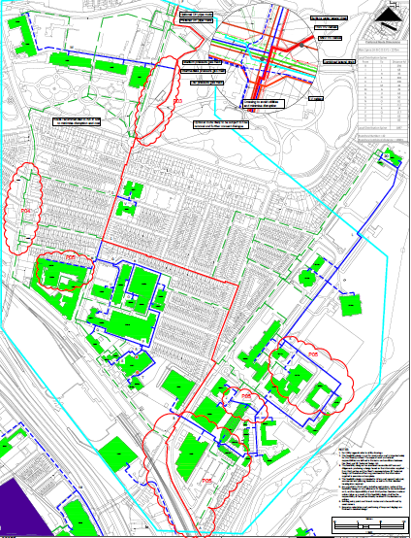
Constraints and Ways Forward
District Heat Network (DHN) Scheme
Helping to protect consumers against rising fossil
fuel prices, providing significant carbon reduction
opportunities and bring significant health benefits
secure, price predictable, low carbon heat

Slide 12
Constraints and Ways Forward
Opportunities to enable investment through:
Commodification of models
Investor engagement
Supply chain development
Training and Skills
Strategic political engagement

Slide 13
Constraints and Ways Forward
Issues:
Current procurement of energy
Current contract management
Policy – strategic view, definition of benefits requirement, fit with wider strategies, policy
Planning – Energy component of local plan
Capacity
DNO

Slide 14

Thank you
Andrew.briggs@stoke.gov.uk

