Slide 1
Local AUTHORITIES & SUSTAINABLE ENERGY: OPPORTUNITIES, CONSTRAINTS AND WAYS FORWARD
14th September 2018
Caroline Kuzemko
Assistant Professor IPE
University of Warwick

Slide 2
Welcome!
Local Authorities & Sustainable Energy: Opportunities, Constraints & Ways Forward Economics and Social Research Council funded via my fellowship on ‘Distributing Powers’
Today is for you! Please participate as fully as you can.
Fire Alarms and Exits/Facilities/Chatham House Rules
Hywel Lloyd, Institute for Public Policy Research (IPPR) & UK100 Network
  Brief history/how we got here
Caroline Kuzemko, University of Warwick
  An international politics view and ‘what to expect’ today

Slide 3
Sustainable energy: in the hands of local government
Hywel Lloyd
Facilitating the Future

Slide 4
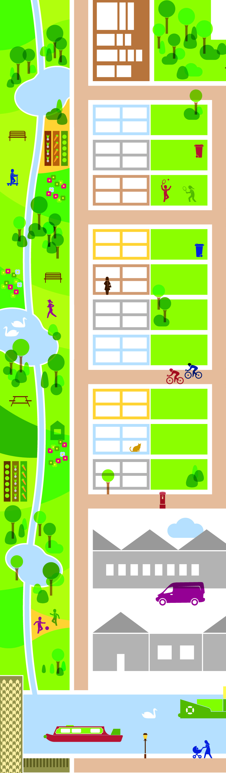


Back to the future ?
A previous energy offer

Slide 5
Centralization
From 1947 - nationalisation
From 1986 - privatisation
From 600+ local and municipal electricity companies to CEGB &12 regional electricity boards
From 1,000+ gas companies to 12 gas boards, with the Gas Council
Greater role for transmission & significant thermal plant ‘away’ from urban centres
Creation of the CEGB; British Gas (bulk suppliers)
Sale of British Gas, break up of CEGB (supply side)
Creation of regional energy retailers
Creation of Ofgem
Exclusion of local authorities from electricity sales

Slide 6
Emerging energy system drivers
Digital technology, measurement, feedback, management
Climate change, and the Climate Change Act & Carbon Budgets (2008) 80% reduction by 2050
EU Renewable energy commitments, 20% by 2020 (of final energy consumption (to 27% by 2030)
AND
The Localism Act 2011 (Wales Well-being FG Act 2015)
LA electricity sales restrictions removed
DECC/BEIS HNDU

Slide 7
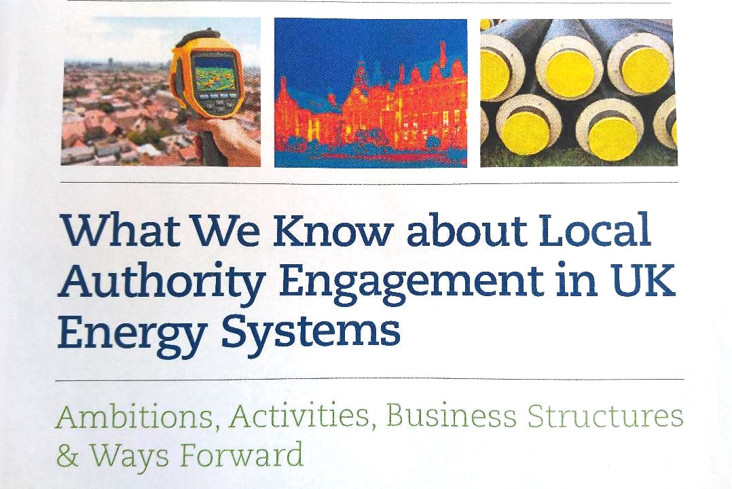

A DE Future for the UK energy system
At IPPR.org

Slide 8
Distributing Powers: Local Authorities & Sustainable Energy
Background: EU and UK energy & climate change policy: power relations, institutions, political debates
UN (COP); IEA; EU; national governments: growing reference to role of local:
  1992 Local Agenda 21 set out the argument for local policy action: problems/solutions have roots in local activities
  Top Down: Meet national/global emissions targets through local achievements
  Leadership, innovation, experiments
  Closer to citizens (disenfranchisement from remote politics)

Slide 9
Constraints: global view
1990s – ambition but frustration:
  Lack of capacity prevents local governments globally from meeting climate goals
Local governments act within contexts: national political; power relations; technological
Listed (interconnected) reasons for lack of capacity:
  Centralised energy infrastructures and national markets
  Liberalisation and powerful TNCs
  Insufficient access to finances and austerity
  Lack of statutory duties in climate change and energy
  Duties without extra powers or finance
  Lack of knowledge capacity/personnel

Slide 10
Opportunities & ways forward: Global View
Technological change:
  Distributed renewables: change WHO can generate and WHERE (and where profits go)
  RES, Storage & ICT underpins new business models (local markets?)
Close to citizens:
  Sustainable energy transitions need widespread public involvement (passive or active)
Learning:
  Some local authorities (Barcelona) strategically engaged in technological and governance experiments
  Share knowledge through networks (C40; Covenant of Mayors +)
Local as a site of leadership/challenge/change:
  Germany and remunicipalisation – bringing energy (and water) closer to the people that use it
  Use new knowledge, evidence of successes, to inform national/global policy debates
  Setting higher targets to encourage greater ambition

Slide 11
How today works
Space for those working for, and/or with, local authorities to come together to freely discuss experiences, ideas, difficulties faced and to learn from one another
3 break-out sessions – looking at LA sustainable energy from different perspectives:
Finance; Place & Planning; Legal, Policy & Regulatory
See back of badge – each delegate gets a chance to think about/debate opportunities constraints and ways forward from each perspective
Final Session - panel debate about ways forward, and Q&A/discussion session
Please do join in as much as you can…

