Slide 1
Why do you want experience?
Ask yourself these questions:
Why are you doing it?
What are the key motivators?
What do you want to achieve?
What type of experience would be most beneficial?
These will help shape your goals, identify your learning priorities.
Notes:
Handout with potential aims
Ask about whether you need sector specific or general experience to achieve you aims?
Paid or unpaid?
Unpaid work experience - Sectors of prevalence: (box to the side)
Arts, Culture, Heritage,
Charities
Education
Health & Social care
Media, broadcasting, publishing
Politics and public strategy
Advertising, Marketing, PR
Public Sector
Pharmaceuticals
Retail
Mention bursary here
Structured programme or generated experience

Slide 2
What Do You Want From Experience?
SUGGESTED QUESTIONS TO ASK WHEN SETTING YOUR GOALS/ NEEDS;
Professional
Which skills do I want to develop in through my experiences?
What experience will enhance my CV?
What types of people do I want to network with?
Are there activities I want to see done in a professional setting?
Personal
What experiences would help me clarify my goals?
What would develop my self-confidence?
What would help me work in a professional environment in the future?
Academic
What kind of experience could help me make better Course/Module choices?
What Modules would be easier if I understood their relevance?
What new technologies/equipment/techniques do I want to be exposed to?
Notes:
Ask them to consider their goals, then consider as go through the session what kind of experience could help achieve this

Slide 3
What counts as
Work Experience?
Extra-curricular activities can be used as evidence on applications
Notes:
Run through the different types
Internship/vacation scheme
An undergraduate internship is a structured period of work experience usually offered by large employers. The majority of internships happen over the summer and last for 6-12 weeks
They should be paid; unless they are part of your course
Some employers offer internships in the Winter or Spring, or 6-12 month internships that could mean taking a year out of your course.
Volunteering
Volunteering is when you give your spare time to an organisation for no payment, although travel and expenses may be reimbursed. This type of work is important for most charities, offering you experience and supporting important social and welfare issues. Volunteering is easier to arrange and often more flexible than a paid job. You may even be able to help out in a role related to your career route, such as finance, IT or PR – even charities and other not-for profit organisation need people in these roles and some offer training along the way
Employers often see volunteering as a reflection of your values and ethics and your commitment to social and welfare issues
Warwick Volunteers
Volunteering Overseas
Work shadowing
Work shadowing is when you observe someone going about their day-to-day role with the aim of gaining a greater understanding of that career. It shouldn’t involve completing any work for the organisation – think of it as a behind-the-scenes tour of someone’s job. As work shadowing doesn’t involve doing any work, it is unpaid, and it is rarely advertised
You should contact an organisation directly with a speculative CV and covering letter
This type of experience is undertaken for a short period of time, can be as short as two or three days
Gives you a chance to gain experience in highly competitive fields (TV, Radio, Clinical Psychology, Law, Engineering etc)
Shadowing can be easier and quicker to arrange than a work placement.
Placement
Placements are structured schemes by organisations to give you an overview of different aspects of work which can include working on a specific project and gaining work knowledge of various departments. Various lengths and could be unpaid or paid
Similarly with internships it is common for companies to use placements to road-test people for permanent appointments.
Talk about entrepreneurship, Competitions as well

Slide 4
Longer vs Shorter
12 month placement
Develops confidence
High level of responsibility
Develops networks
Salary and benefits
1 year commitment
Transitions
Shorter placement
Develops skills
Try more things out
Any year group
Shorter time away from campus
Less responsibility
Less time to impress and build networks

Slide 5

Placements/ Internships
Vacation employment Easter/Summer:
  Can range from 2-3 days to 8-12 weeks plus
  Available in most sectors
  Law insight programmes open to 2nd year non-law students
12 month Placement Search on myAdvantage
Work Experience Search on myAdvantage
Bright Network Internships
Target Jobs Internship Information
Prospects – Work Experience and Internships
Rate My Placement – Placement Years Search

Slide 6

Short Term Mobility
Student Mobility - Short Term Mobility
The University of Warwick is working to establish partnerships with universities across the world in order to offer a range of short mobility opportunities to our students.
Short term mobility opportunities can include:
International summer schools
International research projects
Faculty led programmes
International internships
E.G.
Warwicks - TeamWork Virtual International Programme 2024
Inmternships - IAESTE

Slide 7
Virtual Internships
Remote Internships
Sometimes called ‘online internships’, ‘remote internships’ or ‘e-internships’ these are work experience programmes where you are not physically present at the job location and may have little or no face to face contact with the Organisation they are conducting the internship with.
Increasing found advertised where and alongside more traditional work experience vacancies are posted
Job Simulations
Online programmes where students can interact with virtual clients and colleagues in a way that replicates the day-to-day work of a company.
Forage (formally Inside Sherpa) - https://www.theforage.com/. Host programmes from companies such as Deloitte, KPMG, Accenture, Grant Thornton, BCG, JP Morgan, GE, Linklaters, Pinsent Masons, White & Case
Bright Network - https://www.brightnetwork.co.uk/internship-experience-uk/
Notes:
Also sometimes called ‘online internships’,‘remote internships’ or ‘e-internships’ these are a type of work experience program where the participant is not physically present at the job location and may have little or no face to face contact with the Organisation they are conducting the internship with.
Just like a 'normal' internship, there will be project work/tasks from an employer to complete over a period of time. However, whilst this may be working with a national or international employer, it may not be based at their location, instead completing the work remotely or virtually. Generally there will be regular catch-ups and support from the employer during the virtual internship, but Virtual interns communicate with their employer online through various means including email, Microsoft Teams, skype instant messaging, phone conversations, text messaging, project management tools, etc.
Job Simulations
online programmes where students can interact with virtual clients and colleagues in a way that replicates the day-to-day work of a company.
Inside Sherpa - https://www.insidesherpa.com/. Host programmes from companies such as Deloitte,KPMG, Accenture, Grant Thornton,BCG, JP Morgan, GE, Linklaters, Pinsent Mansons, White & Case

Slide 8



UG Research Support Scheme
Undergraduate Research Support Scheme (URSS)
Wendy Hunt
URSS Coordinator
urss@warwick.ac.uk
www.warwick.ac.uk/urss
urss@warwick.ac.uk
www.warwick.ac.uk/urss
See the URSS Showcase site at urss.warwick.ac.uk

Slide 9
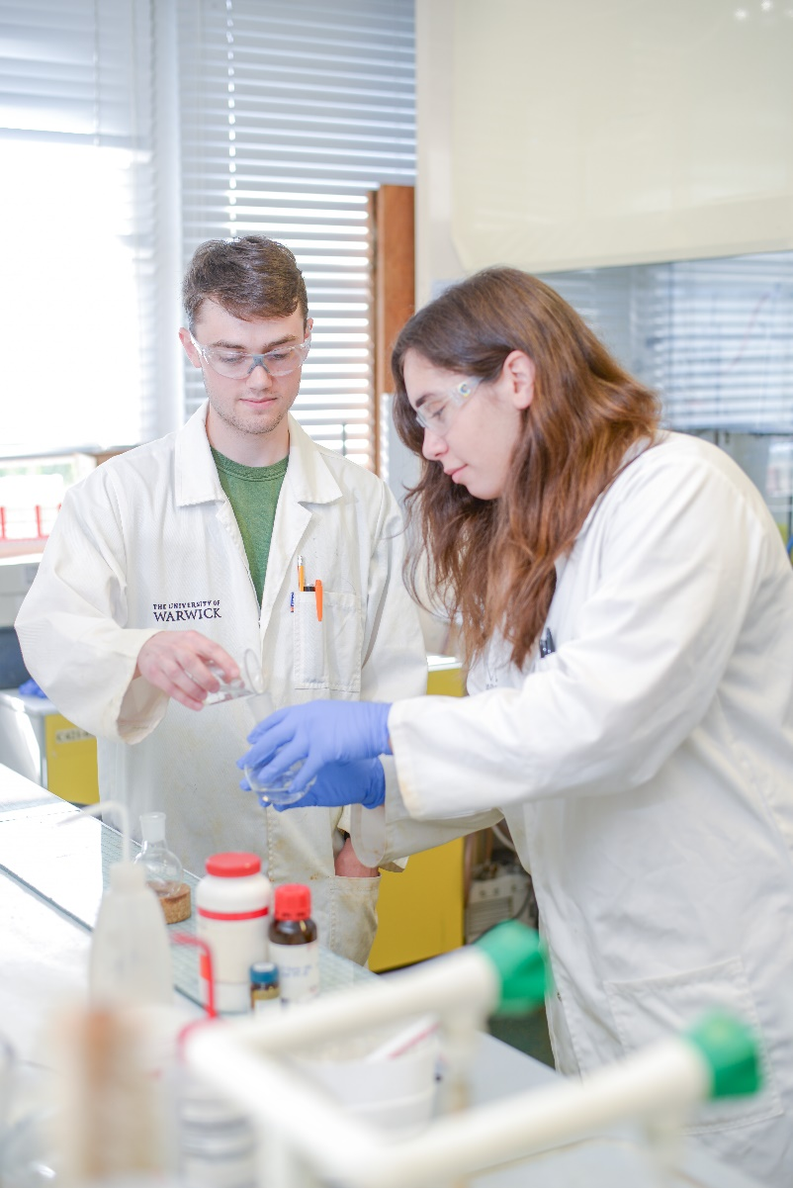
Why do a URSS project?
Get a real insight into working in research at a world-leading, research-led university
Apply for a bursary to carry out a 6-8 week non assessed interdisciplinary research project of your choice
Identify your own research project and find an academic or post-doctoral researcher who can supervise you
Apply for a public engagement only project or run a public engagement activity at the end of your research

Slide 10
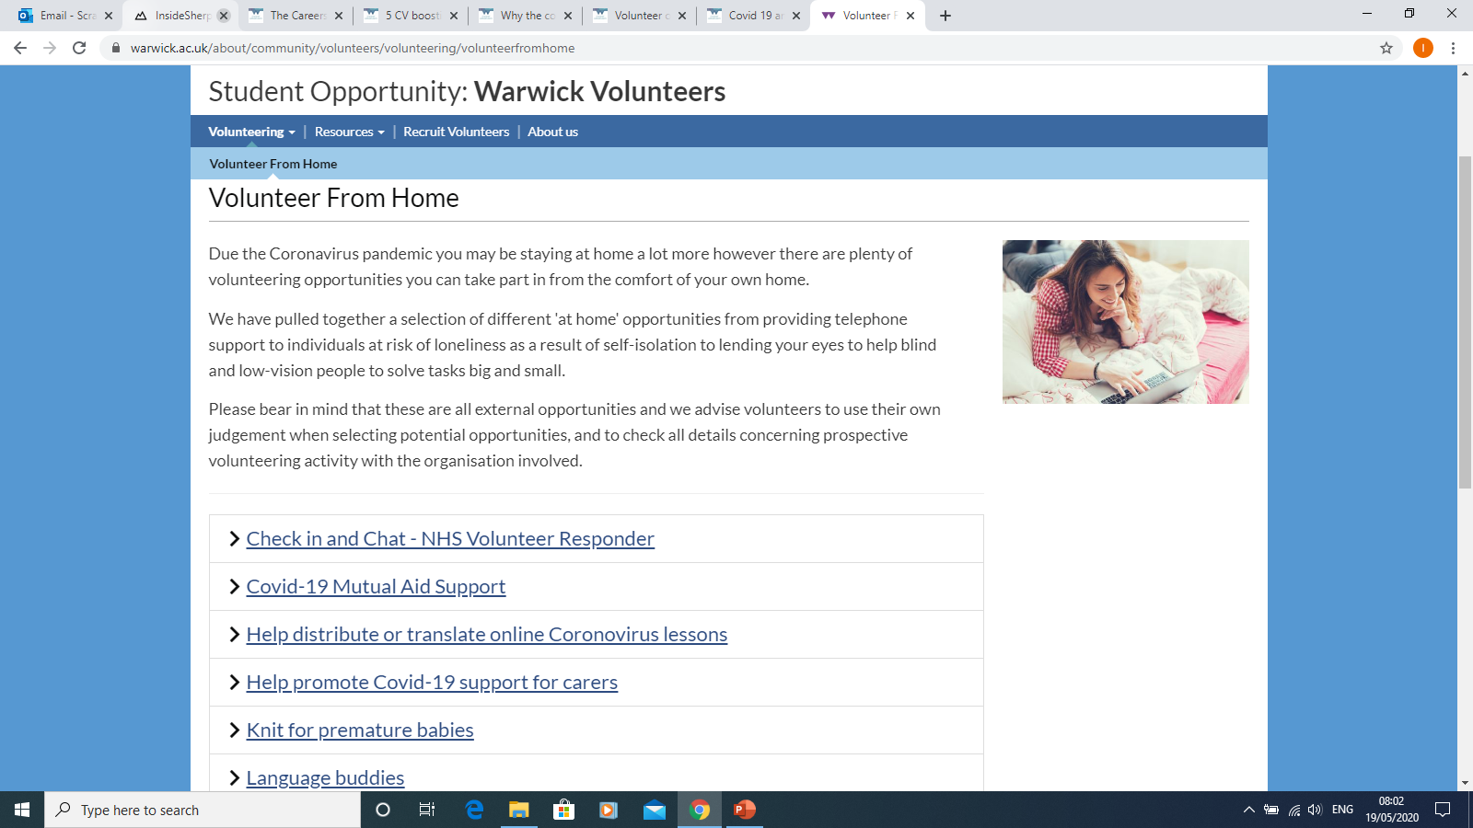
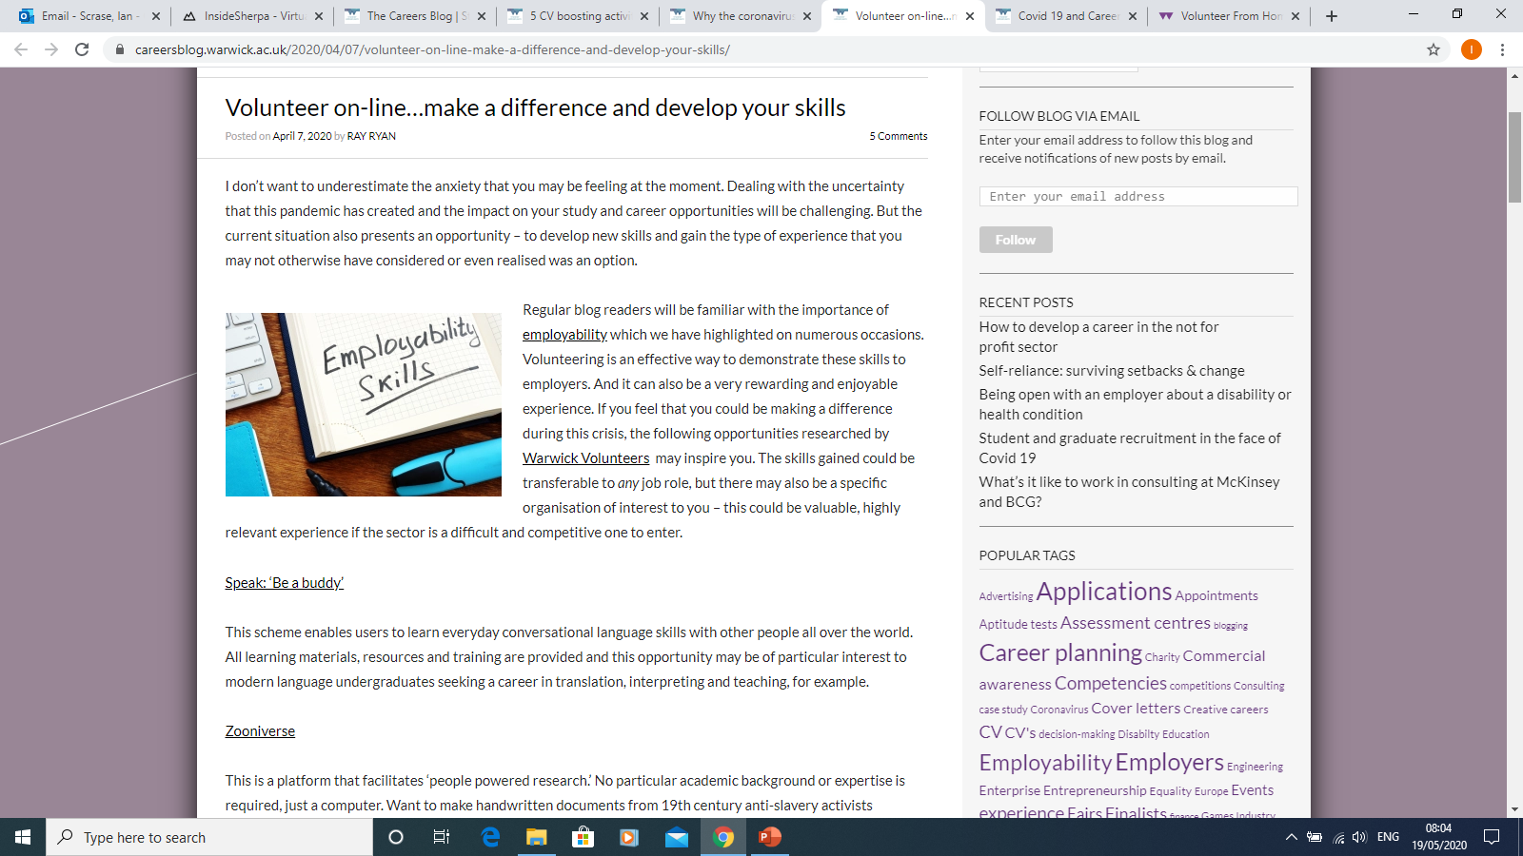
Volunteering
“Put aside preconceptions: volunteering is work experience with the added possibility that the act of choosing to be a volunteer can show even greater initiative and commitment”. (Senior Manager Executive Education, HSBC)
“It doesn’t matter if it’s paid or not but voluntary work would count just as much as paid work in our eyes” (Accenture)
A wide range of Volunteer opportunities are available both in person and online
Warwick Volunteers - https://warwick.ac.uk/about/community/volunteers/
Volunteer online - https://careersblog.warwick.ac.uk/2020/04/07/volunteer-on-line-make-a-difference-and-develop-your-skills/
https://do-it.org/

Slide 11

Warwick Enterprise
Programme / Events / Activities
Startup Sherpas – a new digital course where you can create your own start-up. The programme will take you through the method to lead you through all the steps needed to launch your very own business.
Social Shifters - a digital space where you can learn, collaborate, and get inspired with bite size e-learning and a supportive community of change-makers. You can also plan, build, and launch a successful social enterprise.
Ingenuity 2022 – the Ingenuity Programme is looking to find the best and brightest ideas that will make the greatest impact across the UK.

Slide 12




Learn New Things
Broadening your knowledge base can be beneficial. Many students go on to work in areas not directly related to their Degree or where supplementary knowledge can be an advantage.
Free Online learning platforms
FutureLearn and OpenLearn platforms from the Open University
edX and Class Central Also have free courses from Universities around the world
Alison.com one of the worlds largest online learning platforms
UK Government have set up The Skills Toolkit
Barclays Lifeskills
Learn to code - Code Academy , Spark Databox and The Skills Toolkit

Slide 13
Thank You
Any Questions?

