Slide 1
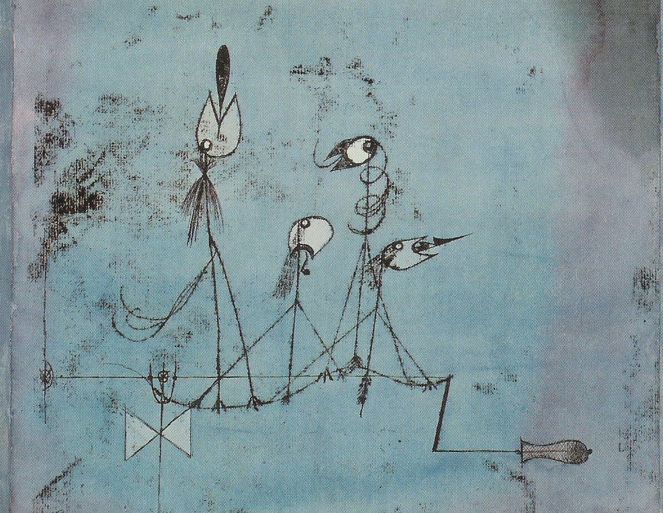
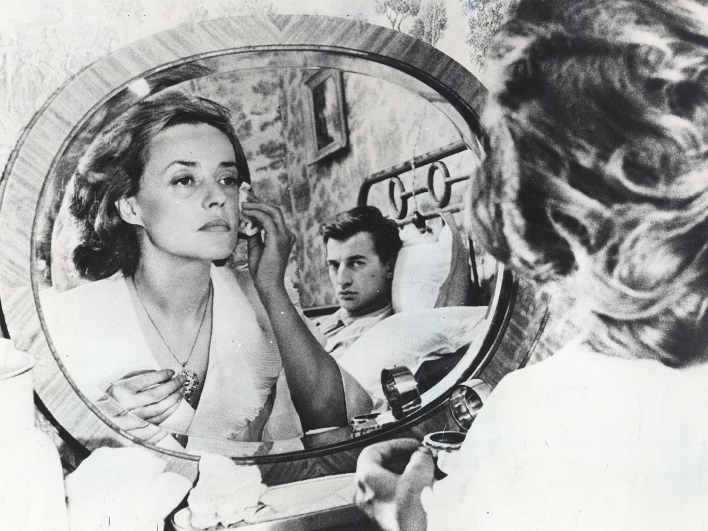
Something About John L. Austin
MEANING AND COMMUNICATION

Slide 2
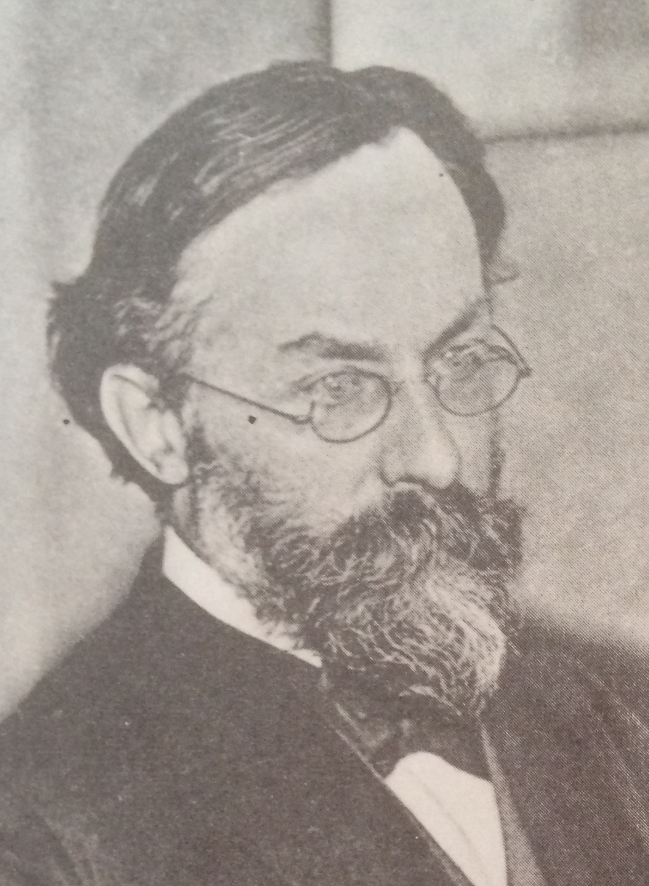
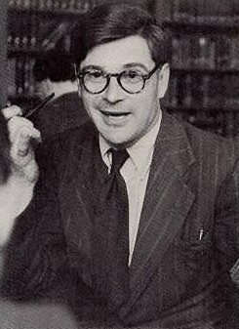
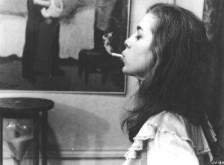
Reading
Reading for this lecture:
P. Grice, “Meaning”, chapter 14 of Studies in the Way of Words

Slide 3
Agenda
Recap
Terminological aside
Grice on meaning

Slide 4
Recap
Why philosophers care about language
Intrinsic puzzles
Framing philosophical doctrine
Moore and Wittgenstein
Enter Grice

Slide 5
Recap
We can use language in order to communicate things.
Grice points to a distinction in the ways we can communicate, or convey, or mean things by what we say or state.

Slide 6
Recap
Grice divides what is communicated or meant into:
What is (explicitly) said or stated.
What is (merely) implicated (the implicature).

Slide 7
Recap
Consider the following exchange:
A: Would you like a coffee.
B: I’ve just had one.

Slide 8
Recap
Grice thinks that what B (explicitly) said is closely linked with the literal meanings of the words they used:
(1*) In the recent past, I’ve had a single unit of something.

Slide 9
Recap
However, Grice allows that some information may have to be added to the meanings of those words in order to derive what was said. In particular, we need to know who “I” is used to talk about, and what “one” is used to refer to:
(2*) In the recent past, B has had a single unit of coffee.

Slide 10
Recap
Even so, what B said does not answer the question: does B want coffee?
However, we are ordinarily in a position to derive further information, via working out what B has suggested, implied, implicated.

Slide 11
Recap
Here, Grice thinks we use a combination of our background knowledge together with general principles governing rational communication.

Slide 12
Recap
Very roughly, we might reason as follows:
B has explicitly stated that she has just had a coffee.
Why? Since she is making a rational attempt at co-operating in our communicative exchange, she must think that her utterance is relevant to our conversation.

Slide 13
Recap
Saying she has just had coffee would be relevant if it indicated an answer to A’s question. B could reasonably expect A to know that people are often happy with having only one coffee in a short space of time, and must be relying on that expectation.

Slide 14
Recap
So, A should use that expectation to derive that B does not now want coffee.
That will be one of the implicatures of B’s saying what she did.

Slide 15
Recap
Grice realises that it will not serve his purposes simply to point to the distinction between what is said and what is implicated.
He seeks to provide a more principled account of the distinction and, in particular, how we are able to derive implicatures.

Slide 16
Recap
To a large extent, this will involve Grice attempting to spell out principles governing rational, co-operative communicative exchanges, and showing how those principles can be used to derive implicatures.
You’ll see more about how that works in the second half of the module.

Slide 17
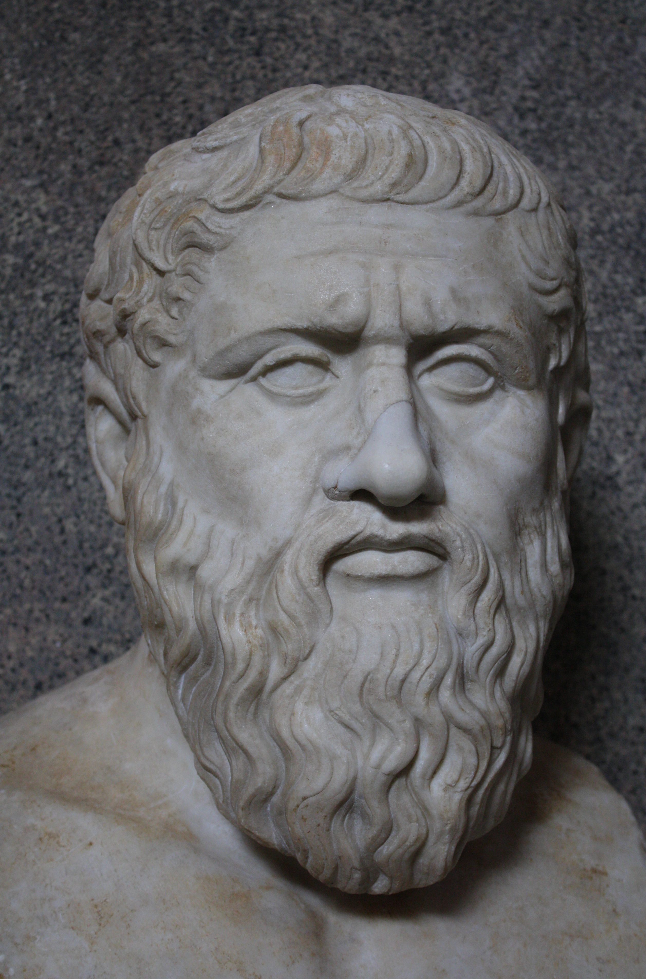
Terminological aside
Philosophers and Linguists study various aspects of language. For instance:
They study the patterns of sound and gesture that can form part of various individual languages, or all human languages. Much of this study is called phonology.

Slide 18
Terminological aside
(ii) They study the various structures that are admissible sentences of individual languages, and of all human languages, the rules governing these structures.

Slide 19
Terminological aside
For instance they try to explain why (3) is acceptable to most English speakers, while (4) isn’t:
Kim ran to the shop.
(4) *Ran the to Kim shop.
This is syntax or syntactic theory.

Slide 20
Terminological aside
(iii) They attempt to characterise and explain what individual words mean, and how the meanings of words is projected, via the syntactic structures of words in which they are embedded, in order to generate the meanings of sentences.

Slide 21
Terminological aside
For instance, they might seek to explain why (5) can only mean that John shaved John, and not that John shaved Bill, while (6) can mean that John shaved Bill, but (ordinarily) not that John shaved John:
Bill watched John shave himself.
Bill watched John shave him.

Slide 22
Terminological aside
The field that studies meanings is semantics or semantic theory, and what is studied is called the semantic properties, or the semantics, of ranges of expressions.

Slide 23
Terminological aside
(iv) Theorists attempt to explain how language, given its other properties, can be used in ordinary communication.

Slide 24
Terminological aside
For instance, we might attempt to explain how, in the right circumstances, (8) and (9) can be communicated by (7).
I’ve had breakfast.
The speaker has eaten breakfast earlier today (rather than: at some time in the past)
The speaker wishes to turn down my offer of breakfast.

Slide 25
Terminological aside
(iv) The field that studies the ways that language is used in communication is pragmatics or pragmatic theory.

Slide 26
Terminological aside
Very roughly, we can think of Grice’s distinction between what is said or stated and what is implicated as corresponding with the distinction between semantics and pragmatics.

Slide 27
Terminological aside
However, we should be aware that there is lots of disputed middle territory. This dispute concerns, for example, whether the derivation of (8) from (7) should be viewed as part of semantics or as part of pragmatics.
I’ve had breakfast.
The speaker has eaten breakfast earlier today (rather than: at some time in the past)

Slide 28
Terminological aside
We can see Grice’s discussion as an attempt to provide a way to decide which aspects of language and its use are responsible for which communicative effects.

Slide 29
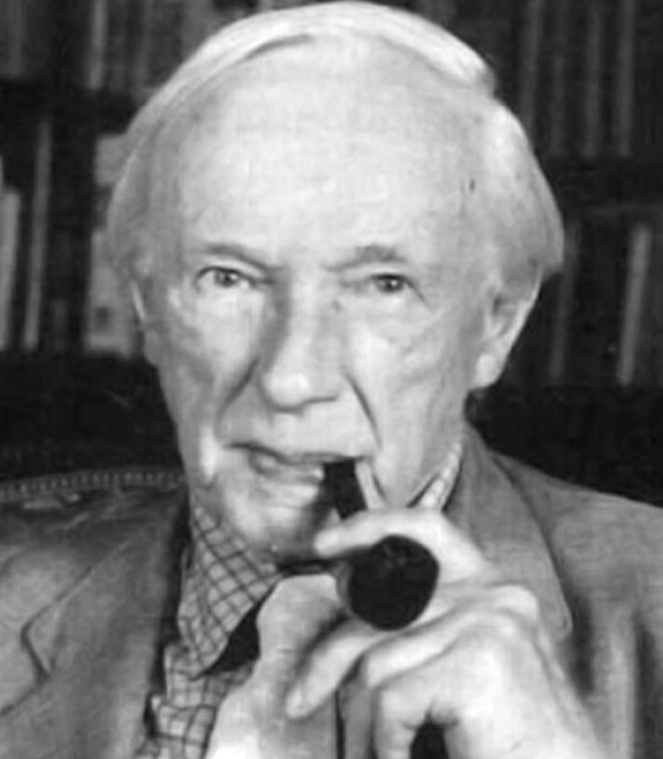
Grice on meaning
In the rest of the first half of the module, we’re going to look in a little more detail at Grice’s general account of what speakers mean (or speaker’s meaning).
This is Grice’s attempt to provide a general account of the sort of significance we afford our utterances on occasions in which we use them in communication, including what is stated and what is implicated.

Slide 30
Grice on meaning
Grice’s project in this area can be viewed as an attempt to give an account of word and sentence meaning in two steps:
(Step 1) An account of speaker’s meaning (what speakers mean on occasions) by appeal to their communicative intentions.
(Step 2) An account of (timeless) word and sentence meaning by appeal to speaker’s meaning.

Slide 31
Grice on meaning
Grice begins, as we did last session, by pointing to a distinction between two sorts of cases:
Cases of Natural Meaning
(10) Those rings mean that the tree is 10 yrs old.
(11) Those spots mean measles.

Slide 32
Grice on meaning
Cases of Non-Natural Meaning
(12) That ring on the bell of the bus means that the bus is stopping.
(13) That remark, “Smith wants a cup of rosie,” meant that Smith would like a cup of tea.

Slide 33
Grice on meaning
Natural meaning is factive, non-natural meaning is nonfactive:
“Those rings mean that the tree is 10 yrs old” entails (is inconsistent with the falsity of) “The tree is 10 yrs old”.
“That ring on the bell means that the bus is stopping” does not entail (is consistent with the falsity of) “The bus is stopping”.

Slide 34
Grice on meaning
Non-natural meaning can be specified by the use of quotation marks, while natural meaning cannot.
“That ring on the bell means “The bus is stopping”” OK
“Those black clouds mean “It will rain”” NOT OK

Slide 35
Grice on meaning
Grice will present candidate accounts of meaning_{NN}. In each case, the accounts are presented using conditionals, or equivalences (IFFs) (we’ll treat them all as purported equivalences).
Grice will then test each candidate in order to see whether the right hand side really is equivalent to a claim about meaning_{NN.}

Slide 36
Grice on meaning
Grice tries to present counterexamples to all but his favoured account. That is, he tries to present us with cases where we can intuit, given our initial grasp on meaning_{NN}, that either (a) or (b) holds:

Slide 37
Grice on meaning
(a) The candidate condition holds, but this is not a case of meaning_{NN}. In that case, the candidate is not sufficient for meaning_{NN.}
(b) This is a case of meaning_{NN}, but this is not a case in which the candidate condition holds. In that case, the candidate is not necessary for meaning_{NN}.

Slide 38
Grice on meaning
First attempt (Causal theory):
Utterance x means_{NN} something iff
x has a tendency to produce in an audience some attitude (e.g. belief that such-and-such) and to have been produced by that attitude.
E.g., An utterance of “It’s raining” has a tendency to produce a belief that it’s raining and to be produced due to a belief that it’s raining.

Slide 39
Grice on meaning
Counterexample:
Students pick their bags up when they believe a lecture is about to end; Students’ picking up their bags tends to produce belief that a lecture is about to end.
But students’ picking up their bags does not mean_{NN} that a lecture is about to end.

Slide 40
Grice on meaning
Second attempt:
Utterance x meant_{NN} that p iff
x was intended by its utterer to induce in an audience the belief that p.

Slide 41
Grice on meaning
Counterexample:
Suppose that I leave B’s handkerchief near the scene of a murder, intending to induce the detective to believe that B did it.
In that case, my leaving the handkerchief wouldn’t mean_{NN} that B did the murder.

Slide 42
Grice on meaning
“Clearly we must at least add that, for x to have meant_{NN} anything, not merely must it have been “uttered” with the intention of inducing a certain belief but also the utterer must have intended an “audience” to recognize the intention behind the utterance” (“Meaning”: 217).

Slide 43
Reading for next time
Reading for next session:
P. Grice, “Utterer’s Meaning and Intentions” chapter 5 in his Studies in the Way of Words.
S. Neale, “Paul Grice and the Philosophy of Language” (1992), §§4-6, pp. 541-556 only, Linguistics and Philosophy vol. 15.

