Slide 1
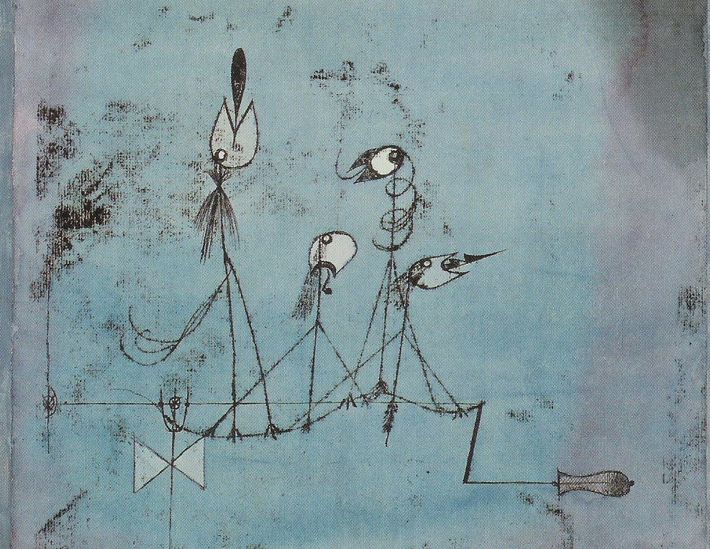

Something About John L. Austin
MEANING AND COMMUNICATION

Slide 2
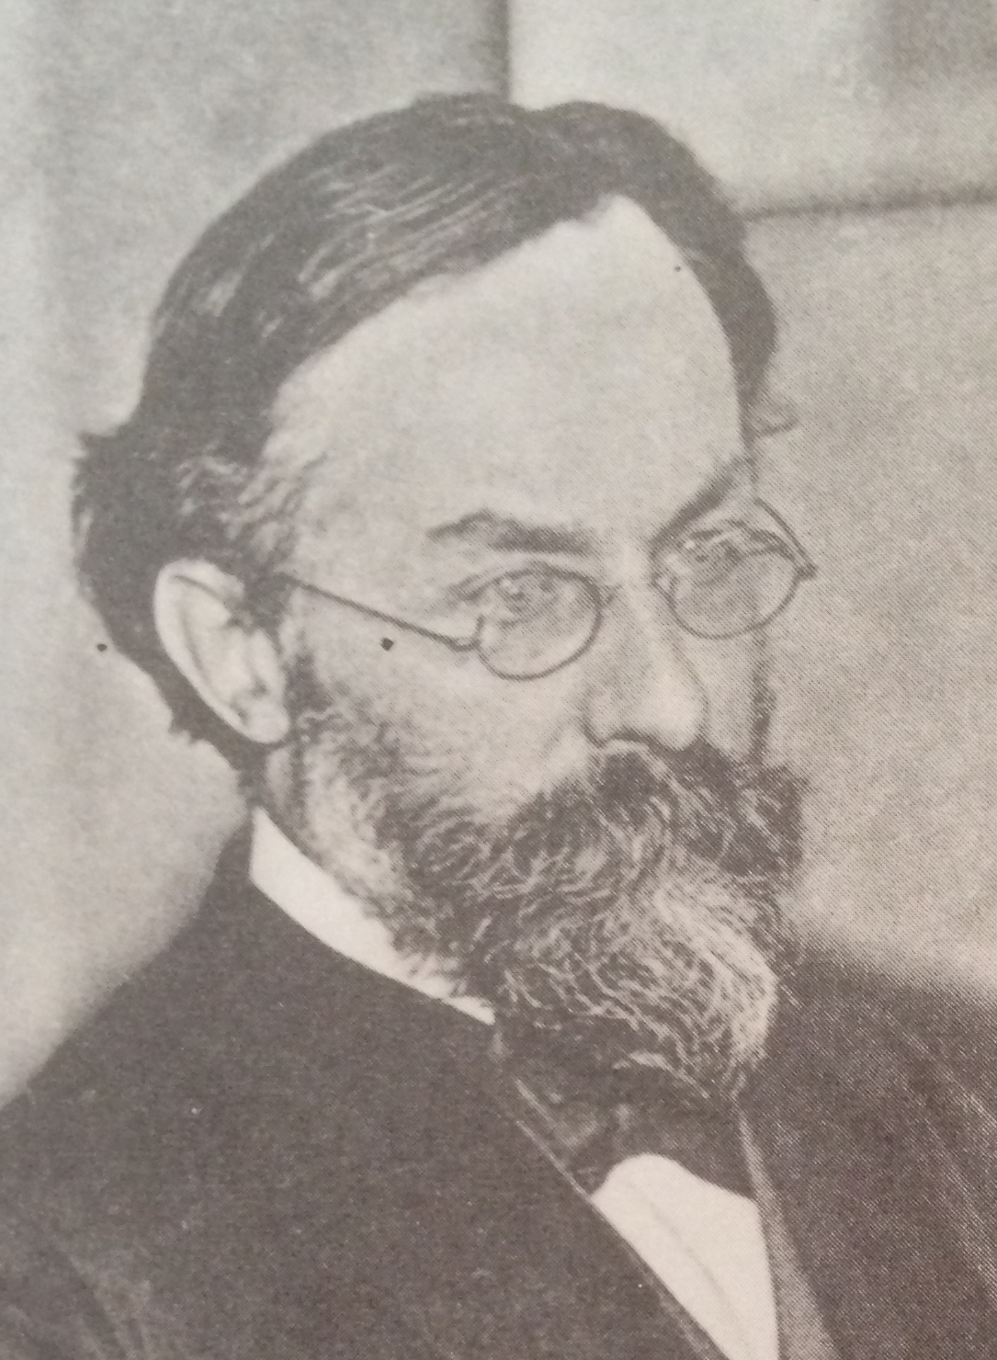
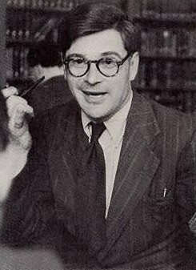

Reading
Reading for this lecture:
Paul Grice “Logic and Conversation”, chapter 2 of Studies in the Way of Words.
Optional:
S. Neale “Paul Grice on Philosophy of Language”, section 2.

Slide 3
Agenda
Recap
Meaning and communication
Word and sentence meaning
Logic and truth conditions

Slide 4
Recap
Testing Grice’s account: sufficiency
Testing Grice’s account: necessity

Slide 5

Recap
Sufficiency:
Adding intentions.
Mutual knowledge.
Negative clause.
Idealisation and loose use.
Reflexive intention.

Slide 6
Recap
Necessity:
1. Interrogation.
2. Lack of authority.
3. Argument.
4. Examination.
5. Standing belief/reminding.

Slide 7
Meaning and communication
We’ re considering two connected issues:
What account we should give of what speakers mean.
The extent to which what one states on an occasion—and so the conditions in which what one states is true or false, or neither—depend on specific features of the occasion or context of speaking.

Slide 8
Meaning and communication
Some philosophers think that what one states, and the conditions in which what one states is true or false, depends very heavily on features of the occasion or context of speaking.
We considered one case of this—uses of sentences involving ‘know’—and we’ll consider some others later on.

Slide 9
Meaning and communication
The view that Grice wants to defend has it that what one states by the use of some words—and so the conditions in which what one states is true or false—is pretty stable across occasions or contexts of speaking.
Apparent variation really only affects some of what one means by what one says: what one implicates.

Slide 10
Meaning and communication
By uttering the words “X has neat handwriting” one states that X has neat handwriting.
But in the right circumstances one can also get across e.g. that X is not a good philosopher, etc.
Grice calls the latter type of message the implicature.

Slide 11
Meaning and communication
Grice suggests that we can view speaker (NN) meaning as subdividing into two subcategories:
What a speaker says: determined more or less by the meanings of the words the speaker uses.
What a speaker implicates: determined by various features of the situation in which the speaker speaks, what they say, the way they say it, and general principles governing rational conversation.

Slide 12
Meaning and communication
When speakers utter words they (speaker) mean various things.
Some of what they mean = what they say (what they make explicit, what they fully articulate)
Some of what they mean = what they implicate (what they suggest, insinuate, get across)

Slide 13
Meaning and communication
So, we face three main tasks:
Understand and assess Grice’s general account of speaker meaning or non-natural meaning.
Understand what is stated—roughly, those bits of speaker meaning that are determined by what our words mean.
Understand what is implicated and its determination on the basis of someone’s stating what they do in the way they do.

Slide 14
Meaning and communication
We now need to work towards the distinction between what is stated and what is implicated, and the apparent need for it, by considering the project of explaining the meanings of words and sentences.

Slide 15
Meaning and communication
We’ll begin by considering some general properties of meaning—some striking facts about competence with language.
Then, we’ll consider a particular way of trying to account for those properties by constructing a compositional meaning theory.

Slide 16
Word and sentence meaning
A sentence is an arrangement of words constructed according to the syntax or grammar of a language.
Bill smokes
(2) *Smokes Bill
“ * “ = ungrammatical

Slide 17
Word and sentence meaning
The syntax or grammar provides more or less specific characterizations of sentences:
Bill smokes
This is a sentence involving a name or singular term or noun-phrase ‘Bill’, followed by a predicate or verb-phrase ‘smokes’.

Slide 18
Word and sentence meaning
An utterance is an event, typically involving the production of a sentence.
Such events occur at a particular time and in a particular place.
If I utter ‘Bill smokes’ and then later utter ‘Bill smokes’, those are two utterances of one sentence.

Slide 19
Word and sentence meaning
A proposition is something one can say or believe, as captured by the that-clauses underlined below:
George said that Bill smokes.
George believes that David pontificates.

Slide 20
Word and sentence meaning
A proposition is one sort of thing that can be true or false.
For instance, if Bill smokes, then the proposition that Bill smokes is true. If Bill doesn’t smoke, then the proposition that Bill smokes is false.

Slide 21
Word and sentence meaning
Sentences are the things we produce when we make utterances.
Propositions are taken to be things that utterances express.
Thus, I can utter the sentence “Bill smokes” and thereby express the proposition that Bill smokes.

Slide 22
Word and sentence meaning
Consider the sentence: “It’s raining today”
Since an utterance of that sentence on Tuesday gave expression to a false proposition, while an utterance of the sentence on Wednesday gave expression to a true proposition, the propositions expressed must differ.

Slide 23
Word and sentence meaning
We might also think that the same proposition can be expressed by utterances on different occasions of different sentences:
“It will rain tomorrow” [uttered on Wednesday]
“It is raining today” [uttered on Thursday]
“It was raining yesterday” [uttered on Friday]

Slide 24
Word and sentence meaning
It’s plausible to think of understanding an utterance of a sentence as being a matter of knowing which proposition the utterance expressed.
Thus, it’s plausible to think of understanding an utterance of “Bill smokes” as being a matter of knowing that it expressed the proposition that Bill smokes.

Slide 25
Word and sentence meaning
Striking fact (a):
If someone utters a sentence and you know which proposition her utterance expresses, then it’s likely that you will also understand which propositions other utterances of the same sentences express.
Conversely, if you don’t understand one utterance of a sentence, it is likely that you won’t understand other utterances of it either.

Slide 26
Word and sentence meaning
Portability. Sentences enable us to communicate in ways that, to a very large extent, are independent of context and background knowledge.
Re-usability. Sentences can be re-used on different occasions and by different people to communicate the same information.

Slide 27
Word and sentence meaning
Compare one off communicative gestures, like pointing to something, or trying to communicate with someone who doesn’t speak any of your languages.
It takes a certain amount of effort to set these things up or get things across. Shared facility with language enables us to bypass setting up, and saves effort in getting things across.

Slide 28
Word and sentence meaning
Hypothesis 1:
Sentences have meanings. Users of a language know the meanings of sentences in that language. Knowing the meaning of a sentence someone utters enables one to know which propositions her utterance expresses.

Slide 29
Word and sentence meaning
Striking fact (b):
Linguistic abilities are systematic—someone who understands an utterance of “Leo ate John” can probably also understand an utterance of “John ate Leo”.

Slide 30

Word and sentence meaning
“there are definite and predictable patterns among the sentences we understand. For example, anyone who understands ‘The rug is under the chair’ can understand ‘The chair is under the rug’” (Szabó 2012, SEP article on ‘Compositionality’).

Slide 31
Word and sentence meaning
Striking fact (c):
Linguistic abilities are productive—we can understand utterances of an indefinitely range of sentences we have never heard before.
Example: “John ate Leo who ate Bill who ate …”

Slide 32
Word and sentence meaning
Productivity: we can understand utterances of an indefinitely large range of sentences we have never heard before.

Slide 33
Word and sentence meaning
Hypothesis 2:
(i) Languages are compositional: that is, sentences are composed of words arranged according to syntactic rules, and the meaning of a sentence is determined by the meanings of its constituent words and their arrangement

Slide 34
Word and sentence meaning
Hypothesis 2:
(ii) We know the meanings of words and the rules governing how they can be arranged into sentences. This enables us to know the meanings of sentences.

Slide 35
Word and sentence meaning
If Hypothesis 2 is correct, we can explain productivity.
Consider an utterance of “Leo ate John who ate Bill.”
According to Hypothesis 2,
1. we know the meanings of the individual words of this sentence and the rules of composition; and
2. the meanings of the individual words together with rules of composition determine the meaning of the sentence uttered.

Slide 36
Word and sentence meaning
And then from Hypothesis 1:
3. Knowing the meaning of the sentence enables us to understand the meaning of the utterance
So, if our hypotheses are correct, we have made a start at explaining the fact that we can immediately understand sentences we’ve never come across before.

Slide 37
Logic and truth conditions
Your abilities to use First Order Logic are systematic and productive.
Systematic:
If you understand:
A → B
then you can probably also understand:
B → A

Slide 38
Logic and truth conditions
Productive:
If you understand:
¬A
then you can probably also understand:
¬¬A
and also:
¬¬¬A
and so on …

Slide 39
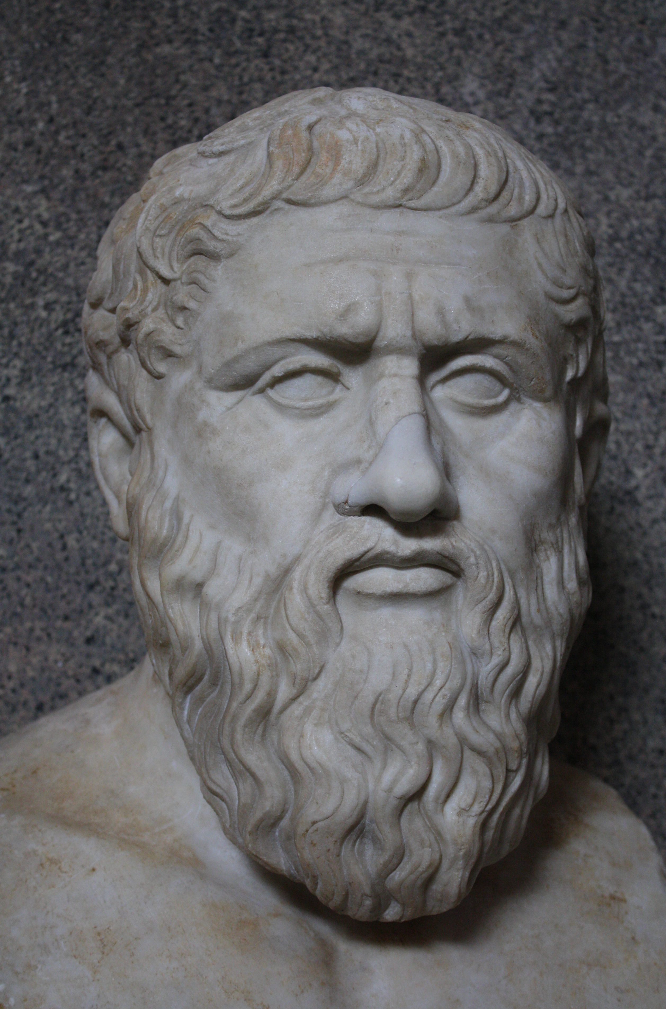
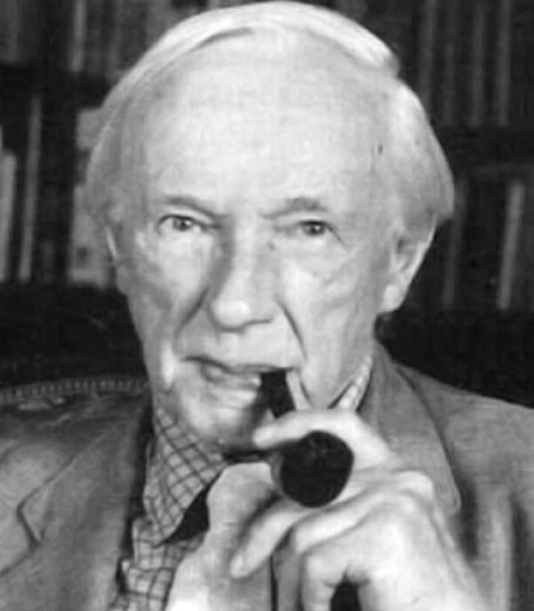
Reading for next time
Reading for next session:
Paul Grice “Logic and Conversation”, chapter 2 of Studies in the Way of Words.
Optional:
S. Neale “Paul Grice on Philosophy of Language”, section 2.

