Slide 1
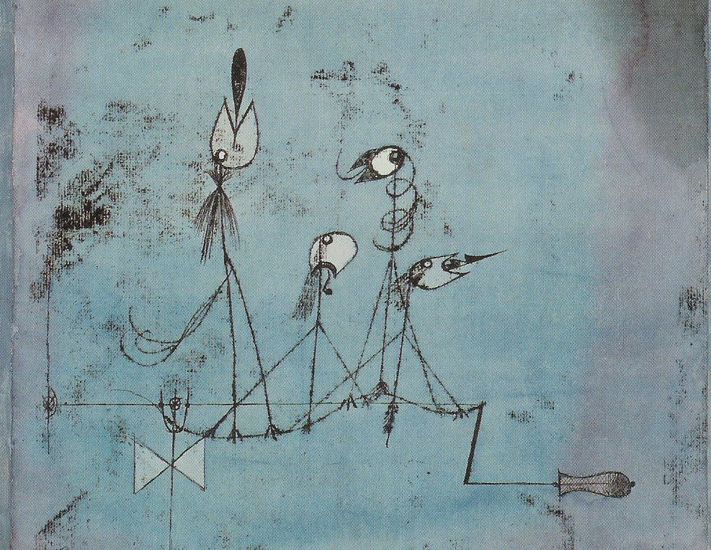

Something About John L. Austin
MEANING AND COMMUNICATION

Slide 2
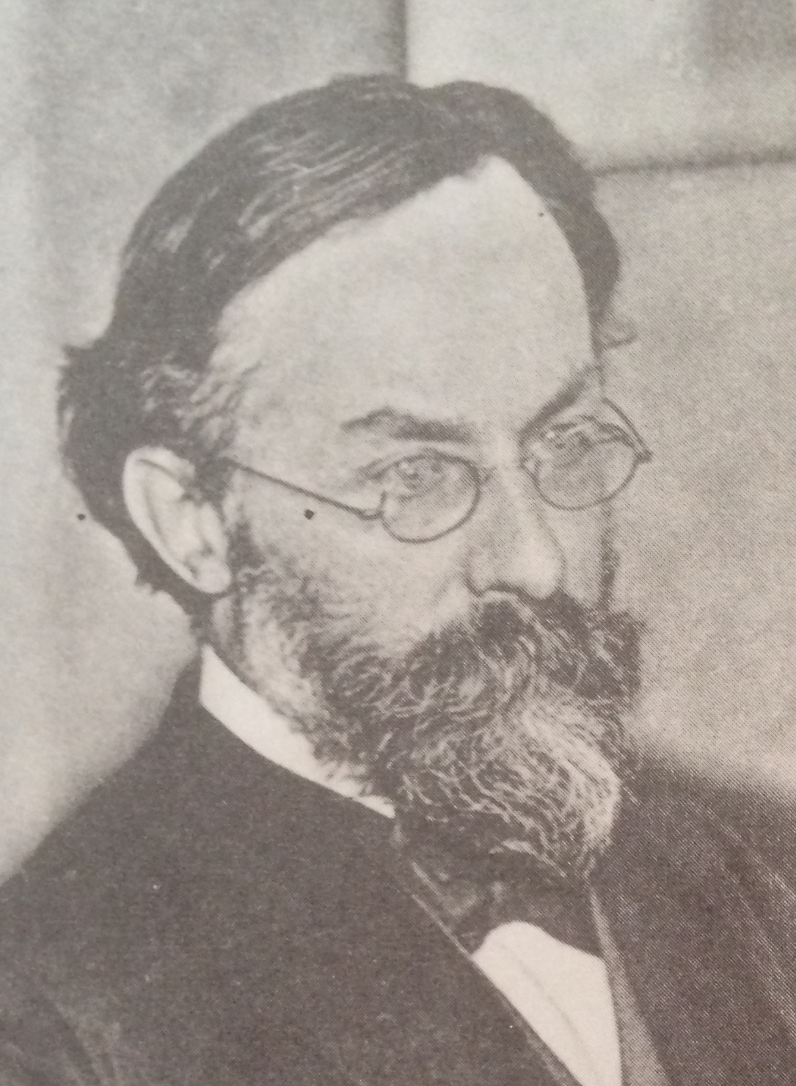
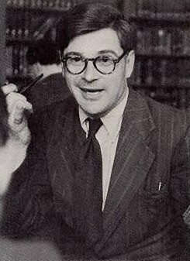

Reading
Reading for this lecture:
Paul Grice “Logic and Conversation”, chapter 2 of Studies in the Way of Words.
Optional:
S. Neale “Paul Grice on Philosophy of Language”, section 2.

Slide 3
Agenda
Recap
Logic and truth conditions
The Programme
And and ‘&’
Open-endedness

Slide 4

Recap
Grice suggests that we can view speaker (NN) meaning as subdividing into two subcategories:
What a speaker says: determined more or less by the meanings of the words the speaker uses.
What a speaker implicates: determined by various features of the situation in which the speaker speaks, what they say, the way they say it, and general principles governing rational conversation.

Slide 5
Recap
We now need to work towards the distinction between what is stated and what is implicated, and the apparent need for it, by considering the project of explaining the meanings of words and sentences.

Slide 6
Recap
Hypothesis 1:
Sentences have meanings. Users of a language know the meanings of sentences in that language. Knowing the meaning of a sentence someone utters enables one to know which propositions her utterance expresses.

Slide 7
Recap
Hypothesis 2:
(i) Languages are compositional: that is, sentences are composed of words arranged according to syntactic rules, and the meaning of a sentence is determined by the meanings of its constituent words and their arrangement

Slide 8
Recap
Hypothesis 2:
(ii) We know the meanings of words and the rules governing how they can be arranged into sentences. This enables us to know the meanings of sentences.

Slide 9
Recap
If Hypothesis 2 is correct, we can explain productivity.
Consider an utterance of “Leo ate John who ate Bill.”
According to Hypothesis 2,
1. we know the meanings of the individual words of this sentence and the rules of composition; and
2. the meanings of the individual words together with rules of composition determine the meaning of the sentence uttered.

Slide 10
Recap
And then from Hypothesis 1:
3. Knowing the meaning of the sentence enables us to understand the meaning of the utterance
So, if our hypotheses are correct, we have made a start at explaining the fact that we can immediately understand sentences we’ve never come across before.

Slide 11
Logic and truth conditions
Your abilities to use First Order Logic are systematic and productive.
Systematic:
If you understand:
A -> B
then you can probably also understand:
B -> A

Slide 12
Logic and truth conditions
Productive:
If you understand:
-A
then you can probably also understand:
--A
and also:
---A
and so on …

Slide 13
Logic and truth conditions
In trying to say what meanings are, what we are looking for is things knowledge of which enable us to understand sentences of FOL.
Suppose you can translate a sentence of FOL into English. Since you understand English, the translation enables you to understand the FOL sentence too.

Slide 14
Logic and truth conditions
For instance, if you know that:
(T) ‘A & B’ can be translated as ‘Bill smokes and George drinks’
Then you understand the FOL sentence A & B.

Slide 15
Logic and truth conditions
What do you need to know about a symbol of FOL in order to be able to translate sentences containing that symbol into English?

Slide 16
Logic and truth conditions
For the sentential connectives &, - and so on, the answer is that you need to know their truth tables. Knowing the truth table for & enables you to translate sentences containing this symbol into English.
Therefore, we have reason to think that the truth table gives the meaning of the symbol.

Slide 17
Logic and truth conditions
1. Knowing the truth table for a sentential connective is sufficient, together with knowledge of the syntax of FOL, to work out the truth table of any complex sentence containing that connective.

Slide 18
Logic and truth conditions
2. Knowing the truth table for a sentence of FOL is sufficient, together with knowledge of what the sentence letters mean, for translating the sentence of FOL into English.

Slide 19
Logic and truth conditions
3. Being able to translate a sentence of FOL into English is sufficient, together with knowledge of English, for knowing what that sentence of FOL means.

Slide 20
Logic and truth conditions
Consider this sentence of FOL:
F(a)
What could you know that would enable you to translate this into English?

Slide 21
Logic and truth conditions
Consider an interpretation which assigns an extension to the predicate and an object to the name:
F : the set of smokers
a : Bill
Given that interpretation, F(a) seems to translate into “Bill is a member of the set of smokers” or “Bill smokes”.

Slide 22
Logic and truth conditions
What should we say about the sentence “Bill smokes”?
Translating that sentence into English won’t help:
“Bill smokes” translates into “Bill smokes”.
And translating into another language, e.g. German, merely postpones the question.

Slide 23
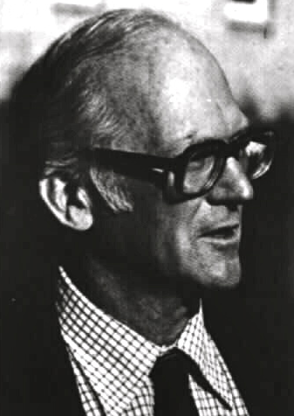
Logic and truth conditions
Davidson’s proposal:
(W) ‘Bill smokes’ is true if and only if Bill smokes.
Knowledge of the statement seems to be sufficient for understanding utterances of this sentence. So there is some plausibility in the idea that (W) tells us the meaning of (W).

Slide 24
Logic and truth conditions
It’s plausible that the meaning of a word is whatever it is that works together with knowledge of rules for composition to enable us to know the meanings of sentences containing the word.

Slide 25
Logic and truth conditions
Proposal:
The referent of ‘Bill’ is Bill.
The extension of ‘smokes’ is the set of things which smoke.
That fits what we said about FOL, and also looks compatible with Davidson’s proposal about sentence meanings.

Slide 26
Logic and truth conditions
But we still need to say something about how “Bill” and “smokes” work together in “Bill smokes.
In English, a name plus a predicate constitutes a sentence.
Any such a sentence is true if and only if the referent of the name is in the extension of the predicate.

Slide 27
Logic and truth conditions
Now that we have a working proposal about what the meanings of sentences are, we can evaluate the proposal about the meanings of words.

Slide 28
The Programme
For each word there is a statement which gives its meaning. For instance, the statement
‘Bill’ refers to Bill
gives the meaning of ‘Bill’.
The statements vary depending on the type of word.

Slide 29
The Programme
2. From statements such as these about the meanings of words, together with rules of composition, it’s possible to derive statements about the conditions under which any sentence containing those words is true.

Slide 30
The Programme
3. So, knowing these statements about the meanings of words, together with knowing the rules of composition, would be sufficient for being in a position to know the conditions under sentences would be true.

Slide 31
The Programme
4. Knowing the conditions under which a sentence is true would be sufficient for understanding utterances of it. So, it would be a way of giving the meaning of the sentence.

Slide 32
And and ‘&’
Consider this natural claim about the meaning of ‘and’:
‘A and B’ is true if and only if A is true and B is true.
On the truth conditional view, it’s natural to hold that this statement gives the meaning of the English word ‘and’.

Slide 33
And and ‘&’
On this view, knowing the meaning of ‘and’ enables you to know the meanings of sentences containing ‘and’, and thereby to understand which propositions utterances of those sentences express.

Slide 34
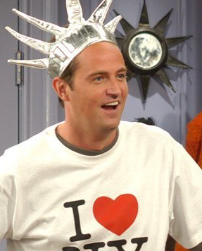
And and ‘&’
SUSIE: But um, here's an idea, have you ever worn women's underwear?
CHANDLER: Well, ye, yes, actually, but, uh, they were my Aunt Edna's, and there were three of us in there.

Slide 35
And and ‘&’
In this first conversation, it’s quite plausible that our little theory of about the meaning of ‘and’ would work.
Chandler reports something that looks like it’s true just in case both the things he said are true.

Slide 36
And and ‘&’
CHANDLER: I, I'm sorry, I uh I already have a roommate.
[…]
EDDIE: No he, he moved out and I moved in.
CHANDLER: Well I, I think we'd remember something like that.

Slide 37
And and ‘&’
In this second conversation, it’s plausible that our little theory of about the meaning of and will not work.
Eddie’s report seems to require that the events he reports happened in a particular order:
The roommate moved out and then, later Eddie moved in.

Slide 38
And and ‘&’
We can fix this problem by giving an alternative statement of the meaning of ‘and’:
‘A and B’ is true if and only if
A is true and B is true, and
(ii) the event described in A occurred before the event described in B.

Slide 39
And and ‘&’
CHANDLER Well then, how do you know when vegetables are done?
PHOEBE Well you know, you just, you eat them and you can tell.

Slide 40
And and ‘&’
In this case, it’s plausible that we need a third account:
‘A and B’ is true if
A is true and B is true and
B because A.

Slide 41
And and ‘&’
Three upshots:
(1) We appear to be forced to admit that there is a difference between the meaning of ‘and’ in English and the meaning of the conjunction symbol ‘&’ in FOL.

Slide 42
And and ‘&’
(2) It appears that ‘and’ is ambiguous:
(a) ‘A and B’ is true if and only if A is true and B is true.
(b) ‘A and B’ is true if and only if (i) A is true and B is true, and (ii) the event described in A occurred before the event described in B.
(c) ‘A and B’ is true if (i) A is true and B is true and (ii) B because A.

Slide 43
And and ‘&’
(3) There seems to be no natural limit to the variety of meanings ‘and’ can be used with.
These upshots are potentially problematic.

Slide 44
And and ‘&’
Recall our explanation of Productivity.
a. Knowing the meaning of ‘and’ enables you to know the meanings of sentences containing ‘and’, and thereby to understand which proposition utterances of sentences containing this word express.

Slide 45
And and ‘&’
b. the words have the same meanings in sentences 1–3, so that the same knowledge is sufficient for understanding them.
This appears to be flouted with respect to ‘and’.

Slide 46
And and ‘&’
It’s plausible that the same meaning is in play, since one doesn’t appear to have to learn anything new in order to grasp the different propositions that are conveyed.
The same sentence, with what appears to be the same meaning, can apparently be used to convey all kinds of different propositions.

Slide 47
Further reading
Donald Davidson, ‘Radical Interpretation,’ with accompanying commentary and toy theory, in Hornsby and Longworth, Reading Philosophy of Language.
Zoltán Gendler Szabó, ‘Compositionality,’ Stanford Encyclopedia of Philosophy.

