Slide 1
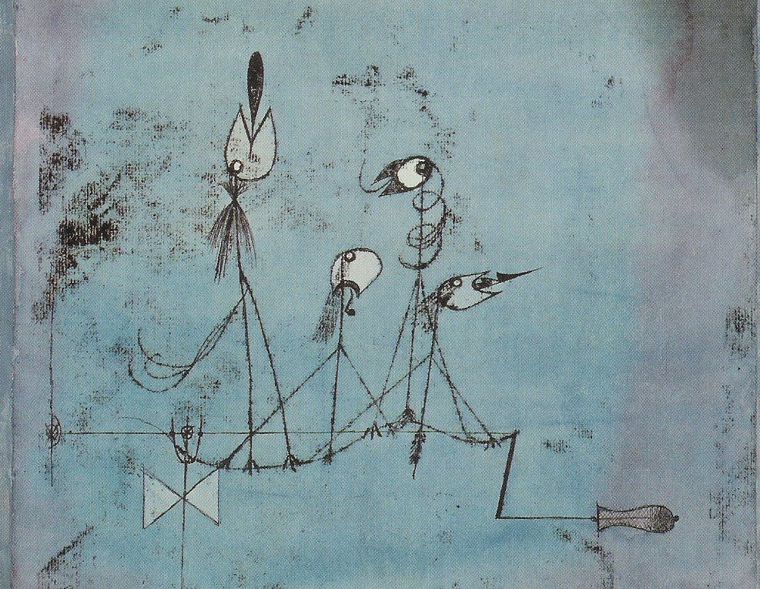

Something About John L. Austin
MEANING AND COMMUNICATION

Slide 2
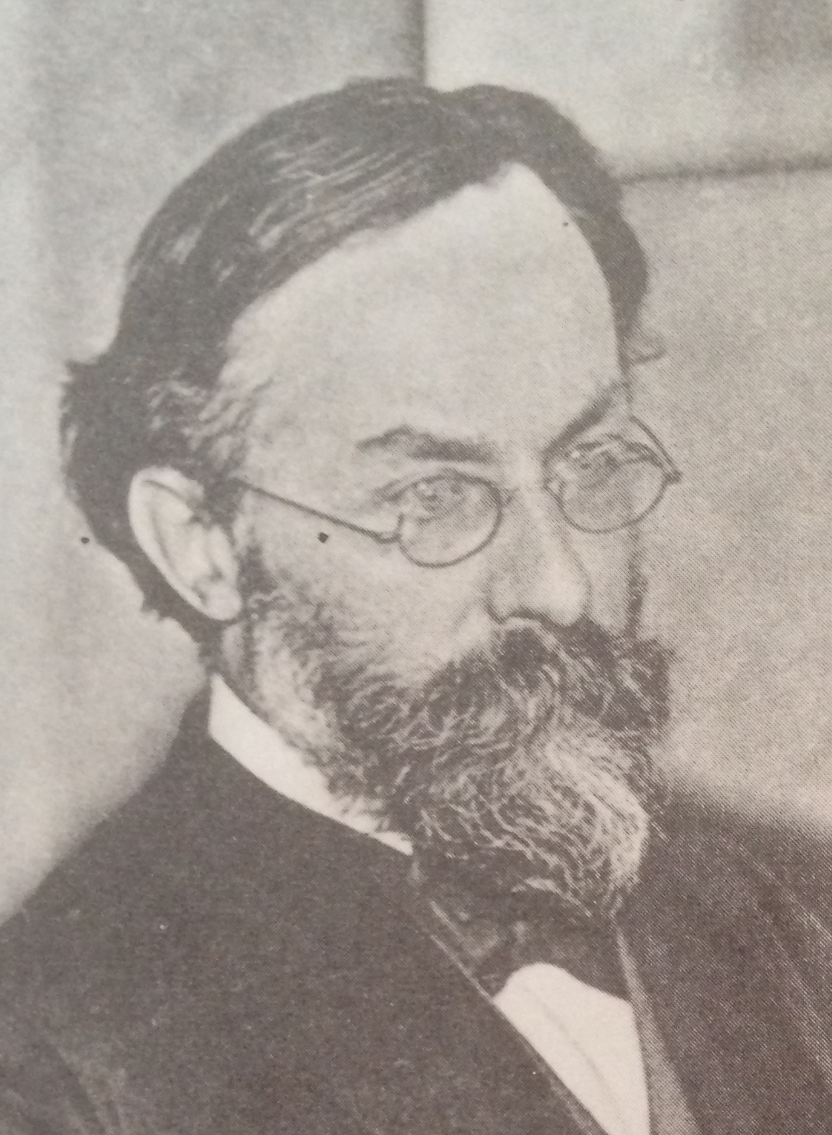
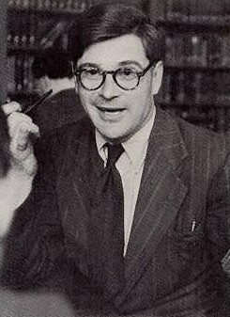

Reading
Reading for this lecture:
Paul Grice “Logic and Conversation”, chapter 2 of Studies in the Way of Words.
Optional:
S. Neale “Paul Grice on Philosophy of Language”, section 2.

Slide 3
Agenda
Recap
Open-endedness
Stating and implicating
The Cooperative Principle
The Cooperative Principle: maxims
Calculating implicatures

Slide 4
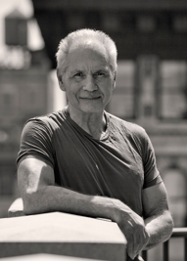
Recap
Grice suggests that we can view speaker (NN) meaning as subdividing into two subcategories:
What a speaker says: determined more or less by the meanings of the words the speaker uses.
What a speaker implicates: determined by various features of the situation in which the speaker speaks, what they say, the way they say it, and general principles governing rational conversation.

Slide 5
Recap
We’re working towards the distinction between what is stated and what is implicated, and the apparent need for it, by considering the project of explaining the meanings of words and sentences.

Slide 6
Recap
Hypothesis 1:
Sentences have meanings. Users of a language know the meanings of sentences in that language. Knowing the meaning of a sentence someone utters enables one to know which propositions her utterance expresses.

Slide 7
Recap
Hypothesis 2:
(i) Languages are compositional: that is, sentences are composed of words arranged according to syntactic rules, and the meaning of a sentence is determined by the meanings of its constituent words and their arrangement

Slide 8
Recap
Hypothesis 2:
(ii) We know the meanings of words and the rules governing how they can be arranged into sentences. This enables us to know the meanings of sentences.

Slide 9
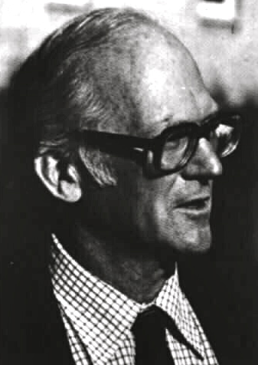
Recap
Consider this natural claim about the meaning of ‘and’:
‘A and B’ is true if and only if A is true and B is true.
On the truth conditional view, it’s natural to hold that this statement gives the meaning of the English word ‘and’.

Slide 10
Recap
On this view, knowing the meaning of ‘and’ enables you to know the meanings of sentences containing ‘and’, and thereby to understand which propositions utterances of those sentences express.

Slide 11
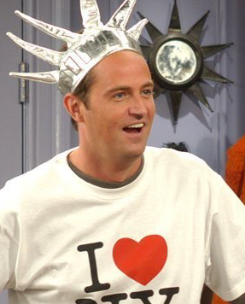
Recap
Three upshots of reflection on ‘and’:
(1) We appear to be forced to admit that there is a difference between the meaning of ‘and’ in English and the meaning of the conjunction symbol ‘&’ in FOL.

Slide 12
Recap
(2) It appears that ‘and’ is ambiguous:
(a) ‘A and B’ is true if and only if A is true and B is true.
(b) ‘A and B’ is true if and only if (i) A is true and B is true, and (ii) the event described in A occurred before the event described in B.
(c) ‘A and B’ is true if (i) A is true and B is true and (ii) B because A.

Slide 13
Recap
(3) There seems to be no natural limit to the variety of meanings ‘and’ can be used with.
These upshots are potentially problematic.

Slide 14
Recap
It’s plausible that the same meaning is in play, since one doesn’t appear to have to learn anything new in order to grasp the different propositions that are conveyed.
The same sentence, with what appears to be the same meaning, can apparently be used to convey all kinds of different propositions.

Slide 15
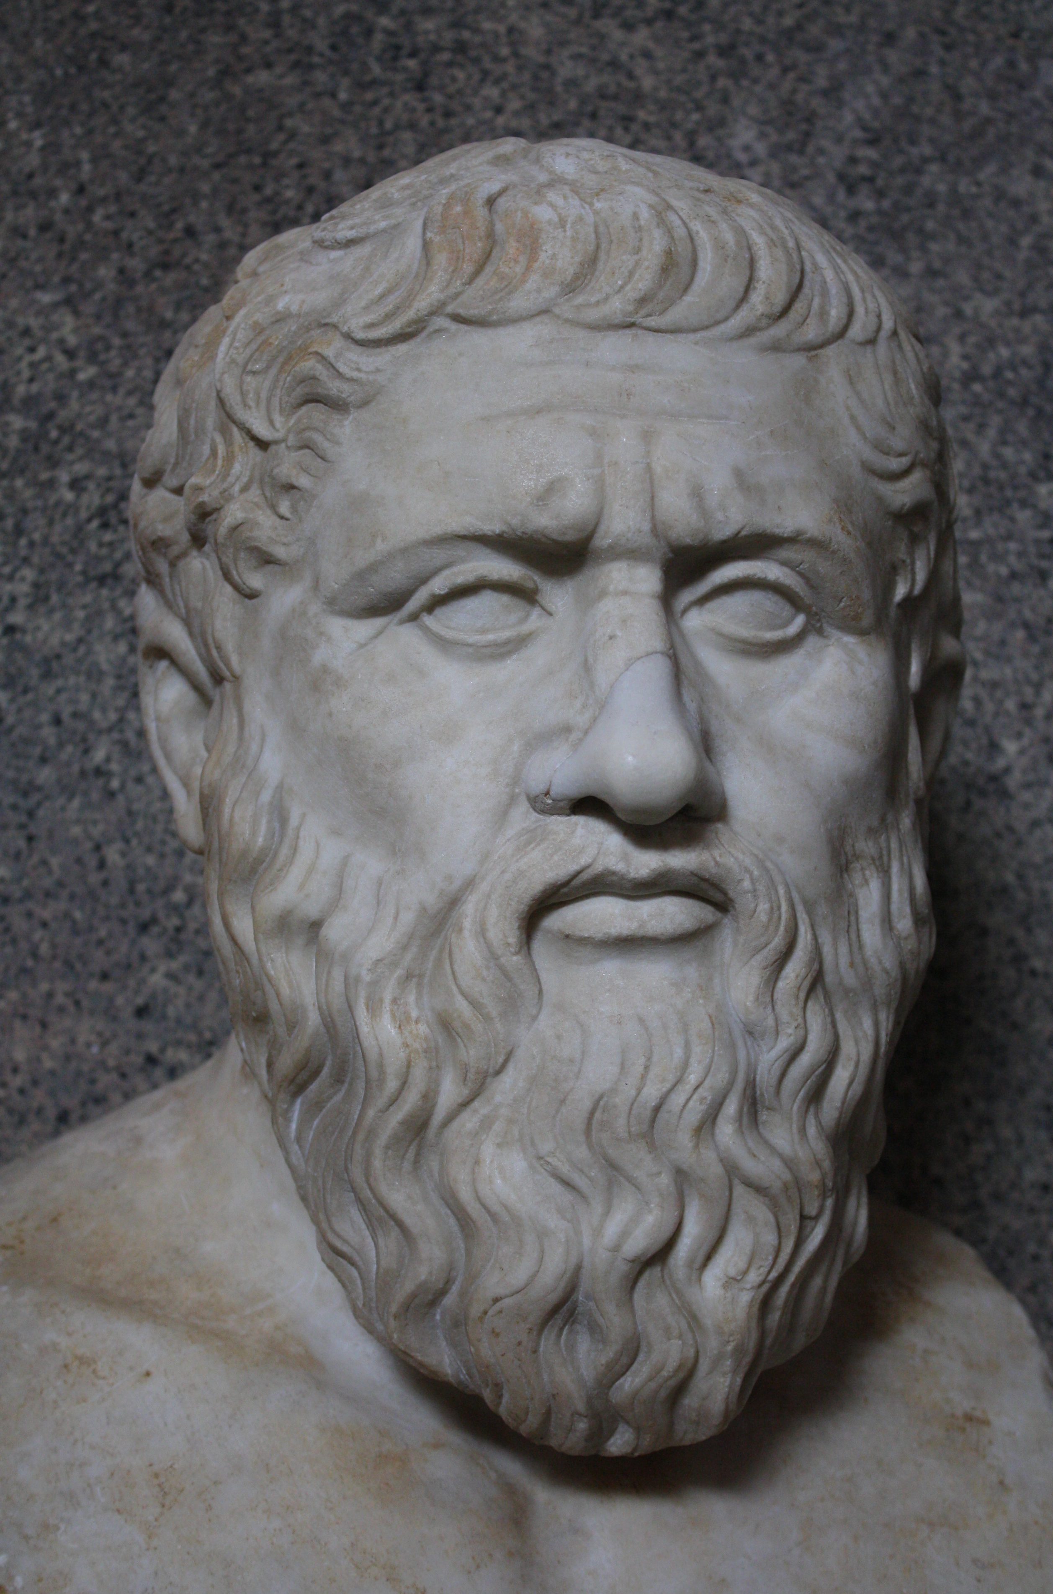
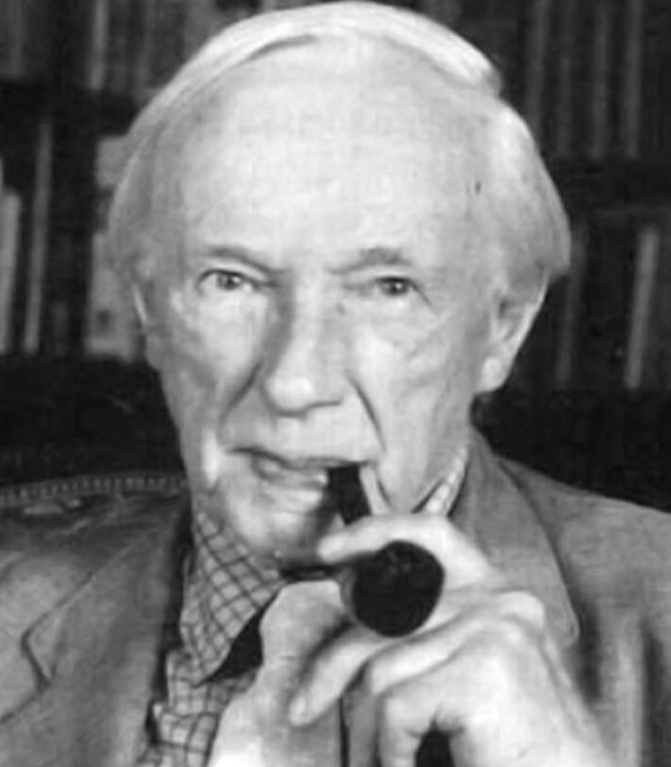
Open-endedness
BILL: “Are you hungry?”
JILL: “I’ve had breakfast”

Slide 16
Open-endedness
Here JILL might be using the sentence to convey the proposition that she is not hungry.
But if it’s late afternoon, JILL might be conveying that she is hungry, since all she’s had is breakfast.

Slide 17
Open-endedness
JILL: “How are you?”
BILL: “I’ve had breakfast”

Slide 18
Open-endedness
Here, BILL might be using the same sentence to convey the proposition that he is sufficiently recovered that he can now eat.
But suppose the participants are staying at a dodgy B&B; in that case, BILL might convey that he feels unwell.

Slide 19
Open-endedness
Striking fact (d):
Utterances of a given sentence can be used to communicate an open-ended range of messages.

Slide 20
Open-endedness
Striking fact (e):
Any fact can in principle be relevant to determining which message an utterance communicates.

Slide 21
Open-endedness
Striking fact (d) is a problem for the Programme. According to the Programme, the meaning of a sentence is given by its truth conditions. For instance:
(W) “I’ve had breakfast” is true if and only if the utterer of the sentence has had breakfast.

Slide 22
Open-endedness
Knowing (W) is not sufficient to work out what different utterances of this sentence have been used to communicate.
In the “Are you hungry?” conversation, for example, you also need to know facts about when people normally have breakfast.

Slide 23
Open-endedness
We introduced meaning by characterising its function: the meaning of a sentence is whatever it is knowledge of which enables language users to understand utterances of that sentence.
If knowledge of (W) does not enable language users to understand utterances of this sentence, it must be false that (W) gives the meaning of “I’ve had breakfast”.

Slide 24
Open-endedness
On the simplest picture of communication, the meaning of a sentence is the message utterances of that sentence communicate.
This is sometimes called the code conception of communication by language.

Slide 25
Open-endedness
Each sentence can be used to communicate a given message, and that message is its meaning. Striking fact (d) shows that this code conception of linguistic communication is false.

Slide 26
Open-endedness
Knowing the meaning of a sentence enables language users to understand utterances of only in conjunction with their background knowledge.

Slide 27
Open-endedness
What we need now is an account of how background knowledge conspires with knowledge of meaning to deliver knowledge of what a speaker is trying to convey.

Slide 28
Stating and implicating
The Programme, as we’ve considered it to this point, ignores the fact that communication consists of intentional actions done for reasons.
We’ve already seen Grice stressing these features of speech activity. Now we’ll consider how they feed into Grice’s account of what is conveyed by the use of bits of language.

Slide 29
Stating and implicating
At this point we need some basic notions from the philosophy of action, some of which we’ve already been making use of. Actions may be
(1) goal directed,
(2) intentional,
(3) done for reasons [there are reasons why words are chosen],
(4) co-ordinated,
(5) co-operative.

Slide 30
Stating and implicating
Goal directed:
For most actions there is one or more goal to be achieved: we walk to the shops with the goal of buying salt; we hit a ball with the goal of scoring points.

Slide 31
Stating and implicating
Intentional:
Shooting can be intentional or accidental (you never intended to press the trigger but someone came up behind you and shocked you).

Slide 32
Stating and implicating
Done for reasons:
There are reasons which explain why an action happens. They answer questions like “Why did X do that?” or “What was your reason for doing that?”

Slide 33
Stating and implicating
Co-ordinated:
People walking on a busy street are making careful adjustments to each others’ actions, avoiding stepping in front of the pram and so on.

Slide 34
Stating and implicating
Co-operative:
Actions are cooperative, roughly speaking, when the agents share a goal and work together in order to achieve that goal.

Slide 35
Stating and implicating
Grice’s central hypothesis is this:
In its purest form, conversation consists of utterances which are goal-directed, intentional, rational, co-ordinated and co-operative actions.
We can use this fact to explain what is conveyed by the use of sentences.

Slide 36
The Cooperative Principle
The Cooperative Principle:
“Make your conversational contribution such as is required, at the stage at which it occurs, by the accepted purpose or direction of the talk exchange in which you are engaged.” (26)

Slide 37
The Cooperative Principle: Maxims
Quantity
1. Make your contribution as informative as is required (for the current purposes of the exchange).
E.g. if someone asks you for directions to the nearest garage, don’t say just say that there are garages around these parts.

Slide 38
The Cooperative Principle: Maxims
Quantity
2. Do not make your contribution more informative than is required.” (25)
E.g. if someone asks you where the nearest garage is, don’t tell them the precise grid co-ordinates, or the location relative to the sun, etc., if you could just point them towards the garage.

Slide 39
The Cooperative Principle: Maxims
Quality
“try to make your contribution one that is true”
1. Do not say what you believe to be false.
2. Do not say that for which you lack adequate evidence.” (27)

Slide 40
The Cooperative Principle: Maxims
Relation
“be relevant”
E.g. don’t start talking about various things worth seeing in the area.

Slide 41
The Cooperative Principle: Maxims
Manner
“Be perspicuous”
1. Avoid obscurity of expression.
E.g. avoid: ‘The existence of a garage three and six score yards hence would not be denied by one who knew all.’
2. Avoid ambiguity.
E.g. avoid ‘the nearest garage is just past the bank’.

Slide 42
The Cooperative Principle: Maxims
Manner
“Be perspicuous”
3. Be brief (avoid unnecessary prolixity).
E.g., don’t go on and on…
4. Be orderly. (27)
E.g., give directions in a useful order...

Slide 43
The Cooperative Principle: Maxims
“…observance of the Cooperative Principle and maxims is reasonable (rational) along the following lines:…” (30)

Slide 44
The Cooperative Principle: Maxims
“…that anyone who cares about the goals that are central to conversation/communication (such as giving and receiving information, influencing and being influenced by others) must be expected to have an interest, given suitable circumstances, in participation in talk exchanges that will be profitable only on the assumption that they are conducted in general accordance with the Cooperative Principle and the maxims.” (30)

Slide 45
The Cooperative Principle: Maxims
How does the co-operative principle help us to deal with the puzzle, and in particular the need to provide an account of what is conveyed, given knowledge of meaning and background knowledge?

Slide 46
Reading for next time
Reading for next session:
Paul Grice “Logic and Conversation”, chapter 2 of Studies in the Way of Words.
Optional:
S. Neale “Paul Grice on Philosophy of Language”, section 2.

