Slide 1
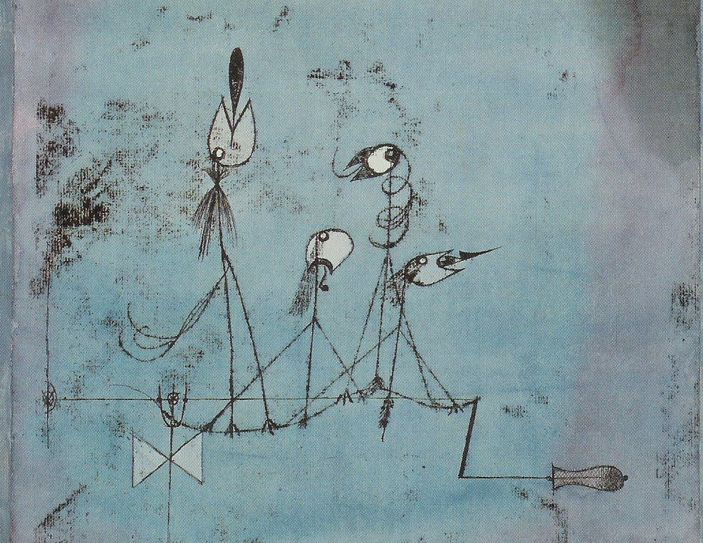
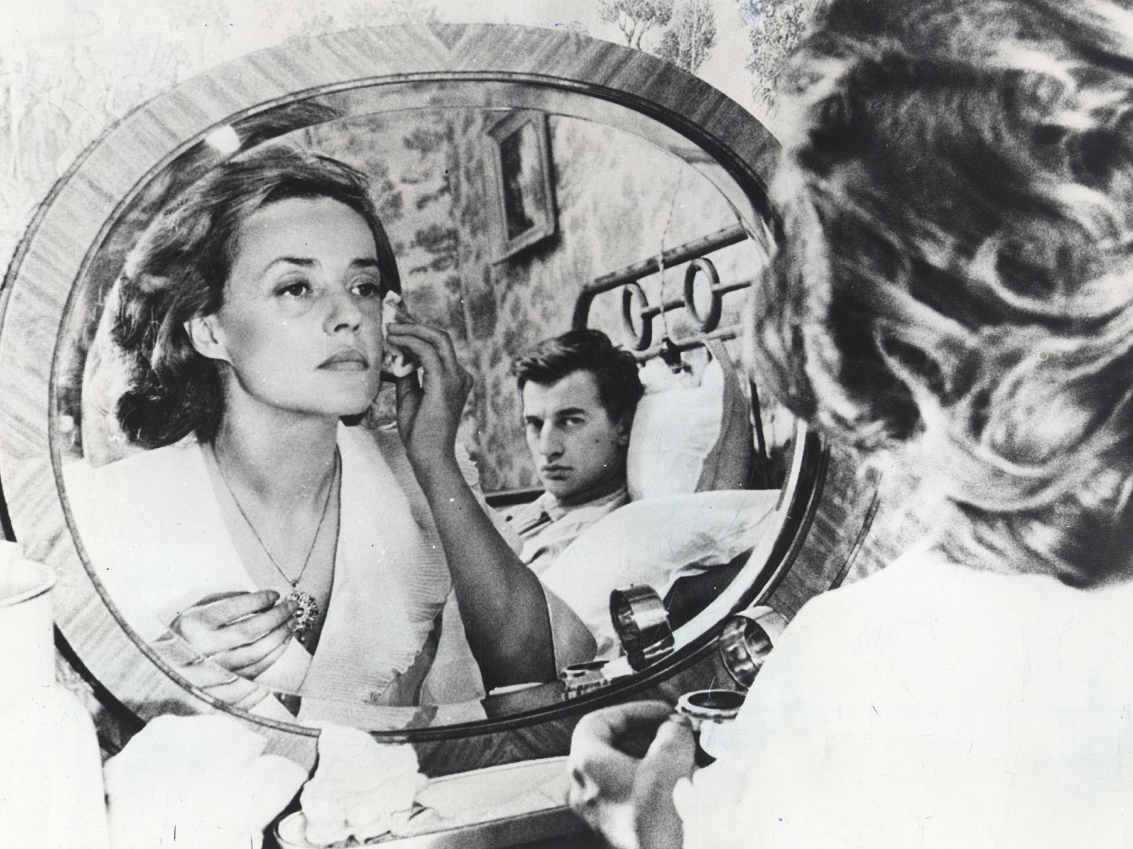
Something About John L. Austin
MEANING AND COMMUNICATION

Slide 2
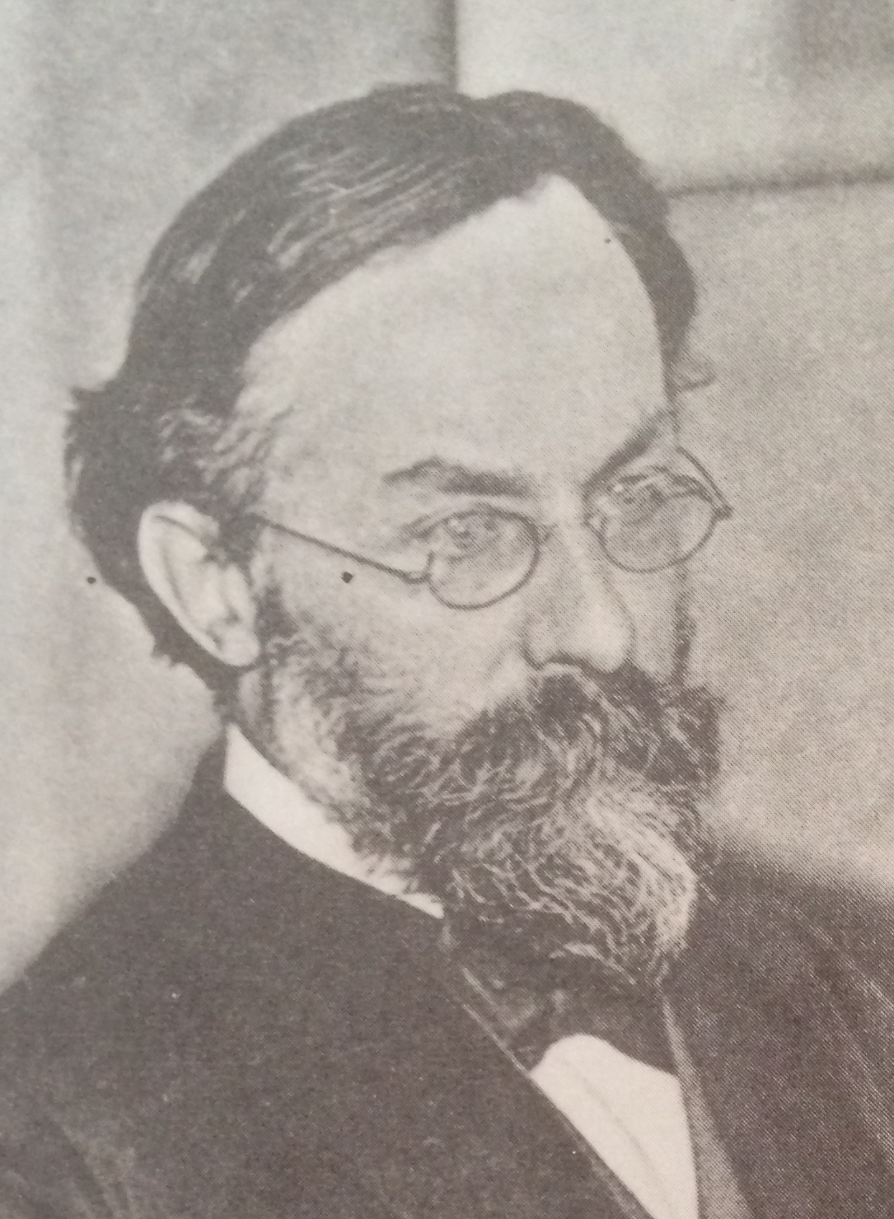
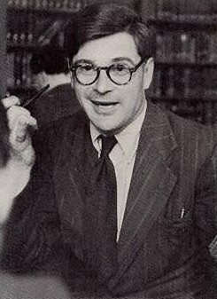
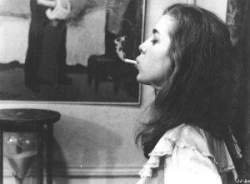
Reading
Reading for this lecture:
Paul Grice “Logic and Conversation”, chapter 2 of Studies in the Way of Words.
Optional:
S. Neale “Paul Grice on Philosophy of Language”, section 2.

Slide 3
Agenda
Recap
Calculating implicatures
Conversation and conventional implicature
FOL and English
Signs of implicature

Slide 4

Recap
The problem:
(I) There is good reason to think that the meanings of words make a stable/uniform contribution to sentence meaning, and sentence meaning makes a stable/uniform contribution to determining what is said.

Slide 5
Recap
The problem:
(II) There is good reason to think that the same words can be used to convey a variety of messages.

Slide 6
Recap
The solution:
(III) Distinguish what is strictly and literally said or stated—what is made fully articulate—from what is merely implicated—what is suggested, insinuated, got across.

Slide 7
Recap
What is strictly and literally said is determined by stable sentence meaning, in accord with compositionality;
What is implicated is determined by what is said, together with the way it is said, together with general principles governing rational communication.

Slide 8
Recap
So, communicative competence consists of two parts:
What one knows by virtue of being a speaker of a particular language. This gives one a head start in figuring out what people mean by enabling one easily to figure out what they are saying.

Slide 9
Recap
(B) What one knows by virtue of being a rational communicator. This more general competence puts one in a position to derive other elements of speaker meaning, in particular the implicature carried by a speaker’s saying what they do.

Slide 10
Recap
Speaker meaning in general is a form of non-natural meaning.
So, it is to be accounted for by appeal to speakers intentions—either reflexive intentions or open-intentions as captured by a multi-clause account.
What is said and what is implicated are two species of speaker meaning.

Slide 11
Recap
Plausibly, saying something is a more basic action than implicating something: one implicates something by saying something.
Plausibly, implicating something is indirect: it is something one does by virtue of doing something else, namely saying something.

Slide 12
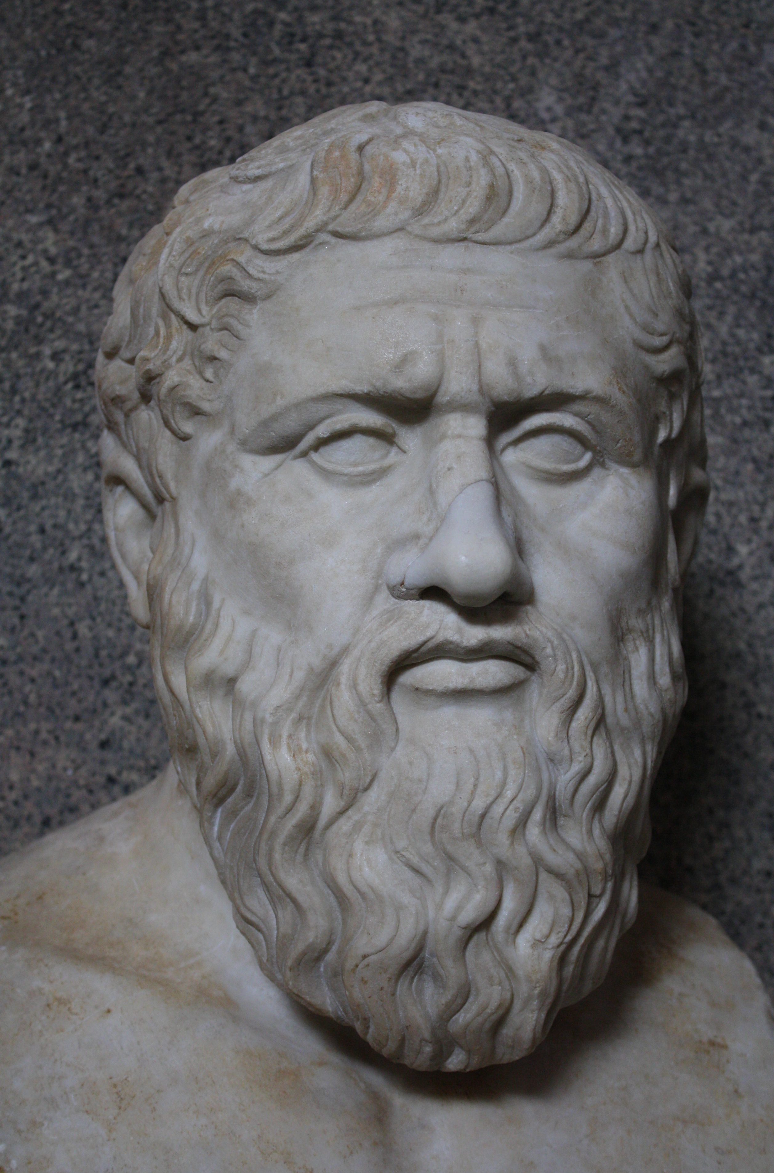
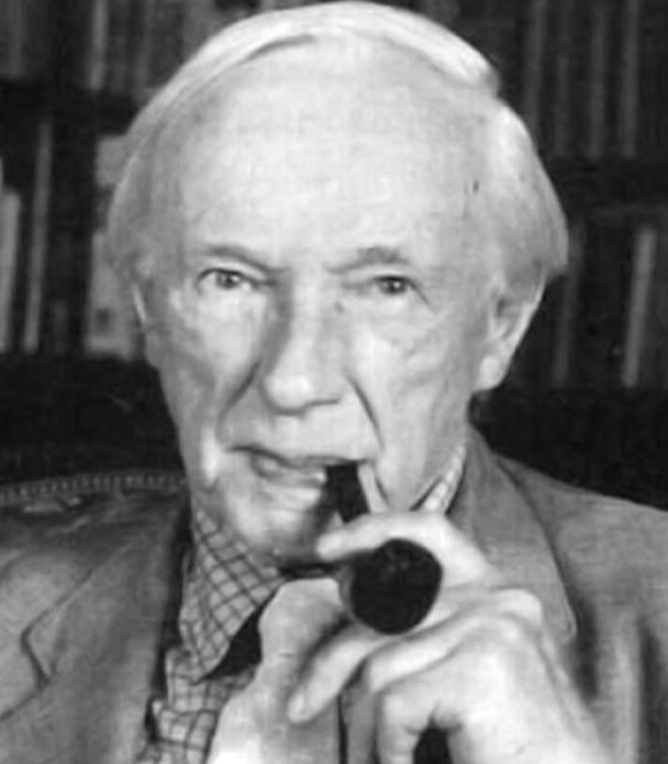
Recap
The Cooperative Principle:
“Make your conversational contribution such as is required, at the stage at which it occurs, by the accepted purpose or direction of the talk exchange in which you are engaged.” (26)

Slide 13
Calculating implicatures
How does the co-operative principle help us to deal with the puzzle, and in particular the need to provide an account of what is conveyed, given knowledge of meaning and background knowledge?

Slide 14
Calculating implicatures
“to calculate a conversational implicature is to calculate what has to be supposed in order to preserve the supposition that the Cooperative Principle is being observed” (39–40)

Slide 15
Calculating implicatures
So the core idea is that a conversational implicature is an assumption you need to make in order to for it to be true that a speaker is sticking to the Cooperative Principle.

Slide 16
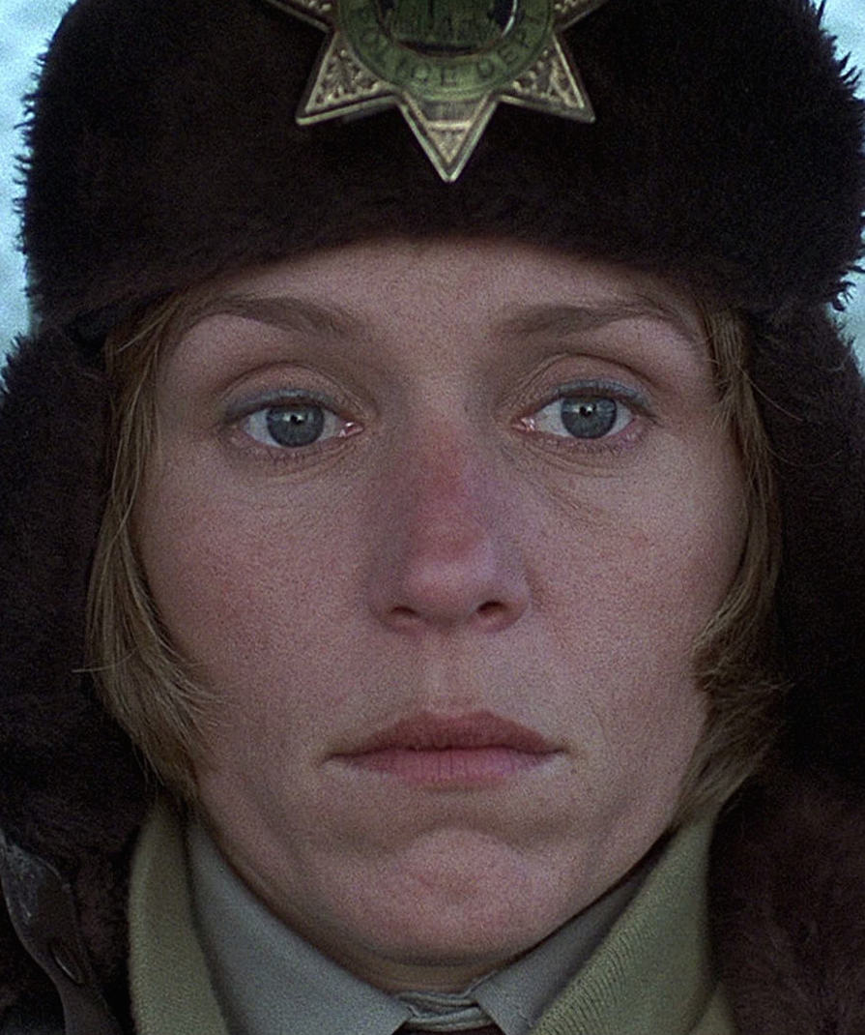
Calculating implicatures
Consider an example (from Fargo):
MARGE: Where is everybody?
LOU: Well – it's cold, Margie.

Slide 17
Calculating implicatures
1. There’s reason to presume that Lou is being cooperative.
2. Unless Lou thought that coldness were the reason why everybody is not here yet, Lou’s contribution would violate Quantity and Relation and so fail to be cooperative.
Lou thinks, and would expect Marge to realise he thinks, that Marge can work out that (2).

Slide 18
Calculating implicatures
Two questions:
Q1. Why have you produced precisely that utterance?
Q2. How can I answer Q1. in a way that treats you as adhering optimally to the Cooperative Principle and maxims?

Slide 19
Conversation and conventional implicature
Speaker meaning
What is stated
Implicature
Conversational implicature
Conventional implicature

Slide 20
Conversation and conventional implicature
(I) Conversational implicatures have to be computable through use of the co-operative principle and maxims. They can vary from occasion to occasion and knowing about them isn’t part of being competent with a form of words.

Slide 21
Conversation and conventional implicature
(II) Conventional implicatures may have an ultimate explanation by appeal to the co-operative principle and maxims. But they have been made habitual or conventional so that any use of a form of words that carries such an implicature will carry the implicature. And competent speakers will know this.

Slide 22
Conversation and conventional implicature
It’s controversial whether there really are such things as conventional implicatures. See Bach ‘Conversational Impliciture’ for discussion.
Even if there are, the ultimate explanation for their existence will often depend on appeal to something like the co-operative principle and maxims.

Slide 23
FOL and English
Consider an utterance of
“My partner is in Oxford or in London”
Some people judge that such an utterance would be false if the utterer knows his partner is in Oxford.

Slide 24
FOL and English
Similarly, suppose I say:
“I’ll be in my office from 2-3pm or I’ll be in my office from 3-4pm”
when I’ll be in my office from 2-4pm, and I know I will.
Is what I’ve stated true or false, or inappropriate?

Slide 25
FOL and English
Cases of this sort have suggested to some theorists that English ‘or’ has an exclusive reading: sentences in which it is the main connective are false if more than one disjunct is true.

Slide 26
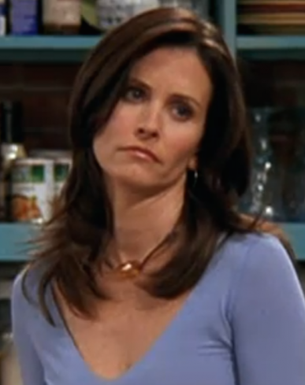
FOL and English
MONICA: Hi. Uh, my friend here was taking down our Christmas lights, and she fell off the balcony and may have broken her foot or ankle or something.
It seems clear that what Monica says is true even if Rachel had broken both her foot and her ankle.

Slide 27
FOL and English
If that’s right, we can’t explain the inappropriateness of my claim by appeal to the idea that English ‘or’ only takes an exclusive reading.
We might then try out the idea that English ‘or’ is ambiguous: sometimes it takes an exclusive reading and sometimes it takes an inclusive reading.

Slide 28
FOL and English
That’s not a very nice explanation.
First, it multiplies senses or meanings, so multiplies the number of particular things a speaker has to learn in order to become competent with this piece of English.

Slide 29
FOL and English
Second, it fails fully to explain the inappropriateness of the target claim. To get an explanation, we need to explain why we seem compelled to give some claims an exclusive reading, given that we don’t feel compelled with respect to other such claims, or other claims involving ambiguity.

Slide 30
FOL and English
“The fact that it would be inappropriate to say "My wife is either in Oxford or in London" when I know perfectly well that she is in Oxford has led to the idea that it is part of the meaning of "or" (or of "either ... or") to convey that the speaker is ignorant of the truth-values of the particular disjuncts” (8)
Note that Grice does not endorse this account.

Slide 31
FOL and English
This offers a more plausible hypothesis about the meaning of the English word ‘or’.
According to this hypothesis, the inappropriateness comes not from ‘or’ being exclusive but from ‘or’ requiring that utterers not know which disjunct is true.

Slide 32
FOL and English
‘A or B’ is true just when (1) ‘AvB’ is true, and (2) there is a non-truth-functional reason for believing ‘AvB’, that is a reason which is not straightforwardly a reason for believing that ‘A’ is true and which is not straightforwardly a reason for believing that ‘B’ is true. (Grice calls this the ‘strong sense’ of ‘or’)

Slide 33
FOL and English
The account is proposed as an account of the meaning of the English disjunction.
So construed, it is supported to the extent that it fits what we know about what is strictly and literally stated by the use of the English disjunction.

Slide 34
FOL and English
However, we’ve distinguished within the totality of what a speaker means by use of a disjunction:
What the speaker strictly and literally states.
What the speaker implicates.

Slide 35
FOL and English
(H1) The strong reading of the disjunction affects what is stated, and so traces to the literal or conventional meaning of the disjunction.
(NB: the conventional meaning NOT the conventional implicature.)

Slide 36
FOL and English
(H2) The strong reading of the disjunction or conditional affects only what is implicated, so is to be explained by appeal to the cooperative principle (general knowledge about rational communication) rather than literal meaning (specific knowledge about English, and about those words in particular).

Slide 37
FOL and English
We might hypothesise that if a speaker knew which disjunct were true, then the maxim of quantity would require them to give that information, rather than use the less informative disjunction. So, by using “or” they implicate that they don’t know which disjunct is true.

Slide 38
Signs of implicature
Grices razor (“Modified Occam’s Razor”):
“Senses are not to be multiplied beyond necessity.”
We know we need general principles governing rational communication. So, we get them for free in application to any particular case.
The very same general principles can do explanatory work for us over a wide range of cases.

Slide 39
Signs of implicature
3. By contrast, appealing to multiple senses, or multiple clause rules of use, has only particular application.
4. So, appeal to general principles is preferable, all else being equal.

Slide 40
Signs of implicature
Suppose, for example, that it turns out that both ‘A or B’ and ‘if A, B’ are subject to a ‘non-truth-conditional grounds’ condition.
One option is to write this into individual expression meanings, either as a conditional clause (“if X then give a non-truth-conditional ground reading”), or by way of ambiguity.

Slide 41
Signs of implicature
But that would involve counting the condition twice.
By contrast, if we can explain this by appeal to a single general principle, we can provide a simpler and more general account.
Hence, Grice’s Razor looks plausible.

Slide 42
Signs of implicature
Cancellability
Where a condition is carried by expression meaning, it ought to be in place whenever the expression occurs. It ought, that is, to have the force of an entailment of what is said by the use of the expression.

Slide 43
Signs of implicature
By contrast, where a condition is in place as an aspect of conversational implicature, it is typically cancellable.
That is, an implicature that arises in some cases might be prevented by explicit or implicit information to the effect that the speaker does not intend it.

Slide 44
Signs of implicature
“He is a bachelor. But I don’t mean to suggest that he’s unmarried.”
Here, one cannot cancel the message that the referent of ‘He’ is unmarried since this is carried by the meaning of ‘bachelor’.

Slide 45
Signs of implicature
In writing a reference for X:
“He has neat handwriting, but I don’t mean to suggest that he is not an excellent philosopher.”
Here, cancellability appears to hold.

Slide 46
Signs of implicature
There’s some plausibility to the claim that the “non-truth-conditional grounds” condition is cancellable:
“I’ll be in my office from 2-3pm or from 3-4pm. Indeed, I’ll be there from 2-3pm.”

Slide 47
Signs of implicature
However, there’s a potential difficulty here, since ambiguity often gives rise to an analogue of cancellability. One can make plain which of two (or more) meanings one intends to exploit by explicitly ruling out the other reading(s):
“He was in the grip of a vice. And I don’t mean the kind one uses for woodwork.”

Slide 48
Signs of implicature
Detachability
Except in cases where the maxim of manner is involved (‘cause this appeals to the specific way something is said), all that matters to an implicature is what is said plus background information and the principle and maxims.

Slide 49
Signs of implicature
Detachability
Suppose that one can say the same thing, or roughly the same thing, using different words. If the communicated message is the same, that suggests that it isn’t triggered by the words, but by what was said. And that suggests implicature.

Slide 50
Signs of implicature
One difficulty in applying this test is that it’s not always clear—and indeed, is one of things we are trying to establish—exactly when two utterances are cases of saying (roughly) the same thing.

Slide 51
Take home exercise
Find at least one apparent violation of each of the Maxims in this conversation:
MARGE Okay, I want you to tell me what these fellas looked like.
HOOKER ONE Well, the little guy, he was kinda funny-looking.
MARGE In what way?
HOOKER ONE I dunno. Just funny-looking.
MARGE Can you be any more specific?
HOOKER ONE I couldn't really say. He wasn't circumcised.
MARGE Was he funny-looking apart from that?
HOOKER ONE Yah…
In each case, what might be implicated?

Slide 52
Take home exercise
Consider our earlier hypothesis that English ‘and’ is ambiguous. What alternative hypothesis might be provided by appeal to implicature? Which of the maxims might be exploited here, and how? Is there reason to favour the implicature based account over the ambiguity account?

