Slide 1
J.S. Mill’s Utilitarianism (1861)
What is the highest good?

Slide 2
Moral Philosophy
Intro to moral philosophy
Focus on Mill’s Utilitarianism
Lecture 1: What is the highest good?
Lecture 2: Why be a utilitarian?
Lecture 3: Utilitarianism and Justice
Lecture 4: Does Utilitarianism undermine integrity?

Slide 3
Introduction to Moral Philosophy
Applied Ethics:
What are appropriate moral judgments in particular cases?
Normative Ethics:
What explains the content of moral judgments?
Meta-ethics:
What explains the status of moral judgments?
Moral Psychology:
What explains how people make moral judgments and their responses to them?
Branches of moral philosophy

Slide 4
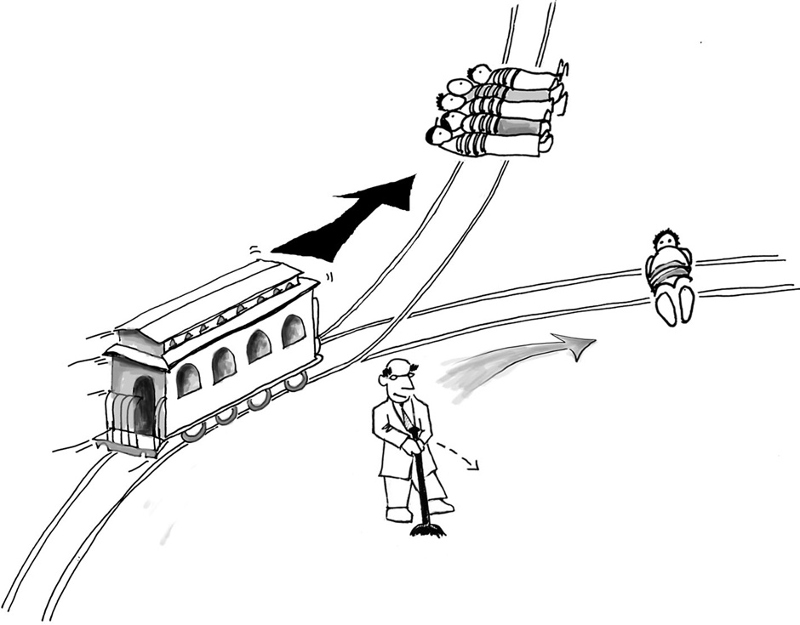
Trolley Problem: Should you pull the lever?

Slide 5
Consequentialism vs. Non-consequentialism
Is it about consequences or actions?
Yes, pull the lever – it’s for the greater good (utilitarianism)
No, don’t pull the lever – killing is worse than letting die (deontological ethics)

Slide 6
What is Utilitarianism?
Normative theory; Action guiding
Theory of the good
Welfarist theory (which consists in the experiences we have; individual welfare)
Consequentialist theory (impact on individual welfare)
Maximisation principle/Sum-ranking: best consequences determine by sum of individual happiness
(cf. Kantian –deontological– ethics, Virtue ethics)

Slide 7
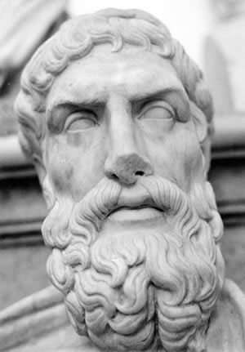
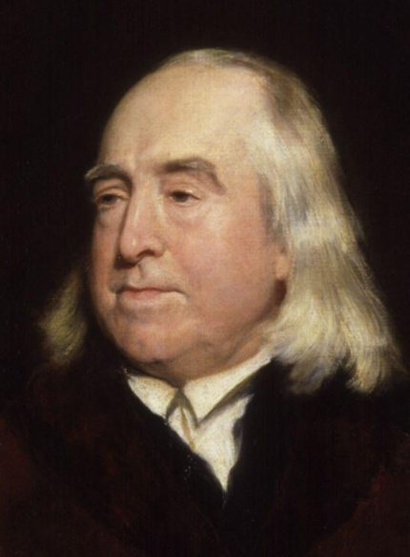
Hedonism and Utilitarianism
Epicurus (341–270 B.C): ‘Pleasure is our first and kindred good. It is the starting-point of every choice and of every aversion, and to it we come back, inasmuch as we make feeling the rule by which to judge of every good thing.’
Bentham (1748-1832): ‘Nature has placed mankind under the governance of two sovereign masters, pain and pleasure. It is for them alone to point out what we ought to do, as well as determine what we shall do’

Slide 8
Psychological vs. Ethical hedonism
Psychological hedonism: Happiness/pleasure is the ultimate motive that persons pursue
A theory about the motives of actions; about what is desired
Ethical hedonism: Happiness is the ultimate good
A theory about what is valuable or desirable

Slide 9
Principle of Utility
Mill: ‘actions are right in proportion as they tend to promote happiness, wrong as they tend to produce the reverse of happiness. By happiness is intended pleasure, and the absence of pain; by unhappiness, pain, and the privation of pleasure.’
Greatest happiness principle – balancing pleasure and pain
Individual – sum total of pleasures/happiness
Community – aggregate of individuals (sum-ranking principle)

Slide 10
Bentham’s Hedonism
Pleasure/pain are uniform experiences
Measure value of pleasure/pain according to:
Intensity
Duration
Certainty/Uncertainty
Propinquity or remoteness
Fecundity
Purity
It’s extent (no. of people affected)

Slide 11
Problem for Bentham
Quantity of pleasure matters
‘Prejudice apart, the game of push-pin is of equal value with the arts and sciences of music and poetry’ (Bentham)

Slide 12
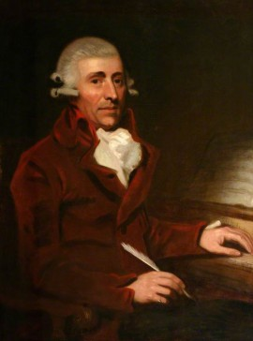
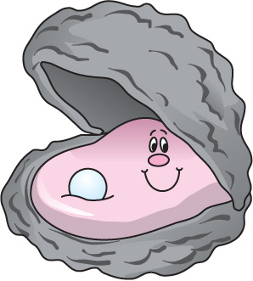
Problem for Bentham
Problem: ‘doctrine worthy only of swine’ e.g. Crisp’s Oyster and Hayden
Quantity can’t be all that matters

Slide 13
Mill’s revision of Bentham’s Utilitarianism
Mill on Bentham: ‘he was not a great philosopher, but he was a great reformer’
Mill: Quality of pleasure
Bodily pleasure vs. Bodily pleasure
Bodily pleasure vs. Intellectual pleasure

Slide 14
Mill’s Hedonism
‘it is quite compatible with the principle of utility to recognise the fact, that some kinds of pleasure are more desirable and valuable than others. It would be absurd that while, in estimating all other things, quality is considered as well as quantity, the estimation of pleasure should be supposed to depend on quantity alone’ (Utilitarianism, ch. 2)

Slide 15
Higher and Lower pleasures
What are lower pleasures?
Bodily sensations
What are higher pleasures?
Engage higher human faculties
Higher pleasures are different in kind from lower pleasures (not just more intense, or longer-lasting, etc.)

Slide 16
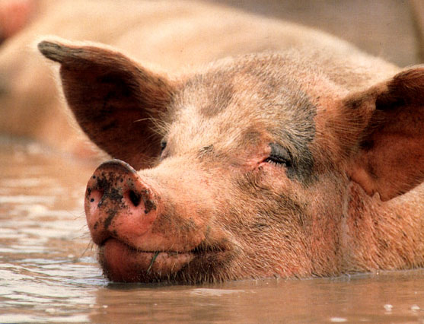
‘it is better to be a human being dissatisfied than a pig satisfied; better to be Socrates dissatisfied than a fool satisfied. And if the fool, or the pig, are of a different opinion, it is because they only know their side of the question. The other party to the comparison knows both sides’
(Mill, Utilitarianism, ch. 2)

Slide 17
How to we tell which are higher pleasures?
The role of competent judges:
‘Of two pleasures, if there be one to which all or almost all who have experience of both give a decided preference, irrespective of any feeling of moral obligation to prefer it, that is the most desirable pleasure.’
(Utilitarianism, ch. 2)

Slide 18
Objection to Hedonism (1): Happiness is elusive
Is happiness a self-defeating end?
Paradox of (psychological) hedonism: happiness is achieved only if it is not directly pursued (in terms of desire fulfiment) – what someone desires is not necessarily what’s best for them
Mill: Utilitarianism does not suggest that individuals ought to promote their own happiness
Is happiness unattainable?
But aiming for the prevention of pain is attainable
Mill: pleasure not constant but something to pursue

Slide 19
Objection to Hedonism (2a): Happiness is subjective
Metaphysical claim: experience of happiness is subjective
Sum-ranking principle can only be applied if the experience of happiness is the same for all individuals (i.e. objective)
Mill must claim that while there are different qualities of pleasure, and not all individuals necessarily experience the whole spectrum, our experience of pleasure of any one quality is the same

Slide 20
Objection to Hedonism (2b): Happiness is subjective
Epistemic claim: Individuals are best judges of their happiness
How do we know that the experience is the same?
Mill’s test: all judgment of those who have experienced different qualities of happiness

Slide 21
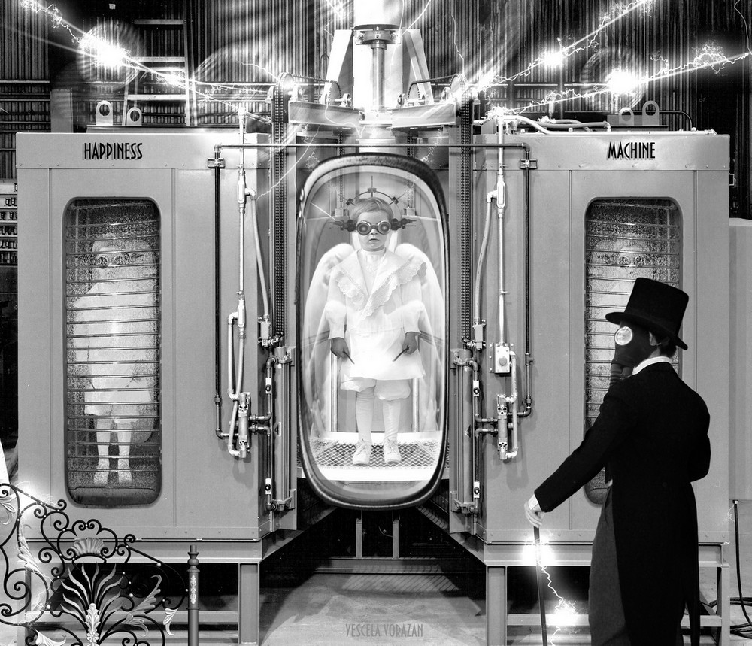
Objections to Hedonism (3): Against Experientialism
Robert Nozick’s experience machine

Slide 22
Questions ...
Is it only the consequences of our actions that matter in deciding what we ought to do?
Are there two distinct (and incommensurable) kinds of pleasures/pains (i.e. higher/lower)?
How might Mill account for our intuitions to the experience machine on his theory?
Can our experiences’ genuineness contribute to their enjoyability?

