Slide 1
PH336
Public Choice

Slide 2
Module Overview
Voters and Elections
Public Goods
Special Interest Groups
Institutionalism
Economics
Choices of households and firms
Political Studies/Science
Behavior of the state, institutions, power

Slide 3
The Public Choice Approach
In this module, I will take primarily a public choice approach to understand the four key topics: voters and elections, public goods, special interest groups, and institutionalism
Public choice - branch of political theory that applies the tools of microeconomics to study political behaviour (also called positive political theory, rational choice theory, political economy)
“Voters and customers are essentially the same people. Mr. Smith buys and votes; he is the same man in the supermarket and the voting booth”. (Gordon Tulloch)
Distinctive features:
Assumes (mostly) rational behaviour by voters, legislators etc. i.e. maximisation of some utility function
Voters, legislators are assumed to interact (“play games”) with well-defined rules: the “rules of the game” are simplified versions of real world constitutional rules
Relies on deductive reasoning, often using mathematical modelling
Intended to be “universally” applicable i.e. to all democracies
Generates testable predictions
First generation vs. second generation : more sophistication in modelling and much more empirical testing

Slide 4
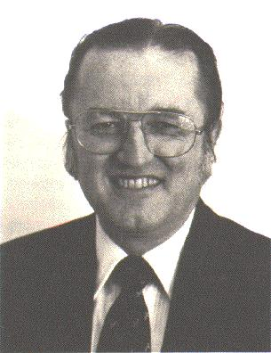
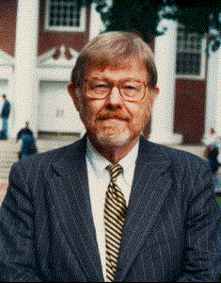
First Generation Public Choice: Some Key Figures
Duncan Black, in 1948 identified basics of median voter theory. He also wrote The Theory of Committees and Elections (1958), summarizing his work.
Anthony Downs, An Economic Theory of Democracy (1957), established the spatial or Downsian model of party politics
Mancur Olson (1965) - The Logic of Collective Action: Public Goods and the Theory of Groups; studied the formation of special interest groups

Slide 5
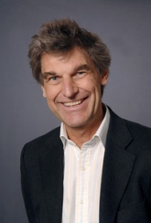
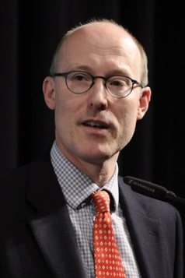

Second Generation Public Choice: Some Key Figures
Torsten Persson and Guido Tabellini, Political Economics (2000): Comprehensive theoretical textbook covering electoral competition, comparative politics, redistributive politics, applications to taxation, monetary policy and much more
Tim Besley, Principled Agents? The Political Economy of Good Government (2006): more accessible, empirical as well as theoretical, focus on government failure, views relationship between politicians and voters as a principal-agent relationship
Daron Acemoglu, two influential books, The Economic Origins of Dictatorship and Democracy, and Why Nations Fail, and much other work on institutions and growth, in particular the spread of democracy

Slide 6
Schools within Public Choice
Public choice is a method of analysis, not a political position: not everybody working in public choice is right-wing/”neo-liberal”/laissez-faire!
Stiglitz – a prolific Nobel prize winner who has made contributions to public choice - is now advising Jeremy Corbyn
First generation public choice tends to be more “anti-state”; view was that politicians and bureaucrats (indeed, all economic actors) only pursue their own interests and must be constrained by institutions and competition in order to protect the public
Virginia School (Buchanan and Tullock): emphasis on government failure, analogous to market failure, one influence on Reagan/Thatcher
Second generation has a much more sophisticated view;
individuals can be self-interested or public-service oriented
Also, they may be more or less competent at various political or bureaucratic tasks
Politicians may have better information than the public
Political institutions should not only provide incentives for politicians to behave, but should also select the best (most competent, most public spirited) candidates for office

Slide 7
Public Choice: the Bigger Picture
How does public choice relate to political science/studies? We look at this in two dimensions: research methods and methodology
Research methods: experiments, case studies, surveys, statistical analysis of data, mathematical modelling, etc.
Methodology In economics) : “methodology is that branch of economics where we examine the ways in which economists justify their theories, and the reasons they offer for preferring one theory over another” (Blaug(1992))
Methodology can be both descriptive - “this is what most economists do” - and a prescriptive one - “this is what economists should do to advance economics”. Blaug(1992))
Distinction important: academic disciplines can agree on methodology, but differ in research methods, or (possibly) vice versa
Chemists use lab experiments, astronomers do not, but both share a “naturalist” methodology of science

Slide 8
Positivist/Naturalist Methodology
Key Features (Moses and Knutsen, Ways of Knowing ):
Observable facts – there exist regularities or patterns in nature that can be observed and described
Sharp distinction between positive and normative statements
Methodological reductionism; the scientific attempt to provide explanation in terms of ever smaller entities e.g. biological phenomena can be reduced to chemical processes
In social science, known as methodological individualism
Principle of falsification – theories cannot be verified, only falsified (Karl Popper)
Testing of theories via experimental method where possible (treatment and control groups): but not always possible e.g. astronomy, social sciences

Slide 9
Public Choice and Positivism/Naturalism
Is public choice (and “neo-classical” economics generally) positivist? And does it matter?
Yes, neo-classical economics is generally positivist : BUT it is also a developing subject, and many criticisms made by non-neo-classical economists (e.g. Geoff Hodgson) and those outside economics are based on outdated, crude stereotypes
An example: the rational choice assumption
The basic assumption: individuals have preferences over possible choices, represented by a utility function, and make choices to maximize their own utility
Widely assumed in economics, but less so with the rise of behavioral economics (loss-aversion, framing, cognitive biases)

Slide 10
Public Choice and Positivism/Naturalism
But economics and economists often criticized for assuming that people are “selfish” i.e. do not care about the utility or consumption levels of others
This is a stronger assumption and is not required by neo-classical economics
Often made for simplicity/convenience only
Again, under revision due to influence of behavioral economics (conditional altruism)
Also, economics and economists often criticized for assuming that people are are perfectly informed
Since the 1970s, a huge amount of work has been done relaxing that assumption, and much of (most of?) the public choice literature does not make it
Many interesting “stylized facts” can only be explained by imperfect/asymmetric information

Slide 11
Politics and Economics- Contrasting or Converging Disciplines?
 | Economics | Political Science/Studies
Subject matter | Mostly economic behaviour, but also (increasingly) political behaviour and institutions | Political behaviour and institutions
Research methods | Mathematical modelling, statistical inference from a variety of data (official statistics, surveys), but increasingly experiments | Case studies and historical methods, some statistical inference from a variety of data, also mathematical modelling, but restricted to the public choice school
Rational choice postulate | Almost always (but not in behavioural economics) | Rarely, restricted to rational/public choice “school”
Methodological individualism | Yes, up to a point | Generally not
Exogenous Institutions | Usually, but not in rational choice institutionalism | No

Slide 12
Classification of Recent Articles by Research Methods
Method | Theory – mathematical model | Theory – other | Experiment or quasi-experiment | Statistical/ Econometrics | Case Study/ Comparative | Total
Economic Journal, Vol 119, Oct 2009 | 8 |  | 3 | 3 |  | 14
British Journal of Political Science, Vol 39, Oct 2009 |  | 2 |  | 3 | 4 | 9
Economic Journal, Vol 125, Sept 2015 | 3 |  |  | 7 |  | 10
British Journal of Political Science, Vol 45, Oct 2015 | 2 |  |  | 8 |  | 10
Articles with both theory and applied work are classified as both with 50:50 weights

