Slide 1

Introduction to PGR Study

Slide 2
Introductions – Thinking About Doctoral Study
The aim: help you understand what doctoral study involves, whether it is right for you, and how to take next steps if you are interested.
Tom Perry – SELCS PGR Director
Emma Langley – ES PGR Lead
Stephanie Schnurr – AL PGR Lead
Phil McCash – CLL PGR Lead
Professional services team: Laura, Amy, Donna (SELCSresearchandPGR@warwick.ac.uk)
The PGR Team:

Slide 3

What is Doctoral Study?
A doctorate is a sustained piece of independent research that contributes new knowledge or understanding.
Main route: MPhil/PhD
Other courses: EdD, Dphil, AppEdPsyD etc.
In short: You work closely with one or two supervisors; you shape the project with their guidance.
It is a long-term academic and professional commitment rather than a taught course.

Slide 4
Why Do People Do a Doctorate?
People start doctorates for different reasons, including:
Curiosity and intellectual interest.
Career development, in academia or beyond.
Professional expertise and specialisation.
A desire to tackle a real problem or question that matters to them.
Personal motivation and long-term goals.
Earnings?
Employment?
Fulfilment?

Slide 5

What Is It Like to Be a PGR Student?
Regular supervision meetings (usually monthly).
Research methods training in your department and through the Doctoral College.
Academic activities: seminars, reading groups, conferences.
Support from supervisors, PGR Leads, and professional services PGR SELCS
A mix of independence and support
The highs: freedom, depth, expertise, community
The challenges: uncertainty, self-management, time pressure.

Slide 6
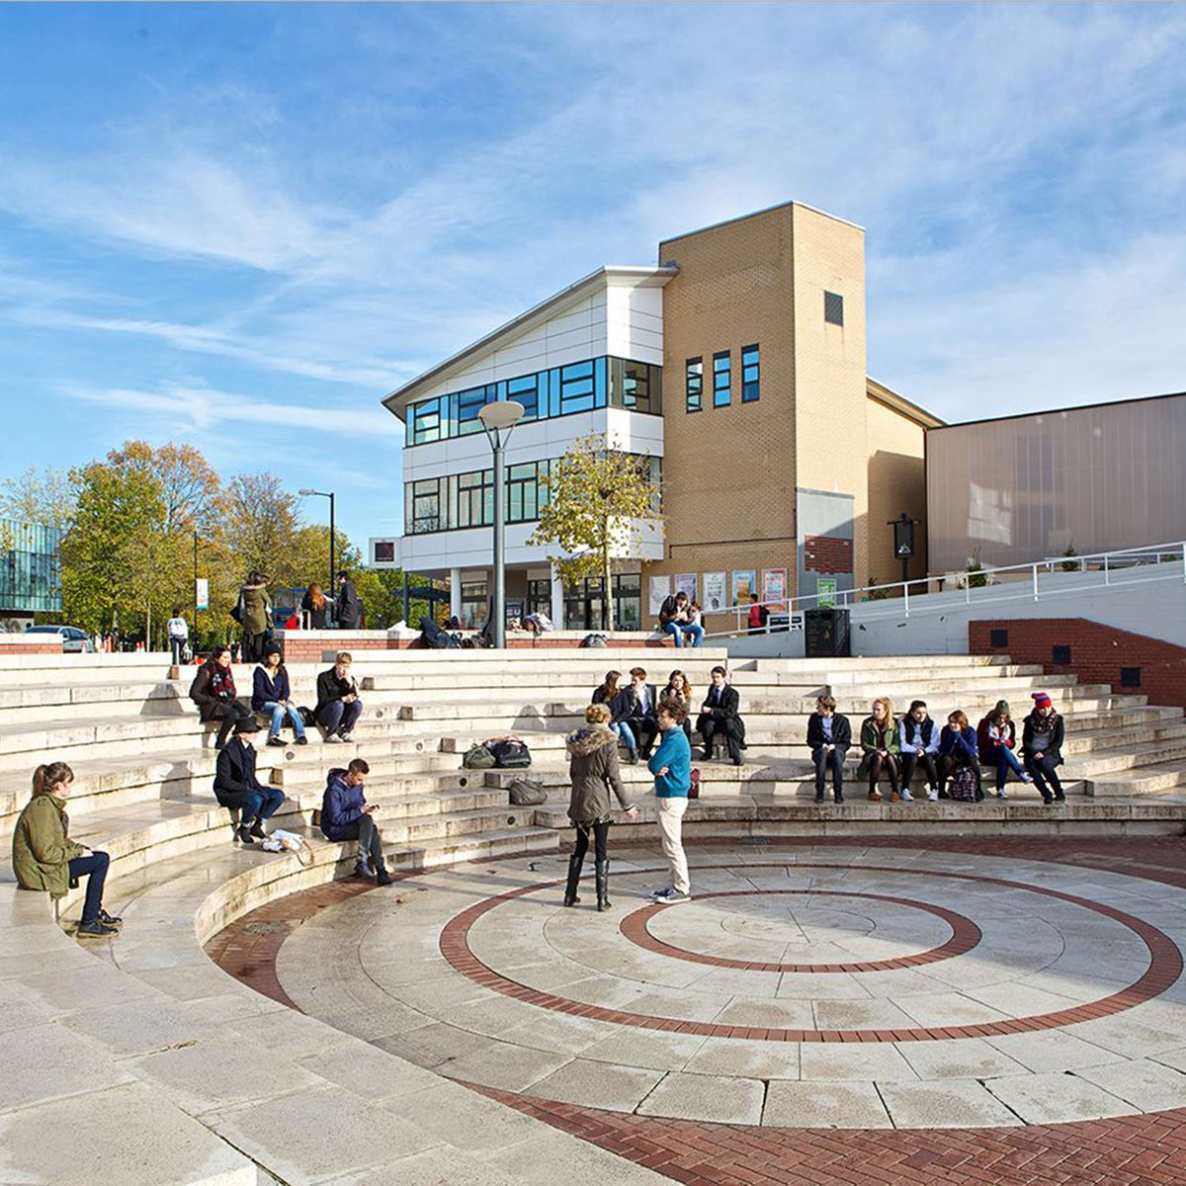
The SELCS Research Environment
One school with four centres:
Applied Linguistics
Education Studies
Lifelong Learning
Teacher Education.
Interdisciplinary research culture, strong networks, varied seminars and events.
~1,000 students and 200 staff across the school
Community of c. 150 PhD researchers
Opportunities to join research groups, attend seminars, contribute to the PGR community.

Slide 7

Postgraduate research (PhD)
Centre for Education Studies
MPhil/PhD in Education
MPhil/PhD in Education and Psychology
Centre for Lifelong Learning
MPhil/PhD in Adult Education and Lifelong Learning
MPhil/PhD in Open Professional Studies
MPhil/PhD in Social Policy and Social Work
Centre for Teacher Education
MPhil/PhD in Education
Notes:
FC – Background and challenges – both slides – 13:25 – 13:30

Slide 8

Postgraduate research (PhD)
Applied Linguistics
Applied Linguistics MPhil/PhD
English Language Teaching MPhil/PhD
English Language Teaching and Applied Linguistics MPhil/PhD
Discourse Studies MPhil/PhD
Intercultural Communication MPhil/PhD
Linguistics MPhil/PhD
Notes:
FC – Background and challenges – both slides – 13:25 – 13:30

Slide 9
Our Expertise and Postgraduate Research (PhD) Supervision
The School of Education, Learning and Communication Sciences is a large, interdisciplinary department and can offer PhD supervisory expertise across disciplinary areas and in distinctive specialist topics:
Language, Communication & Linguistics
English language teaching and assessment
Intercultural communication and multilingualism
Discourse, pragmatics and sociolinguistics
Language policy and planning
Technology and AI in language learning
Teacher Education & Professional Learning
Initial teacher education and mentoring
Professional identity, reflection and resilience
Coaching, feedback and CPD
Practitioner research and enquiry
Curriculum, pedagogy and assessment reform
Digital and blended learning
Education, Learning, Society and Policy
Educational inequalities and inclusion
Education policy, leadership and improvement
Wellbeing, motivation and learner agency
Education and psychology
Sustainability and environmental education
Migration, language and identity
Creativity and arts-based research
Lifelong & Adult Learning
Adult and community education
Career development and work-based learning
Lifelong learning, ageing and intergenerational learning

Slide 10
What Makes a Good Doctoral Topic?
A strong topic tends to be:
Focused enough to be researchable within 3–4 years.
Grounded in a clear problem, debate, or gap in the literature.
Feasible in terms of methods, access, and ethics.
Connected to existing strengths within the school.
Motivating enough to sustain your interest over time.

Slide 11

What Should You Think About Before Applying?
Time commitment (especially alongside work or caring responsibilities).
Funding and financial planning.
Whether you enjoy independent research.
What you want to do afterwards.
How it fits with your personal and professional life.

Slide 12
The Application Process (Step by Step)
Read about our programmes and research areas.
Develop an initial idea or question.
Draft a short research proposal outline.
Identify possible supervisors and check their publications.
Contact prospective supervisors with a brief summary and CV (usually not a full proposal).
Refine your proposal with feedback.
Apply through the Warwick online system.
Prepare for potential interview.
https://warwick.ac.uk/fac/soc/selcs/applyingpgr/
https://warwick.ac.uk/fac/soc/ces/prospective/postgraduate/research

Slide 13

Finding the Right Supervisor
• Use staff profiles and publications to find research alignment.
• Look for someone working in your field or method.
• Contact them with a short, focused message: topic, why them, your background.
• Keep an open mind about who might be a good fit; your preferred person may not always have capacity.
• A good supervisor-topic match is more important than a “big name”.

Slide 14

Writing a Strong Research Proposal
Include:
• A clear research question.
• Why the topic matters (the rationale).
• Brief literature positioning.
• Proposed methods and data.
• Feasibility and ethics.
• Fit with Warwick and potential supervisors.
• A short list of relevant references.

Slide 15
Scholarships and Funding
They are many funds out there – but they competitive!
ESRC Midlands Graduate School DTP.
Chancellor’s and departmental scholarships.
International scholarships and national funding schemes.
Often highly competitive; many expect a strong proposal and CV.
Check closing dates early – they often fall in January or February.
Further details at:
https://warwick.ac.uk/study/scholarships-and-bursaries/scholarships
There are upcoming deadlines for the central PGR scholarship competitions for Sep26 entry: 8th Dec for course applications and 11th Dec for scholarship applications.
See: Warwick PGR Scholarship Competitions

Slide 16
Careers After a Doctorate
A doctorate leads to various paths:
Academic careers and teaching in HE.
Research roles in government, think tanks, NGOs, charities.
Educational leadership, policy, consultancy, evaluation
Professional practice: teacher education, curriculum design, language education, adult learning.
Employment routes vary; the degree is not only for academics.

Slide 17
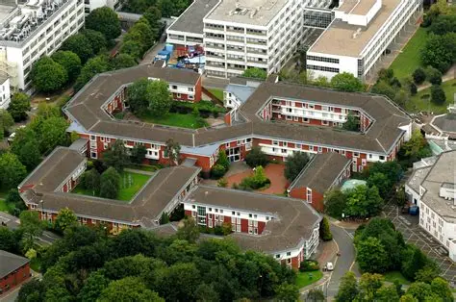
Final Advice
Start reading around your area now.
Talk to potential supervisors early.
Be realistic about scope and methods.
Choose a topic you are prepared to “live with” for several years.
Think ahead to funding deadlines.
Remember that doctoral study is intense but also rewarding.

Slide 18

Questions and Discussion
Common questions:
Am I academically ready for a PhD?
What if my English or academic writing needs development?
Can I study part-time?
How fixed does my topic need to be?
How do I balance a doctorate with work?
What support is available during the programme?

