Slide 1

PGCert in Transferable Skills
(PGCTS)
Dr Daniel Franklin

Slide 2
Student development
Your PhD develops your disciplinary expertise. PGCTS helps you develop how you work as a researcher and professional.
‘Essential’ skills boost income, predict job satisfaction, increase life satisfaction, decrease unemployment (Skills Builder Partnership, 2023)
“The labour market of most doctoral candidates will be outside academia.” (71%) – European University Association, (2025).
Overall student development is key to your progress while a PhD student.
We, the institution that is delivering your discipline specific education, is also telling you that (transferable) skills are important.

Slide 3

Student development is part of doctoral education
UKRI – fund half of the PhDs at the university. Hold universities to account – are students getting what is best for them? Through funding disciplinary research, UKRI interest is in the students’ overall experience and benefits.
transferable skills are non-negotiable. Core part of being prepared for careers in and out of academia (UKRI statement on doctoral training, 2024).

Slide 4
PGCTS
Through the programme, you will develop and apply skills in areas such as:
communication and collaboration
project management
reflection and self-awareness
planning, adaptability and professional judgement
applying/transfering your skills beyond your immediate research project
The aim is not simply to attend training, but to become more deliberate, effective and adaptable in how you work.
…because being a subject expert alone is unlikely to be enough.

Slide 5
Marginal gains
You are going to be an expert in your field.
You may or may not continue to work in that field.
There are always other candidates.
You will be elite, and to get ahead, you will only get marginal gains…

Slide 6
Capability development
The PGCTS has training…
But there is equal focus on developing skills as part of your PhD.
i.e., within your discipline, but not about your discipline.
Skills for your PhD and for all careers, academic and non-academic
There is progression of those skills.
There is flexibility and student responsibility for shaping the development.

Slide 7
PGCTS
PG Certificate in Transferable Skills: Total 6 modules × 10 credits each. Usually, 2 per year.
PG Award in Transferable Skills: Total 2 modules × 10 credits each.
Standards and progress are formally overseen by the Exam Board. In practice you deal mainly with your supervisor and departmental Director of Graduate Studies (or equivalent).
This is training held to an academic standard.

Slide 8
Structure of the course
Year 1 | Doctoral Skills 1 | Option
Year 2 | Doctoral Skills 2 | Option
Year 3 | Doctoral Skills 3 | Option

Slide 9
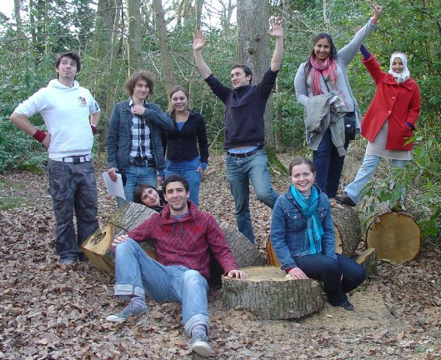
Option modules
‘Building collaborative professional relationships’ *
Communicating with non-specialists *
Decision-making & Leadership *
Research Ethics & Practice *
Business, Innovation & Commercialisation
Project management *
App development: From ideas to practical tools
Languages
Intro to teaching
Scientific writing for publication (SEM only)
You can really do as many as you like, when you like.

Slide 10
Doctoral Skills (core) modules
In these modules you gather evidence of what you are already doing.
Doctoral Skills 1-3 cover the skills needed and used by PhD students.
You collate a portfolio based around your research activities.
Tasks supported by supervisor feedback.

Slide 11
Doctoral Skills assessment
Assessment | DS1 | DS2 | DS3
1. Research Plan, literature review, project budget & risk analysis | x | x | x
2. Time Management | x | x | x
3. Critical review | x | x
4. Networking | x | x | x
5. Oral Presentation | x | x | x
6. Applications of research / Intellectual Property (IP) | x | x
7. Teaching / Supervision |  | x | x
8. Career Development | x | x | x
9. Problem Solving | x | x | x
10. Communication to Non-Specialists | x | x
11. Ethical principles | x |  | x
12. Skill transfer |  |  | x

Slide 12
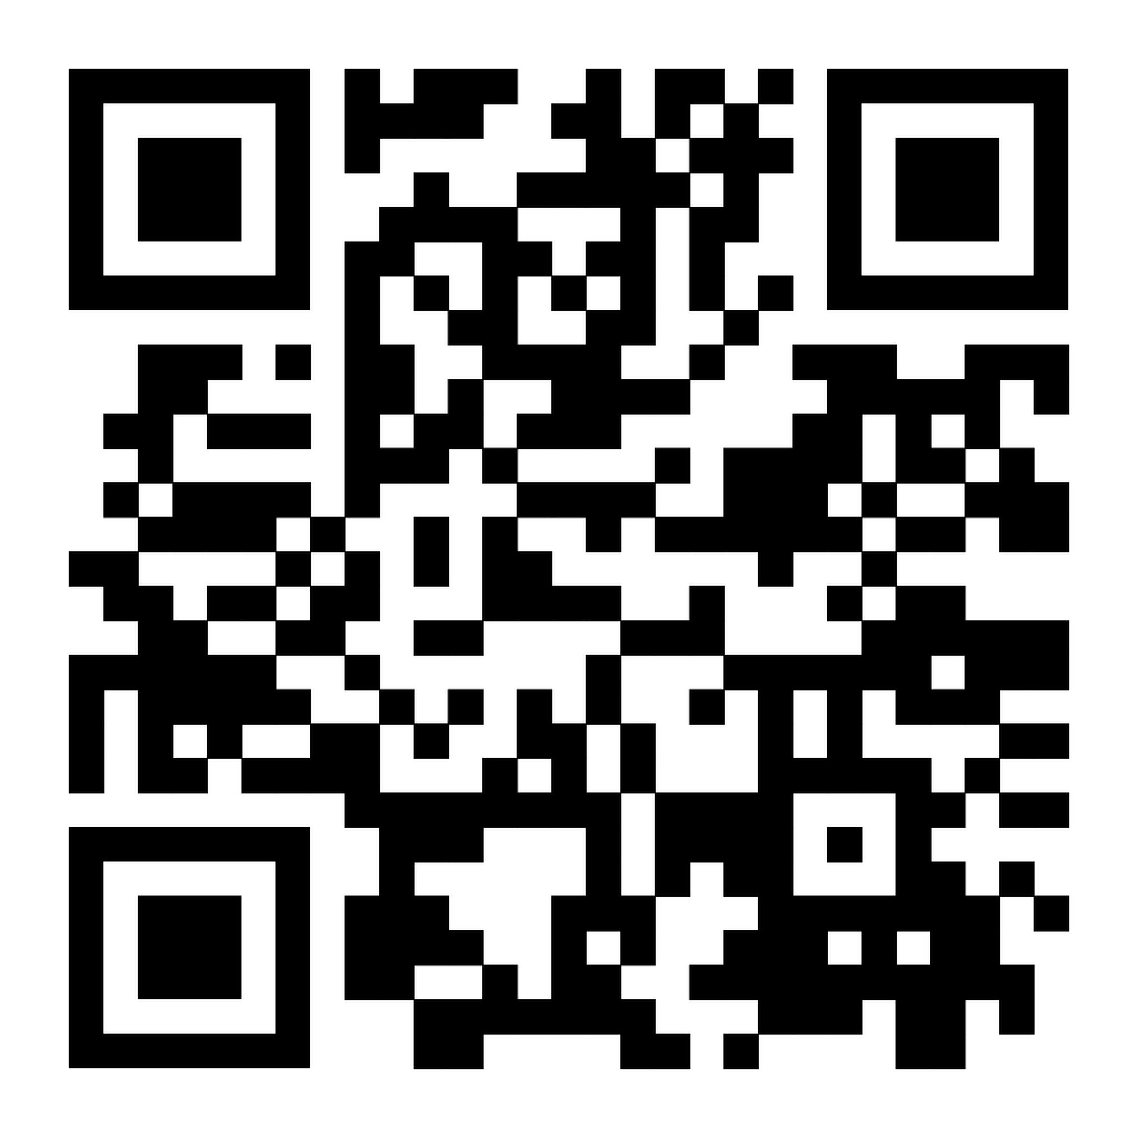
What to do…
Go to Transferable Skills website:
warwick.ac.uk/transferableskills
Sign up for Doctoral Skills 1 in SkillsForge
Pick some options according you your interests.
Any questions, email: transferable.skills@warwick.ac.uk
Notes:
QR code

Slide 13

Always focus on your development…
It will be as important as your degree(s)
Notes:
By the end of your PhD, don't just be able to say what you know.
Be able to show how you work, what you can do, and how you've developed.

