Slide 1


Welcome!
PGR Induction – School of Education, Learning and Communication Sciences
1st October 2026
Tom Perry SELCS PGR Director
Emma Langley ES PGR Lead
Stephanie Schnurr AL PGR Lead
Phil McCash CLL PGR Lead

Slide 2
Initial Introductions
Welcome
Names – you/us
Where are you from?
Your doctorate – what topic will you be studying?
Any questions you have right now?
Please take a label and pop your preferred name on it

Slide 3
Today’s Agenda
10am: Welcome & introductions
  Getting to know you (and us)
  Research in SELCS – Why do we do it? What makes for good research?
  Research methods training
  Some key information about your PGR programme and what to expect this year
  Postgraduate Certificate in Transferable Skills
12pm-1pm: Light lunch
1pm-2pm: Break out meetings with ES, AL, & CLL PGR Leads
2pm-3pm: Current PGR Q&A panel: meeting current PGRs

Slide 4

Take a moment to think about the following. When you are ready, talk to someone next to you about these questions.
Why are you doing a doctorate?
Why have you chosen your topic?
What is the context of your research? Why is this important to you?
What approaches will you use to research your chosen area? Why?
What are you most looking forward to with your doctoral studies?
What are you most nervous about?

Slide 5
Thinking about your field and becoming a researcher…
1. Why do we do research?
2. What makes for ‘good’ research?

Slide 6
Research methods training

Slide 7
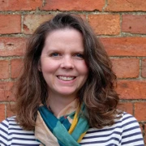
SELCS Research Methods training
Module leader: Prof. Emma Smith (right)
Build on and extend your understanding of research methods
Develop a critical, flexible (and potentially interdisciplinary) approach to research methodologies
Delivered by researchers from across SELCS
Sessions on Wednesday afternoons, 4-6pm, throughout the year (plus 1 hour drop in session each Wednesday at 3pm)
Attendance expected for Year 1 PGRs, those who have completed upgrade can attend any sessions of interest
Further information available on Moodle
E.Smith.22@warwick.ac.uk

Slide 8
University research methods & skills provision
Doctoral College
  Researcher Development Programme
Library
  Inc. Research training and events
IT Services
  Inc. IT Induction
Research ethics online courses (link)
Preparing to teach (ADC – link)

Slide 9
Key information

Slide 10
Supporting you with your studies…
Supervisor/s (meetings in person)
Centre PGR Leads (Emma, Steph, Phil)
SELCS PGR Director (Tom)
Professional services support (Laura, Jacob, Donna) SELCSresearchandPGR@warwick.ac.uk, office C1.10 (Social Sciences)
Personal Tutor
University support – Wellbeing Services, Student Union, Disability Services, Doctoral College, Researcher Development (all hyperlinked)

Slide 11
Some useful links
The Doctoral college:
  https://warwick.ac.uk/services/dc/
  https://warwick.ac.uk/services/dc/eventsandopps/welcome/
Researcher development:
  https://warwick.ac.uk/services/dc/research/pgr/
Wellbeing:
  https://warwick.ac.uk/services/wellbeing
  https://warwick.ac.uk/fac/soc/al/intranet/wellbeing/

Slide 12
Social Support and Engagement
Postgraduate community
Broader community of students within SELCS
  Opportunities and events within the department/school: research seminars, teaching opportunities, reading groups etc.
Annual school PGR research conference
Opportunities to mix with others beyond SELCS

Slide 13

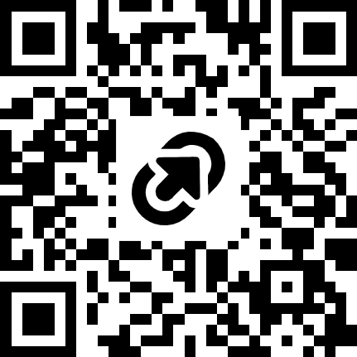
Sunday Education, Learning and Communication ‘Shut up and Write!’ group
Monthly online Teams meetings, 9.20-12.00pm, second Sunday of the month
Flexible space for writing or working on an academic project
For students and staff in Education, Learning or Communication (broadly defined), at Warwick and beyond
Open to all; part-time, time-poor and those experiencing challenges particularly welcome
https://tinyurl.com/SundaySUAW

Slide 14
Academic commitments
Research methods training
Regular supervision (FT/PT)
Completion of ethical approval form – aligned with upgrade process
Upgrade to PhD status
Annual reviews of progress [all years, every year]
Delivery of seminar linked to your work
Final submission and viva

Slide 15
Important information
Study rooms dedicated to research students (see your handbook)
You are welcome (and encouraged) to use the Staff/PGR Common Room and Kitchen (1st floor of this building)
Notifications via email or via the PGR Announcements Moodle (appear as an email)
Your PGR students’ handbook:
  please read this carefully and return to it each year at least

Slide 16
Student voice
Informally with tutors and supervisors
PGR Leads – we are always happy to hear from students
Staff-student liaison committee (SSLC)
University student voice activities and complaints procedure
PRES Survey: https://www.advance-he.ac.uk/reports-publications-and-resources/postgraduate-research-experience-survey-pres

Slide 17
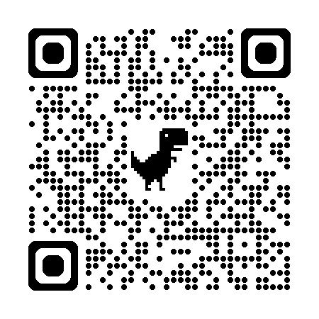
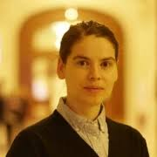

SELCS SSLC (Student-Staff Liaison Committee)
Academic Convenor: Dr Georgiana Mihut (Georgiana.Mihut@warwick.ac.uk)
Your voice on research training, supervision processes and PGR support
Student-led, supported by staff; feeds into Faculty and University decisions
Open to full-time, part-time and distance PGRs across SELCS
Sign-up information coming soon

Slide 18
Get involved…
PGR Community roles will be advertised soon.
Why is it good to get involved?
SSLC reps needed
PGR Seminar Convenors
Conference committee
Teaching experience/opportunities
Other ideas very welcome

Slide 19
Year 1 – what should I expect?
PhD (FT) YEAR 1 – orientation, literature review, research methods training, preparation of upgrade paper and ethics form(s) (upgrade in months 9-13)
PhD (PT): YEAR 1 – orientation, literature review, research methods training (upgrade in months 21-24)

Slide 20
Systems
Tabula (supervision records, monitoring points, personal tutor meeting records)
Moodle (research methods resources and information, announcements)
Teams (sessions, online meetings)
Warwick email (please check regularly and use for communications with staff, other students as needed)
Spend some time exploring and familiarising yourselves with these systems. But don’t worry – we’ll send further information about all of this as needed.

Slide 21
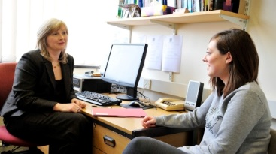
Personal Tutoring/Advising
Personal Tutors/Advisers are an accessible, approachable point of contact with your department.
Most students are assigned their own personal tutor.
Your personal tutor will provide academic and personal support throughout your time at Warwick.
Your personal tutor belongs to a strong university wide personal tutor system led by the Dean of Students’ office and supported by other university services.

Slide 22
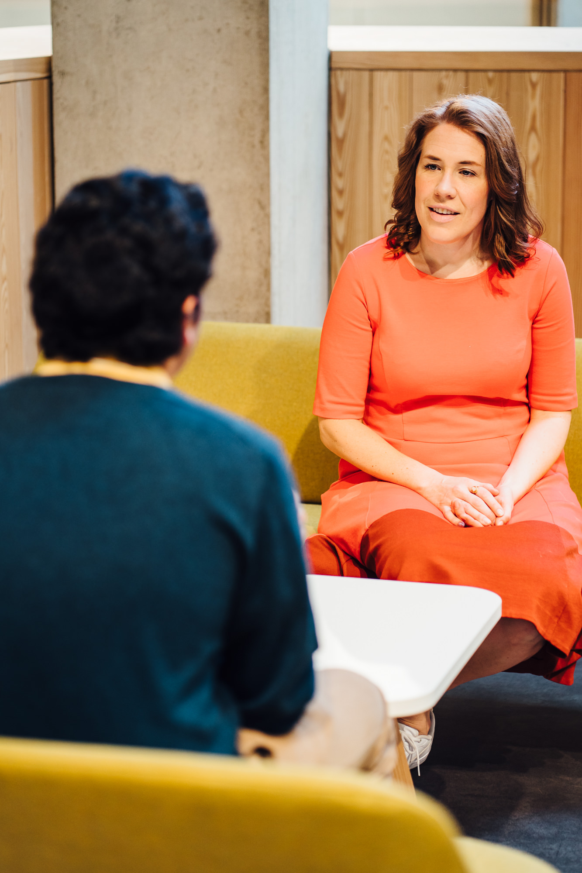
Personal Tutor/Adviser & PGRs
As an outsider to the supervision relationship, your personal tutor can be an independent listener/advisor who will treat your meeting as confidential*
Can also be a good place to discuss more personal issues
Your supervisor may also suggest that you speak to your personal tutor
*Personal Tutors are required to treat your conversations as confidential and only to disclose to a third party by agreement with the student or if there is reason to believe that there is risk of harm to the student or others.

Slide 23

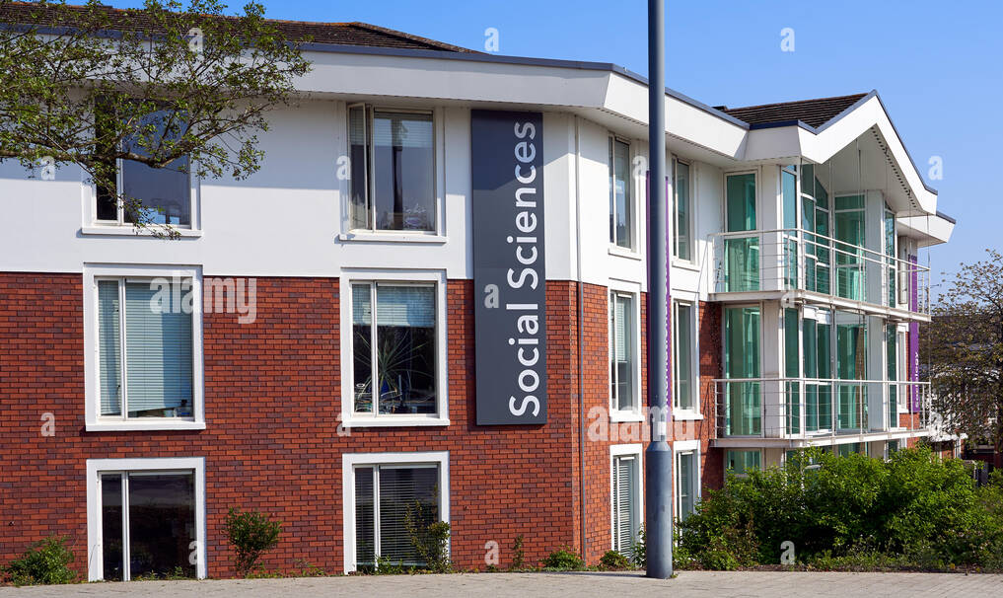
Your Personal Tutor/Adviser
Tabula
  Your profile will include details of your Personal Tutor (once we have allocated them)
Where are they located?
  In Social Sciences Building and Lifelong Learning Building
  ES, AL & CLL websites list room numbers and contact details

Slide 24
SELCS PGR Professional Services
Donna Jay
Laura Larard
Jacob Williams
Located in C1.10 (Social Sciences)
Please feel free to email us at SELCSResearchandPGR@warwick.ac.uk

Slide 25
SELCS PGR Professional Services
What we can help with:
Specific queries about anything to do administratively with your degree: annual reviews, upgrades, supervision, change of circumstances, and more!
General university enquiries.
Signposting to other university services.
We’re always here to help, so please do get in touch!

Slide 26
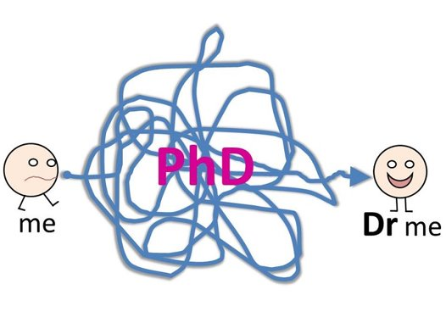
Enjoy the journey!

Slide 27
Any questions?

Slide 28


Slide 29
Current PGR students - introductions
Name
Where are you from? What did you do before/during doctoral study?
Research topic and interests
Any wider roles, experiences, jobs…

Slide 30
Discussions with our PGRs
3. How does supervision work? How can I get the most out of it?
2. How do I engage with the literature in my chosen area?
1. Tell us about Year 1. What should new PGRs know?
6. What are the best things about doing a doctorate? What are the main challenges?
4. How do I meet people and develop networks connected to my research?
5. What is the Upgrade process? What is it like?

Slide 31
Any questions?

Slide 32
Next induction activities
Wednesday 7th October | 14:00-15:00 Research Exchange, Floor 3, Library | Introduction to the Library Led by Christine Bradford from the Library, this session will help you navigate resources and tools available to researchers
 | 16:00-18:00 P5.21, Physics | Postgraduate Research Methods The first of our weekly Postgraduate Research Methods sessions. These sessions are designed to help postgraduate researchers build confidence in key research concepts, approaches, and skills, while providing opportunities to learn from others and engage with the wider research community throughout the year. The sessions will run in the same slot, weekly during term time.

Slide 33

Thank you for your participation today ☺
If you have any questions or worries, stay behind for a moment now or email us after the session.
Tom: tom.perry@warwick.ac.uk
Emma: E.Langley.1@warwick.ac.uk
Steph: S.Schnurr@warwick.ac.uk
Phil: p.t.mccash@warwick.ac.uk
PGR team: SELCSResearchandPGR@warwick.ac.uk

