Slide 1

Increase student motivation with digital badges

Slide 2



Agenda
What are badges and why use them
Uses
Timing
Examples
Considerations
Process
Resources
Demo

Slide 3

What are digital badges?
Digital badges in education are electronic symbols used as micro-credentials to declare and document achievement or skills mastered in different learning settings.
They contain metadata with info on the learner, the badge issuer, and the evidence submitted to earn the badge.
“Originating from game-based learning environments and massively open online courses (MOOCS), badges are seen used in a variety of context, including recognizing skill-based competencies, participatory awards, professional development and digital portfolios” Reid et al, 2015.

Slide 4

“digital badges are online representations of learning experiences and activities that tell a story about the learner’s education and skills”
Gamrat et al., 2014.

Slide 5
Why use them?
they offer a credible way for learners to establish portfolios and express knowledge
they help promote lifelong learning and CPD
gamification is being widely introduced as a strategy to improve learner engagement
they help drive learner motivation, engagement and satisfaction in the long term.
they are easily shared over social networks
they can help to improve course completion rates
they motivate students to develop new skills

Slide 6
Potential uses
certify the assessment and skill mastery of learner
gauge what learners are interested in and engaging with most - aligning learning goals with outcomes.
monitor student performance
potential employers can use them to validate skills and knowledge
students can showcase soft skills

Slide 7
When to use them?
completion of a short course
completion of one (substantial) unit of a long course or module (e.g. PrEnq or PP)
completion of a special (substantial) task e.g. facilitating an online course or supporting peers to an extraordinary degree.
after attendance at a conference/short course/training session
Ad-hoc – consistently demonstrating WTV

Slide 8



Examples

Slide 9

Considerations
Design
Dissemination and delivery
Impact measurement – collect data on participation and completion rates. This can be checked in Moodle.
Micro badges V Master badges
How hard to obtain -they should not be too easy to get (e.g., not just for a single forum post, but for contributing to forum posts across a whole semester).
Don’t issue too many
Use only if student are gaining additional, digital or academic/employability/career skills.
Professional Vs Fun
How do they align to LOs?

Slide 10
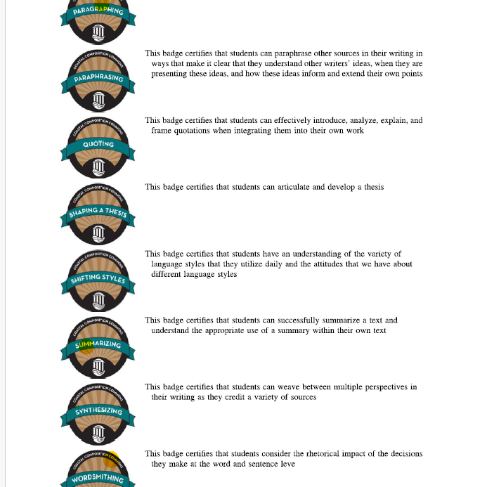
What are the learning Objectives of each badge? Image taken from Reid 2015 paper.C:\Users\u2070903\OneDrive - University of Warwick\digital badges paper 2.pdf

Slide 11
Process
Set clear criteria and standards for awarding the microcredential and determine if it will be standalone or stackable for academic credit.
Create a dissemination plan to inform the trainees and staff about the microcredential's value and evaluation process.
Define the look and feel of the badge and its content.
Measure the impact of microcredentials by collecting data on participation and completion rates

Slide 12

The visual recognition and sense of accomplishment associated with badges can boost motivation, encouraging students to set and achieve goals.

Slide 13
Badge Resources
Tools to design your own badges:
Google Drawings
Canva
Adobe Spark
Badging Systems
Badgelist.com
Canvas (Badgr is integrated)
Add-On for Google Sheets: Magic Digital Badges

Slide 14

Demo time
Create a badge in Canva
Upload it to Moodle
Create an account in Badgr
Brand colours

Slide 15
Further resources
Guidance
https://docs.moodle.org/403/en/Badges
https://www.timeshighereducation.com/campus/how-design-and-build-microcredentials-four-steps
https://www.digitary.net/the-value-of-digital-badges-in-the-education-sector/
https://educationaltechnologyjournal.springeropen.com/articles/10.1186/s41239-019-0175-9#Sec15
Papers
https://arrow.tudublin.ie/cgi/viewcontent.cgi?article=1062&context=ijap
https://link.springer.com/journal/10639/volumes-and-issues

