Slide 1
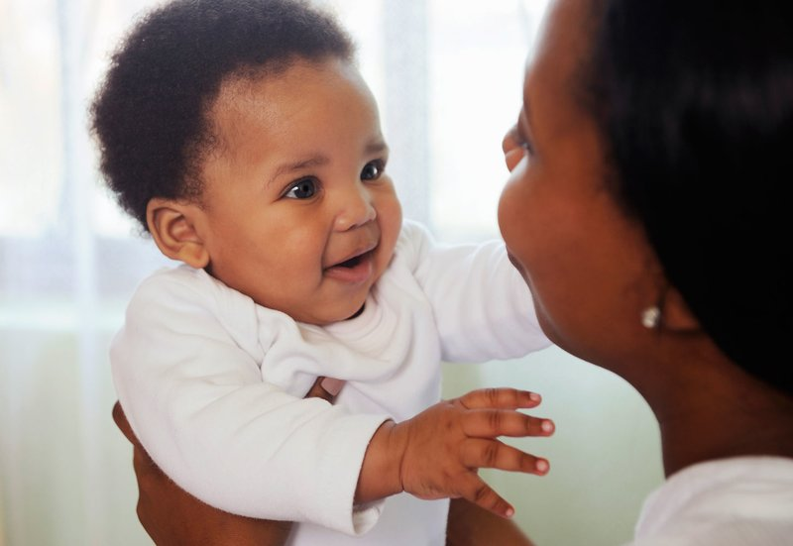
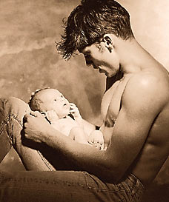
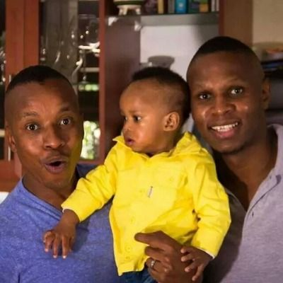
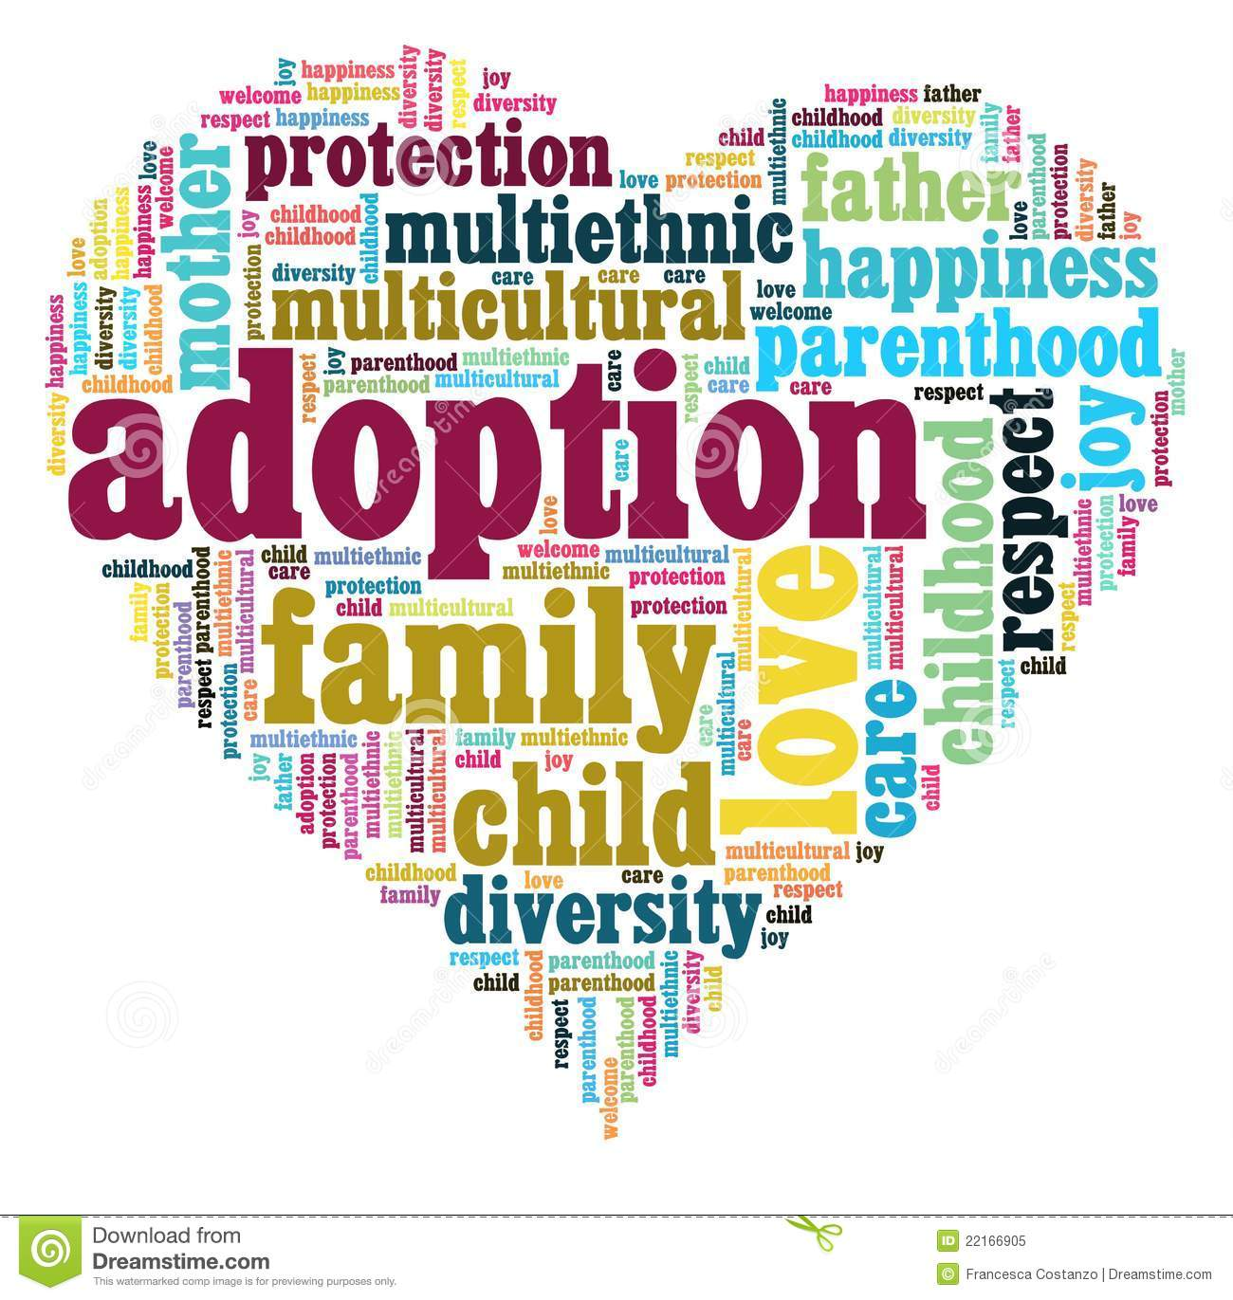
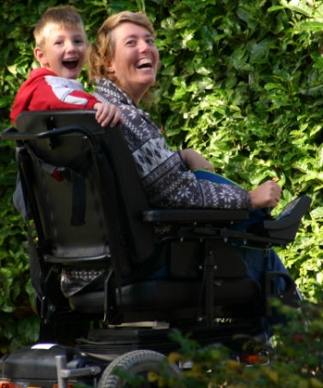


Transformations: Gender, Reproduction and Parenting in Contemporary Society
2020/21
Intermediate Year
SO231-15
Caroline Wright
Option Overview
c.wright@warwick.ac.uk
Notes:
Hello everybody! I’m Caroline Wright and I teach the intermediate year Sociology module Transformations, SO231. It’s 15 CATS and at the moment it’s planned to run in the Spring term, with the summative assessment due after the Easter vacation.

Slide 2
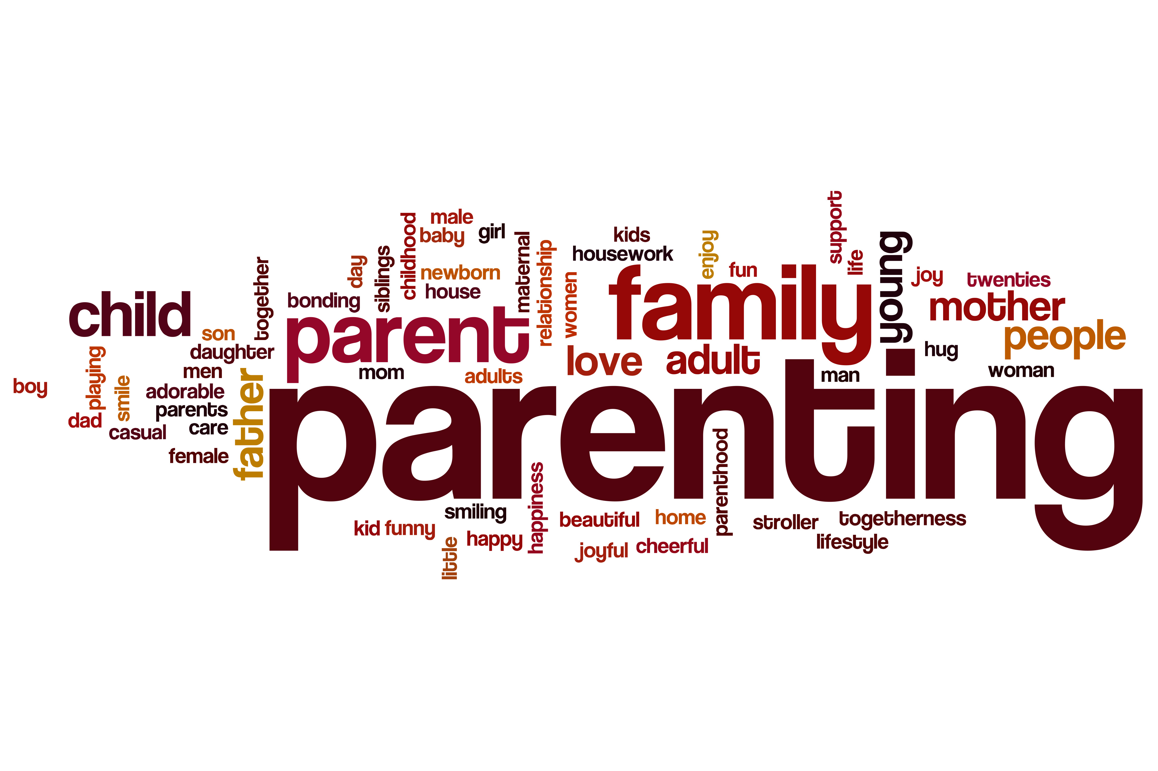
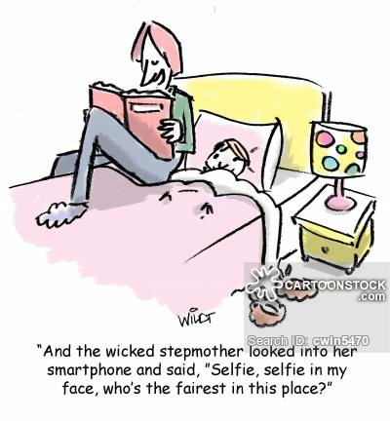
Introduction
  Takes something apparently ordinary
  and routine – having and bringing
  up children – and shakes it up
  Reproduction generates anxiety and various institutions seek to govern it
  Media representations sensationalise reproduction
  Ordinary people are getting on with having and raising children in increasingly diverse ways
  Transformations addresses changing practices
  and discourses about reproduction
  Mainly UK based, some international focus
  Informed by feminist approaches
  Offers sociological insight into issues most of us will deal with
Notes:
Sociology has a long tradition of shaking things up. This module takes something we might consider ordinary and routine – having and bringing up children – and renders it strange, something to be explained rather than assumed, certainly not natural but embedded in social and cultural values , practices and inequalities. It soon becomes clear that reproduction generates a lot of anxiety and a range of key institutions seek to govern it (by they medical, legal, or social welfare). The media often sensationalises reproduction, making much of pregnant men; disabled parents; single mothers; ‘wicked’ stepmothers.
At the same time it’s also clear that many people are getting on with the business of having and raising children in increasingly diverse and creative ways, and as sociologists we’re interested in how they make sense of their experiences.
So Transformations addresses changing practices and discourses about reproduction, mainly in the UK but with some international perspectives. It takes a gendered approach, mostly framed around feminist perspectives, concerned with men’s lives as well as women’s, trans and non-binary people’s experiences as well as those of cisgender people. So if you enjoy gendered modules then consider it; it is unapologetically feminist though, so it won’t be for everybody! You’ll also enjoy Transformations if you’re interested in how social variables like class, ‘race’/ethnicity, (dis)ability, sexuality etc. crosscut gender, ie if you’re interested in intersectionality. Law/Soc students interested in reproductive rights/reproductive justice often take this module, and it’s popular with mature students returning to study, who are often juggling parenting and University themselves.
What students tell me they like best is that we address issues that feel very real to them, now or in the past or future, and to friends and family around them. It stimulates us to think seriously about our reproductive potential, whether and when we want children, if we would consider adoption, how we might make a family in the future if we’re gay, lesbian or trans. It also helps to make sociological sense of contested issues, such as the reproductive rights of disabled people; men who give birth; transracial adoption and international surrogacy. Plus module topics are always to the fore in film, TV and celebrity lives, and students enjoy learning to think them through sociologically.

Slide 3
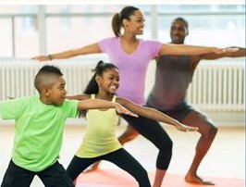
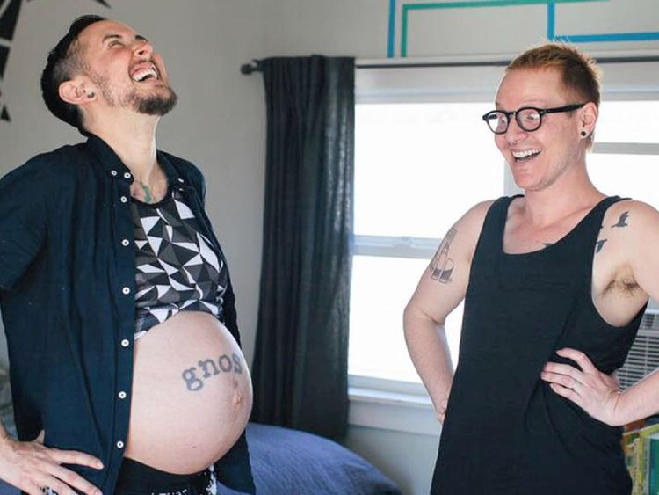
Key Questions
Why do women have children? Why do
men have children? Who needs children?
Do we have a right to be parents? To adopt?
To access donor eggs/sperm/wombs?
How do narratives of class, ‘race’/ethnicity, age, sexuality, (dis)ability inform ideas about who’s ‘fit’ to parent?
To what extent do femininities rely on motherhood?
Why are women with disabilities so often denied reproductive justice?
How do the dominant constructions of ‘good’
fathering link to masculinities?
What does it mean when a trans man has a
baby?
Notes:
I’ve put up here some of the key questions that we ask on the module, to give you an idea, and I’ll just go through the first 3. We start by asking a question that may seem obvious but in fact requires close attention:
Why do women have children? Why do men have children?
Connected to this we ask:
Who needs children? Does needing children give other people the right to make claims over people’s reproductive capacities? Who owns women’s reproductive bodies?
Do we have a right to be parents? To adopt? To infertility treatment? How do narratives of class, ‘race’/ethnicity, age, sexuality and (dis)ability inform ideas about who’s ‘fit’ to parent? For example, why is there a fear of lone mothers? Why do disabled women face assumptions that they won’t want/shouldn’t have children? Should gay and lesbian couples be able to adopt? Should we be able to adopt children from other countries, a la Madonna?
Why does society think nothing of men becoming fathers in their 60s or 70s but frown on new reproductive technologies that might allow women to become mothers in their 50s and 60s?

Slide 4



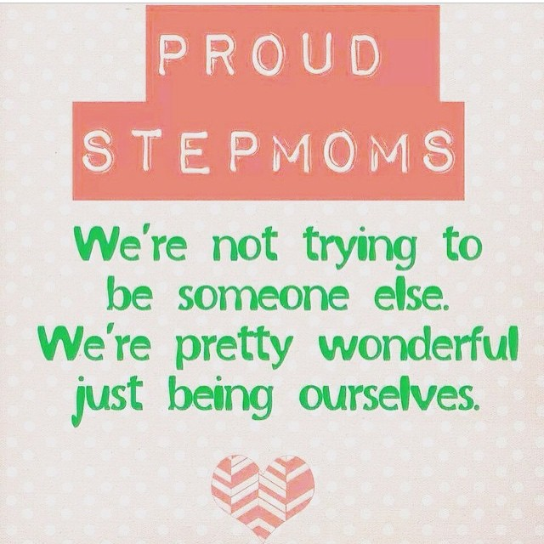

Parenting: Genetic
          Social
          Gestational
          Link between biological and social parenting can’t be assumed
          Why does separation of the two generate such anxiety?
Notes:
We’ll unpick parenting and distinguish three types: genetic, social and gestational. Being a parent by providing genetic material; being a parent by caring for and raising a child (social parenting); being a mother by bringing a foetus to term in the womb (gestational motherhood).
It’s often assumed that parents are both biologically and socially related to their children, but changing family forms and new reproductive technologies make this far from inevitable. Think of step-parents, adoptive parents, foster parents, sperm and egg donors, surrogate mothers; the lesbian woman whose partner gets pregnant and gives birth; the gay men who make a family through surrogacy. We analyse the fears and anxieties that arise when biological and social parenting are separated, for example about the wicked stepmother; the money-grabbing surrogate mother or sperm donor; the child of a lesbian couple with ‘two mummies’.

Slide 5

Module Structure
Week 1 Introduction: Reproduction Matters
Week 2 Why Do We Have Children?
Week 3 Who Owns Women’s Bodies? Who Needs Children?
Week 4 Femininity and Motherhood: Towards an Uncoupling?
Week 5 Masculinity and Fatherhood: Beyond the Breadwinner Role?
Week 6 Reading Week
Week 7 Single-, Queer- and Trans-Parenting: Can Parenting ‘Be’ What Parenting ‘Is’?
Week 7 Class Work due (group presentation)
Week 8 The Politics of Adoption: Transracial and Transnational Controversies
Week 9 The Politics of Surrogacy: National and Global Issues
Week 10 Conclusions: Towards Reproductive Justice?
Late April Summative Work due (3000 word research essay)

Slide 6




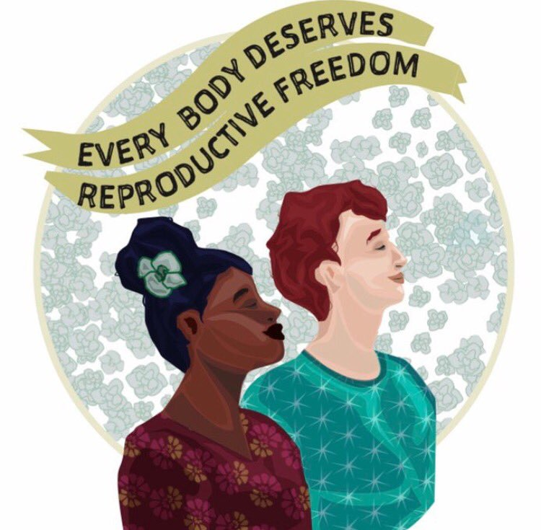
Practicalities
Participatory style of teaching, including
in lectures, with structure and support
All core readings and viewings on Talis Aspire
Lecture Capture normally used
Reading Week – week 6
Summative Assessment: 1 x 3000 word research essay
Formative Assessment: 1 x group seminar presentation
Notes:
Now for some Practicalities. The module offers structure and support but you’ll be participating from the start, including in lectures and with some mini group research projects to present in seminars as the module progresses that you will then submit as formative work.
All core readings and viewings are available electronically for ease of access, using Talis Aspire.
I used Lecture Capture so if you have to miss a lecture you can catch-up. At the same time, lectures involve your participation so it’s always better to be there.
Summative Assessment is by a 3000 word research essay.
I hope that’s given you some idea of the module. And of course asking students who’ve taken the module this year what it’s really like will be a good guide!

Slide 7

Indicative Reading
Almack, Kathryn (2011) ‘Display Work: Lesbian Parent Couples and Their Families of Origin Negotiating New Kin Relationships’, in Esther Dermott & Julie Seymour (Eds) Displaying Families: A New Concept for the Sociology of Family Life, Basingstoke: Palgrave Macmillan, pp. 102-118
Chen, Diane et al (2018) ‘Attitudes Toward Fertility and Reproductive Health Among Transgender and Gender-Nonconforming Adolescents’, Journal of Adolescent Health, Vol. 63, No. 1, pp. 62-68
Donath, Oma (2015) ‘Choosing Motherhood? Agency and Regret Within Reproduction and Mothering Retrospective Accounts’, Women’s Studies International Forum, Vol. 53, pp. 200-209
Joffe, Carol and Jennifer Reich (Eds) (2015) Reproduction and Society: Interdisciplinary Readings, London; New York: Routledge, pp. 32-42
Jones, Cecily (2013) ‘“Human Weeds, Not Fit to Breed?”: African Caribbean Women and Reproductive Disparities in Britain’, Critical Public Health, Vol. 23, No. 1, pp. 49-61
Kallianes V. and P. Rubenfeld (1997) ‘Disabled Women and Reproductive Rights’, Disability & Society, Vol. 12, No. 2, pp. 203-221
Knudsen, Lara M. (2006) Reproductive Rights in a Global Context, Nashville: Vanderbilt University Press
Martin, Lauren J. (2014) ‘Anticipating Infertility: Egg Freezing, Genetic Preservation, and Risk’, Gender and Society, Vol. 24, No. 4, pp. 526-545
Miller, Tina (2011) ‘Falling Back into Gender? Men’s Narratives and Practices around First-time Fatherhood’, Sociology, Vol. 45, No. 6, pp. 1094-1109
Nandy, Amrita (2015) ‘Natural Mother = Real Mother? Choice and agency among un/natural ‘mothers’ in India’, Women’s Studies International Forum, Vol. 53, pp. 129-138
Nash, Meredith (Ed.) (2014) Reframing Reproduction: Conceiving Gendered Experiences, Basingstoke; New York: Palgrave Macmillan
Pande, Amrita (2016) ‘Global reproductive inequalities, neo-eugenics and commercial surrogacy in India’, Current Sociology, Vol. 64, No. 2, pp. 244-258
Roberts, Dorothy (1999) Killing the Black Body: Race, Reproduction, and the Meaning of Liberty New York: Vintage

Slide 8


Any questions, please email me:
c.wright@warwick.ac.uk
Notes:
If you have any questions please email me: c.wright@warwick.ac.uk

