Slide 1

Library Induction 2025
Lucie Thomas – Research and Academic Support Librarian for Sociology

Slide 2

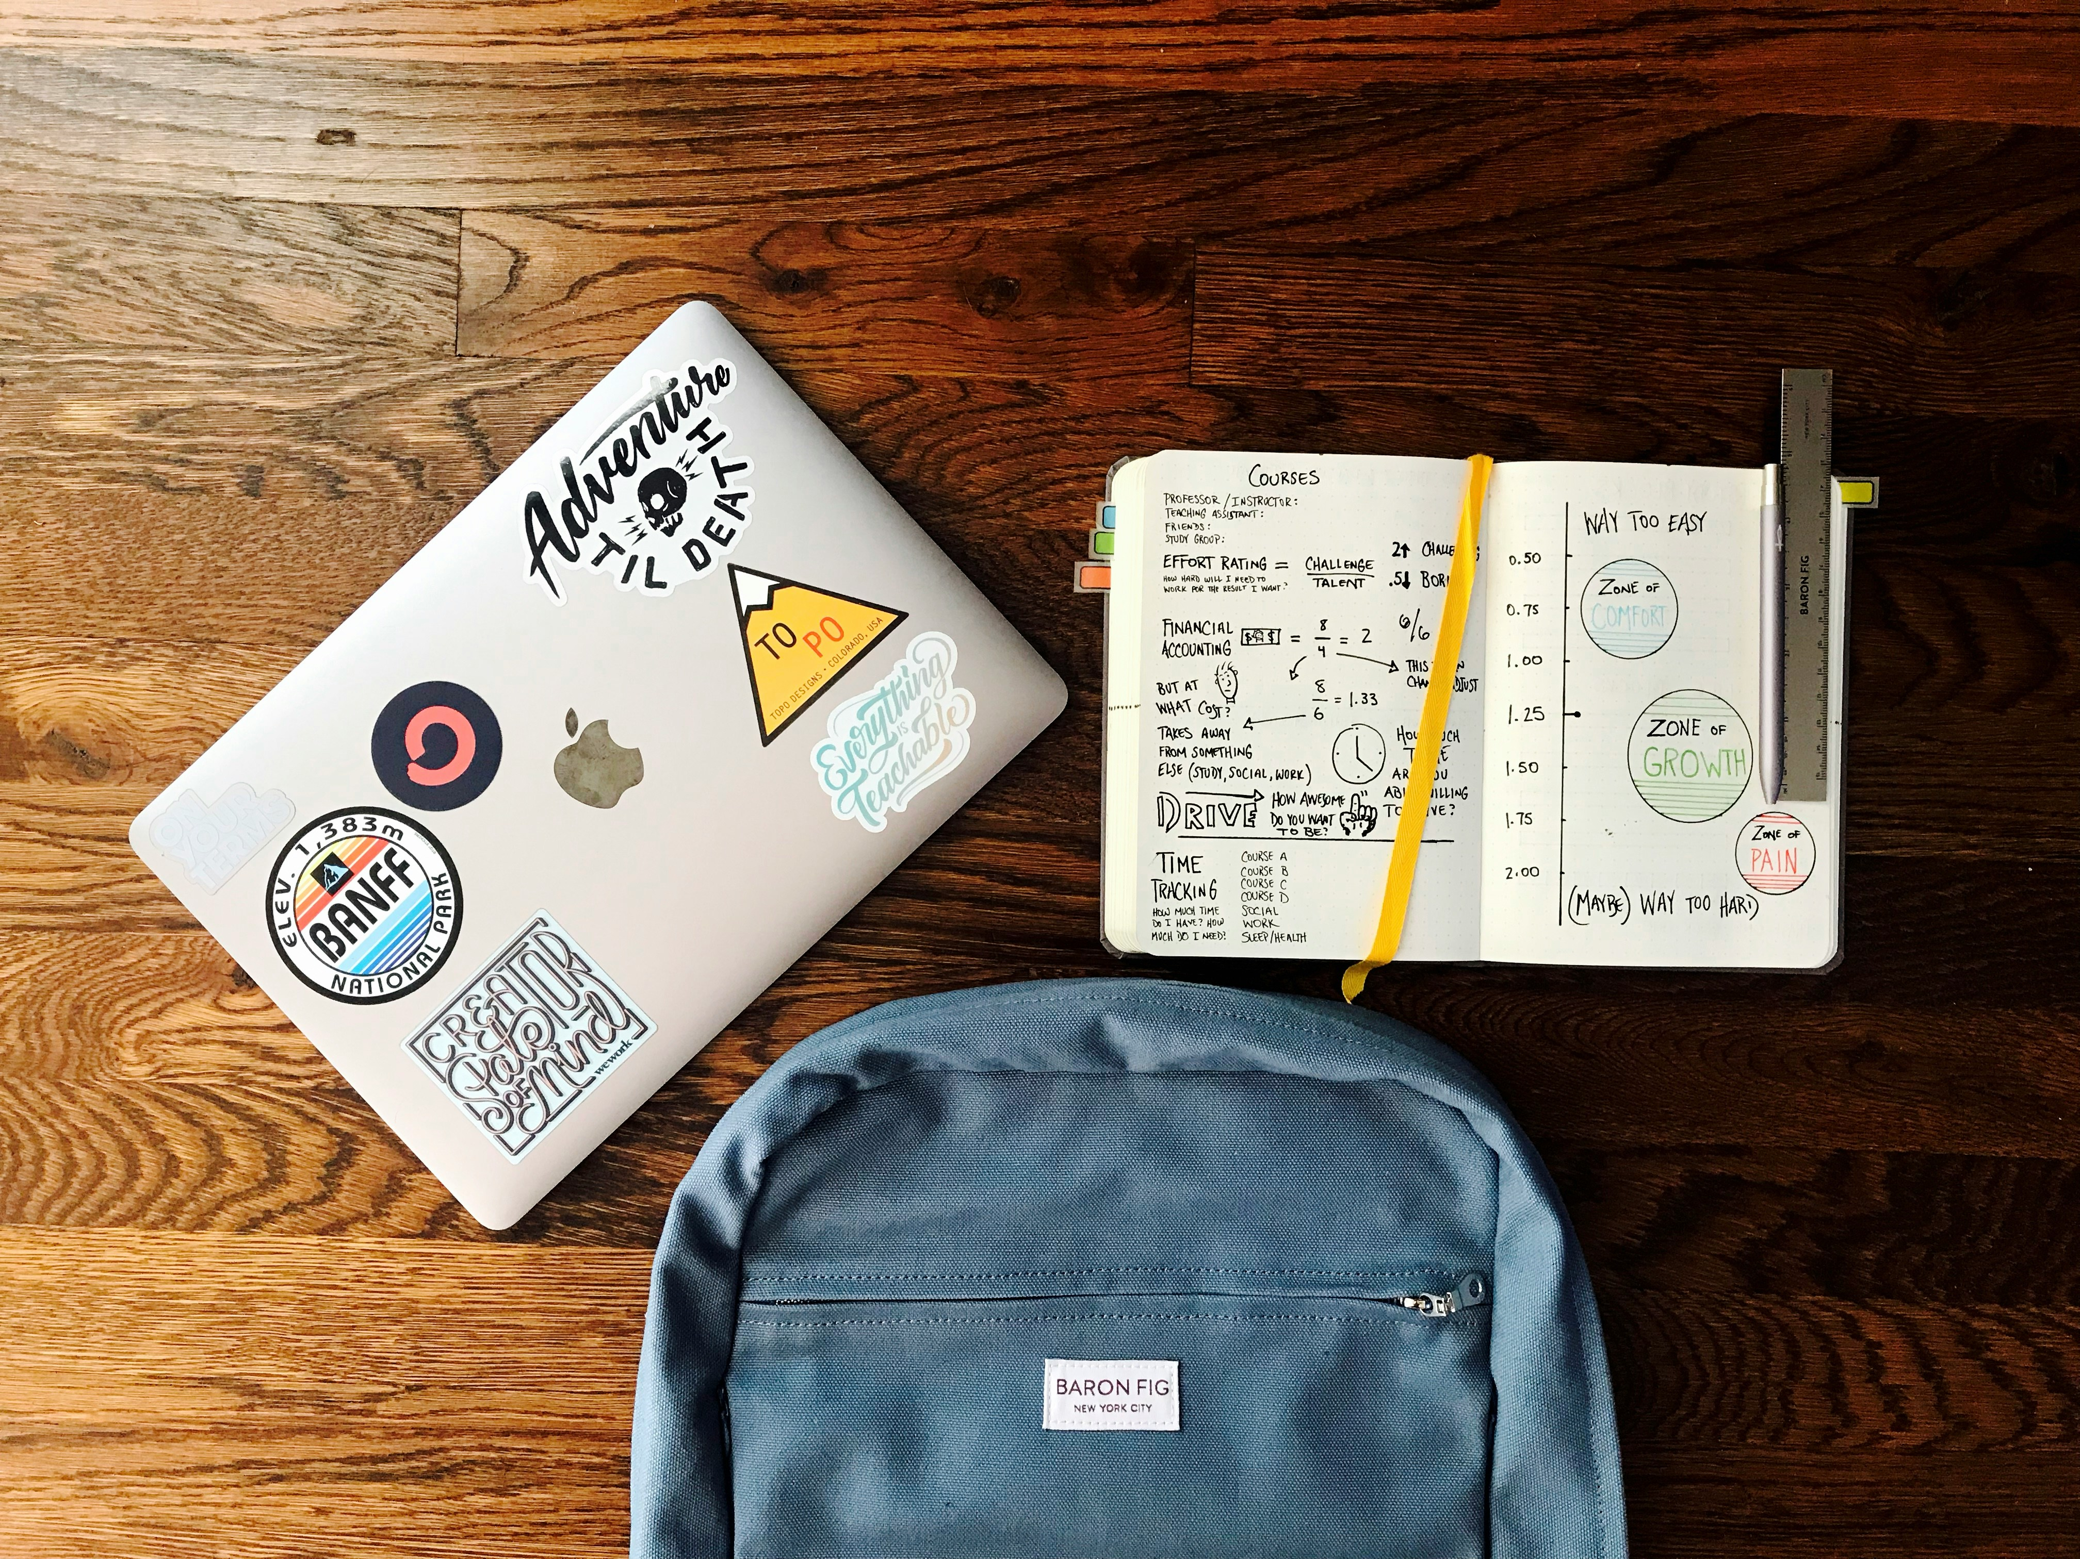
How can the Library help you?
  Opening hours: 24/7
  IT and Library Helpdesks available
  Café Library & Coffee Bar
  Individual and group study spaces
  Desktop PC’s
  Breathing Space

Slide 3
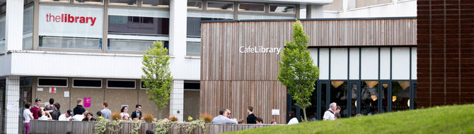
Locating the Library on the Interactive Campus Map
Exploring the Library from home

Slide 4

The Library Website
The best source of information relating to the Library.
The best place to access all of our digital resources.

Slide 5
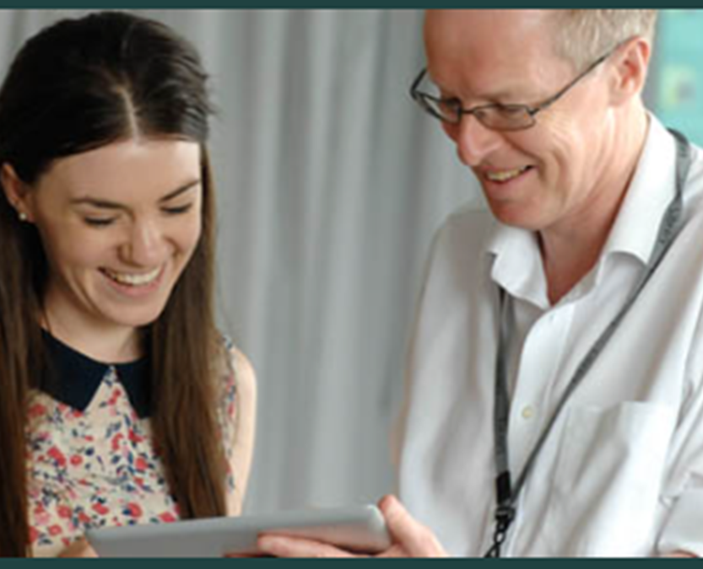
How can the Library help you?
Go to the Library to:
  Find your way around the building
  Access digital and print resources
  Find full texts
  Search for information
  Reference correctly

Slide 6
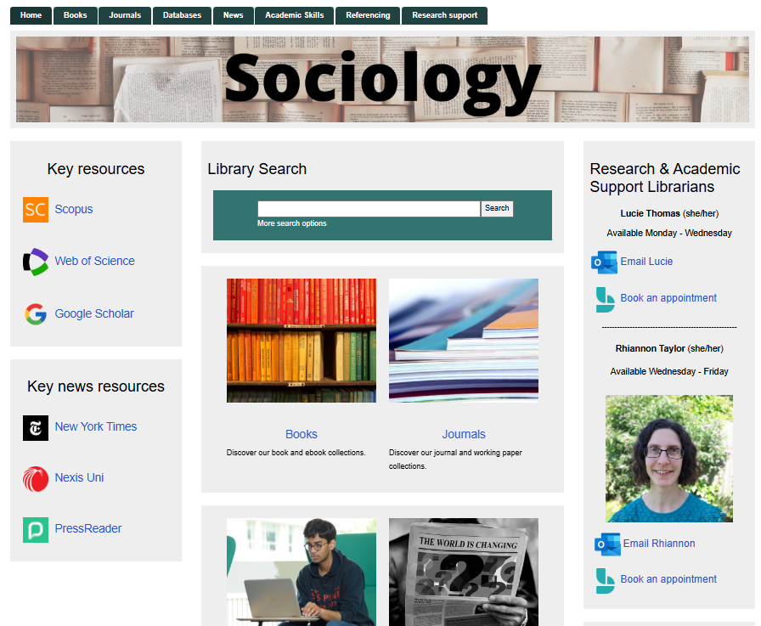

The Library Guide for Sociology
Subject specific support
Descriptions of resources
Links to support – including support with referencing

Slide 7
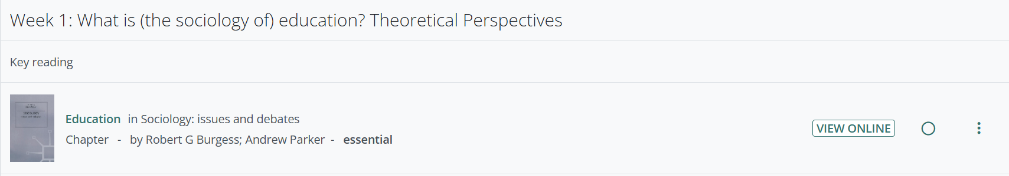
Your Reading Lists
Key Reading

Slide 8
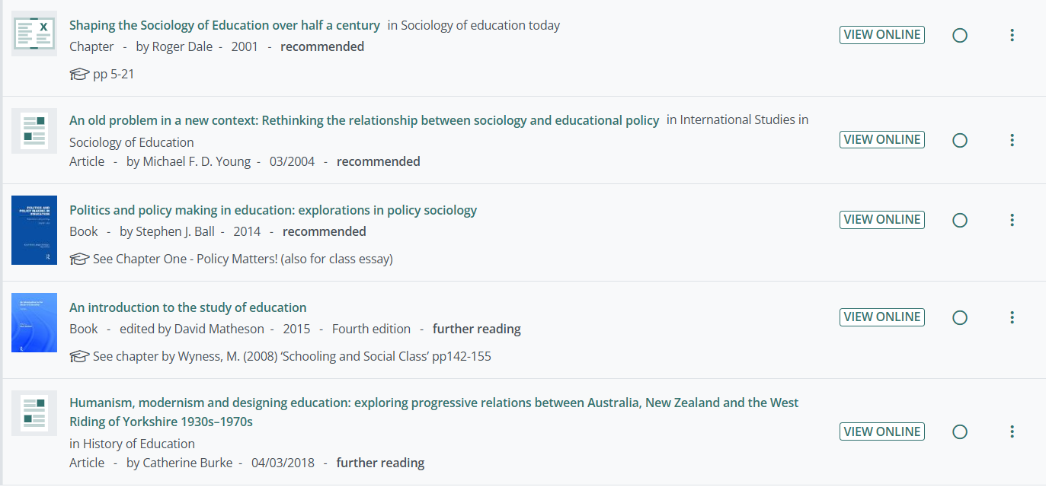
Recommended and Further Reading
Notes:
You may want to read a little wider than the items on your reading list. The Library Search box from the Library homepage allows you to search for the books held by the Library, including e-books that you can access from home.
Enter some keywords that reflect the area you want to research. If you are looking for a specific book, you can enter the author name and some keywords.
For example, you could look for books on: global public health pandemics
Use the filters on the left hand side to restrict the results to e-books.
When you find a book that looks relevant, click on the title and sign in with your University username and password.
E-books vary in their usability. In some, each chapter is a PDF and you can download the whole book. Other e-books are more restrictive in the number of pages you can download or copy.
Watch the video to see an example of how to search for books

Slide 9

Finding resources
Let’s find a resource

Slide 10
Welcome week 2026
Come and Explore your Library!
When? Welcome Week and Monday-Wednesday in Week 1.
Meet Library staff and our Library Student Partners.
Find out about everything the Library has to offer at our Welcome Stand
Join one of our Library Tours
Notes:
If, when you click on the WebBridge button, you see a message saying that we do not have online access, you should see a link to our Article Reach service. This allows you to request the article, free of charge. If we are able to get a copy of the article, it will be delivered to your Warwick inbox within a couple of days.

Slide 11
Further help and advice
  Ask Library staff or Library Student Partners
  Email us via Library@warwick.ac.uk
  Contact your Research & Academic Support Librarian:
  https://warwick.ac.uk/services/library/subjects/academic-support-librarians
  Check out our online guides and videos
Notes:
So, please do get in touch if you need any questions about the Library, including help with accessing an e-book or the full text of an article, help with a literature search and using our databases such as Psycinfo or Web of Science and questions about referencing.

Slide 12



Need Further Help?
  Ask Library staff or Library Student Partners
  Email us via Library@warwick.ac.uk
  Check out our online guides and videos

