Slide 1

Warwick Students’ Union
Always Something For You

Slide 2

Your Democratic and Academic Representation

Slide 3
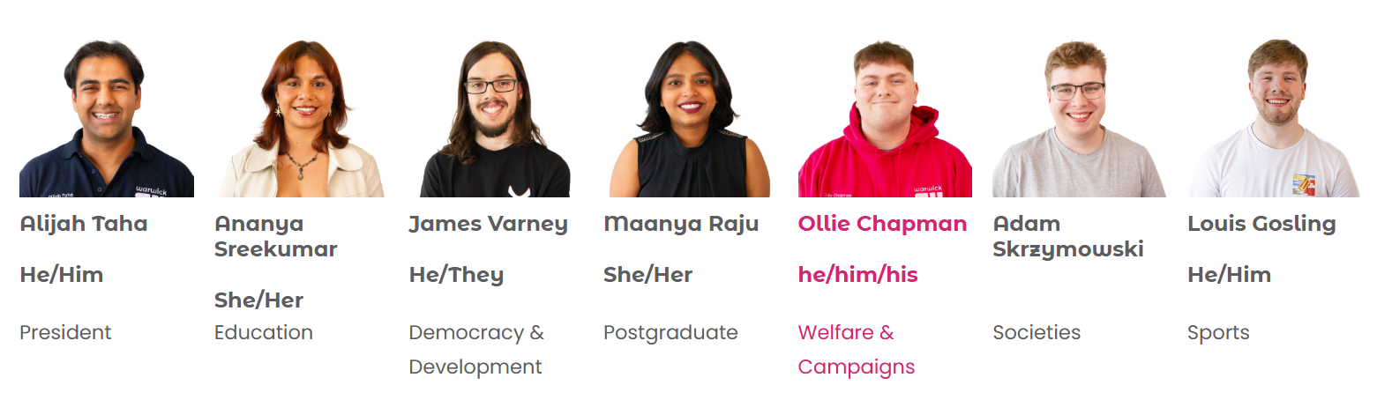
Your Democratic Representation
Officer Team

Slide 4
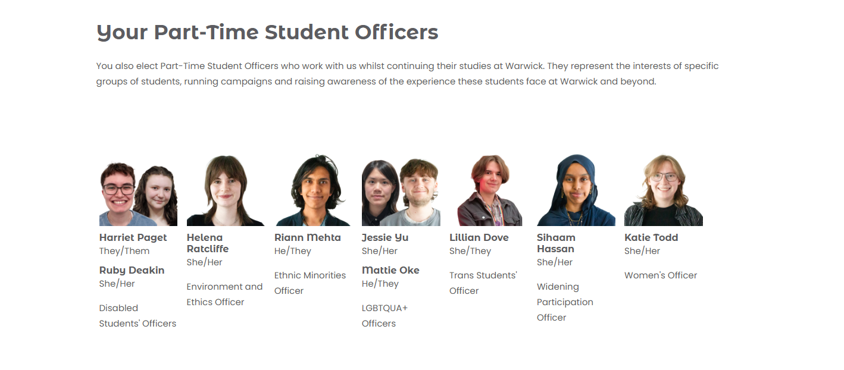
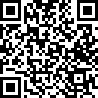
Your Democratic Representation
Elections for Forums and other PTO’s

Slide 5
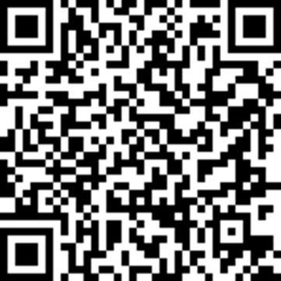
Your Academic Representation
The SU's Academic Representation system ensures that students have a say on their educational experience here at Warwick.
We currently have 300+ course reps who have been elected by students to represent the interests of those on their course.
Students can provide feedback to their Course Rep, which they then discuss with their Department at a Student Staff Liaison Committee.
This can lead to constructive changes to the course, such as receiving specific learning resources, improvements to timetabling, or continuing aspects of a course that students have enjoyed.
To nominate yourself please scan the QR code below or ask your Academic Convener about how to nominate.

Slide 6
Your Support and Advice

Slide 7

Your Support and Advice
Free, confidential, impartial and non-judgemental advice, independent from the University.
Personal Issues
Housing Advice
Course-related problems
Immigra-tion issues
Finance and Funding
Support Sign-posting
University Complaints/ Disciplinary Proceedings
The service is easy to access, just fill out an enquiry form at warwicksu.com/help-support/ and one of our expert advisors will reach out within 2 working days.

Slide 8




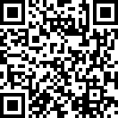

Your Campaigns and Ideas
Course Reps
Ideas Platform

Slide 9
Your Socialising

Slide 10
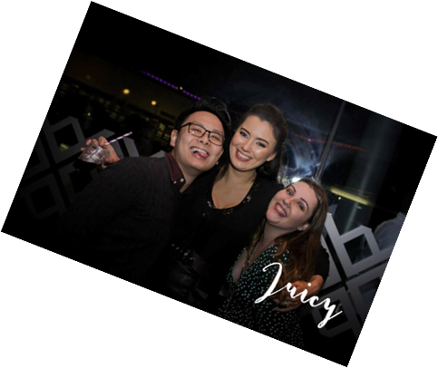







Your Socialising
Course Reps
Our Food and Drink Outlets
We run a packed programme of events throughout the year, from club nights in the Copper Rooms to our Pub Quiz in the Dirty Duck, to dog-petting sessions in exam season, as well as supporting hundreds of student groups in running their own events.
Over 60 Sports Clubs!
Over 250 Societies!
All revenue from our outlets goes straight back into delivering services for Warwick students!

Slide 11

Any questions?
Please do drop in and say hello!

