Slide 1
Get Started with the Library
Ten things you need to know
Katherine Waters

Slide 2

My Warwick App

Slide 3
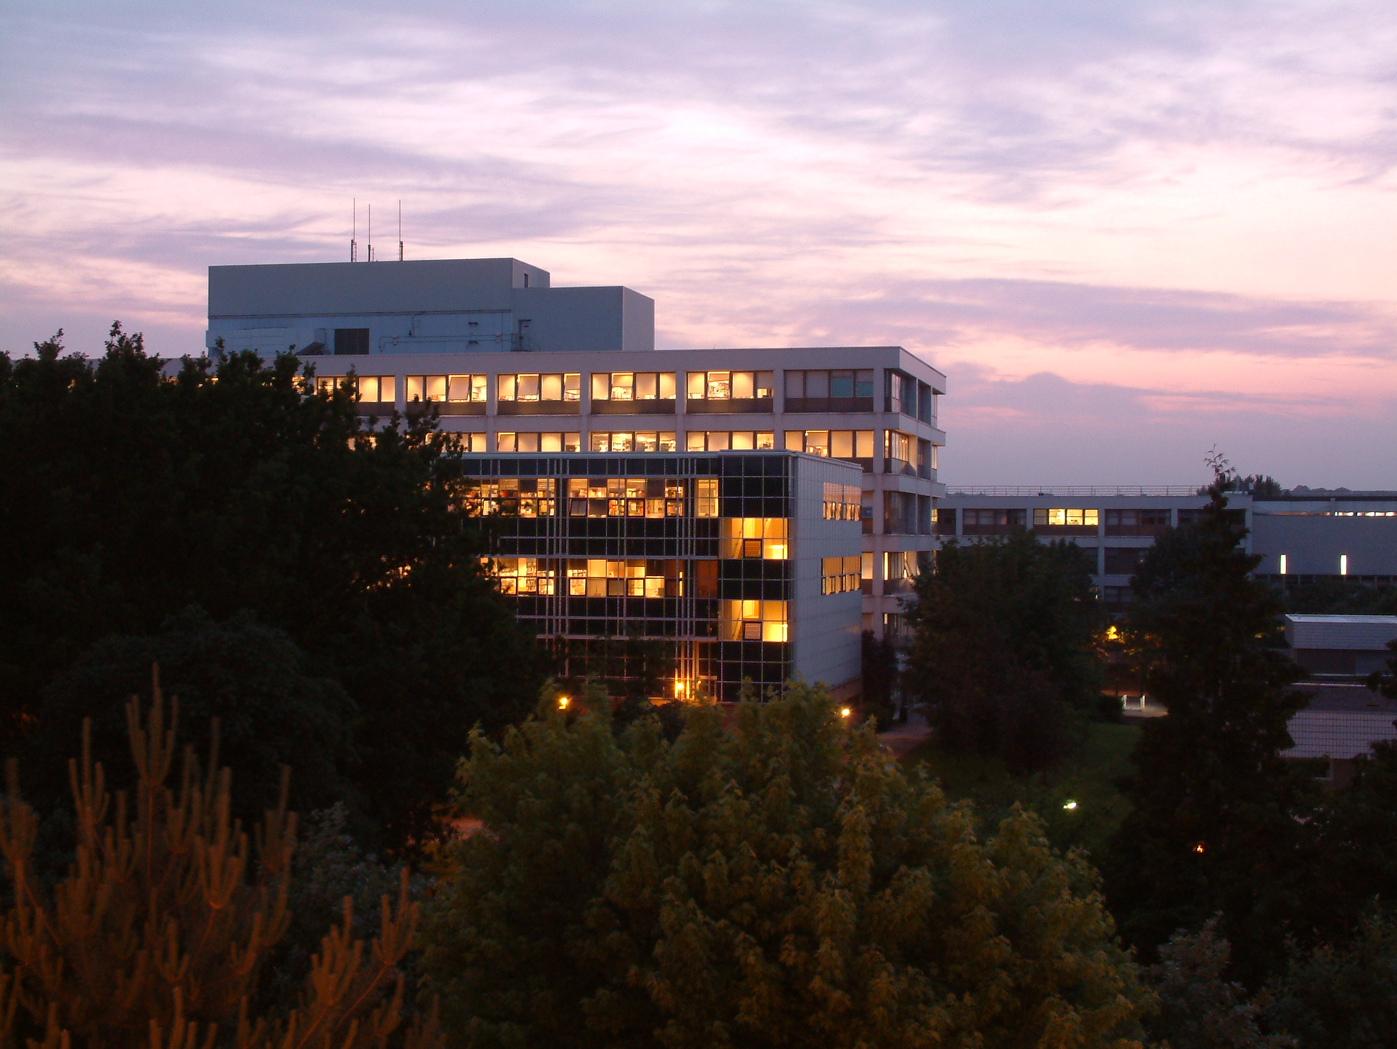
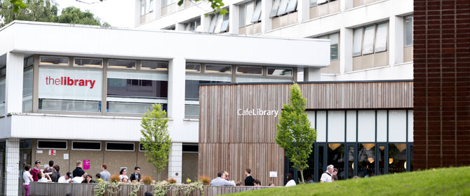
We’re open 24/7 all year
*staffed between 8.30-21.30

Slide 4
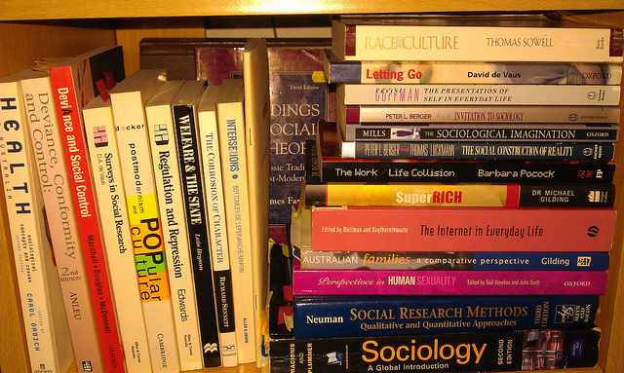
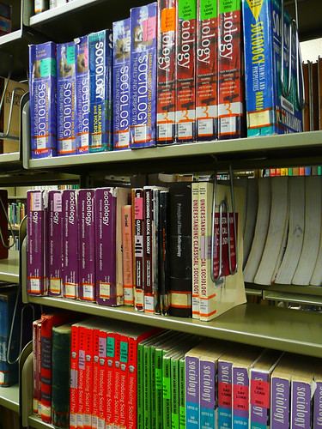
2. We have over a million books
You can borrow up to 15 as well as two from Short Loan
The short loan collection is on floor 1- separate from the
main collection
Sociology is mainly* on floor 5 starting in the H section
"June 15 (take 2)" by >littleyiye< is licensed under CC BY 2.0

Slide 5
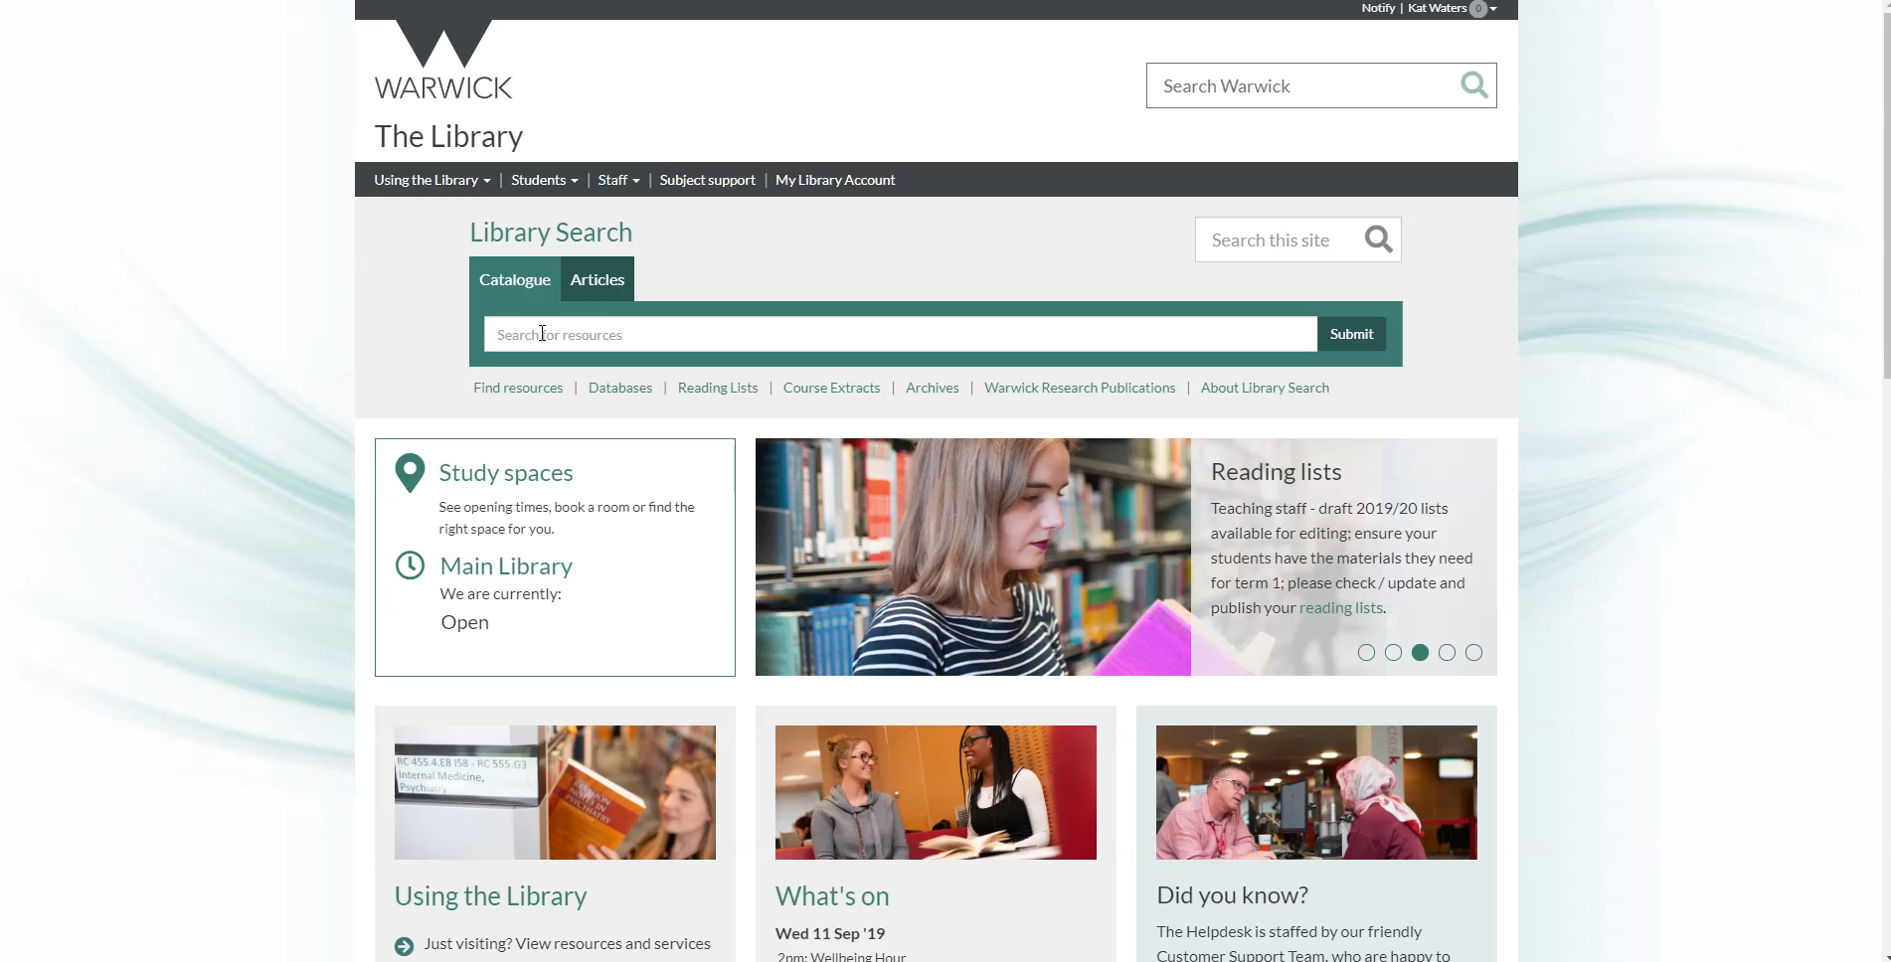
3. Find books and articles using Library Search

Slide 6
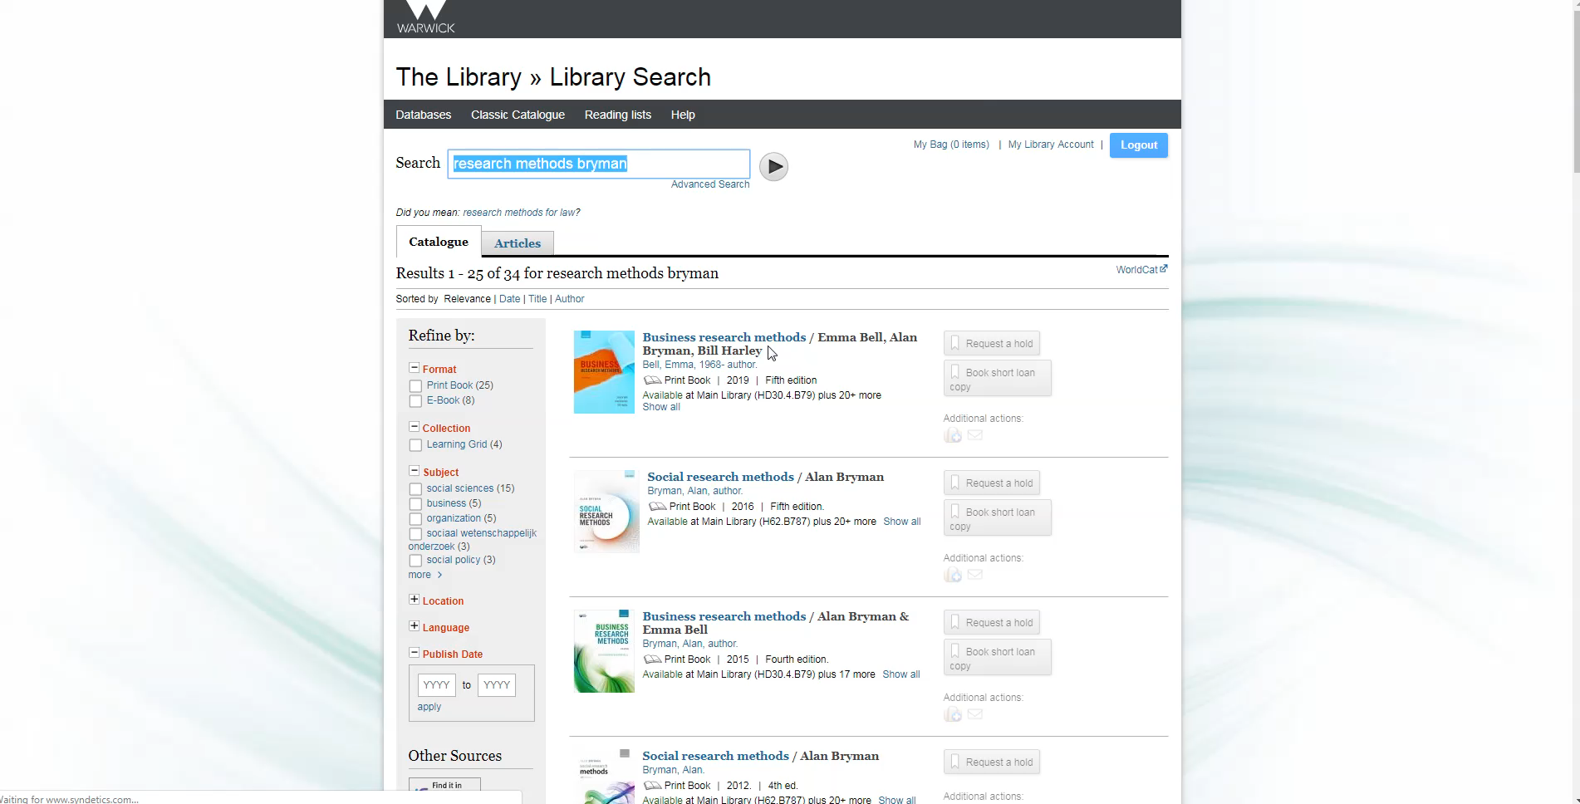
4. You can renew your books and place a hold on books that are out on loan

Slide 7
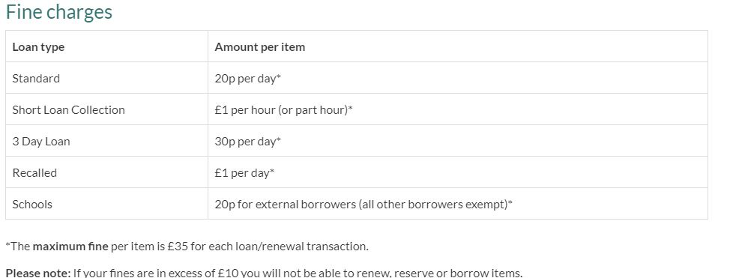
5. Fines
Don’t get caught out by fines – return or renew your books on or before the return date

Slide 8
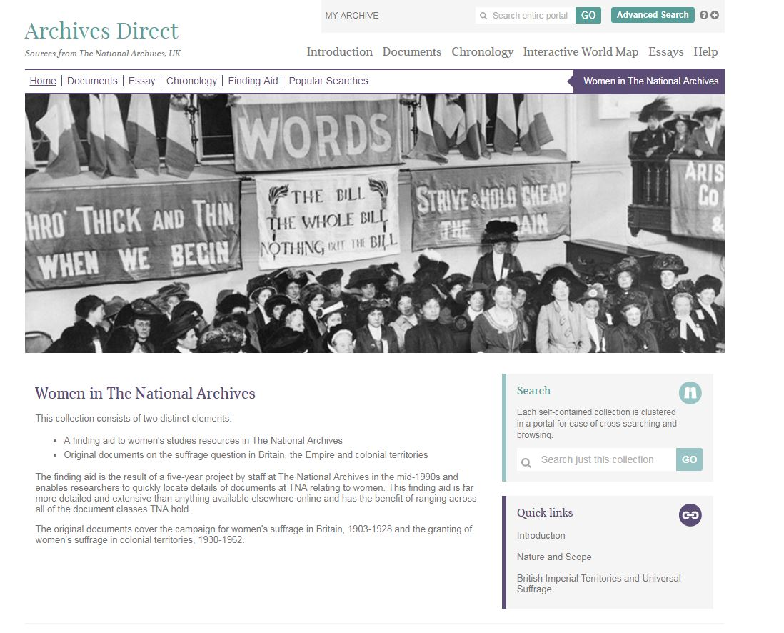
6.We have a huge range of journals and databases for your subject area

Slide 9

Explore them from the Library Search page

Slide 10
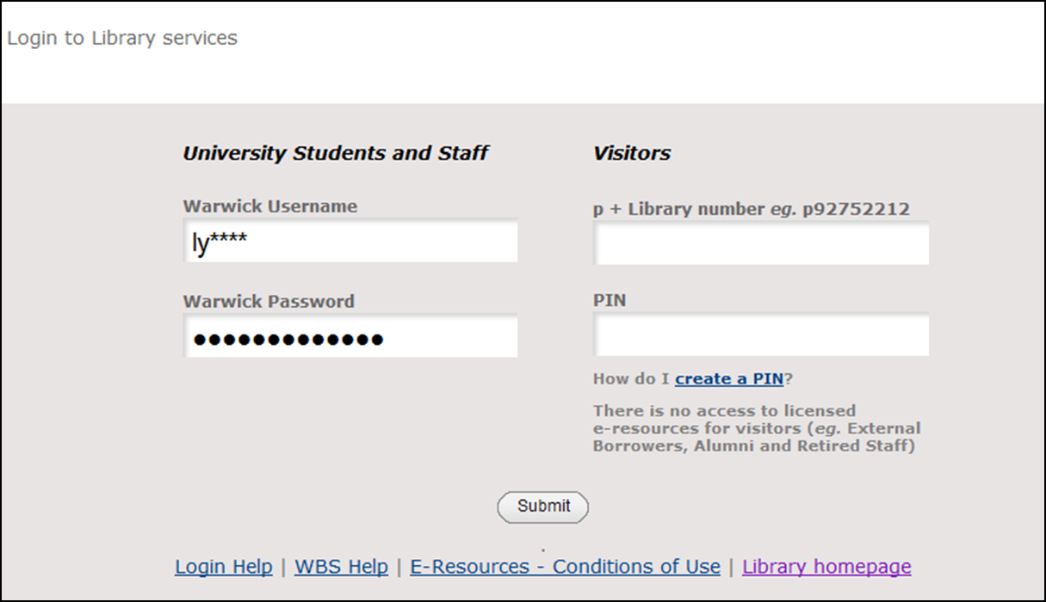
7. Use your Warwick login to access resources

Slide 11
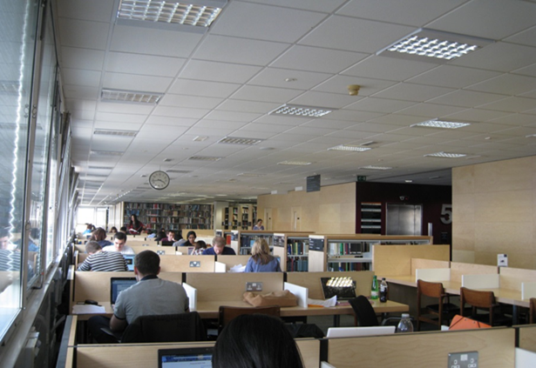
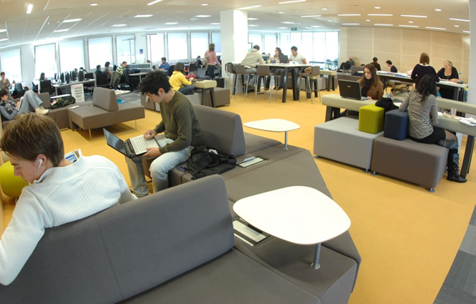
8. Different places to study
Quiet study space on floors 3-5
Informal study space floor 1 and 2 and in the Learning Grid University and Learning Grid Rootes

Slide 12
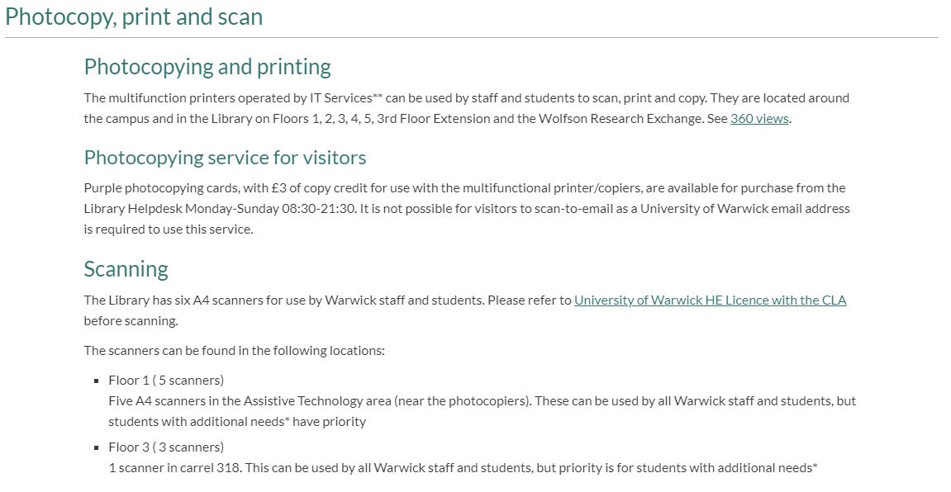
9. Printing, photocopying, scanning

Slide 13
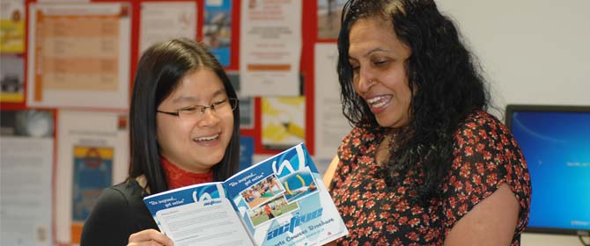
10. Help
Get Started
Everything you need to know about the library, including booking a library tour.
https://warwick.ac.uk/services/library/using/help/new-users
Help desk on floor 1
Librarian available from 1-3pm every week day in “The Pod” on level 1.
Katherine.waters@Warwick.ac.uk

Slide 14
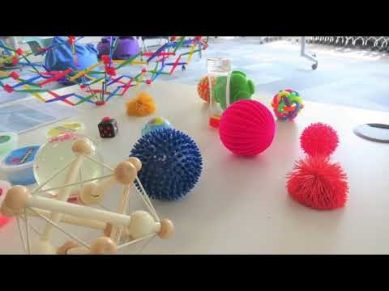
Study Happy
Notes:
We run events throughout the year – Kirby the penguin is the mascot so keep an eye out for him
Events support wellbeing, skills development and community and include: PAT Dogs, mindfulness, craft events, games afternoons, cultural events, ukuleles and much more
All events are free and open to all students
Details on Library What’s On calendar and on the Library Facebook page
Regular events:
Kirby Corner: Every Tuesday 2.45 – 4.15 in Rootes Learning Grid or Floor one, Library
Library Language Exchange:
Fortnightly, Rootes – dates and details on the Library What’s On calendar and Facebook
Peer led skills workshops – dates and details on the Library What’s On calendar and Facebook

Slide 15
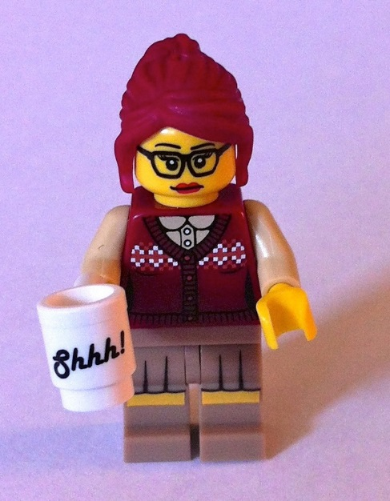
Academic Support Librarian for Sociology
Katherine Waters
Katherine.waters@Warwick.c.uk
02476 (5) 22972
Working days: Tuesday, Wednesday, Thursday (all day)
Pronouns: She/Her

