Slide 1
DEPARTMENT OF SOCIOLOGY
WELCOME WEEK 2019

Slide 2
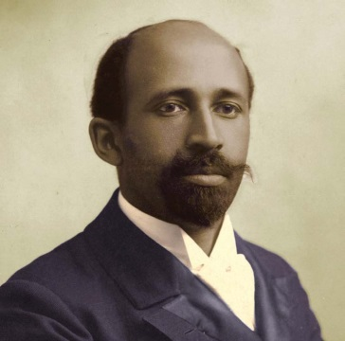



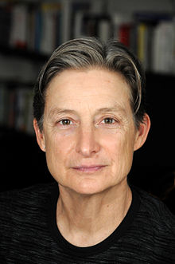
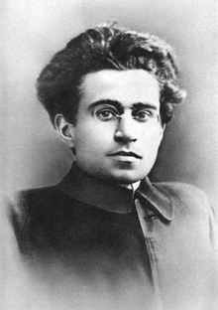
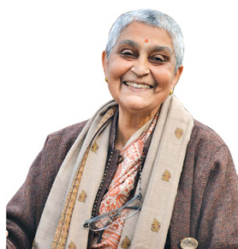

Welcome to Warwick Sociology
Professor Virinder S Kalra
Head of Department
Notes:
VK

Slide 3

W. E. B. Du Bois
Simone de Beauvoir
Angela Davis
Edward Said
Judith Butler
Gayatri Spivak
Stuart Hall
Antonio Gramsci
Notes:
VK

Slide 4


Warwick Sociology
2019
2022
Notes:
VK

Slide 5
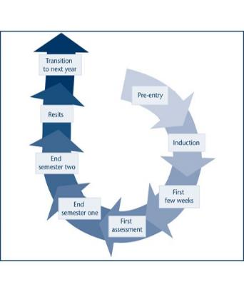
A
ABOUT MY ROLE
Dr André Celtel
Director of Student Experience and Progression (DSEP)
Pre-university
At-university
Post-university
Notes:
AC

Slide 6
INTRODUCING …
A
HEAD OF DEPARTMENT
Virinder Kalra
A
UNDERGRADUATE TEAM
Nisha Kapoor (Director of Undergraduate Studies)
Katy Harsant (Deputy Director of Undergraduate Studies)
André Celtel (Director of Student Experience and Progression)
Charles Turner (Senior Tutor)
Azrini Wahidin (Director of International Programmes)
Darani Anand (Departmental Administrator, Teaching and Learning)
Faye Brown (Taught Programmes Officer)
Chau Ho (Taught Programmes Officer)
Notes:
AC

Slide 7

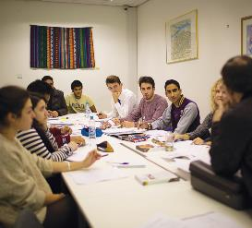
LECTURES AND SEMINARS
A
Combination of lectures and seminars.
Lectures will introduce you to a particular topic.
Seminars build on lectures (and readings) to develop your thinking about a topic.
Classes are kept small enough for you to have access to the tutor as well as space to have your say during each session.
The more you put into seminars the more you will get out of them!
Notes:
AC

Slide 8
ACADEMIC SKILLS
A
ACADEMIC SKILLS FOR SOCIOLOGISTS
Tuesdays 17:00 (wks 2, 4, 5, 7, 8, 10)
Referencing
Plagiarism
Paraphrasing/Summarising
Searching for Sources
Essay Structure
Critical Reading and Writing
Check out university academic skills support and resources here and here
ADVICE AND FEEDBACK HOURS
All module convenors, lectures and tutors have Advice and Feedback hours (posted outside offices and on moodle pages)
Discuss points raised in lectures
Advice on essay writing; further feedback
Make use of these!
ESSAY CLINIC
Opportunity to bring along three or four essays to a meeting with the DSEP to discuss potential areas of general improvement
A
Notes:
AC

Slide 9
IN-SESSIONAL ENGLISH LANGUAGE SERVICES (FOR INTERNATIONAL STUDENTS)
A
In-sessional English classes are additional academic English language classes for international students
How to write an assignment or how to participate in a seminar – ‘stand-alone’ workshops (no need to register) available in weeks 2 & 3 (Term 1).
Weekly academic English language classes (from wk 4, 21 Oct) – register online between 30 Sept and 25 Oct).
English conversation practice in a friendly and safe setting – join the university’s ‘English conversation club’.
Further information on all these is available at: https://warwick.ac.uk/fac/soc/al/study/learn-english/in-sessional/
or email: insessional@warwick.ac.uk
Notes:
AC

Slide 10

PERSONAL DEVELOPMENT, CAREERS, OPPORTUNITIES
A
EXAMPLE OPPORTUNITIES
1:1 careers sessions with department’s Senior Careers Consultant (Clare Halldron)
Opportunity to do independent, fully funded, research over the summer (URSS).
Opportunity to publish in the department’s very own sociology journal
Present at undergraduate conferences (BCUR, ICUR)
Become a Sociology Ambassador – help with outreach and widening participation activities.
Watch out for regular ‘DSEP’ emails and see here for more information on the above and other opportunities
Notes:
AC

Slide 11
PERSONAL TUTORS AND SENIOR TUTOR
A
Each student allocated a Personal Tutor (via Tabula)
Academic mentor, references, module choices, personal development, problems or difficulties
Draw on a wide range of university services: Student Support, Mental Health and Wellbeing, Disability Services, Counselling Services, Residential Life
University monitoring points: need to meet with your Personal Tutor at least once a Term. First monitoring point is by the end of Week 3 this term
The Senior Tutor – Dr Charles Turner– can also be contacted if for any reason your Personal Tutor is unavailable or you would like to discuss any issues regrading the Personal Tutor system.
A
Notes:
CT

Slide 12
UNDERGRADUATE PASTORAL CARE TEAM
A
DIRECTOR OF UNDERGRADUATE STUDIES
Dr Nisha Kapoor
DEPUTY DIRECTOR OF UNDERGRADUATE STUDIES
Dr Katy Harsant
SENIOR TUTOR
Dr Charles Turner
If you’re having problems or need advice, your first point of contact should be your personal tutor.
However, you’re also welcome to contact any member of the pastoral care team.
OTHER CONTACTS
Sexual Harassment Advisor – Dr Cath Lambert
Racial Equality Advisor – Prof Akwugo Emejulu
Disability Champions – Dr Ravi Thiara & Amy Clarke
TAUGHT PROGRAMMES OFFICERS
Faye Brown & Chau Ho
DEPARTMENT ADMINISTRATOR (TEACHING)
Darani Anand

Slide 13
UNDERGRADUATE STUDIES
A
The undergraduate portal on the Sociology webpage is where you will find key information related to your studies
It’s also where you’ll find the Undergraduate Handbook – please read this carefully as it contains everything that you need to know about the department, assessment, policies, procedures etc
Closer to assessment time we’ll talk to you about extensions and mitigating circumstances
A

Slide 14
WELLBEING SUPPORT SERVICES
A
KEY MESSAGES FROM WELLBEING SUPPORT
Get a healthy work-life balance
Respect yourself and others
Be self-aware
Seek out support when necessary
A
Notes:
Get a healthy work-life balance - We really hope your time at Warwick is productive and enjoyable, so we promote Wellbeing and a healthy balance of work, rest and play.
Respect yourself and others -Warwick is a vibrant community – we respect ourselves & others; we look out for ourselves & others.
Be self-aware - It might get tough sometimes; things don’t always go to plan, and life is a learning curve. Be aware of what you think you’ll manage well and also what you might find challenging. And plan how you can build your skills and resilience for when times may be tough.
Seek out support when necessary - Support is on hand for those difficult times, so remember, Wellbeing Support Services have a range of services for a wide range of needs (if you’re undergraduate or postgraduate; home or international; part-time or full-time …). There’s lots of other support available too. Seeking out the right help early on can ensure issues are manageable.

Slide 15
WELLBEING WELCOME WEEK EVENTS
A
Event | Day | Time | location
Take a Break tent (an informal introduction to wellbeing) | Monday-Friday | 11.00-3.00 | Senate Lawn
Drop-in | Monday Tuesday Wednesday Thursday Friday | 11.00-1.00 2.00-4.00 11.00-1.00 2.00-4.00 11.00-1.00 | Senate house
Emotional resilience workshop | Wednesday Thursday | 3.00-4.30 1.30-3.00 | Ramphal (R0.12)
Living well at Warwick workshop | Tuesday Friday | 2.00-3.30 10.30-12.00 | Humanities (H0.03) Oculus (OC0.01)
Maximising your time at Warwick (introduction to well being) | Monday Tuesday Wednesday Thursday Friday | 2.00-3.00pm | Oculus (Oc0.03) Arts Centre theatre Arts Centre theatre Arts Centre theatre Arts Centre theatre
Notes:
KH – This is the timetable of Wellbeing events that Penny asked us also to promote – in particular, she says that the ‘Maximising your time at Warwick’ would be particularly beneficial to students.

Slide 16
STUDENT–STAFF LIAISON COMMITTEE (SSLC)
A
SSLCs are committees made up of student representatives and members of staff.
Provide accessible arena for students to discuss with staff issues connected to teaching, learning and student support (e.g. curriculum development; feedback and assessment; library resources; careers and employability).
Strongest mechanism for students to get involved in the shaping of academic life in the department.
They also provide an opportunity for the department to consult with students and receive feedback on new proposals.
You can also use our 'Student Voice' feedback web form
Look out for our responses to feedback on the ‘You Said, We Did’ page
A
SSLC CONVENORS
Sociology – Katy Harsant
History and Sociology – Steve Fuller
Law and Sociology – Steve Fuller
Politics and Sociology – Steve Fuller
Sociology & Quant Methods – Roxana Baltaru
Notes:
KH

Slide 17
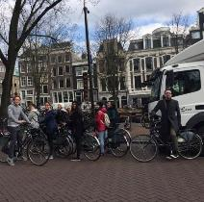
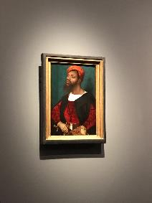
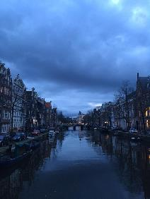
A
2018 - Postcolonial Amsterdam: Multiculture, Gentrification and Urban Space
SOCIOLOGY STUDY TRIP
Each year, the department organises a Study Trip in the last week of the Spring Term
Previous destinations have included Belgrade, Copenhagen, Lisbon, Berlin, Athens and Seville
The trip is subsidised by the department and the cost to students is usually £300 or less
Open to all Sociology students (UG, PGT, PhD)
Look out for more information – places go fast!
Notes:
?

Slide 18
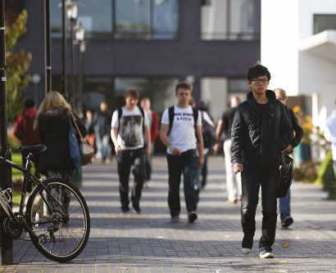
A
STUDYING ABROAD
In your 2nd year, you can apply to study abroad during the following year.
Your degree will be extended to 4 years (5 for BA Law and Sociology).
Some partner universities teach in the local language, but several partner universities in non-English-speaking countries offer teaching in English.
Funding is available for students going to partner universities in Europe.
Our network of partner universities is always changing, but currently students can apply for study abroad places in the Czech Republic, Denmark, Finland, France, Germany, the Netherlands, Portugal, Spain, Sweden, as well as Australia, Canada, China, Hong Kong, Japan, Malaysia and South Korea.
Notes:
?

Slide 19

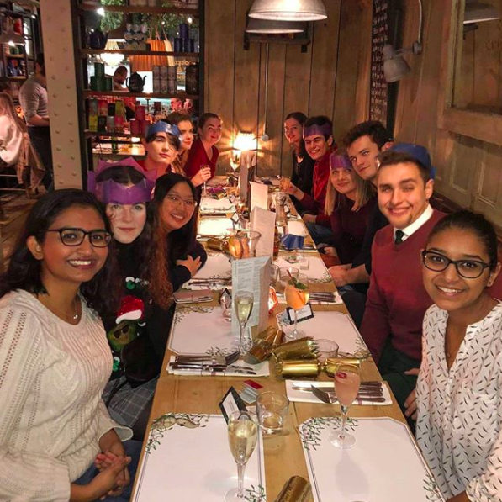
We are a welcoming and inclusive society with a diverse range of members that share an interest in Sociology
We offer a wide range of events:
Academic Events – from documentary screenings to careers fairs
Social Events – from bowling to bar crawls
Welfare Events – our mentoring scheme and advice drop-in sessions
Charity Events – SocSoc Socks, quiz nights and an annual raffle. All proceeds go to local charities
Whatever your interests may be, we’re sure SocSoc will have something to offer you!
Notes:
SocSoc

Slide 20
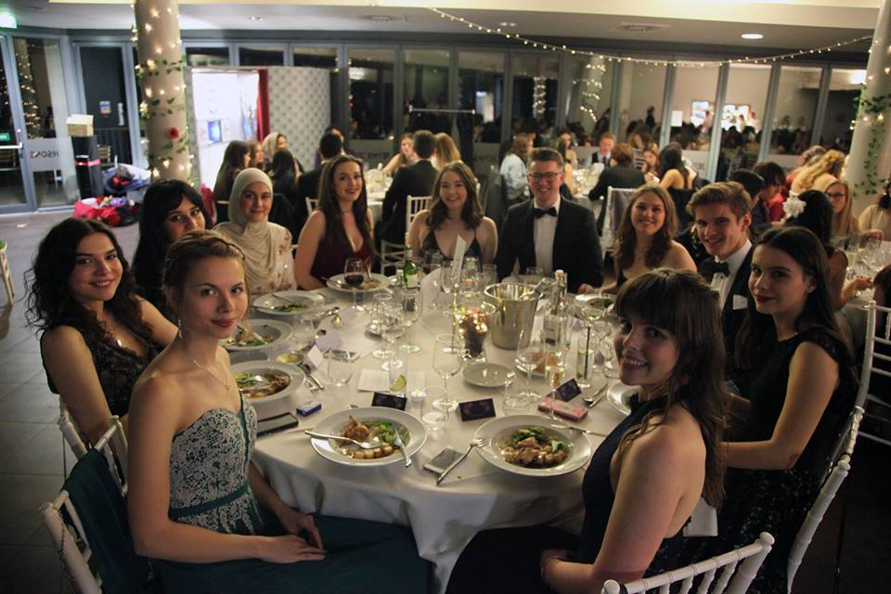
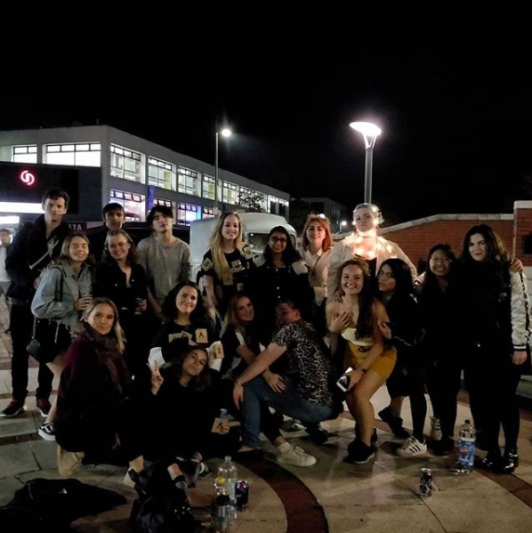
What’s on?
Societies Fair! – Wednesday 25 September; 10:00—17:00pm
SocSoc will be in the Main Hall. Feel free to come check out our stall, chat with the Exec and grab some free stuff while you’re at it.
Quiz – Thursday 26 September; 12:00–13:00am
A fun, hopefully interesting way to get involved with the society a bit more and meet other students on the course. Promise the questions will be good!
Introduction to SocSoc – Thursday 26 September; 14:00–15:00pm
Just a small panel discussion with a few more of our exec members we want to here any questions you may have and tell you a bit about our academic mentor scheme coming up.
For info on the socials we’ll be having during Freshers’ Week + Week 1, make sure to like our page on Facebook:
https://www.facebook.com/SociologySociety/
Don’t forget to join the Warwick Sociology Class of 2022 group if you haven’t done so already!
Notes:
SocSoc

Slide 21
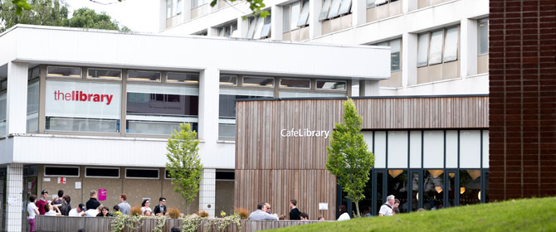
INTRODUCTION TO THE LIBRARY
A
Notes:
KH

Slide 22




WARWICK STUDENT UNION
A
A
Notes:
SU rep

Slide 23
INTRODUCTION TO
IT SERVICES
THE LIBRARY
A
Notes:
KH

Slide 24
MODULE AND SEMINAR REGISTRATION
A
Module registration opened on 23 September 2019.
You must have enrolled online and set up your IT account before you will be able to access Module Registration.
To register for modules please log on to MyWarwick or www.warwick.ac.uk/evision.
All modules are worth a certain number of ‘CATS’. CATS stands for ‘Credit Accumulation and Transfer Scheme’. All first year modules in Sociology are worth 15 CATS. You must take 120 CATS each academic year in total (60 CATS in the Autumn Term, 60 CATS in the Spring Term).
Some modules are ‘core’. This means that you have to take them and they will be pre-registered for you on the system.
A
Notes:
CT

Slide 25
MODULE AND SEMINAR REGISTRATION
A
Course Structures are available on the Undergraduate Portal.
The Course Structures detail which modules are core and how many optional module CATS you have each term. For a full list of available optional modules please see the Undergraduate Portal.
You can take up to 30 CATS of modules from outside the Department of Sociology. We call these ‘outside option’ modules.
If you choose to take an outside option please ensure that you speak to the department running the module and check that you are permitted to take the module.
You do not have to take any outside options if you don’t want to. It is fine to only take modules from within the Sociology Department.
Some modules have a choice of assessment method (e.g. an essay OR an examination). You must select which assessment method you would like to take.
A
Notes:
CT

Slide 26
MODULE AND SEMINAR REGISTRATION
A
You access your timetable through Tabula: https://tabula.warwick.ac.uk/
Once you have registered for your chosen modules your lectures will automatically populate on your Tabula timetable.
The Department of Sociology operates a ‘self-sign up’ system for selecting seminars. You will need to select the seminar you would like to attend from a range which will be offered on Tabula. Once you have selected your seminar for each module, they will also populate on your timetable.
It is your responsibility to ensure your seminars do not clash.
A
Notes:
CT

Slide 27
MODULE AND SEMINAR REGISTRATION
A
Need Help?
Contact Faye Brown or Chau Ho, Taught Programmes Officers, with any queries:
Email: socugresource@warwick.ac.uk
Telephone: 02476 523600 or 02476 524771
In person: Sociology Reception (E0.06), Ground Floor, E Corridor, Social Sciences Building
Module and Seminar Registration Drop-in sessions:
Tuesday 24th September, 12:00-13:00 in E0.23 (Social Sciences Building)
Thursday 26th September, 10:00-11:00 in the Sociology Common Room (D0.04)
Bring your laptop and we can help you navigate the system if you are struggling.
You can also find lots of essential information in the Undergraduate Handbook.
A
Notes:
CT

Slide 28
A
THIS WEEK (AND NEXT) AT A GLANCE
Tuesday 24 September 2019
11:00-12:00: Q&A and Department Tour
12:00-13:00: Lunch for students on the joint BA Law and Sociology degree (Location tbc)
12:00-13:00: Module & Seminar Registration Drop-In Session (E0.23, Social Sciences Building)
Wednesday 25 September 2019
11:00-12:00: Erasmus/Exchange Welcome Meeting (S0.08, Social Sciences Building)
14:00-15:00: Welcome meeting for students on the joint degree students (S0.20, Social Sciences Building).
18:00 - late evening: Scavenger Hunt (organised by Sociology Society) (meet in D0.04, Sociology Common Room, Social Sciences Building).
Thursday 26 September 2019
10:00-11:00: Module & Seminar Registration Drop-In Session (D0.04, Sociology Common Room, Social Sciences Building).
12:00-13:00: Sociology Pub Quiz (Studio Theatre, Arts Centre, Ground Floor).
14:00-15:00: Introduction to Sociology Society (MS0.1, Zeeman Building).
Notes:
AC

Slide 29
A
Q&A AND GUIDED TOUR
Humanities
Group A H0.56
Group B H0.58
Group C H0.60
Group D H0.61
Group E H0.64
Group F H0.66
Notes:
AC

