Slide 1
DEPARTMENT OF SOCIOLOGY
WELCOME BACK 2019

Slide 2
INTRODUCING …
A
HEAD OF DEPARTMENT
Virinder Kalra
A
UNDERGRADUATE TEAM
Nisha Kapoor (Director of Undergraduate Studies)
Katy Harsant (Deputy Director of Undergraduate Studies)
André Celtel (Director of Student Experience and Progression)
Charles Turner (Senior Tutor)
Azrini Wahidin (Director of International Programmes)
Darani Anand (Departmental Administrator, Teaching and Learning)
Faye Brown (Taught Programmes Officer)
Chau Ho (Taught Programmes Officer)
Notes:
AC

Slide 3
PERSONAL TUTORS AND SENIOR TUTOR
A
Each student allocated a Personal Tutor (via Tabula)
  Academic mentor, references, module choices, personal development, problems or difficulties
  Draw on a wide range of university services: Student Support, Mental Health and Wellbeing, Disability Services, Counselling Services, Residential Life
  University monitoring points: need to meet with your Personal Tutor at least once a Term. First monitoring point is by the end of Week 3 this term
The Senior Tutor – Dr Charles Turner– can also be contacted if for any reason your Personal Tutor is unavailable or you would like to discuss any issues regrading the Personal Tutor system.
A
Notes:
CT

Slide 4
UNDERGRADUATE PASTORAL CARE TEAM
A
DIRECTOR OF UNDERGRADUATE STUDIES
Dr Nisha Kapoor
DEPUTY DIRECTOR OF UNDERGRADUATE STUDIES
Dr Katy Harsant
SENIOR TUTOR
Dr Charles Turner
If you’re having problems or need advice, your first point of contact should be your personal tutor.
However, you’re also welcome to contact any member of the pastoral care team.
OTHER CONTACTS
Sexual Harassment Advisor – Dr Cath Lambert
Racial Equality Advisor – Prof Akwugo Emejulu
Disability Champions – Dr Ravi Thiara & Amy Clarke
TAUGHT PROGRAMMES OFFICERS
Faye Brown & Chau Ho
DEPARTMENT ADMINISTRATOR (TEACHING)
Darani Anand

Slide 5
UNDERGRADUATE STUDIES
A
The undergraduate portal on the Sociology webpage is where you will find key information related to your studies
It’s also where you’ll find the Undergraduate Handbook – please read this carefully as it contains everything that you need to know about the department, assessment, policies, procedures etc
Extensions and mitigating circumstances
A

Slide 6
WELLBEING SUPPORT SERVICES
A
KEY MESSAGES FROM WELLBEING SUPPORT
Get a healthy work-life balance
Respect yourself and others
Be self-aware
Seek out support when necessary
A
Notes:
Get a healthy work-life balance - We really hope your time at Warwick is productive and enjoyable, so we promote Wellbeing and a healthy balance of work, rest and play.
Respect yourself and others -Warwick is a vibrant community – we respect ourselves & others; we look out for ourselves & others.
Be self-aware - It might get tough sometimes; things don’t always go to plan, and life is a learning curve. Be aware of what you think you’ll manage well and also what you might find challenging. And plan how you can build your skills and resilience for when times may be tough.
Seek out support when necessary - Support is on hand for those difficult times, so remember, Wellbeing Support Services have a range of services for a wide range of needs (if you’re undergraduate or postgraduate; home or international; part-time or full-time …). There’s lots of other support available too. Seeking out the right help early on can ensure issues are manageable.

Slide 7
STUDENT–STAFF LIAISON COMMITTEE (SSLC)
A
SSLCs are committees made up of student representatives and members of staff.
Provide accessible arena for students to discuss with staff issues connected to teaching, learning and student support (e.g. curriculum development; feedback and assessment; library resources; careers and employability).
Strongest mechanism for students to get involved in the shaping of academic life in the department.
They also provide an opportunity for the department to consult with students and receive feedback on new proposals.
You can also use our 'Student Voice' feedback web form
Look out for our responses to feedback on the ‘You Said, We Did’ page
A
SSLC CONVENORS
Sociology – Katy Harsant
History and Sociology – Steve Fuller
Law and Sociology – Steve Fuller
Politics and Sociology – Steve Fuller
Sociology & Quant Methods – Roxana Baltaru
Notes:
KH

Slide 8
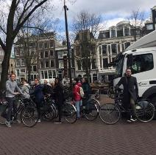
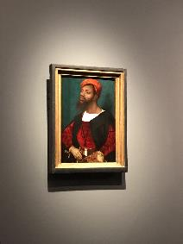
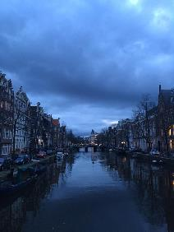
A
2018 - Postcolonial Amsterdam: Multiculture, Gentrification and Urban Space
SOCIOLOGY STUDY TRIP
Each year, the department organises a Study Trip in the last week of the Spring Term
Previous destinations have included Belgrade, Copenhagen, Lisbon, Berlin, Athens and Seville
The trip is subsidised by the department and the cost to students is usually £300 or less
Open to all Sociology students (UG, PGT, PhD)
Look out for more information – places go fast!
Notes:
?

Slide 9
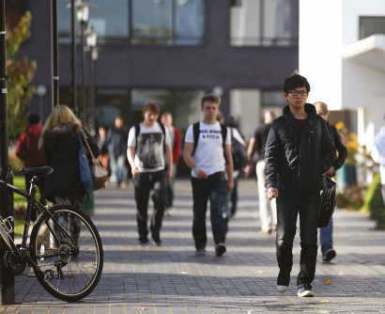
A
STUDYING ABROAD
In your 2nd year, you can apply to study abroad during the following year.
Your degree will be extended to 4 years (5 for BA Law and Sociology).
Some partner universities teach in the local language, but several partner universities in non-English-speaking countries offer teaching in English.
Funding is available for students going to partner universities in Europe.
Our network of partner universities is always changing, but currently students can apply for study abroad places in the Czech Republic, Denmark, Finland, France, Germany, the Netherlands, Portugal,
Spain, Sweden, as well as Australia, Canada, China, Hong Kong,
Japan, Malaysia and South Korea.
Notes:
?

Slide 10
ACADEMIC SKILLS
A
ADVICE AND FEEDBACK HOURS
All module convenors, lectures and tutors have Advice and Feedback hours (posted outside offices and on moodle pages)
  Discuss points raised in lectures
  Advice on essay writing; further feedback
Make use of these!
ESSAY CLINIC
Opportunity to bring along three or four essays to a meeting with the DSEP to discuss potential areas of general improvement
A
Writing mentors (drop-in or appointment)
Email support (writing e-line)
Assignment mentoring day
Academic skills appointments (exam revision, time management, note-making etc.)
Write Right (Moodle course on academic writing)
Critical thinking courses
Language support for international students
Exam revision workshop
Student Opportunity: Skills
Notes:
AC

Slide 11
IN-SESSIONAL ENGLISH LANGUAGE SERVICES (FOR INTERNATIONAL STUDENTS)
A
In-sessional English classes are additional academic English language classes for international students
  How to write an assignment or how to participate in a seminar – ‘stand-alone’ workshops (no need to register) available in weeks 2 & 3 (Term 1).
  Weekly academic English language classes (from wk 4, 21 Oct) – register online between 30 Sept and 25 Oct).
  English conversation practice in a friendly and safe setting – join the university’s ‘English conversation club’.
Further information on all these is available at: https://warwick.ac.uk/fac/soc/al/study/learn-english/in-sessional/
or email: insessional@warwick.ac.uk
Notes:
AC

Slide 12
‘STUDENT AS PRODUCER’
A
“All undergraduate students in all higher education institutions should experience learning through … research and inquiry. In undergraduate research, students learn … in ways that come as close as possible to the experience of academic staff carrying out their disciplinary research.”
(Healey and Jenkins, 2009).
Undergraduate Research Funding
Undergraduate Research Support Scheme (URSS)
Institute of Advanced Teaching and Learning (ITAL) ‘Student as Producer’ funding
Lord Rootes Memorial Fund
Undergraduate Conferences
International Conference of Undergraduate Research (ICUR)
British Conference of Undergraduate Research (BCUR)
Undergraduate Journals
Warwick Sociology Journal
Reinvention: an International Journal of Undergraduate Research
Other undergraduate journals
Find further info on undergraduate research at Warwick here and here.
Notes:
AC

Slide 13



UG Research Support Scheme
Undergraduate Research Support Scheme (URSS)
Wendy Hunt
URSS Coordinator
urss@warwick.ac.uk
www.warwick.ac.uk/urss

Slide 14
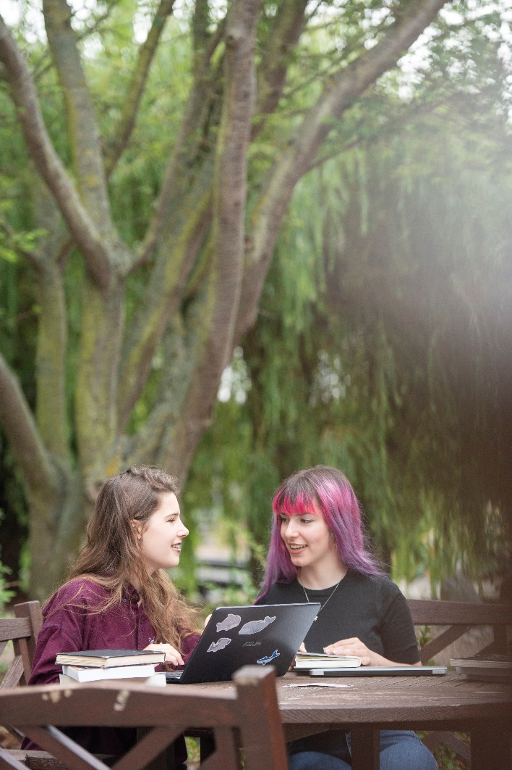
Why do a URSS project?
Apply for a bursary to carry out a 6-10 week non-assessed research project of your choice over the summer
Get a real insight into working in research at a world-leading, research-led university
Identify your own research project and find an academic or post-doctoral student who can supervise you

Slide 15
Why get involved?
Get a real taste of research
Develop transferable skills for further study or a career
Opportunity for an international experience
Build your CV & confidence
Receive a Certificate of Completion & get the URSS recorded on your Higher Education Achievement Record (HEAR)
Receive a bursary to assist with living and travel costs
Complete an online portfolio; attend workshops; develop research skills
Opportunity to present & publish your research

Slide 16
How do I get involved ?
Let staff in department know you are interested in doing a URSS project
Approach an academic/post doctoral student in your chosen subject to discuss your ideas for a possible project
Ask if there are any on-going research projects in your department
Talk to former URSS participants about their experience
Identify a government organisation, research centre, lab or NGO and see if they would be willing to host you to carry out your research project

Slide 17
How do I apply?
Application opens 30 September 2019 - www.warwick.ac.uk/urss
Applications closes on 3 January 2020
Application should be completed in conjunction with your supervisor
Application has 2 sections: section 1 (completed by student), section 2 (completed by supervisor)
Attend one of the drop-in session in the Student Opportunity Hub on the Piazza (every Wednesday between 2-4pm)
Come along to the URSS Showcase -Wed 13 November 2019, 1-4pm, Panorama room, Rootes Building

Slide 18
What do I include in my application?
Each is assessed and scored against criteria focused on impact, quality and value for money
Consider how the project contributes to a knowledge base, the community, or internationally
Include what you hope to gain from doing the URSS
Make sure the project is realistic, feasible and can be carried out in the time frame specified
Include a breakdown of your budget
Each application is reviewed on an individual basis by a review pair

Slide 19
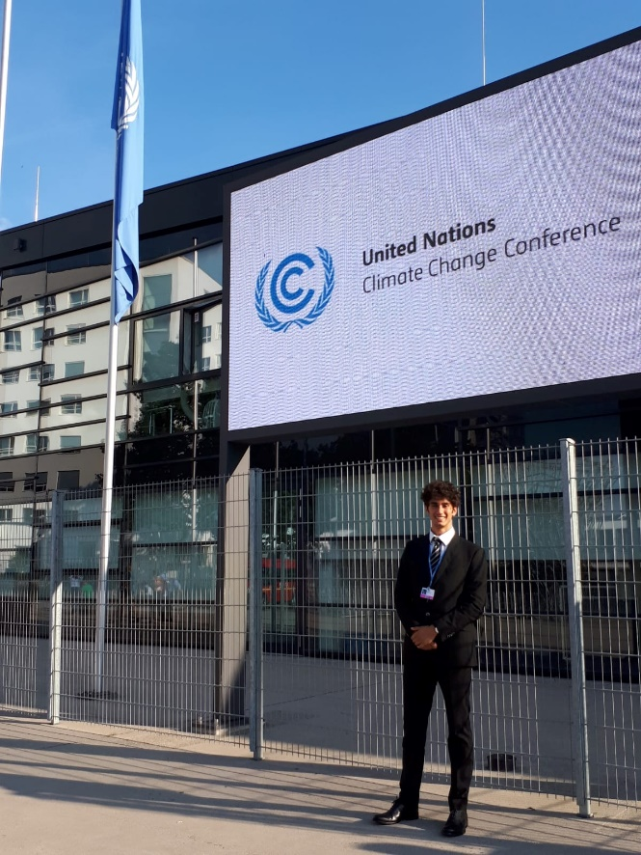
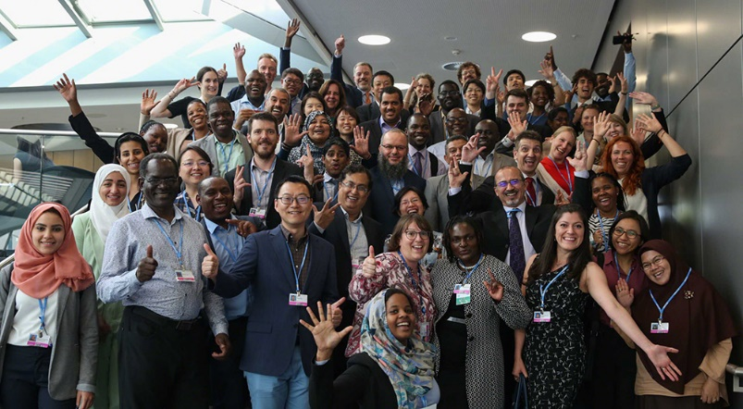
Nicola Blasetti, URSS participant 2019
Global Sustainable Development
I graduated in Politics and International Studies & Global Sustainable Development in July 2019. Over this summer I carried out my second URSS-financed research project. I spent ten weeks in Rome while being hosted at the Italian Ministry for the Environment, Land and Sea. My research looked at showcasing the impacts of climate change in Italy and the policies that have been implemented to fight the climate crisis. The poster, which resulted from the project, will be exhibited at the Italian pavilion of Cop25 in Chile, in December 2019. Thanks to the URSS bursary I managed to cover my expenses and to attend the UN Climate Conference in Bonn in June 2019, where I was part of the Italian delegation of climate negotiators. At the Conference I supported my colleagues and experienced the functioning of the United Nations.
If you are interested in learning more about a specific area of research while exploring the world, don’t miss out on this opportunity! I would do it all over again if I had the chance. My URSS projects have definitely been the highlight of my university experience.

Slide 20
What the students say…….
The best part of the URSS experience for me was meeting everyone in the team that I worked with. They were all super friendly and went out of their way to make me feel comfortable and a part of their team.
The URSS experience has given me a good insight into life as a research scientist…. and would now consider studying further!
URSS project is an amazing experience for me. I never imagined working in a biochemistry lab & doing official practical experiment with PhDs or Postdocs before
The best part of the URSS Experience was the knowledge that my research could hopefully benefit others one day. My URSS project was inspired by my own real-life experience of being bullied and embarking on this project was a great way to de-stress and channel the negativity into a positive experience. I hope that with my research, I could raise awareness on such behaviours and hopefully inspire lawmakers to enact legislation that can combat social exclusion bullying, in the hopes of increasing justice for victims of mental bullying in the future.
The best part of my URSS experience was working alongside PhD students and having a leading academic in the field available for guidance at any time.
The best thing about my URSS Experience was getting to research in another country. I experienced the challenges of using foreign language sources and working in a completely new setting. I was hugely rewarded, gaining wonderful cultural experiences and having the opportunity to uncover fascinating new archival sources that contribute to the existing literature on my topic.
The best part of the URSS was getting the opportunity to make a real and significant difference to society whilst gaining valuable experience in my chosen field, all whilst focusing my career path

Slide 21
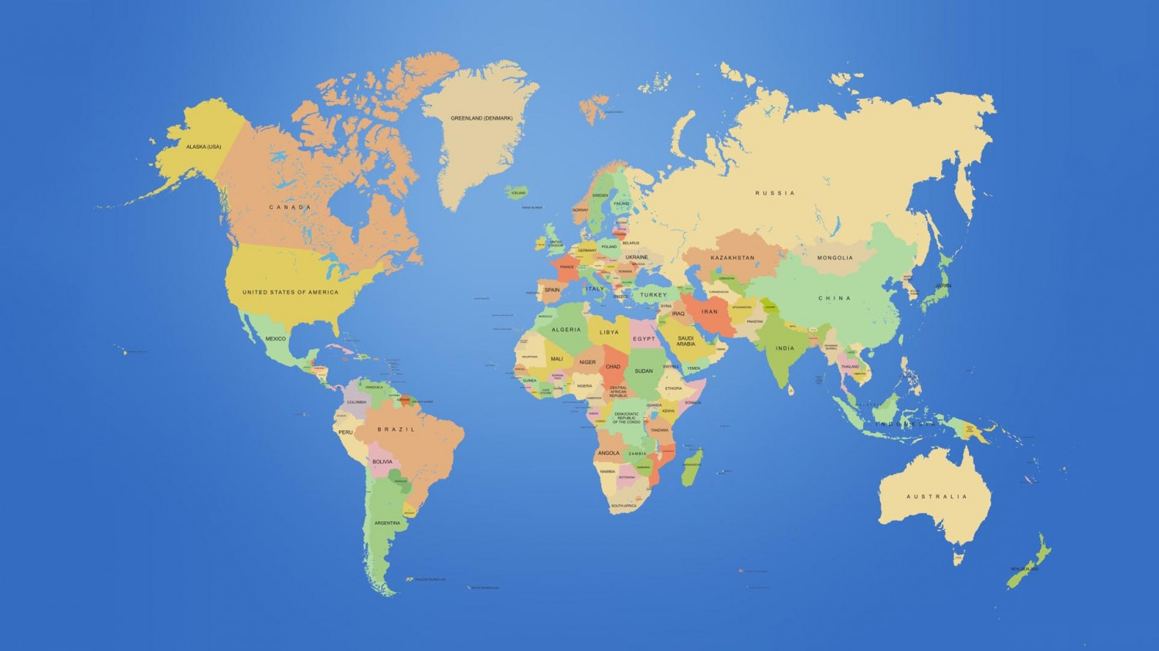
Austria
Bulgaria
Croatia
Denmark
France
Germany
Hungary
Malta
Poland
Serbia
Slovenia
Sweden
Switzerland
Romania
Ukraine
Egypt
Cambodia
China
Hong Kong
Indonesia
Singapore
Sri Lanka
Taiwan
Thailand
Argentina
Canada
Mexico
Peru
USA
Where the URSS students went in 2019

Slide 22
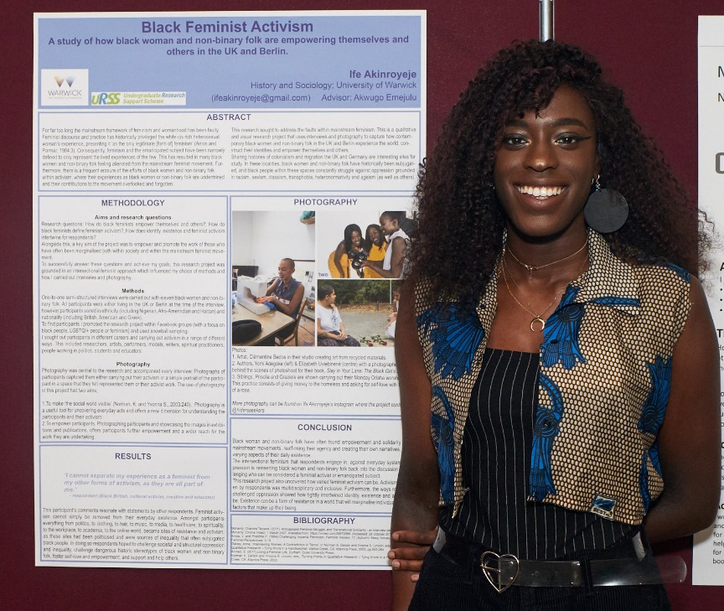

Any questions?
“I thoroughly enjoyed the URSS experience and gained so much from the programme. I have increased my skills in everything from research methods, to creating and presenting research, to communicating research to different audiences to organisation and time-management”
Ife Akinroyeje, URSS participant, History & Sociology
Wendy Hunt
URSS Coordinator
urss@warwick.ac.uk
www.warwick.ac.uk/urss
Notes:
Introduce objectives of the session. Negotiate expectations.

Slide 23

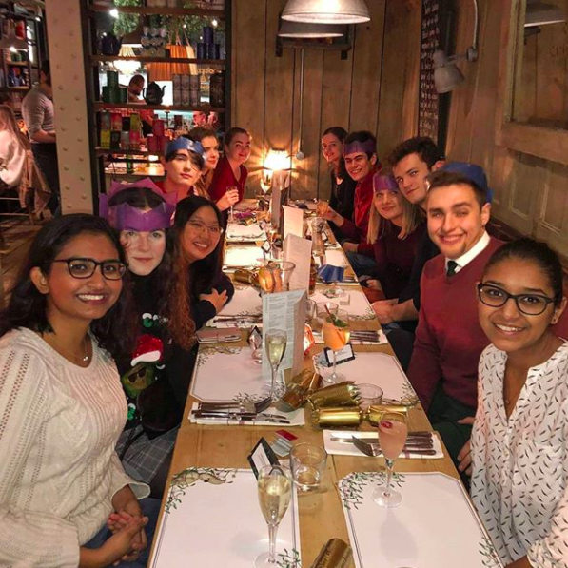
We are a welcoming and inclusive society with a diverse range of members that share an interest in Sociology
We offer a wide range of events:
Academic Events – from documentary screenings to careers fairs
Social Events – from bowling to bar crawls
Welfare Events – our mentoring scheme and advice drop-in sessions
Charity Events – SocSoc Socks, quiz nights and an annual raffle. All proceeds go to local charities
Whatever your interests may be, we’re sure SocSoc will have something to offer you!
Notes:
SocSoc

Slide 24

C
Clare Halldron- Careers Consultant
Sociology- c.m.halldron@warwick.ac.uk

Slide 25


Events & Workshops Autumn 2019
10am – 3.30pm Fri 4th Oct : Volunteering Fair
11am – 4pm Thurs 10th Oct: Autumn Careers Fair
6.30pm – 8.30pm Wed 23rd Oct: Careers in the Creative Industries
6.30pm – 8.30pm Tues 29th Oct: Careers in the Public Sector
11am- 4.00pm Thurs 17th Oct: Business, Finance & Consulting
1.00pm- 4.00pm Tues 22nd Oct: Law Fair
Making applications in the creative industries I An introduction to Freelancing I Marketing insights I Civil Service I Intercultural Communication I
Making Career Choices I Effective Applications I Considering a Masters

Slide 26
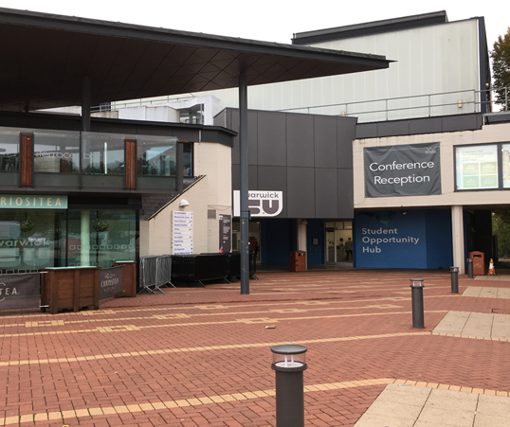
One to one support
Drop In: Thursday AM- Sociology Students
Bookable Appointments: Thursday PM
Social Sciences Careers Office
(University House appointments Mon-Fri)
Job Search Advice- Student Opportunity Hub
Drop In Monday - Friday 8.30am- 2pm

Slide 27
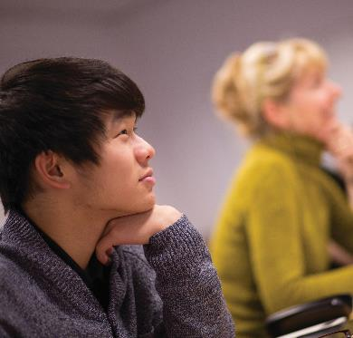
PERSONAL DEVELOPMENT, CAREERS, OPPORTUNITIES
A
FULL CAREERS PROGRAMME
Workshops/events/activities for all years
OPPORTUNITIES
Wide range of opportunities to explore.
DSEP EMAILS
Watch out for regular ‘DSEP’ emails.
Discuss with Personal Tutor or make one-to-one DSEP appointment.
Notes:
AC

Slide 28
MODULE AND SEMINAR REGISTRATION
A
Need Help?
Contact Faye Brown or Chau Ho, Taught Programmes Officers, with any queries:
Email: socugresource@warwick.ac.uk
Telephone: 02476 523600 or 02476 524771
In person: Sociology Reception (E0.06), Ground Floor, E Corridor, Social Sciences Building
A

