Slide 1


The Sleep of the Nation
Simon Williams
Department of Sociology, University of Warwick
Problems, Politics, Prospects

Slide 2
Some Questions to Ponder…
Are we a sleep ‘poor’ nation of bleary-eyed Britons?
Is sleep another (hidden) ‘national debt’ we are trading on?
What are the costs and consequence of poor sleep for society?
What, if anything, should be done about it?

Slide 3
Problems, Politics, Prospects…
Provocative or Rhetorical questions?
Maybe, BUT…
Sleep problematized and politicised in countless ways today in the ‘24/7 society’
Many claims, discourses, debates on the problems, politics, prospects of sleep today…

Slide 4
Problems: Counting Sleep…(1)
Great British Sleep Survey (2012) -- completed by 21,300 adults– which reports:
An average sleep score in the UK of 5.1 out of 10, which ‘just scrapes into the average category’
Sleep problems affect 1 in 3 of us at any time, it is claimed, and about 10% of us on a chronic basis
42% of those on sleeping pills had sleep problems for over a decade
New GBSS survey just launched with the aim of helping to ‘better understand the nation’s sleep’ http://www.eye.ox.ac.uk/news/great-british-sleep-survey-launched

Slide 5
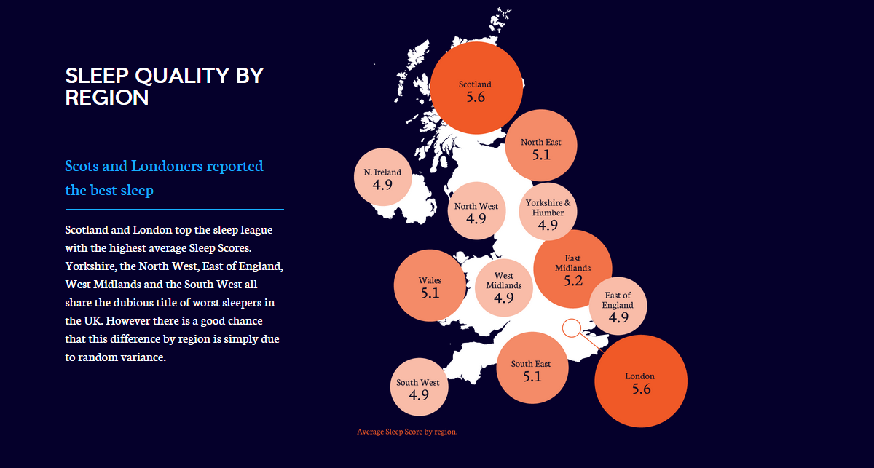
Source: Great British Sleep Survey (2011)

Slide 6
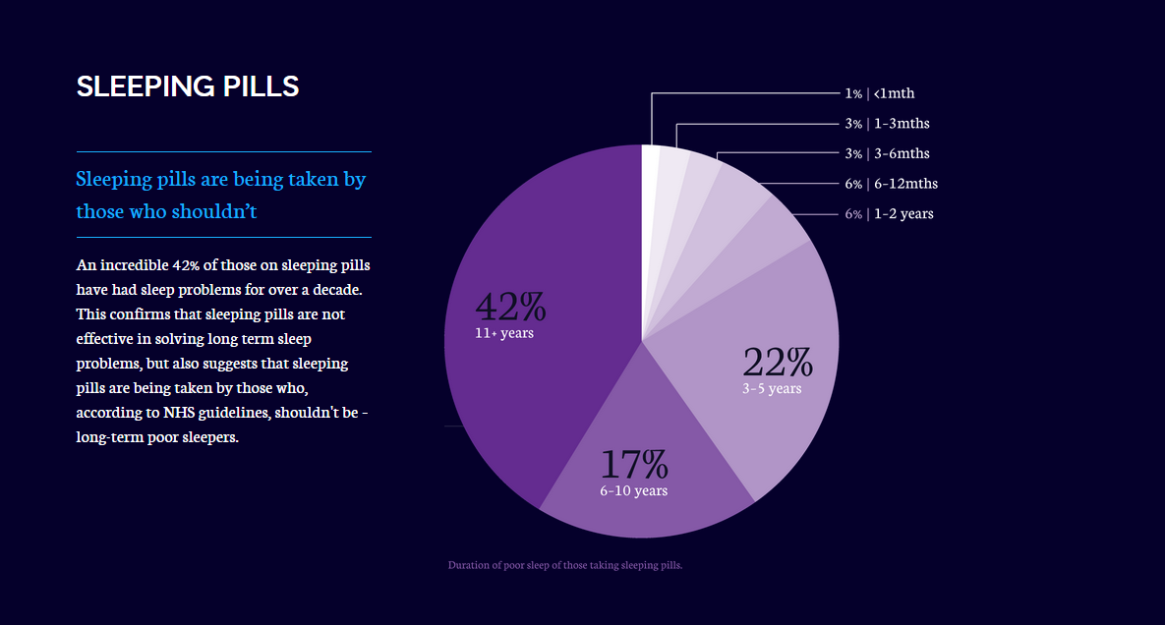
Source: Great British Sleep Survey (2011)

Slide 7
Problems…Counting sleep (4)
Preliminary Findings from (First wave) ESRC Understanding Society Survey (Arber and Meadows 2011) -- completed by a representative sample of over 17,000 people living in the UK:
Sleep duration: overall 1/3rd of people reported sleeping less than 6.5 hours per night, with 12% reporting very short sleep (less than 6 hours per night)
Long work hours (more than 48hrs per week) associated with an increase in short sleep duration
Strong linkages evident between disadvantaged SES and short sleep duration

Slide 8
Problems…Counting sleep (5)
Sleep medications: 1/10th report taking sleep medications (including prescription and OTC) on more than 3 nights a week, with strong and linear age gradient, especially for women
Sleep quality: overall women more likely to have sleep problems than men, several sleep problems found to increase with age, such as taking sleeping medications and waking up in the night.

Slide 9
Problems…Counting Sleep (6)
Claims of widespread ‘social jet lag’ due to clash, drift or mismatch between our biological and social clocks…

Slide 10
Problems…Counting Sleep (7)
Costs and Consequences – Public as well as Personal, including:
Health
  -- Mental and physical
  -- Approximately 1o million prescriptions for sleeping pills (prescription hypnotics) issued each year in England and Wales alone, costing the NHS approx. £88 million in 2013
Safety
  – Accidents; drowsiness every bit as dangerous as drunkenness
Productivity and Performance

Slide 11
Problems…Counting Sleep (8)
Causes:
Wide range of factors cited such as:
  Long-standing negative attitudes toward sleep and punishing work schedules
  Artificial light; (digital) technology; non-stop culture; 24/7 society
  Underlying medical conditions and (un)diagnosed/(un)treated sleep disorders
  A fundamental clash or drift between our biological and social clocks resulting in widespread ‘social jet lag’…

Slide 12
Problems…Counting Sleep (9)
These claims, facts, figures echoed and amplified through Reports from the likes of:
  Demos (2004) – “Dream on: Sleep in the 24/7 Society”
  BACP (2005) – “Insomniac Briton”
  MHF (2011) – “Sleep Matters: the Impact of Sleep on Health and Wellbeing”

Slide 13
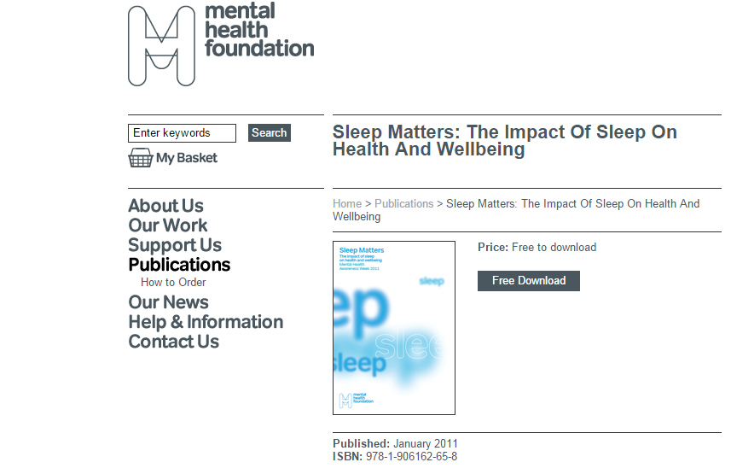

Slide 14
Politics…
So…
What, if anything, should be done about this?

Slide 15
Politics: Championing Sleep (1)
Pro-Sleep Agendas – spanning medical, corporate and third sector advocates. Range of measures called for, including:
Medicine, Health Care and Public Health:
Better medical training and treatment regarding sleep matters
Development of NICE guidelines for insomnia management – greater training in and use of non-pharmacological therapies to complement existing guidance using pharmacological therapies
Promotion of new (digital) technologies to track and treat sleep problems (e.g. CBTi, smartphone apps etc.)
Reduction in sleep problems as part of new public health outcomes framework

Slide 16
Politics: Championing Sleep (2)
Pro-Sleep Agendas – cont…
Work: End to long hours cultures, breakfast meetings etc.; design of more “sleep-friendly” or “sleep-wise” shift work schedules, promotion of workplace napping etc.
Home & School: Better education on sleep matters/sleep hygiene (parents & children), later school start times for sleepy teenagers (already underway in some US states)
Other Public and Political Measures: Provision of better public napping facilities; further measures to reduce environmental noise and light pollution; politicians and other public figures to lead by example, challenging long-standing negative sleep (‘is for wimps’) attitudes and values…

Slide 17
Politics: Contesting Sleep (1)
BUT … an ‘uphill struggle’ or ‘distant dream’ perhaps given:
  Prevailing negative attitudes and agendas which continue to dismiss or devalue sleep in the 24/7 society
  Disputes, past and present, regarding the extent of the problem and the efficacy or wisdom of these pro-sleep agendas …
  Recourse to other ‘more important matters’ or ‘pressing priorities’…

Slide 18
Politics: Contesting Sleep (2)
At most:
  A matter for doctors and other sleep experts to address, in the case of bona fide sleep disorders?
BUT BEYOND that:
  The ‘Nanny State’ gone mad!

Slide 19
Politics: Paradoxes (3)
These problems evident in our own ESRC study. A paradox evident (in our stakeholder/public focus groups) whereby sleep:
Both valued and dismissed: acknowledged as a vital part of everyday/night life, but often not at the forefront of people’s minds
Sleep need individualised, cut back on and put last in list of priorities, if placed in list at all
Work, study, childcare, housework, leisure and other precious ‘me time’ in ‘busy lives’ often prioritised over time afforded to sleep, sometimes wilfully, but mostly not…

Slide 20
Prospects: A Better or Well-Slept Nation …(1)?
Two future scenarios regarding the sleep of the nation:
  Pessimistic Scenario (1): Continuation or exacerbation of existing sleep problems…A ‘Sleep-Poor’ or ‘Sleep-less’ Nation?
  Optimistic Scenario (2): Further progress/traction of “Pro-Sleep” Agendas …A ‘Better’ or ‘Well-Slept’ Nation?

Slide 21
Prospects: A Bettor Well-Slept Nation …(2)?
Scenario 1 the most likely or realistic, in the immediate/near future, given:
Other priorities will, in all probability, continue to trump sleep matters
The lure or temptation of ‘enhancements’ to reduce or ‘customise’ our sleep still further in the 24/7 society…?

Slide 22
Prospects: A Better or Well Slept Nation…(3)?
To the extent nevertheless that:
Sleep is a problem for some if not many of us today
These problems and struggles are social as well as medical, public as well as personal
Then:
Concerted and coordinated policies to protect and promote the sleep of nation may well be called for on precisely these counts
Getting sufficient sleep, moreover, is:
A human right
Another (hidden) dimension of inequality -- if not inequity or injustice?
Vital to current and future GWB not just GDP Political Agendas

Slide 23
Prospects: A Better or Well-Slept Nation …(4)?
A crucial role for the social sciences here too in documenting, discussing and debating the problems and prospects of sleep:
  Today’s event, for example…
Part and parcel of the politics of sleep …
END

