Slide 1

40 years of homicide trends in England and Wales
Dr. Emily Gray,
Professor Stephen Farrall,
and Professor Andromachi Tseloni

Slide 2
Long Term Violence Trends in England and Wales
Homicides in E&W account for a fraction of deaths. Between 2017 to 2021, homicide was the cause of 1 in every 800 deaths (Morgan et al, 2020).
Homicide research in E&W has been limited by low rates and access to quality data, which has left a critical gap in explaining the trends.
Recorded homicides in E&W increased from the mid-1960s until a peak in 2003.
From the early 1990s, homicides have been decreasing in numerous industrialised countries, although the decline in E&W was delayed by almost a decade compared to other western countries (Miles and Buehler 2020).

Slide 3
Non-lethal Violence Trends (Crime Survey for England and Wales) 1982-2019 (rates per 1k, pop)

Slide 4
Homicide Trends (Homicide Index) 1977-2020 (rates per 100k, pop)
Homicide rate – persons killed in England and Wales 1977-2020 (per 100k pop)

Slide 5
Homicide victimisation by gender - England & Wales, 1977-2020 (rate per 100k)

Slide 6
Homicide by gender relationship - Homicide Index (England & Wales) 1977-2020 (rate per 100k)

Slide 7
Dynamic Victimisation Context – 40 years
Female victims
Majority of female homicide victims are killed by partners or family members.
This pattern is remarkably consistent over four decades.
Intimate partner killings remain the dominant context, showing the persistence of gendered violence in domestic spaces.
Acquaintance/stranger killings of women are rare and stable over time.
Highlights the enduring link between gender inequality and lethal violence against women.
Male victims
Occurs largely outside the home: acquaintances and strangers dominate.
Proportions are much higher than for women, with marked volatility over time (periodic spikes).
Domestic contexts (partner/family) are a minor but persistent element.
Suggests male victimisation is more shaped by public, social, and situational factors — including disputes, street violence, and illicit markets.
Unlike the steady female pattern, male homicide is less predictable and harder to explain

Slide 8

Summary: gendered long-term homicide trends
Persistent steady downward trend in male-on-female violence over forty years, although the context of female homicide within an intimate relationship or family remains consistent.
Meanwhile, male-on-male violence, particularly outside of domestic contexts (acquaintance/ stranger), shows resilience and periodic sharp volatility (spikes) – which we lack clear understanding of.

Slide 9
Homicide Trends in BAME populations
Data Limitations
Ethnic data is a relatively recent analytical resource in Homicide Index, collected from 1997.
Similarly, it was only introduced as a demographic category in the 1991 census, with the adoption of a seven-category classification system (Laux, 2019).
The Labour Force Survey was one of the first to incorporate this categorisation in 1993.
For ethnicity, population-adjusted homicide rates provide the most meaningful measure, because they account for the size of each group in England and Wales. (see also Kumar et al. 2020, 2022)

Slide 10
Homicide victim-to-population ratio by ethnicity
Census year | N, white† homicide victims | % of homicide victims | % in Pop estimate | White vic'sation ratio
2001 | 517 | 0.711 | 0.913 | 0.778
2011 | 409 | 0.686 | 0.860 | 0.797
2021 | 277 | 0.695 | 0.817 | 0.851
 | N, Asian†† homicide victims | % of homicide victims | % in Pop estimate | Asian vic'sation ratio
2001 | 60 | 0.083 | 0.044 | 1.875
2011 | 46 | 0.077 | 0.075 | 1.029
2021 | 37 | 0.093 | 0.093 | 0.999
 | N, Black ††† homicide victims | % of homicide victims | % in Pop estimate | Black vic'sation ratio
2001 | 103 | 0.141 | 0.022 | 6.439
2011 | 107 | 0.179 | 0.033 | 5.440
2021 | 66 | 0.165 | 0.040 | 4.145
Black individuals: over six times more likely than expected to be homicide victims in 2001; substantial overrepresentation persisted in 2011 and 2021.
Asian individuals: overrepresented in 2001; broadly proportionate in 2011 and 2021.
White individuals: underrepresented across all three census years.
† White British, Irish and any other White background.
†† Indian, Pakistani, Bangladeshi and any other Asian background.
††† Caribbean, African and any other Black background

Slide 11
Access to Justice
Unsolved cases
1977–early 1990s: proportion of homicide victims without an identified suspect stable (around 5%).
Around early 2000s and again from 2010: sharp rise in unsolved cases.
By 2016: around 15% of homicides had no suspect identified.
Implications: raises concerns about the capacity of police and the wider society to address lethal violence. See Nicholls et al, 2025.
Data Caveat. Homicide Index is a live data-set - updated as police investigations progress.
Homicide investigations can take a long time to complete, so we must treat recent years with caution, as no-suspect figures may reduce over time.

Slide 12
% No suspects identified - male victims age 16-30, 1997-2019
.
As a percentage of unsolved homicides, young Black men (aged 16-30) have some of the highest proportions of unsolved cases since 1997.
Frequently above 20%, and even when proportions declined in the mid-2010s, it remained higher than for other groups

Slide 13

Access to Justice: Court outcomes for homicide cases (England & Wales) 1997-2020
All victims
White: 41% murder, 32% manslaughter, 7% acquitted.
Asian: 50% murder, 23% manslaughter, 7% acquitted.
Black: 44% murder, 23% manslaughter, 12% acquitted.
Young male victims (16–30)
White: 41% murder, 37% manslaughter, 10% acquitted,
Asian: 52% murder, 22% manslaughter, 12% acquitted,
Black: 44% murder, 18% manslaughter, 16% acquitted.

Slide 14
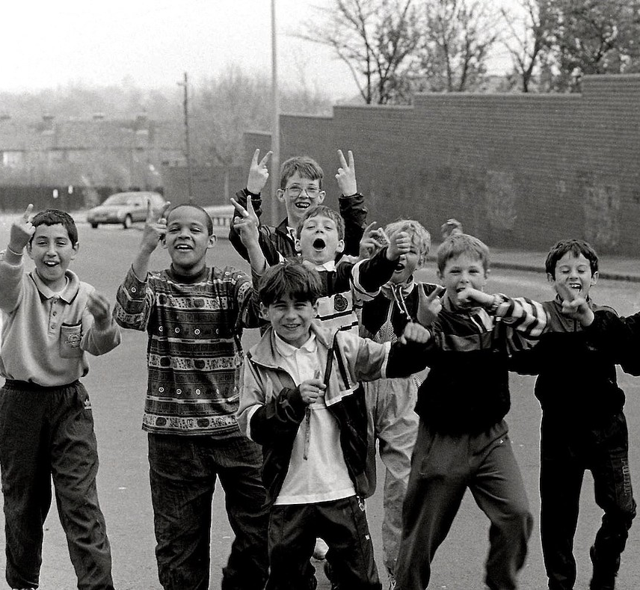
Looking at political cohorts
Question: Does homicide vary across different political periods over the past 40 years in England and Wales, if so how?
Method: Age, period and cohort effects.
See (Gray et al, 2019). Different generations live at different times, grow up with different socialisation experiences and encounter changing social norms and institutions, all of which may result in cohort differences in their experience of crime.

Slide 15
Age, Period, Cohort Analysis
AGE
PERIOD
COHORT
Temporal shifts that impact a group who are ‘growing up’ and being socialised in a particular manner. Gen X, Boomers.
Temporal change as an individual ages (i.e. childhood, adolescence, adulthood, etc)
Temporal relevance of the period which impacts the whole population in a similar way (a pandemic, war)

Slide 16
Our Cohorts
Post-War Consensus (‘45-’64): commitment to full employment; generous welfare state; low crime rates
Wilson/Callaghan/Heath (‘65-’79): initial questioning of PWC; crime starts to rise
Thatcher/Major (‘79-’97): extensive welfare retrenchment; dramatic increases in crime
New Labour (‘97-’10): limited reinvestment in welfare state, esp. amongst disadvantaged people

Slide 17
Homicide rate per 100k pop (victims) 1977-2020 by political generation

Slide 18
Lethal Violence Across Political Generations
It appears that there is a strong relationship between political generations and homicides (rates; victims).
Confirms some of our earlier analyses with regards to crime in general.
Explanations? Welfare spend; economy; inequality were part of the explanation for general crime rates from our earlier work.
These may vary in significance for cohorts.

Slide 19
Contact
Emily.Gray@warwick.ac.uk

Slide 20
References
Gray E, Grasso, M, Farrall S, Jennings W, Hay C. 2019. Political Socialization, Worry about Crime and Antisocial Behaviour: An Analysis of Age, Period and Cohort Effects, The British Journal of Criminology, https://doi.org/10.1093/bjc/azy024
Kumar S, Sherman LW, Strang H. 2020. Racial disparities in homicide victimisation rates: how to improve transparency by the Office of National Statistics in England and Wales. Camb. J. Evidence-Based Polic. 4(3):178–86
Kumar S, Sherman LW, Strang H. 2022. The fall and rise of racial inequality in London homicides: a challenge for policing by consent. Camb. J. Evidenced-Based Polic. 6:202–25
Laux R. 2019. 50 years of collecting ethnicity data. Cabinet Office https://history.blog.gov.uk/2019/03/07/50-years-of-collecting-ethnicity-data/
Miles C., and Buehler E. 2020. The homicide drop in England and Wales 2004–2014. Criminology & Criminal Justice, 22(1), 3-23.
Morgan N, Shaw, O, Mailley J, Channing R, Sweiry, A, Kruithof K, Bloom J, Kent A, Smith K, and Romaniuk A. 2020 Trends and Drivers of Homicide. Home Office Research Report 113.
Nicholls R, Brookman F, Jones H, and Maguire E. 2025. Homicides in England and Wales: The Effects of Victim and Offense Characteristics on Case Clearance. Homicide Studies. https://doi.org/10.1177/10887679251320257

Slide 21
Relationship context with offender – % female homicide victims 1977-2020

Slide 22
Relationship context with offender – % male homicide victims 1977-2020

Slide 23
Percentage of no-suspects located in homicide victimisation 1977-2020**

Slide 24
Our Political Cohorts
 | Post-War Consensus | Wilson/ Callaghan/ Heath | Thatcher/ Major Generation | New Labour Generation
Years (formative years) | 1945-1964 | 1965-1978 | 1979-1996 | 1997-2010
 | (18 years) | (13 years) | (18 years) | (13 years)
Years of birth | 1925-1944 | 1945-1958 | 1959-1976 | 1977-1990
Aged 15 | 1940-1959 | 1960-1973 | 1974-1992 | 1993-2006
Age at homicide peak (2003) | 59-78 | 45-58 | 27-44 | 13-26

