Slide 1
The Burgess Shale Controversies
Contested views of the Cambrian ‘explosion’ and the history of life
Part 1: A Multiplicity of ‘Weird Wonders’?
Walcott versus Whittington et al (and Gould)
Tony Elger
East Lothian U3a November 2018
Note: full sources for images used are given in the attached notes for each slide

Slide 2
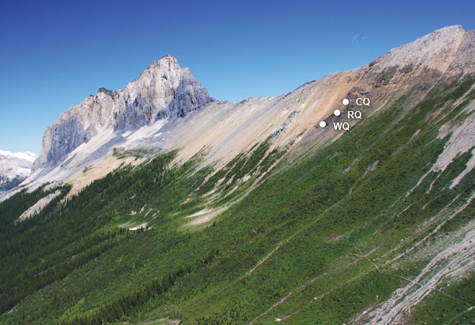
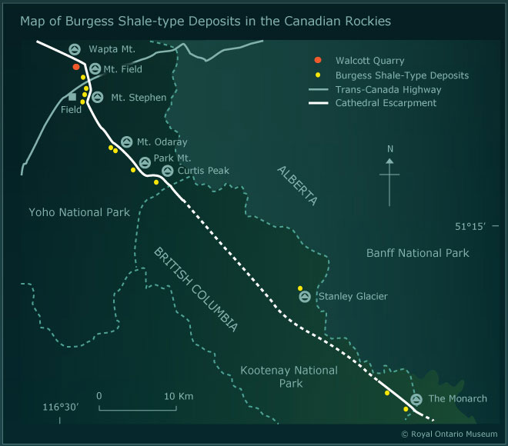
What is the Burgess Shale?
Located in mountainous country in the Rockies of north west Canada
Middle Cambrian sedimentary rock on Wapta mountain-side close to Field
Famous for abundance of soft bodied fossils
© Royal Ontario Museum website
Notes:
Left hand ROM image: ‘Aerial view showing Wapta Mountain with main Burgess Shale sites’ at ROM/Parks Canada web site,
Royal Ontario Museum https://burgess-shale.rom.on.ca/en/science/burgess-shale/01-today.php
Right hand ROM image: ‘Map of Burgess Shale-type Deposits in the Canadian Rockies’ at ROM/Parks Canada web site
Royal Ontario Museum https://burgess-shale.rom.on.ca/en/science/burgess-shale/01-today.php

Slide 3
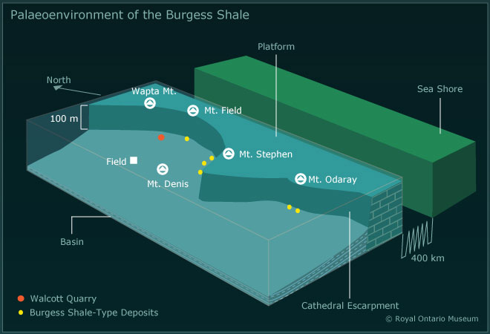
The distinctive preservation of soft bodied Burgess fossils
Fossilisation in rare conservation ‘lagerstätte’ produced by mud slides from continental shelf
Soft-tissue preservation linked to
specific chemistry of Cambrian
oceans: rapid burial in fine
sediments; low sulphates so low
oxidation; high alkalinity so early
carbonate sealing of sediments
Death assemblages of squashed specimens, but with layered soft-body preservation
Small specimens often complete, larger ones broken
Image from excellent Royal Ontario Museum website
Notes:
Image from ROM: ‘Palaeoenvironment of the Burgess Shale’ at ROM/Parks Canada web site
Royal Ontario Museum https://burgess-shale.rom.on.ca/en/science/burgess-shale/02-geological background.php

Slide 4
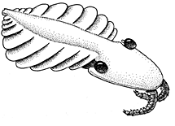
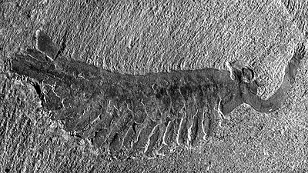
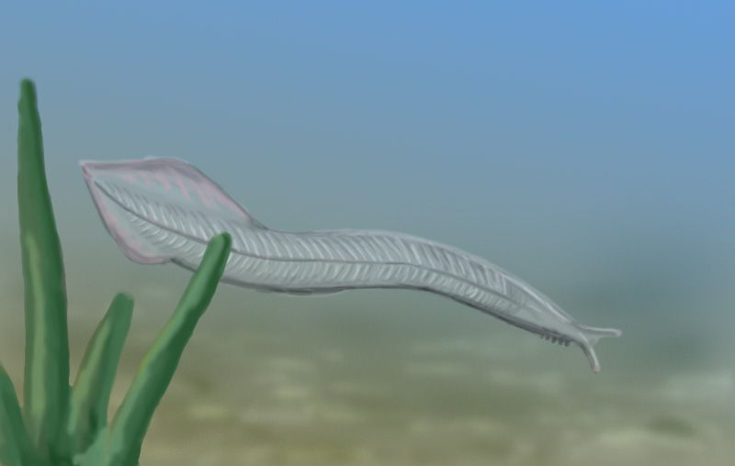
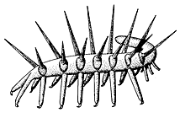
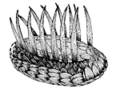
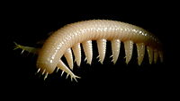
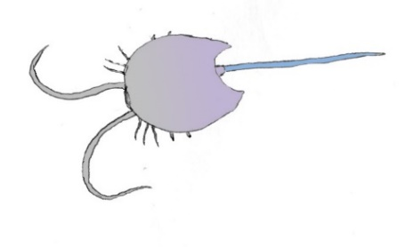
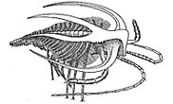
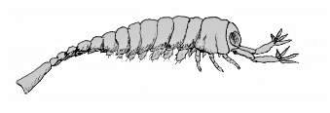
Some examples of Burgess shale fossils
Anomalocaris (30-60 cm)
Opabinia (7+ cm)
Pikaia
(5+ cm)
Hallucigenia [version 2]
(2 cm)
Wiwaxia (3 cm)
Ayesha (>4 cm.)
Marella (4 cm)
Yohoia (2 cm)
Burgessia
(3 cm)
Notes:
Several of these images are from the Smithsonian Institution Burgess Shale fossils web-site at https://natural history2.si.edu/paleobiology/burgess/
Anomolocaris is at Smithsonian as above /anomalocaris.html
Hallucigenia is at Smithsonian as above /hallucigenia.html
Marrella is at Smithsonian as above marrella.html
Wiwaxia is at Smithsonian web-site as above /wiwaxia.html
Several of the images are from Wikipedia at wiki/fossils_of_the_Burgess_Shale#/media/
The image of Aysheaia is from wikimedia commons at media/File:Aysheaia2.jpg illustration by Citron/CC-BY-SA-3.0 ?
The image of Burgessia is from wikimedia commons at media/File:Burgessia.jpg © Ghedoghedo
The image of Pikaia is from Wikimedia commons at media/File:Pikaia_BW.jpg illustration by Nobu Tamura
The image of Yohoia is from Wikimedia commons at media/File:Yohoia.jpg © Ghedoghedo
The edited image of Opabinia is from Royal Ottawa Museum (ROM) Home > Fossil Gallery > Opabinia
(or at Smithsonian Institution as above /opabinia.html)

Slide 5
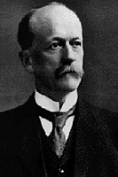
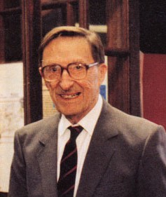
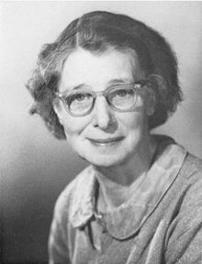
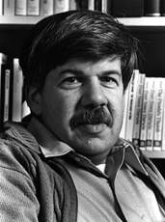
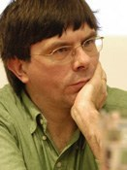

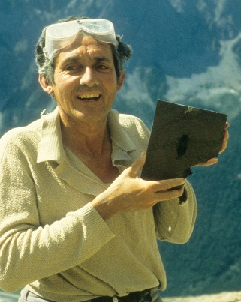
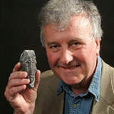
Key figures involved in the Burgess fossil controversies
Charles Dolittle
Walcott
1850-1927
Harry B.
Whittington
1916-
2010
Sidnie Milana
Manton
1902-
1979
Stephen
Jay
Gould
1941-
2002
Simon
Conway
Morris
1951-
Derek
Briggs
1950-
Desmond
Collins
1938-(retired
2005)
Richard
Fortey
1946-
Notes:
Walcott image © Smithsonian Institution Archives photograph by Pach Brothers, NY circa 1900 Record Unit 95, Box 23, Folder 21-B ID 83-14147 at //siarchives.si.edu/collections/siris_sic_9229
Whittington image from ROM website at https://burgess-shale.rom.on.ca/en/history/discoveries/05-rom.php
Manton Wikipedia image at wiki/Sidnie_Manton photograph by W Bird 1967 © Fellows of the Royal Society
Gould image at ‘University of Michigan Wonders of the Universe’ from Stanford Presedatorial Lectures: SJG, at https://prelectur.Stanford.edu/lectures/gould/
Conway Morris image from Department of Earth Sciences, University of Cambridge website at directory/simon_conway_morris
Briggs image at Yale University: ‘The People of Geology and Geophysics’ /profile/derek-briggs/about
Collins image: ‘Desmond Collins holding a newly discovered fossil’ (Sanctacaris) 1983 at ROM/Parks Canada web site
Royal Ontario Museum https://burgess-shale.rom.on.ca/en/history/discoveries/05-rom.php
Fortey image from Royal Society members at https://royalsociety.org/people/Richard-fortey-11450

Slide 6
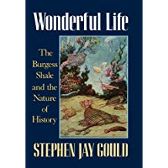
My main source for this talk: Stephen Gould’s Wonderful Life
Published by
Hutchinson Radius
1989; Penguin 1991;
Vintage 2000
Gould also stresses the radical implications of their work in terms of the early diversity of life forms in the Cambrian, the decimation of this diversity thereafter, and in consequence the major role of contingency in the history of life
Wonderful Life offers a detailed intellectual history of debates over the Burgess Shale fossils and a blow by blow account of the research achievements of Whittington and his team at Cambridge in the 1970s and 1980s
Wonderful Life became a prize
winning and best selling book,
and a continuing source of
both inspiration & controversy
Notes:
Image of Cover page of Stephen Jay Gould (1989) Wonderful Life: The Burgess Shale and the Nature of History Penguin edition 1991

Slide 7
Gould as advocate of the public understanding of geology
Harvard palaeontologist/evolutionary biologist committed to public understanding of science/science history (famous for monthly essays in Natural History)
Heterodox Darwinian who stressed the multi-level and constrained operation of selection processes (genes/ genomes/ individuals/ species) and faced criticism from proponents of micro-evolutionary orthodoxy
Involved in linked controversies about racism, genetic reductionism, socio-biology, catastrophism, punctuated equilibrium (‘jerks’ versus ‘creeps’), and the role of contingencies in natural history
In the 1970s Gould was an advocate of quantitative palaeobiology (with Schopf, Raup & Sepkoski) as they sought to secure the role of palaeontology within natural science (via work on species diversity, pulses of evolution and mass extinctions)
In Wonderful Life he did not repudiate quantitative studies but he did argue strongly for the scientific status of qualitative research and historical explanation
After his book, and partly as a critique of his arguments, a fresh wave of controversies arose about interpretations of the Burgess Shale fossils [considered in part 2]

Slide 8
Starting point: debates about the ‘Cambrian explosion’
Early geologists (including Darwin), were puzzled by the absence of fossils in the Precambrian. They invoked rarity of preservation, but expected fossils would be found
In 1900s the Burgess Shale provided a very rare ‘window’ on early Cambrian fossils, perhaps suggesting a rapid proliferation of phyla and species just before this time
Post-war discovery of Precambrian Ediacaran fossils showed existence of earlier fauna, but these were enigmatic specimens and their linkage to later creatures unclear
Many questions remain about the transition from Ediacaran to early Cambrian faunas (decline allowing replacement vs competition and displacement; glimpse of gradual processes vs window on ‘rapid explosion’)
Gould argues that the Burgess Shale fossils suggest a geologically rapid ‘explosion’ of diverse phyla/body plans in the early to mid Cambrian, in a period of experimentation
This was followed by the extinction of many, leaving a relatively small number of body plans to survive beyond the Cambrian, resulting in growing diversity but less disparity
But the discovery of a range of other Precambrian and especially Cambrian ‘lagerstätten’ from the 1970s onwards (especially in China, Canada & Greenland) provided a wider context for reinterpreting Burgess Shale fossils and addressing the Cambrian ‘explosion’

Slide 9
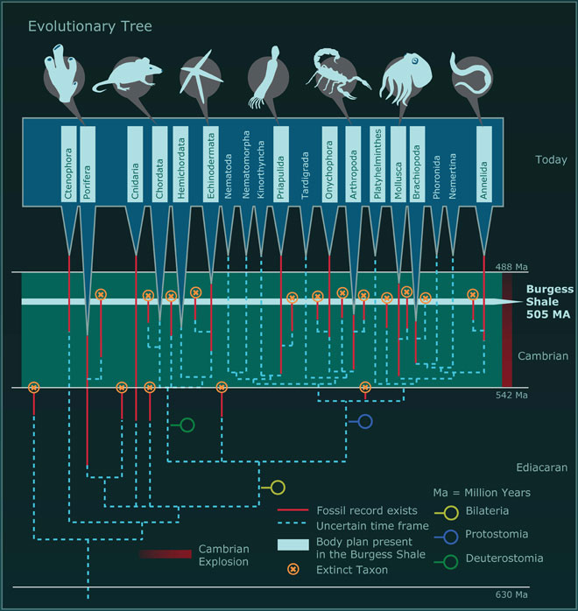
Diagram illustrating the concentration of origins of new body plans during the ‘Cambrian Explosion’
(pink lines within Cambrian)
and the extinction of around half the taxa before the end of the Cambrian
(orange dots plus crosses)
from Royal Ottawa Museum website
Notes:
ROM image: ‘The origin and diversification of animals during the Cambrian Explosion’ from ROM/Parks Canada web site
© Royal Ontario Museum https://burgess-shale.rom.on.ca/en/science/origin/04-cambrian-explosion.php

Slide 10
Charles Walcott’s career & discovery of Burgess fossils
Walcott became assistant geologist in NY then joined USGS on its formation in 1879, rising through ranks to become head (1894), then in 1907 became boss of Smithsonian Institution (National Museums in Washington), deeply involved in broader science policy
Initial discoveries of Cambrian fossils in the 1890s, by surveyors linked to the Canadian Pacific Railway, led to identification of the ‘Ogygopsis beds’ in the Canadian Rockies
Initially an amateur collector of trilobites (some with soft parts) Walcott became an acknowledged US expert and provided early commentary on material from the Canadian ‘Ogygopsis beds’ sent him by collectors
Visited the area in 1909, searched widely across Cambrian beds, found the source of exceptionally preserved fossils and began excavation of the ‘Walcott Quarry’ (but legend of specimen exposed by slipping mule on last day of expedition later used to dramatize ‘accidental discovery’)
Returned with his family summer after summer (despite personal tragedies of deaths of wife and two sons), accumulating a vast array of fossils (at least 68,000 specimens), most returned to the Smithsonian but some dispersed to other centres
Walcott planned to provide a detailed examination of these fossils but administrative duties and death in office curtailed such detailed work
While Walcott was alive these beds were seen as his preserve, while later state agencies limited access to the protected site, so little fresh research was done until 1960s

Slide 11
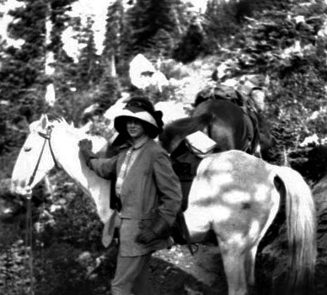
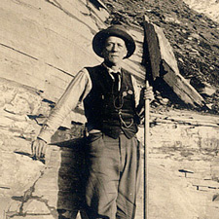
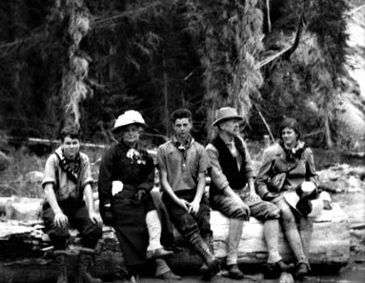
Walcott’s exploration of the Burgess fauna
Helen with horses on the Burgess Shale trail, but not so
dramatic as the legend.
Mules were used to carry
specimens down the mountain
Charles with prying pole used for quarrying at Walcott Quarry. Other tools were picks, hammers, chisels and small explosive charges
Collecting specimens was a
family affair (Stuart, Helena,
Sidney, Charles and Helen).
Sidney found the first specimen of what became named Sidneyia
Notes:
Left hand image, of Helen with horses on the Burgess Shale trail © Erin Younger Family Collection, reproduced
from ROM/Parks Canada website at https://burgess-shale.rom.on.ca/em/history/discoveries/02-Walcott.php
Middle image, of Walcott at the Walcott quarry 1911-12, © Smithsonian Institution Archives (photograph from Record Unit 95 Box 24 Folder 2A) reproduced in ROM/Parks Canada website at https://burgess-shale.rom.on.ca/em/history/discoveries/02-walcott.php
Right hand image of Walcott family, Wapta Falls, Yoho National Park, 1910? (Smithsonian Institution Archives image 84-16281), © Erin Younger Family Collection, from ROM/Parks Canada website at https://burgess-shale.rom.on.ca/em/history/discoveries/02-walcott.php

Slide 12
Walcott’s interpretation of the Burgess fauna
Walcott’s administrative duties as the leading US science administrator limited time for research & writing and he died in office having planned to return to study of the specimens after retirement
He did write reports on some key specimens and photographed others awaiting more study (he also pioneered panoramic photography) but Gould stresses the preliminary nature of his research & (with Whittington) notes the photographs were heavily (‘egregiously’) retouched
Gould argues that Walcott, traditional in outlook and with little time, was blinkered by his existing assumptions about stately phyletic progress, so ‘shoe-horned’ his odd specimens into known phyla
Yochelson (and Conway Morris) defend Walcott, emphasising the effort involved in his prodigious collecting; the explicitly preliminary character of most of his research; and that retouching aimed to bring out crucial features that didn’t photograph well. They stress the conventions of the time discouraged identification of new phyla, while within this framework Walcott recognised the novelty of many of his specimens (and few of his classifications were questioned at the time)
Many of Gould’s criticisms are informed by hindsight following the Cambridge research, and there remains continuing controversy about some of the Burgess Shale creatures, but the preliminary and problematical character of Walcott’s interpretations is difficult to contest
BUT Walcott also left a legacy of thousands of museum specimens which ultimately provided considerable scope for ‘fieldwork’ in the specimen drawers at the Smithsonian and elsewhere

Slide 13
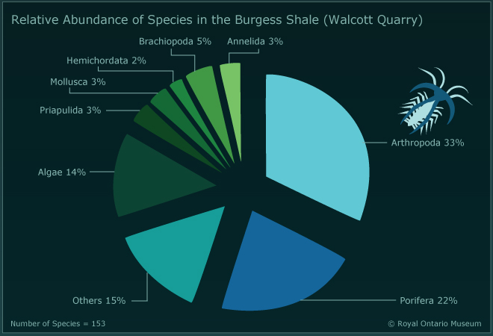
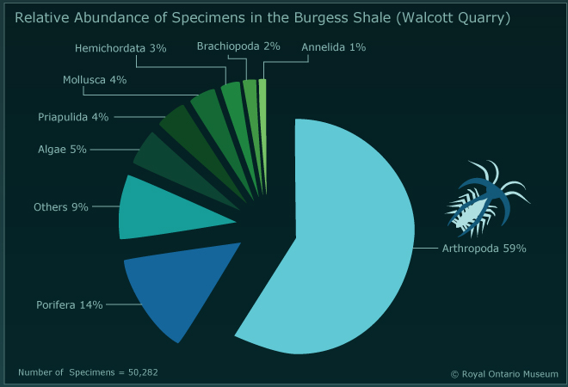
Arthropods and other fossils in the Walcott quarry
Cumulative data tabulated and displayed on the informative Royal Ontario Museum website, showing the predominance of arthropods – the focus of controversies – but also a range of other soft and hard bodied creatures (esp. corals and sponges) discussed by Walcott, by species (out of 153) and specimens (out of 50,282)
Notes:
Left ROM image: ‘Relative Abundance of Species in the Burgess Shale (Walcott Quarry)’ from ROM/Parks Canada web site
© Royal Ontario Museum https://burgess-shale.rom.on.ca/en/science/burgess-shale/03-fossils.php
Right ROM image: ‘Relative Abundance of Specimens in the Burgess Shale (Walcott Quarry)’ from ROM/Parks Canada web site © Royal Ontario Museum https://burgess-shale.rom.on.ca/en/science/burgess-shale/03-fossils.php

Slide 14
Rediscovering the Burgess Shale: Whittington’s restudy
After Walcott’s death there were few new contributions to analysing the BS fauna, though Raymond dug another quarry nearby and Simonetta re-examined some of Walcott’s specimens
Canada had few Burgess fossils and in the 1960s the Canadian Geological Survey decided to reinvestigate BS and ‘repatriate’ its fossils, both through fieldwork and study of existing specimens. CGS conducted fieldwork around Walcott and Raymond quarries in 1966 and 1967, finding important specimens, but the National Park then refused permission for further excavation
Whittington, an acknowledged trilobite expert with experience of soft bodied specimens, was appointed as project leader (but soon moved from Harvard to Cambridge UK). He assembled a team of two colleagues (Hughes & Bruton), two PhD students (Briggs & Conway Morris) who joined in 1972, and several CGS/ROM palaeontologists (esp. Collins who renewed local fieldwork)
Whittington started the detailed & rigorous study of one suite of creatures, while Briggs focused on bivalve arthropods and Conway Morris on varied ‘worms’. Primary methods involved making camera lucida drawings based on excavation of successive layers of specimens (a destructive process); comparisons of parts and counterparts (often previously separated); careful consideration of oddly oriented specimens; and photography in ultra-violet light
They initially expected to rapidly confirm, correct and elaborate on Walcott but soon began to diverge from his taxonomic approach and (says Gould) jettisoned the conical ‘shoe horn’. As such they made a ‘quiet revolution’ without ‘heroic fieldwork’ or novel techniques

Slide 15
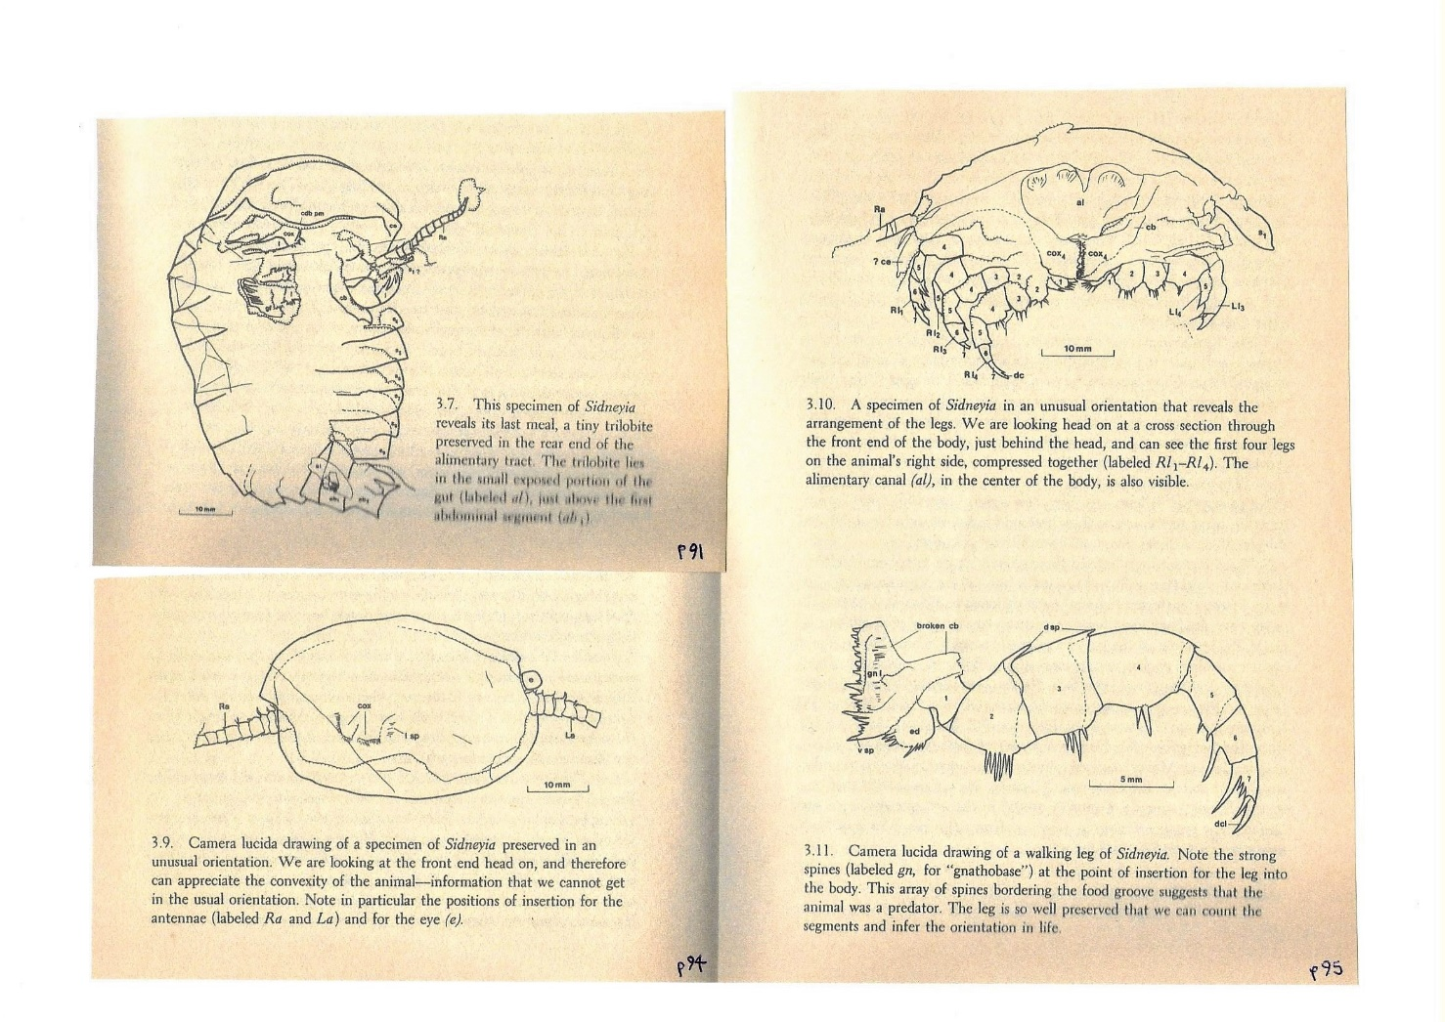
Examples of camera lucida drawings from Bruton’s 1981 study of Sidneyia, reproduced from Wonderful Life (1989) pp 91, 94 & 95
View from behind head
reveals sequence of limbs
Small trilobite in gut
excavated gut to reveal meal
of small trilobite
Details of spines
use of specimens in unusual
orientations
Attachment of antenna
details of limb
“You start with a squashed and horribly distorted mess and finish with a composite figure of a plausibly living organism”
Wonderful Life p 100
Notes:
All figures taken from Stephen Jay Gould (1989) Wonderful Life: The Burgess Shale and the Nature of History Penguin edition 1991
Left top drawing: figure 3.7 p 91
Left bottom drawing: figure 3.9 p 94
Right top drawing: figure 3.10 p 95
Right bottom drawing: figure 3.11 p 95

Slide 16
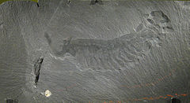
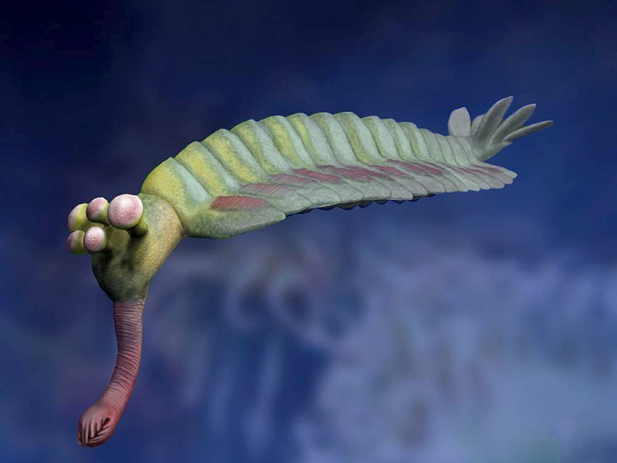
The pivotal role of Opabinia in Harry Whittington’s research
Whittington began with an exhaustive monograph (arising from 4+ years research) on Marrella, the commonest BS organism (13,000 specimens) then moved on to more peculiar Yohoia (400 specimens)
Provisionally categorised both as trilobite-like despite important differences – but increasing doubts and ?
Weirdness of Opabinia (10 good specimens) – frontal nozzle, five eyes, tail piece, absence of appendages – provoked more radical response of leaving phylum unresolved (& caused laughter at Pal.Ass. Meeting)
Gould argues this was turning point in recognising that body plans were more varied than existing taxonomic categories
This theme was consolidated by the team through the later 1970s, including research by Whittington on Naraoia, a valved trilobite and Aysheaia
Photograph of Opabinia specimen
Reconstruction of Opabinia
Notes:
Top left image of Opabinia regalis (USNM 57683) is from Whittington, Figure 4 in Phil. Trans. R. Soc. Lond. B 1975 271, 1-43, "The Enigmatic Animal Opabinia regalis, Middle Cambrian, Burgess Shale, British Columbia", courtesy The Royal Society) and ultimately © Smithsonian Institution – National Museum of Natural History, photo: Jean-Bernard Caron
Bottom left reconstruction of Opabinia in life, image by Nobu Tamura and copied under Dreative Commons, from http://spinops.blogspot.ca/2017/02/opabinia-regalis.html

Slide 17
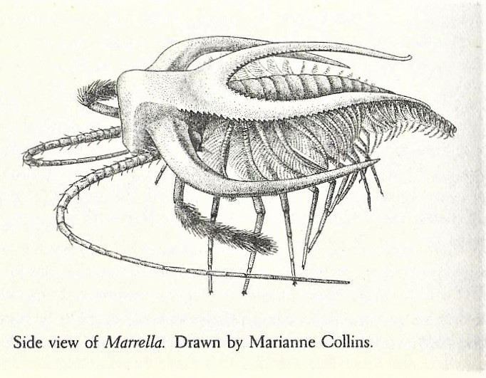
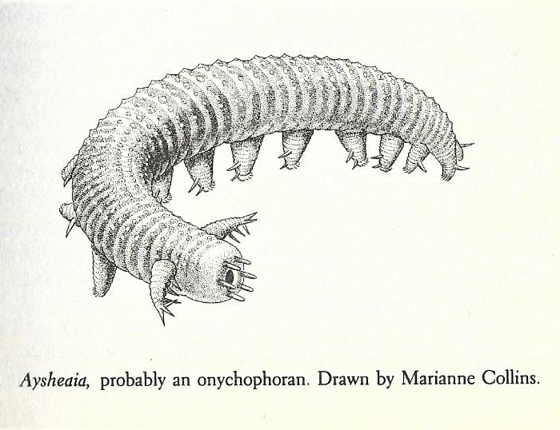
Species from two phases in Whittington’s project
As the new approach was developed and codified Whittington (1978) undertook a re-examination of Ayshaeia, initially regarded as an annelid worm by Walcott and later seen to resemble the modern Onychophora. But Whittington, noting the absence of jaws, argued that this ‘bizarre form’ belonged to another separate unique group. However, Gould suggests that in this case Whittington was over-enthusiastic and instead endorses a later assessment which places it back among the Onychophora!
Whittington (1971) began with his lengthy
study of Marrella, refining his dissection
techniques. Despite misgivings, at this stage
he continued to locate it among recognised
groups (in this case Størmer’s Trilobitoidea)
before later deciding this grouping was
actually artificial and incoherent
Notes:
Images from Stephen Jay Gould (1989) Wonderful Life: The Burgess Shale and the Nature of History Penguin edition 1991
Left: ‘side view of Marrella. Drawn by Marianne Collins’, Figure 3.12 p 114
Right: ‘Aysheaia, probably an onychophoran. Drawn by Marrianne Collins’, Figure 3.41 p 169

Slide 18
Simon Conway Morris as a discoverer of weird wonders
His first contributions as a PhD student were a rapid series of short papers on five weird wonders – Nectocaris; Odontogriphus; Dinomischus; Amiskwia and Hallucigenia – found in a search through Walcott’s specimen drawers
Some had been labelled/photographed by Walcott but none had been described. All involved small numbers of specimens (1; 2; 3; 5 & 30), but these discoveries reinforced the new approach. During his searches Conway Morris is famously reported to have exclaimed ‘Oh fuck, not another phylum’
This distinctive approach apparently reflected his iconoclastic personality and his concern to catch up after being delayed by illness. Gould argues this contrasted with but also complemented, Whittington’s meticulous procedures, in “a lovely synergism between two different approaches” (Wonderful Life p 143)
Later Conway Morris provided more detailed treatments of priapulid & polychaete worms and an exemplary monograph on Wiwaxia [we return to this in Part 2]
Conway Morris’s own argument for an ‘explosion’ of diverse novel phyla was a major influence on Gould’s broader analysis in Wonderful Life BUT as we will see in Part 2 he later became a polemical and hostile critic of Gould while glossing over his own earlier views

Slide 19
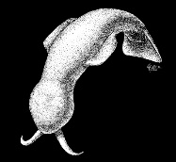

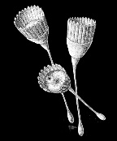
Some of the ‘weird wonders’ Conway Morris discovered in Walcott’s drawers
The gelatinous swimming animal Amiskwia, around 2 cm
Drawn by Marianne Collins
Specimens of Dinomischus, stalked & with mouth & anus in calyx
around 2 cm Drawn by Marianne Collins
The single specimen of the
enigmatic Nectocaris
‘When Simon completed his initial sequence of five papers on curiosities, the tentative and peculiar had become a Burgess norm, and the notion of separate lineages beyond the realm of modern anatomy had displaced the conventional fall back to “primitive” and “precursor”’ Wonderful Life p 145
Notes:
Left: Amiskwia saggitaformis reconstructed, drawn by and © Marianne Collins from ROM fossil Gallery web-site
https://burgess-shale.rom.on.ca/en/fossil-gallery/amiskwia
Middle: Photo of Nectocaris pteryx from Collins Quarry by J-B Caron © ROM at
https://burgess-shale.rom.on.ca/en/history/discoveries/05-rom.php
Right: Dinomischus isolatus reconstructed, drawn by and © Marianne Collins from ROM fossil Gallery web-site
https://burgess-shale.rom.on.ca/en/fossil-gallery/dinomischus

Slide 20
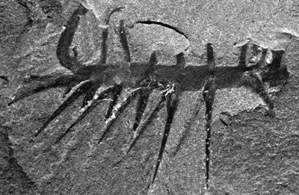
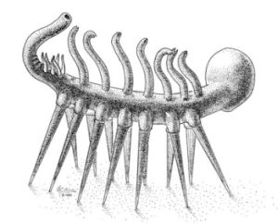
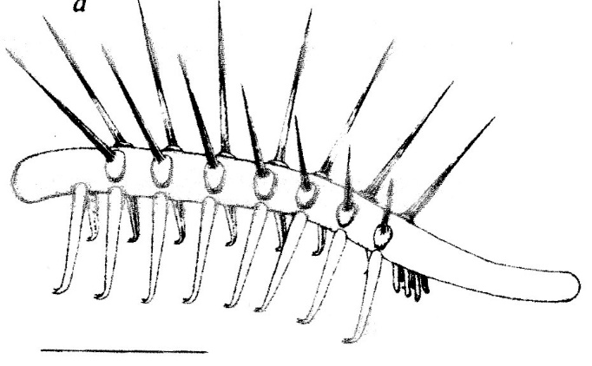
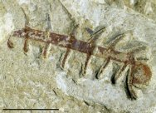
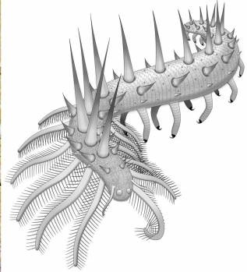
Changing reconstructions of a ‘weird wonder’, Hallucigenia
Conway Morris’s initial (1977) reconstruction, walking on spines, endorsed by Gould after some hesitation
Inverted (‘right way up’) reconstruction by Ramskold & Hou (1991) with paired tube-legs and spines on back
Burgess Shale Specimen
Chengjiang Specimen
More recent reconstruction with
more details of front and rear
based on better preserved
Chinese specimens
As Conway Morris notes in his Crucible of
Creation (1998), scientific research involves
risking mistakes and making corrections!
Notes:
Upper left photograph © Smithsonian Institution at https://naturalhistory2.si.edu/paleobiology/burgess/imgBurgess/hallucigenia hallucigenia.gif
Upper middle image © Smithsonian Institution at https://naturalhistory2.si.edu/paleobiology/burgess/imgBurgess/hallucigenia hallucigenia.D3gif
Upper right image Figure 4a Reconstruction of ‘armoured lobopod’ Hallucigenia sparsa (based on type material from Walcott Quarry) Lars Ramskold and Hou, Xingjang ‘New Early Cambrian Animal and Onychophoran Affinities of Enigmatic Metazoans’, Nature 351 (1991) p 227
Lower left photograph of Chengjiang specimen from www.fossilmuseumnat/Fossil_Sites/Chengjiang/Hallucigenia/CJF1174Bt.jpg
Lower middle image © rom, restoration by Danielle Dufault, 2017, taken from www.Palaeontologyonline.com/articles/2017/fossil_focus_hallucigenia/fig3_updated_reconstruction

Slide 21
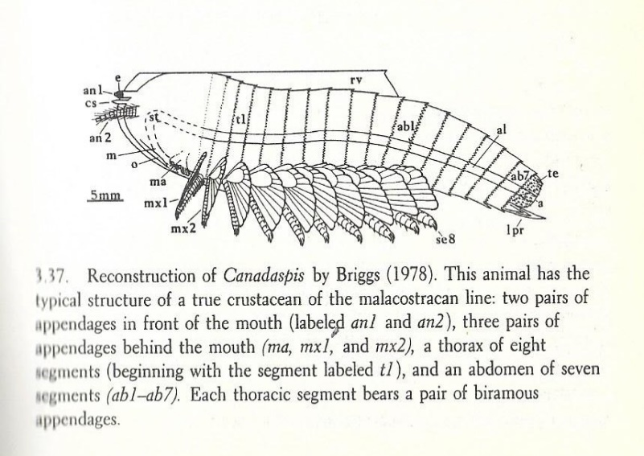
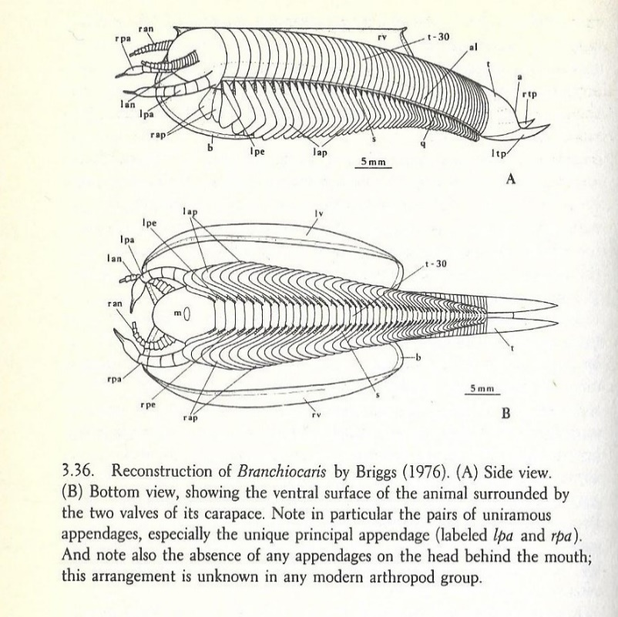
Derek Briggs documents both ‘ordinary’ and ‘weird’ arthropods
The bivalve arthropods studied by Briggs included an instructive contrast between Canadaspis and Branchiocaris
Canadaspis, a common creature of the BS, was shown to be a true crustacean, fitting within a successful modern group
By contrast the rare Branchiocaris (5 specimens) was a unique arthropod lacking the multiple head appendages of crustaceans
Thus Gould emphasies that these bivalve arthropods “formed an artificial category hiding an unanticipated anatomical disparity” (Wonderful Life p 160)
Gould notes the familiar character of Canadaspis showed that the BS fauna was not just an odd ‘failed experiment’ BUT that predicting which body plan would survive would be difficult
Briggs has continued to work on soft-bodied Cambrian fossils within & beyond the BS, but has criticised the idea of numerous unique phyla in favour of an approach to taxonomy based on cladistics [see part 2]
Canadaspis, a ‘true crustacean’
Branchiocaris, another ‘unique arthropod’
Notes:
Images from Stephen Jay Gould (1989) Wonderful Life: The Burgess Shale and the Nature of History Penguin edition 1991
Top image: ‘Reconstruction of Canadaspis by Briggs (1978)’ Figure 3.37 p 161
Lower images: ‘Reconsruction of Branchiocaris by Briggs (1976)’ Figure 3.36 p 160

Slide 22
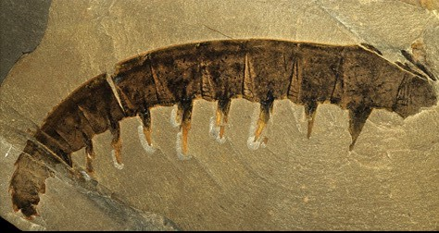
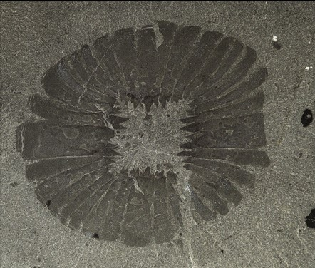
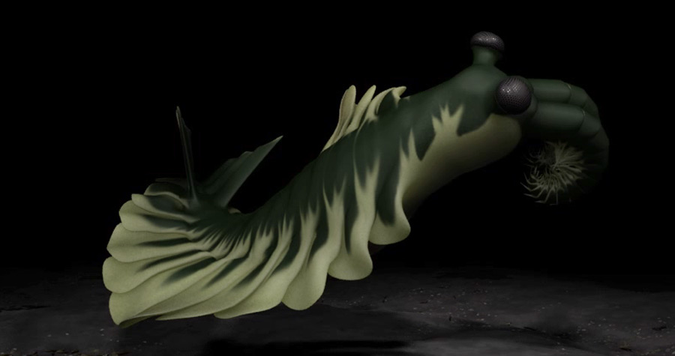
The Cambridge reconstruction of Anomalocaris as an apex predator
Originally thought of as the abdomen of a
crustacean (Whiteaves 1892), later as
the leg of a large arthropod (Briggs 1979)
BUT dissection of Burgess Shale specimens
(Whittington & Briggs 1985) revealed that
they were large anterior limbs of the largest
animal in the fauna, seen as an apex predator
Walcott specimen which he identified as a jellyfish
Note that the
conditions of
preservation of
these larger
Burgess Shale
fossils had often
involved
dismemberment!
AND excavation of the details of some attached specimens revealed that these were the mouth
parts of a large predator
Further work has continued on the family of anomalocarids, especially by Collins (1996)
Notes:
All images taken from Royal Ottawa Museum Burgess Shale web-site and © Royal Ottawa Museum, found at https://burgess-shale.rom.on.ca/en/fossil-gallery/view-species.php?id==1&ref=1&&ref=i [Anomalocaris images]
Upper left image of an individual claw ROM 61040 photo by Jean-Bernard Caron
Lower left image is of a 3D model © ROM
Upper right image of mouth part with pointed teeth ROM 61044 photo by Jean-Bernard Caron

Slide 23
Summary of taxonomic revisions (Walcott to Cambridge)
Around 80% of all named animal species are arthropods (mainly insects)
Walcott allocated all 22 Burgess arthropods to one of the 4 recognised groups characterised by distinctive body plans: Uniramia (millipedes, insects, etc.), Crustacea, Chelicerata (spiders etc.), and Trilobita (extinct)
BUT after the Cambridge research only two were recognised as trilobites (one of which Walcott had regarded as a crustacean), one was a crustacean, 6 were unclassifiable bivalve arthropods or non-arthropods, 11 were ‘reclassified as arthropods of unique anatomy’ (falling outside the four standard sub-classes, and two (Opabinia and Anomalocaris) were regarded as unique phyla (not arthropods)
Meanwhile among the Burgess ‘worms’ three (Amiskwia, Hallucigenia and Wiwaxia) had been redefined as new phyla and one (Aysheaia) remained contested, but there were 6 that Walcott identified correctly as polychaetes, while Conway Morris identified another 6 as priapulids, a phylum now represented by just a few extant members
Overall, this provided the basis for Gould’s argument that the Burgess contained both ordinary and unique anatomies in abundance while disparate body plans were found at each level of taxonomic classification: Phylum, Classes, Families and Genera

Slide 24
Cambridge reinterpretation of Burgess Shale fossils, in a five act sequence of study, from table 3.3 and text in Gould (1989)
Year described | Name | No of specimens | Status for Walcott | Revised Status | Reviser
1971 | Marrella | 13,000 | close to trilobite | unique arthropod | Whittington
1974 | Yohoia | 400 | branchiopod crustacean | unique arthropod | Whittington
1975 | Olenoides |  | trilobite (called Nathorstia) | trilobite | Whittington
1975 | Opabinia | 10 | branchiopod crustacean | new phylum | Whittington
1975 | Burgessia | common | branchiopod crustacean | unique arthropod | Hughes
1976 | Nectocaris | 1 | (unknown) | new phylum | Conway Morris
1976 | Odontogriphus | 1+1 | (unknown) | new phylum | Conway Morris
1977 | Dinomischus | 3 | (unknown) | new phylum | Conway Morris
1977 | Amiskwia | 5 | chaetograph worm | new phylum | Conway Morris
1977 | Hallucigenia | 30 | polychaete worm | new phylum | Conway Morris
1978 | Branchiocaris | 5 | malacostracan crustacean | unique arthropod | Briggs
1977 | Perspicaris |  | malacostracan crustacean | (?) malacostracan | Briggs
1978 | Canadaspis | thousands | malacostracan crustacean (called Hymenocaris) | malacostracan representing crustaceans | Briggs
1977 | Naraoia |  | branchiopod crustacean | soft-bodied trilobite | Whittington
1985 | Tegopelte |  | (unknown) | soft-bodied trilobite | Whittington
1978 | Aysheaia | 19 | polychaete worm | (?) onychophoran representing uniramians or new phylum | Whittington (but he overstates oddity?)
1981 | Odaraia | 29 | malacostracan crustacean | unique arthropod | Briggs
1981 | Sidneyia |  | merostome (with appendage of Anomalocaris as feeding limb) | unique arthropod | Bruton
1981 | Molaria | rare | merostome | unique arthropod | Whittington
1981 | Habelia | rare | merostome | unique arthropod | Whittington
1981 | Sarotrocercus | rare | (unknown) | unique arthropod | Whittington
1981 | Actaeus | 1 | (unknown) | unique arthropod | Whittington
1981 | Alalcomenaeus | rare | (unknown) | unique arthropod | Whittington
19 | Emeraldella |  | merostome | unique arthropod | Bruton & Whittington
1983 | Leanchoilia |  | branchiopod crustacean | unique arthropod | Bruton & Whittington
1988 | Sanctacaris |  | (unknown) | chelicerate arthropod | Briggs & Collins
1985 | Wiwaxia |  | polychaete worm | new phylum | Conway Morris
1985 | Anomalocaris* | 100 appendages and other fragments | brachiopod crusteacean (* Walcott also identified parts of the final animal as jellyfish & sea cucumber) | new phylum | Whittington & Briggs
2012 | Pikaia | 114 | polychaete worm | chordata | Conway Morris & Caron
ACT 1 Growing doubts on location in existing arthropod groups
ACT 2 True oddity didn’t fit
ACT 3 More ‘oddballs’ among specimens consolidate focus on distinctiveness & disparity
as features of the fauna: anomalies become normal
ACT 4 Reallocation under-lines distinctiveness of fauna
ACT 5 Research programme
comes to fruition by charting
range of different
‘experimental’ permutations
from the ‘arthropod grabbag’,
+ adding two further new phyla
ACT 6? [Part 2] work continues
Notes:
Adapted from Stephen Jay Gould (1989) Wonderful Life: The Burgess Shale and the Nature of History Penguin edition 1991, Table 3.3 ‘The Burgess Shale Drama: Dramatis Personae in Order of Appearance’ pp 210-211, in the light of accompanying discussion and the later commentary of Keynyn Brysse ‘From weird wonders to stem lineages’ (2008)

Slide 25
Resume of the Cambridge Interpretation of the Burgess fauna
Whittington et al began with the expectation that their more detailed work would largely fit within Walcott’s framework and would therefore be completed fairly rapidly, but soon developed the view that many weird specimens did not fit well into the phyla to which they had been assigned. Their detailed research encouraged them to challenge many of Walcott’s phylum designations and to treat markedly different body plans as new phyla
This was reinforced by the influence of Sidnie Manton (hardly mentioned by Gould but given more attention elsewhere) who was a world expert on arthropods who regarded them as ‘polyphyletic’ rather than ‘monophyletic’
This led them to suggest that the ‘Cambrian explosion’ was characterised by a ‘lawn’ of many different phyla, only a minority of which survived to become ancestors of existing phyla and species. BUT they also downplayed the superior adaptability of the survivors, as the ‘oddballs’ seemed specialised rather than ‘primitive’, making chance an important influence
This view was strongly embraced by Gould in his Wonderful Life, as a basis for an even broader argument about evolutionary contingencies which challenged the assumption that evolution delivered long term progress rather than local adaptation
BUT further research on the Burgess Shale and similar fossils, coupled with new ideas in taxonomy, soon led to challenges to the standard Cambridge (and Gould) characterisation of the implications of their findings [see part 2]

Slide 26
The role of Sidnie Milana Manton, expert on living arthropods
The older of 2 sisters (both became FRSs!); undergraduate & PhD at Girton, Cambridge; first woman Demonstrator in Comparative Anatomy, then Director of Studies & Research Fellow; Reader at Kings, London (1949-1960), then linked to QMC and British Museum
Recognised world authority on arthropods, especially their embryological development, mechanisms of feeding, and locomotion; 63 scientific publications (1927-1979) inc. The Arthropoda: Habits, functional morphology and evolution (1977). She also published impressions of science in the USSR & on the breeding and genetics of rare cat breeds!
She addressed the character of evolutionary relationships among arthropods, especially distinguishing between common ancestry and convergent features, and argued for the polyphyletic rather than monophyletic evolution of arthropod anatomies
This influenced the Cambridge team’s interpretation of the diverse body plans of the BS arthropods as a ‘phylogenetic lawn’, though Gould says little about her influence
Baron (2009) argues Manton’s analysis (and that of other members of the ‘British School’) was based on an ‘idealist’ notion of archetypal body-plans, perhaps reflecting a training predating the ‘modern Darwinian synthesis’. As we will see in part 2, many later researchers championed the alternative monophyletic view

Slide 27
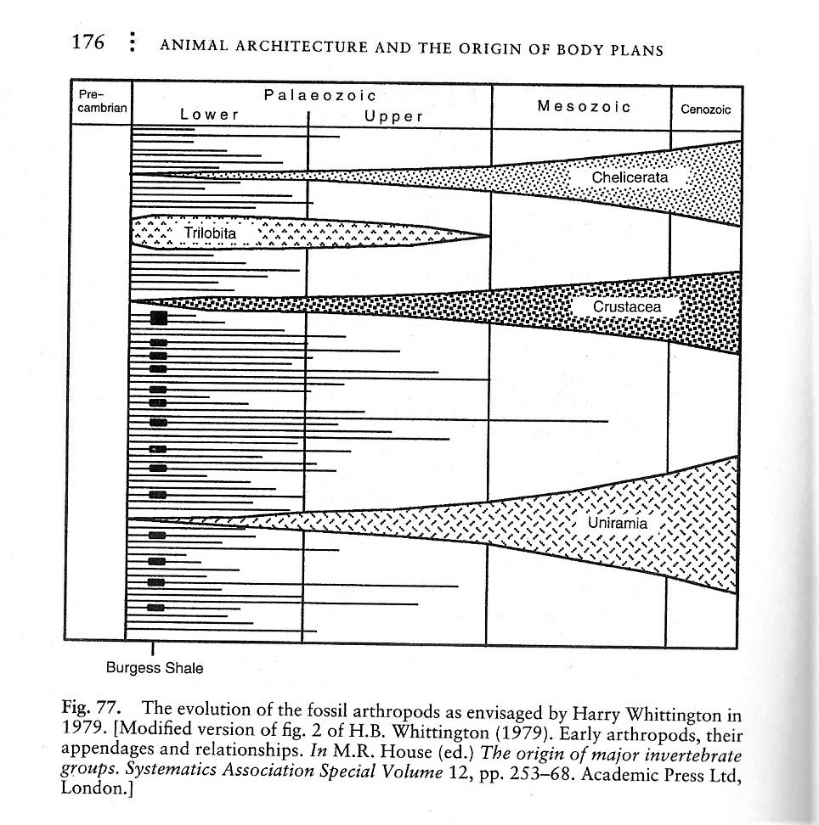
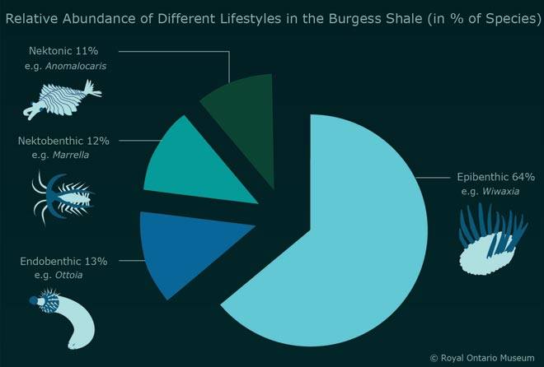
Overall themes: disparity of body plans and complex ecology
Whittington’s famous 1979 depiction of a phylogenetic lawn and extinction (reproduced from Conway Morris, Crucibles of Creation)
Different lifestyles indicative of the complex ecology of the fauna before burial in the Burgess Shale (diagram from ROM BS website) Benthic = bottom dwelling Nektonic = free swimming
Notes:
Left hand figure taken from Simon Conway Morris (1998) The Crucible of Creation: The Burgess Shale and the Rise of Animals OUP, Figure 77 p 176, titled ‘The evolution of the fossil arthropods as envisaged by Harry Whittington (1979)’
Right hand image from ROM: ‘Relative Abundance of Different Lifestyles in the Burgess Shale (% of Species)’ from ROM/Parks Canada web site, Royal Ontario Museum https://burgess-shale.rom.on.ca/en/science/burgess-shale/03-fossils.php

Slide 28
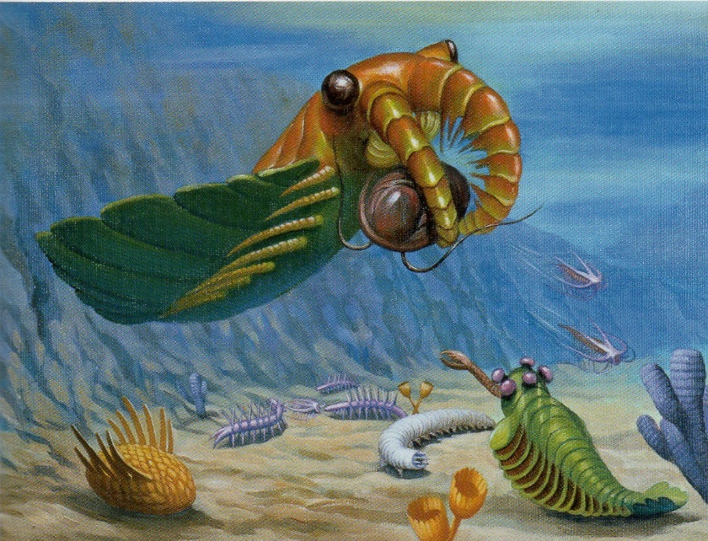
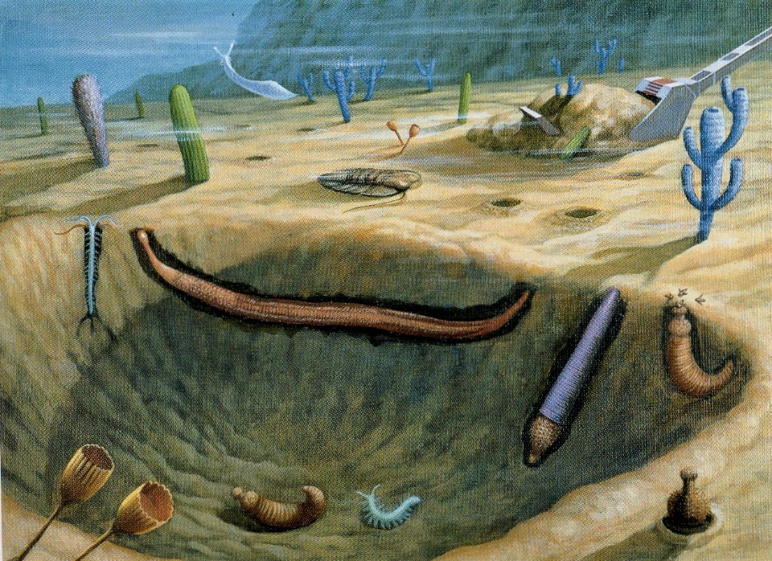
Two portraits of the ecology of some Burgess Shale species
(taken from Conway Morris The Crucible of Creation 1998, colour plates by Yukio Sato)
Anomalocaris captures a trilobite among mobile bottom dwellers and attached sessile epifauna, with Opabinia with its five eyes looking on
Mud dwelling ‘infauna’, mainly priapulids but also a polychaete annelid, alongside sessile ‘mud-stickers’, largely non-arthropod creatures
Notes:
Colour plates from Simon Conway Morris (1998) The Crucible of Creation: The Burgess Shale and the Rise of Animals OUP, plate 3 opposite p 88 and plate 1 opposite plate 4

Slide 29
Making sense of the Burgess fossils: Gould’s overview
Gould emphasised that the interpretation of such fossils involves the interplay of analytical frameworks and empirical investigation BUT argues that Walcott’s traditional assumptions overrode his limited observations
By contrast Whittington engaged in lengthy and detailed investigations which allowed findings to guide interpretations (though we should note Whittington and Gould were each also guided by pre-existing analytical approaches, to arthropod phylogeny and evolutionary theory respectively)
Gould saw the key finding of a wide disparity of body plans in the Cambrian as a basis for emphasising the rapid evolution of such disparity in the Cambrian ‘explosion’ and the subsequent decimation of this varied fauna to leave a narrower range of body plans today
He combined this with the argument that the pattern of such decimation could not be readily explained in terms of different levels of evolutionary fitness, to emphasise the importance of unforeseen contingencies (like those implicated in mass extinctions) in explaining which genera and body plans died out and which survived
This highlights the importance of particular historical events – of ‘natural history’ – alongside (?) general biological laws in explaining the history of life, an argument dramatized in Gould’s thought experiments with ‘replaying the tape of life’, inspired by the film Wonderful Life. This led him to argue that the outcomes of evolution should be seen as accidental rather than progressive
He also speculated that the Cambrian explosion itself involved a particular flexibility in early evolutionary processes, generating rapid and unmatched diversity from a ‘grab bag’ of possibilities

Slide 30
Continuing controversies following Wonderful Life
Gould argued passionately that science should embrace BOTH quantitative and qualitative, covering law and historical, explanations, and that all such analyses are provisional and should be tested against the evidence. Historians of science suggest that the period following Wonderful Life has seen a continuing ‘web of controversies’ about the significance of the Burgess Shale fauna
As Gould himself noted, fieldwork on Cambrian lagerstättes has continued, in the Canadian Rockies but also in China, Greenland and elsewhere, adding new species and new interpretations of the fauna. Together with fresh evidence about Precambrian life, this has prompted revisions to our understanding of the character of the Cambrian explosion
A major shift in the thinking of systematic taxonomists in biology led to the rise of newer methods of classification of organisms (especially cladistics) which challenged the Manton/Cambridge/ Gould orthodoxies. Briggs and Fortey, in particular, have applied these newer methods to the Burgess Shale fauna, to suggest that the apparent oddballs may be less weird exceptions then they appeared
Despite their shared emphasis on ‘weird wonders’, arguments between Conway Morris and Gould show that they diverged in their understanding of the Cambrian explosion and in their wider analyses of evolutionary processes. Their differences include contrasting judgements of the power & scope of micro-evolutionary mechanisms, such as niche filling and convergent evolution, and their implications for such key ideas as contingency and progress in the history of life

Slide 31
Key Sources
Christian Baron (2011) ‘A Web of Controversies: Complexity in the Burgess Shale Debate’ Journal of the History of Biology 44.1: 745-760
Keynyn Brysse (2008) ‘From Weird Wonders to Stem Lineages: the second reclassification of the Burgess Shale fauna’ Studies in the History and Philosophy of Biological and Biomedical Sciences 39: 298-313
* Simon Conway Morris (1998) The Crucible of Creation: The Burgess Shale and the Rise of Animals OUP
Simon Conway Morris (2000) ‘The Cambrian “Explosion”: Slow-fuse or megatonnage? PNAS 97.9: 4426-4429
* Simon Conway Morris and Stephen Jay Gould (1999) ‘Showdown on the Burgess Shale’ Natural History Magazine 107.10: 48-56
Simon Conway Morris, Richard Corfield and Jane Frances, hosted by Melvyn Bragg “The Cambrian Period/The Cambrian Explosion” In Our Time, 17 February 2005, BBC Radio 4
* Stephen Jay Gould (1989) Wonderful Life: The Burgess Shale and the Nature of History Penguin edition 1991
Stephen Jay Gould (1992) ‘The Reversal of Hallucigenia’ Natural History Magazine January
* Royal Ontario Museum https://burgess-shale.rom.on.ca/en/ The ROM/Parks Canada web site
David Sepkoski (2005) ‘Stephen Jay Gould, Jack Sepkoski and the “Quantitative Revolution“ in American Paleobiology’ Journal of the History of Biology 38: 209-237
* Ellis L Yochelson (1996) ‘Discovery, Collection and Description of the Middle Cambrian Burgess Shale Biota by Charles Dolittle Walcott’, Proceedings of the American Philosophical Society 140.4: 469-545

Slide 32
Further References
Christian Baron (2009) ‘Epistemic Values in the Burgess Shale Debate’ Studies in the History and Philosophy of Biological and Biomedical Sciences 40: 286-295
Derek Briggs (2014) ‘Paleontology: A New Burgess Shale Fauna’ Current Biology 24.10: R398-R400
Derek Briggs (2015) ‘The Cambrian Explosion’, Current Biology 26, R846-R875
Derek Briggs and Richard Fortey (1989) ‘The early radiation and relationships of the major arthropod groups’ Science: 246: 241-243
Derek Briggs, Richard Fortey and M.A. Wills (1992) ‘Morphological disparity in the Cambrian’ Science 250: 1670-1673
Keynyn Brysse (2011) ‘What is a phylum? Systematics, evolution and the Burgess Shale’ Palaeontographica Canadiana 31: 19-38
Jean-Barnard Caron et al (2014) ‘A new phyllopod bed-like assemblage from the Burgess Shale of the Canadian Rockies’ Nature Communications 5, Article number: 3210
Simon Conway Morris (1988?) ‘Burgess Shale Faunas and the Cambrian Explosion’ Science 246: 339-346
Simon Conway Morris & Jean-Bernard Caron (2012) ‘Pikaia gracilens Walcott, a stem-group chordate from the Middle Cambrian of British Columbia’ Biological Reviews??
G. Fryer (1980) ‘Sidnie Milana Manton 1902-1979’ Biographical Memoirs of Fellows of Royal Society 26:327-356
Richard Fortey (1998) ‘Shock Lobsters: Review of Conway Morris, The Crucible of Creation’ London Review of Books 20.19: 24-25
Mike Foote, Stephen Jay Gould, Michael Lee, Derek Briggs, Richard Fortey and Matthew Wuills (1992) ‘Cambrian and Recent Morphological Disparity’ Science 258 No 5069: 1816-1818
Diego Garcia-Bellido and Desmond Collins (2006/2011) ‘A new study of Marella splendens (Arthropoda, Marrellomorpha) from the Middle Cambrian Burgess Shale, British Columbia, Canada’ Canadian Journal of Earth Sciences 43: 721-742
David Sepkoski (2016) ‘”Replaying Life’s Tape”: Simulations, metaphors and historicity in Stephen Jay Gould’s view of life’ Studies in History and Philosophy of Biological and Biomedical Sciences 58: 73-81

Slide 33
Background Sources and Resources
Martin Brasier (2009) Darwin’s Lost World: The Hidden History of Animal Life OUP
ENK Clarkson (1998) Invertebrate Palaeontology and Evolution Blackwell 4th ed pp??
Richard Fortey (1997) Life: An Unauthorised Biography, chapter 4 ‘My animals and other fossils’, Flamingo
Richard Fortey (2000) Trilobite: Eyewitness to Evolution, chapter 5 ‘Exploding Trilobites’, Flamingo
Stephen Jay Gould Ever Since Darwin (14,15); Flamingo’s Smile (15,16); Dinosaur in a Haystack (9); Bully for Brontosaurus (16); Eight Little Piggies (13, 21, 22, 23, 24); Leonardo’s Mountain of Clams (15,16,17,19*, 21); I Have Landed (18); Life’s Grandeur/Full House (2,3,12,13, *14)
Alison McConwell and Adrian Currie (2017) ‘Gouldian Arguments and the Sources of Contingency’ Biology and Philosophy 32.2
Myrna Perez (2012) ‘Evolutionary Activism: Stephen Jay Gould, the New Left and sociobiology’ Endeavour
Derek Turner (2011) Paleontology: A Philosophical Introduction, especially chapters 8-9 CUP
https://paleobiology.si.edu/burgess/ Smithsonian Institution/National Museum of Natural History web site, which includes index page of Burgess Shale specimens
www.burgess-shale.bc.com The Burgess Shale Geoscience Foundation web site
www.ucmp.Berkeley.edu/Cambrian/burgesss.htm
www.smithsonianmag.com/history/the-burgess-shale-evolution-big-bang-33813957/ Article from August 2009
www.fossilmuseum.net/Fossil-Sites/burgessshale.htm

