Slide 1
The Burgess Shale Controversies
Contested views of the Cambrian ‘explosion’ and the history of life
Part 2: Not so Weird but still Wonderful
Gould (and Whittington) versus Briggs and Conway Morris
Tony Elger
East Lothian U3a 2019
Note: full sources for images used are given in the attached notes for each slide

Slide 2
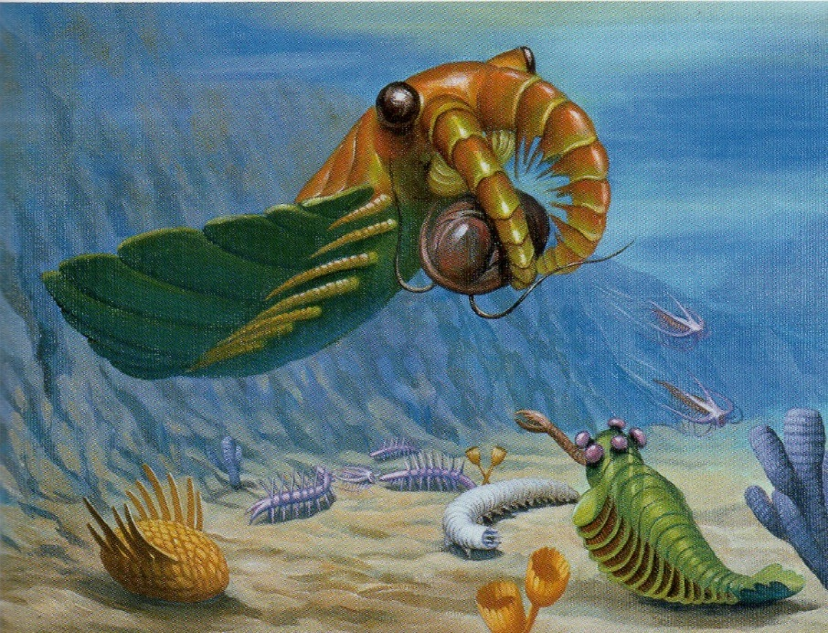
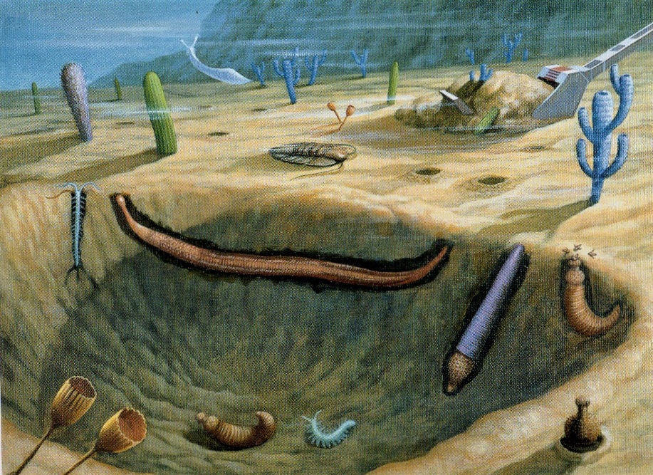
Two portraits of the ecology of some Burgess Shale species
(taken from Conway Morris The Crucible of Creation 1998, colour plates by Yukio Sato)
Anomalocaris captures a trilobite among mobile bottom dwellers and attached sessile epifauna, with Opabinia with its five eyes looking on
Mud dwelling ‘infauna’, mainly priapulids but also a polychaete annelid, alongside sessile ‘mud-stickers’, largely non-arthropod creatures
Notes:
Colour plates from Simon Conway Morris (1998) The Crucible of Creation: The Burgess Shale and the Rise of Animals OUP,
Plate 3 opposite p 88 and plate 1 opposite plate 4

Slide 3
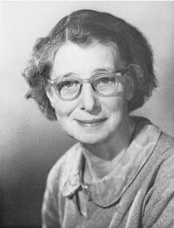
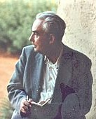
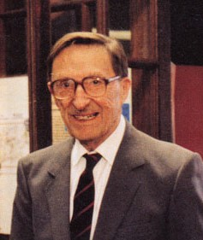
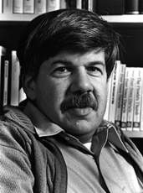
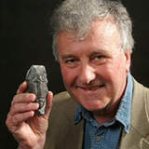
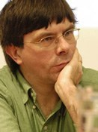

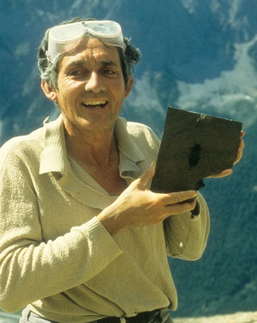


Some of those influencing recent Burgess fossil controversies
Sidnie
Milana
Manton
1902-
1979
Willi
Hennig
1913-
1976
Harry
Whittington
1916-2010
Stephen
Jay
Gould
1941-
2002
Richard
Fortey
1946-
Simon
Conway
Morris
1951-
Desmond
Collins
1938- (retired
2005)
Hou,
Xian-Guang
1949-
Jean-
Bernard
Caron
1974-
Derek
Briggs
1950-
Notes:
Manton Wikipedia image at wiki/Sidnie_Manton photograph by W Bird 1967 © Fellows of the Royal Society
Hennig Wkipedia image from wiki/Willi_Hennig by Irma Hennig circa 1970 covered by GFDL
Whittington image from the ROM history website, https://burgess-shale.rom.on.ca/en/history/discoveries/04-gsc.php
Gould image at ‘University of Michigan Wonders of the Universe’ from Stanford Presedatorial Lectures: SJG, at https://prelectur.Stanford.edu/lectures/gould/
Fortey image from Royal Society Fellows at https://royalsociety.org/people/richard-fortey-11450
Conway Morris image from Department of Earth Sciences, University of Cambridge website at directory/simon_conway_morris
Briggs image at Yale University: ‘The People of Geology and Geophysics’ /profile/derek-briggs/about
Collins image: ‘Desmond Collins holding a newly discovered fossil’ (Sanctacaris) 1988 at ROM/Parks Canada web site
© Royal Ontario Museum https://burgess-shale.rom.on.ca/en/history/discoveries/05-rom.php
Hou image © ‘2006 The Holeung Ho Lee Foundation: Award of Paleontology and Archeology Prize’, at www.hlhl.org.cn/English/showsub.asp?id+591
Caron image photograph by Brian Sumers (2012) at Royal Ottawa Museum:Collections and Research at www.rom.on.cn/en/collections-research/rom-staff/jean-bernard-caron

Slide 4
A reminder of Gould’s account of interpreting the Burgess fossils
Gould suggested that Walcott’s administrative duties & traditional assumptions fostered hasty and mistaken interpretations of his specimens. By contrast Whittington’s lengthy and detailed research allowed investigations to guide analyses (though both Whittington & Gould were also influenced by pre-existing analytical approaches, including Manton’s views on arthropod phylogeny)
Gould argued that the key Cambridge finding – of a wide disparity of body plans in the Cambrian – reflected the rapid evolution of such disparity in the Cambrian ‘explosion’, while this was followed by the decimation of this varied fauna to leave a narrower range of body plans today
He also speculated that this ‘explosion’ involved a particular flexibility in early evolutionary processes, generating rapid and unmatched diversity from a ‘grab bag’ of possibilities (14 of the 19 current soft bodied phyla were present), and argued strongly that the later pattern of decimation could not be fully explained in terms of different levels of evolutionary fitness
He therefore emphasised the importance of unforeseen contingencies (like those implicated in mass extinctions) in explaining which genera and body plans died out and which survived, and thus the importance of particular historical events – of ‘natural history’ – in explaining the history of life
This argument was dramatized in his thought experiments with ‘replaying the tape of life’, which led him to argue that evolutionary processes did not guarantee progressive change – in particular ‘humanoid creatures with self-conscious intelligence’ would probably not have emerged
BUT note that Gould also argued that scientific analyses, including his own, needed to be formulated in testable form; should be tested against fresh evidence; and thus remained open to refutation. Thus he urged further research on both Cambrian biotas and evolutionary mechanisms

Slide 5
The continuing ‘web of controversies’ following Wonderful Life
Fieldwork on Cambrian lagerstätten has continued, in the Canadian Rockies but also in China, Greenland and elsewhere, adding new species and new interpretations of the fauna. Gould commented on some of the early findings in Wonderful Life but didn’t revise his overall argument
Recent research provides fresh evidence on the context & character of Precambrian life and some ‘molecular clock’ data suggest an early Precambrian divergence of taxa, prompting revisions to our understanding of the ‘Cambrian explosion’, but much of this remains contentious or inconclusive
A major shift in the thinking of ‘systematic taxonomists’ in biology has led to the rise of newer methods of classification of organisms (especially cladistics) with direct implications for palaeontology. Cladistics challenged the Manton/Cambridge/Gould orthodoxy about the arthropod ‘phyletic lawn’, and when applied to the Burgess Shale fauna it suggested that the apparent oddballs were less weird exceptions then once thought
Despite their shared initial emphasis on ‘weird wonders’, arguments between Conway Morris and Gould revealed that they diverged sharply in their understanding of the Cambrian ‘explosion’ and in their wider analyses of evolutionary processes. Their disagreements included differing assessments of the power and scope of micro-evolutionary mechanisms (such as niche filling and convergent evolution) and contrasting evaluations of the roles of contingency and progress in the history of life
Baron (2011) argues that the result has been a whole ‘web’ of cross-disciplinary controversies

Slide 6
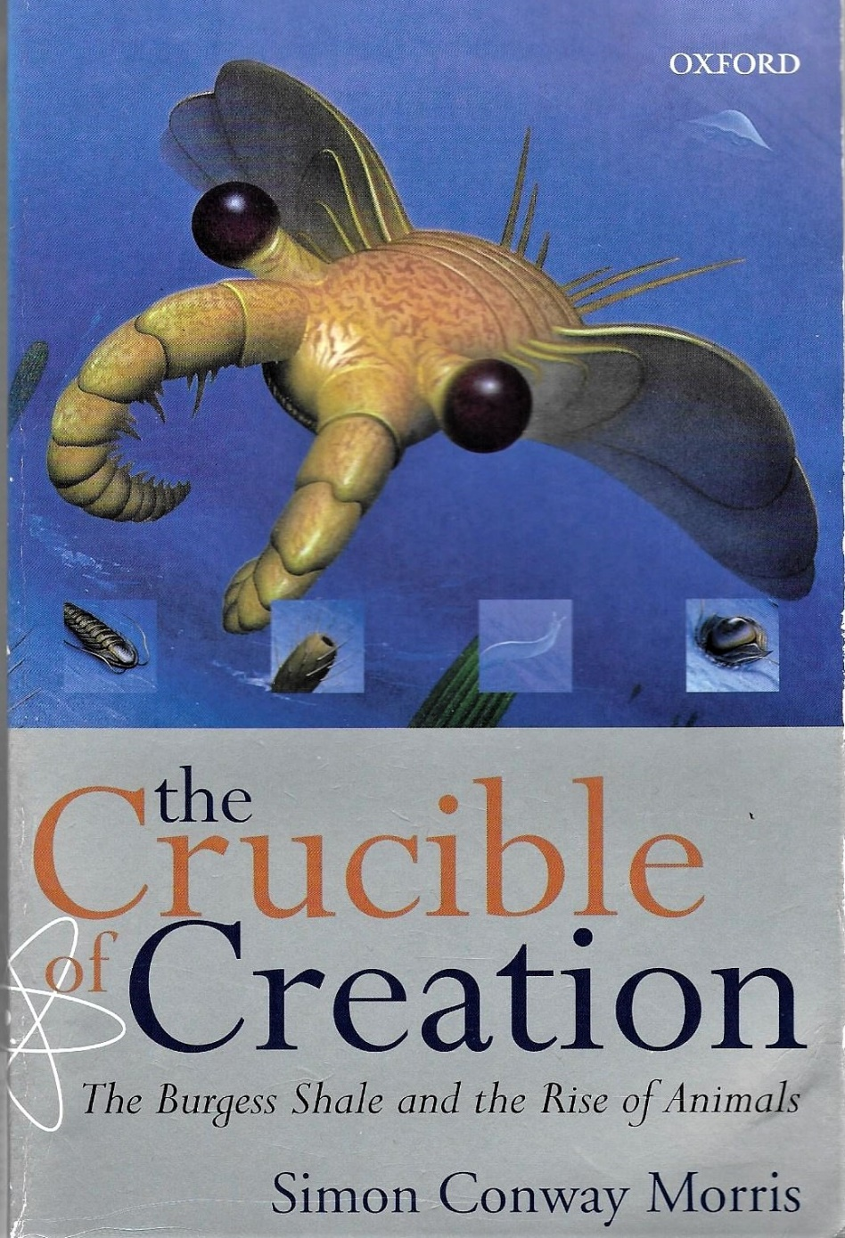
My main sources for the debates after Wonderful Life
Many of the protagonists have written articles and reviews as contributions to the continuing debates since Gould’s book, but Conway Morris’s The Crucible of Creation offers an accessible overview of the issues and the sharpest critique of Gould’s approach, while Briggs and Fortey’s ‘Wonderful Strife: systematics, stem groups and the phylogenetic signal of the Cambrian Radiation’ Paleobiology 31 (2005) is a good stocktaking
OUP 1998
Another important source is the extensive Royal Ottawa Museum website dedicated to the Burgess Shale & its fauna
Finally there is valuable commentary on the Burgess Shale studies and controversies by historians/ philosophers of science, esp. Keynyn Brysse, ‘From Weird Wonders to Stem Lineages: The second reclassification of the Burgess Shale fauna’ Studies in the History & Philosophy of Biological & Biomedical Sciences 39 (2008) & ‘What is a Phylum’ Palaeontographica Canadiana 31 (2011) + Christian Baron, ‘A Web of Controversies: Complexity in the Burgess Shale Debate’ Journal of the History of Biology 44 (2011)
Notes:
Image is front cover of Simon Conway Morris (1998) The Crucible of Creation: The Burgess Shale and the Rise of Animals OUP

Slide 7
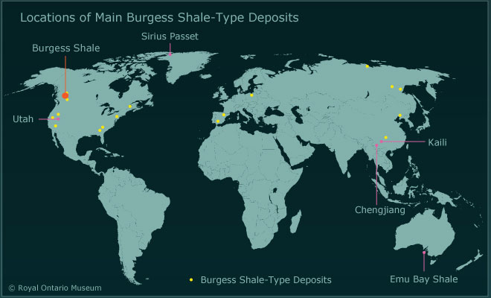
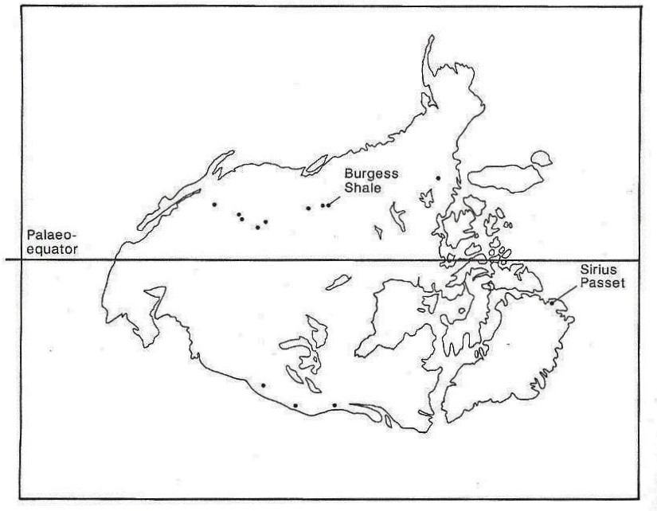
The international geographical range of BS-type lagerstätten
Map from Royal Ottawa Museum website, showing BS type deposits and related faunas found across North America, Europe, Eastern Russia, China and Australia, underlining what Briggs (2014) characterises as the global ‘connectivity of Cambrian life’
Map from Crucible of Creation, showing occurrence of a range of BS type deposits on the fringes of the ancient continent of Laurentia, suggesting similar conditions of marine deposition around its shelf
Notes:
Map on left: ‘Location of Main Burgess Shale-Type Deposits’ from Royal Ontario Museum web site at
https://burgess-shale.rom.on.ca/en/science/origin/04-cambrian-explosion.php
Map on right taken from Simon Conway Morris (1998) The Crucible of Creation: The Burgess Shale and the Rise of Animals OUP p 118, fig 50, captioned ‘The ancient continent of Laurentia. Each dot represents a fauna of Burgess Shale type …’

Slide 8
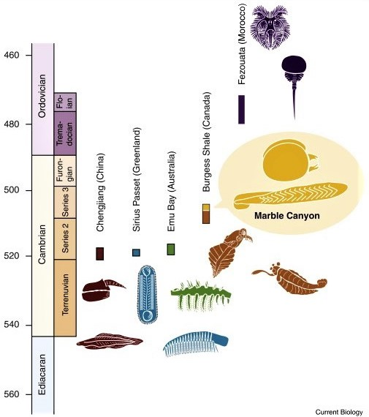
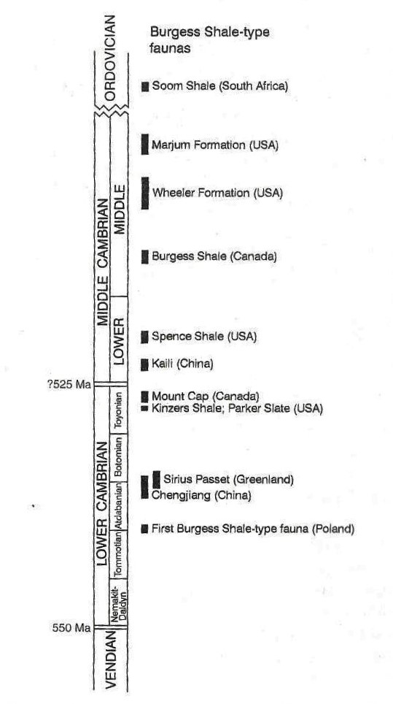
The temporal range of BS-type sites in and after the Cambrian
Note the lower boundary of the Cambrian has been redrawn and the absolute dates of both upper and lower boundaries have been much revised (reducing the duration of the period)
The Rockies BS sites tap into several different sediments roughly contiguous in time, but the latest, at Marble Canyon, is the youngest of these Middle Cambrian sites
Several other comparable lagerstätten, in China (Chengjiang), Greenland (Sirius Passet) and Australia (Emu Bay), are distinctly earlier, Lower Cambrian
Some of the BS fauna – including Anomalocarids and Marrellomorphs – are also found in Ordovician rocks in Morocco (Fezoutata), so some
survived longer than often thought
Diagram to left from Crucible of Creation (1998)
Diagram to right from Briggs (2014)
Notes:
Image on left from Simon Conway Morris (1998) The Crucible of Creation: The Burgess Shale and the Rise of Animals OUP,
p 123 fig 55, captioned ‘Distribution of some principal Burgess Shale-type localities in the Lower and Middle Cambrian’
Image on right from Derek Briggs (2014) ‘Palaeontology: A New Burgess Shale Fauna’ Current Biology 24.10: R398-R400, figure 1 R399

Slide 9
Placing the Burgess Shale fauna in international context
There are quite numerous BS type sites, in North America, Greenland, Europe, East Russia, China & Australia, with overlapping faunas and comparable, though not identical, soft bodied preservation
Budd (2003) still characterises the Burgess Shale, Chengjiang and Sirius Passet sites as ‘the big three’ in terms of quantity and quality of specimens. Some of the other sites have yielded few specimens, are very difficult to access (as in Siberia) or the quarries have now disappeared (esp. in the US), with surviving specimens confined to museum collections
Discoveries of BS fauna in the Rockies have extended beyond the Walcott and Raymond quarries in a series of ROM expeditions to other local sites, yielding a rich array of specimens which justify Conway Morris’s view that the Burgess Shale is ‘still the exemplar and yardstick of Cambrian life’
Together these sites have yielded better specimens of existing species, further new creatures and consequently fresh interpretations, though Gould included the initial discoveries at Chengjiang and Sirius Passet when he wrote Wonderful Life
This new material has fed revisions to the analyses of the Burgess Shale and the Cambrian ‘explosion’ developed by Whittington et al and celebrated by Gould, BUT these fresh interpretations have also been driven by a conceptual transformation which has swept into palaeontology from biology, in the form of ‘cladistics’
So we need to place the BS fauna in this new cross-disciplinary intellectual context as well

Slide 10
Conceptual innovation: a brief introduction to cladistics
In the 1970s & 1980s contrasting approaches to the classification of organisms and evolutionary relationships were in contention, generating controversy and schism in biology (including generational rivalry). Conway Morris reports ‘the battle … was vigorous, often acrimonious and sometimes even bitter’, but eventually cladistics, inspired by Hennig (1950/1966) and with its new jargon, became dominant in biology
Cladistics bases comparisons on a wide range of ‘characters’ of each taxon, including molecular & genetic alongside anatomical & behavioural features, and gives attention to similarities (‘synapomorphies’) as well as differences. Thus cladists criticise earlier ideas about body plans for prioritising some features over others, and avoid giving undue weight to odd/unique features (‘autapomorphies’). Systematic analysis of the resulting data, aided by using computer algorithms, can generate ‘parsimonious’ trees of taxonomic relationships
Pure cladists focus on living genera, dismissing fossil evidence as too unreliable. This delayed the use of cladistics by palaeontologists, who wish to locate fossils in evolutionary relationships in terms of shared ancestry and also patterns of extinction. Jeffries (1979) made cladistics more useful to geologists by highlighting the distinction between ‘crown groups’ (extant groups with common features from a common ancestor) and ‘stem groups’ (extinct lineages with mixed features predating such ancestors)
BUT generating cladograms is not just a mechanical process. Judgements are needed about which shared features result from evolutionary convergence (analogy) versus shared inheritance (homology) and which features are ‘ancestral’ or ‘primitive’ (‘plesiomorphic’) hence widely shared and insufficiently discriminating, and which are ‘recent’ or ‘derived’ (‘apomorphic’) denoting specific/recent common ancestry
Both Gould and Conway Morris have significant reservations about cladistics: judgements must still be made; different plausible trees may be generated; some ‘characters’ may be interdependent; and contemporary molecular data remains distant from earlier evolutionary history

Slide 11
Adapted from Brysse Studies in Hist & Phil of Biol and Biomed Sciences 39, 2008
Simple cladistics ‘tree diagram’ highlighting ‘stem lineages’
(and prefiguring the reappraisal of some weird wonders)
onycophora
arthropoda
Present
Crown group defined by extant genera plus extinct genera above their last common ancestor
[& Budd adopts the crown group as a rather restrictive concept of ‘phylum’]
Last common ancestor sharing
all defining features (‘synapomorphies’) of crown group
Hallucigenia
Anomalocaris
Opabinia
Middle Cambrian
Stem lineages (or groups) that fall below the
last common ancestor of a crown group, and
thus possess what Budd (2003) terms a
‘confusing mixture’ of some characters shared
by that group and some peculiar to themselves
(‘autapomorphies’)
[& Briggs and Fortey add stem group to crown
group to constitute a more inclusive ‘phylum’]
Thus Hallucigenia, Anomalocaris & Opabinia
are no longer such ‘weird wonders’ as they are
now ‘confusing mixtures’ related to ‘much more
“respectable”’ specified stem lineages
Divergence from presumed annelid ancestor
Adapted from Brysse Studies in Hist & Phil of Biol and Biomed Sciences 39, 2008
Notes:
Diagram adapted from Keynyn Brysse (2008) ‘From Weird Wonders to Stem Lineages: the second reclassification of the Burgess Shale fauna’ Studies in the History and Philosophy of Biological and Biomedical Sciences 39: 298-313, Figure 8 p 310, in the light of discussions in Brysse, Budd (2003) and Briggs and Fortey (2005)

Slide 12
Continuing research on BS faunas in the Canadian Rockies
Desmond Collins, based at the University of Toronto and the Royal Ottawa Museum (ROM) began to prospect more widely near the original Burgess quarries when the National Park authorities were still resistant to collecting at the original sites, and he found a series of other fossiliferous localities within a few kilometres.
Later Collins was also permitted to lead fresh excavations at the Walcott and Raymond Quarries alongside continuing explorations in the wider locality. From 2006 Jean-Bernard Caron, also based at Toronto and the ROM, took over and added further new sites, including Marble Canyon in 2012
By 2015 the Royal Ottawa Museum had accumulated 150,000 specimens (including many slabs with more than one fossil), compared with the 65,000 still held at the Smithsonian
This has provided the basis for (a) the more detailed analysis of species recognised earlier; (b) the identification and characterisation of further new genera; (c) fuller accounts of the overall ecology and interactions of the BS fauna; and (d) wider comparisons with the similar and related creatures at the other leading sites where soft-bodied Cambrian fossils have been found
This continuing research has moved away from the Manton/Whittington idea of the phyletic lawn of ‘weird wonders’ and has often embraced the methods of cladistics in search of precursors of existing phyla (what Briggs calls ‘sister plesions’) characterised by mixed and/or ‘more primitive’ features
But this cladistics methodology can still yield uncertain results, with different researchers offering alternative ‘cladograms’, especially when applied to partially preserved and enigmatic fossils. Furthermore, such reclassification still leaves several other aspects of the debates surrounding the Burgess Shale fauna unresolved

Slide 13
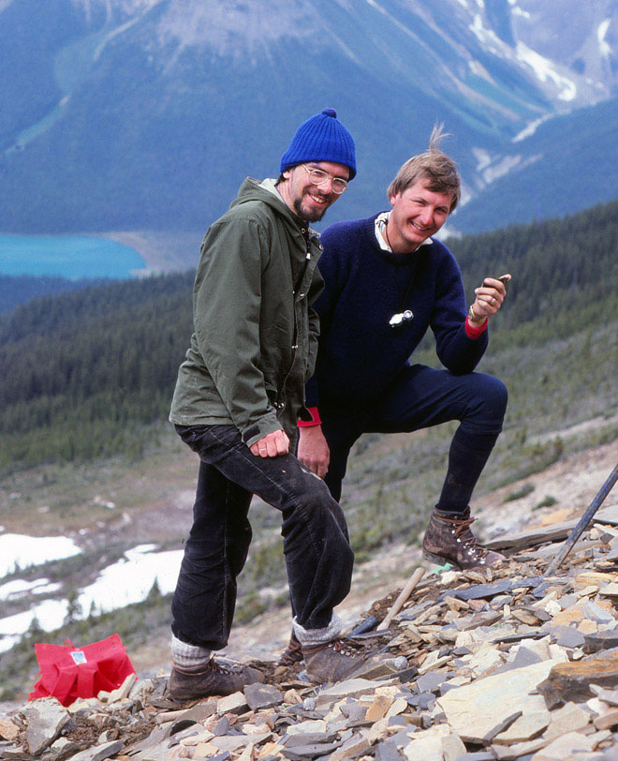
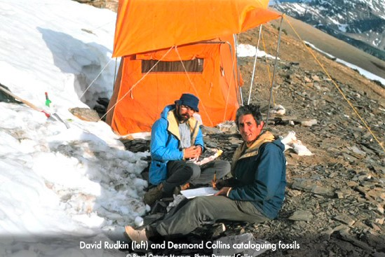
Participants in further research on BS faunas in Canada
Simon Conway Morris and Derek Briggs
have continued to participate in active
research on the Burgess Shale
Desmond Collins joined the BS research in the late 1960s and was project leader for 18 expeditions from 1975 to 1999. He oversaw fresh excavations at the old quarries and extended the search for new sites which have also yielded a rich array of specimens
Des Collins (right)
and David Rudkin
cataloguing fossils
at Walcott quarry
in the 1980s
Conway Morris
and Briggs on
the talus near
Walcott quarry
1981
Notes:
Left hand photo of Conway Morris and Briggs ©ROM photo by Desmond Collins July 12 1981, Royal Ontario Museum/Parks Canada web site at https://burgess-shale.rom.on.ca/en/history/discoveries/05-rom.php
Left hand photo of Rudkin and Collins © ROM, ROM/Parks Canada web site, at
https://burgess-shale.rom.on.ca/en/history/discoveries/05-rom.php

Slide 14
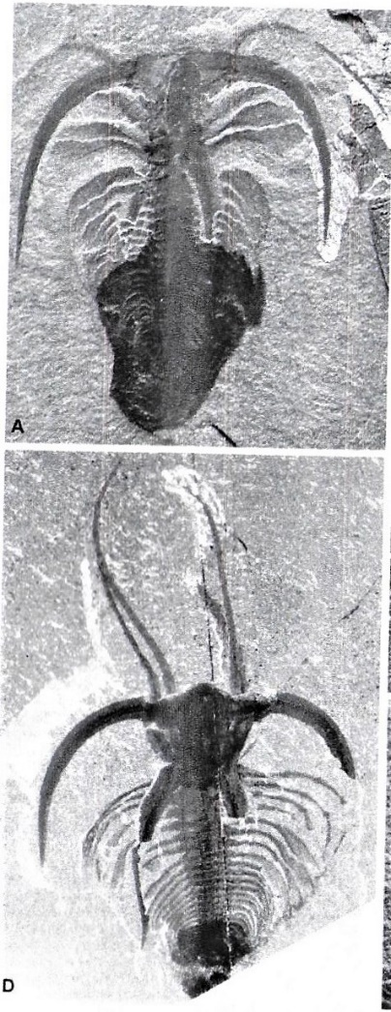
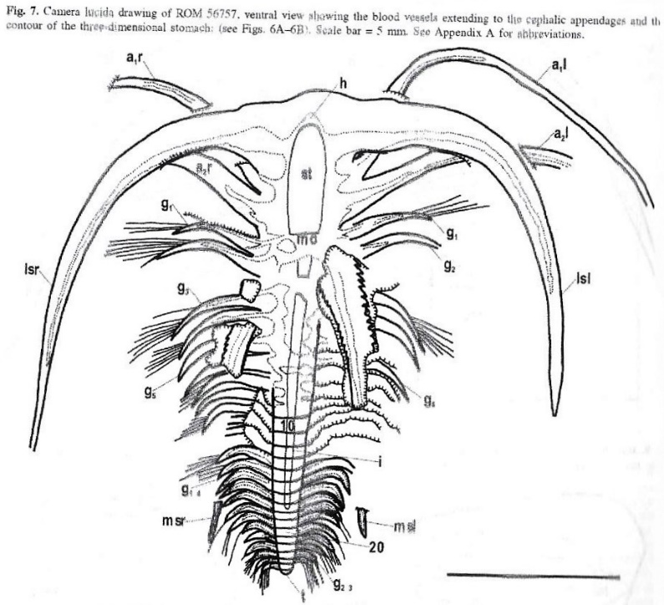
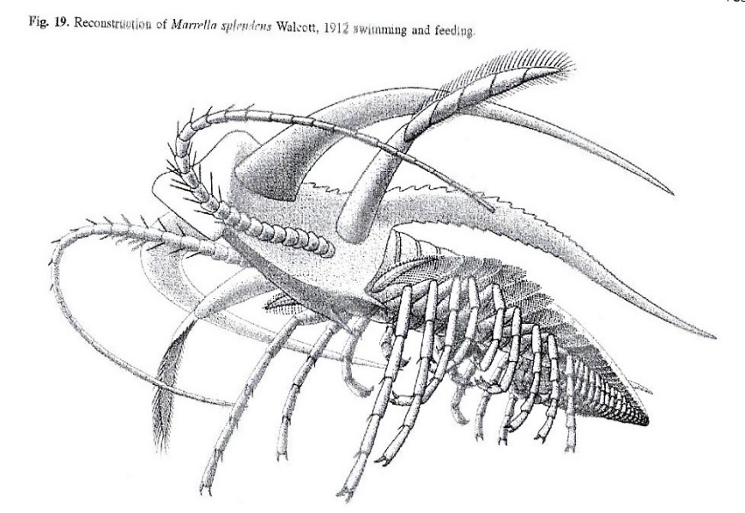
A new study of an old favourite: Marrella
Collection of many additional specimens enabled Garcia-Bellido and Collins (2011) to revisit Whittington’s classic analysis, using 1,000+ fossils from the 9,000 found by ROM since 1973
New information on ‘anatomy, functional morphology and behaviour’ allowed revision and refinement of Whittington’s account. They identified the second set of head ‘antennae’ as definite swimming appendages, without a primary sensory function, clarifying Marella’s mode of life
Both differential reflectiveness & element analysis clarified the location and form of the gut (Al, K) and blood vessels (C), showing a substantial supply of blood to the swimming appendages
The specimens ranged from 2.4 mm to almost 2.5 cm and from 17 to 26 body segments, providing ‘an almost complete ontogenetic sequence’
Camera lucida drawing showing stomach and blood vessels
Two photographs of same specimen under different lights
Reconstruction of Marella splendens swimming and feeding
Notes:
All figures taken directly from Diego Garcia-Bellido and Desmond Collins (2006) ‘A new study of Marella splendens (Arthropoda, Marrellomorpha) from the Middle Cambrian Burgess Shale, British Columbia, Canada’ Canadian Journal of Earth Sciences 43: 721-742, as follows:
Photos on left of Marella splendens taken from photos A [ventral, overall, no reflection] and C [dorsal, overall, reflective] from Figure 6 p 728
Top figure on right taken from Figure 7 p 729, a camera lucida drawing of ROM 56757, ventral view
Bottom figure on right taken from Figure 19 p 739, titled ‘Reconstruction of Marrella splendens Walcott 1912 swimming and feeding’

Slide 15
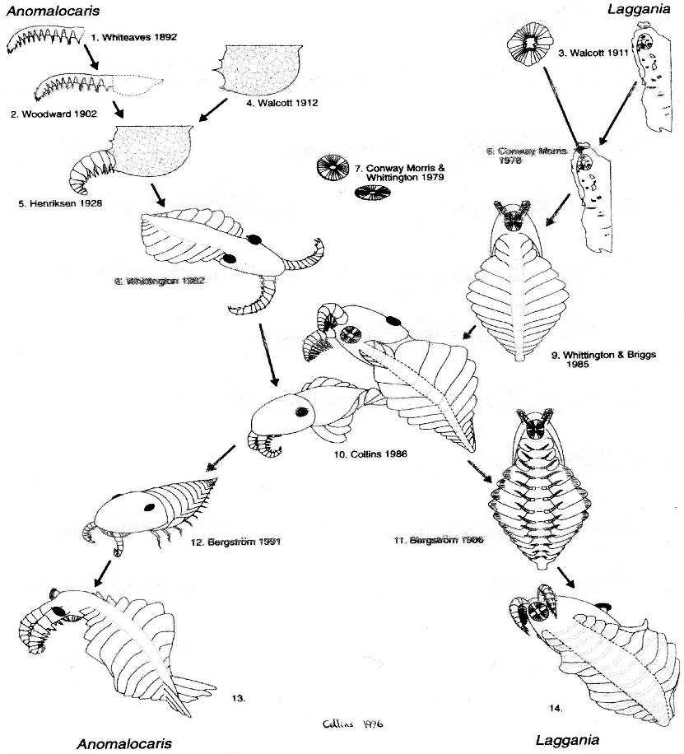
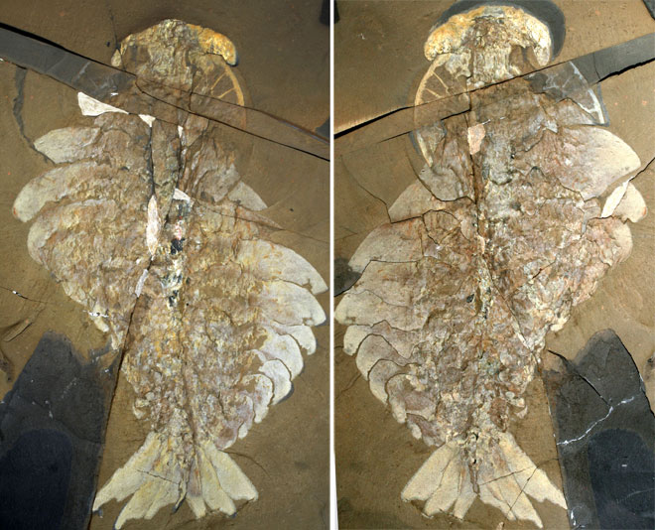
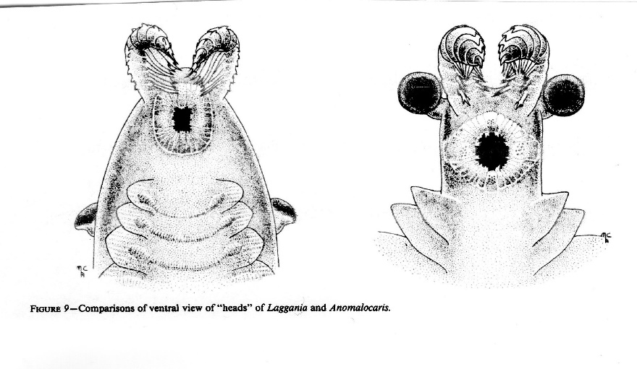
The continuing saga of the Anomalocarids
Collins 1991
Gould had noted how several different fragments were combined to construct the apex predator Anomalocaris (left)
The ROM expeditions found new and better specimens of this and related animals (right: best part & counterpart)
Anomalocarids were also found in
Chengjiang, Australia and Morocco
Collins (1996) reviewed the evidence and distinguished more clearly between Anomalocaris canadensis and Laggania cambria, with quite different bodies and ‘very different heads with different positions of the eyes and slightly different jaws’ (see left), concluding that such differences between these (and also other) species justified assignment to different genera within a clade, but as members of an extinct class and order of arthropoda, not a distinct ‘odd’ phylum
Collins also remarked ‘that when studying fossil remains of animals with no apparent living descendants, everyone is groping in the dark’
Notes:
Figure on top left reproduced from Desmond Collins (1996) ‘The “Evolution’ of Anomalocaris and its classification…’ Journal of Paleontology 70: 280-293, p 282, titled ‘Anomalocaridid reconstructions from 1892 to 1996’
Figure on bottom left reproduced from Desmond Collins (1996) ‘The “Evolution’ of Anomalocaris and its classification…’ Journal of Paleontology 70: 280-293, figure 9 p 290, titled ‘Comparison of ventral views of “heads” of Laggania and Anomalocaris’
Photograph on top right taken by Jean-Bernard Caron © ROM and captioned ‘The most complete Anomalocaris canadensis ever found was collected in 1991 in the Raymond Quarry (part and counterpart)’ from Royal Ontario Museum/Parks Canada website; https://burgess-shale.rom.on.ca/en/history/discoveries/05-rom.php

Slide 16
Pikaia: new finds underpin a more definitive species description
In 1979 Conway Morris characterised Pikaia, a laterally compressed two cm long ribbon-like creature, as a chordate, contradicting Walcott’s (1911) view that it was a polychaete worm, and by 1989 Gould regarded this early and rare chordate as emblematic of the contingent survival of the ancestors of vertebrates (and thus ourselves)
It was not until 2012 that Conway Morris, with Jean-Bernard Caron, provided a fully detailed description of Pikaia based on 114 available specimens, of which around 60 were collected in the ROM expeditions led by Collins between 1994 and 1999
The 2012 paper weaves together a description of observed features and an analysis of the processes of fossilisation which influenced the appearance of these features in different specimens, with different orientations, patterns of decay and mineralisation
The key features include a small bilobed head with two tentacles, a spindle shaped body with keel and fins, nine pairs of appendages, a series of sinusoidal (not annular) segments interpreted as musculature, a mouth and gut, signs of a notochord and a ‘dorsal organ’ (Conway Morris had previously construed this ‘dorsal organ’ as itself a notochord) BUT note other researchers (e.g. Lacalli 2012; Mallatt & Holland 2013) are still querying some of these features and interpretations
Conway Morris and Caron argue that contemporary genomic data from highly derived and specialised species provides a limited basis for constructing evolutionary relationships so the evidence from fossils remains pivotal BUT they also recognise that the uneven evidence from Pikaia and other proto-chordates makes much of their own interpretation rather speculative and the extent to which Pikaia can be seen as a ‘basal’ or ‘specialised’ chordate remains contested

Slide 17
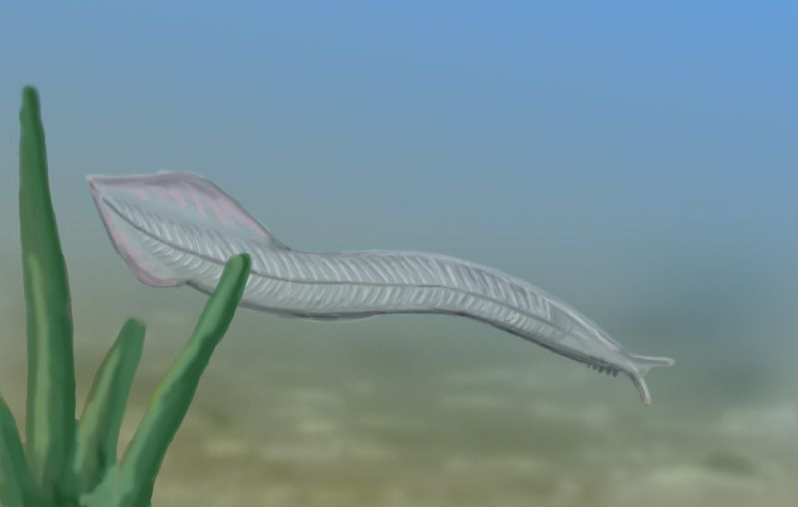
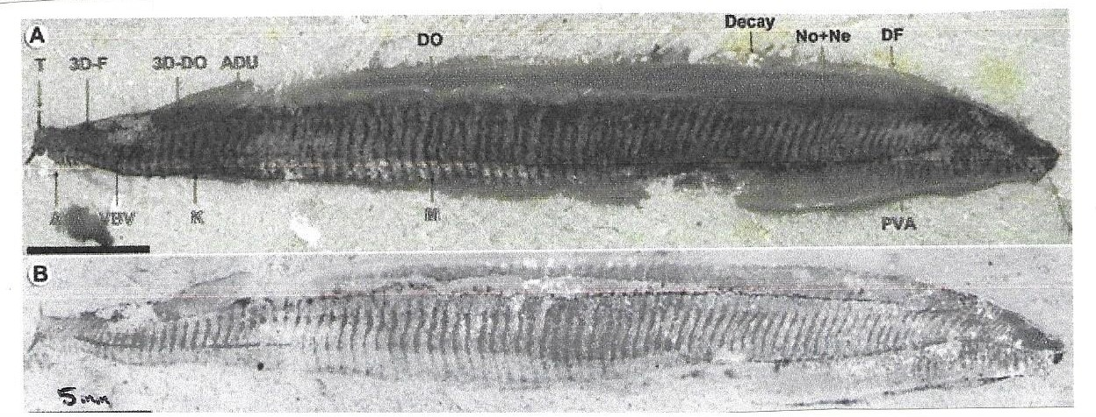
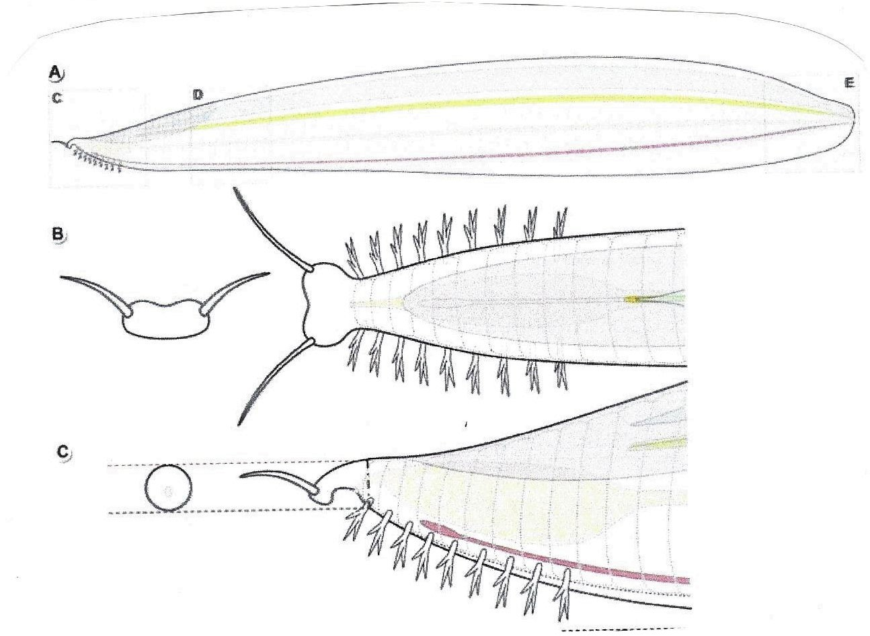
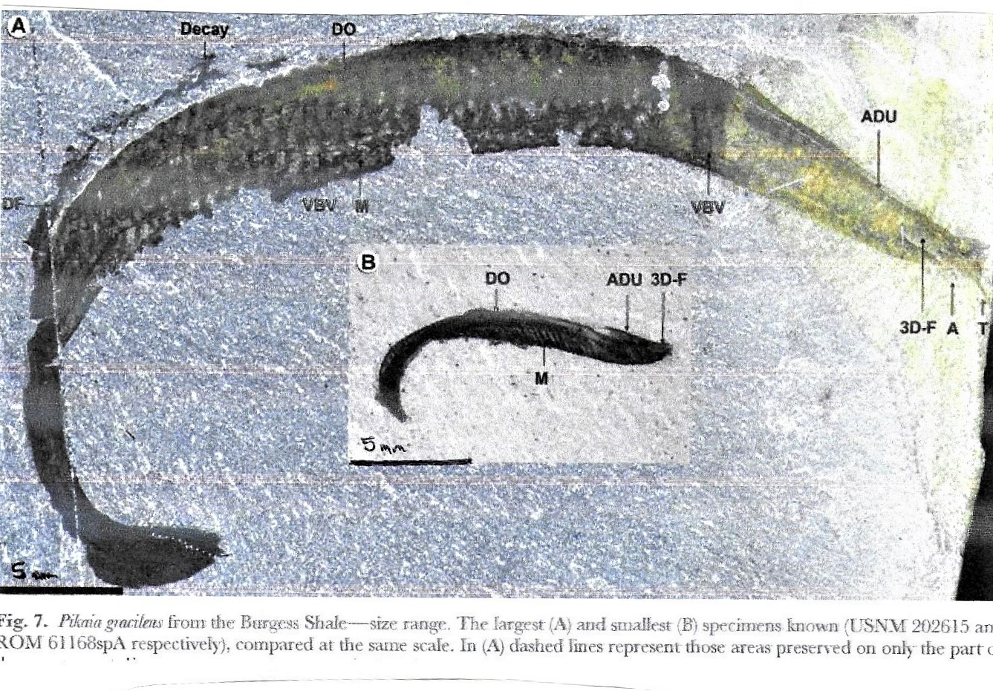
Pikaia: images supporting the new species description
Artist’s impression of free swimming Pikaia
Photos and drawings
from Conway Morris
and Caron 2012
Pikaia specimens
photographed
under different
conditions: A polarised light and B backscattering electron micrograph
Anatomical
diagrams of Pikaia by Conway Morris & Caron
Smallest and largest specimens of Pikaia, scale bars 5 mm
Notes:
Top left hand image by Nobu Tamura from Wikimedia commons at wiki/fossils_of_the_Burgess_Shale#/media/File:Pikaia_BW.jpg
Photographs on upper right taken from Simon Conway Morris & Jean-Bernard Caron (2012) ‘Pikaia gracilens Walcott, a stem-group chordate from the Middle Cambrian of British Columbia’ Biological Reviews 112 pp 1-33, figure 5 p 6 ‘Pikaia gracelens from the Burgess Shale – preservation. USNM 198684 photographed under different conditions’, images A [polarized light conditions] and B [‘backscattered scanning electron microscope]
Photographs on lower right taken from Simon Conway Morris & Jean-Bernard Caron (2012) ‘Pikaia gracilens Walcott, a stem-group chordate from the Middle Cambrian of British Columbia’ Biological Reviews 112 pp 1-33, figure 7 p 9, showing ‘size range, with the largest (A) and smallest (B) specimens known’
Drawings on lower left taken from Simon Conway Morris & Jean-Bernard Caron (2012) ‘Pikaia gracilens Walcott, a stem-group chordate from the Middle Cambrian of British Columbia’ Biological Reviews 112 pp 1-33, figure 8 p 12, A [‘overall lateral view’], B and C [‘close ups of the anterior section B front and dorsal view, C lateral view’

Slide 18
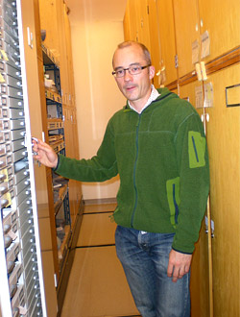
Current research led by Jean-Bernard Caron at ROM
Caron, a Frenchman captivated by Gould’s account, went to Canada to do his PhD with Collins and is now a leading author on the BS
He was appointed curator at ROM & University of Toronto in 2006, and followed Collins in searching for new BS localities, with particular success at Marble Canyon, around 40 km from Walcott Quarry
This site, atop rather than beneath the Cathedral escarpment, is characterised by a notably high density and diversity of fossils, yielding over 3,000 specimens in 15 days of fieldwork in 2012 – and eleven of the 55 taxa found there were new to science
Two thirds of its genera duplicated those at Walcott Quarry, but there were very good specimens of some key species (including the arthropod Mollisonia and the stem chordate Metaspriggina)
But this fossil assemblage was also distinctive in its trace fossils and having two Chinese stem arthropods (Primicaris and Misszhouia)
Caron et al (2014) suggest this material offers ‘new insights into the initial diversification of metazoans’, and shows ‘the potential of the BS to yield [further] exceptional biotas … largely untapped’, so fieldwork was continuing at Marble Canyon in 2017
Caron has also overseen the opening of the ROM collection of 150,000 specimens to other researchers, facilitating population studies and cladistics comparisons
Notes:
Photo on left of ‘J-B Caron showing some of the ROM collection fossils’, taken from 2015 ROM [Burgess Shale] evolution tour blog at https://www.strangescience.net/romtour.htm accessed 23/10/2018

Slide 19
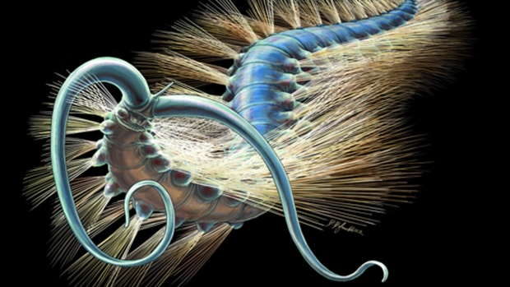
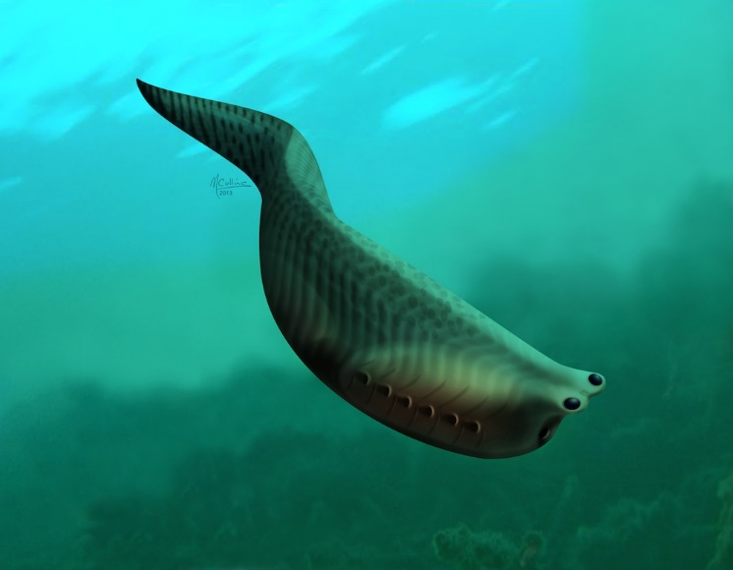
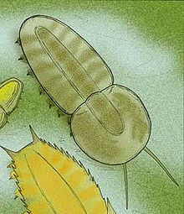
Exemplars of different contributions of the Marble Canyon finds
Left:
Kootenayscolex barbarensis,
a newly described Burgess
Shale Polychaete, a bristled
annelid worm, based
primarily on 500 specimens
from Marble Canyon
Centre: Metaspriggina walcotti, a stem chordate first known from only two indifferent specimens at the Walcott Quarry. However over 30 good specimens were found at Marble Canyon, including traces of liver and heart, throwing fresh light on chordate evolution
Right: Misszhouia, a stem
arthropod akin to a soft
bodied trilobite, was first identified in China but also found at Marble Quarry, underlining the wide geographical and temporal range of the BS taxa
Notes:
Left hand image of Kootenayscolex © rom, restoration by Danielle Dufault, 2018, taken from ROM Blog ‘The life cycle of a new fossil: meet the ancient cousin of the earthworm’ by Karon Nauglu at www.rom.on.ca/en/blog/the-life-cycle-of-a-new-fossil-meet-the-ancient-cousin-of-the-earthworm
Middle image of Metaspriggina © Conway Morris and Caron, restoration by Marianne Collins, 2014, taken from ROM Blog ‘A fish with a big Bang’ by Jean-Bernard Caron at www.rom.on.ca/en/blog/metaspriggina
Right hand image is an ‘artist’s restoration’ of the trilobite-like Misszhouia longscaudata, by Stanton F Fink (2007) from https://en.wikipedia.org/wiki/Misszhouia

Slide 20
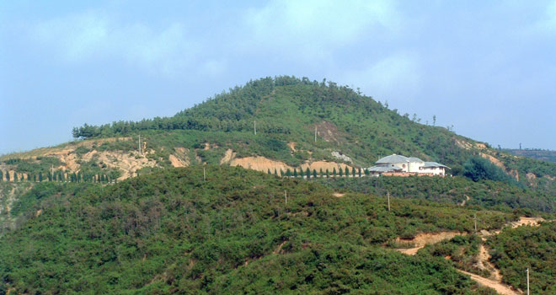
Chengjiang, Southern China
The first Chengjiang fossils were described by Henri Mansuy (1912) but only in 1984 did Hou, Xian-Guang discover the rich locality at Maotianshan, where extensive excavations continue
Clarkson (1998) registers ‘a mixed fauna of Lower Cambrian shelly and soft-bodied animals’ with similarities and differences from the BS: there are lots of similar arthropods, and a wider range of hemichordates, lobopodians and smaller priapulid worms. Relatives of Hallucigenia & Anomalocaris stand out, but there seems to be an absence of
polychaete annelids and halkieriids
The similarities with the BS are particularly notable because Chengjiang represents both the oldest such assemblage (basal Lower Cambrian) and arose beside another continental shelf (not off Laurentia)
Chengjiang fossils are found in mud-stones deposited in shallow water, with some exquisite specimens ‘preserved as reddish-brown impressions on yellow shale’, though organic materials are less directly preserved than in the BS
Site of Chengjiang fauna in hillside exposures at Maotianshan
Notes:
‘’Maotsinshan Hill, Southern China, where the first Lower Cambrian Chengjiang fossils were discovered’ Photo by Fangchen Zhao © Nanjing Institute of Geology and Palaeontology, Chinese Academy of Sciences, from ROM web site at
https://burgess-shale.rom.on.ca/en/science/origin/04-cambrian-explosion.php

Slide 21
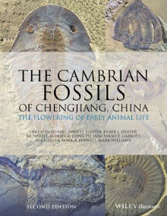
Chinese research on the Chengjiang Cambrian fauna
There has been substantial research on the Cambrian fauna of Chengjiang (see right) and this continues
This has involved strong competition especially between Hou, Xian-guang and Chen, Jun-yuan, each leading their own teams of Chinese and western palaeontologists (and Chinese villager excavators)
According to Fortey (2000: 131) this rivalry ‘makes the BS controversies seem almost decorous. Rival teams of collectors .. racing to be first. Peasants .. paid to come up with the goodies, even whisking fossils from under the noses of their competitors .. Rival publications. Cloak and dagger has been followed by back stabbing’
Nevertheless one early consequence of investigations of Hallucigenia-like lobopodians at Chengjiang was the revision of Conway Morris’s initial characterisation of the Burgess Shale erstwhile ‘weird wonder’ Hallucigenia, turning it right way up, reversing its back to front, and identifying it as a lobopodian (see next slide)
Notes:
Image is the front cover of the second edition of The Cambrian Fossils of Chengjiang, China, edited by Hou, Xian-guang, David J Siveter, Richard J Aldridge, Cong, Pei-gun, Sarah E Gabbutt, Ma, Xian-ya, Mark A Purnell and Mark Williams, published by John Wiley 2017, ISBN 13.978-1118896389

Slide 22
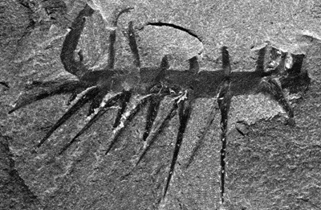
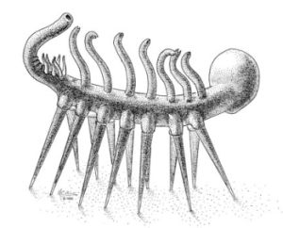
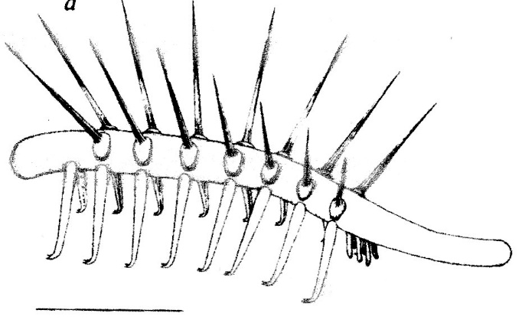
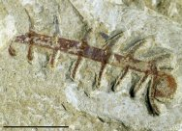
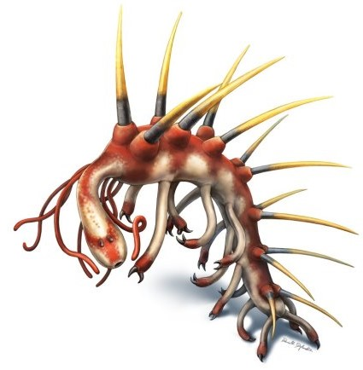
Reminder of successive reconstructions of Hallucigenia
Conway Morris’s initial (1977) reconstruction walking on spines, endorsed by Gould after some hesitation
Inverted (‘right way up’) reconstruction by Ramskold & Hou (1991) with paired tube-legs and spines on back
Burgess Shale Specimen
Chiengjiang Specimen
More recent reconstructions with more details of head and rear are based on better preserved Chinese specimens (Smith and Caron 2015, drawing by Danielle Dufault)
Such reconstructions have underpinned
reconceptualization of this creature as an
onychophoran stem group arthropod
(see Budd 2003, Smith 2017)
Notes:
Upper left photograph © Smithsonian Institution at https://naturalhistory2.si.edu/paleobiology/burgess/imgBurgess/hallucigenia hallucigenia.gif
Upper middle image © Smithsonian Institution at https://naturalhistory2.si.edu/paleobiology/burgess/imgBurgess/hallucigenia hallucigenia.D3gif
Upper right image Figure 4a Reconstruction of ‘armoured lobopod’ Hallucigenia sparsa (based on type material from Walcott Quarry) Lars Ramskold and Hou, Xingjang ‘New Early Cambrian Animal and Onychophoran Affinities of Enigmatic Metazoans’, Nature 351 (1991) p 227
Lower left photograph of Chengjiang specimen from www.fossilmuseumnat/Fossil_Sites/Chengjiang/Hallucigenia/CJF1174Bt.jpg
Lower middle image © rom, restoration by Danielle Dufault, 2017, taken from www.Palaeontologyonline.com/articles/2017/fossil_focus_hallucigenia/fig3_updated_reconstruction/

Slide 23
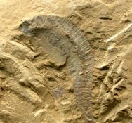

Yunnanozooans: a key focus of Chiangjiang controversy
Photograph of fossil Yunnanozooan
Artist’s rendition of Yunnanozooan
Chordates and their precursors are much more abundant in Chiangjiang than in the BS, despite being Lower Cambrian
One example, based on a lone specimen, is the cephalochordate Cathymyrus diadexus (‘Chinese eel’), in 1998 deemed the oldest chordate yet identified. Another is the fishlike stem group craniate, Haikovichthys. But most controversy centres on what Conway Morris called the ‘very strange’ Yunnanozoon, characterised by Briggs & Fortey as a ‘blade shaped soft bodied segmented animal’
Initial interpretation of this creature, by Hou et al (1991), left its affinities unresolved; Chen et al (1995) then used additional evidence to argue it was a cephalochordate more ‘derived’ (advanced) than Pikaia; but then Shu et al (1996) used other features to argue it ‘occupies a much more primitive position in … the hemichordates’ (acorn worms), a view Conway Morris regarded as more plausible though not entirely convincing
But Briggs & Fortey (2005) note Chen et al (1999) then ‘discovered abundant well-preserved specimens of a new Yunnanozoan (Haikouella) that appeared more craniate-like than cephalo-chordate-like’, suggesting they were a sister group of the vertebrates. Shu et al and Conway Morris (2003) expressed scepticism on the basis of their own research on putative muscle fibres and gills, but a more systematic treatment by Chen et al (2001, 2003) supported this diagnosis of crainiate affinities, though some dispute continues
Notes:
Upper left image is of photograph of fossil at www.fossilmuseum.net/Fossil_Galleries/Chengjiang/Yunnanozoon_lividum/Yunnanozoon_lividum.jpg
Upper right image is an ‘artist’s reconstruction’ of Haikouella_lanceolata, a primitive chordate, by Apokoryitaros at https://en.wikipedia.org/wiki/Haikouella#/media/File:Haikouella_lanceolata.jpg

Slide 24
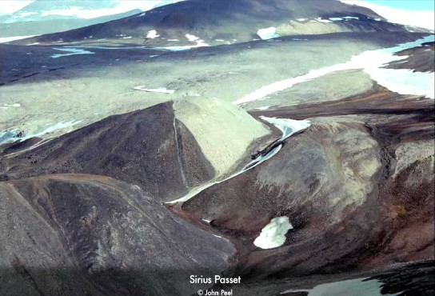
Sirius Passet, Peary Land, North Greenland
This inaccessible area was first explored by sledge in the early 1960s, but fossils from the early Cambrian, including soft-bodied specimens, were first discovered by the Greenland Geological Survey in 1984 and 1985
These fossils had been entombed in deep water by mud slides from the Laurentian shelf
Conway Morris participated in follow-up visits from 1989 and a Cambridge/Uppsalla research project through the 1990s, developing several analyses of the Sirius Passet fauna
Sirius Passet
There was a varied fauna, included polychaete annelids, large priapulids and many arthropods (some large), but few shelly fossils such as trilobites or brachiopods (perhaps because of low oxygen levels)
Of particular scientific importance were articulated halkieriids, ‘slug like creatures with a covering of scales’. Adults had about 2000 of these ‘sclerites’ but previously & elsewhere these had only been found as separate and scattered scales
*
Notes:
Photograph: ‘Southern side of Sirius Passet’ with fossiliferous locality yellow asterisked, Figure 2A in John S Peel and Jon R Ineson (2011) ‘The extent of the Sirius Passet Lagerstatte (early Cambrian) of North Greenland’ Bulletin of Geosciences 86.3 539 and also at ROM website: https://burgess-shale.rom.on.ca/ea/science/origin/04-Cambrian-explosion.php

Slide 25
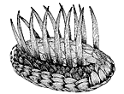
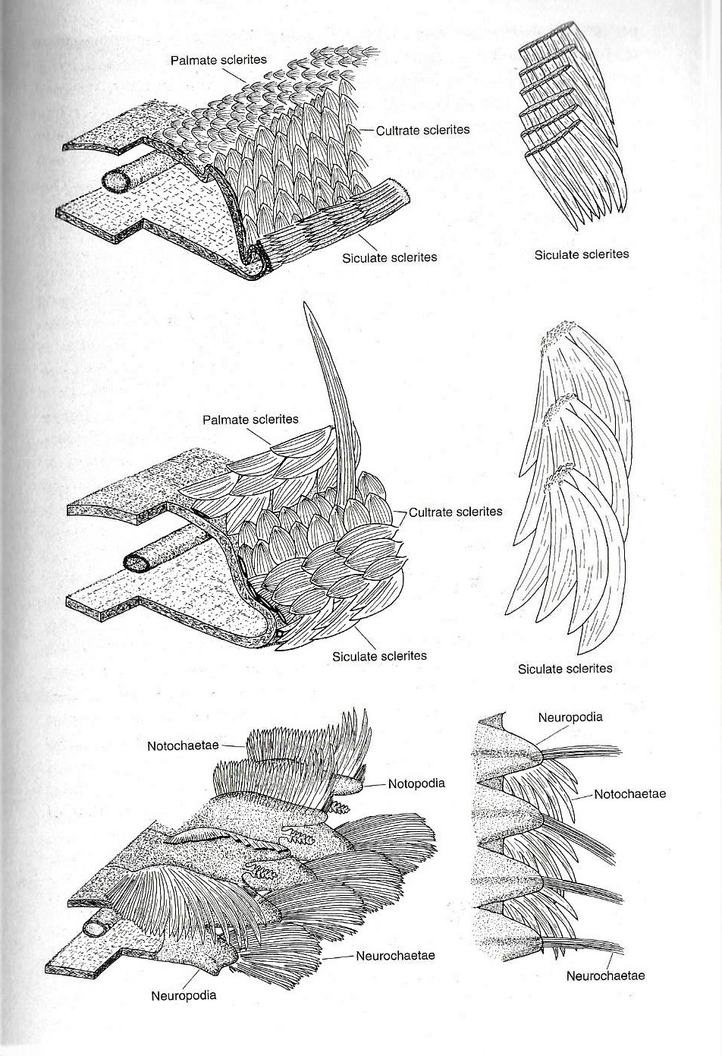
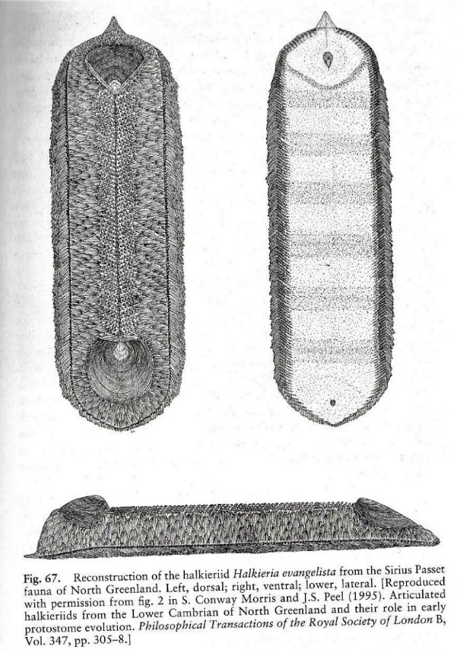
Conway Morris on sclerites, Wiwaxia and the halkieriids
In the Cambridge reappraisal of BS
fossils Conway Morris noted Wiwaxia (left) displayed a mix of worm- and mollusc-like features, including sclerites and spines, radula and slug-like ‘foot’, so another ‘weird wonder’
The articulated specimens of the Greenland halkieriids (left) enabled a detailed analysis of the structure and disposition of their sclerites compared with Wiwaxia and the polychaete annelid Canadia spinosa
This led CM to reconsider possible evolutionary relationships between these creatures in terms of ‘possible anatomical transitions’ between sclerite/chaetae structures (see right)
1. halkieriid
Wiwaxia
2. wiwaxid
3. Canadia spinosa
Articukated halkieriid
Notes:
Upper left image © Smithsonian Institution is wiwaxia01.gif at www.naturalhistory2.si.edu/paleobiology/burgess/wiwaxia.html
Figures on lower left taken directly from Simon Conway Morris (1998) The Crucible of Creation: The Burgess Shale and the Rise of Animals OUP, figure figure 67 p 155, ‘Reconstruction of the halkieriid …’
Figures on right taken directly from Simon Conway Morris (1998) The Crucible of Creation: The Burgess Shale and the Rise of Animals OUP, figure 84 p 191, showing ‘proposed anatomical transitions between the halkieriids ... the wiwaxids … and a primitive polychaete annelid …’

Slide 26
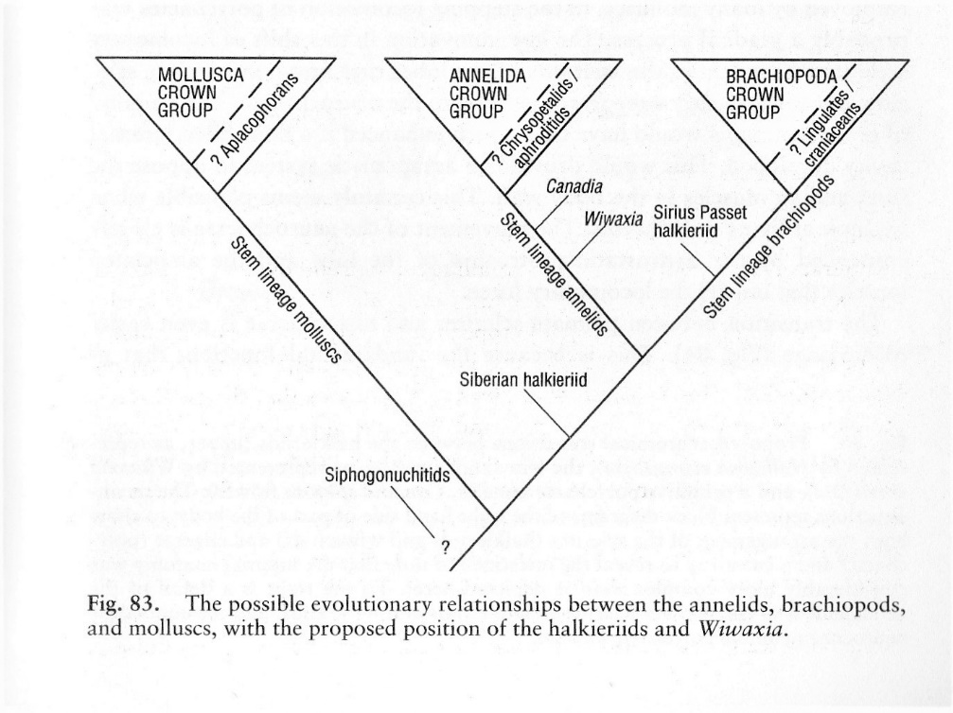
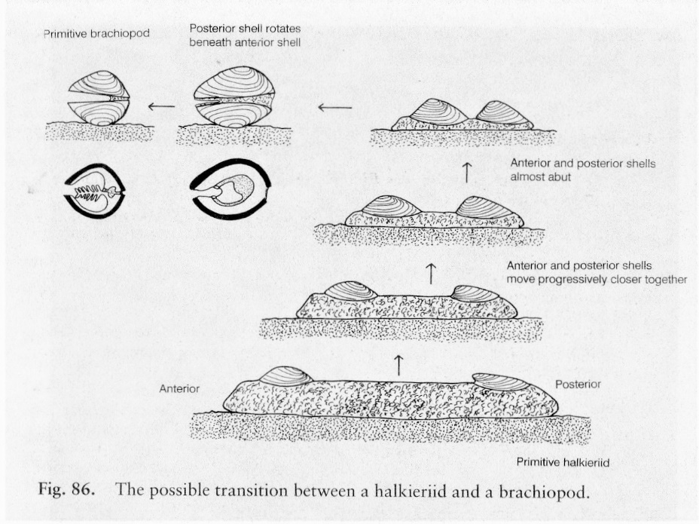
CM on halkieriids, brachiopods and wider evolutionary relations
Molluscs
Lingula
Aphrodites
Canadia
Sirius Passet
halkieriid
Wiwaxia (2006)
as a stem lineage mollusc?
Wiwaxia
(1998)
Siberian halkieriid
Wiwaxia (2015) on the stem lineage for both annelids and molluscs!
In Crucible of Creation the evolutionary relationships implied by these analyses were then summarised in cladistic diagrammatic form (but note the position of Wiwaxia was revised again by Caron et al, 2006 and yet again by Zhang et al, 2015)
Even more speculatively, Conway Morris also
considered the possible evolutionary relationship between halkieriids (with their two large shell-like posterior and anterior sclerites) and bivalved brachiopods (though Gould is sceptical)
Notes:
Figure on left taken from Simon Conway Morris (1998) The Crucible of Creation: The Burgess Shale and the Rise of Animals OUP, figure 86 p 194, titled ‘The possible transition between a halkieriid and a brachiopod’
Diagrams on right adapted from Simon Conway Morris (1998) The Crucible of Creation: The Burgess Shale and the Rise of Animals OUP, figure 83 p 189, titled ‘The possible evolutionary relationships between the annelids, brachiopods, and molluscs’, with additional possibilities for Wiwaxia suggested by Caron et al (2006) and Zhang et al (2025)

Slide 27
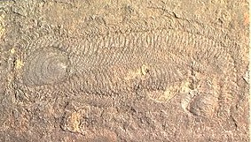
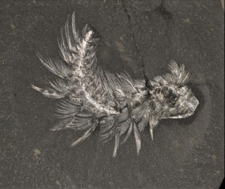
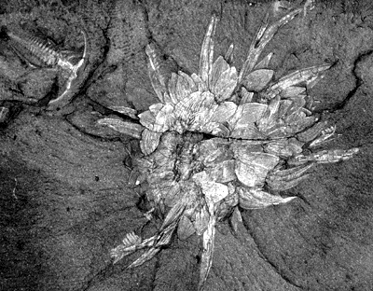
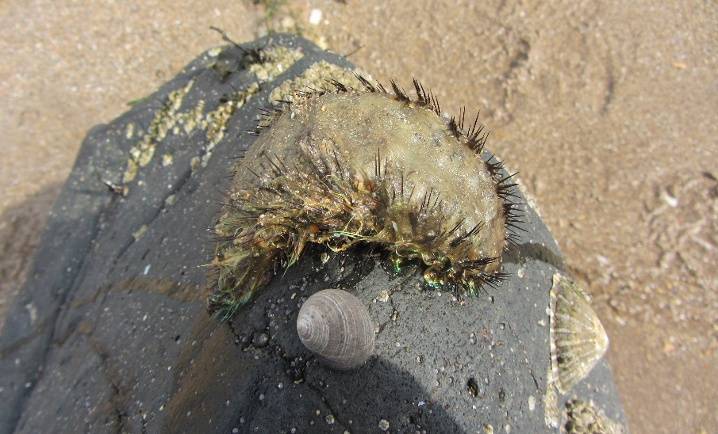
Halkieriids & stem lineage annelids: Wiwaxia, Canadia, Aphrodite
Left: Halkieria evangelista, a
stem lineage brachiopod,
1.5 to 8 cm
Right: Canadia spinose, a stem lineage annelid,
5-20 cm
Left: Wiwaxia corrugata,
a stem lineage annelid (or
mollusc?) 4 cm
Right: Aphrodite aculeate,
(aka ‘sea mouse’) an
extant crown group annelid,
10-20 cm, photographed
on beach near Gullane
Notes:
Upper left image of Halkieria evangelsita is a Wikimedia photograph by Jacob Vinther (2006) at https://en.wikipedia.org/wiki/Halkieriid#/media/File:Halkeiria2.jpg
Upper right image of Canadia spinose is of ROM specimen 61145 photographed by Jean-Bernard Caron © rom at https://burgess-shale.rom.on.ca/en/fossil-gallery/view-species.php?id=33&m=5&
Lower left image of wiwaxia © Smithsoinian Institution at https://naturalhistory2.si.edu/paleobiology/burgess/wiwaxia.html photograph of Wiwaxia fossil at file: wiwaxia.gif
Lower right mage is photograph of an Aphrodite oculeate at Black Rocks, Gullane, East Lothian photographed by Tony Elger (2018)

Slide 28
Briggs and Fortey apply cladistics to the fauna of the Burgess Shale
Derek Briggs has continued to work on BS and other soft bodied faunas, especially but not only in the Cambrian (he was in the team that researched the Granton Carboniferous conodont animal)
As a member of the Cambridge team in the 1970s Briggs expressed early reservations about the idea of the ‘phyletic lawn’, and saw Jeffries’s (1979) revision of cladistics as an alternative.
He worked with Richard Fortey on the first cladistic analyses of the Burgess Shale fauna, shifting attention from the peculiarities of ‘oddballs’ (problematic taxa with features that don’t fit modern forms) to diagnostic similarities which indicate relationships with recognised clades (as primitive hybrids or ancestral stem groups), using developing computer capabilities (e.g. PAUP program) to generate findings
On this basis Briggs & Fortey (1989, 2005) found that many of the apparently peculiar creatures of the BS were comfortably accommodated within a map of relationships which indicate a remote common ancestor, with most classified as (proto)arthropods and others as onycophora. Fortey (1998) concedes that some of these creatures remain very strange (e.g. Opabina with its five eyes) but their analysis cautions against exaggerating the uniqueness and diversity of this fauna, even if some of the unusual features of these early creatures are still subject to different interpretations
Briggs & Fortey argue that such cladistic analysis can work from both bottom-up fossil-based morphological data, and top-down molecular (especially DNA) data, though they also acknowledge that ‘it would be incorrect to claim that even major features of the tree are uncontroversial”, with lowish consistency indices and unresolved questions of homology and polarity
Briggs and Fortey (2005) also add that for the Precambrian, ‘one good fossil at an unexpected time and place could still have the effect of overturning any preconceptions’

Slide 29
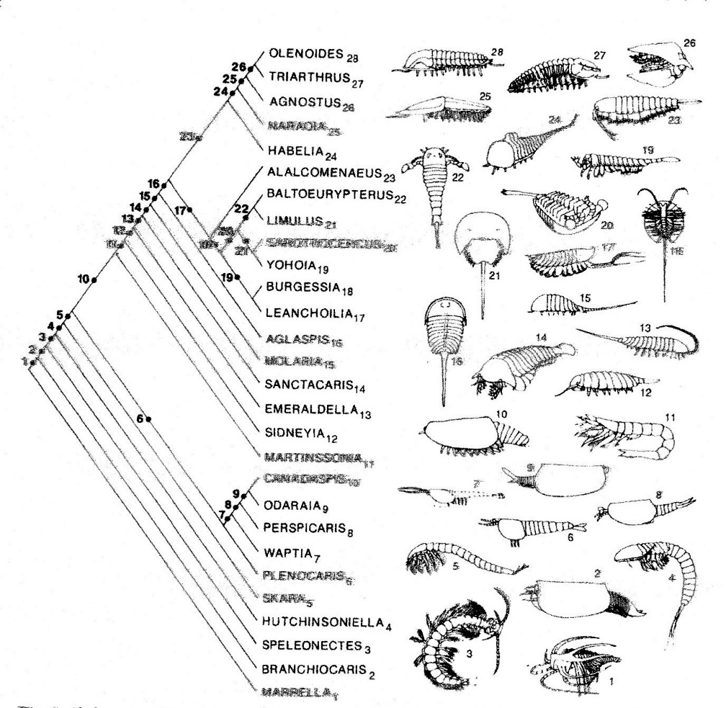
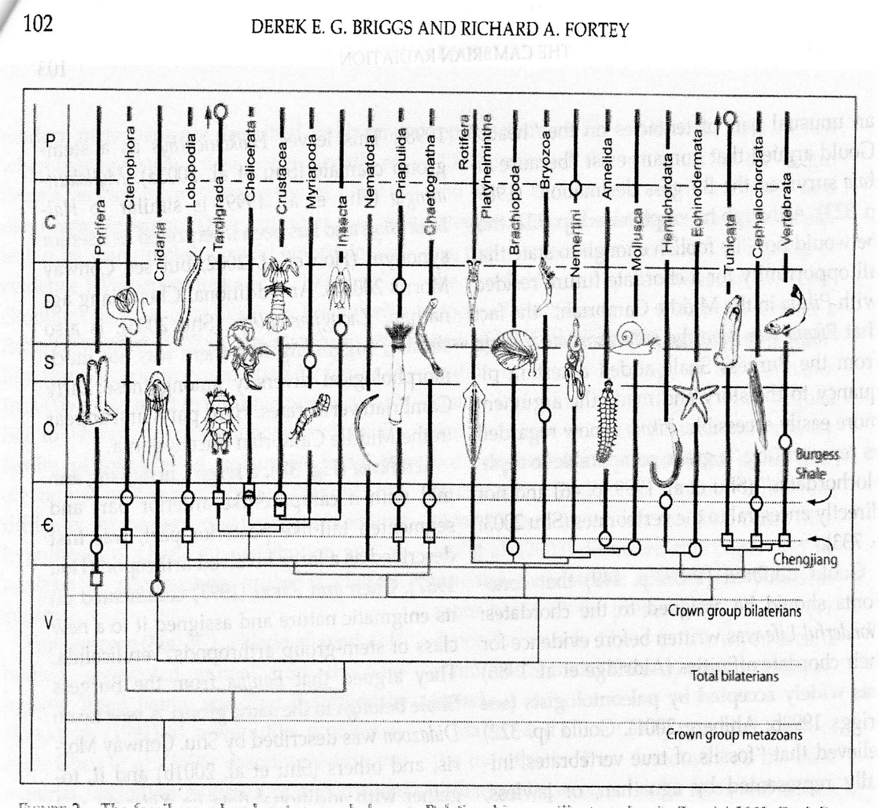
Cladistic analyses of trees of relationships among BS genera
Cladistic analysis & periodisationof metazoan relationships (2005)
Cladistic analysis of arthropod relationships (1989)
Notes:
Diagram on left from Derek Briggs and Richard Fortey (1989) ‘The early radiation and relationships of the major arthropod groups’ Science: 246: 241-243, figure 1 p246 (also reproduced in Brysse 2008)
Diagram on right from Derek Briggs and Richard Fortey (2005) ‘Wonderful Strife: systematics, stem groups and the phylogenetic signal of the Cambrian radiation’ Paleobiology 31: 94-112, figure 2 p 102

Slide 30

A sequence of evolutionary stages for ancestral arthropods
Graham Budd (1996, 2003), who completed his PhD with Conway Morris, underlines this critique of Whittington & Gould’s weird wonders by assigning erstwhile problematic taxa to an arthropod stem group
His ‘parsimonious reconstruction’ of evolutionary changes for ancestral arthropods (right) gives a full series, from the ‘most basal, worm-like taxa’ through acquisition of a series of distinctive arthropod features (sclerites, levering muscles, biramous limb, head appendages) – “arthropodisation”
Finally he also links this sequential acquisition to ideas about evolving ‘ecological and selective pressures’
This qualifies the notion of a Cambrian explosion by highlighting a dynamic of development through the Cambrian linked to growing ecological complexity
But Budd (2003) also recognises that ‘reception of … these attempts [at phylogeny] has been mixed
and they stand at different stages of maturity’
Notes:
Diagram on right from Graham Budd (2003) ‘The Cambrian Fossil Record and the Origin of the Phyla’ Integrative and Comparative Biology 41: 157-165, figure 4 p 160 (also reproduced in Brysse (2008)

Slide 31
Summary of first, second and third phases in the revised classification of the most problematical members of the Burgess Shale fauna (adapted from Brysse 2008 table 2 and text)
Year described | Name | PHASE 1 Status for Walcott | PHASE 2 Status for Whittington and his team | Revised by: | PHASE 3 Later revisions | Revised by:
1971 | Marrella # | close to trilobite | unique arthropod | Whittington | trilobite/chelicerate stem group | Briggs and Fortey (1989)
1974 | Yohoia # | branchiopod crustacean or trilobitoid | unique arthropod | Whittington | trilobite/chelicerate stem group | Briggs and Fortey (1989)
1975 | Opabinia # | branchiopod crustacean | new phylum | Whittington | dinocarid (?) stem group arthropod | Budd (1996, 2003)
1975 | Burgessia # | branchiopod crustacean | unique arthropod | Hughes | stem-group chelicerate | Briggs and Fortey (1989)
1977 | Hallucigenia # | polychaete worm | new phylum | Conway Morris | onychophoran stem group | Caron et al (2006) ???
1978 | Branchiocaris # | malacostracan crustacean | unique arthropod | Briggs | malacostracan crustacean | Briggs and Fortey (1989)
1985 | Wiwaxia # | polychaete worm | new phylum | Conway Morris | mollusc | Caron et al (2006)
1985 | Anomalocaris* # | brachiopod crusteacean (* Walcott also identified parts of the final animal as jellyfish & sea cucumber) | new phylum | Whittington & Briggs | dinocarid stem group arthropod | Collins (1996)
Revisions covered in my earlier talk
(summarised by Gould 1989)
More recent cladistics-led revisions
(summarised by Brysse 2008)
Key former weird wonders,
now belong in stem groups
leading to existing phyla
Notes:
Table adapted from Keynyn Brysse (2008) ‘From Weird Wonders to Stem Lineages: the second reclassification of the Burgess Shale fauna’ Studies in the History and Philosophy of Biological and Biomedical Sciences 39: 298-313, table 2 p 304

Slide 32




Resume of phases of controversy over evolutionary relationships
Starting point: wide range of soft bodied specimens including such ‘oddballs’ as Hallucigenia, Anomalocaris
and Opabinia
H
A
O
1. Walcott’s first allocation of each enigmatic oddball genus to an existing modern phylum, either annelida or arthropoda (have they been ‘shoe-horned’ in?)
A
O
H
2. Whittington et al (and Gould) regard enigmatics
each as members of distinct phyla separate from modern phyla, and originating from distinct annelid ancestors (metaphor of the ‘lawn’ of ‘weird wonders’)
H
A
O
3. Cladists locate enigmatics on the classificatory stems associated with modern groups, Hallucigenia on stem leading to onychophorans and Anomalocaris and Opabina on stem leading to true arthropods (while the branched stems register oddity in relation to extant taxa)
H
A
O
BUT also note Brysse’s concern that the apparent precision of cladistics threatened to crowd out continuing attention to other key issues in evolutionary palaeontology
Diagrams adapted from Brysse Studies in Hist &
Phil of Biol and Biomed Sciences 39, 2008
Notes:
Diagrams on right taken directly from Keynyn Brysse (2008) ‘From Weird Wonders to Stem Lineages: the second reclassification of the Burgess Shale fauna’ Studies in the History and Philosophy of Biological and Biomedical Sciences 39: 298-313 figures 5 and 6 p 309 and figures 7 and 8 p 310, with animation added

Slide 33
Simon Conway Morris contests Gould and offers his own synthesis
As we have seen, Conway Morris has remained a major interpreter of BS-type fossils since his PhD on the ‘worms’ of the BS, cautious about cladistics but championing the continued role of fossils (and not just contemporary genetic profiles) in understanding the history of life (see his studies of Pikiai, Halkieriids, etc)
His early analyses embraced the diagnosis of many ‘weird wonders’, directly inspiring Gould’s key argument in Wonderful Life (he also tried ‘replaying the tape’) BUT Crucible of Creation is a caustic repudiation of Gould’s main arguments which glosses over SCM’s own earlier enthusiasms and casts Gould as seeking to ‘demolish’ existing evolutionary theory (Fortey suggests this animus partly reflects jealousy at Gould’s popular success)
BUT Conway Morris also pioneered analysis of the ecology & interaction of BS creatures, focussing especially on predator/ prey relationships and food chains and their ‘complex interactions and feedbacks’, and drawing cautious parallels with recent ecologies. This highlights the possible spread of ‘arms races’ between increasingly active predators (mobility; eye-sight; jaws; bioturbation) and increasingly defensive prey (spines; shells; skeletons; deeper burrowing), noting such telling features as a preponderance of right-side bites
He therefore stresses the selective pressures driving both the retreat of some species and evolutionary innovation, and against Gould he sees this as sufficient to produce both a ‘slow-fuse’ Cambrian explosion and any later winnowing of body-plans
He also sees the process of convergent evolution as pervasive, with the capacity to by-pass contingent extinctions, follow limited bio-mechanical pathways, and yield longer term ‘progressive’ evolutionary trends, including the repeated emergence of such capabilities as intelligence (cf the octopus). This underpins his view of the transcendent dynamic of progressive evolution on earth, which he couples with an emphasis on the special responsibility of humanity towards our planet and biosphere
Perhaps surprisingly, though, in this context he is kinder to Dawkins – who emphasises micro-evolutionary mechanisms of fitness and survival and embraces ‘progress’, but within an atheist, ‘genetic reductionist’ and ‘materialistic’ world view criticised by Conway Morris – than he is to Gould – who is sceptical about the adequacy of micro-evolutionary mechanisms and ‘just so’ stories of adaptation, but emphasises that science and religion should coexist as non-competing forms of knowledge (and also argues for human responsibility)
Notes:
When Conway Morris shared the thought experiment of ‘rerunning the tape’ of the history of life he recognised that contingency and sub-optimal selection would allow outcomes to diverge in terms of body plans (so wiwaxids might replace molluscs)

Slide 34
Gould versus Conway Morris: a resume
Cambrian radiation was relatively rapid/ explosive (?), though precursors remain opaque
Cambrian explosion of experimentation meant variety of life characterised by maximum (?) disparity at multiple scales (genus, family, order, class, phylum)
Niche filling, selection pressures and labile genomes all played roles as mechanisms of Cambrian explosion
Growing interdependency in both genetic and morphological features tended to stabilise then entrench
or ‘lock in’ body plans (seen as emergent phyla?)
Cambrian taxa faced widespread extinction later, based more on external contingencies than on adaptive capacity, & such contingent extinctions drove a decline in overall disparity (??)
There is no guarantee of progress and repeatability in rerunning the tape of life because of extinction events and also rigidified body plans
Critic of both ‘cladistic and genetic reductionism’ and advocate of a revised ‘multi-level’ ‘Darwinian plus’ model
(expounded in his final book, Gould 2002)
Molecular clock data suggest a slow, longish ‘fuse’ (?) for the Cambrian radiation but uncharted during Ediacaran
Cambrian period genuinely saw rapid proliferation of taxa and wide disparity of forms of life
Niche filling, competition and selection pressures are sufficient (?) as mechanisms of longer Cambrian radiation
Ecological dynamics fuel continuing evolutionary innovation through the Cambrian and beyond, challenging claims for underlying body-plans (and underlining a pragmatic view of phyla, as ‘little more than a statement of taxonomic ignorance’)
No evidence of overall decline in diversity or disparity of forms of life since the Cambrian, instead shifts within occupied ‘morphospace’
Contingent extinctions are by-passed by continuing evolutionary innovation, with the strong capacity of convergent evolution to reproduce emergent capabilities and deliver ‘progressive' change (?)
Committed to the micro-evolutionary ‘modern [neo-Darwinian] synthesis’ with a strong progressive dynamic

Slide 35


The Cambrian Radiation and Patterns of Long-term Disparity
Features of the debate about the Cambrian ‘Explosion’ (taken from Marshall 2006), placing trends in diversity and disparity in context
Different views of disparity over deep time, taken from the ROM website. In Crucible of Creation Conway Morris is closer to the ‘traditional view’ than that of Fortey et al
Notes:
Left hand diagram: Charles R. Marshall (2006) ‘Explaining the Cambrian “Explosion” of Animals’, Annual Review of Earth and Planetary Sciences, 34: 355-384, figure 1 p 358, titled ‘Complex anatomy of the Cambrian “explosion”’
Right hand diagram: ‘Models of Relative Disparity Over Time’ © Royal Ottawa Museum, taken from
https://burgess-shale.rom.on.ca/en/science/burgess-shale/03-fossils.php

Slide 36
“Wonderful Strife”: taking stock in recent decades
Gould’s Wonderful Life was both an inspiration for researchers and a goad for critics, but as such helped stimulate valuable programmes of research on Cambrian and wider evolutionary processes
We should note that rival interpretations of Precambrian evolution and related geophysical triggers (like ‘slushball earth’ or oxygen levels), and their implications for the Cambrian radiation, all remain rather speculative given the limited fossil evidence and controversies about molecular clock data
Briggs et al were successful in using cladistics to position many apparent ‘odd ball’ taxa in stem groups, explicating their phylogenetic relationships with both extinct and extant phyla BUT (i) some fossils remain enigmatic, while (ii) this well focused success left other key issues unresolved
Gould defended his ‘inverted cone’ by contrasting morphological disparity with the species diversity addressed by cladistics, BUT (i) measuring disparity is messy and contentious, and (ii) the Cambrian radiation involved unprecedented disparity BUT there is little evidence of cumulative decline since
The notion of contingency is contested – is it just random events or rather processes (like an asteroid hit) that impinge from beyond the existing dynamics of an ecological system? – but most commentators accept that such contingent processes play some role in evolution, the questions are: how much and how can we judge?
For Conway Morris convergent evolution is the crucial micro-evolutionary process which short-circuits the disruptive contingencies highlighted by Gould and ultimately delivers progress. Everyone recognises cases of convergent evolution but many are unconvinced that it plays this systemic role
Notes:
In relation to paragraph four above, I originally wrote ‘little evidence of a long term decline’, but Keynyn Brysse (personal communication 4/2019)
points out that this may imply a gradualist view whereas Gould focussed on the way in which one or more episodes of sudden random
extinction within the Cambrian could reduce disparity, so I have substituted ‘cumulative decline’ to try to avoid any implication that Gould
envisaged the involvement of a gradual continuous process of attrition
In relation to the final paragraph, Briggs and Fortey remark that to recast the history of life in terms of convergence places a singular emphasis
on one aspect of a complex story

Slide 37
Conclusions
The cladistics conceptual revolution was successful in changing our view of the relationships between the Burgess Shale and later and present fauna. As Fortey (1998: 111) says “one may still marvel at the fecundity of nature without making wild assertions about every fossil belonging to a different world”
Making sense of the Cambrian soft-bodied creatures remains challenging. Palaeontologists have shown considerable ingenuity in wringing amazing details from such intractable materials, and fresh discoveries continue to fuel this research, but major gaps and uncertainties persist
Cladistics was initially championed by biologists against palaeontologists but was then adapted and reconfigured by palaeontologists to yield better understandings of the evolutionary history of life
Cladistics provided a rigorous methodology for addressing one set of questions, about the phylogeny of the Cambrian fauna, but other important questions about the tempo and process of evolution (flagged by both Gould and Conway Morris) were often pushed to one side
Some of the questions raised may not be amenable to scientific scrutiny, but others are likely to require more intensive cross-disciplinary research and analysis, generating fresh trans-disciplinary ‘webs of controversy’
This includes proposals for an ‘extended evolutionary synthesis’ (Laland et al 2015) addressing such topics as ‘evo-devo’, regulatory genetic toolkits, developmental plasticity, epigenetic and inclusive inheritance, niche construction, and evolvability, and proposing linkages to wider ecologies, plate tectonics and beyond
Finally philosophers/historians of science have argued that the rhetorical devices used by the protagonists in the recent controversies (Gould’s focus on Walcott’s multifaceted traditionalism or Conway Morris’s polemical demonization of Gould) often conceal more than they reveal about the issues at stake

Slide 38



The Burgess Shale in the contemporary imagination
Right:
Anomalocaris
as a soft toy,
popular
in Japan
Above left: Tourists visit the Raymond Quarry at what
is now designated as a UNESCO world heritage site
Below right: Guide on an organised visit notes protected closed areas
Notes:
Image on left titled ‘Work at the level of the original Raymond Quarry with a group of tourists’ photo by Desmond Collins, taken from the ROM/Parks Canada web site at https://burgess-shale.rom.on.ca/en/history/discoveries/05-rom.php
Image on upper right showing organised party of visitors with guide checking notice of closed area designed to protect Park Canada fossil sites, taken from ROM Burgess Shale site at https://burgess-shale.rom.on.ca/en/parks-Canada/protect/index.php#respect-rules
Image on lower right captioned ‘Stuffed Anomalocaris toys are popular in Japan’ with image from Amazon.com, taken from 2015 ROM [Burgess Shale] evolution tour blog at https://www.strangescience.net/romtour.htm accessed 23/10/2018

Slide 39
Key Sources
Christian Baron (2011) ‘A Web of Controversies: Complexity in the Burgess Shale Debate’ Journal of the History of Biology 44.1: 745-760
Derek Briggs (2014) ‘Paleontology: A New Burgess Shale Fauna’ Current Biology 24.10: R398-R400
Derek Briggs (2015) ‘The Cambrian Explosion’, Current Biology 26, R846-R875
* Derek Briggs and Richard Fortey (2005) ‘Wonderful Strife: systematics, stem groups and the phylogenetic signal of the Cambrian radiation’ Paleobiology 31: 94-112
* Keynyn Brysse (2008) ‘From Weird Wonders to Stem Lineages: the second reclassification of the Burgess Shale fauna’ Studies in the History and Philosophy of Biological and Biomedical Sciences 39: 298-313
Graham Budd (2003) ‘The Cambrian Fossil Record and the Origin of the Phyla’ Integrative and Comparative Biology 41: 157-165
Jean-Barnard Caron et al (2014) ‘A new phyllopod bed-like assemblage from the Burgess Shale of the Canadian Rockies’ Nature Communications 5, Article number: 3210
* Simon Conway Morris (1998) The Crucible of Creation: The Burgess Shale and the Rise of Animals OUP
* Simon Conway Morris and Stephen Jay Gould (1999) ‘Showdown on the Burgess Shale’ Natural History Magazine 107.10: 48-56
Simon Conway Morris & Jean-Bernard Caron (2012) ‘Pikaia gracilens Walcott, a stem-group chordate from the Middle Cambrian of British Columbia’ Biological Reviews 112 pp??
Stephen Jay Gould (1989) Wonderful Life: The Burgess Shale and the Nature of History Penguin edition 1991
Stephen Jay Gould (1991) ‘The disparity of the Burgess Shale arthropod fauna and the limits of cladistics analysis: why we must strive to quantify morphospace’ Paleobiology 17.4: 411-423
Kevin N. Laland et al (2915) ‘The extended evolutionary synthesis: its structure, assumptions and predictions’ Proceeding of Royal Society B 282: 1019
* Royal Ontario Museum https://burgess-shale.rom.on.ca/en/ The ROM/Parks Canada web site

Slide 40
Additional Web Sources
https://paleobiology.si.edu/burgess/ Smithsonian Institution/National Museum of Natural History web site, which includes index page of Burgess Shale specimens
www.burgess-shale.bc.com The Burgess Shale Geoscience Foundation web site
www.ucmp.Berkeley.edu/Cambrian/burgesss.htm
www.smithsonianmag.com/history/the-burgess-shale-evolution-big-bang-33813957/ Article from August 2009
www.fossilmuseum.net/Fossil-Sites/burgessshale.htm
www.ucmp.Berkeley.edu/clad/clad1.html The Journey into Phylogenetic Systematics Introduction to Cladistics website
Wikipedia (2018) ‘Fossils of the Burgess Shale’ accessed 3/10/2018
Wikipedia (2019) ‘Evolutionary developmental biology’ accessed 25/1/2019
Wikipedia (2019) ‘Extended evolutionary synthesis’ accessed 25/1/2019

Slide 41
Further References/Sources
Christian Baron (2009) ‘Epistemic Values in the Burgess Shale Debate’ Studies in the History and Philosophy of Biological and Biomedical Sciences 40: 286-295
Derek Briggs and Richard Fortey (1989) ‘The early radiation and relationships of the major arthropod groups’ Science: 246: 241-243
Derek Briggs, Richard Fortey and M.A. Wills (1992) ‘Morphological disparity in the Cambrian’ Science 250: 1670-1673
Keynyn Brysse (2011) ‘What is a phylum? Systematics, evolution and the Burgess Shale’ Palaeontographica Canadiana 31: 19-38
Graham Budd (1996) ‘The morphology of Opabinia regalis and the reconstruction of the arthropod stem group’ Lethaia 29
Jean-Bernard Caron et al (2006) ‘A soft-bodied mollusc with radula from the Middle Cambrian Burgess Shale’ Nature 442: 159-163
ENK Clarkson (1998) Invertebrate Palaeontology and Evolution Blackwell 4th ed pp??
Desmond Collins (1996) ‘The “Evolution’ of Anomalocaris and its classification…’ Journal of Paleontology 70: 280-293
Simon Conway Morris (1988?) ‘Burgess Shale Faunas and the Cambrian Explosion’ Science 246: 339-346
Simon Conway Morris (2000) ‘The Cambrian “Explosion”: Slow-fuse or megatonnage?’ PNAS 97.9: 4426-4429
Simon Conway Morris (2009) ‘How the Burgess Shale came to Cambridge and what happened’,
Simon Conway Morris, Richard Corfield and Jane Frances (2005), hosted by Melvyn Bragg “The Cambrian Period/The Cambrian Explosion” In Our Time, 17 February 2005, BBC Radio 4
Mike Foote, Stephen Jay Gould, Michael Lee, Derek Briggs, Richard Fortey and Matthew Wills (1992) ‘Cambrian and Recent Morphological Disparity’ Science 258 No 5069: 1816-1818
Richard Fortey (1997) Life: An Unauthorised Biography, chapter 4 ‘My animals and other fossils’, Flamingo
Richard Fortey (1998) ‘Shock Lobsters: Review of Conway Morris, The Crucible of Creation’ London Review of Books 20.19: 24-25
Richard Fortey (2000) Trilobite: Eyewitness to Evolution, chapter 5 ‘Exploding Trilobites’, Flamingo

Slide 42
Diego Garcia-Bellido and Desmond Collins (2006) ‘A new study of Marella splendens (Arthropoda, Marrellomorpha) from the Middle Cambrian Burgess Shale, British Columbia, Canada’ Canadian Journal of Earth Sciences 43: 721-742
Peter Godfrey-Smith (2018) Other Minds: the Octopus and the Evolution of Intelligent Life Collins
Stephen Jay Gould (1992) ‘The Reversal of Hallucigenia’ Natural History Magazine January
Stephen Jay Gould (1977-1998) Ontogeny & Phylogeny; Ever Since Darwin; Flamingo’s Smile; Dinosaur in a Haystack; Bully for Brontosaurus; Eight Little Piggies; Leonardo’s Mountain of Clams; I Have Landed; Life’s Grandeur/Full House
Stephen Jay Gould (2002) The Structure of Evolutionary Theory Harvard University Press
Thurston Lacalli (2012) ’The Middle Cambrian fossil Pikaia and the evolution of chordate swimming’ EvoDevo 2012, 3.2 (abstract)
Jeffrey S Levington (2008) ‘The Cambrian Explosion: How do we use the evidence? Bioscience 58.9: 855-864
Jon Mallatt and Nicholas Holland (2013) ‘Pikaia gracilens Walcott: Stem chordate or already specialised in the Cambrian?’ Journal Of Experimental Zoology B 320.4: abstract
Charles R. Marshall (2006) ‘Explaining the Cambrian “Explosion” of Animals’, Annual Review of Earth and Planetary Sciences, 34: 355-384
David Quammen (200?) ‘The man who knew too much: Stephen Jay Gould’s opus posthumus’ Harper’s Magazine Jube 1: 73-80
David Sepkoski (2016) ‘”Replaying Life’s Tape”: Simulations, metaphors and historicity in Stephen Jay Gould’s view of life’ Studies in History and Philosophy of Biological and Biomedical Sciences 58: 73-81
Martin R Smith and Jean-Bernard Caron (2015) ‘Hallucigenia’s head and the pharyngeal armature of early ecdysozoans’ Nature 523: 75-78
Martin Smith (2017) ‘Fossil Focus – Hallucigenia and the evolution of animal body plans’ Palaeontology Online 5, article 5: 1-9
Derek Turner (2011) Paleontology: A Philosophical Introduction, especially chapters 8-9 CUP
Mathew Wills, Derek Briggs and Richard Fortey (1994) ‘Disparity as an evolutionary index: a comparison of Cambrian and Recent arthropods’ Paleobiology 20:83-130
Zhifei Zhang et al (2015) ‘New Reconstruction of the Wiwaxia scleritome, with data from Chengjiang juveniles’ Scientific Reports 5, 14810

