Slide 1
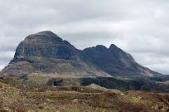
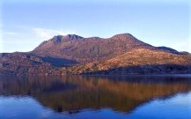
Ingenuity and Controversy in Studying the Precambrian
‘Deep, deep time’
Tony Elger
East Lothian U3a Geology Group
January 2021
Notes:
The Precambrian 2021 U3a slides definitive version 6.3.21
‘Deep, deep time’ to emphasise the extent of the time before the well-established periods from the Cambrian onwards, back to the time when geology gives way to historical astronomy
People will no doubt identify the Scottish Precambrian exposures in the photos (see below)

Slide 2
Episode One
A story of metamorphic rocks (mainly)
and radioactive clocks
Notes:
‘Metamorphic rocks and radioactive or radiometric clocks’ partly because these are key themes (and tools) in Robert Muir Wood’s (1978) chapter on the Precambrian in On the Rocks
‘Mainly’ because there are also sequences of un-metamorphosed sedimentary and igneous rocks in the Precambrian

Slide 3
Characteristic Scottish Precambrian Landscapes
Suilven, a mountain of Meso to Neoproterozoic Torridonian Sandstone, resting on a glaciated cnoc and lochan platform of Archaean to Paleoproterozoic Lewisian Gneiss (source: ‘Suilven’ entry, Wikipedia)
Slioch, a Meso to Neoproterozoic Torridonian Sandstone mountain infilling an ancient valley eroded into Lewisian Gneiss (seen across Loch Maree) (source: John Mendum et al 2001 © SNH image)
Notes:
Source for left hand image: Photo by Paul Hermans taken 2011, from Wikipedia entry for ‘Suilven’ (pronounced Soo l ven)
Source for right hand image: SNH image for Slioch (pronounced Shlioc) from John Mendum et al (2001) Northwest Highlands: A landscape fashioned by geology, p 13
We will come back to the Eons and Eras within the Precambrian (Mesoproterozoic etc) shortly

Slide 4
Agenda
Episode One: Charting the Precambrian
What’s in a name?
Eons, Eras and Periods in the Pre-Cambrian (or is that Precambrian?)
Probing the enigmatic Precambrian:
Metamorphic pathways and radioactive clocks
Interim conclusions and some of the protagonists in debates
Episode Two: The Evolution of the Precambrian
How did the earth and life evolve during the Precambrian?
Developments in the Hadean, the Archaean and the Proterozoic Eons
The Precambrian in Scotland
An Outline of Structure, Sequence and Fieldwork
Conclusions, References and Resources
Notes:
Introduction 4 slides
What’s in a name? 4 slides
Probing the enigmatic Precambrian 7 slides
Interim conclusions & protagonists 4 slides
Introduction to episode two 2 slides
How did the earth and life evolve during the Precambrian?
Hadean 2 slides
Archaean 3 slides
Proterozoic 5 slides
The Precambrian in Scotland 4 slides
Conclusions, References and Resources
5 slides

Slide 5
From the ‘Pre-Cambrian’ to the ‘Precambrian’ & Beyond
The deep time before the Cambrian (before ~ 542 Ma) is now understood to cover a period of around 4000 Ma, from the initial formation of the earth’s surface to the start of the Cambrian, which represents over 88% of the earth’s history
The Pre-Cambrian (or as it was sometimes called, the Cryptozoic or even Azoic) was originally primarily defined in terms of its enigmatic character in contrast to increasing knowledge about the established geological column from the Cambrian onwards
This Pre-Cambrian was obscure because it was unamenable to conventional methods of stratigraphy, largely because of the strongly altered (often multiply metamorphosed) character of many of the rocks but also because of the apparent absence of fossils
In the later twentieth century this period was increasingly defined more positively as the Precambrian, as (i) rocks were dated, (ii) rare and cryptic fossils were found and (iii) underlying geological processes characteristic of different time periods were investigated in their own right
Finally, as such investigations progressed (including in astrogeology), more refined distinctions were made to demarcate the Proterozoic as a distinct eon of the late Precambrian, with the Archaean and, before that, the Hadean as more ancient eons (and the Proterozoic and Archaean were themselves further divided into several eras)
In this context the Precambrian has increasingly been displaced as a formal stratigraphic unit, at first being characterised as a Super-Eon, but by the 2010s often regarded only as an ‘informal’ category, though the term still remains in common usage (as in the journal Precambrian Research!)
But these newer distinctions continue to pose major questions about the interpretation of the rocks that predate the Cambrian, and as will be seen these questions (and answers) are very important for an understanding of the geology of Scotland
Notes:
Sources: Martin Rudwick (2014) Earth’s Deep History, esp chapter 11; Martin Brasier (2011) Secret Chambers, esp chapters 9-11; Michael Allaby (2008) Oxford Dictionary of Earth Sciences (3rd ed) OUP; Malcolm Rider (2005) Hutton’s Arse, Rider-French Consulting ch 1; Thomas R. Holtz (2020) ‘Geology 102: Historical Geology’, Department of Geology, University of Maryland, Spring Semester 2020 at https://www.geol.umd.edu/~tholtz/G120/lectures;
International Commission on Stratigraphy, ‘International Chronographic Chart 2020/03’ at www.stratigraphy.org
My focus here is on the changing terminology used in internationally recognised stratigraphy, and what this reflects about changing understandings. Our textbooks are good indicators of the changing usage. Robert Muir Wood’s (1978) On the Rocks has a chapter on the ‘Pre-Cambrian’; uses a lower-case p in the text; but adds a note at the end of the chapter, that ‘The Pre-Cambrian is also officially known as Precambrian’ (p 76). Meanwhile Graham Park’s (2019) Introducing Geology highlights the three eons constituting the long Precambrian and devotes almost half of his chapter on ‘Earth History’ to their specific features. The journal Precambrian Research, founded in 1974 with one volume a year, now has one per month.

Slide 6
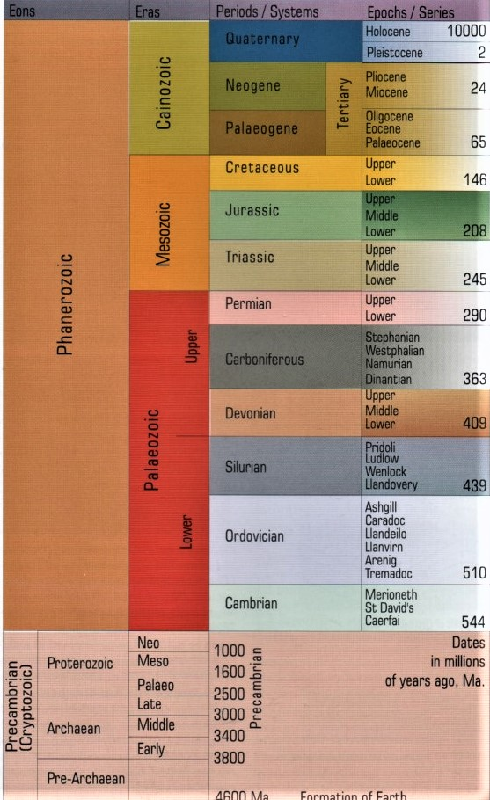
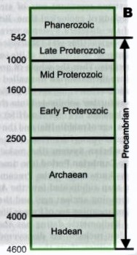
The Precambrian in its Wider Stratigraphic Context
Left: a familiar image with the Proterozoic,
Archaean & Pre-Archaean
Eons added below the
standard stratigraphic
column of the Phanerozoic, with its Periods from the Cambrian to the Quaternary
(from Toghill 2000 p 16)
Right: the stratigraphic
column to uniform scale, showing the full extent of the Precambrian, with the
Pre-Archaean now named as the ‘informal’ Hadean
(from Park, 2019, p 73). This underlines the enormous deep time available for the evolution of the earth and of life
Notes:
Source for left hand column image: Peter Toghill (2000) ‘Geological Time Scale’ (but using different scales for Precambrian and for Cambrian onwards – an example of a widespread convention) in The Geology of Britain: An Introduction, p 16
Source for right hand column image: Graham Park (2019) (3rd edition) ‘The stratigraphic column drawn to [a unitary] scale’ in Introducing Geology: A Guide to the World of Rocks, p 73

Slide 7
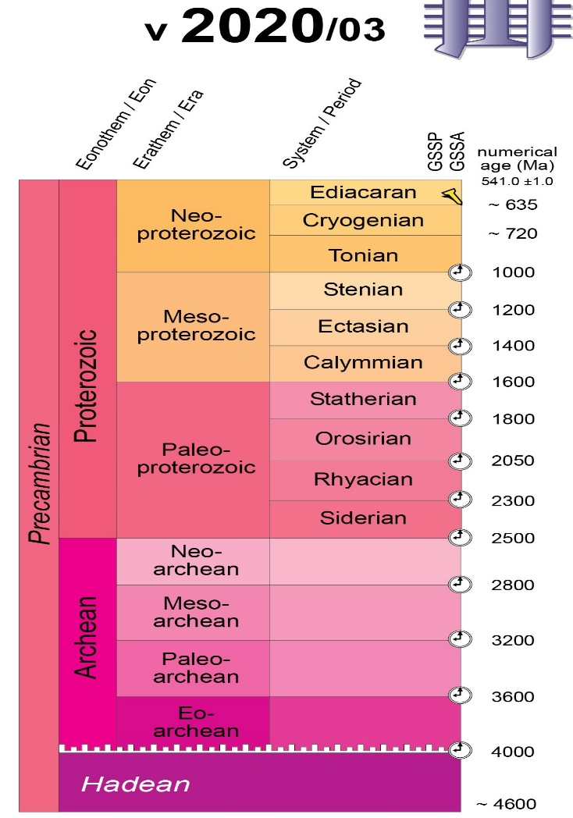
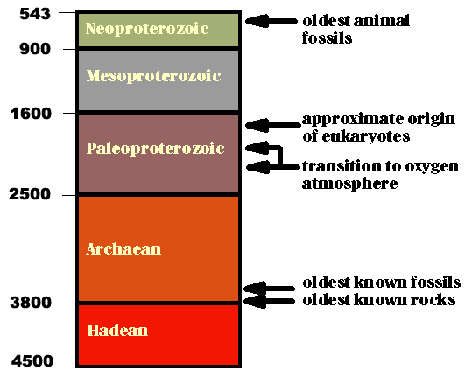
Details of the ‘Stratigraphic Column’ of the Precambrian
From the International Commission on Stratigraphy (sub-ctte of IUGS)
GSSP = Global Boundary Stratotype Section and Point, ‘golden spike’
GSSA = Global Standard Stratographic Age, based on radiometric clocks
From University of California, Berkeley: significant events
But note (i) variant spellings and meanings of Archean/ Archaean
And note (ii) there remain some significant variations in age specifications from different sources
Notes:
Source for left hand image: Precambrian section from International Commission on Stratigraphy, ‘International Chronostratigraphic Chart 2020/03’ www.stratigraphy.org
Note the International Commission on Stratigraphy (ICS), founded in 1974, is the largest active daughter organisation/sub-committee of the International Union of Geological Sciences (IUGS)
Source for right hand image: ‘Precambrian events’ from ‘The divisions of Precambrian time’, website: ucmp.Berkeley.edu/Precambrian/Precambrian.html
Source on variant meanings of Archaean: In a note to his discussion of the ‘Archean Eon’ Holtz suggests that ‘(Archean (..EAN) refers to a part of Earth history; Archaean (...AEAN) refers to a type of prokaryotic organism, and thus a branch of the Tree of Life)’
See R. Holtz (2020) ‘Geology 102: Historical Geology’, Department of Geology, University of Maryland, Spring Semester 2020 at https://www.geol.umd.edu/~tholtz/G120/lectures BUT this is not a consistent usage
And note the variations in age specifications and the continuing revision of some of these ages over time

Slide 8
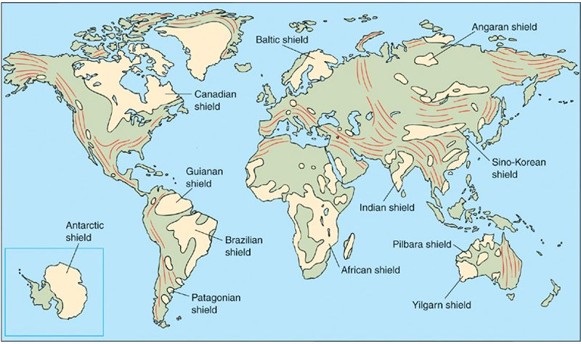
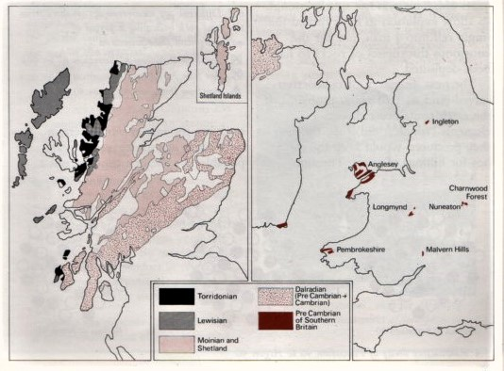
Distribution of Precambrian Rocks:
Global, Scotland and the rest of Britain
Global distribution of Precambrian outcrops,
concentrated in a series of tectonically very stable
cratons exposed as ‘shields’, though Precambrian deposits
also form a (very variable) buried platform or
basement elsewhere
Small outcrops in England and Wales, but British Precambrian exposures are concentrated in Highland Scotland (Muir Wood 1978: 63)
Notes:
Source for left hand image: ‘Precambrian Cratons: Shields and Platforms’, slide 6 of a presentation on the ‘Proterozoic, the Making of the Modern World’ at slideplayer.com/slide/4907751/
Holtz explains that:
Precambrian Shield is an exposed surface of Precambrian bedrock
Platform (aka ‘basement’) is surface of Precambrian bedrock covered by post-Precambrian rocks
Craton is Precambrian Shield + Platform
Source for right hand image: Robert Muir Wood (1978) On the Rocks, p 63.
Peter Toghill (2000) Geology of Britain: An Introduction (Airlife) provides more detail on maps and structures for Scotland, England and Wales in his chapter 1 ‘Britain during the Precambrian’ – for this detail see later slides

Slide 9
Probing Features of the Enigmatic Precambrian
Some Precambrian rocks are little changed sedimentary deposits (e.g. Torridonian sandstone) and some are relatively unaltered igneous rocks, but most have been subjected to metamorphic transformation by being buried, squeezed and heated (but not melted)
The variations in temperature and pressure produce different ‘grades’ of metamorphism, while rocks may be subjected to more then one episode of metamorphic change
Metamorphism alters the mineral components of rocks, overwriting pre-existing patterns of sedimentary bedding or crystallization with different lines of crystal cleavage and new patterns of foliation, so original igneous or bedding features (and also fossils) are strongly distorted (with lower grade metamorphism) or even obliterated (with higher grade metamorphism), undermining standard stratigraphic techniques
Muir Wood (1978) rehearses the impact of these metamorphic recrystallization processes in transforming rocks along distinctive ‘metamorphic pathways’ – for example from clay to shale to slate to schist or gneiss – see next slides
Though the fossil record is quite sparse even in the Cambrian (which appears to feature the earliest animals with hard parts alongside a range of complex soft-bodied creatures) increasing fossil evidence of (often microscopic) life has been found in the Proterozoic and even earlier, but this currently remains insufficient to provide an independent basis for determining the stratigraphic relationships between Precambrian rock deposits
A pivotal outcome of earlier controversy about the absolute age of the earth (between Lord Kelvin and Arthur Holmes among others) was recognition of the substantial range and amount of radioactive material in the earth and the importance of such material in sustaining the heat engine of the planet. It was soon realised that the processes of radioactive decay which characterised these materials could also provide molecular clocks to probe the absolute age of the Precambrian rocks – see later
Notes:
Sources: Thomas R. Holtz (2020) ‘Geology 102: Historical Geology’ Department of Geology, University of Maryland, Spring Semester 2020 at https://www.geol.umd.edu/~tholtz/G120/lectures/
Robert Muir Wood (1978) On the Rocks, chapter 6; Martin Rudwick (2014) Earth’s Deep History, chapter 11; Graham Park (2019) Introducing Geology: A Guide to the World of Rocks, chapter 8; Richard Fortey (2004) The Earth: An Intimate History, chapter 10; Martin Brasier (2012) Secret Chambers: the inside story of cells and complex life, chapters 8-11; Malcolm Rider (2005) Hutton’s Arse: 3 billion years of extraordinary geology in Scotland’s Northern Highlands, Rider-French Consulting, chapters 1 and 6; Wikipedia page on ‘Precambrian’
These points provide the rationale for following both Muir Wood and Park in looking in a bit more detail at both ‘metamorphic rocks’ and ‘radioactive [or radiometric] clocks’ before considering specific developments in the course of the Precambrian
One of the pioneers of radiometric dating was geophysicist Arthur Holmes at Edinburgh, who challenged the conservative estimates of the age of the earth provided by Lord Kelvin in the late 19th century
(see Martin Rudwick (2014) Earth’s Deep History pp 231-7)

Slide 10
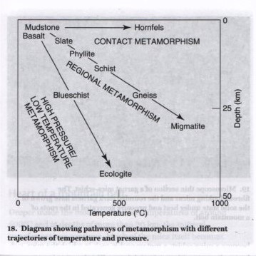
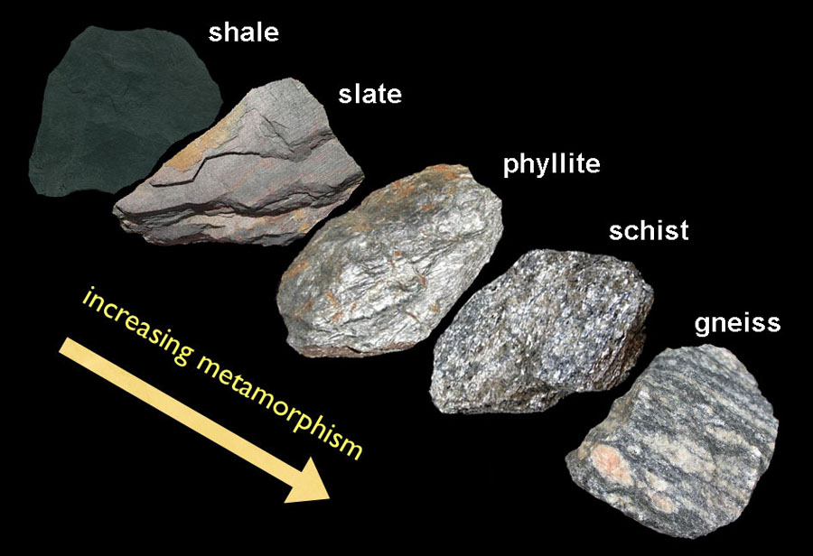
Rock Series and Metamorphic Pathways
Regional metamorphic rock series
© geologycafe.com
(see also Muir Wood 1978 p70)
Metamorphic pathways (Zalasiewicz 2016 p55)
clay
Contact Metamorphism
Regional
Metamorphism
Burial,
Dynamic &
Subduction
Metamorphism
Notes:
Source for left Image: ‘The Regional Metamorphic Rock Series’, Figure 11-5 from the Open Source textbook, Introduction to Earth Science found at geologycafe.com (compare Robert Muir Wood, 1978, On the Rocks, fig. 6.11)
Source for right image: Jan Zalasiewicz (2016) Rocks: A Very Short Introduction, p 55, ‘Diagram showing pathways of metamorphism with different trajectories of temperature and pressure’.
The pathways of metamorphism with different trajectories of temperature and pressure provide a template for analysing the processes underlying particular metamorphic formations
Contact and regional metamorphism are each well defined, though their impacts can coexist. But ‘high pressure/low temperature’ seems to cover several processes, including ‘Burial metamorphism’ associated with subsiding basins; ‘Dynamic metamorphism’ associated with faults and sheer zones (where temperature is only relatively low) and in Zalasiewicz’s account ‘Subduction metamorphism’

Slide 11
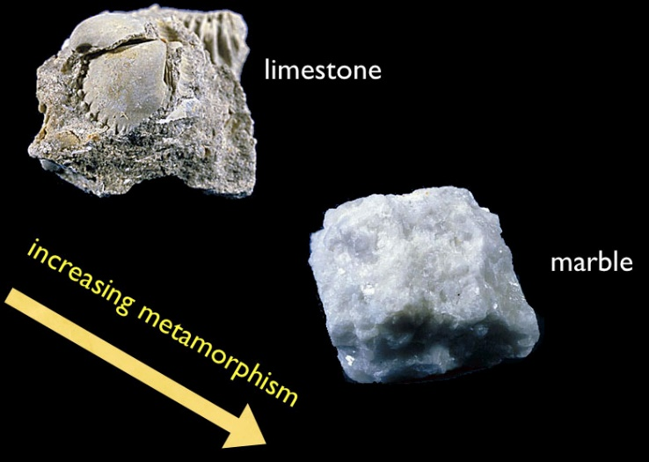
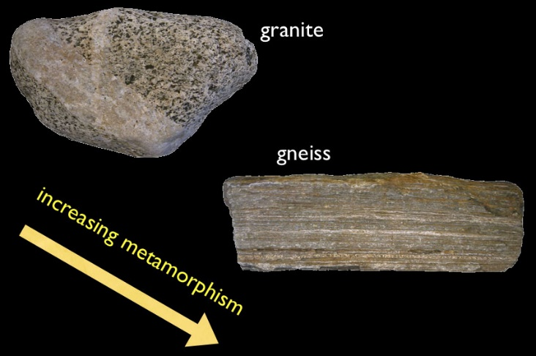
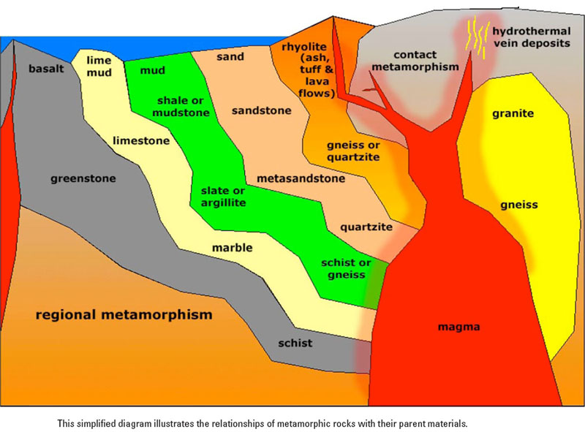
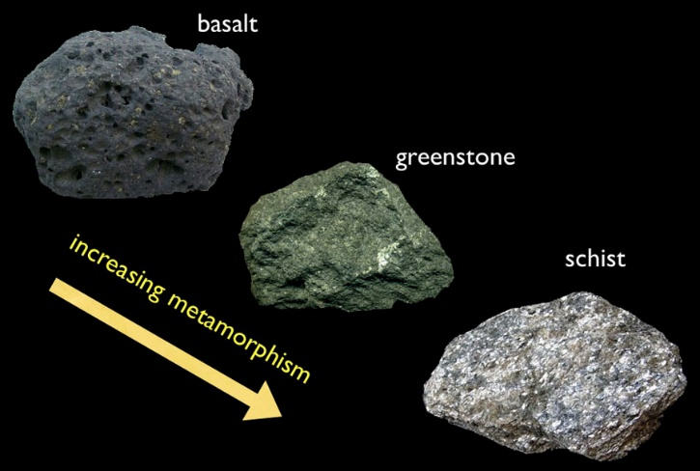
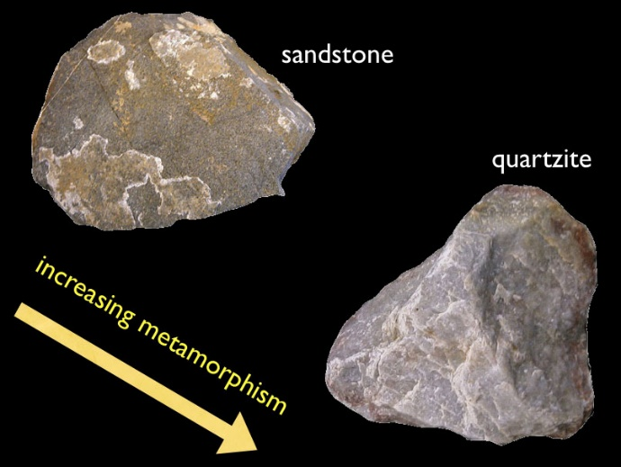
Simplified Diagram Mapping Further Parent Rocks and
Related Metamorphic Pathways © geologycafe.com
But note that ‘retrogressive metamorphism’ can also occur, where higher grade minerals are altered into lower grade minerals as a metamorphic system cools down, especially when water is present
Notes:
Source for the four Rock Series Images: Open Source textbook, Introduction to Earth Science, figures 11-6, 11-7, 11-8 and 11-10 at https://getbooks.miracosta.edu/earth_science/chapter_11.html, linked to geologycafe.com (comparable images are also provided in Robert Muir Wood On the Rocks, 1978 )
Source for the central diagram mapping Types of Metamorphism: Earth Science Australia website entry on ‘Metamorphic Rocks’, p 4 at earthsciorg/mineral/rockmin/meta/meta.html.
This source provides a good overview of regional, contact and dynamic metamorphism, as well as metamorphic ‘textures’, foliation and ‘grades’.
It also highlights the scope for ‘retrogressive metamorphism’ where higher grade minerals are altered into lower grade minerals as a metamorphic system cools down, especially when water is present

Slide 12
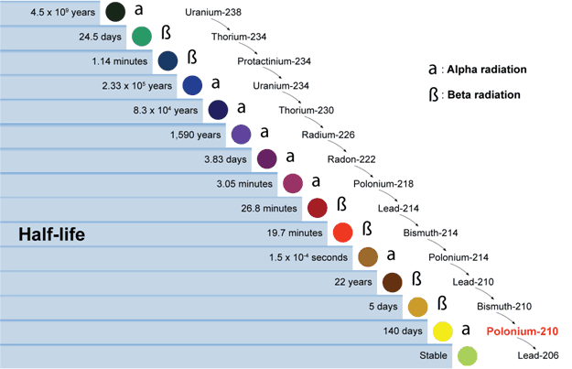
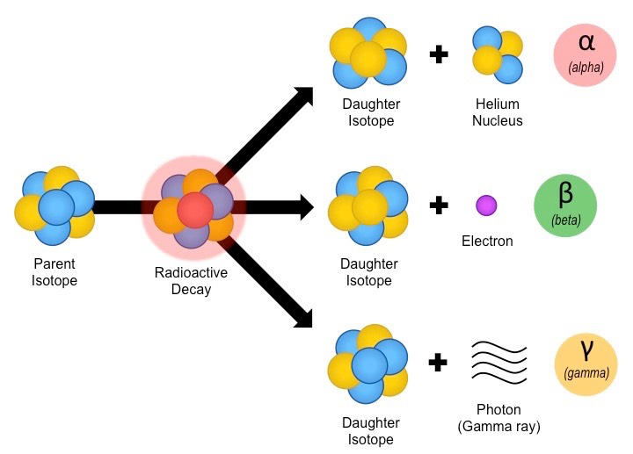
The Instability and Half-life of Radioactive Elements
Radioactive elements are unstable and decay, primarily through loss of sub-atomic particles (and energy): α decay reduces atomic number by 2 (protons) and mass by 4 (protons + neutrons) changing both chemical element and isotope; β decay alters neutron to proton (mass unchanged, atomic number +1) and releases electron, altering element only. The successive phases of radioactive decay to reach a stable element can be mapped as a decay chain
Such instability and decay occurs at a constant and distinctive rate for each parent radioactive element, measured by its half-life (the time it takes for half of the source element to be converted) and this half-life varies massively between elements, from a matter of seconds to billions of years
92
Decay of radioactive parent isotope to daughter isotopes as a result of α, β or γ decay
© Bioninja website
90
Atomic number in red
91
92
90
88
86
84
82
83
84
Uranium 238 decay chain showing half lives of elements/isotopes
© Canadian Nuclear Safety Commission
82
83
84
82
Notes:
Sources: Robert Muir Wood (1978) On the Rocks, chapter 6; Richard Dawkins (2009) ‘Radioactive Clocks’ in The Greatest Show on Earth, pp 91-102; Jan Zalasiewicz (2016) ‘Time-keeper Rocks’ in Rocks: A Very Short Introduction, pp 27-28; Graham Park, ‘Absolute dating’ in Introducing Geology (2019) pp 74-76.
The depiction of types of radioactive decay (lower right) is from the BioNinja website at
https://in.bioninja.com.au/standard-level/topic5-evolution-and-biosci/5i-evidence-for-evolution/radioactive-decay.html
The depiction of the Uranium 238 decay chain, showing types of decay, half-lives and atomic numbers is from the Canadian Nuclear Safety Commission at nuclearsafety.gc.ca
Uranium 238 has a half-life of 4.5 x 10⁹ years (4.5 Ga)
Uranium 234 has a half-life of 2.33 x 10⁵ years
Thorium 230 has a half-life of 8.3 x 10⁴years

Slide 13




Absolute Ages Provided by ‘Radioactive Clocks’
This is the basis for radioactive (or radiometric) clocks, measuring the ratio of the parent/source element and isotope to the final stable daughter element (and isotope) produced by the decay (most often measured by a mass spectrometer): if half of the original element has been transformed then the age of the sample is equal to the half life of the parent (if three quarters then the age is twice the half-life)
If stable end-point elements are trapped within so-called ‘time keeper rocks’, where rock crystals (such as zircon, monazite or mica) retain both the unstable source element and the daughter element, we can establish absolute dates for the formation of igneous or metamorphic rocks (or even appropriate crystals from sedimentary rocks) to within about 1% error – though the analytical techniques involved are quite complex (cf Mathez 2000)
32 atoms of U-235 in a grain of zircon, formed as granite cools
704 Ma later: half atoms now lead-207
(one half life)
1,408 Ma later: three quarters now lead-207
(two half lives)
2,112 Ma later: seven-eighths now lead-207
(three half lives)
Unstable source/parent isotope of | decays to stable daughter | with a half-life in million years (Ma)/ billion years (Ga) of
Rubidium-87 | Strontium | 49,000 Ma 49.0 Ga
Rhenium-187 | Osmium-187 | 41,600 Ma 41.6 Ga
Thorium-232 (in Monazite) | Lead-208 | 14,000 Ma 14.0 Ga
Uranium-238 (in Zircon or Monazite) | Lead-206 | 4,500 Ma 4.5 Ga
Potassium-40 (in Mica) | Argon-40 | 1,260 Ma 1.26 Ga
Uranium-235 (in Zircon or Monazite) | Lead 207 | 704 Ma 0.704 Ga
Samarium-147 | Neodymium-143 | 108 Ma 0.108 Ga
[table adapted from Dawkins (2009) p 102]
Key
for
us
Notes:
Sources: Robert Muir Wood (1978) On the Rocks, chapter 6; Richard Dawkins (2009) ‘Radioactive Clocks’ in The Greatest Show on Earth, pp 91-102; Jan Zalasiewicz (2016) ‘Time-keeper Rocks’ in Rocks: A Very Short Introduction, pp 27-28; Graham Park, ‘Absolute dating’ in Introducing Geology (2019) pp 74-76.
The zircon crystal sequence is adapted from Adam Hart-Davis (ed) Science: The Definitive Visual Guide (2015) Penguin Random House, ‘Dating the Earth’ p 180.
Source for bottom table is Richard Dawkins (2009) ‘Radioactive Clocks’ in The Greatest Show on Earth pp 91-102
A brief account of the technical and intellectual complexity of analysing the structure and probing the age of ancient zircon crystals is provided by Edmond Mathez (ed) Earth: Inside and Out, excerpt on ‘Zircon Chronology’ (2000) New Press/ American Museum of Natural History (web-based ‘Curriculum Collection’). Key points are need to locate crystals in their wider geological context; to direct probes to address specific layers of crystallisation; and to separate out scarce but dense zircons from matrix for mass spectrometry

Slide 14
Absolute (Atomic Clock) Ages of Scottish Precambrian Rocks
As we have seen, conventional stratigraphy has been of little use in exploring Precambrian rocks, and geologists have only been able to establish ‘golden spikes’ for the very end of the Proterozoic. However, absolute ages determined by radiometric clocks have been central to the analysis of the Precambrian geological column, albeit with significant scope for controversy, revision and refinement
Examples of the absolute ages of Scottish rocks from the North West Highlands
(from Johnson et al in Goodenough and Krabbendam 2011)
Archaean Gneiss (Assynt Ter) tonolitic protolith 3030-2960 Ma metamorphosed 2960-2700 Ma
Archaean Gneiss (Rhiconich Ter) granodiorite protolith 2840-2800 Ma reworked 1740-1670 Ma
Paleoproterozoic Scourie Dyke Swarm 2400-2000 Ma part reworked 1740-1670 Ma
Mesoproterozoic Stoer Gp source rock detrital zircons 2500-1740 Ma deposition circa 1200 Ma
Neoproterozoic Torridon Gp deposition detrital zircons 1070-900 Ma
Thus Precambrian rocks, in Scotland and elsewhere, have been targets of increasingly refined absolute dating (more precise & with wider range of rock types) alongside petrographic analysis and mapping of outcrops and structures
This range of evidence has facilitated a sequential analysis of tectonic processes, continental evolution, climate changes (including ice ages), and emergent ecosystems, especially for the Proterozoic but also back into the Archaean and even the Hadean. This will be the focus of Episode Two
Notes:
Source for table of absolute ages of Scottish Precambrian rocks is:: Michael Johnson et al ‘Geological Framework of the North-West Highlands’, in Kathryn Goodenough and Maarten Krabbendam (2011) A Geological Excursion Guide to the North-West Highlands of Scotland EGS/NMS
Tonolite is a particular form of silica oversaturated, coarse-grained igneous rock
Granodiorite is another distinctive and widespread coarse-grained igneous rock

Slide 15
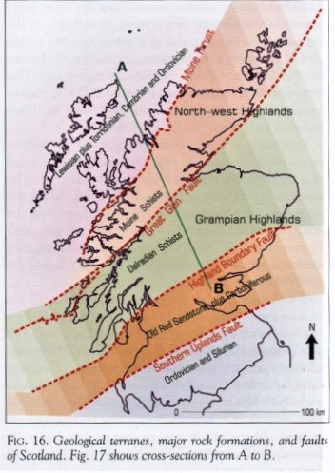
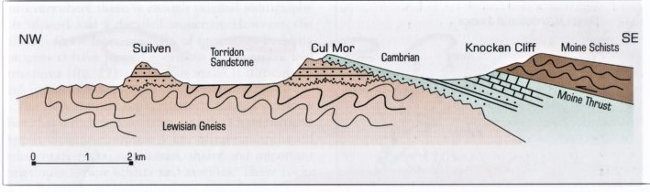
The Structure and Exposure of the Precambrian of Scotland
M
T
T
L
L
M
L+T
Above: cross-section through the Precambrian Rocks – and Cambrian ‘filling’, shown by red lines – of North-West Scotland (from Toghill
2000: 23)
Left: a map of
the geological
terranes, major
rock formations and major
faults across Scotland, with the Precambrian covering the Lewisian (Archaean and Paleoproterozoic), the Torridonian (Meso to Neoproterozoic), the Moinian and part of the Dalradian (Neoproterozoic) (from Toghill 2000: 25)
D
In episode two we will draw on recent field guides to consider the sequential origination and transformation of these Precambrian rocks
Notes:
Map and section taken from Peter Toghill (2000) The Geology of Britain, Figure 13 p 23 and figure 16 p 25 with discussion through his chapter 1 ‘Britain During the Precambrian’

Slide 16
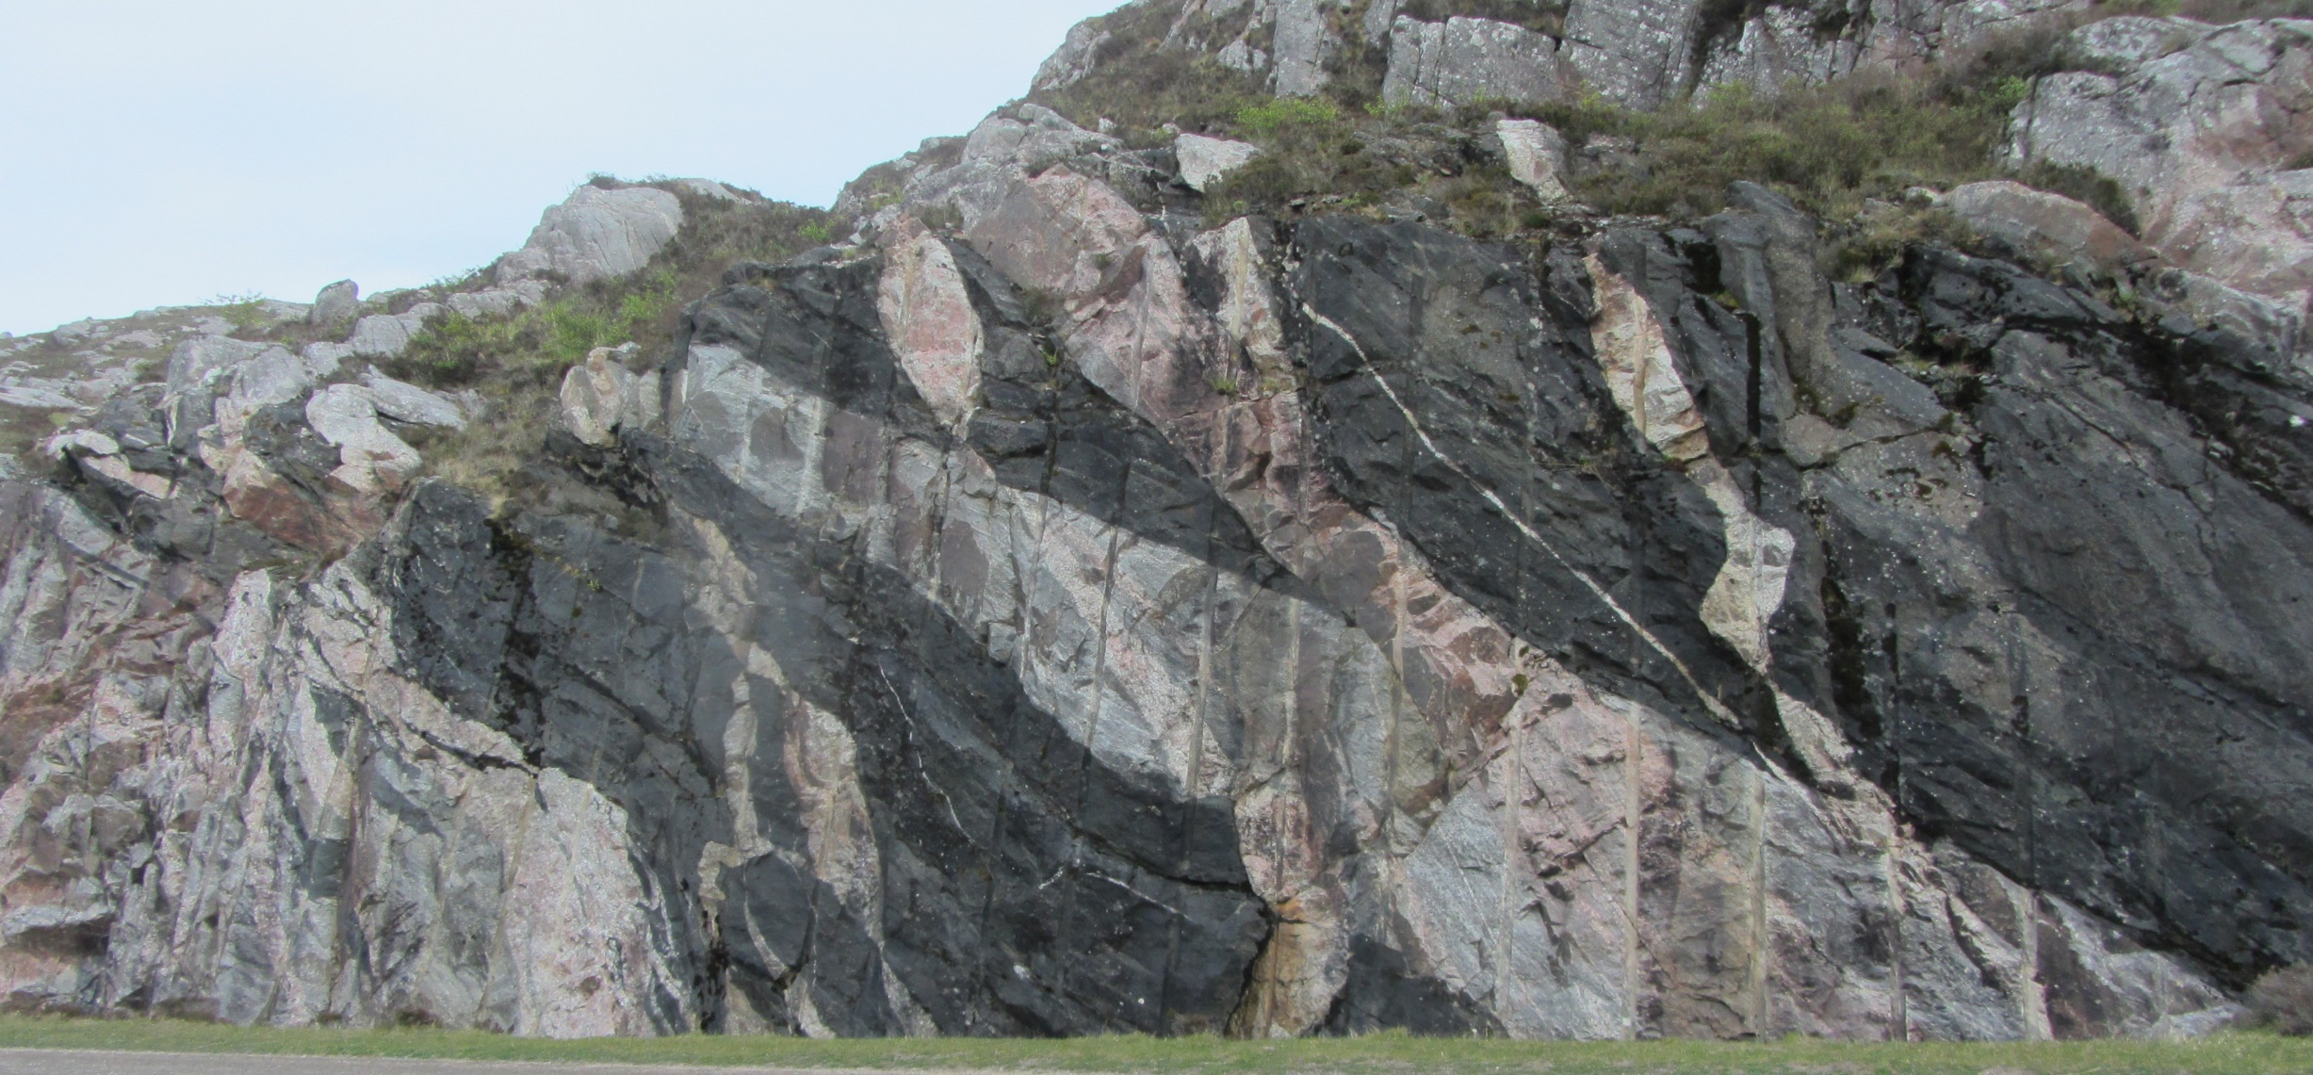
Nice Gneissosity!
The famous ‘multi-coloured rock stop’ on the A838, a road cutting in the Rhiconich Terrane which shows ’the complexities of the Lewisian Gneiss Complex’ where grey tonalitic gneisses (~ 2820 Ma, with ‘well developed gneissosity’!) are cut by black Scourie Dykes (~ 2200 Ma) and pink Laxfordian granite (~ 1855 Ma)
[Photo, Tony Elger; geological commentary, Maarten Krabbendam 2011]
Notes:
Commentary on the ‘rock stop’ is provided by Maarten Krabbendam ‘Locality 16.111: Loch na Fiacaill – the multi-coloured rock stop’ within Excursion 16 ‘Roadside Stops around the North West Highlands’ p 205 in Kathryn M. Goodenough and Maarten Krabbendam (eds) (2011) A Geological Excursion Guide to the North-West Highlands of Scotland EGS/NMS
Also relevant are Malcolm Rider (2005) Hutton’s Arse, Rider-French, chapter 6 and John Mendum et al (2001) Northwest Highlands: A landscape fashioned by geology BGS/SNH pp 10-11 ‘The early crust’

Slide 17
Interim Conclusions
The Precambrian covers a vast period of persistently enigmatic deep, deep time – more than seven-eighths of the earth’s history
Conventional stratigraphic approaches to the relative dating of Precambrian rock formations are largely inappropriate because of the predominance of metamorphic rocks, though sedimentary sequences are not unknown
But radiometric clocks using patterns of radioactive decay provide good absolute dating of these formations back through the Proterozoic and the Archaean, and even into the Hadean, in North West Scotland and across the globe
Absolute dating plus structural and petrographic analyses have led to increasingly sophisticated accounts of sequences of rock formation and metamorphism in the earth history of North West Scotland and elsewhere, and this knowledge is reflected in an increasingly detailed Precambrian stratigraphic column
As we will see in episode 2, there is a long history of unicellular life from the Archaean onward, but complex eukaryotic cells and multicellular organisms only developed in the Proterozoic, with the soft bodied Ediacaran fauna confined to the end of this eon
The Precambrian remains a focus of major controversies about earth history and early life but also ingenious research to overcome the limitations of the Precambrian geological record

Slide 18
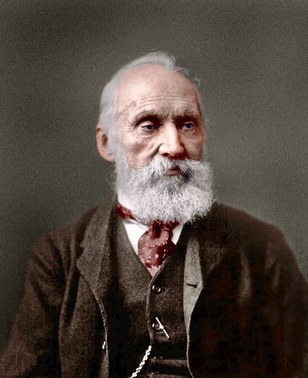
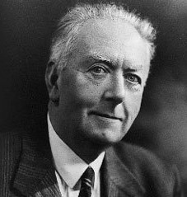



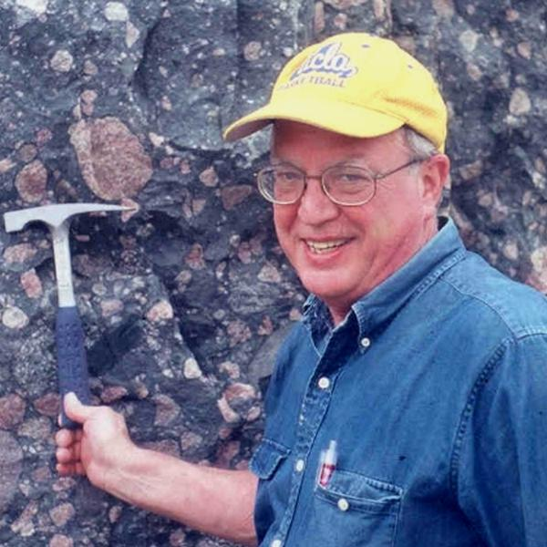


Some key figures in controversies about the earth and life in the Precambrian
William
Thompson,
Lord Kelvin
1821-1907
Age of Earth
only 40-90
Ma
Arthur
Holmes
1890-1965
Age of
Earth
about
3000 Ma
Martin Glaessner
1906-1989
Ediacaran
fauna as precursors of animals
‘Dolf’
Seilacher
1925-2014
Ediacaran
fauna as
evolutionary
dead end
Kelvin’s estimates cut the time available for geological and evolutionary
processes, while Holmes’s radiometric results gave much more time
Lynn
Margulis
1938-2011
Theorist of
symbiotic
origins of
eukaryotes
Bill
Schopf
1941-
Discoverer
of oldest
Archaean
fossils
Martin
Brasier
1947-2014
Sceptical
appraisal
of oldest
“fossils”
Joseph
Kirschvink
1953-
Proponent
of “snowball
earth”
In episode two we will meet other protagonists in analysing these processes, including those depicted above
Notes:
Sources for portraits
Portrait of Lord Kelvin: Wikipedia Images, Pinterest: Historical
People, Historical Portraits
Portrait of Arthur Holmes: Wikipedia Images, Geological Society of
Glasgow [see slides 9 and 37 for Kelvin vs Holmes]
Portrait of Martin Glaessner: Wikipedia Images, Australian Academy
of Sciences
Portrait of Dolf Seilacher: Wikipedia Images, Alchetron, the Free
Social Encyclopedia
[see slides 31 and 37 for Glaessner vs Seilacher]
Portrait of Lynn Margulis: Wikipedia Images, Wikipedia image
[see slides 29, 30 and 37]
Portrait of Bill Schopf: Wikipedia Images, EPSS (Earth, Planetary and
Space Sciences), UCLA
Portrait of Martin Brasier: Wikipedia Images, Micropalaeontological
Society [see slides 25, 26 and 37 for Schopf vs Brasier]
Portrait of Joseph Kirschvink: Wikipedia Images, Division of
Geological and Planetary Sciences, Caltech [see slide 28]

Slide 19
Key References
Martin Brasier (2012) Secret Chambers: the inside story of cells and complex life, OUP, esp. chapters 9-11
Richard Dawkins (2009) ‘Radioactive Clocks’ in The Greatest Show on Earth, Black Swan, pp 91-102
Richard Fortey (2005) The Earth: An intimate history Harper Perennial chapter 10
Michael Johnson et al (2011) ‘Geological Framework of the North-west Highlands’, in Kathryn Goodenough and Maarten Krabbendam (eds) An Excursion Guide to the North-West Highlands of Scotland, EGS, pp 9-35
Edmond Mathez (ed) (2000) ‘Zircon Chronology: Dating the oldest material on earth’, in Earth: Inside and Out, New Press, Am. Mus. Nat. Hist.
Graham Park (2019) Introducing Geology: A guide to the world of rocks (third edition) Dunedin, esp. chapters 8 & 10
Malcolm Rider (2005) Hutton’s Arse: 3 billion years of extraordinary geology in Scotland’s Northern Highlands, Rider-French Consulting chs 1 & 6
Martin J.S. Rudwick (2014) Earth’s Deep History: How it was Discovered and Why it Matters, University of Chicago Press
Peter Toghill (2000) The Geology of Britain: An introduction, Swan Hill Press, esp. chapter 1
Robert Muir Wood (1978) On the Rocks: A Geology of Britain, BBC, esp. chapter 6
Jan Zalasiewicz (2010) Rocks: a very short introduction, OUP, esp chapter 4, ‘Rocks transformed’

Slide 20
Episode Two
The evolution of the Precambrian
and Scotland’s ancient rocks
Notes:
The Precambrian 2021 U3a slides definitive version 15.2.21
‘The evolution of the Precambrian’ explores developments during the deep time before the well-established periods from the Cambrian onwards, back to the time when HISTORICAL GEOLOGY gives way to historical astronomy
This historical geology draws particularly on the analysis of metamorphic processes and radiometric clocks discussed in episode one

Slide 21
Reminder of the ‘Stratigraphic Column’ of the Precambrian
From the International Commission on Stratigraphy (sub-committee of IUGS)
In many respects geological research has pushed backwards, through the familiar periods of the Phanerozoic down to the Cambrian, and then back through the deeper time of the Precambrian, via the Proterozoic back into the Archaean and finally to the earliest (geological) times of the Hadean, progressively extending the depth of ‘deep time’ over time
To understand the historical geology of the earth and the evolution of life, however, we need to start from the beginning, tracing developments at least from the start of the Hadean, through the Archaean and then through earlier and later eras of the long Proterozoic
I hope to show that this history is illuminated both by the ingenuity of ‘deep, deep time’ geological researchers and through the controversies they have engaged in, albeit with rather more fugitive evidence and speculative theorising for the earlier parts of the story
Notes:
Source for left hand image: Precambrian section from International Commission on Stratigraphy, ‘International Chronostratigraphic Chart 2020/03’ www.stratigraphy.org
Note the International Commission on Stratigraphy (ICS), founded in 1974, is the largest active daughter organisation/sub-committee of the International Union of Geological Sciences (IUGS)
The presentation of the historical geology of the Precambrian in the next ten slides draws particularly on: Thomas R. Holtz (2020) ‘Geology 102: Historical Geology’, Department of Geology, University of Maryland, Spring Semester 2020, lecture notes on the Hadean, Archaen and Proterozoic, at https://www.geol.umd.edu/~tholtz/G120/lectures/

Slide 22
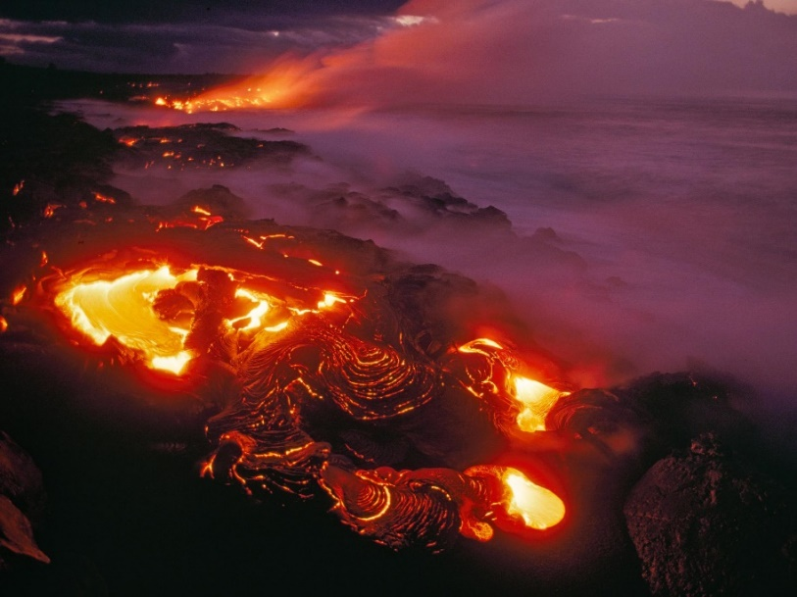
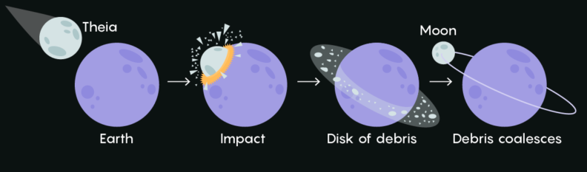
The Hadean Eon (4600 to 4000 Ma)
The Hadean (or Priscoan) predates the earliest known earth rocks and started with the condensation and clumping of material from solar dust clouds (c 4560 Ma) [NB: all Ma ages are indicative not definitive]
Heat and gravitational differentiation then produced a dense liquid core, lighter liquid mantle, fragmentary crust, H₂O oceans and an atmosphere of dense CO₂ and volatile hydrogen and helium
A probable planetary collision (‘glancing blows’?) produced the earth-moon system (c 4500 Ma) while the Late Heavy Bombardment (LHB) of comets and asteroids probably continued from 4100 to 3800 Ma
The earth’s rotating core generated a magnetic field which began to shield the atmosphere from the solar wind (and earliest life has been extrapolated to the end of the Hadean but this remains speculative)
Above: Hadean magma ocean evoked by photo of lava flow on Hawiaii (Chris Johns 2013 © National Geographic)
So analyses of the Hadean sit at an interface between astronomy and geology
Left: Schematic representation of giant impact hypothesis, of collision of Theia and the proto-earth (Tellus) to form the earth-moon system (wiki.png © ‘citronade’)
Notes:
Sources: Thomas R. Holtz (2020) ‘Geology 102: Historical Geology’ Department of Geology, University of Maryland, Spring Semester 2020 at https://www.geol.umd.edu/~tholtz/G120/lectures/102Hadean.html
Colin Goldblatt et al (2010) ‘The Eons of Chaos and Hades’, Solid Earth, 1; Graham Park (2019) Introducing Geology, chapter 10; Richard Fortey (2004) The Earth: An Intimate History , chapter 10; Norman Sleep (2010) ‘The Hadean-Archaean Environment’, Cold Spring Harbour Perspectives in Biology, 2:a00222527; Wikipedia on ‘Giant Impact Hypothesis’ & ‘Hadean’
Source for upper image: Photograph of Lava flow at Kilavea Volcano, Hawaii, by Chris Johns for the National Geographic, illustrating article on ‘Why Ancient Earth was so Warm’, and evoking Hadean Magma Ocean, at www.nationalgeographic.com/news/2013/7/130715
Source for lower image: ‘Simple representation of the Giant Impact Hypothesis’ (simple_model.png), with collision of Theia and proto-earth (Tellus) forming earth-moon system, by ‘Citronade’, in Wikipedia entry on ‘Giant Impact Hypothesis’. For the competing ‘multiple impacts model’ see Robert I Citron et al (2018) ‘The role of multiple giant impacts in the formation of the Earth-Moon system’, Astro-Physics Preprint (ricitron@Berkeley.edu) Themes: primarily astrophysics; for problems of modelling impacts and typicality of moon rock data see Mann (2018) discussed in notes to next slide

Slide 23
Can we add the Chaotian before the Hadean Eon?
The Hadean remains an ‘informal’ label and Thomas Holtz (2020) sees it as a ‘zen’ eon, defined by absence and destined to shrink as ever older rocks are discovered to push back its end date
But Colin Goldblatt et al (2010) are much more positive about the Hadean as a distinct Eon – and they also stake a claim for an even earlier Eon, the Chaotian
Furthermore they boldly offer a more detailed periodisation of each of these Eons in terms of Eras and Periods, though all of these designations remain ‘informal’, unratified by the IUGS
They argue that the Hadean can be delineated using earth geology, starting after the formation of the earth-moon system (4510 Ma) and perhaps ending with the end of the LHB (by 3900 Ma?)
They link several Hadean ‘periods’ to dated crustal materials, such as Australian Jack Hills zircons (4400 Ma) and Canadian Acasta Gneiss (4030 Ma)
Finally, and most strikingly, they also outline and periodise an even earlier Eon, which they name the Chaotian, marked only by solar system processes (though some researchers have reconstrued it as the first era within the Hadean eon, replacing the Hephaestean)
Eon | Era | Period | Age (Ga)
Hadean | Neohadean | Promethean | ?3.9-4.0
 |  | Acastan | 4.0-4.1
 | Mesohadean | Procrustean | 4.1-4.2
 |  | Canadian | 4.2-4.3
 | Palaeohadean | Jacobian | 4.3-4.4
 |  | Hephaestean | 4.4-~4.5
Chaotian | Neochaotian | Titanmachean
 |  | Hypentian
 | Eochaotian | Erebrean
 |  | Nephelean
Adapted from Goldblatt et al (2010) p 2
Notes:
Sources: Colin Goldblatt et al (2010) ‘The Eons of Chaos and Hades’, Solid Earth, 1, 1-3 [table is taken from p2, and note this was the first article in this new journal (Solid Earth!) produced by the European Geoscience Union; Wikipedia on ‘Hadean’ and ‘Chaotian’ (these report on the various proposed Chaotian revisions and their still informal status); and Thomas R. Holtz (2020) ‘Geology 102: Historical Geology’ Department of Geology, University of Maryland, Spring Semester 2020 at https://www.geol.umd.edu/~tholtz/G120/lectures/102Hadean.html
Note that Adam Mann (2018) ‘Bashing holes in the tale of the Earth’s troubled youth’ Nature, 553: 393-5, provides a discussion of the controversies about the extent, dating and sequencing of the LHB, focused on the representativeness or otherwise of the moon crater samples brought back by Apollo and on the modelling of gravitational forces and trajectories of collision objects, while Norman Sleep (2010) ‘The Hadean-Archaean Environment’, Cold Spring Harbour Perspectives in Biology, 2:a00222527, discusses the challenges in addressing the origins of life and the identity of the last universal common ancestor (LUCA) when ‘lack of ancient rocks hinders all these efforts to the point of grasping at straws’ (p1), but he also identifies some rock ‘bio-signatures’ relevant to these issues

Slide 24
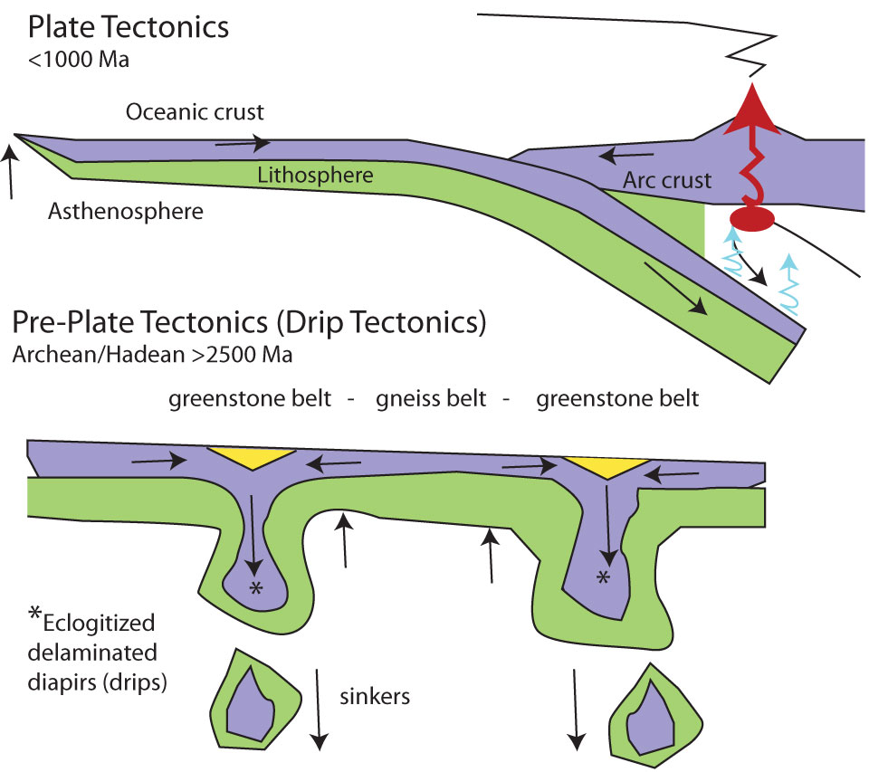
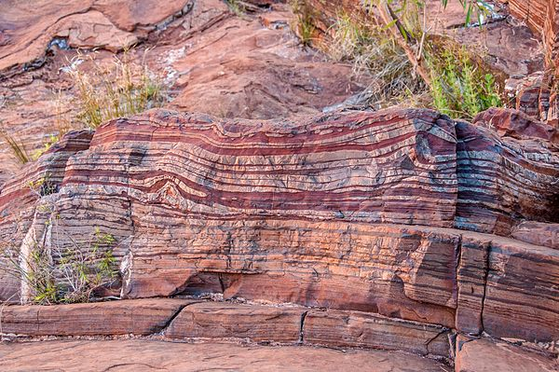
The Earth in the Archaean Eon (4000 to 2500 Ma)
Conventionally (contra Goldblatt et al) the Archaean began
with the formation of the oldest known rocks (now circa
4030 Ma but with zircons of 4400 Ma)
It caught the end of the LHB (lasting till 3800 Ma), then
experienced relative cooling and greater climatic stability (atmosphere mainly N, CO₂, CH₄)
The Archaean then became characterised by: (i) extensive volcanism;
(ii) early tectonic activity (‘drip’ or ‘vertical’ tectonics);
(iii) limited craton formation (but possibly an incipient supercontinent between 3600 & 2700 Ma);
(iv) the growth of oceans; and (v) increasing deep water sedimentation (from 3100 Ma on)
Rock formation was characterised by distinctive banded
gneiss and greenstones (4030 to 2500 Ma), as in the
Barberton Greenstone Belt in South Africa (around 3400 Ma), and Banded Iron Formations (BIFs), as within the greenstone belt at Isua in Greenland (around 3750 Ma) – though deposition of such BIFs continued through the Archean and the early Proterozoic (mainly from 2700 to 1800 Ma)
Proterozoic and later
Archaean
Comparison of tectonic
processes from Arndt
(2013) fig 5.8 p 50
Banded Iron Formation, Fortescue Falls, Western Australia
Notes:
Sources: Thomas R. Holtz (2020) ‘Geology 102: Historical Geology’ Department of Geology, University of Maryland, Spring Semester 2020 at www.geol.umd.edu/~tholtz/G120/lectures/102Archean.html
Graham Park (2019) Introducing Geology, chapter 10; Wikipedia on ‘Banded Iron Formations’ and ‘Archean’; Richard Fortey (2004) The Earth: An Intimate History, chapter 10 ; and Norman Sleep (2010) ‘The Hadean-Archaean Environment’, Cold Spring Harbour Perspectives in Biology 2:a002527
Top image: ‘Comparison of Plate and Drip Tectonics’ from Nicolas T Arndt (2013) ‘Formation and Evolution of the Continental Crust’, Geochemical Perspectives 2.1, figure 5.8 p 50 (after Stern)
Lower image: Banded Iron Formation, at Fortescue Falls, Dales Gorge, Karijini National Park, Western Australia, Photo by Graeme Churchyard, University of Bristol, from Wikipedia entry on ‘Banded Iron Formations’ (this classic BIF is actually Paleoproterozoic, 2461 Ma but there were extensive BIFs in both the Archaean and the Proterozoic) BIFs especially involved magnetite (Fe₃O₄) flakes.
Themes: start of continent formation, but predating standard tectonic processes; BIFs represent metamorphosed deep water sediments, and Greenstone belts have alternating units of metamorphosed igneous and sedimentary rocks from sutures between proto-continents

Slide 25

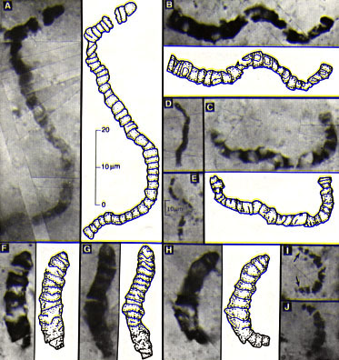
Life in the Archaean Eon (4000 to 2500 Ma)
Traces of complex microfossils have been claimed from early in the Archaean (e.g. Apex Chert 3460 Ma) but this remains controversial: some apparent biomarkers may arise from seepage from younger rocks but crucially many may be inorganic ‘self organising structures’ (SOS) as Brasier et al 2006 & 2015 argue
However, there is suggestive evidence of microbial mats and stromatolites from around 2900 Ma and stronger evidence of simple prokaryotic (lacking nucleus) ‘extremophile’ Archeabacteria by 2600 Ma
M
O
F
A
O
T
Y
O
F
Image of volcanoes, oceans and stromatolites
in the mid Archaean © Peter Sawyer/Smithsonian
y
ldest
ossils
re
lder
han
our
ldest
ossils
Some of the early Archaean structures characterised as organic by Schopf (1993) but regarded as inorganic SOS by Brasier et al (2006). Schopf and Brasier engaged in a famous public debate about these claims at the 2002 NASA Astrobiology Science Conference
Notes:
Sources: Martin Brasier et al (2006) ‘A fresh look at the fossil evidence for early Archaean Cellular Life’, Philosophical Transactions of the Royal Society B 361; J. William Schopf (2006) ‘Fossil evidence of Archaean life’ Philosophical Transactions of the Royal Society B 361: 869-885; Martin Brasier et al (2015) ‘Changing the picture of Earth’s earliest fossils (3.5-1.9 Ga)’ PNAS 112.16; Richard Fortey (2002) Fossils: The Key to the Past, (third ed) chapter 5; Martin Whitehouse et al (2019) ‘On the antiquity of Eoarchean chemofossils’, Precambrian Research 323 pp 70-81; Wikipedia on ‘Archean’; Thomas R. Holtz (2020) ‘Geology 102: Historical Geology’ Department of Geology, University of Maryland, Spring Semester 2020, at https://www.geol.umd.edu/~tholtz/G120/lectures/102Archean.html
Absolute ages for early extremophiles (2.6 Ga) and stromatolites (2.9 Ga) are from Brasier et al (2006) ‘A fresh look at the fossil evidence for early Archaean cellular life, Phil Trans Royal Soc B, p 899 and p891 (Mozaan)
Image on Left, artist’s impression of volcanoes, oceans and stromatolites in the mid Archaean © Peter Sawyer/Smithsonian Institution, from Astrobiology at NASA web-site
Image on Right, of possible early Archaean organic life, from William Schopf (1993) ‘Microfossils of the Early Archaean Apex Chert: New evidence for the antiquity of life’ Science 260, 5108: 640-646.
In 2002 Schopf and Brasier engaged in a famous public debate on the status of the Apex Chert ‘fossils’ at the NASA Astrobiology Science Conference, an event outlined by Robert Hazen in Nicola McLoughlin et al (2015) ‘A Tribute to Martin D. Brasier’, Astrobiology 15.10: 945-6

Slide 26
Brasier et al on early Archaean (3400Ma) habitats & life forms
(Schematic diagram adapted from Brasier et al 2006 fig4 p893, capturing their side of the argument)
For both earth and astro-biology Brasier et al (2006; 2015)(i) argue the ‘null hypothesis’ for judging potential life forms should be of non-biological origin;
(ii) deploy multiple new imaging techniques to assess such structures;
(iii) stress placement in wider geological and chemical contexts, and fit between life forms & ecological niches;
(iv) offer cautious overall assessments of claimed early Archaean life forms
Likely habitats in green & black, chemical cycles in red volcanic ash
sea water
planktonic cell
aggregates/‘fluffs’
benthic ‘wisps’ and mats
silica rich gel
sandstone
hyper-
thermophiles
aqueous alteration of pillow basalts
pillow basalts,
ash and cherts euendoliths -
cavities created by microbes
abiotic deep Carbon synthesis
dyke Jaspilitic chert rims
Apex Chert (3460 Ma) yields pseudo-fossils
Si, Na H₂0, CO₂ C, CO₂
CH₄, O₂ Fe, Cr
H₂O, Si,
CO, C Cu, Cr, Mn, Ca, Mg, Fe, Si H₂O
Zn, Ba, Si CO₂
Cu, Cr, Mn, Zn,
Ca, Mg, Fe, Si C, CO,
H, S
Strelley Pool Sandstone (3430 Ma) yields likely euendolith evidence of microbes
Notes:
Source for diagram: Martin Brasier et al (2006) ‘A fresh look at the fossil evidence for early Archaean Cellular Life’, Philosophical Transactions of the Royal Society B 361 figure 4 p 893
See also Martin Brasier et al (2015) ‘Changing the picture of Earth’s earliest fossils (3.5-1.9 Ga)’ PNAS 112.16
In the same journal issue as Brasier et al, J. William Schopf (2006) ‘Fossil evidence of Archaean life’ Philosophical Transactions of the Royal Society B 361: 869-885, provides a catalogue of 48 Archaean deposits containing claimed biogenic stromatolites and 14 units containing putative microfossils in response to the sceptics, and to ‘support the view that life’s existence dates from more than or equal to 3500 Myr ago’.
From previous slide: MOFAOTYOF stands for My Oldest Fossils Are Older Than Your Oldest Fossils, an inclination that Brasier documents and criticises in his book Darwin’s Lost World (2009) especially pp 163-169. In particular this tendency, driven in part by competition for funding and prestige, involves a propensity to identify a hoped for organism rather than subjecting the material to a dispassionate evaluation of its possible abiogenic origins.

Slide 27
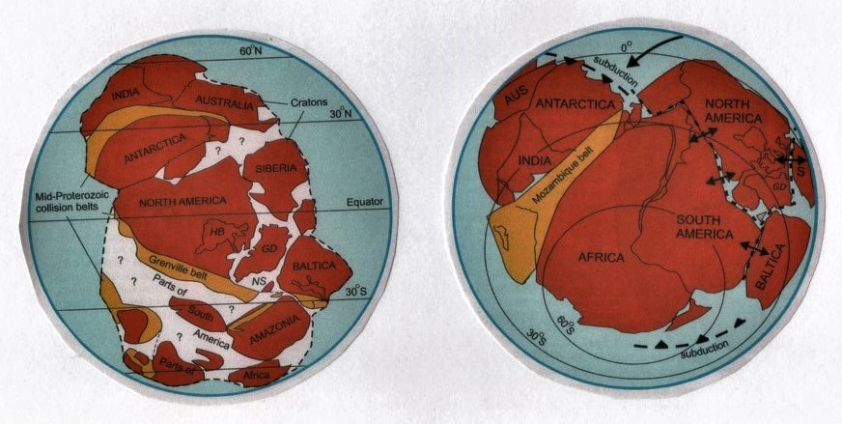
The Earth in the Proterozoic (2500 to 542 Ma): Plate Tectonics
The long Proterozoic saw the development of recognisable plate tectonic processes, such as subduction, mountain building, extensive continent formation (including the assembly and reassembly of major super-continents from the jostling cratons), and the accumulation of sediments in braided rivers and shallow seas
The paleomagnetic and geochronological evidence for such dominant super-continents becomes clearer for the late Proterozoic, when Rodinia (from 1100 to 850 Ma) and Pannotia (from 700 to 550 Ma) each involved distinctive configurations of the major cratons
Rodinia, a major supercontinent with multiple cratons,
collision belts and
subduction, at the
end of the Mid
Proterozoic,
1000 Ma ago
Pannotia, a single supercontinent
with subduction zones,
orogenic belts and
incipient rifts, in
the Late Proterozoic,
700 Ma ago
Northern Scotland
(depositing Torridonian sandstone from
braided rivers and shallow lakes)
Figures from Park (2019)
pp 95-6, figures 10.2 & 10.3
Notes:
Source of images: Graham Park (2019) Introducing Geology: A Guide to the World of Rocks, Figure 10.2 p 95 and Figure 10.3 p 6, as part of the discussion of Chapter 10, ‘Turning the pages – Earth History’
Note especially Park’s reconstruction of processes of continental amalgamation and separation during the Proterozoic and also see Richard Fortey The Earth: An Intimate History (2004) chapter 10 and Wikipedia on ‘Proterozoic’ and ‘Boring Billion’
This indicates the tectonic and climatic context for the deposition of Torridonian sandstone, involving fluvial erosion, canyon formation, deposition and erosion in braided river systems, shallow lakes and microbial mats

Slide 28
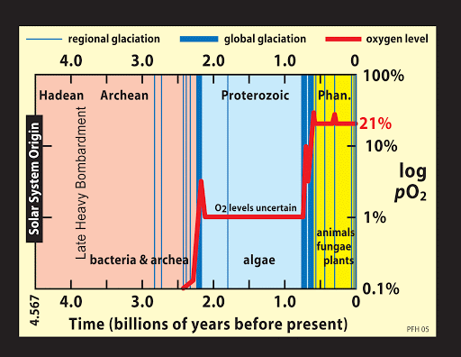
The Oxygenation Process during the Proterozoic Eon
A major feature of change during the Proterozoic was the increasing role of oxygen (and displacement of methane) in the atmosphere, apparently driven by anaerobic prokaryotic cyanobacterial photo-synthesisers
The increased oxygen was initially absorbed in massive ‘BIFs’ (especially between 2700-2400 Ma) but later had a major impact on the climate and ecology of the earth, limiting the niches for anaerobic bacteria vulnerable to free oxygen and generating an ozone layer which filtered UV light, thus increasing scope for the development of new life-forms reliant on, rather than poisoned by, oxygen
Another consequence was a cooling of the atmosphere as a result of the loss of greenhouse gases such as methane, which precipitated several ice ages, including the Huronian early in the Proterozoic (2400 to 2200 Ma) and a cluster of severe ice ages during the Cryogenian period in the Late Proterozoic (850-635 Ma), culminating in a near global ‘Snowball/Slushball earth’ (710-635 Ma)
Left: Timeline for oxygen levels and glaciations (from phys.org/news/
2010-11 © Michael Schirber)
This places the Proterozoic and its ‘boring billion’ (the long period of stasis between the ice ages) in wider context
But also note the continuing arguments and uncertainties about both tectonics and climates
Notes:
Sources: Thomas R. Holtz (2020) ‘Geology 102: Historical Geology’ Department of Geology, University of Maryland, Spring Semester 2020 at https://www.geol.umd.edu/~tholtz/G120/lectures/102Proterozoic.html
Martin Brasier ((2012) Secret Chambers (chapters 8-11); Graham Park (2019) Introducing Geology chapter 10; Richard Fortey The Earth: An Intimate History (2004) chapter 10; Richard Fortey (2002) Fossils: The Key to the Past (third ed), chapter 5; Wikipedia on ‘Boring Billion’, and ‘Proterozoic’
Chart of timeline of oxygen levels and glaciations by Michael Schirber from ‘Thawing a Planet Size Snowball’ phys.org/news/2010-11-planet-size-snowball.html and Astrobio.net
The snowball earth hypothesis was proposed by Joseph Kirschvink and others but remains contested. Key areas of research and debate are covered in Michael Schriber (2015) ‘”Snowball Earth” Might Have Been Slushy’, Astrobiology Magazine August, and in the extensive Wikipedia entry for ‘Snowball Earth’ accessed 31.1.2021
Controversies continue about the composition of the Proterozoic atmosphere and oceans (including extent of oxygenation) , as well as the extent of subduction and mountain building – see especially Wiki on ‘Boring Billion’
There are also arguments about the conditions precipitating, reinforcing (albedo) and terminating snowball earth dynamics, with links to contemporary climate change debates

Slide 29
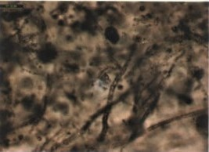
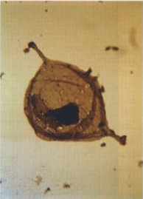
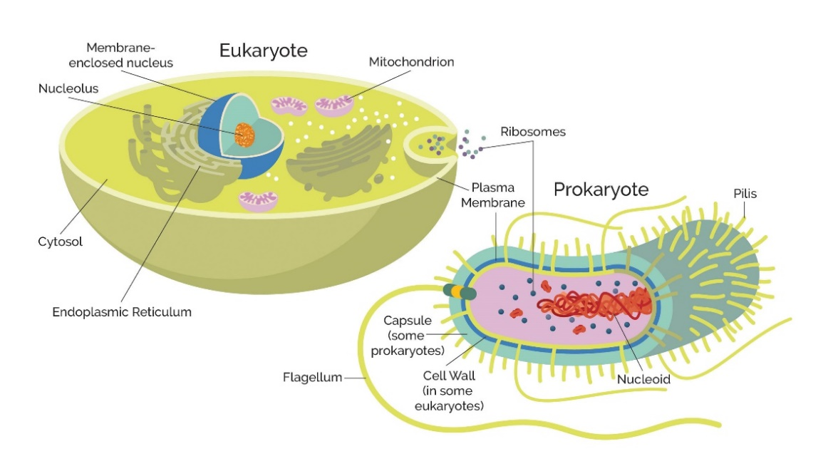
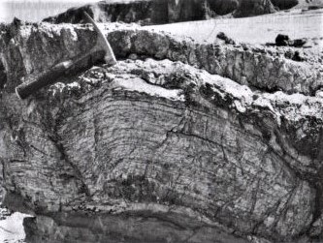
Life during the Proterozoic Eon (2500 to 542 Ma)
Unicellular prokaryotes (e.g. cyanobacteria) remained important in the Proterozoic, often in agglomerations as mats or stromatolites, and now on land as well as in water
But more complex eukaryotic cells, with nucleus and organelles (e.g. algae) also became established (Fortey 1997, Brasier 2012), though still characterised by only short food chains
Below: Tappania, a 0.1 mm eukaryote cell, perhaps a green algal resting stage, from the Australian Roper Group, 1450 Ma (Brasier 2012: plate 14B)
Above: Blobs of Huronispora and filaments of Gunflintia, prokaryote iron bacteria from Canadian Gunflint Chert, 1900 Ma. Slide 0.1 mm across (Brasier 2012 plate 12B)
Left: Stromatolite from the Late Neoproterozoic (650 Ma) Dalradian rocks of Scotland (Zalasiewicz 2016: 82) [hammer for scale]
Above: Schematic comparison of eukaryotic and
prokaryotic cells – perhaps THE fundamental division in life forms? (from image in Gleishmann 2020)
Notes:
Sources: Martin Brasier (2012) Secret Chambers, esp. chapters 7-10; Martin Brasier et al (2015) ‘Changing the picture of Earth’s earliest fossils (3.5-1.9 Ga) with new approaches and new discoveries’, PNAS 112.16; Thomas R. Holtz (2020) ‘Geology 102: Historical Geology’ Department of Geology, University of Maryland, Spring Semester 2020 https://www.geol.umd.edu/~tholtz/G120/lectures/102Proterozoic.html
Richard Fortey (1998) Life: an unauthorised biography chapter 3 and (2002) Fossils: The Key to the Past, (third edition) chapter 5; Emmanuelle Javaux and Andrew Knoll (2017) ‘Micropaleontology of the lower Mesoproterozoic Roper Group, Australia’ J Paleontology 91.2 199-229; Wikipedia on ‘Lynn Margulis’, Precambrian’, ‘Prokaryotes’ & ‘Proterozoic’
Sources of photos: Gunflintia from the Gunflint Chert and Tappiana from the Roper Group, both from Martin Brasier (2012) Secret Chambers, plates 12A and 14B; Stromatolite from Jan Zalasiewicz (2016) Rocks: A Very Short Introduction, page 82; stylised comparison diagrams of prokaryote and eukaryote cells from Nicole Gleishmann (September 28th 2020) ‘Prokaryotes versus Eukaryotes: what are the key differences’ Cell Sciences Newsletter, at https://www.technologynetwork.com/cell-science/articles/

Slide 30
The ‘Symbiogenesis’ of the Eukaryotes in the Mesoproterozoic
By 1990s the unorthodox argument of Lynn Margulis, that the cellular complexity of eukaryotes developed as a result of endosymbiosis by simpler prokaryotic cells, became widely accepted, at least for origination of mitochondria, chloroplasts and nucleus
Resistant biopolymer, wall ornamentation, vegetative cell wall and cyst
Simple multicellularity
Research on Australian Roper Group microfossils (right) showed the continuing importance of prokaryotes but also the emergence of eukaryotic features (cell structures like Golgi or scales, and processes like heterotrophy or photosynthesis), during the Meso and Neoproterozoic
Cytoskeleton, endomembranes, Golgi, molecular mapping of cell interiors, heterotrophy, binary division and budding
Vegetative cell differentiation, photosynthesis (primary endosymbiosis), coenocytic vegetative structure, sexual reproduction
Roper Group
The ‘boring billion’ between the Huronian and Late Proterozoic glacial cycles (1900 to 900 Ma) was a
uniquely long phase of tectonic, ecological and climate stability with contested implications for evolving life forms
Eukaryovory, tests, scales, biomineralization?
BUT Brasier (2012) develops the positive argument that the resulting nutrient-poor ‘blue-water ecosystem’ promoted ‘symbiogenesis’, as potentially reversible
prokaryotic endosymbiosis evolved into
an irreversible mutual dependency and
cellular complexity in eukaryotes
Tissues, embryogenesis, carnivory,
mineralized skeletons
Paleoproterozoic I Mesoproterozoic I Neoproterozoic I
2000 Ma 1600 Ma 1000 Ma 541
Timing of biological innovations in early eukaryotes (cf figure 10 Javaux & Knoll 2017)
Notes:
Sources: Martin Brasier (2012) Secret Chambers, esp. chapters 7-10 (note: in this book Brasier draws particularly on the work of Lynn Margulis); Martin Brasier et al (2015) ‘Changing the picture of Earth’s earliest fossils (3.5-1.9 Ga) with new approaches and new discoveries’, PNAS 112.16; Thomas R. Holtz (2020) ‘Geology 102: Historical Geology’ Department of Geology, University of Maryland, Spring Semester 2020 https://www.geol.umd.edu/~tholtz/G120/lectures/102Proterozoic.html
Emmanuelle Javaux and Andrew Knoll (2017) ‘Micropaleontology of the lower Mesoproterozoic Roper Group, Australia and implications for early eukaryotic evolution’ J. Palaeontology, 91.2 199-229; Laura Erne & Thijs Ettema (2017) ‘The symbiosis that changed the World’, Microbiology Society 9 August; Richard Fortey (1998) Life: an unauthorised biography chapter 3; Richard Fortey (2002) Fossils: The Key to the Past, (third edition) chapter 5; Wikipedia on ‘Boring Billion’, ‘Lynn Margulis’, Precambrian’, ‘Prokaryotes’ and ‘Proterozoic’
Source for diagram on right: Javaux and Knoll (2017) J. Paleontology, 91.2 adapted from figure 10 p26
(Don’t worry about the technical terms)
The Golgi apparatus is a distinctive organelle in eukaryotic organisms, that transfers (and modifies) molecules from the endoplasmic reticulum to their cellular destination. Heterotrophs do not produce their own food but are consumers of sources of organic carbon from plant and animal matter

Slide 31
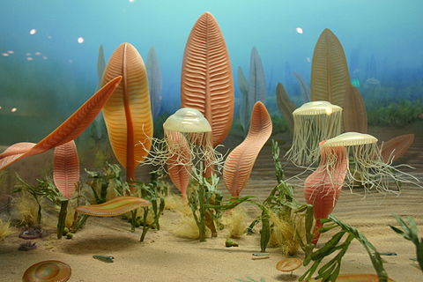
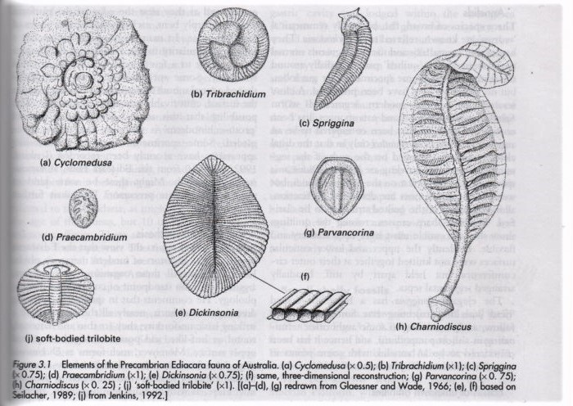
Complex Life in the Late Proterozoic (635-542 Ma)
But complex multicellular organic life – the soft-bodied Ediacaran fauna first discovered in the 1940s but initially seen as Cambrian – emerged only after the last Proterozoic glaciations (635-542 Ma) (Fortey 1997)
This bottom dwelling fauna was distinctive in their lack of internal guts, sensory organs or appendages but they appeared to absorb nutrients through their ‘quilted’ surfaces
Links with later, Cambrian, creatures have remained contested – Glaessner stressed continuity with later forms, while Seilacher saw them as a distinct dead-end – BUT well preserved specimens of Dickinsonia from NW Russia have recently revealed high concentrations of cholesterol, suggesting they were animals rather than, for example, lichens, fungi or protozoans
Examples of the Ediacaran fauna of Australia,
figure 3.1 from Ewan Clarkson (1998) p59
Above: ‘Life in the Ediacaran sea’ Diorama
by Ryan Somma © Smithsonian 1980
Notes:
Sources: Thomas R. Holtz (2020) ‘Geology 102: Historical Geology’ Department of Geology, University of Maryland, Spring Semester 2020 https://www.geol.umd.edu/~tholtz/G120/lectures/102Proterozoic.html
Martin Brasier (2009) Darwin’s Lost World, esp. chapter 6; Richard Fortey (1998) Life: an unauthorised biography, chapter 3; Ewan Clarkson (1998) Invertebrate Palaeontology and Evolution (fourth ed) chapter 3.3; Richard Fortey (2002) Fossils: The Key to the Past (third edition) chapter 5; William McMahon & Neil Davies (2020) ‘Physical and biological functioning in Proterozoic rivers: evidence from … NW Scotland’, Scot. J. Geol. 56.1 pp 1-29; Wikipedia on ‘Ediacaran’, ‘Precambrian’ and ‘Proterozoic’
Image on left: ‘Life in the Ediacaran sea’ by Ryan Somma, a diorama displayed in 1980 at the Smithsonian Institution
Image on right: Elements of the Ediacaran fauna of Australia, figure 3.1 from Ewan Clarkson (1998) Invertebrate Palaeontology and Evolution (fourth ed) p 59
The Australian Ediacaran fossils were first discovered in the 1940s by the mineral geologist Reginald Sprigg. Some were also discovered (against the grain of professional expectations) at Charnwood Forest in the UK, by schoolboy Roger Mason (hence Charnia masoni) in 1957 but also the previous year by schoolgirl Tina Negus (though her find was dismissed) – see Brasier (2009) chapter 6
Richard Caulfield, Martin Brasier and Rachel Wood also provide a useful discussion of the discovery and significance of the Ediacaran Biota in an episode of the BBC In Our Time Series (2009). The 2018 findings were reported by Paul Rincon as ‘Earliest animal fossils are identified’, on the BBC News website 20.9.2018

Slide 32
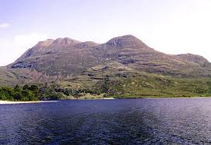
Characteristic Scottish Precambrian Landscapes
Suilven, a mountain of Meso to Neoproterozoic
Torridonian Sandstone, resting on a glaciated cnoc and lochan platform of Archaean to Paleoproterozoic Lewisian Gneiss (source: ‘Suilven’ entry, Wikipedia)
Slioch, a Meso to Neoproterozoic Torridonian Sandstone mountain infilling an ancient valley eroded into Lewisian
Gneiss (seen across Loch Maree)
(source: John Mendum et al 2001 © SNH image)
Note that organic life in the Proterozoic altered the chemistry of the sea, land & atmosphere and thus the evolution of the climate and ecosystems, but had little impact on sedimentary and erosive processes (see McMahon & Davies SJG 2020) leaving distinctive (non-uniformitarian?) patterns of sedimentation in the Torridonian sandstones
Notes:
Source for left hand image: Photo by Paul Hermans taken 2011, from Wikipedia entry for ‘Suilven’ (pronounced Soo l ven)
Source for right hand image: SNH image for Slioch (pronounced Shlioc) from John Mendum et al (2001) Northwest Highlands: A landscape fashioned by geology, p 13
Source on the distinctive (non-uniformitarian) character of sedimentation and erosive processes in the Torridonian group sandstones: William McMahon and Neil Davies (2020) ‘Physical and biological functioning in Proterozoic rivers: evidence from the archetypal pre-vegetation alluvium of Torridon Group, NW Scotland’, Scottish Journal of Geology 56.1 pp 1-29

Slide 33
The Structure and Exposure of the Precambrian of Scotland
M
T
T
L
L
M
L+T
Above: cross-section through the Precambrian Rocks – and Cambrian ‘filling’, shown by red lines – of North-West Scotland (from Toghill
2000: 23)
Left: a map of
the geological
terranes, major rock
formations and major faults across
Scotland, with the Precambrian covering
the Lewisian (Archaean & Paleoproterozoic), the Torridonian (Meso to Neoproterozoic), the Moinian and part of the Dalradian (Neoproterozoic & Cambrian, 730-470 Ma )
(from Toghill 2000: 25)
D
The next slide details the sequential origination and transformation of these Precambrian rocks, drawing on Toghill 2000; Johnson et al 2011 and Strachan et al 2010
Notes:
Map and section taken from Peter Toghill (2000) The Geology of Britain, Figure 13 p 23 and figure 16 p 25 with discussion through his chapter 1 ‘Britain During the Precambrian’

Slide 34
Formation and Reformation of the Lewisian Gneiss Complex, Britain’s Oldest (Archaean & Paleoproterozoic) Rock
Meso to Neoproterozoic Formation and Erosion of Torridonian Sandstone and Conglomerate
Neoproterozoic Formation and Reformation of the complex
Moine Schists
Massive volume of sedimentary sandstone (with microbial mats) deposited on eroded Lewisian landscape by rivers and lakes in hot climate (1200-700 Ma)
Sandstones and shales from erosion of Rodinian mountains deposited in east between 1000-870 Ma, including fragments of Lewisian gneiss
Initially igneous rocks implicated
in formation of continents (part of Laurentia) in anoxic conditions during Archaean (3030-2800 Ma)
Metamorphic episodes around 1000, 800 {and 460} Ma transformed sandstones and shales into banded schists
Several major episodes of metamorphosis – Badcallian (2490 Ma), Scourian (2400-2000 Ma) then Laxfordian (1940-1670 Ma), with some sedimentation and suite of intruded dykes within gneiss
Partial erosion of horizontal bedded sandstones followed by inundation by sea and deposition of newer sand and limestones {later metamorphosed into Cambrian quartzite (544 Ma)}
Despite proximity to equator, late Precambrian glaciation added tillites/ boulder clay
Prolonged erosion leaves deeply eroded Lewisian gneiss landscape and unconformity before massive sedimentary sandstone deposit
{Long processes of further erosion left isolated mountains of sandstone topped with Cambrian quartzite and surrounded by ancient Lewisian landscape}
{Formation moved west, fore-shortened & metamorphosed in low-angle thrust over younger rocks in Caledonian orogeny (430 Ma)}
{Later exhumation of ancient cnoc and lochan landscape as sandstone eroded}
Notes:
Sources: Richard Fortey The Earth: An Intimate History (2004) chapter 10, provides an accessible introduction to the Precambrian of the NW Highlands; and another readable introduction is provided by Malcolm Rider (2005) Hutton’s Arse: 3 billion years of extraordinary geology in Scotland’s Northern Highlands, Rider-French Consulting, chapters 1 and 6
More technical accounts are provided in Peter Toghill (2000) The Geology of Britain, chapter 1, esp pp 21-27; Michael Johnson et al ‘Geological Framework of the North-west Highlands’ in Kathryn Goddenough and Maarten Krabbendam (eds) (2011) A Geological Excursion Guide to the North-West Highlands of Scotland and Rob Strachan et al ‘Summary of Moine Geology’ in Rob Strachan et al (2010) An Excursion Guide to the Moine Geology of the Northern Highlands of Scotland
Note that on this slide the brown text refers to processes taking place after the Precambrian

Slide 35
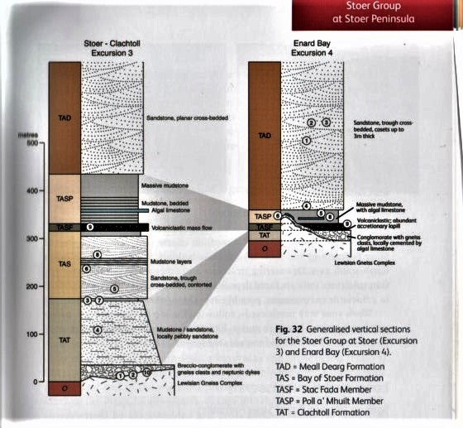
Scope for fieldwork visits to Precambrian rock formations in North-West Scotland:
An example from the Mesoproterozoic Stoer
Group in Assynt
Left: Generalised vertical sections for the Stoer Group at Stoer (excursion 3) and Enard Bay (excursion 4) from A Geological Excursion Guide to the North-West Highlands of Scotland (eds) Kathryn M. Goodenough and Maarten Krabbendam, EGS, 2017, p67
Features at these localities include
Brecciated conglomerate overlying Lewisian Gneiss, marking an exhumed landscape and a major unconformity
Cross-bedding indicative of braided river systems for deposition of the Stoer sandstones
Desiccation cracks and ripple marks suggesting the existence of shallow lakes
Vesicle trails indicative of volcanic ash falls (or perhaps ejecta from a meteorite impact?) p 71
Algal limestone which apparently ‘represents the oldest life form on the British Isles’ p 80
Notes:
Generalised vertical sections for the Stoer Group at Stoer and Enard Bay Figure 32, p 67 in Maarten Krabbendam, ‘Excursion 3, Stoer Group at Stoer Peninsula’ and ‘Excursion 4, Stoer Group at Enard Bay’ in Kathryn Goodenough and Maarten Krabbendam (2011) A Geological Excursion Guide to the North-West Highlands of Scotland EGS/NMS pp 62-84. Details of the sedimentology are provided within these excursions
Three articles that address the character of microbial mats and eukaryotes in Stoer and Torridonian sandstone deposits in more detail are:
R.L. Upfold (1984) ‘Tufted microbial (cyanobacterial) mats from the Proterozoic Stoer Group, Scotland’ Geological Magazine 121.4: 351-355
Richard Callow, Leila Battison and Martin Brasier (2011) ‘Diverse microbially induced sedimentary structures from 1 Ga lakes of the Diabaig Formation, Torridon Group, NW Scotland’ Sedimentary Geology 239: 117-128
Paul Strother, Leila Battison, Martin Brasier and Charles H. Wellman (2011)
‘Earth’s earliest non-marine eukaryotes’ Nature 473 26 May 505-9
Also relevant is Malcolm Rider (2005) Hutton’s Arse: 3 billion years of extraordinary geology in Scotland’s Northern Highlands, Rider-French Consulting, chapters 1 and 6

Slide 36
Summary Conclusions
The Precambrian covers a vast period of persistently enigmatic deep, deep time – more than seven-eighths of the earth’s history – where conventional stratigraphic approaches to the relative dating of rock formations are largely ineffective because of the predominance of metamorphic rocks and the rarity of macrofossils (though sedimentary sequences are not unknown)
However radiometric clocks using patterns of radioactive decay have provided increasingly precise absolute dating of Precambrian rock formations back through the Proterozoic, the Archaean and into the Hadean, and though the subduction of much of the older crust means fewer exposures of the most ancient rocks these have sometimes been complemented by specimens from the wider solar system
Such absolute dating, combined with structural and petrographic analyses, has supported increasingly sophisticated accounts of sequences of rock formation, tectonic processes and metamorphism, especially through the Archaean and Proterozoic, summarised in an increasingly detailed Precambrian stratigraphic column
There is a long history of unicellular life from the Archaean onwards, and the evolution of such life forms has become a major research topic, but complex eukaryotic cells and multicellular organisms only developed through the Proterozoic, with the larger soft-bodied Ediacaran fauna confined to the end of this eon
An important feature of recent Precambrian research has been the integration of accounts of astronomical, climatic, geological and biological processes, and attention to the changing interactions of these features through geological deep time, prompting caution in subjecting such developments to a strongly uniformitarian interpretation

Slide 37
Discovering and Interpreting the Precambrian
Since the late 19th century the Precambrian has been a focus of both ingenious research to overcome the limitations of the early geological record and major controversies about the significance of this research for key features of earth history and early life, but over time there have been important changes in the domain assumptions of researchers and the social organisation of their expertise
In the late 19th century the work of the Geological Survey professionals on the NW Highlands was powerfully criticised by the ‘Archaeans’ (Hicks, Bonney, Callaway, Lapworth and others). Characterised as ‘amateurs’ by the Survey, they had considerable experience of UK Precambrian outcrops, and are best seen as ‘new professionals’, experts on such ancient rocks and with new institutional bases for research in museums and provincial universities (Oldroyd 1990)
By the early 20th century the age of the earth remained controversial: while Hutton, Lyell and Darwin posited very deep time (as permitted by non-fundamentalist theology), the physicist Kelvin estimated the cooling of the earth to sharply reduce the time available, until geophysicists like Holmes highlighted radioactive heat and used radiometric dating to return us to deep time, a view later reinforced by evidence from moon and meteorite rocks (see Rudwick 2014)
A deep scepticism about claimed Precambrian fossils was reinforced by the late 19th century misidentification of pseudo-fossils (e.g.Eozoon), so the Ediacaran fauna (first found by non-specialists) was initially seen as Cambrian. But after the Gunflint Chert discoveries in the 1950s competition for funding and prestige encouraged researchers to stake stronger claims to have found the oldest Precambrian fossils (Mofaotyof). In turn this has generated considerable debate about the criteria for such claims, reinforced by the space race and searches for life beyond earth (Brasier 2009)
New theories, techniques and sources of data in studies of Precambrian earth history have increasingly involved collaboration among different specialists, within the earth sciences and beyond. Key examples of such cross disciplinary work involve astronomers and geologists studying the early earth, and microbiologists, geneticists and palaeontologists studying early life forms, each promoting new interdisciplinary groupings and career pathways (Brasier 2012)
Notes:
The relationship between the Survey professionals (defending Murchison’s Silurian analysis of the NW Highlands) and the new Archaean professionals is discussed by David Oldroyd (1990) The Highlands Controversy, esp. chapter 7
The arguments over the age of the earth, and especially the shrinking estimates of Lord Kelvin versus the much longer radiometric estimates of Arthur Holmes, are widely discussed, not least in Martin Rudwick (2014) Earth’s Deep History, pp 231-238
The arguments about Eozoon, ‘my oldest fossil’ and pseudo-fossils is covered in detail by Martin Brasier (2009) Darwin’s Lost World, esp pp 163-9 and chapter 8
The relationship between astronomers and geologists is touched on by Rudwick (2014) Earth’s Deep History; the relationship between micro-biologists and micro-paleontologists is explored by Brasier (2012) Secret Chambers, esp chapters 7-9; and the broader theme of interdisciplinarity is displayed in Nicola McLoughlin et al (2015) ‘A Tribute to Martin D. Brasier’, Astrobiology 15.10

Slide 38
Main References
Brasier’s contribution
Martin Brasier (2012) Secret Chambers: the inside story of cells and complex life, OUP, esp. chapters 9-11
Martin Brasier, Nicola McLoughlin, Owen Green and David Wacey (2006) ‘A fresh look at the fossil evidence for early Archaean Cellular Life’, Philosophical Transactions of the Royal Society B 361: 887-902
Martin D. Brasier, Jonathan Antcliffe, Martin Saunders and David Wacey (2015) ‘Changing the picture of Earth’s earliest fossils (3.5-1.9 Ga) with new approaches and new discoveries’, Proceedings of the National Academy of Sciences (PNAS) 112.16 pp 4859-4864
Specific topics and techniques
Richard Dawkins (2009) ‘Radioactive Clocks’ in The Greatest Show on Earth, Black Swan, pp 91-102
Laura Erne and Thijs Ettema (2017) ‘The symbiosis that changed the world’, Microbiology Society, 9 August (web source)
Richard Fortey (2005) The Earth: An intimate history Harper Perennial chapter 10
Michael Johnson et al (2011) ‘Geological Framework of the North-west Highlands’, in Kathryn Goodenough and Maarten Krabbendam (eds) An Excursion Guide to the North-West Highlands of Scotland, EGS, pp 9-35
Edmond Mathez (ed) (2000) ‘Zircon Chronology: Dating the oldest material on earth’, in Earth: Inside and Out, New Press, Am. Mus. Nat. Hist. (web)
Textbook overviews
Graham Park (2019) Introducing Geology: A guide to the world of rocks (third edition) Dunedin, esp. chapters 8 & 10
Martin J.S. Rudwick (2014) Earth’s Deep History: How it was Discovered and Why it Matters, University of Chicago Press
Peter Toghill (2000) The Geology of Britain: An introduction, Swan Hill Press, esp. chapter 1
Robert Muir Wood (1978) On the Rocks: A Geology of Britain, BBC, esp. chapter 6

Slide 39
Further Sources 1
Michael Allaby (ed) (2008) Oxford Dictionary of Earth Sciences (third edition), OUP
Nicolas T Arndt (2013) ‘Formation and Evolution of the Continental Crust’, Geochemical Perspectives 2.1
Martin Brasier (2009) Darwin’s Lost World: The hidden history of animal life, OUP
Richard Callow et al (2011) ‘Diverse microbially induced sedimentary structures from 1 Ga lakes of the Diabaig Formation, Torridon Group’ Sedimentary Geology 239: 117-128
Richard Caulfield, Martin Brasier and Rachel Wood (2009) discuss the discovery and significance of the Ediacaran Biota in the BBC In Our Time Series
Robert I Citron et al (2018) ‘The role of multiple giant impacts in the formation of the Earth-Moon system’, Astro-Physics Preprint
Euan Clarkson (1998) Invertebrate Palaeontology and Evolution (fourth edition), Blackwell
Adam Hart-Davis (ed) (2015) Science: The Definitive Visual Guide, Penguin Random House, ‘Dating the Earth’ p 180
Richard Fortey (1997) Life: an unauthorized biography, Flamingo, chapters 2 and 3
Richard Fortey (2002) Fossils: The Key to the Past, (third ed) Natural History Museum, chapter 5 ‘Origin of life and its early history’
Nicole Gleishmann (2020) ‘Prokaryotes versus Eukaryotes: what are the key differences?’ Cell Sciences Newsletter 28 September
Colin Goldblatt et al (2010) ‘The Eons of Chaos and Hades’ Solid Earth 1, 1-3
Thomas R. Holtz (2020) ‘Geology 102: Historical Geology’ Department of Geology, University of Maryland, Spring Semester https://www.geol.umd.edu/~tholtz/G120/lectures/102Hadean.html and equivalents for Archean and Proterozoic
Emmanuelle Javaux and Andrew Knoll (2017) ‘Micropaleontology of the lower Mesoproterozoic Roper Group, Australia and implications for early eukaryotic evolution’ J. Paleontology, 91.2 199-229
Adam Mann (2018) ‘Bashing holes in the tale of the Earth’s troubled youth’ Nature, 553: 393-5
Nicola McLoughlin et al (2015) ‘A Tribute to Martin D. Brasier: Palaeobiologist and Astrobiologist’, Astrobiology 15.10: 940-948
William McMahon and Neil Davies (2020) ‘Physical and biological functioning in Proterozoic rivers: evidence from the archetypal pre- vegetation alluvium of Torridon Group, NW Scotland’, Scottish Journal of Geology 56.1 pp 1-29

Slide 40
Further Sources 2
John Mendum et al (2001) Northwest Highlands: A landscape fashioned by geology, SNH/BGS
David Oldroyd (1990) The Highlands Controversy, Chicago University Press, esp. chapter 7
Malcolm Rider (2005) Hutton’s Arse: 3 billion years of extraordinary geology in Scotland’s Northern Highlands, Rider-French Consulting
chapters 1 & 6
Martin J.S. Rudwick (2014) Earth’s Deep History: How it was Discovered and Why it Matters, University of Chicago Press
J. William Schopf (1993) ‘Microfossils of the Early Archaean Apex Chert: New evidence for the antiquity of life’ Science 260, 5108: 640-646
J. William Schopf (2006) ‘Fossil evidence of Archaean life’ Philosophical Transactions of the Royal Society B 361: 869-885
Michael Schriber (2010) ‘Thawing a Planet Size Snowball’ phys.org/news/2010-11-planet-size-snowball.html
Michael Schirber (2015) ‘”Snowball Earth” Might Have Been Slushy’ Astrobiology Magazine NASA Goddard Institute August
Norman Sleep (2010) ‘The Hadean-Archaean Environment’, Cold Spring Harbour Perspectives in Biology, 2:a00222527 at www.cshperspectives.org
Rob Strachan et al (2010) ‘Summary of Moine Geology’, in Rob Strachan et al (eds) An Excursion Guide to the Moine Geology of the Northern Highlands of Scotland, EGS
Paul Strother, Leila Battison, Martin Brasier and Charles H. Wellman (2011) ‘Earth’s earliest non-marine eukaryotes’ Nature 473 26 May 505-9
R.L. Upfold (1984) ‘Tufted microbial (cyanobacterial) mats from the Proterozoic Stoer Group, Scotland’ Geological Magazine 121.4: 351- 355
Martin J. Whitehouse et al (2019) ‘On the antiquity of Eoarchean chemofossils’ Precambrian Research 323 pp 70-81
Jan Zalasiewicz (2010) Rocks: a very short introduction, OUP, esp chapter 4, ‘Rocks transformed’
Wikipedia pages on ‘Acasta Gneiss’, ‘Archaen’, ‘Banded Iron Formations’, ‘Barberton Greenstone Belt’, ‘Boring Billion’, ‘Chaotian’, ‘Ediacaran’, ‘Giant Impact Hypothesis’, ‘Hadean’, ‘Isua Greenstone Belt’, ‘Jack Hills’, ‘Lynn Margulis’, ‘Precambrian’, ‘Prokaryotes’, ‘Proterozoic’, ‘Snowball Earth’ and ‘Suilven’

Slide 41
Note an Edinburgh Geological Society zoom lecture on a Precambrian topic, coming up soon:
Wednesday 17th Feb 2021 7pm Tony Spencer on ‘The Port Askaig Formation in Argyle:
repeated climatic changes in a Cryogenian glacial sequence’
His talk also illustrates the widening range of disciplines now exploring such formations
This ‘powerpoint’ provides material for personal educational study only
and should not be disseminated elsewhere.
Acknowledgement of sources for images and text are provided on the notes pages for each slide
END

